Slide 1

MTech in CSE (2024 - 2026)
Semester - IV
UE24CS7A1A - Project Work Phase - 2
Review - 1
Project Title : Real-Time Multi-Camera Person Tracking and Re-identification System
Project ID : PW_24_CN_02
Project Guide : Dr. Chaitra N
Student Name : Durgesh Gowda C
Student SRN : PES1PG24CS023

Slide 2
Problem Statement
Surveillance systems use multiple cameras but monitoring them manually is difficult and inefficient.
Most systems can track a person only within one camera view.
They fail to recognize the same person across different cameras due to changes in lighting, angle, or appearance.
This leads to fragmented tracking and reduced effectiveness in real-time monitoring.
This project aims to build a real-time multi-camera person tracking and re-identification system using computer vision and deep learning.

Slide 3
Scope
Develop a real-time system that can detect, track, and identify people across multiple CCTV cameras.
Implement person detection, single-camera tracking, and cross-camera re-identification modules.
Integrate results from multiple cameras to maintain a consistent global identity for each person.
Evaluate system performance on standard datasets and sample CCTV footage.
Demonstrate potential for use in security, smart surveillance, and crowd monitoring applications.

Slide 4
Applications/Use cases
Smart Surveillance and Security
Public Safety & Law Enforcement
Retail and Commercial Analytics
Smart Cities

Slide 5
Design Constraints, Assumptions & Dependencies
Constraints
Real-time processing on consumer hardware
Limited camera overlap
Appearance-based tracking without face recognition
CPU/MPS-based inference (no dedicated GPU required)
Assumptions
Cameras are static
People move at normal walking speeds
Person appearance remains moderately consistent
Bounding boxes are reasonably accurate
Dependencies
Camera availability and permissions
Lighting conditions
Detection accuracy
Stable frame capture rate

Slide 6
Technologies Used
Programming Language: Python
Detection Model: YOLO (Ultralytics)
Feature Extraction: ResNet-18 (PyTorch)
Similarity Search: FAISS
Computer Vision: OpenCV
Deep Learning Framework: PyTorch
Data Storage: Pickle + FAISS Index
Visualization: OpenCV UI

Slide 7
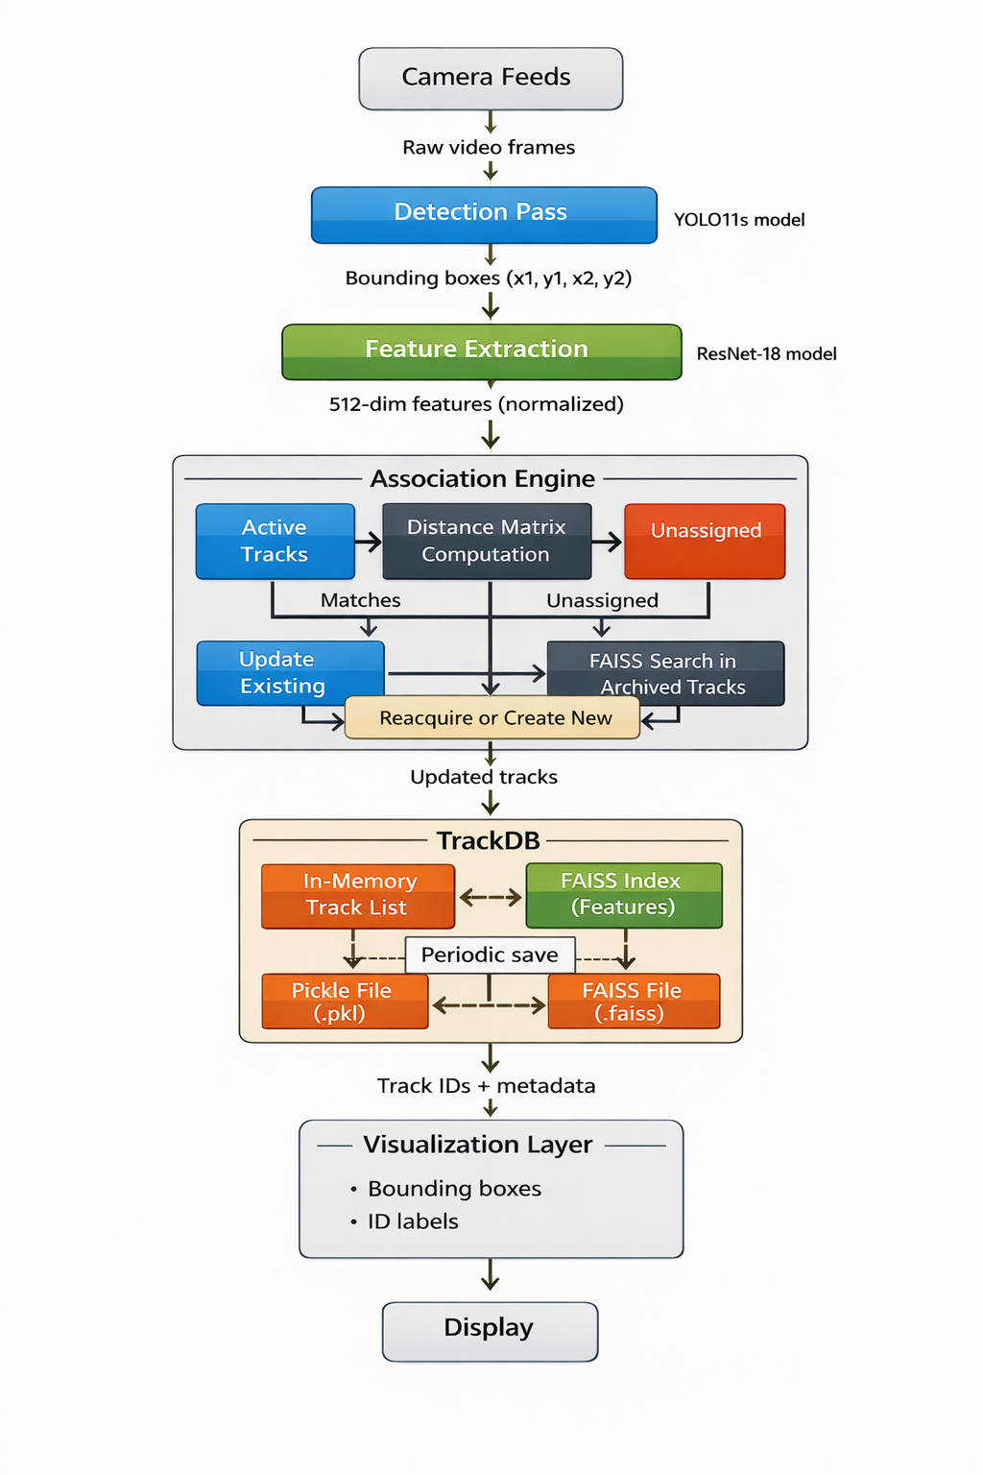
Flow Diagram

Slide 8
Proposed Methodology / Approach
Capture frames from multiple cameras
Detect persons using YOLO
Extract appearance embeddings using ResNet-18
Match detections with active tracks using:
  Visual similarity
  Spatial constraints
Persist track features using FAISS
Reacquire archived identities when reappearing
Merge highly similar mature tracks
Archive inactive tracks and manage ID reuse

Slide 9
Architecture
Camera Input Layer
Detection Layer
Feature Extraction Layer
Association Engine (Tracker and matching)
Track Database (TrackDB)
Visualization Layer
Data Flow:
Cameras → Detection → Embedding → Tracking → Persistence → Visualization

Slide 10
1. Camera Feeds
Multiple cameras provide raw video frames
Each camera stream is processed independently
Frames are resized and validated before further processing

Slide 11
2. Detection Pass (YOLO11s)
Uses YOLO11s deep learning model
Detects persons in each frame
Outputs bounding boxes in (x1, y1, x2, y2) format
Filters non-person classes and low-confidence detections

Slide 12
3. Feature Extraction (ResNet-18)
Crops detected person regions
Uses ResNet-18 backbone
Produces 512-dimensional normalized appearance embeddings
Applies feature validation and normalization
Ensures embedding stability across frames

Slide 13
4. Association Engine (core intelligence of the system)
Active Tracks Matching
Computes distance matrix between detections and active tracks
Uses cosine distance for visual similarity
Applies spatial constraints for same-camera matching
Unassigned Detections Handling
Detections that do not match active tracks are marked unassigned
These detections are sent for FAISS search in archived tracks
Reacquire or Create New
If a high-quality match is found → reacquire existing ID
Otherwise → create a new track
Enforces minimum maturity rules to avoid false re-identification

Slide 14
5. TrackDB (Persistence Layer)
In-Memory Track List
Stores active and archived track objects
Maintains metadata such as:
Track ID
Feature vector
Camera history
Detection count
Timestamps
FAISS Index
Stores appearance features for fast similarity search
Enables efficient re-identification across time and cameras
Periodic Save
Track metadata saved as Pickle (.pkl)
FAISS index

Slide 15
Expected Deliverables (continued)
Phase / Task | Description | Duration | Timeline (Weeks)
1. Project Planning & Research | Review literature, define objectives, gather resources | 2 weeks | Week 1 - 2
2. System Design & Architecture | Design system modules: detection, tracking, ReID, database | 2 weeks | Week 3 - 4
3. Data Collection & Preprocessing | Collect CCTV/video data, prepare datasets for training/testing | 1 weeks | Week 5
4. Model Selection & Development | Implement YOLOv8 for detection and FastReID for ReID | 3 weeks | Week 6 - 8
5. Integration & Real-Time Pipeline | Combine detection, tracking, and cross-camera ID modules | 2 weeks | Week 9 - 10
6. Testing & Evaluation | Evaluate with MOTA, IDF1, and mAP metrics; optimize performance | 2 weeks | Week 11 - 12
7. Documentation & Report Writing | Prepare project report, code documentation, and presentation | 2 weeks | Week 13 - 14
8. Final Presentation & Demo | Present working prototype and final results | 1 week | Week 15

Slide 16
Problems Faced
Camera Clarity (low resolution and differential resolution)
Camera Angle
Occlusion
Partial visibility or no visibility of Faces
Lighting
Clothes (Changing and Uniform)
Cross-Camera ID matching

Slide 17
Results
Significant reduction in ID switching
Accurate re-identification after occlusion
Stable identity tracking across cameras
Controlled and safe ID reuse
Real-time performance on standard hardware
Improved robustness compared to baseline trackers

Slide 19
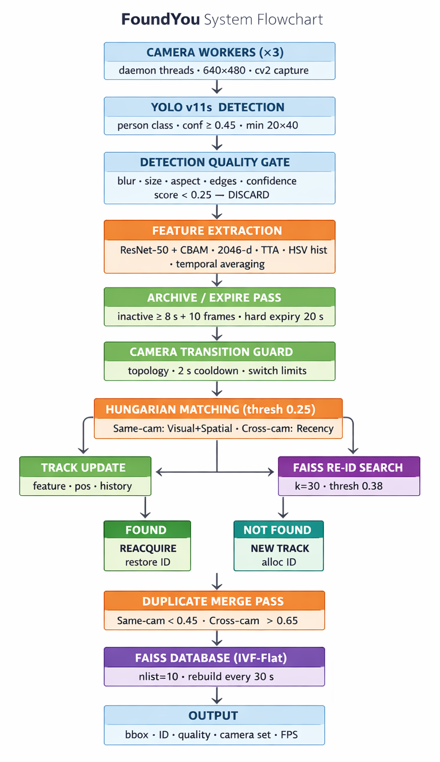
FlowChart

Slide 20
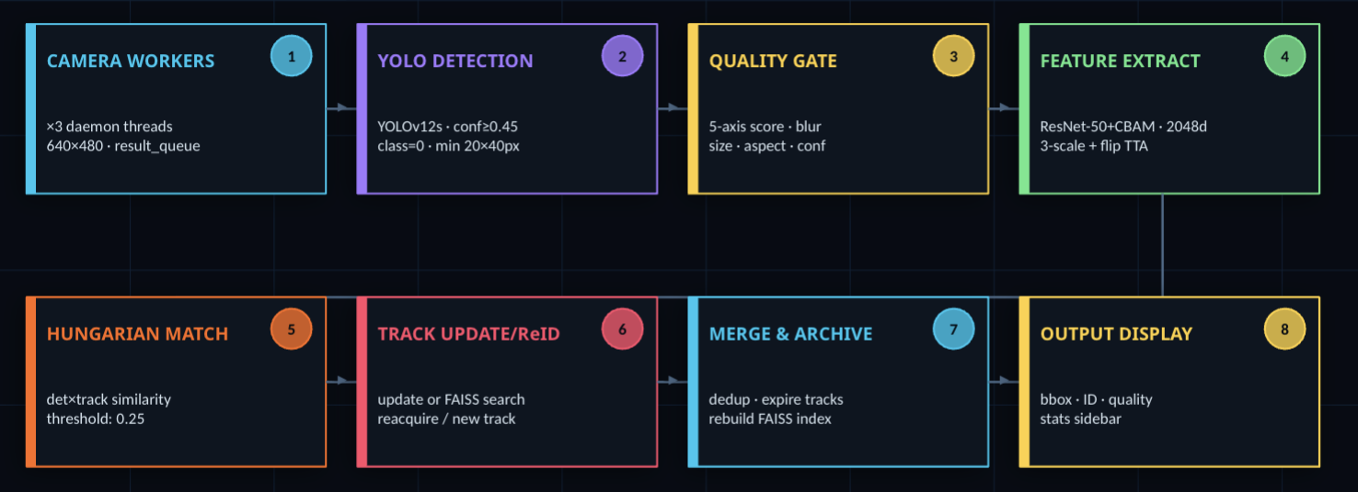
Simplified flowchart

Slide 21
Improvements over Phase 1
ResNet18 to ResNet50
Multi-threaded camera workers
Batch processing
CBAM – Convolutional Block Attention Module
HSV fusion (Normalizing color)
Graph based Matcher (Hungarian Algorithm)
Archive and expire logic
Hierrarchical track DB (FAISS - IndexIVFFlat)

Slide 22
Flow
Camera Workers (Camera feed in batches - queue)
YOLO detection (YOLO 11s)
Quality gate – sharpness, relative size to frame, aspect ratio, edge richness, YOLO confidence
Feature Extraction (ResNet50 with CBAM + color histogram)
Archive/Expire Pass – 10 frames or 8 secs (archived). 20 secs (expire)
Camera Transition Guard – Ping Pong guard (0.5 – 15 secs)

Slide 23
Matching
Hungarian Matching between every detection and every active track
Track Update and Re-ID Search
Reacquire or New Track
Merge Pass (rebuild faiss)
FAISS IVF-Flat index rebuilt every 30 secs (and trains on acquiring 2048 vectors)

Slide 24
THANK YOU

