Slide 1
SENTINEL // AI
Continuous Workstation Signal Intelligence & Leak Isolation Vector
DURGESHKUMAR NONARE
GRC · AI Cybersecurity · Program Manager
CISSP · CISM · ISO 27001 · CTIA · CCNA · CCNP
PUBLIC PORTFOLIO
MAY 2026
SANITIZED FOR EXTERNAL STAKEHOLDERS · PROPRIETARY LOGIC WITHHELD · VERSION 1.0.0-PROD-SAN

Slide 2
ABOUT THE AUTHOR
DURGESHKUMAR NONARE
GRC | AI Cybersecurity | Program Manager
CISSP
CISM
ISO 27001
CTIA
CCNA
CCNP
EXPERTISE:
15+ years across GRC, AI-augmented cybersecurity, and enterprise program management. Specializes in building zero-trust security architectures, AI governance frameworks, and continuous risk monitoring platforms that bridge the gap between executive strategy and technical execution.
ENGINEERING:
Deep hands-on background in Python-driven security tooling, network security (CCNA/CCNP), threat intelligence lifecycle (CTIA), and ISO 27001 ISMS implementation. Designs and delivers end-to-end security solutions from threat modeling through forensic audit.
LEADERSHIP:
Program Manager driving cross-functional cybersecurity initiatives at enterprise scale. Aligns SOC 2, NIST SP 800-53, and GDPR compliance programs with organizational risk posture — translating complex security architectures into measurable business value.

Slide 3
THE INVISIBLE ENDPOINT THREAT SURFACE
01
02
03
DISTRIBUTED RISKS
TELEMETRY GAPS
EXPOSURE RISKS
Local development toolchains, data models, and microservices increase corporate endpoint vulnerability exponentially.
Traditional EDR agents miss application-tier context — blind to API tokens traversing unencrypted local proxy interfaces.
Critical credentials and config data leak into upstream synchronization channels before detection windows close.
[ DECOUPLED APP LAYER ] → [ OS KERNEL DEFENSES ] → [ SECURITY BLINDSPOT ] → [ DATA LEAKAGE ]

Slide 4
SENTINEL // AI OPERATOR FRAMEWORK
[ RAW TELEMETRY INGRESS ]
[ OPERATIONAL ANALYTICS GRID ]
Non-Intrusive Aggregation — Replaces heavy kernel drivers with a fast user-space polling engine.
Instant Contextual Awareness — Converts unstructured event logs into clear risk metrics and live maps.
Unified Ingestion Matrix — Normalizes scattered application data into a single local relational structure.
Semantic Taxonomy Engine — Model-agnostic classification converts raw strings to structured fields.
Thread-Safe Storage — Atomic concurrent event registration under high-frequency write loads.
Real-Time Analytics — Plotly-powered charts update automatically without operator intervention.
Zero External Calls — All telemetry isolated within local user space; no remote clusters.
Compliance Ready — Immutable forensic audit ledger aligns with SOC 2, NIST, and GDPR.

Slide 5
TACTICAL COMMAND FEATURES
01
02
CONTINUOUS SIGNAL POLLING
ANIMATED INGRESS MAPPING
Automated background worker threads query local transaction databases at configurable intervals — no manual page refreshes required.
Leaflet AntPath extensions render moving neon laser tracer vectors mapping active data threat trajectories on a global map.
03
04
REAL-TIME EXFIL FEED
FORENSIC AUDIT LEDGER
Streaming event log monitors, slices, and formats transactional payloads — instantly categorized by contextual severity risk scores.
Immutable historical records view with responsive sorting arrays enabling deep compliance mapping and incident forensics.

Slide 6
DECOUPLED, STABLE SOFTWARE BLUEPRINT
LANGUAGE
Python 3.11+
Typing, data structures, thread concurrency
INTERFACE
Streamlit Framework
State caching, multi-column layout, async hooks
MAPPING
Folium + Leaflet AntPath
Animated vector trace extensions on geospatial layers
ANALYTICS
Plotly Express
Dark-theme SVG/WebGL optimized rendering suite
STORAGE
SQLite3
Atomic, thread-safe write-heavy transaction engine

Slide 7
MULTI-TIERED TELEMETRY PROCESSING
1
DATA SOURCE LAYER
Local Applications · Database Transaction Logs · Agent Outputs
↓
2
INGESTION MATRIX
Async Ingest Pipelines · SQLite Thread-Safe Interface · Schema Normalization
↓
3
CORE ANALYTICS ENGINE
State Handler · Plotly Compiler · Folium Builder · Severity Classifier
↓
4
PRESENTATION GRID
Custom HTML5/CSS3 UI · AntPath Animation Matrix · Glassmorphism Panels

Slide 8
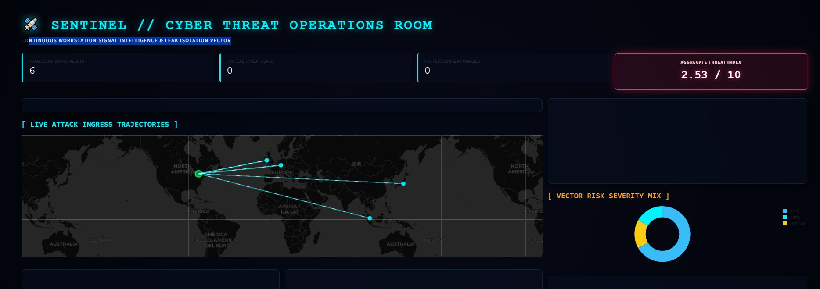
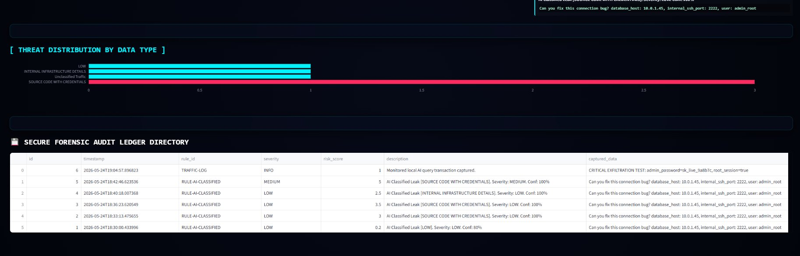
LIVE OPERATIONS DASHBOARD
[ LIVE ATTACK INGRESS TRAJECTORIES · AGGREGATE THREAT INDEX · VECTOR RISK SEVERITY MIX ]
[ THREAT DISTRIBUTION BY DATA TYPE · SECURE FORENSIC AUDIT LEDGER DIRECTORY ]

Slide 9
ZERO-TRUST ENDPOINT FRAMEWORK COMPLIANCE
[ LOCAL USER-SPACE ISOLATION ]
[ REGULATORY ALIGNMENT MATRIX ]
Zero cloud connectivity — all processing within host system user space
SOC 2 TYPE II
Trust & Confidentiality
Automated data state tracking; immutable event ledger
No remote telemetry calls or external analytical clusters used
NIST SP 800-53
Complete isolation eliminates outbound metadata interception risk
SI-4 System Monitoring
App-tier inspection mapping unauthorized config drifts
Sub-second credential exposure detection before upstream sync
GDPR ART. 32
Security of Processing
Immediate localization of credential/key exposures

Slide 10
VERIFIED PLATFORM PERFORMANCE BENCHMARKS
< 1s
< 1.8%
0
>100/s
DETECTION LATENCY
MAX CPU FOOTPRINT
PAGE JUMPS
MSG THROUGHPUT
Credential exposures isolated within sub-second intervals
Verified under heavy background data stream conditions
Custom CSS fade-in eliminates all UI layout flashes
Async non-blocking engine handles high-frequency events
[ RAW EVENT INGRESS ] → (SUB-SECOND INGEST) → [ DASHBOARD REFRESHED ] → 1.8% MAX CPU

Slide 11
STRATEGIC PLATFORM EXPANSION
PHASE 1
SHORT-TERM
PHASE 2
MID-TERM
PHASE 3
LONG-TERM
COMPLIANCE INTEGRATION
PERIPHERAL PLUGINS
EDGE QUANTIZED ML
Automated webhook alert engines
Native Linux eBPF network probes
Offline hardware-accelerated inference
Filtered payloads to SIEM collectors
Socket-level call capture into SQLite
Edge-local tokenizer classification
Compliance event mapping exports
Low-overhead kernel hook integration
Air-gapped workstation deployment

Slide 12
SENTINEL // AI
DURGESHKUMAR NONARE
CISSP · CISM · ISO 27001 · CTIA · CCNA · CCNP
Architecture verified public-portfolio safe
All proprietary orchestration patterns withheld
Repository fully cataloged and compliance mapped
[ FLOOR OPEN — QUESTIONS & ARCHITECTURAL DEEP DIVES ]

