Slide 1
TITANIUM INDUSTRIES

Slide 2
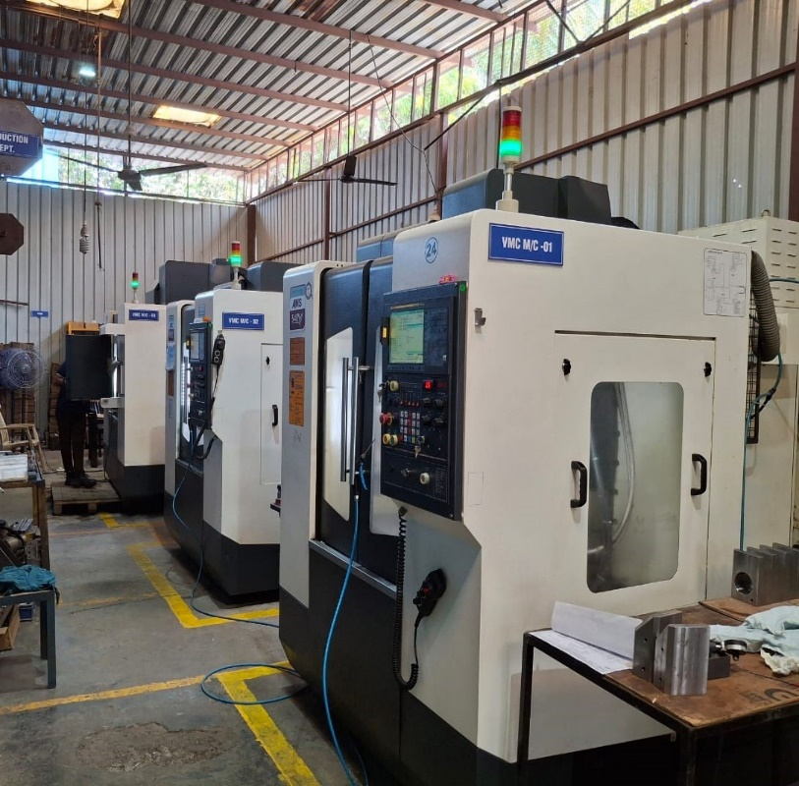
SCOPE OF WORK
Titanium Industries specialized in the précised machining of VMC (Vertical Machining Centre) and CNC (Computer Numerical Control) components. We proudly serve the following sector:
Oil Sector
High-precision components
for oil and gas equipments.
Robotics Sector
Advance parts for robotics
fixture and BIW fixture
Automobile Sector
Reliable and Durable components
for automotive manufacturers.
Agriculture Sector
Advanced parts for agricultural machinery

Slide 3
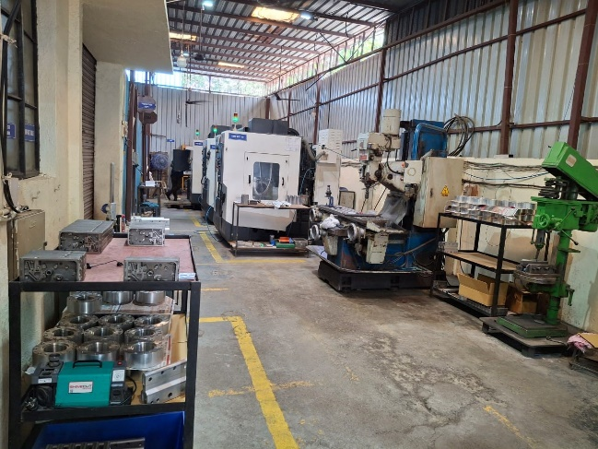
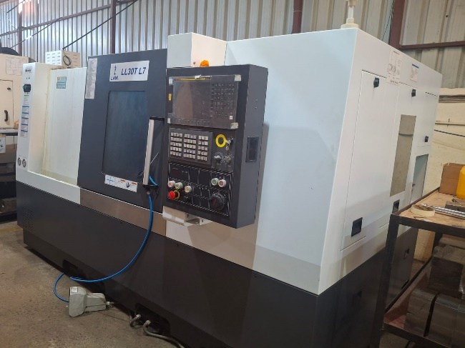
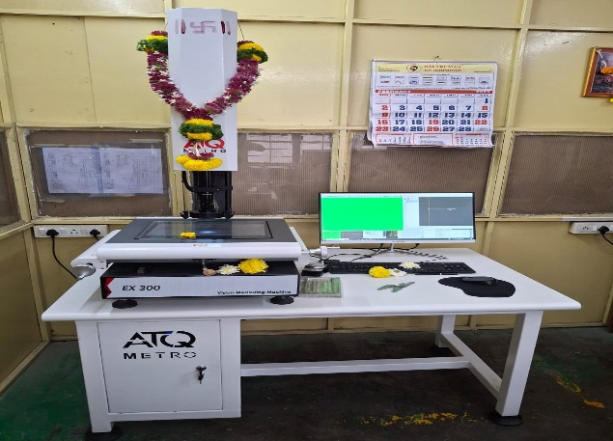
INFRASTRUCTURE
Our facility, located in Swami Vivekanand Industrial Estate, Hadapsar, Pune-28 spans 2000 sq. ft. and well equipped with cutting-edge machinery to meet diverse machining requirements. & Another Unit at Wadki added three CNC BFW make 1000 Sq. Ft

Slide 4
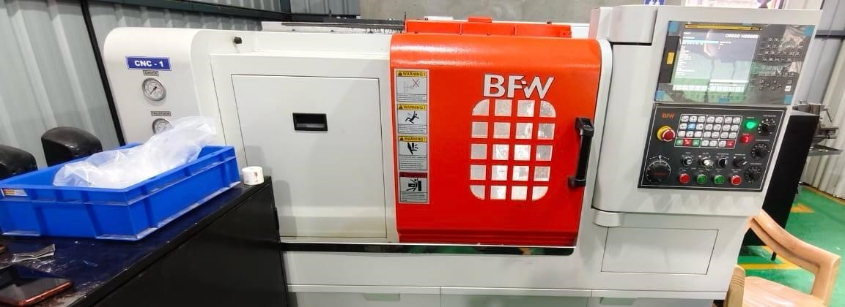
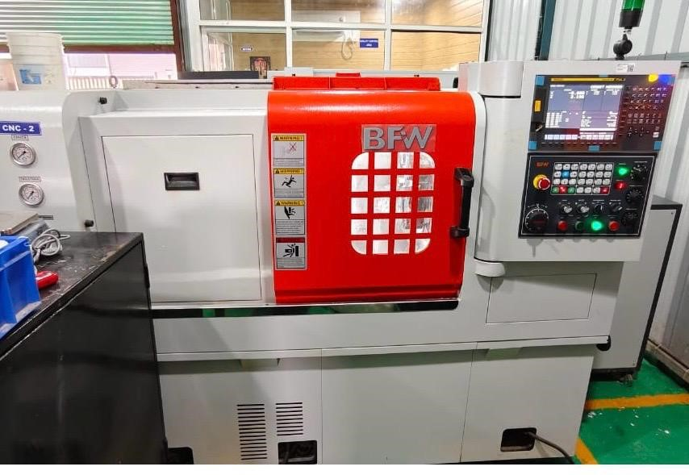
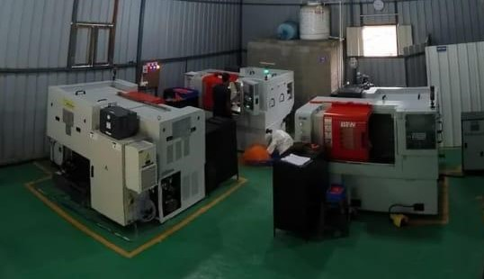
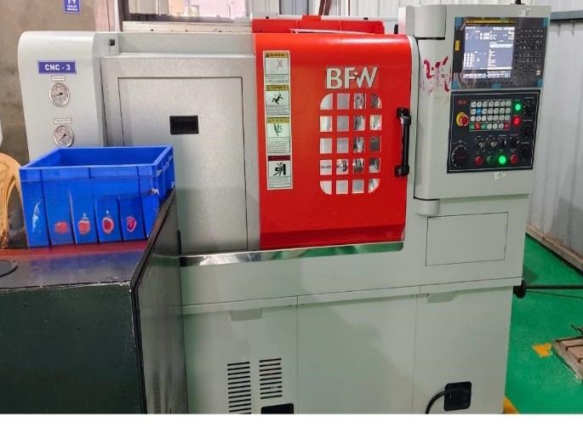
Newly Added CNC BFW Make

Slide 5
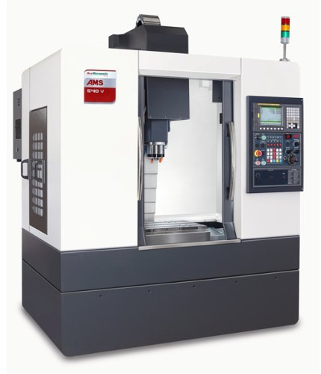
INFRASTRUCTURE
MCV 450
Make : AMS
Travel : 800 X 450 X 650
Accuracy : 0.08 Micron for 300 mm
Control : Fanuc
Qty.: 1 No.

Slide 6
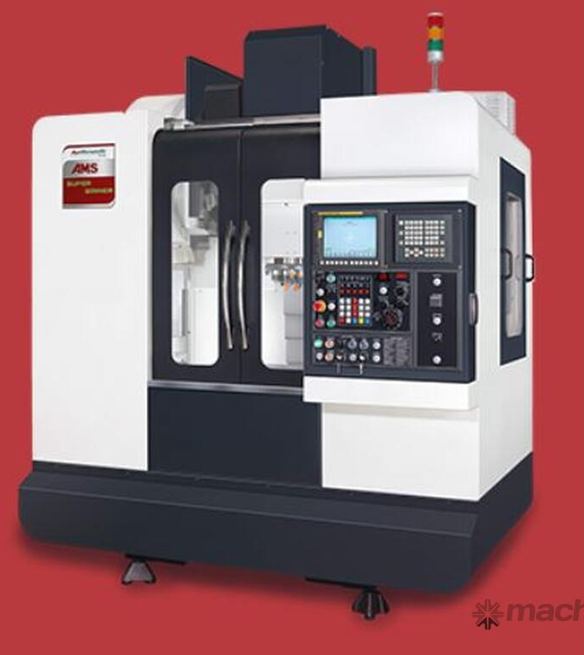
INFRASTRUCTURE
AMS 540-V
Make : AMS
Travel : 500 X 450 X 400
Accuracy : 0.08 Micron for 300 mm
Control : Fanuc
Qty.: 3 Nos.

Slide 7
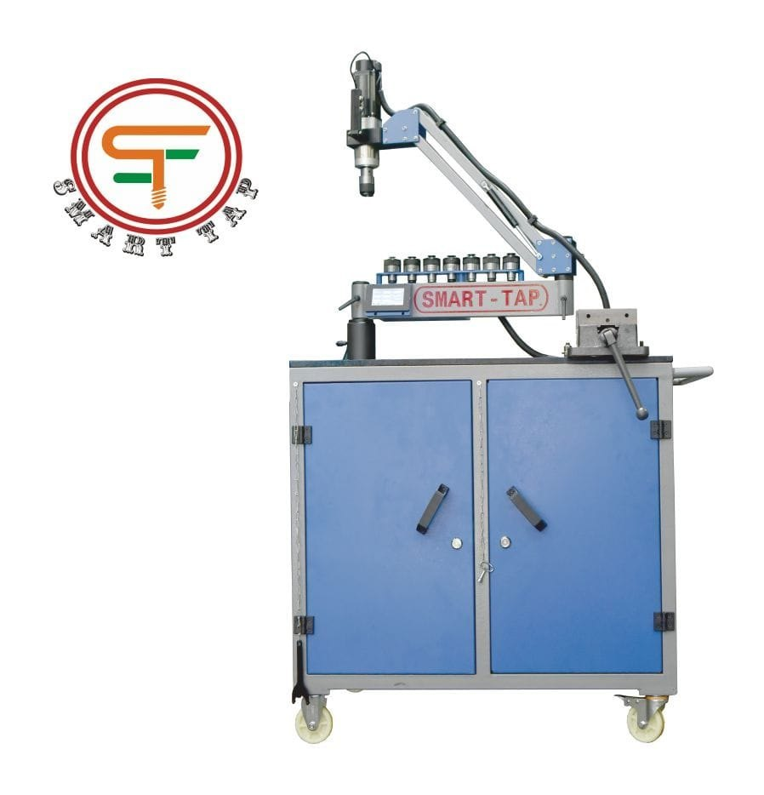
INFRASTRUCTURE
SMART TAP
Make : SMART TAP AUTOMATIC MACHINE
Max Tapping Size : Ø16.00 mm
Qty. : 1 No.

Slide 8
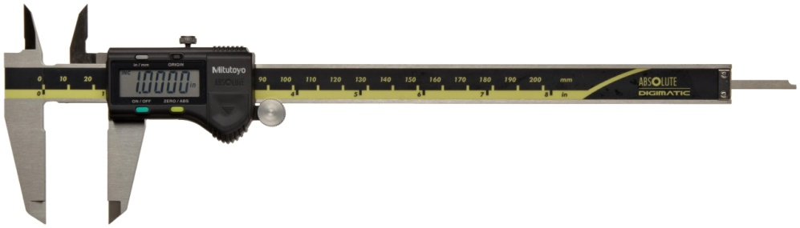
QUALITY CONTROL
Titanium Industries places a strong emphasis on quality. We use advanced tools for precise measurements, including :
Digital Vernier Callipers :
Make : Mitutoyo
150mm : 1 Nos.
300 mm : 2 Nos.

Slide 9
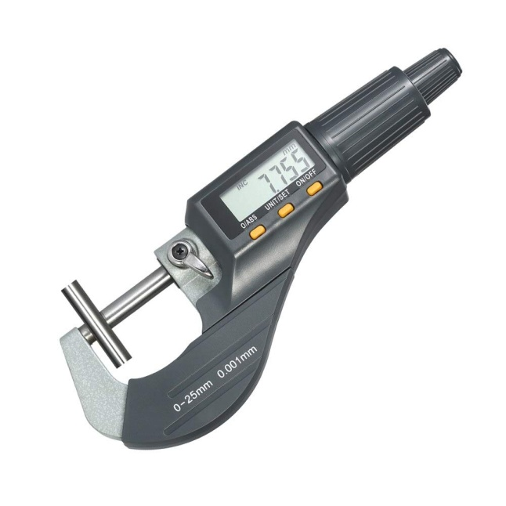
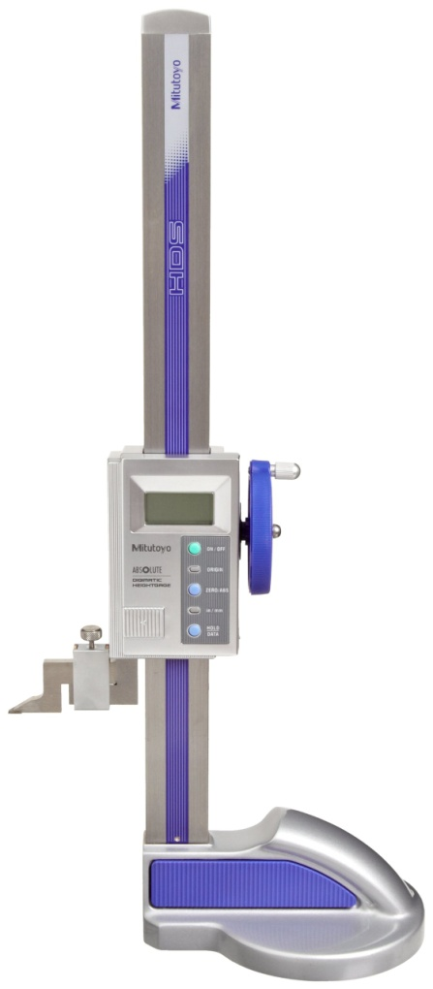
QUALITY CONTROL
Digital Micro Meter : (Mitutoyo)
25 mm : 1 No's.
50 mm : 1 No's.
75 mm : 1 No's.
100 mm : 1 No's.
150 mm : 1 No's.
200 mm : 1 No's.
Digital Height Gauge
Make : Mitutoyo
300 mm : 1 No's.

Slide 10
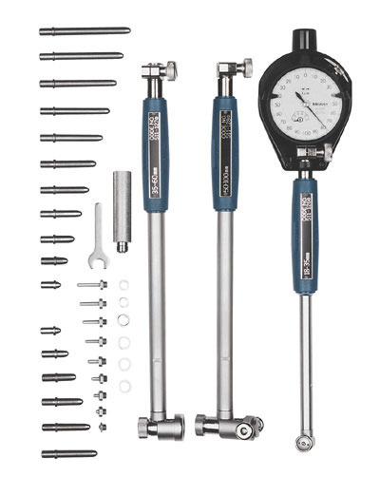
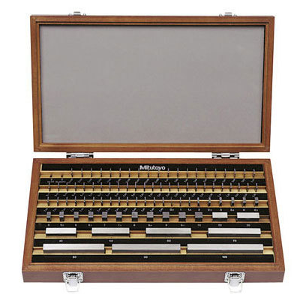
QUALITY CONTROL
Bore Gauges and Slip Gauges :
Bore Gauges : Ø14.00 mm to Ø300 mm
Slip Gauge : 1 Set.

Slide 11
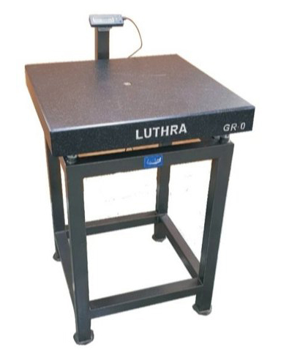
QUALITY CONTROL
Surface Plate :
Make : Luthra
Size : 600mm X 600 MM
Qty : 2 Nos.
For critical parameter measurement, we have partnered with Accurate Sales & Services Pvt. Ltd. A trusted brand specializing in CMM technology, to ensure the highest accuracy in our components.

Slide 12
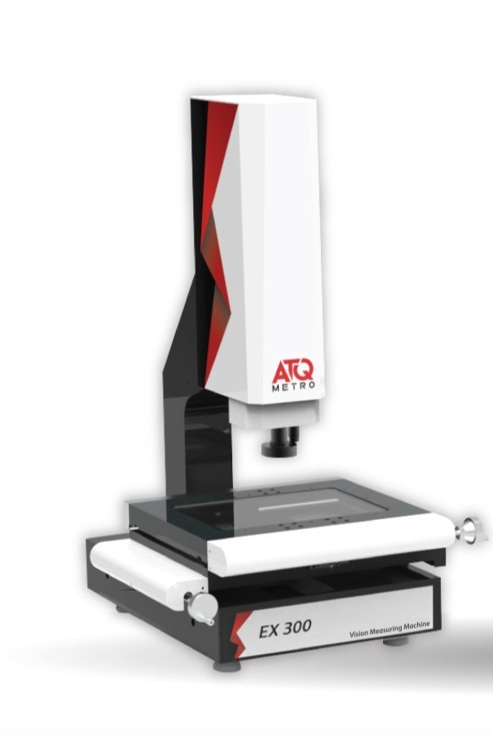
QUALITY CONTROL
At Titaniumm Industries, we are committed to continuous improvement and enhancing our capabilities to meet the growing demands of our clients.
Video Measuring Machine
We plan to add a VMM machine (Vision Measuring Machine) for advanced quality control.
Make : ATQ
Bed Size : 300mm X 300 mm X 300 mm
These machines offer value through their precision, speed, and versatility in dimensional measurement and inspection. These machines utilize advanced image processing and high-speed stage control for accurate and fast measurements of complex parts, according to ATQMETRO.

Slide 13
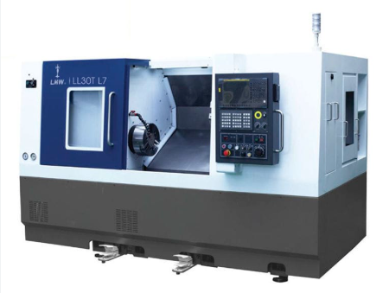
INFRASTRUCTURE
At Titaniumm Industries, we are committed to continuous improvement and enhancing our capabilities to meet the growing demands of our clients.
We added a 2 Axis CNC machine for CNC Turning Purpose.
Make : LMW
Diameter : 620 MM
Length : 611 MM
Adding a CNC turning machine significantly enhances the company's manufacturing capabilities by increasing precision, efficiency, and consistency in production. This investment allows for faster turnaround times, reduced manual labor, and improved product quality, leading to greater customer satisfaction. It also enables the company to handle complex and high-volume jobs more effectively, opening up new business opportunities and strengthening its competitive position in the market.

Slide 14












CLIENTS

Slide 15
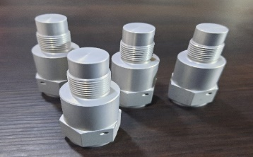
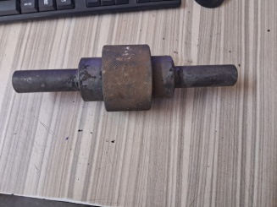
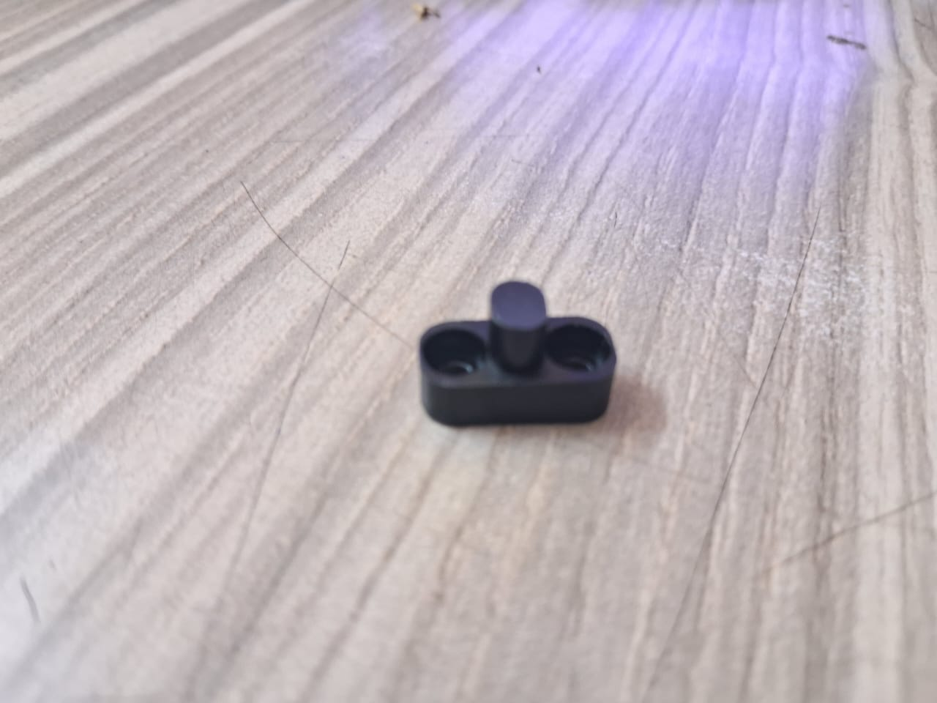
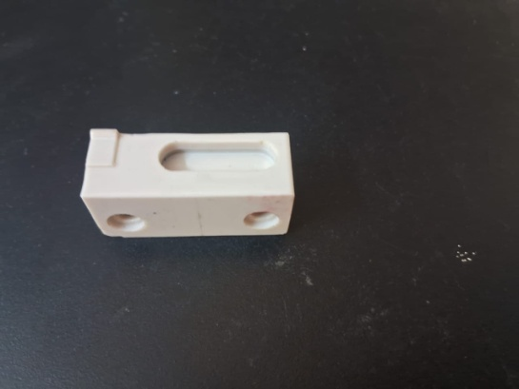
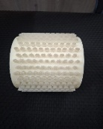
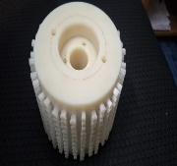
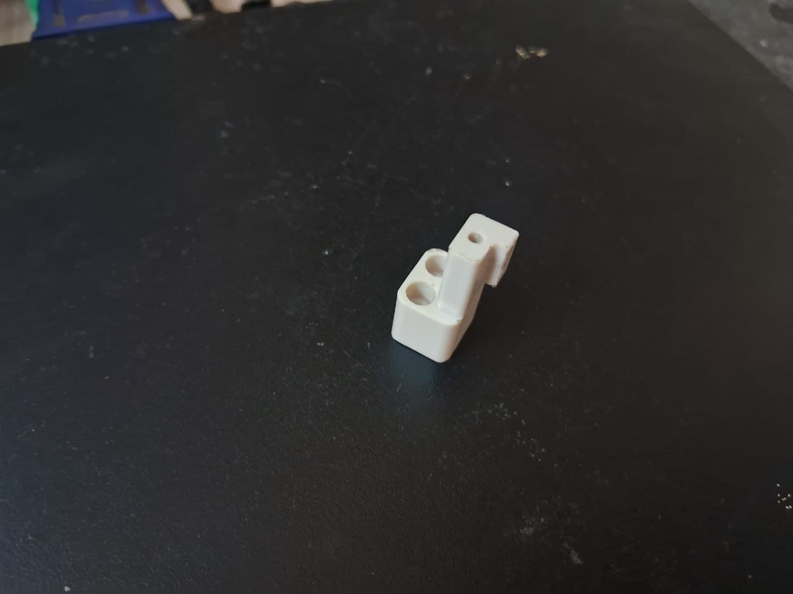
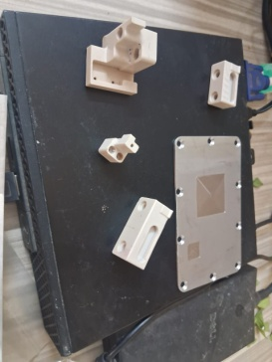
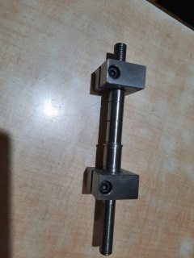
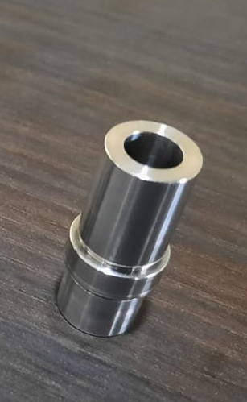
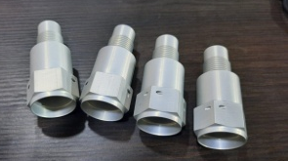
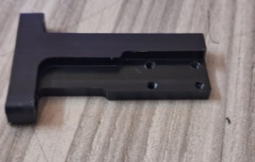
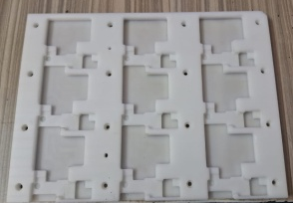
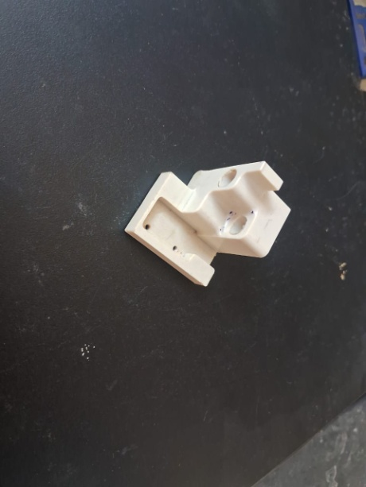
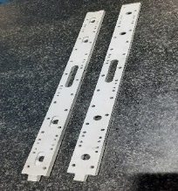
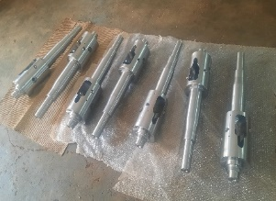
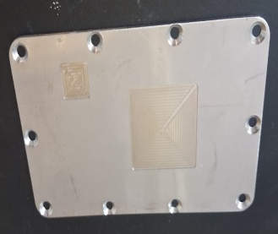
PARTS GALLERY

Slide 16
THANK YOU
TITANIUM INDUSTRIES
GSTIN: AARFT1277F1ZT
PAN : AARFT1277F
Address : Sr. No 54, Plot No-83, Swami V H SOCY Industrial Estate, Handewadi Road,
Pune – 411028 Mobile : 9665771023 Email : titaniumindustries1509@gmail.com

