Slide 1
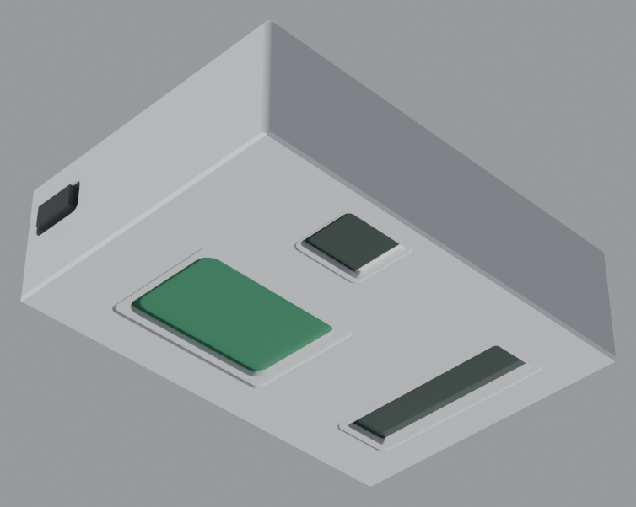
TEAM SUN RISES INDIA · THE ADITYA BIRLA PUBLIC SCHOOL, RENUKOOT · CLASS 9
Astro Smart
Attendance
A ₹1,500 RFID + fingerprint terminal that marks attendance
without internet, heals itself when a sensor fails,
and screws to a classroom wall.
ESP32
RC522 13.56 MHZ
R307 OPTICAL
FIREBASE CLOUD
The shipped enclosure, v3.6 — 110 × 155 × 46 mm,
four printed parts, 22 screws
STEM 2026-27 · Kreativity League · Sonbhadra, Uttar Pradesh, India
ASTRO SMART ATTENDANCE — THE TECHNOLOGY
01 / 39
Notes:
OPEN WITH THIS (45 s).
"Indian schools lose 10 to 15 minutes of teaching in every single period to roll call,
and the register, the parent and the report card never talk to each other. We built a
box that costs fifteen hundred rupees, mounts on the wall, and does it with a tap of a
card or a thumb - with no internet needed at the moment of scanning."
Say what the deck is: it is the technology behind the product, and every number in it
can be reproduced from the repository.

Slide 2
HOW TO USE THIS DECK
Three parts, one argument
Read it straight through, or jump to the part the jury is asking about. Every slide carries speaker notes and says which file produced its numbers.
01
02
03
THE SYSTEM
THE ENGINEERING
THE EVIDENCE
Slides 3–13
Slides 14–25
Slides 26–39
What it does, what is inside, how a tap becomes a parent's email. Hardware choices explained against the alternatives they beat.
The part no other school team has: a parametric CAD model, four independent checkers, and a physics audit that argues with the model until it gives up.
Reproduce it, break it, find every risk we know about, and see where each file lives.
IF YOU HAVE ONLY THREE MINUTES
3 → 4 → 5 → 7 → 14 → 17 → 19 → 30
system · stack · problem · RFID · CAD method · the four checkers · the RFID fix · the results — the spine of the 7-minute zonal video.
HOW TO USE THIS DECK
02 / 39
Notes:
Point at the three parts, then tell them which three slides to watch if they are short of time.

Slide 3
SYSTEM ARCHITECTURE
Six layers between a thumb and a report card
①
②
③
④
Card or finger
RC522 + R307
ESP32 DevKit V1
Local proof
MIFARE / ISO 14443A card or a registered thumb
13.56 MHz reader and optical fingerprint, both 3.3 V
Dual core 240 MHz, Wi-Fi, every module on its own bus
LCD confirms, buzzer sounds, record queued in flash
sync when the link is up
⑤
⑥
⑦
⑧
Offline queue
Firebase
Dashboards
Parent alert
Every scan survives a power cut or a dead router
Auth · Realtime DB · Hosting, all HTTPS
Admin, student and guardian views, live
Automatic email on a late or absent mark
Astro AI 2.0 watches every layer above
and recovers it
TWO RULES HOLD THE ARCHITECTURE TOGETHER
▪ Local first. a scan is never lost because the internet was down
▪ Server second. the cloud is a replica the dashboards read, not the source of truth
ARCHITECTURE — README · DOCS/MASTER_PROMPT.MD
03 / 39
Notes:
Walk the arrows once, left to right, top then bottom.
The important sentence: the ESP32 decides. It does not wait for Firebase to say the
student is present - it proves the scan locally, tells the student with the LCD and the
buzzer, and queues the record. The cloud is the replica the dashboards read.

Slide 4
TECHNOLOGY INVENTORY
Every technology in the product, and what it is for
Six columns, grouped by layer. Nothing on this slide is decoration — each entry is a decision, and the slide after each one explains why.
HARDWARE
BUSES & PINS
FIRMWARE
CLOUD
CAD PIPELINE
VERIFICATION
ESP32 DevKit V1
SPI (VSPI)
Arduino C++
Firebase Auth
Python + numpy
Ray casting
compute + Wi-Fi
reader
sketches on ESP32
three roles
the generator
aperture + keep-outs
RC522 13.56 MHz
UART2
Astro AI 2.0
Realtime Database
trimesh
0.02 mm probing
card identity
fingerprint
11 self-checks
attendance tree
mesh + watertight
every rebate and lip
R307 optical
I²C
Task watchdog
Security rules
manifold3d
Envelope sweep
finger identity
display
per-task recovery
server-side access
exact booleans
installability
LCD1602 + I²C
LittleFS
Brown-out detect
Firebase Hosting
shapely
Slicer simulation
student feedback
offline queue
safe writes
dashboards + CDN
2-D cut profiles
layer reality
3010 fan
NTP + RTC
FreeRTOS tasks
Email alerts
Blender 4.5 LTS
SHA-256 manifest
air + demisting
period timing
scan ∥ sync
guardian digest
assembly + renders
pack integrity
PLA / PETG
OTA partitions
Exponential backoff
glTF / .glb
Canvas 2D viewer
the body
field updates
sync retry
web 3D
review in a browser
36 technologies across six layers — and the rest of this deck takes each layer apart, with the measurement that justified it.
TECHNOLOGY INVENTORY — README.MD, TOOLS/, CAD/, EXPORTS/
04 / 39
Notes:
Use this as the map. Do not read it out: say "six layers, thirty-six technologies, and from
here on the deck takes each layer apart."
If a jury member asks "what did you actually learn", pick one entry from each column and
explain the trade-off. That is the slide's purpose - it makes the breadth visible in one glance.

Slide 5
BILL OF MATERIALS
What ₹1,500 actually buys
Five parts from a hobby-electronics catalogue, a 3D-printed box, and no licence fee — ever.
Layer | What we chose | Why this one
Compute | ESP32 DevKit V1 | Wi-Fi + dual core for ₹450-class money
Identity | RC522 13.56 MHz reader | ₹150-class MIFARE reader, 10 mm range
Biometric | R307 optical module | 1,000 templates, matched on the module
Feedback | LCD1602 + I²C backpack | Two wires instead of ten
Enclosure | 4 printed parts, 159 g PLA | ₹200 of filament, not a ₹4,000 box
Cloud | Firebase Spark tier | No servers to run; HTTPS and rules included
₹1,500
TARGET COST PER UNIT, PER OUR BRIEF
95 %
CHEAPER THAN A COMMERCIAL BIOMETRIC TERMINAL
₹0
RECURRING LICENCE. FREE TIER COVERS A SCHOOL
Honesty note: the CAD audit carries no price at all — master_prompt §3.1 forbids it. The ₹1,500 is the team's target, not a quote.
BILL OF MATERIALS — README.MD
05 / 39
Notes:
Do not read the table. Say the sentence: "the whole trick is that nothing in this box is
a specialist part. Every line is in a hobby catalogue in Mirzapur, or printed on our own bed."
If asked about the ₹1,500: it is the target in our brief. The margin we actually protect is
the recurring one - there is no licence, ever.

Slide 6
PROBLEM
Ten minutes of teaching, lost every period
Manual attendance is slow, disconnected and unverifiable — and it is not a problem of one school.
10–15
15 Lakh+
3
0
MINUTES OF TEACHING LOST PER CLASS, EVERY PERIOD
SCHOOLS IN INDIA FACING THE SAME REGISTER
SEPARATE REGISTERS THAT NEVER MEET: CLASS, PARENT, REPORT
OFFLINE BEHAVIOUR IN THE SYSTEMS SCHOOLS CAN AFFORD
WHAT GOES WRONG TODAY
WHAT WE INSIST ON INSTEAD
— The teacher reads 40 names. Two minutes minimum, four if the room is noisy — seven times a day.
— The register is paper. A parent finds out at month-end, or never.
— Proxy attendance is trivial. One friend answers for three students.
— Reporting is manual. Someone re-keys the register for the monthly return.
— Nothing works offline. The affordable systems need the internet up at 8 a.m.
✓ Two factors, not one. a card that can be handed to a friend, plus a thumb that cannot.
✓ Proof at the door. the student sees the mark before they sit down.
✓ Offline first. the day runs with the router unplugged.
✓ The parent knows by 9:15. not at the end of the month.
✓ ₹1,500, no licence. affordable at 15-lakh-school scale or it is not a solution.
PROBLEM — README.MD
06 / 39
Notes:
Land the four numbers, then the left column, then the right.
The strongest line: "we are not trying to make attendance clever. We are trying to make it
cost fifteen hundred rupees and still work when the internet is down, because that is the
only version fifteen lakh schools can actually buy."

Slide 7
THE MICROCONTROLLER
ESP32 DevKit V1 — chosen for the buses, not the Wi-Fi
Every module in the box gets its own hardware bus, which is what makes the self-healing firmware possible at all.
Bus | Carries | What it protects
SPI (VSPI) | RC522 RFID reader | 10 Mbps clock, so a card's 4-byte UID is read before the student moves
UART 2 | R307 fingerprint | its own wire pair: fingerprint traffic cannot corrupt an RFID read
I²C | LCD1602 backpack | 2 pins for the whole display, leaving GPIO free for the buzzer and fan
Flash | offline queue (LittleFS) | a full school day of scans survives a power cut
Wi-Fi | Firebase sync | one batched HTTPS call per shift, not one per scan
RTC + NTP | time | a record keeps the right period even if the router is down at 8 a.m.
WHY NOT THE OBVIOUS BOARD
Arduino Uno — ₹450
16 MHz, 2 KB RAM, no Wi-Fi. Adding connectivity costs more than the ESP32 itself.
ESP8266 — ₹250
One core, so the RFID loop and the cloud sync fight each other for the CPU.
ESP32 DevKit V1 — ₹450
240 MHz dual core · 520 KB SRAM · 4 MB flash · Wi-Fi + BLE · OTA · 3.3 V.
Board is 51.45 × 28.33 × 1.6 mm with 11 mm of header stack — the enclosure reserves 16 mm of component height inside a 40 mm cavity.
COMPUTE LAYER — DOCS/MASTER_PROMPT.MD §5, §9
07 / 39
Notes:
The line that wins this slide: "we did not choose the ESP32 because it has Wi-Fi. We chose
it because it has enough separate buses that no sensor can starve another one, and enough
flash to hold a whole day of scans."
The Uno and ESP8266 cards are there so the choice looks like a decision, not a default.

Slide 8
IDENTITY — RFID
13.56 MHz, and the 3 mm mistake that killed v1
The reader is the reason the enclosure exists in this shape. An RFID antenna will not scan through plastic.
RC522 → ESP32 (VSPI BUS)
WHAT ACTUALLY BLOCKS A SCAN
RC522 pin | ESP32 | Role
SDA / SS | GPIO 5 | chip select
SCK | GPIO 18 | SPI clock
MOSI | GPIO 23 | data to reader
MISO | GPIO 19 | data from reader
RST | GPIO 27 | hard reset line
3.3 V / GND | 3V3 / GND | ≈26 mA, never 5 V
Plastic is invisible
Air gap is everything
13.56 MHz through 2.20 mm of PLA = 0.0001 dB. The wall was never the problem.
v1 printed 3 mm of floor over the antenna and the 10 mm card range collapsed.
Metal detunes the coil
Bars cast a shadow
Nearest steel screw head is 38 mm from the coil centre, against a ~25 mm loop.
v2's two stiffener bars cost 190 mm² of shadow. v3: 0 of 8,269 rays blocked.
These are the Arduino core's default VSPI pins — no software remap needed.
ONE TAP, 40 MILLISECONDS
Field on
Card wakes
Anti-collision
UID + CRC
Lookup
reader radiates 13.56 MHz
harvests power from the field
one card answers, others stay silent
4 or 7 bytes, integrity checked
UID → student, local table in flash
RC522 LAYER — MASTER_PROMPT §8 · V3_PHYSICS_AUDIT.TXT §6
08 / 39
Notes:
This is a story slide. Tell it as one: "v1 did not work. The box looked right and the reader
would not read, because we had printed three millimetres of plastic between the student's
card and the antenna. We measured it, we took the floor out, and we proved by ray-casting
that all 8,269 lines through the window are open."
The pin map is here because the jury usually asks "how is it wired".

Slide 9
IDENTITY — BIOMETRIC
The fingerprint never leaves the sensor
R307 does its own matching, so the ESP32 only ever learns 'template 41 matched'. That is a privacy decision, not a shortcut.
WHY TWO FACTORS AND NOT ONE
ON THE MODULE
Threat | Card only | Card + thumb
Card handed to a friend | works | fails
Card left at home | no mark | thumb still marks
Wet or dirty thumb | — | card still marks
Cost of the second factor | — | ₹650
▪ 500 DPI optical prism, 19 × 21 mm glass
▪ 1,000 templates in its own flash — nothing external to leak
▪ matching happens in the module 1:1 by ID or 1:N across the school
▪ only a verdict crosses the wire match / no-match plus a template number
NEVER ON THE WIRE
✕ no fingerprint image
✕ no template copy
✕ no name — the cloud stores an ID, the register maps it
THE RULE WE CHOSE
A scan is valid when either factor matches, and both are logged as separate evidence. The teacher can always see which one marked the student.
R307 LAYER — MASTER_PROMPT §5, §13 · PHYSICS AUDIT §7
09 / 39
Notes:
Say the privacy sentence out loud - juries remember it: "the fingerprint image never leaves
the sensor. The cloud only ever sees 'template 41 matched at 08:41'."
The table answers the obvious question: why pay 650 rupees for a second factor.

Slide 10
OFFLINE-FIRST
A day of attendance survives the router being unplugged
The ESP32 is the source of truth for the school day. Firebase is the replica that the dashboards read.
①
②
③
④
⑤
SCAN
DECIDE
PROVE
QUEUE
SYNC
card UID or fingerprint verdict
local lookup table, in flash
LCD + buzzer, before the student sits
CRC-checked record appended to a ring buffer
batched HTTPS write when Wi-Fi returns
THE FOUR FAILURES A SCHOOL ACTUALLY HAS, AND WHAT THE BOX DOES
Failure | What a network-only system does | What Astro does
Internet down at 8 a.m. | no attendance at all | full day runs; 4 MB flash holds weeks of scans
Power cut mid-period | the scan in progress is lost | each record is appended the moment it is confirmed
Wi-Fi back, sync restarts | duplicate or out-of-order rows | idempotent write keyed on (student, date, period) — a double sync cannot duplicate
Clock wrong after an outage | scans land in the wrong period | NTP re-sync at boot; a monotonic counter keeps order if time is unknown
Design rule that came out of this table: a record is written to flash before the LCD may say “present”. A student who has seen their mark can walk away knowing it exists, network or not.
OFFLINE BEHAVIOUR — README.MD; FIRMWARE DESIGN RULE
10 / 39
Notes:
The single sentence for this slide: "the box tells the student they are marked before it
phones home, and it never queues an unconfirmed record."
If asked how the firmware knows the period: NTP gives the time, a timetable table in flash
turns the time into period 1-8, and the monotonic counter orders records if the clock is wrong.

Slide 11
CLOUD LAYER
Firebase does four jobs so a school runs no servers
Authentication, a realtime database, hosting and security rules — all on the free tier, all HTTPS by default.
AUTHENTICATION
REALTIME DATABASE
THE TREE THE APP READS
Email / password plus custom claims: one login tree, three roles. Claims are checked in the rules, not in the page.
A JSON tree with a client-side cache. A write from the ESP32 appears on the dashboard with no refresh.
schools/
{schoolId}/
students/{uid}/ name, class, section, guardian
attendance/{YYYY-MM-DD}/
P1: { state: "P", at: "08:41", by: "rfid" }
P2: { state: "L", at: "09:12", by: "finger" }
devices/{mac}/ firmware, lastSync, health
HOSTING
SECURITY RULES
Static dashboards on a global CDN with TLS included. Nothing to patch, nothing to pay.
Tested per path: a guardian reads only their ward, a student only their own row, an admin the school.
≈10 KB per sync — it survives a 2G link
WHY NOT A REAL SERVER
0
HTTPS
A school has no sysadmin. Firebase's free tier costs nothing, needs no patching, and gives HTTPS, auth and a CDN out of the box. If the school later needs SQL reporting, the data is one export away.
SERVERS TO RUN OR PATCH
BY DEFAULT, WITH AUTH AND RULES
CLOUD LAYER — README.MD
11 / 39
Notes:
Four services, four sentences. Then point at the JSON on the right and say: "this is the
whole database. A school's attendance is a tree about ten kilobytes per sync."
The 'why not a real server' box is the answer to the jury member who says 'why not just use
MySQL' - because the school would then need an administrator.

Slide 12
ACCESS MODEL
Three roles, three views of the same record
Role is a claim in the login token, and the database rules enforce it — the dashboard is not the security boundary.
ADMIN
STUDENT
GUARDIAN
Principal, class teacher
The learner
Parent at home
▪ mark, edit and justify any record
▪ enrol students and cards
▪ daily and period reports, CSV export
▪ device health and last-sync for every box
▪ own attendance, day and period
▪ own percentage and trend
▪ cannot see any other student's row
▪ cannot write anything
▪ their ward only, read-only
▪ the same email the alert comes from
▪ period-level detail, not just a daily tick
▪ can opt out of email, not of the record
THE RULE THAT MAKES THIS REAL
attendance/$date/$period: write if isAdmin(school) || isDevice(mac)
read if isAdmin(school) || uid == auth.uid || wardOf(auth.uid) == uid
ACCESS MODEL — README.MD · DECK SLIDE 10
12 / 39
Notes:
The point of the pseudo-rules: a student who opens developer tools and edits the page still
cannot read another student's attendance, because the rule runs on the server.
Guardian can opt out of email but not of the record - attendance is a legal record in India.

Slide 13
GUARDIAN ALERTS
The parent knows at 9:15, not at month-end
An email is a notification about a record — never the record itself. If the mail fails, the attendance does not.
A MORNING, MINUTE BY MINUTE
To: guardian@example.com
08:40
08:41
08:42
09:15
09:16
09:17
Attendance update —
Renukoot Public School, Class 9-B
Card tap
Row written to flash
Synced to Firebase
Absence list closes
Guardian email queued
Delivered / retried
Anant was marked ABSENT in period 2 (09:10)
on 12 Nov 2026.
Period 1 — present, by card, 08:41
ANTI-SPAM RULES LEARNED THE HARD WAY
— One digest per student per day. a parent who gets eleven emails stops reading all of them.
— Quiet hours. nothing is sent between 21:00 and 07:00; it goes out at 07:05.
— Late is not absent. the first alert says late; only an unmarked period escalates.
— Retry with backoff, then fall back. three attempts, then the admin's dashboard shows the row as undelivered.
— The record wins. a failed email never changes an attendance state.
View full record
Sent automatically. Do not reply.
To stop these, ask the class teacher.
Illustrative mock-up of the digest email
ALERTING — README.MD KEY FEATURES
13 / 39
Notes:
The email mock is the slide parents in the audience remember. Point at the period line: the
parent does not just learn 'absent', they learn period 1 was fine and period 2 was not.
Say the anti-spam line as a design decision: "we cap it at one email a day per child, because
a parent who is spammed stops reading, and then the system has failed socially even if it
worked technically."

Slide 14
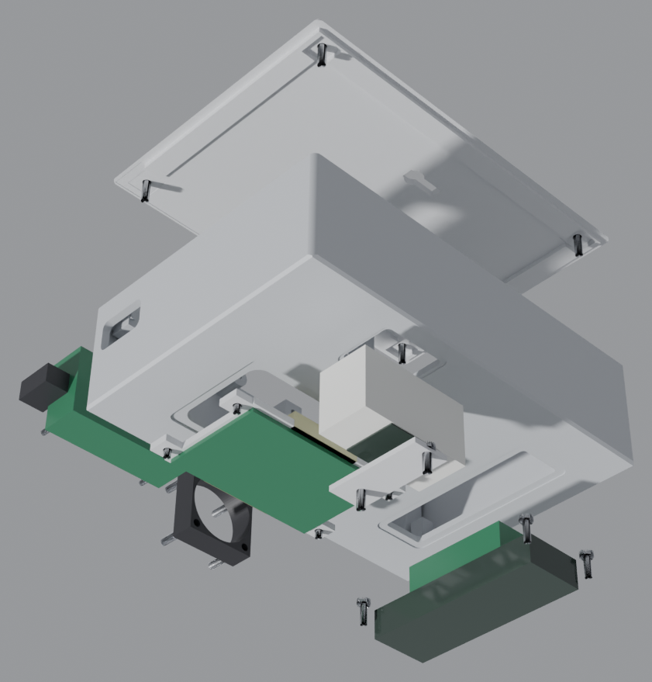
THE ENCLOSURE
Six parts, four impossible constraints, no supports
Everything inside the box was given before the box was drawn. The outer size is an output, not an input.
RFID needs air
Optics need a cone
The 13.56 MHz coil cannot scan through a printed floor. The window must be a true through-cut, nothing across it.
The R307 prism needs a clear 20° cone to the finger; the LCD needs ±34° horizontally.
No supports allowed
Summer PLA
It must print on a school's own bed, front face down, with no support material and no raft.
Renukoot in May puts a wall-mounted box near PLA's 60 °C glass transition.
Exploded assembly: shell, rear plate, R307 bracket, RC522 ring — the four printed parts
THE ANSWER: DERIVE THE SHELL FROM THE PARTS
110
155
46
— Place the real envelopes first, with the vendor-tolerance clearances.
— Then wrap 2.6–3.0 mm walls around them — the size falls out of that arithmetic.
— Result: 110 × 155 × 46 mm, 4 printed parts, 172.2 cm³ of plastic.
MM WIDE
MM TALL
MM DEEP
ENCLOSURE CONSTRAINTS — MASTER_PROMPT §6, §8, §13, §14
14 / 39
Notes:
Frame it as a puzzle: four things are true about the parts before a single line is drawn, and
the four of them fight each other. The RFID wants air. The optics want an opening. The printer
wants no supports. The PLA wants thickness.
The answer is the method, and that is the next ten slides.

Slide 15
METHOD
The CAD is a program, not a drawing
tools/build_v3.py holds every dimension as a named, sourced parameter. Change one number, and the box, every check and every report rebuild in about a minute.
tools/build_v3.py — the parameter block, verbatim
PROVENANCE IS IN THE COMMENTS
Tag | Means | If it is wrong
[V1] | measured from the team's own v1 STL | built from the delivered part
[REF] | component reference from the team | a printed fit absorbs 0.35 mm
[EST] | engineering estimate | tagged VERIFY_ACTUAL_HARDWARE
[WEB] | a published vendor drawing | dated in the source comment
P = dict(
W=110.0, H=155.0, D=46.0,
wall_side=2.6, wall_top=3.0, wall_front=3.0, plate_t=3.0,
fit=0.35, rebate=(0.45, 3.0),
lcd_window=(66.0, 17.5), lcd_centre=(0.0, 51.95), # [V1]
lcd_hole_pitch=(75.1, 31.0), # [V1] == 1602 std
r307_window=(19.3, 21.2), r307_centre=(35.95, -24.1),
r307_body=(20.0, 44.1, 23.5),
rc522_board=(40.0, 60.0, 1.6),
rfid_window=(38.0, 56.0), rfid_bars=(0, 0.0),
)
THE STACK
ONE COMMAND REBUILDS EVERY PART, CHECK AND REPORT
trimesh 5.1.1
manifold3d 3.5.4
mesh I/O, watertight tests, booleans
exact boolean kernel — this is what makes unions watertight
$ python3 tools/build_v3.py
shapely 2.2.0
mapbox-earcut 2.1.0
→ cad/v3/*.stl + docs/v3_audit.txt
2-D booleans for every cut profile
triangulation of the resulting polygons
about 60 seconds, and it refuses to write a bad mesh
numpy / scipy
matplotlib
ray sampling, probes, audit statistics
the drawing sheets and section figures
Canvas 2D + JS
the 3D viewer: hand-written rasteriser, no library
METHOD — TOOLS/BUILD_V3.PY · TOOLS/REQUIREMENTS_V3.TXT
15 / 39
Notes:
This is the slide that separates the project from a school 3D-printing project.
"The CAD is not a drawing. It is a Python program with a dictionary at the top. Every number
in that dictionary has a comment saying where it came from - our own part, the team's
measurement, a vendor drawing, or an estimate that we are obliged to verify."
If someone asks about Blender: Blender renders and exports; it does not decide. The geometry
is decided by the program.

Slide 16
PIPELINE
From a dictionary to a printed part
Six stages, and a gate between every two of them. Nothing reaches the pack unless a program said PASS.
01
02
03
04
05
06
PARAMETERS
SOLIDS
CUTS
STL
ORIENT
PACK
P = dict(...) with provenance on every value
primitives → boolean union → exact manifold body
openings, pilots, rebates, then re-union what must survive
watertight, 1 body, 0 open edges — asserted before writing
bed alignment baked into the triangles, then re-verified
4 STLs + print order + SHA-256 + figures + .blend + .glb
THE GATE THAT MATTERS
A file is never written on trust
Why this order (master_prompt §19)
✓ the STL must report watertight = True and bodies = 1
✓ normals must point outward and the volume must be positive
✓ a pilot must break through exactly one surface, never become an enclosed void
✓ every bolt-on feature must overlap its host by ≥ 0.5 mm or the mesh splits
— Hollow first, then union. the pocket cut would otherwise delete the bosses.
— Cut, then re-union. grille bars, stiffeners and ribs are cut in and put back with overlap.
— Re-audit after every change — a stale PASS is worse than a FAIL.
— Regenerate the pack last, so the SHA-256 manifest always describes what shipped.
PIPELINE — MASTER_PROMPT §19 · TOOLS/BUILD_V3.PY · TOOLS/MAKE_PACK_V3.PY
16 / 39
Notes:
Do not explain all six boxes. Explain the gate: "the builder refuses to write a file that is
not watertight and a single body. We learned that the hard way - our first gauge printed
hollow because the mesh was closed with its normals pointing inward."
That story is real and it is in docs/v3_design_notes.md section 8.

Slide 17
VERIFICATION
Four independent programs, one mesh
Each one asks a different question, and none of them can see the others' answers. The second one never imports the generator at all.
Program | The question it asks | Output | Result
build_v3.py | Sections A–K: is the parametric model itself consistent — walls, fits, keep-outs, apertures? | docs/v3_audit.txt | ALL CHECKS PASS
verify_v3.py | Forget the generator: re-type every dimension and re-measure the shipped triangles alone | independent_verify.txt | ALL CHECKS PASS
audit_physics_v3.py | 10 sections of physics: fasteners, airflow, RF, optics, PLA, kinematics, slicer | v3_physics_audit.txt | no failures
check_grooves_v3.py | Walk a 0.02 mm probe down every rebate, lip and hole — what does the plastic actually offer? | v3_groove_check.txt | 34/34 as designed
hole_probe_v3.py | Cast a ray down all 22 pilots: can the documented screw length actually seat? | v3_hole_probe.txt | gate: exit ≠ 0
Independence, not repetition
The audit argues back
Docs are checked too
verify_v3.py shares no code with build_v3.py. It re-types 30+ dimensions by hand and re-measures them off the triangles, so a wrong parameter cannot hide behind a passing check.
audit_physics_v3.py found three real defects that both CAD checkers had passed: a countersink opening onto a corner round, a plate with a hole through it, and an RFID board that could not physically be installed.
Section 10 of the physics audit re-reads every number in the design notes and the print order and compares it with the mesh. A stale claim is treated as a bug.
VERIFICATION — DOCS/V3_*.TXT · TOOLS/VERIFY_V3.PY, AUDIT_PHYSICS_V3.PY
17 / 39
Notes:
The killer line for a technical jury: "one program wrote the box, but four others had to agree
before we were allowed to print it - and one of them is not allowed to import the program
that made the box."
The magenta card is the honest part: the physics audit found three defects that both CAD
checkers passed. That is why it exists.

Slide 18
MECHANICAL DETAIL
22 pilots, all at the thread's minor diameter
A self-tapping screw into printed PLA needs a pilot smaller than nominal, or it spins instead of biting. Every hole is measured in the shipped mesh.
Joint | Screw | n | Pilot | Depth | Pull-out | Load held | Reserve
LCD1602 bezel | M2.5 | 4 | Ø2.04 | 6.3 | 188 N | 0.88 N | 213×
R307 bracket | M3 | 2 | Ø2.48 | 6.3 | 221 N | 0.18 N | 1253×
RC522 ring | M2.5 | 4 | Ø2.04 | 2.5 | 75 N | 0.17 N | 447×
ESP32 bosses | M2.2 | 4 | Ø1.78 | 5.7 | 147 N | 0.25 N | 598×
Fan posts | M3 | 4 | Ø2.48 | 10.3 | 362 N | 0.15 N | 2458×
Rear plate | M3 | 4 | Ø2.48 | 8.3 | 291 N | 0.59 N | 495×
PULL-OUT MODEL
F = τ · π · d_minor · L · 0.55
τ = 8.5 MPa cross-layer shear
0.55 = thread fill
213–2458×
RESERVE ON EVERY JOINT
0
GLUE JOINTS, CLIPS OR SNAP-FITS IN V3
THE AUDIT'S OWN CONCLUSION
Fastener count and screwdriver access govern this box — not fastener strength. Every module got its own 2–4 screws and a clear, straight driver path; nothing needs a washer or a nut.
FASTENERS — V3_PHYSICS_AUDIT.TXT §1, §2; V3_HOLE_PROBE.TXT
18 / 39
Notes:
The formula is here so nobody can accuse us of a made-up strength number.
Then the punchline, which is genuinely the interesting engineering result: the screws are
four to two-thousand times stronger than they need to be. What actually decides this design is
whether a screwdriver can reach the screw - which is why v3 replaced v2's clip bars with
screws everywhere.

Slide 19
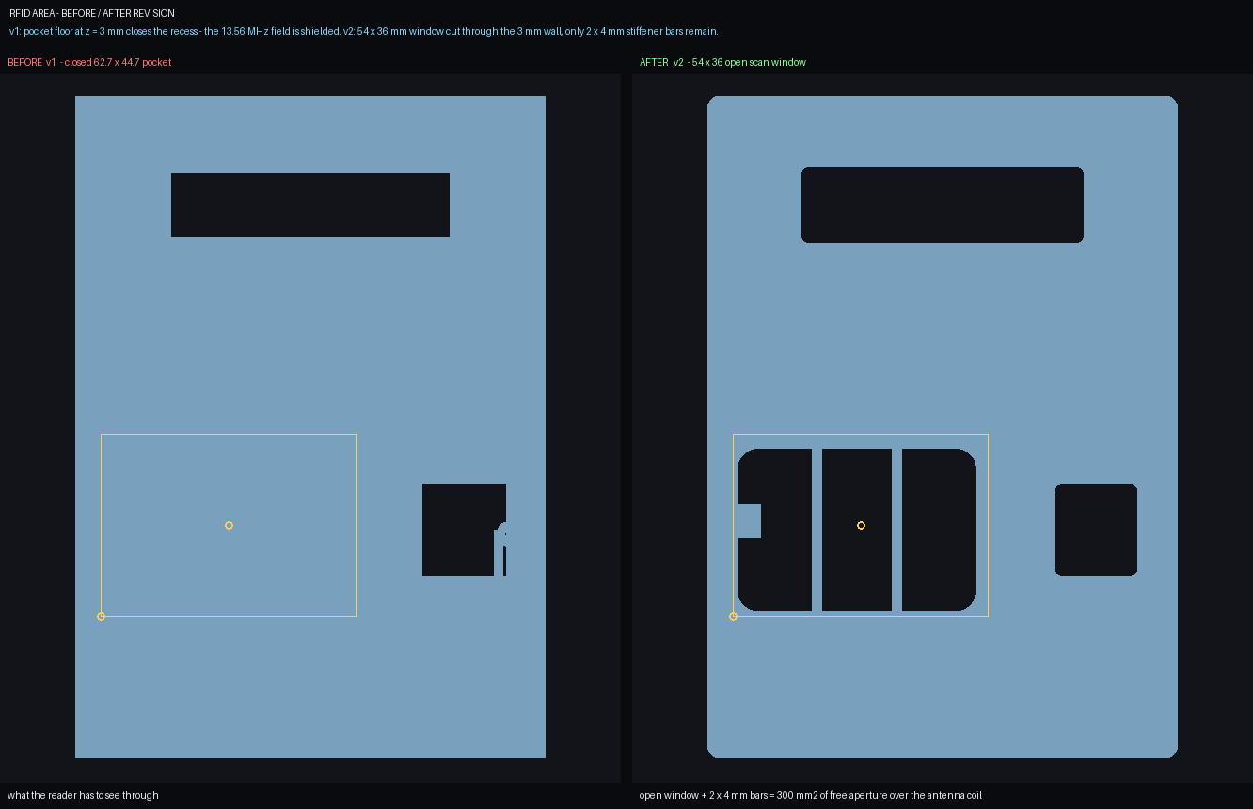
CASE STUDY
v1 did not scan. Here is the exact fix.
The single most important change between the first printed box and the shipped one, and how it was proved rather than assumed.
THE DEFECT
v1 printed a closed pocket floor 3 mm in front of the RC522 antenna. The card's field could not reach it; no card ever read.
THE FIRST FIX
v2 opened a 56 × 38 mm window but kept two stiffener bars across it. The window was 90.4 % open — and 190 mm² of antenna shadow remained.
Front face, same projection: v2's two 2.5 mm stiffener bars (left) vs v3's fully open aperture (right)
THE REAL FIX
HOW IT IS PROVED — NOT ASSERTED
v3 turns the board portrait and cuts a 38 × 56 mm window with rounded R5 corners: 100 % open, nothing across the coil, and the wall around it is a 2.0 mm ledge ring braced by four corner gussets instead of bars.
8,269 rays are cast through the aperture from outside the front face. 0 are blocked. A separate keep-out volume in front of the coil is proved empty of printed material — and the 13.56 MHz loss through the remaining 2.20 mm of PLA is 0.0001 dB.
RFID FIX — V3_DESIGN_NOTES.MD §1, §6 · PHYSICS AUDIT §6
19 / 39
Notes:
This is the story to tell if you have only one story. v1 failed. Not "looked imperfect" -
failed: no card could be read. The team found the cause, changed the layout, and then built a
ray-casting proof so the defect could never come back silently.
Numbers: v2 lost 190 mm2 of antenna shadow to two stiffener bars. v3: 8,269 rays, 0 blocked.

Slide 20
ASSEMBLY
Every part fits through the back — proved with a swept column
The rear plate is the only opening. So a part is installable only if a column swept from its seat out of the box misses every printed surface.
ORDER OF ASSEMBLY
Every module clears the 104.8 × 149.0 mm rear opening
1
ESP32
Module | Envelope (mm) | Swept column
LCD1602 + backpack | 80.0 × 36.0 | 0.00 mm³
RC522 board | 60.0 × 40.0 | 0.00 mm³
R307 module | 44.1 × 20.0 | 0.00 mm³
ESP32 DevKit | 51.5 × 28.3 | 0.00 mm³
3010 fan | 30.0 × 30.0 | 0.00 mm³
hand + 4 mm hex key | 60.0 × 60.0 | clear
onto four stand-off bosses on the −X wall
2
RC522 + ring
board drops in, one ring clamps both edges
3
R307
two 23.5 mm posts, dog-bone bracket over it
4
LCD1602
onto four bosses, the last thing visible from outside
5
fan
into its Ø28 bore on four internal posts
6
rear plate
Also proved: the plate leaves and returns without disturbing any module — 0.00 mm³ swept against the shell, the bracket and the ring.
four M3 into 9 mm bosses — closed
ASSEMBLY — PHYSICS AUDIT §3; V3_DESIGN_NOTES.MD §6, §10
20 / 39
Notes:
The interesting failure the audit caught: in v3.0 the RC522 was laid landscape, 60 mm across a
bay that is 58.35 mm wide. The board could not physically go in - in any orientation. That is
the kind of error you only find by sweeping the part through the space instead of looking at a
drawing.
The fix was to mount the reader portrait, which also widened the ligament between the RFID
window and the fingerprint window from 17.5 to 22.5 mm.

Slide 21
MANUFACTURING
Four parts, one bed, zero supports
Printed on any 220 × 220 × 250 mm FDM printer. The orientation a slicer must see is baked into the STL triangles.
File | x | Volume | Printed | Footprint | First layer
01_MAIN_SHELL | 1 | 115.2 cm³ | 113.6 g | 110 × 155 × 43 | 11,396 mm², 1 contour
02_REAR_PLATE | 1 | 53.8 cm³ | 41.5 g | 110 × 155 × 5 | 2,997 mm², 1 contour
04_RC522_RING | 1 | 2.2 cm³ | 2.7 g | 43.6 × 76.0 × 2.6 | 883 mm², 1 contour
03_R307_BRACKET | 1 | 1.0 cm³ | 1.2 g | 36.8 × 14.0 × 3.2 | 501 mm², 1 contour
all four |  | 172.2 cm³ | 159 g | 0.45 nozzle, 3 walls, 15 % | no supports, no raft
0.30 %
OF FACES STEEPER THAN 60°, EACH BRIDGING < 3 MM
6.3
SETS FROM ONE 1 KG SPOOL — 53 M OF FILAMENT
214
PRINTER SETTINGS THE PRINT ORDER SPECIFIES
SLICES CHECKED: 0 SELF-INTERSECTIONS, 0 EMPTY LAYERS
0.2 mm
3
15–20 %
3
PLA or PETG
none
layer height
perimeters
infill
top/bottom skins
material
supports
Every one of those four first layers is a single closed contour — islands on a first layer lift and shed debris.
PRINTING — EXPORTS/README_PRINT_ORDER_V3.TXT · PHYSICS AUDIT §9
21 / 39
Notes:
The number to say: 159 grams, four parts, no supports, one spool prints six and a third sets.
The subtle engineering bit at the bottom: every part's first layer is one closed contour. A
printed island on the first layer is what peels off mid-print, so the audit checks for it on
all four files.

Slide 22
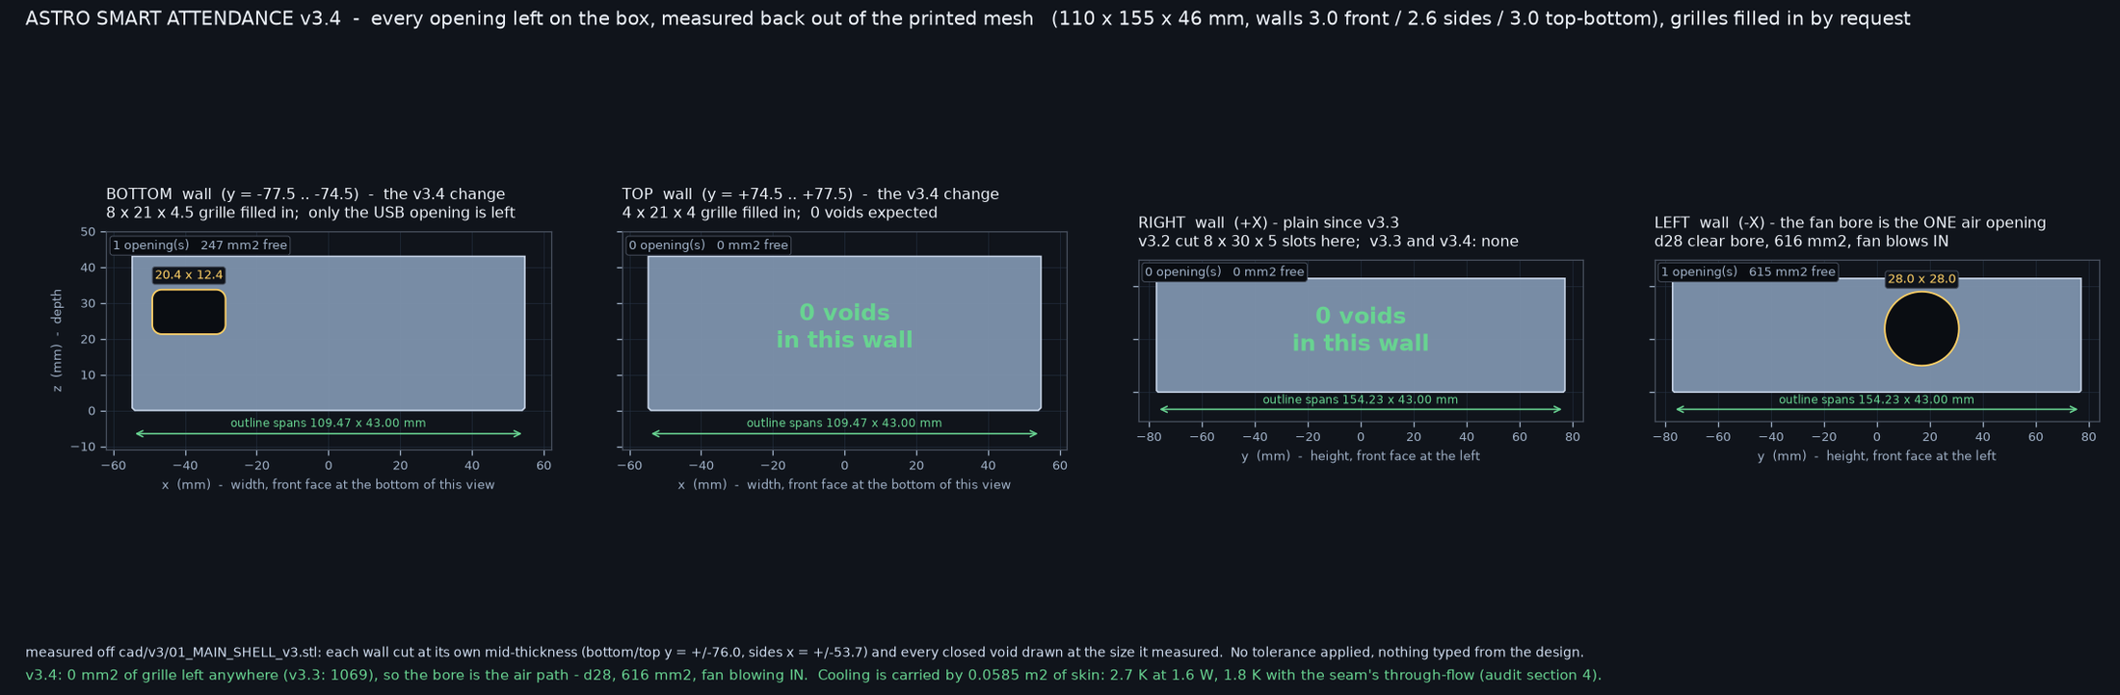
THERMAL
We deleted the vents and measured the cost
A 3010 fan, a Ø28 bore as the only air opening, and a heat path that mostly does not care about openings at all.
TWO PATHS IN PARALLEL
1 · Passive skin
2 · Fan through-flow
ΔT = P / (h · A)
0.25 L/s through 784 cm³
2.7 K above ambient
one air change every 3.2 s
heat leaves through the PLA by convection and radiation
orifices in series with the fan's own curve
Every opening on the printed box, measured at mid-thickness
Measured | v3.3 (12 grille slots) | v3.4 (1 bore, shipped)
Outlet area | 1,069 mm² across 12 slots | 0 mm² — all twelve filled in
Air opening | bore + grilles | 615 mm² Ø28, and nothing else
ΔT at 1.6 W (both paths) | 1.6 K | 1.8 K
Ceiling for the ESP32 crystal | 12 K | 12 K
Plastic saved | — | 3.2 cm³ / 3 g
THE HONEST RESULT
Closing twelve vents costs about 0.2 K. What the fan actually does inside a near-sealed box is break the boundary layer off the LCD and the R307 prism, and hold the enclosure slightly above room pressure so dust is pushed out of the optics rather than sucked in.
Ceiling check: 12 K is where the ESP32 crystal starts to drift. We sit 10.2 K inside it.
THERMAL — PHYSICS AUDIT §4 · V3_DESIGN_NOTES.MD §7, §9
22 / 39
Notes:
This slide is deliberately honest, and that is the point. The jury will assume more holes means
better cooling. The measurement says otherwise: the plastic skin is the resistor, not the holes.
The best sentence: "we removed twelve openings because the user asked for a clean box, and then
we measured what it cost. Two-tenths of a kelvin."

Slide 23
MATERIAL AND ENVIRONMENT
This box hangs on a wall in Sonbhadra
The ambient numbers matter more than the CAD numbers. PLA's glass transition is the constraint that decided the wall thickness.
Condition | Surface temp | PLA Tg ≈ 60 °C | Verdict
Shaded indoor wall, May peak | 45 °C | +15 K margin | PLA is fine
Sun through a window onto the wall | 55 °C | +5 K margin | PLA is fine
Unshaded outside wall / closed room | 65 °C | −5 K | print PETG (Tg ≈ 80 °C)
SHRINKAGE VS THE PRINTED FIT
Filament | Shrink | Effect on the 0.25 mm register
dry, tuned | 0.2 % | 0.21 mm — absorbed
humid, monsoon | 0.5 % | 0.52 mm — still closes
WHY A HUMID SPOOL STILL CLOSES THE BOX
— The register frame is eight separate ribs — an oversized rib flexes, it cannot lock the plate out.
— Four M3 screws draw the plate home against any 0.5 % growth.
— Both parts are the same plastic, so thermal growth is common-mode and cancels.
— Switching to PETG needs no geometry change — only the nozzle and bed temperatures change.
PETG is the drop-in upgrade
230–240 °C nozzle, 80–90 °C bed. Same four files, same 22 pilots, no re-drawing.
AND THE DUST
The enclosure runs at slight positive pressure, so air leaves through the R307 prism relief and the plate seam rather than entering around the optics. Dust on an optical sensor is a recalibration, not a cleaning.
MATERIAL — PHYSICS AUDIT §5 · V3_DESIGN_NOTES.MD §4
23 / 39
Notes:
This is the slide that makes the design local. Most teams design a box for a lab. This one is
designed for a classroom in Sonbhadra in May, where a west wall in the afternoon is 55 degrees.
The PETG line is the answer to "what if it is hotter": no re-design, print it in PETG.

Slide 24
DESIGN ITERATION
v2 was a repaired v1. v3 is a different decision.
Same layout engine, different answers — and every change is measured before and after.
 | v2 | v3 (shipped) | Why
Overall size | 110 × 155 × 48 | 110 × 155 × 46 | depth came out of the RFID stack, not a guess
Side wall | 2.4 mm | 2.6 mm | v2's thinnest structural wall was 1.2 mm at the vents
RFID aperture | 56 × 38 + 2 bars (90.4 % open) | 38 × 56, 100 % open | 8,269 rays, 0 blocked; 190 mm² of shadow removed
RC522 hold-down | 2 clamp bars, printed ×2 | 1 flat ring, printed ×1 | 2.2 cm³ instead of two 1.6 cm³ bars; nothing in front of the coil
Fan opening | Ø26 with 3 moulded bars | Ø28, nothing across it | the print's most fragile sliver is gone
Front openings | flush cut | 0.45 × 3.0 mm rebate ring | each module's own bezel registers; no chipped edge
Fingerprint mount | 2 posts + flat strap over the glass | dog-bone bracket + seat ribs | the bracket lifts off without prying on the glass
Rear closure | 2 mm solid plug (79.6 cm³) | 8-sided register frame (53.8 cm³) | 26 cm³ less plastic, real clearance for the ESP32
Plastic | 199.6 cm³ | 172.2 cm³ | 159 g printed instead of 396 g all-up
Every one of these is a flag in build_v3.py, not a lost version: side_intake=True restores v3.2's perforated wall, grilles=True restores v3.3's twelve slots. The decisions are reversible in one line, so they can be argued with instead of defended.
ITERATION — V3_DESIGN_NOTES.MD §1
24 / 39
Notes:
Do not read the table. Say: "v2 was our first box with the mistakes patched. v3 was us deciding
again from the parts, and the differences are measured in the same table."
If a jury member questions a change, every row has a number and a file.

Slide 25
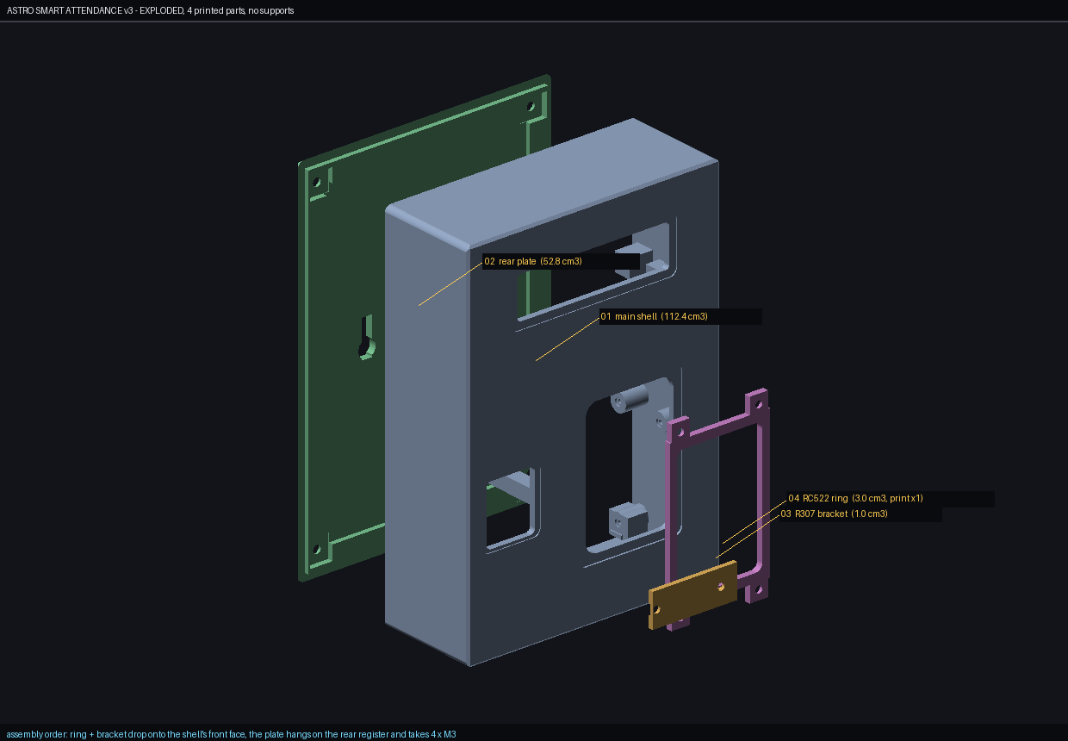
DELIVERABLES
A .blend, a .glb and a viewer anyone can open
The CAD is not a screenshot in a report. It ships as editable 3D, with the modules, the fan and all 22 screws modelled at their measured lengths.
File | What it is
ASTRO_…_v3.blend | Blender 4.5 LTS scene: 4 solids, 5 module envelopes, a real 3010 fan, 22 screws
ASTRO_…_v3_assembly.glb | one-file glTF for any web viewer or phone
v3_assembly STLs ×4 | the print files, bed-aligned, SHA-256 listed
viewer_offline.html | 2.6 MB single file — meshes and a Canvas 2D viewer, no library
README_PRINT_ORDER_v3.txt | print order, screws, settings, assembly sequence
THE .BLEND IS CHECKED TOO
Exploded view generated by tools/make_fixing_v3.py — shell, rear plate, R307 bracket and the RC522 ring, with the fastener positions measured off the mesh.
— It re-derives every volume from the file's own polygons: 115.22 / 53.80 / 1.01 / 2.19 cm³
— Every screw axis lands on a hole centre — worst error 0.000 mm
— Nothing may poke outside the case + 2.5 mm — caught a floating USB plug
— Three Cycles frames must not be blank — checked by pixel variance
The viewer needs no three.js: tools/make_offline_viewer.py embeds the meshes and a painter's-algorithm renderer in one HTML file.
DELIVERABLES — V3_DESIGN_NOTES.MD §11 · TOOLS/MAKE_BLEND_V3.PY, CHECK_BLEND_V3.PY
25 / 39
Notes:
Offer the .glb to the jury on a phone. That is the moment this stops being a report and becomes
a product.
The four bullets are there to make the point that even the presentation artefact is verified.

Slide 26
ASTRO AI 2.0
Eleven checks that keep a classroom box alive
An attendance terminal has no technician. Astro AI is the firmware layer that detects, recovers and reports — without a student ever losing a mark.
01
RFID reader absent
02
Card read errors
03
Fingerprint sensor
SPI version register silent → re-init bus, retry ×3
CRC failures spike → lower SPI clock, re-tune
UART timeout → power-cycle the module
04
Display blank
05
Clock drift
06
Wi-Fi down
I²C NACK → re-address 0x27/0x3F, re-init backpack
NTP delta over 60 s → resync, keep order
keep scanning, buffer, retry with backoff
07
Flash full
08
Power brown-out
09
Watchdog
flush synced batches first, never unsynced
detector trips → safe write, clean boot
task stalled → only that task is reset
10
Firmware integrity
11
Memory pressure
OTA hash mismatch → roll back
heap low → drop the log, keep the queue
THE RULE IT IS BUILT ON
WHY 11 AND NOT 3
Never lose a mark to recover a sensor. A dead reader leaves the fingerprint working, and the other way round.
Each one is a failure we could reach on the bench: a pulled jumper wire, a dead router, a drained battery.
ASTRO AI 2.0 — README.MD KEY FEATURES
26 / 39
Notes:
Say the red rule first: "never lose a mark to recover a sensor."
Then explain that the eleven are not hypothetical - each one is a failure the team could produce
in the workshop with a pulled wire or an unplugged router. That is the difference between a
feature list and a testable one.

Slide 27
VALIDATION
What was tested, and what the numbers actually mean
Two kinds of evidence in this project: tests the team ran on the prototype, and checks that regenerate themselves from the shipped files.
PROTOTYPE TEST RESULTS
CHECKS THAT SHIP WITH THE REPOSITORY
Metric | Result
Feature tests passing | 140 / 140
Stress-test cases verified | 10,000,000
Compiler warnings | 0
Compiler errors | 0
Prototype status | working, ready
Check | Coverage
Parametric audit A–K | walls, fits, keep-outs, apertures
STL-only verification | manifold, bed-aligned, every hole
Physics audit, 10 sections | fasteners, air, RF, optics, PLA, slicer
Groove probe, 34 values | each rebate and lip at 0.02 mm
Hole probe, 22 pilots | does the documented screw seat?
Blend check | volumes, screw axes, render frames
WHAT THE STRESS NUMBER IS, PRECISELY
THE DIFFERENCE
The 10,000,000 is generated input space — UID × timestamp × duplicate × offline-length combinations driven through the record logic. It is not ten million students, and we do not present it as such.
Prototype tests prove the electronics. The generated checks prove the product — and they re-run on every rebuild, so they cannot go stale.
VALIDATION — README.MD · DOCS/V3_*.TXT
27 / 39
Notes:
Be precise about 10,000,000. Say exactly what the deck says: it is input-combination space, not
students. A jury that catches you inflating one number stops believing the rest, and the rest is
better than the inflated number.

Slide 28
IMPACT — TIME AND MONEY
Where the 10–15 minutes comes back
A conservative classroom arithmetic, using our own numbers and nothing else.
105
≈32
8
256
MINUTES PER DAY PER SECTION (7 PERIODS × 15 MIN)
TEACHING DAYS RECOVERED PER YEAR PER SECTION
SECTIONS SERVED BY ONE ₹1,500 TERMINAL
TEACHING DAYS RETURNED ACROSS THOSE SECTIONS
THE ARITHMETIC, SHOWN SO IT CAN BE ARGUED WITH
Step | Calculation | Result
Time lost per section per day | 7 periods × 15 min of manual roll call | 105 min
Teaching days lost per section per year | 105 min × 220 school days ÷ 720 min in a teaching day | ≈32 days
One terminal, rotating sections | 8 sections × 32 days | 256 teaching days
Hardware cost | ₹1,500 one time, plus ₹200 of filament per replacement shell | ₹0 recurring
Parent notification | was month-end or never; is 09:15 the same day | same-day
WHAT WE DO NOT CLAIM
✕ all 15 minutes is recoverable — a card tap still takes 2 s per student
✕ the teacher is not replaced by the box
✕ the pilot school result is not yet measured
Even at a third of that recovery the terminal pays for itself in teaching time inside one term.
IMPACT — DECK ARITHMETIC FROM README.MD FIGURES
28 / 39
Notes:
Show the arithmetic, then point at the red box. Juries reward a team that bounds its own claim.
If pushed: "the honest statement is two to four minutes per period is recoverable, not fifteen.
Even that is 8 to 16 teaching days per section per year."

Slide 29
IMPACT — BEYOND THE REGISTER
What else becomes possible once attendance is data
The terminal is the cheapest way to get one reliable fact per student per period. Everything here is a consequence of having that fact.
Early-warning for dropouts
Teacher's own workload
Mid-day meal planning
Three consecutive absences is the earliest reliable signal a school has. A record that writes itself can flag it the same week.
The monthly return is generated, not re-keyed. That is hours per teacher per term, and it is the complaint we heard most.
Head-count at 09:15 rather than at the counter. Less waste, and a number the kitchen can act on.
Honest report cards
A platform, not a product
Local manufacture
Attendance becomes a per-period fact instead of a monthly guess, so the report card and the register finally agree.
The same box with a different sensor is a lab-equipment register, a library ledger, a staff muster roll.
Every part is printable in Renukoot. Replacing one is a filament spool, not a purchase order.
THE SCALE ARGUMENT
There are over 15 lakh schools in India. What lets this reach them is not cleverness — it is that it costs ₹1,500, prints locally, needs no technician and runs with the internet down. A ₹40,000 terminal with an annual licence cannot cross that gap.
IMPACT — README.MD; TEAM INTERVIEWS
29 / 39
Notes:
Do not oversell. Pick two cards and explain them properly: the early-warning signal and the
teacher's monthly return. Those are the two teachers actually asked for.

Slide 30
EVIDENCE
The scoreboard — every line has a file behind it
What is claimed | Measured by | Result | File
The shell is one watertight solid | build_v3.py, from triangles | 11,108 tris, 1 body, 0 open edges | v3_audit.txt
The RFID window is genuinely open | 8,269 rays through the aperture | 0 blocked | v3_audit.txt
Nothing printed is in front of the coil | boolean volume of the keep-out | 0.00 mm³ | v3_audit.txt
The box is dry and closed | plate sliced at mid-thickness | exactly 6 voids = 4 screws + 2 keyhole slots | v3_independent_verify.txt
Every rebate and lip is as designed | 0.02 mm probe walk | 34 / 34 values within 0.035 mm | v3_groove_check.txt
Every documented screw can seat | ray down 22 pilot axes | all 22 pass, exit code 0 | v3_hole_probe.txt
Holes cannot crack the corners | plastic between cone and outline | min 2.25 mm (v3.0: 0.08 mm) | v3_physics_audit.txt §8
The parts print where we say | 214 slicer layers | 0 self-intersections, 0 empty layers | v3_physics_audit.txt §9
The docs match the mesh | text re-read and compared | no stale claims | v3_physics_audit.txt §10
The .blend is the parts it says it is | volumes from its own polygons | 172.22 cm³ total, 110.00 × 155.00 × 46.00 | v3_blend_check.txt
SCOREBOARD — DOCS/*.TXT, EACH REGENERATED BY A PROGRAM IN TOOLS/
30 / 39
Notes:
This is the slide to leave on screen while the jury asks questions. Every row is a claim we can
defend by running a command.
Pick two rows to talk about: the 8,269 rays (because it is vivid) and the 34 groove values
(because it proves the plastic is where it was told to be, not merely where it was designed).

Slide 31
HONEST LIMITATIONS
What is not closed yet
The repository's own audit file lists these as open items, so the deck does too. A claim list without a limitation list is a sales pitch, not engineering.
Open item | Status | How it is handled | Owner
ESP32 pad-hole diameter | unpublished | M2.2 or M2 both pass the Ø1.8 pilot; decides nothing geometric | vendor data
RC522 corner-hole pitch | deliberately unused | the ring clamps the board edges, so any brand fits | by design
R307 mounting holes | do not exist | the bracket clamps the housing, exactly as stock kits do | by design
Pressure drop across the plate seam | assumed | recorded as a NOTE in the audit, never as a gate | print-dependent
Field trial in a real classroom | not yet run | pilot planned; impact numbers are arithmetic, not measured | next phase
PLA on an unshaded external wall | out of spec | print in PETG — no geometry change needed | material advice
THE RULE WE WORKED BY
Never write PASS unless a check produced that PASS. Where a value is unknown, write VERIFY_ACTUAL_HARDWARE and say so. It is in the master prompt as a non-negotiable rule, and it is the reason this deck can show a limitations slide at all.
LIMITATIONS — MASTER_PROMPT §3, §4 · V3_DESIGN_NOTES.MD §5, §10
31 / 39
Notes:
Open this slide before the jury asks the hard question. Say: "here is what is not closed, and
here is how each one is contained."
The rule at the bottom is from §3 of our own brief. Quoting your own constraint document is a
strong move - it shows the discipline was chosen, not improvised.

Slide 32
REPRODUCIBILITY
Anyone can rebuild this in about a minute
Pinned dependencies, one command per stage, and a SHA-256 manifest that proves the bytes in the pack are the bytes the checks passed.
PINNED, SO IT REBUILDS THE SAME
# 1 environment
python3 -m venv .venv
.venv/bin/pip install -r tools/requirements_v3.txt
# 2 rebuild the geometry + run the parametric audit
.venv/bin/python tools/build_v3.py # RESULT: ALL CHECKS PASS
# 3 verify the STLs alone (does not import the builder)
.venv/bin/python tools/verify_v3.py # INDEPENDENT RESULT: ALL CHECKS PASS
# 4 the physics, the grooves and the screw depths
.venv/bin/python tools/audit_physics_v3.py # PHYSICS RESULT: no failures
.venv/bin/python tools/check_grooves_v3.py # EVERY GROOVE AND FIT MEASURES AS DESIGNED
.venv/bin/python tools/hole_probe_v3.py # gate: non-zero exit if a screw cannot seat
# 5 rebuild the pack and the .blend
.venv/bin/python tools/make_pack_v3.py && .venv/bin/python tools/make_blend_v3.py
Package | Pin
numpy | 2.4.6
trimesh | 5.1.1
manifold3d | 3.5.4
mapbox-earcut | 2.1.0
shapely | 2.2.0
scipy / matplotlib | 1.17.1 / 3.11.2
bpy (optional) | 4.5.14
AND IT REPRODUCES EXACTLY
A from-scratch rebuild with these pins reproduces 3 of the 4 STLs byte-for-byte, and the shell as the same solid — same volume, same area.
exports/SHA256SUMS_v3.txt lists a hash for every file in the pack, so a download can be proved against the build that passed.
REPRODUCIBILITY — TOOLS/REQUIREMENTS_V3.TXT · EXPORTS/SHA256SUMS_V3.TXT
32 / 39
Notes:
Offer the command. If the jury has a laptop with python, this is runnable in front of them.
The byte-for-byte line matters: it says the build is deterministic apart from a known
triangulation-diagonal flip, which the requirements file names explicitly.

Slide 33
FAILURE ANALYSIS
Three defects the checks caught — and one they missed
The most useful part of this project is the list of things that were wrong. Each one changed a design rule permanently.
F11
A rear-plate countersink opened onto a corner round
MEDIUM
THE RULE IT CREATED
The Ø6.6 mm 90° cone was 0.08 mm from the R3 corner, so the screw head had a hole to fall into. Fixed by moving all four screws 3.5 mm inboard — plastic at the corners went from 0.08 to 2.25 mm.
New rule: an audit must measure plastic between a cone and the outline, not just the hole.
F12
The rear plate had a 15.6 × 63 mm hole through it
HIGH
THE RULE IT CREATED
A cut meant only to clear the ESP32's bosses ran through the whole 3 mm skin instead of the 2 mm frame. The shipped plate was open to dust. Fixed by stopping the cut at the frame's own top surface.
New rule: slice the plate at mid-thickness and demand exactly 6 voids.
F13
The RFID reader could not be installed at all
HIGH
THE RULE IT CREATED
Laid landscape, the 60 mm board needed a 58.35 mm bay. It could not go in in any orientation, and no build order fixes plastic printed into the wall. Fixed by mounting it portrait.
New rule: sweep every part's real path, do not look at a drawing.
v1
The reader could not scan — the defect that started v2
HIGH
THE RULE IT CREATED
A closed 3 mm pocket floor over the antenna blocked the field. Everything looked right, and nothing worked. This is the defect that produced the ray-cast aperture proof.
New rule: a scan window is proved by rays through it, never by a picture of it.
DEFECTS — V3_DESIGN_NOTES.MD §6, §8 · MASTER_PROMPT STATUS HEADER
33 / 39
Notes:
This is the strongest slide for a technical jury and the weakest for a nervous one. Choose it
deliberately.
Say: "we are showing you our bugs because every one of them turned into a permanent check. F13
in particular is embarrassing - the reader physically could not go in - and that is exactly why
section 3 of the physics audit exists."

Slide 34
TEAM
Five people, five parts of the same box
Class 9, The Aditya Birla Public School, Renukoot — with a mentor who made us prove every number.
SG
AT
TU
DS
DD
Shaurya Gupta
Anant Tiwari
Tejash Upadhyaye
Diwakar Singh
Devansh Dakard
Team lead · firmware & cloud
Ideation & user research
Hardware integration
Product design & 3D
Testing & documentation
ESP32 firmware, Astro AI, Firebase schema, the web dashboards.
The problem interviews with teachers and parents, and the offline-first requirement.
Wiring, bus assignment, power budget and every bench test that produced a failure row.
The enclosure programme: parametric CAD, the four checkers, print validation.
The audit trail, the print order, the pack and this deck's evidence chain.
MENTOR
HOW THE WORK WAS SPLIT
Dr. Jayesh Shinde
Every member owns a deliverable that is checked by someone else — firmware by the hardware owner, CAD by the testing owner, documentation by all five. Nothing in the pack was signed off by the person who made it.
The Aditya Birla Public School, Renukoot
The standing instruction that shaped this project: no claim without a measurement, and no PASS that a program did not produce.
TEAM — README.MD
34 / 39
Notes:
Teamwork is 20 of the 100 League points, so do not skip this. Name each person and the thing
they own. Then say the cross-check sentence - it is what 'collaboration' looks like in practice.

Slide 35
NEXT
What a pilot term would actually test
Five questions that cannot be answered in a workshop, in the order a school would need them answered.
# | Question for the pilot | How it is measured | Pass criterion
1 | Does a whole class clear the door in under two minutes? | Time 40 students, 20 school days, with the teacher timing | ≤ 3 min at the 95th percentile
2 | What is the real false-reject rate on growing fingers? | Every reject logged with reason and retried within 10 s | < 2 % of scans needing a retry
3 | How many days a term run with no internet at all? | Sync backlog and recovery on the dashboard | zero lost records, all reconciled
4 | Does the PLA survive one full summer on a west wall? | Surface thermocouple plus a monthly fit check | no sag, plate still closes by hand
5 | Do parents read the alerts? | Open and click rate on the digest | ≥ 50 % open within 24 h
SHIPPED TODAY
NEEDED TO REACH A SECOND SCHOOL
✓ working prototype, 140/140 feature tests
✓ four print files and a verified assembly model
✓ a cloud dashboard with three roles live
▪ a provisioning flow a teacher can run unaided
▪ SMS fallback for guardians without email
▪ a district deployment guide with the SQL export
PILOT PLAN — DECK 27, 28 AND 30 TURNED INTO PASS CRITERIA
35 / 39
Notes:
Every pilot question has a pass criterion with a number, which is what makes it a pilot and not
a wish. If the jury asks 'what next', read row 1 and row 3.

Slide 36
APPENDIX A
Pin-out and power budget
Signal | ESP32 pin | Module | Notes
SPI SCK | GPIO 18 | RC522 | VSPI, 4–10 MHz, 3.3 V
SPI MISO | GPIO 19 | RC522 | 3.3 V logic, no level shifter
SPI MOSI | GPIO 23 | RC522 | —
SPI SS | GPIO 5 | RC522 | software chip-select
RST | GPIO 27 | RC522 | also used by Astro AI to recover
UART2 TX | GPIO 17 | R307 | 57600 baud, 3.3 V
UART2 RX | GPIO 16 | R307 | —
I²C SDA | GPIO 21 | LCD1602 backpack | address 0x27 or 0x3F, probed at boot
I²C SCL | GPIO 22 | LCD1602 backpack | shared-bus recovery in Astro AI
Buzzer | GPIO 25 | buzzer | confirm tone, PWM
Fan | 3V3 + MOSFET | 3010 fan | continuous, ~0.1 W
POWER
Rail | Load | Note
3.3 V logic | ≈ 26 mA | RC522, idle
3.3 V logic | peak ≈ 120 mA | RC522 field on + ESP32 TX
R307 | ≈ 60 mA / 120 mA | idle / capture
LCD + backpack | ≈ 20 mA | backlight on
3010 fan | ≈ 30 mA | continuous
WHY THE RAIL MATTERS
Peak draw is about 300 mA with the field on and the sensor capturing, so a 5 V 1 A supply into the DevKit's regulator is enough with headroom. The enclosure's USB slot is the only cable opening on the box — 20.4 × 12.4 mm, sized around a real plug body plus 1.2 mm all round.
No pin is used twice: SPI, UART2, I2C, buzzer and fan each own their lines.
APPENDIX A — WIRING AND POWER
36 / 39
Notes:
Reference slide. Use it only if a jury member asks how it is wired or what it draws.

Slide 37
APPENDIX B
The numbers, in one place
Every figure quoted in this deck, with the audit section that produced it.
Quantity | Value | Source
Outer size | 110.00 × 155.00 × 46.00 mm | physics audit §10
Shell volume / triangles | 115.2 cm³ / 11,108 tris | v3_audit.txt, verify_v3.py
All four parts | 172.2 cm³ CAD → 159 g printed | physics audit §9
RFID aperture | 38.00 × 56.00, 0 of 8,269 rays blocked | audit §K, physics §6
Fan bore | Ø28.00 mm, 615 mm², the only air opening | physics §4
LCD window / rebate | 66.00 × 17.50 / 72.00 × 23.53 × 0.45 | groove check
R307 window / relief | 19.3 × 21.2 in a 25.3 × 27.2 rebate | groove check
Register lip | 104.305 × 148.503 in 104.785 × 148.982 | groove check
Pilots | 22 holes Ø1.78–2.50, thinnest skin 1.40 mm | hole probe
Pull-out reserve | 213× to 2,458× on every joint | physics audit §1
ΔT at 1.6 W | 1.8 K combined (ceiling 12 K) | physics audit §4
13.56 MHz loss in 2.20 mm PLA | 0.0001 dB | physics audit §6
Supports needed | none; 0.30 % of faces over 60° | physics audit §9
Print from one 1 kg spool | 6.3 sets | physics audit §9
APPENDIX B — TRACEABILITY TABLE
37 / 39
Notes:
The reference page. Every number here can be re-derived by running one of the five programs in tools/.

Slide 38
APPENDIX C
Where every file lives
The repository is organised so that a stranger can rebuild the product, not just read about it.
docs/
tools/
cad/ · exports/ · renders/
master_prompt.md
build_v3.py
cad/v3/*.stl
the consolidated engineering brief, §1–26
the generator; every dimension is a parameter
the four print files, bed-aligned
v3_design_notes.md
verify_v3.py
v2/ and v1/
the measured design history, v3 → v3.6
independent STL checker
the two earlier generations
v3_audit.txt
audit_physics_v3.py
exports/*.zip
parametric audit A–K
10-section physics audit
print pack, STL-only pack, full pack
v3_independent_verify.txt
check_grooves_v3.py
*.blend / *.glb
STL-only verification
0.02 mm probe walk
editable 3D and web 3D
v3_physics_audit.txt
hole_probe_v3.py
viewer_offline.html
10 sections of physics
screw-depth gate
single-file 3D viewer
v3_groove_check.txt
make_blend_v3.py
SHA256SUMS_v3.txt
34 probed fits
.blend, .glb, Cycles frames
a hash for every shipped file
v3_hole_probe.txt
make_pack_v3.py
renders/*.png
22 screw depths
the shipping pack and SHA-256 list
drawing sheets, sections, exploded views
v3_blend_build / check.txt
requirements_v3.txt
presentation/
the .blend and its verification
every pin in the environment
this deck and the script that builds it
APPENDIX C — REPOSITORY MAP
38 / 39
Notes:
Reference slide. Point at tools/ and say: this is the part you can run.

Slide 39

IN ONE SENTENCE
A ₹1,500 box that marks
attendance with a card or a
thumb, works with the internet
down, and is proved before
it is printed.
140/140
4
0
159 g
FEATURE TESTS
INDEPENDENT CHECKERS
SUPPORTS NEEDED
OF PRINTED PLASTIC
Team Sun Rises India · Class 9 · The Aditya Birla Public School, Renukoot
Mentor: Dr. Jayesh Shinde · Sonbhadra, Uttar Pradesh, India
Front face, v3.6: LCD window, R307 optical
window, 100 % open RFID aperture
THANK YOU — QUESTIONS
39 / 39
Notes:
Close on the sentence, not the specs. Then stop talking and let them ask.
If a jury member asks 'what are you most proud of', the answer is on slide 32: the list of things
that were wrong. That answer is hard to fake and it is true.

