Slide 1
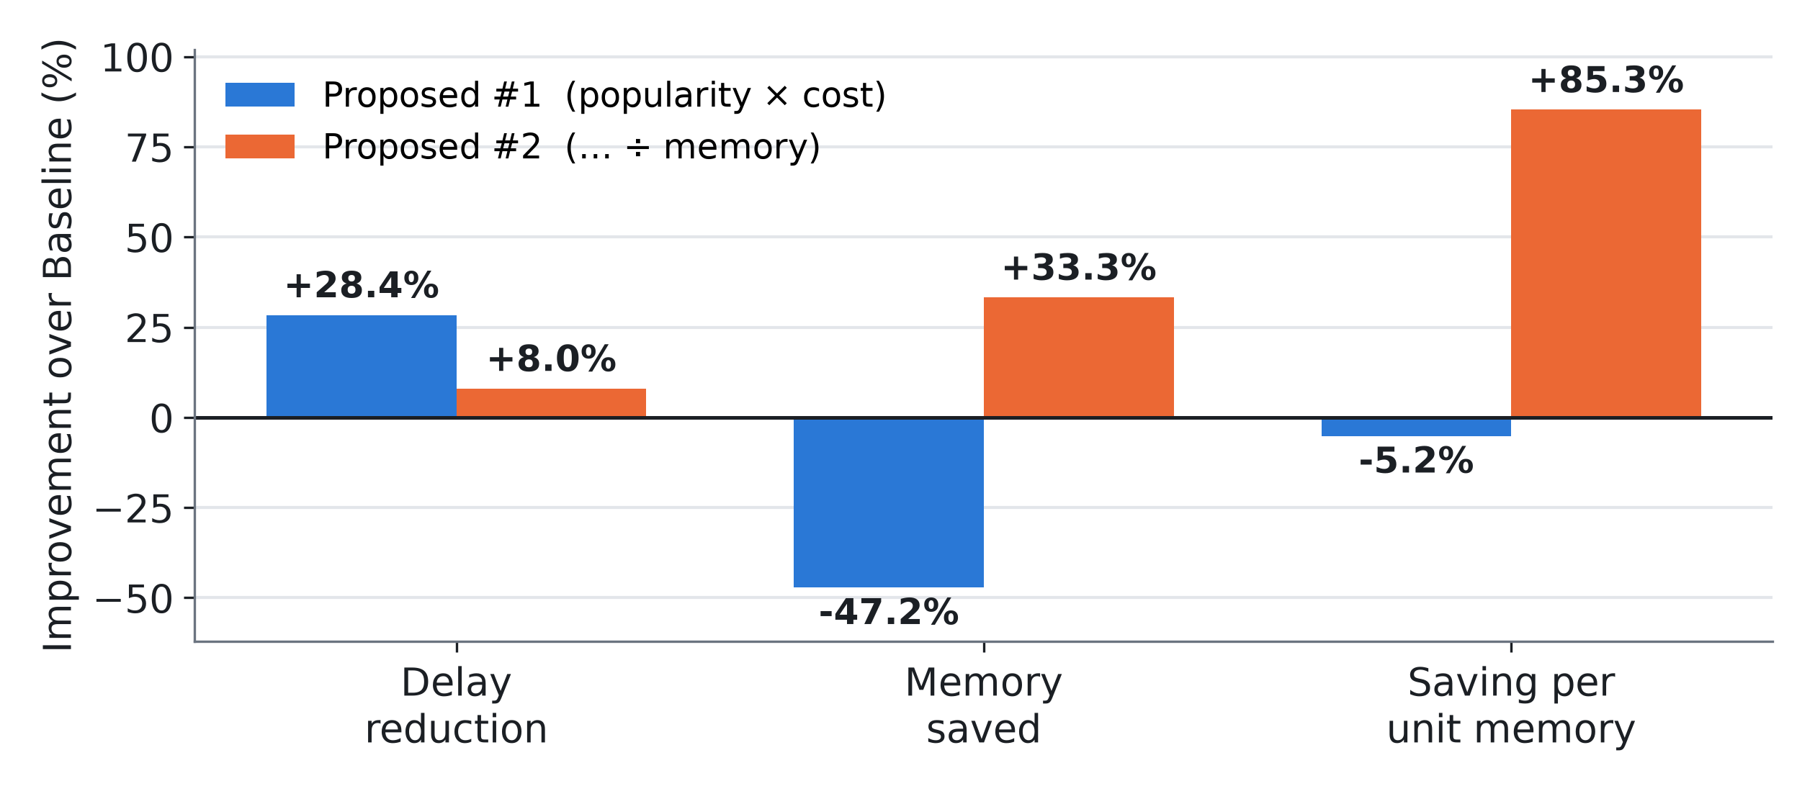
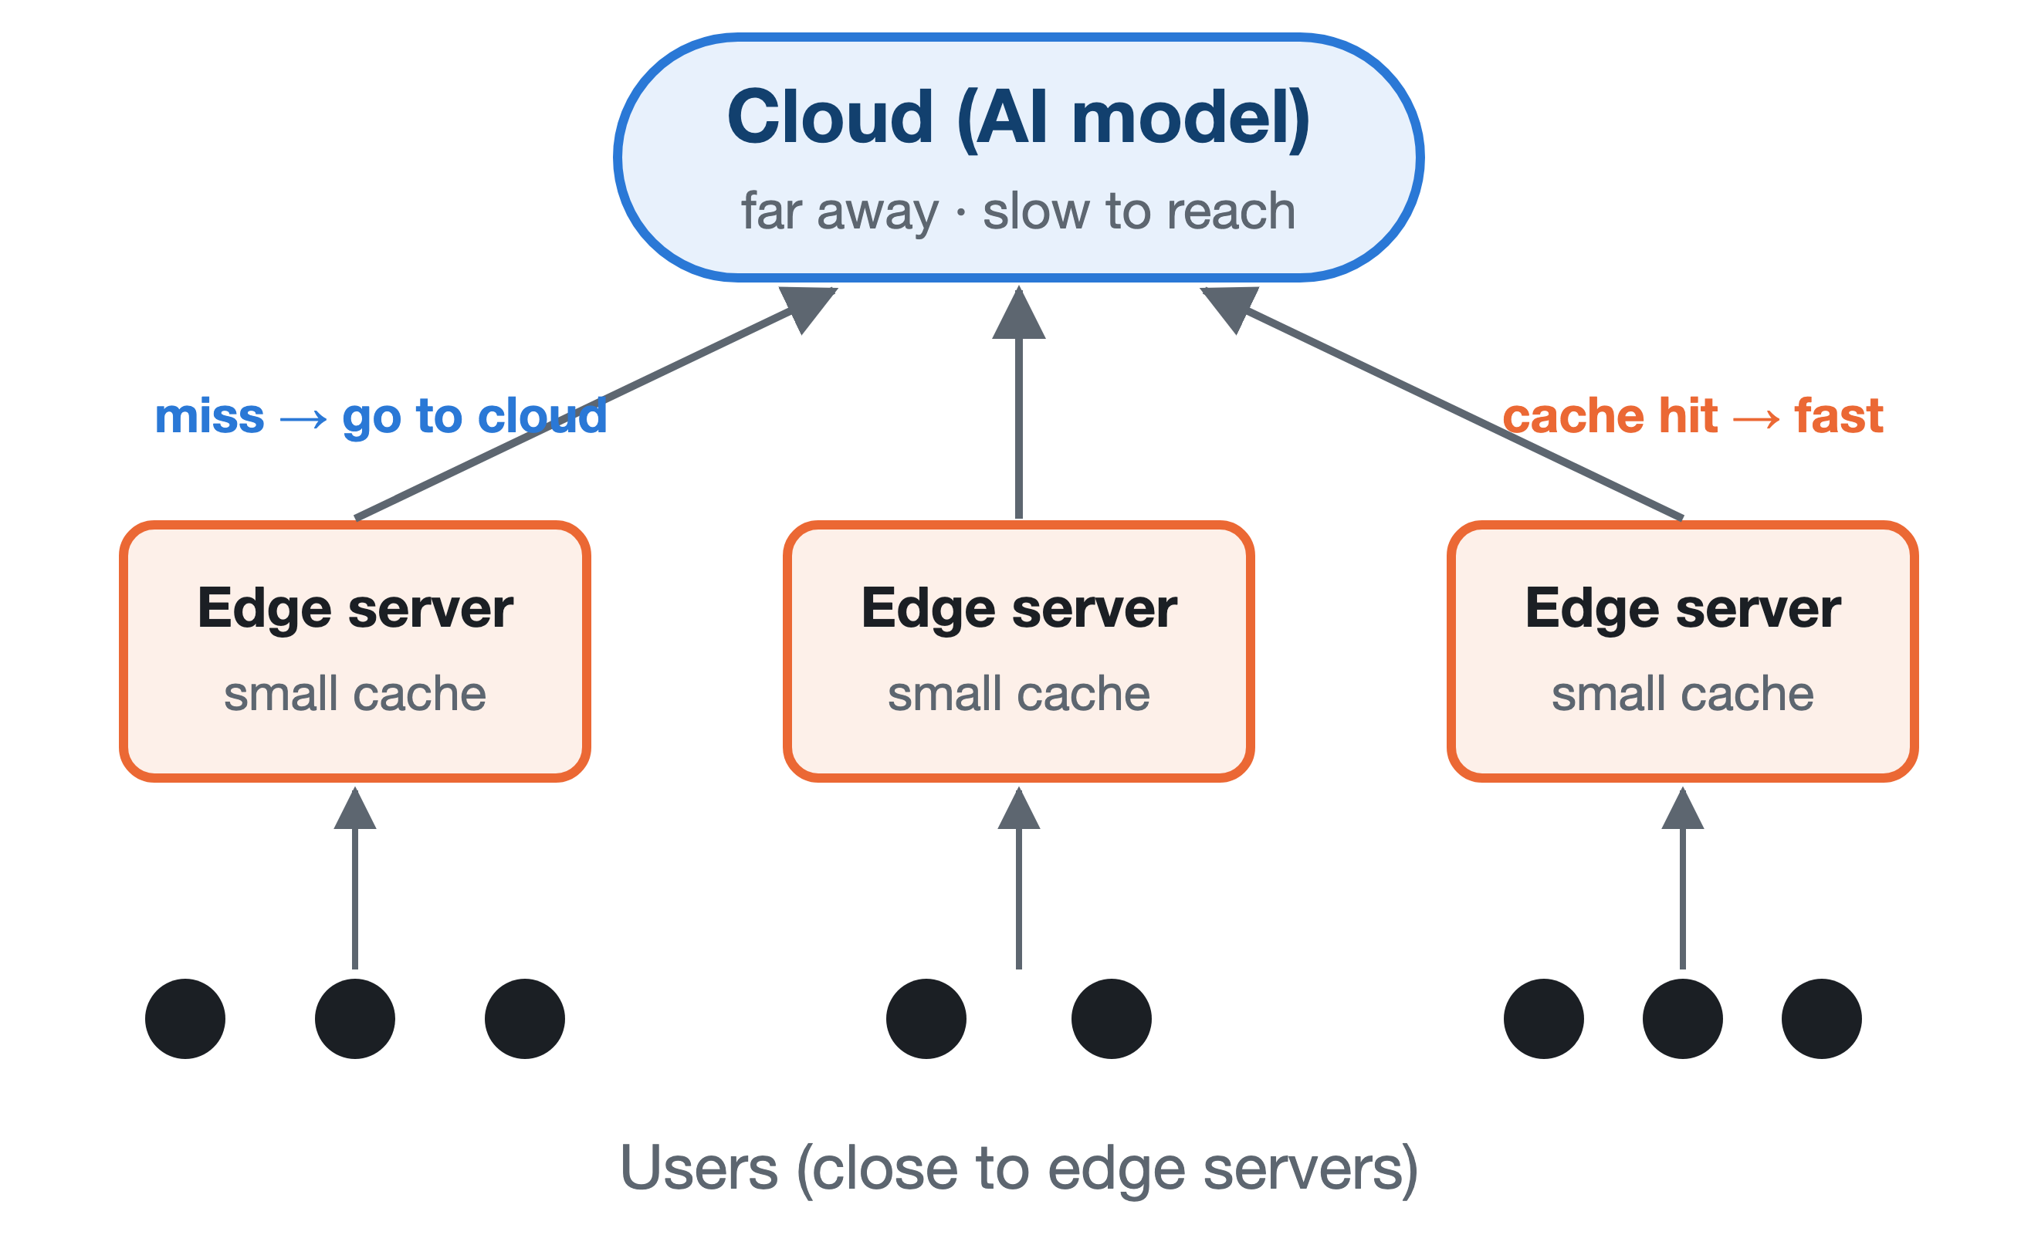
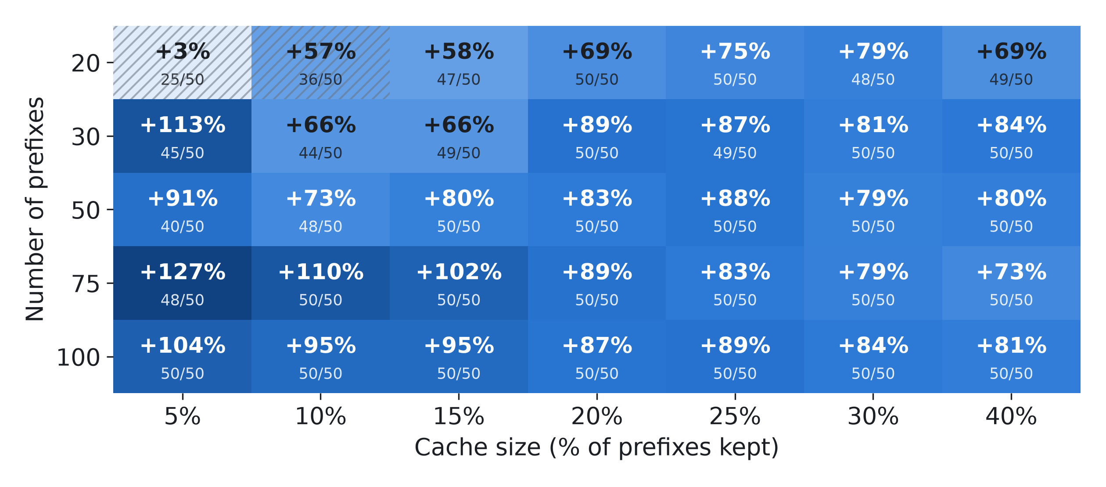
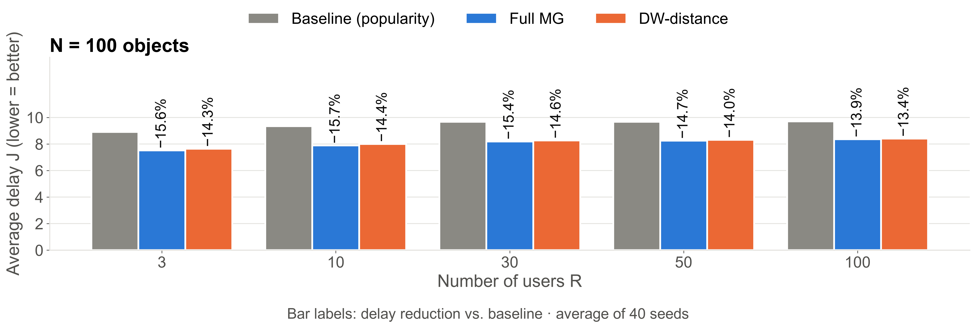
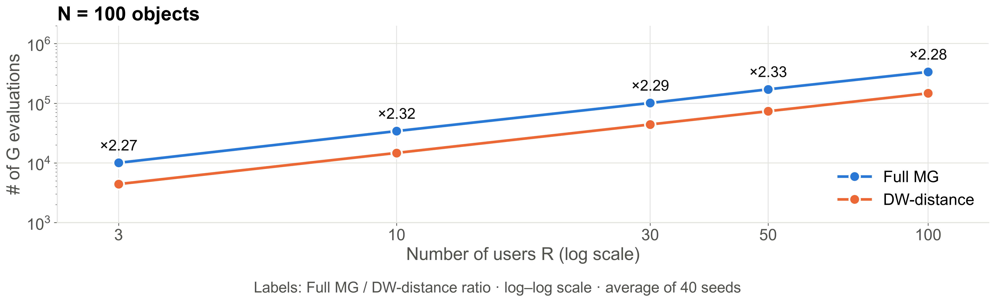

Keep the Right Things Close: Smarter Caching for AI Services at the Network Edge
Hyeon Uk Jang, Seung Hwan Lee
NEXT Lab, Dept. of IT Intelligence Information Engineering, Jeonbuk National University
OVERVIEW
RESULTS ② · WORK B: WHAT TO CACHE
AI services such as translation and chatbots run on powerful servers in a distant cloud. Every request travels there and waits for the answer.
Many requests are repeats. Keeping a copy on a small edge server near the user makes the next answer much faster.
But edge servers are small. So: what should we keep, and where? Popularity alone is not enough: items differ in time saved and memory used.
Key idea. An edge GPU runs many models and precisions. Prefixes of the same length cost the same compute but use up to 9× (model) and 4× (precision) more memory.
Baseline: most popular first
Proposed #1: popular × costly to compute
Proposed #2: (popular × costly) ÷ memory used
20 prefixes, top 5 kept, median of 50 setups. #1 is fastest but uses ~1.5× memory; #2 saves 85% more per unit memory.
GOALS
Work A · Which AI results go on which edge server? Place answers on several edge servers to minimise delay, using distance and recompute cost.
Work B · Which LLM work is worth the memory? Cache shared prompt work (KV cache) with the most saving per unit of GPU memory.
RESULTS ① · WORK A: WHERE TO PLACE RESULTS
Key idea. A cheap answer (Weather, 1) is not worth a far server: the cloud is faster (2+2+1 = 5 < 7). An expensive one (Translation, 18) is: far server 7 < cloud 2+2+18 = 22.
Baseline: popular items, round-robin
Full MG: best item–server pair at each step
DW-distance: same rule, one server per turn (by demand)
Saving per unit memory, #2 vs. #1 (median, wins/50; hatched < 40). 100 prefixes, 20% kept: +87% (50/50), still 10.7% faster than Baseline.
CONCLUSIONS
"Most popular first" leaves a lot on the table.
Work A: 14–26% lower delay; DW-distance keeps most of it at < ½ compute.
Work B: speed → #1; short on memory → #2 (+85% per memory).
14–16%
lower delay than Baseline
60 / 60
settings: Full MG lowest
< ½
compute (DW), ≤ 2.2% loss
FUTURE WORK
More edge servers (5, 10), changing requests
Real GPU profiling of compute and memory
REFERENCES
[1] J. Wang et al., "KVCache Cache in the Wild," USENIX ATC, 2025.
40-seed average, 3 servers. Full MG has the lowest delay in every setting.
CONTACT
Scan to visit our lab
NEXT Lab
https://sites.google.com/view/nextlab-web/
jh.sung@jbnu.ac.kr
DW-distance needs 2.2–2.4× fewer gain (G) evaluations than Full MG.

