Slide 1
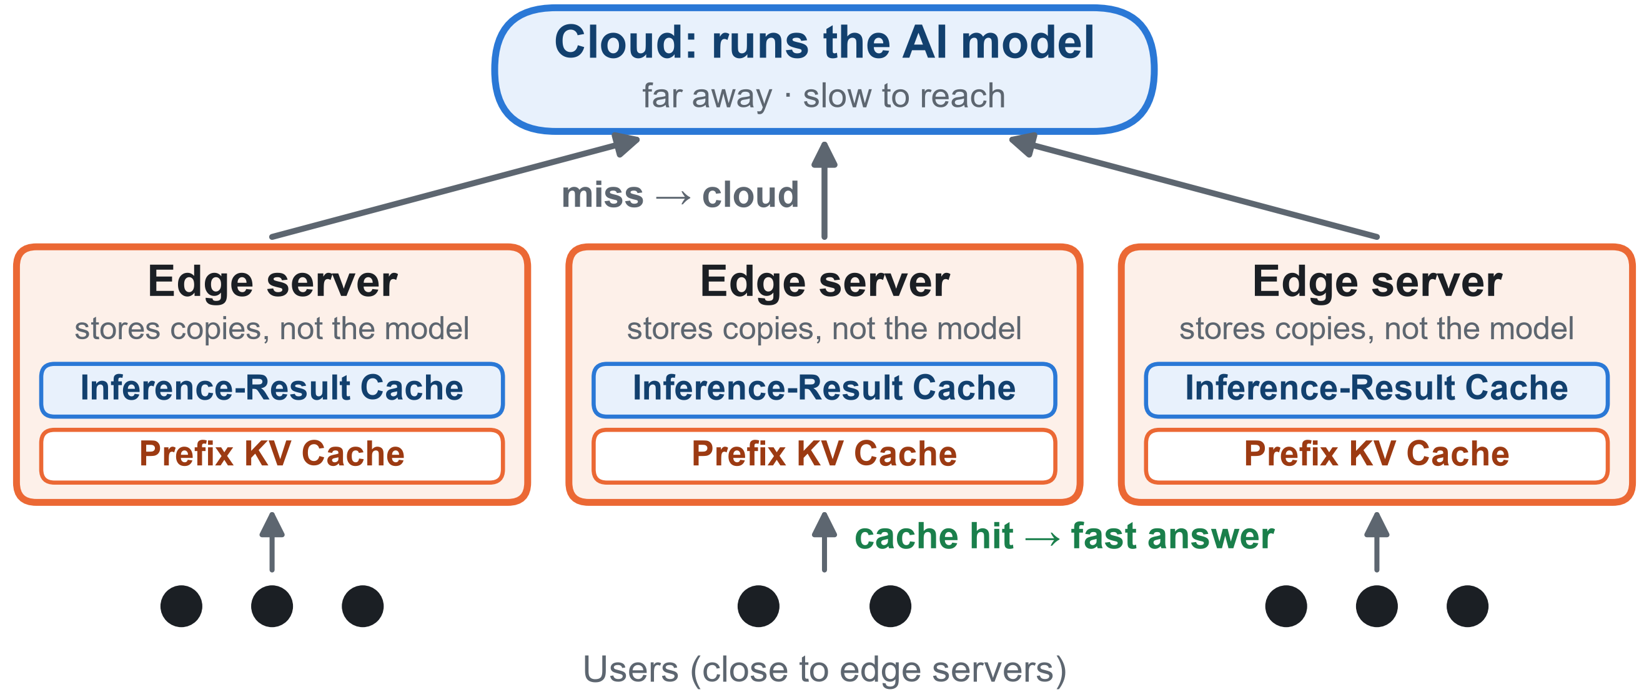
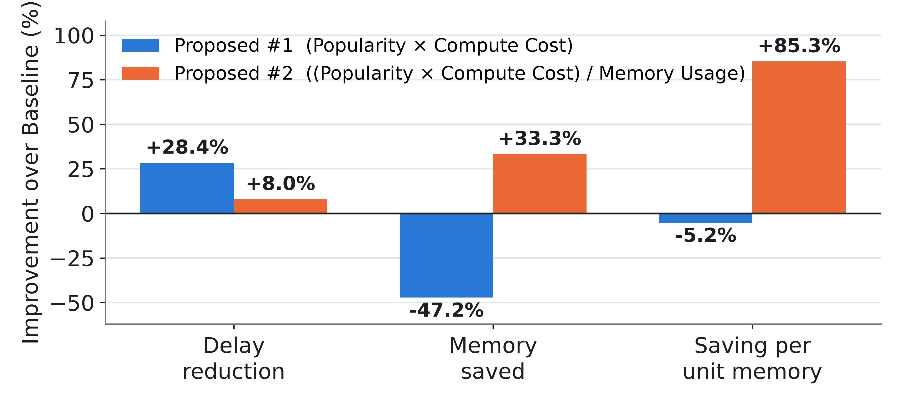

Keep the Right Things Close:
Smarter Caching for AI Services at the Network Edge
Hyeon Uk Jang, Seung Hwan Lee, and Ji Hoon Sung (Advisor)
NEXT Lab, Dept. of IT Intelligence Information Engineering, Jeonbuk National University
OVERVIEW
RESULTS ② · Work A: INFERENCE-RESULT CACHING
Network for AI aims to make AI services faster and more efficient through network and edge resources. Many AI services, such as translation and chatbots, rely on powerful cloud servers, leading to long response times.
Many requests are repeats. Keeping a copy on a small edge server near the user makes the next answer much faster.
But edge servers are small. So: what should we keep, and where? Popularity alone is not enough: items differ in time saved and memory used.
Key idea. A cheap answer (e.g., Weather, 1) is not worth a far server: the cloud is faster (2+2+1 = 5 < 7). An expensive one (e.g., Translation, 18) is: far server 7 < cloud 2+2+18 = 22.
Baseline: popular items, round-robin
• Full MG (Full Marginal Gain): most delay-saving item–server pair
• DW MG (Demand-Weighted MG): one server per turn, by demand
13–16%
lower avg. delay than Baseline (Both MG)
5 / 5
settings (R = 3–100): Full MG has the lowest delay
< ½
DW MG gain evaluations vs. Full MG; delay ≤ 1.6% higher
Both MG methods cut delay by 13–16% vs. Baseline
GOALS
40-seed average, 3 servers. Full MG has the lowest delay in every setting.
Work A · Inference-Result Caching: Which AI results go on which edge server? Minimise delay using distance and recompute cost.
Work B · Prefix KV Caching: Which LLM prompt work is worth the memory? Keep shared prompt work (KV cache) with the most saving per unit of GPU memory.
DW MG requires fewer than half as many gain evaluations as Full MG
half
RESULTS ① · Work B: Prefix KV Caching
DW MG needs ~2.3× fewer gain evaluations than Full MG.
Key idea. Prefill computation cost and KV-cache memory usage may grow at different rates with prefix length. Considering both can improve caching efficiency.
Baseline: most popular first
Proposed #1: Popularity × Compute Cost
Proposed #2: (Popularity × Compute Cost) / Memory Usage
CONCLUSIONS
"Most popular first" leaves a lot on the table.
Work A: 13–16% lower avg. delay than Baseline (both MG methods); DW MG keeps most of it at < ½ the gain evaluations.
Work B: two trade-offs. #1 gives the lowest delay; #2 fits tight memory, saving 85% more delay per unit memory than Baseline.
FUTURE WORK
Larger edge networks and dynamic request patterns
RL (Reinforcement Learning)-based adaptive cache placement
Real GPU profiling of compute and memory
Median of 50 runs (20 prefixes, top 5 kept). A trade-off, not a winner: #1 cuts delay most but uses 47% more memory; #2 uses 33% less memory and saves 85% more delay per unit memory.
REFERENCES
[1] J. Wang et al., "KVCache Cache in the Wild: Characterizing and Optimizing KVCache Cache at a Large Cloud Provider," in Proc. USENIX ATC, 2025.
[2] S. Regmi and C. P. Pun, "GPT Semantic Cache: Reducing LLM Costs and Latency via Semantic Embedding Caching," arXiv preprint arXiv:2411.05276, 2024.
[3] C. Tian et al., "CLONE: Customizing LLMs for efficient latency-aware inference at the edge," in Proc. USENIX Annu. Tech. Conf. (USENIX ATC), 2025.
[4] B. Gao et al., "Online Context Caching for Distributed Large Language Models Serving," in Proc. IEEE INFOCOM, 2025.
CONTACT
Scan to visit our lab
NEXT Lab
https://sites.google.com/view/nextlab-web/
jh.sung@jbnu.ac.kr

