Slide 1
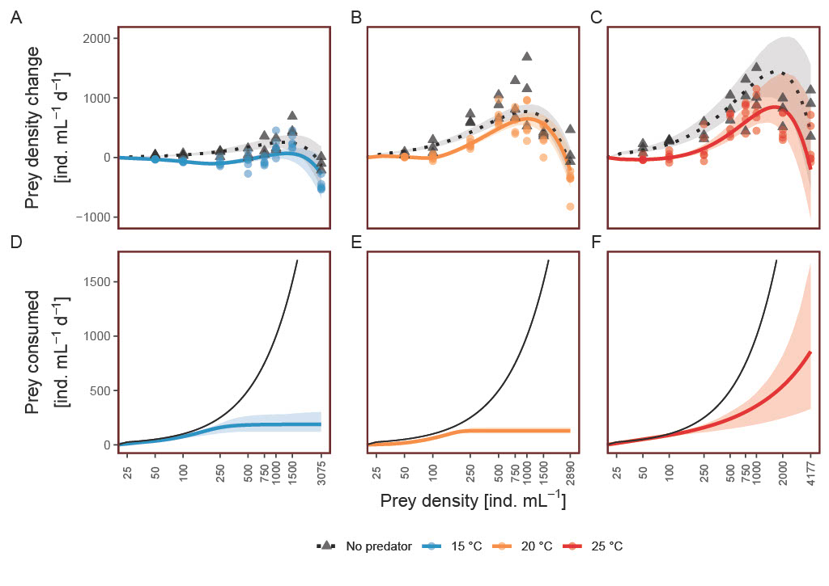
Warming can destabilize predator–prey interactions by shifting the functional response from Type III to Type II

