Slide 1
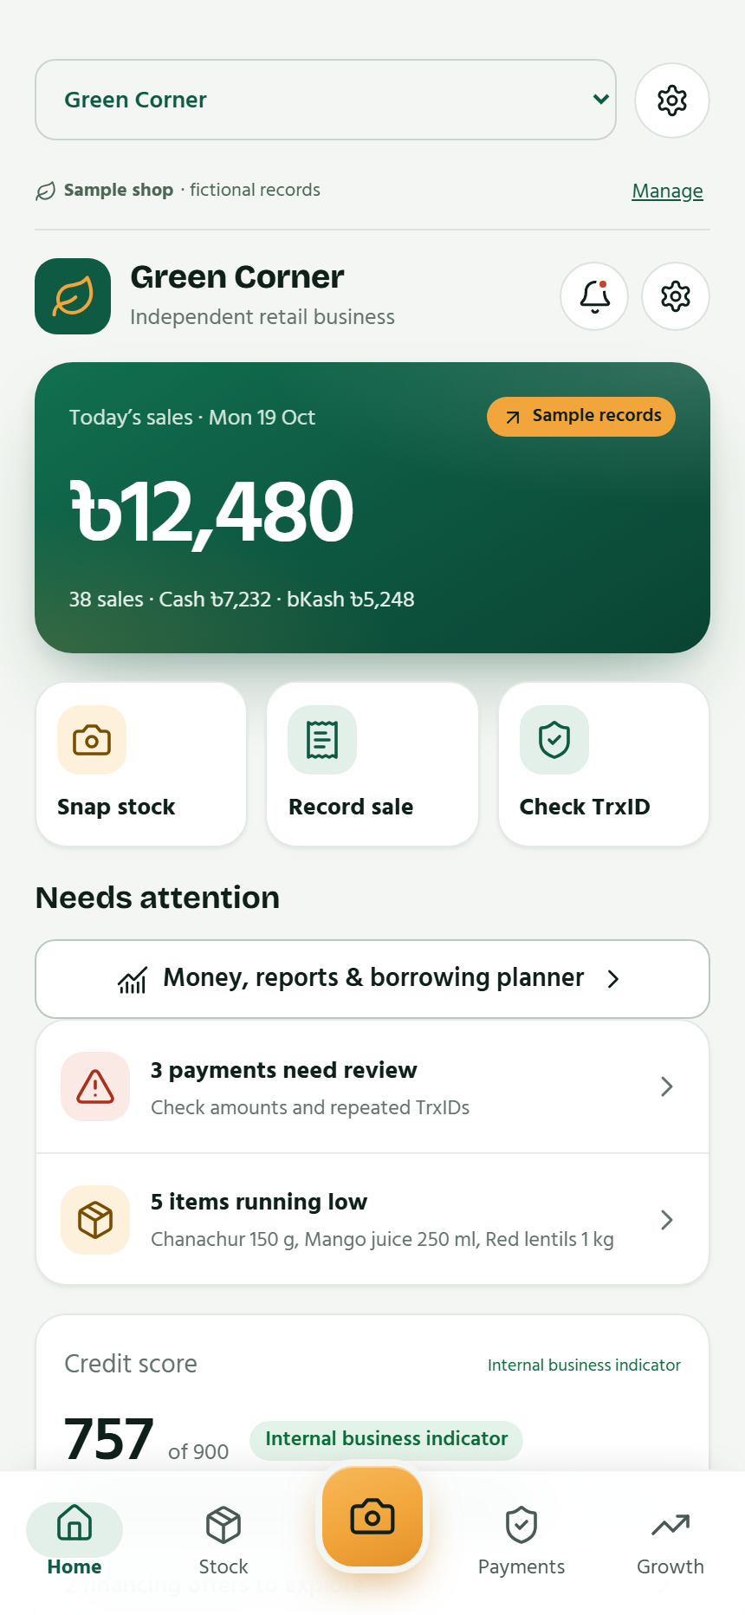
GreenBiz
Financial inclusion
for small businesses
Everyday records build a financial history.
GreenBiz
01 / 25
Notes:
Core vision: help small businesses build a financial history through stock, sales and payment activity, then use that history to understand their business and explore suitable finance. The owner confirmed financial inclusion as the main purpose. Screens show fictional sample data.
Sources: original GreenBiz full-concept deck; owner-confirmed financial-inclusion vision; supplied 2.1 change notes; App-Website/docs/FEATURES-2.1.md, MOTION-2.2.md and VALIDATION.md (latest version appendices). Screens show fictional sample records in the current app UI. Currency and payment labels reflect the current build, not universal market coverage.

Slide 2
The missing business history
An active business needs
a history it can explain.
Scattered records
Sales, stock and payment messages sit in different places.
Mixed money
Personal transfers can obscure business performance.
GreenBiz
02 / 25
Notes:
Problem framing from the original owner concept, not a quantified market study. The reused home screen creates a continuous native Morph movement from the cover. The broader challenge is documenting everyday business activity, particularly where formal records are limited.
Sources: original GreenBiz full-concept deck; owner-confirmed financial-inclusion vision; supplied 2.1 change notes; App-Website/docs/FEATURES-2.1.md, MOTION-2.2.md and VALIDATION.md (latest version appendices). Screens show fictional sample records in the current app UI. Currency and payment labels reflect the current build, not universal market coverage.

Slide 3
The daily business cycle
01
02
03
04
Stock arrives
A sale happens
Money is recorded
A history grows
Add measured items, prices and quantities.
Review products, quantities and payment method.
Link a receipt and classify business activity.
Read trends and improve the business profile.
GreenBiz
03 / 25
Notes:
Inventory, checkout, payment records and reports connect within a shop workspace. Sales deduct stock atomically. Receipt linking prevents duplicate sale income. The profile depends on recorded information and is not an independently verified financial statement.
Sources: original GreenBiz full-concept deck; owner-confirmed financial-inclusion vision; supplied 2.1 change notes; App-Website/docs/FEATURES-2.1.md, MOTION-2.2.md and VALIDATION.md (latest version appendices). Screens show fictional sample records in the current app UI. Currency and payment labels reflect the current build, not universal market coverage.

Slide 4
The full product at a glance
Separate shops
Stock and checkout
Each business keeps its own workspace.
Measured quantities and linked stock updates.
Payments and expenses
Reports
SMS review, manual records and classifications.
Period trends, comparisons and exports.
Credit and loan plans
AI assistance
Explainable indicators and published-term estimates.
Photo drafts, sale matching and advice.
GreenBiz
04 / 25
Notes:
Full product map restores the scope of the earlier deck. Optional merchant web tools, customer invoices and the bank portal appear later. Core manual operation remains available without a merchant-run business server.
Sources: original GreenBiz full-concept deck; owner-confirmed financial-inclusion vision; supplied 2.1 change notes; App-Website/docs/FEATURES-2.1.md, MOTION-2.2.md and VALIDATION.md (latest version appendices). Screens show fictional sample records in the current app UI. Currency and payment labels reflect the current build, not universal market coverage.

Slide 5
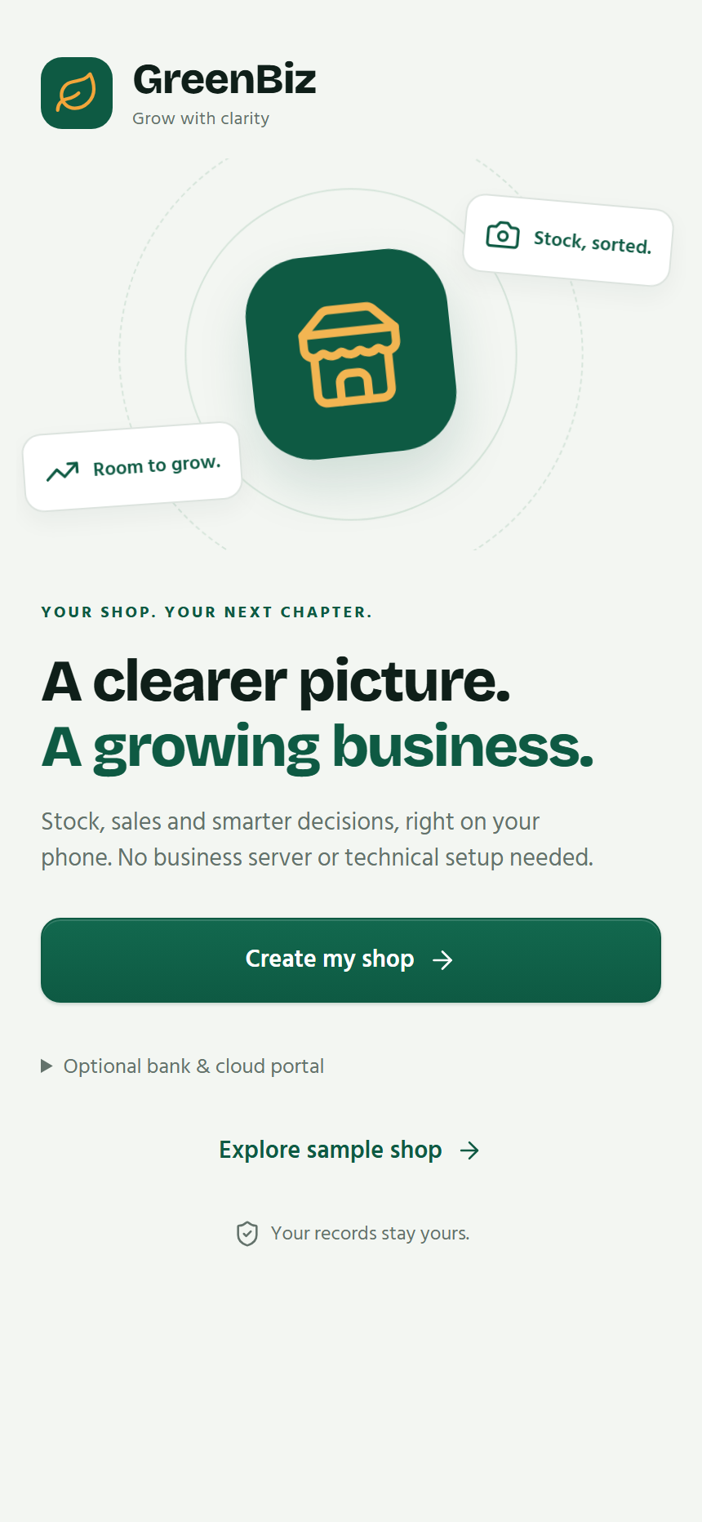
A first session with no server setup
Create a real shop
Enter the shop details and start with empty records.
Add the first items
Use manual entry or review photo suggestions.
Make the first sale
Keep the stock, sale and payment connected.
GreenBiz
05 / 25
Notes:
The first-session story from the original deck is restored. The sample shop remains separate from real device records. Multiple shops keep stock, sales and transactions separate. Core device tools require no business-server account or user AI key. Online AI and optional cloud functions have separate connectivity requirements.
Sources: original GreenBiz full-concept deck; owner-confirmed financial-inclusion vision; supplied 2.1 change notes; App-Website/docs/FEATURES-2.1.md, MOTION-2.2.md and VALIDATION.md (latest version appendices). Screens show fictional sample records in the current app UI. Currency and payment labels reflect the current build, not universal market coverage.

Slide 6
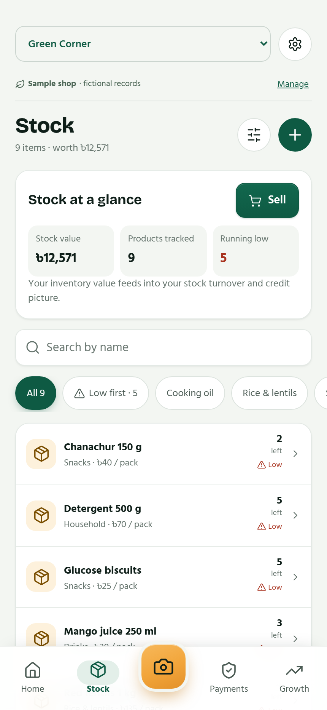
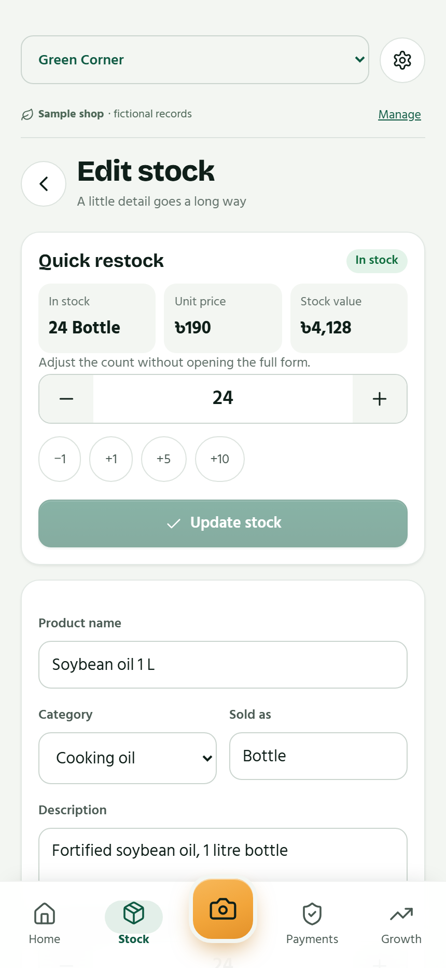
Inventory that supports everyday work
Measured goods
Pieces, bottles and fractional quantities, including weight-based sales.
Stock at a glance
See stock value and products running low or out of stock.
Quick actions
Sell directly or restock with −1, +1, +5 and +10 controls.
GreenBiz
06 / 25
Notes:
Current inventory and product-detail screens show restored quick restock, stock value, out-of-stock labels and direct Sell action. Quantities support up to three decimals. Historical sales preserve the item snapshot. Photo or manual entry still needs owner review.
Sources: original GreenBiz full-concept deck; owner-confirmed financial-inclusion vision; supplied 2.1 change notes; App-Website/docs/FEATURES-2.1.md, MOTION-2.2.md and VALIDATION.md (latest version appendices). Screens show fictional sample records in the current app UI. Currency and payment labels reflect the current build, not universal market coverage.

Slide 7
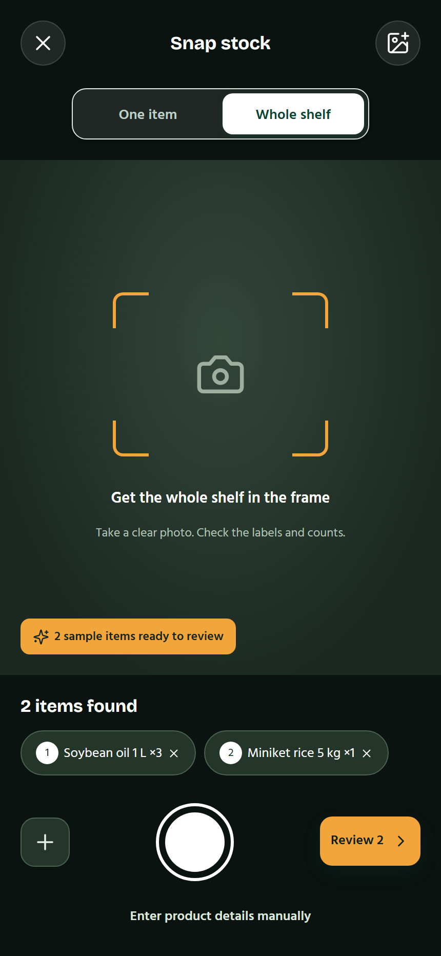
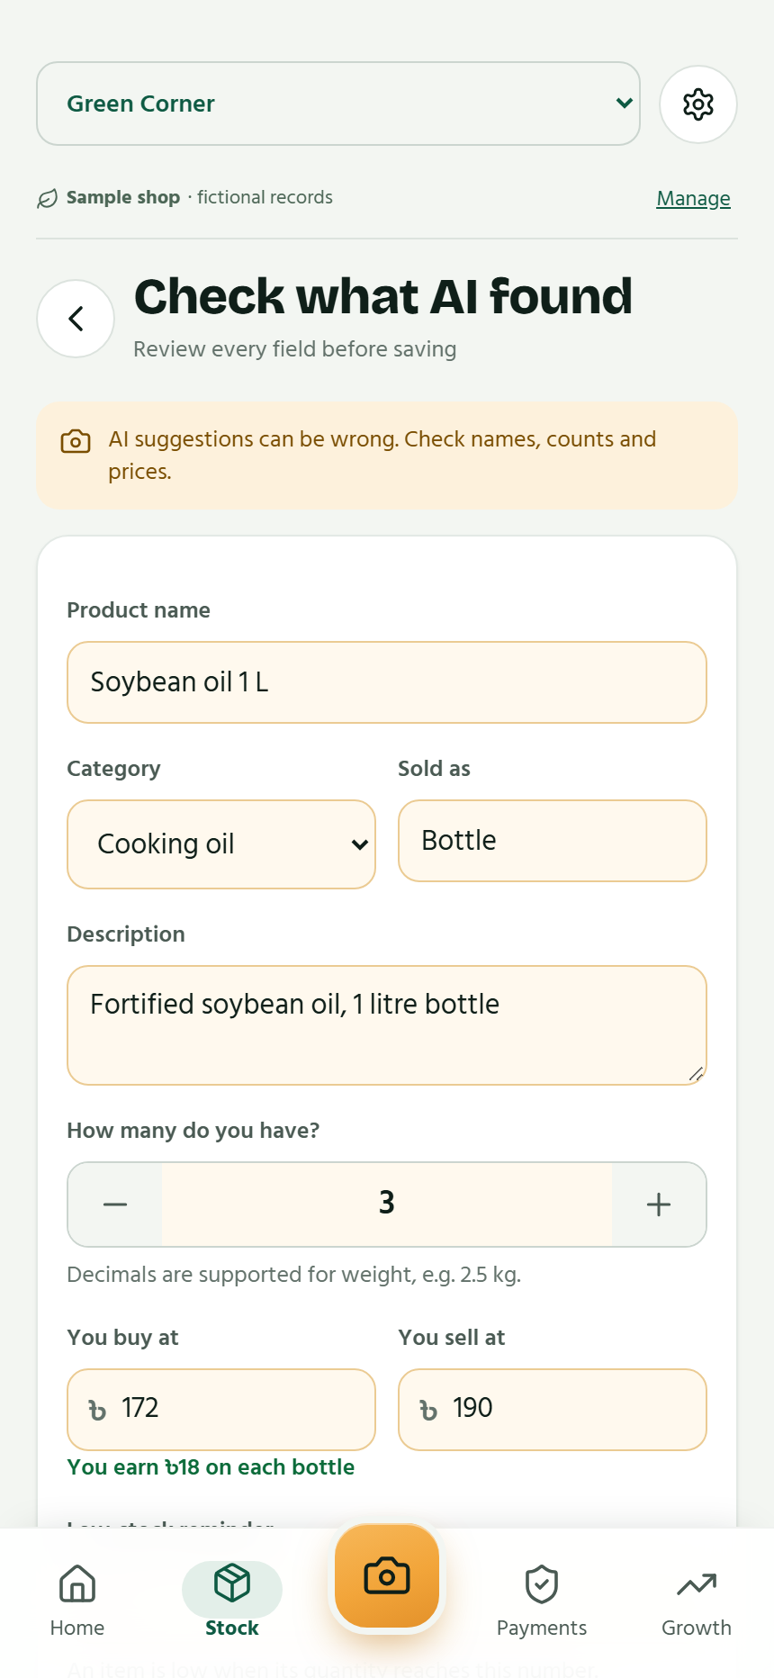
Photo stock entry with owner review
Capture or choose a photo
The scan proposes draft products and quantities.
Review every field
Check the name, unit, count, cost and selling price before saving.
Sample scan results, shown in the real app UI
GreenBiz
07 / 25
Notes:
Actual current camera and product-review UI, using the app built-in fictional sample scan. These pictures do not establish image-recognition accuracy on real stock photos. Owner review is mandatory. Native Morph carries the two screen surrounds forward from the inventory slide.
Sources: original GreenBiz full-concept deck; owner-confirmed financial-inclusion vision; supplied 2.1 change notes; App-Website/docs/FEATURES-2.1.md, MOTION-2.2.md and VALIDATION.md (latest version appendices). Screens show fictional sample records in the current app UI. Currency and payment labels reflect the current build, not universal market coverage.

Slide 8
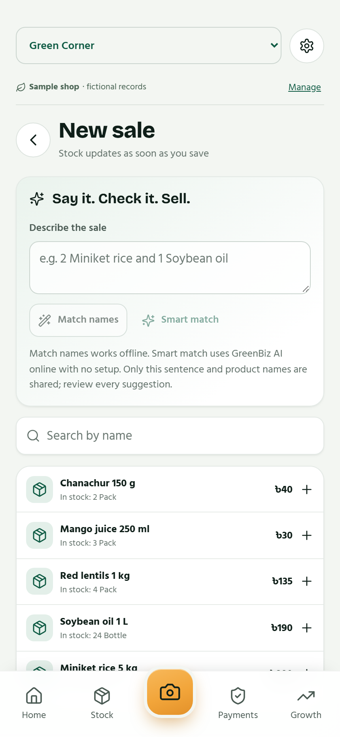
Checkout by touch, text or voice
“Sell 1.5 kg rice”
Type, speak or tap
Offline name matching and online AI assistance help choose existing products.
Confirm the sale
Review quantity and payment method. Stock updates with the saved sale.
GreenBiz
08 / 25
Notes:
Checkout restores the original typing, voice and fractional-sale story. Voice depends on device speech recognition and permissions. Online AI is optional. All suggestions remain reviewable. The current app offers cash and supported mobile-money/bank methods, including Other.
Sources: original GreenBiz full-concept deck; owner-confirmed financial-inclusion vision; supplied 2.1 change notes; App-Website/docs/FEATURES-2.1.md, MOTION-2.2.md and VALIDATION.md (latest version appendices). Screens show fictional sample records in the current app UI. Currency and payment labels reflect the current build, not universal market coverage.

Slide 9
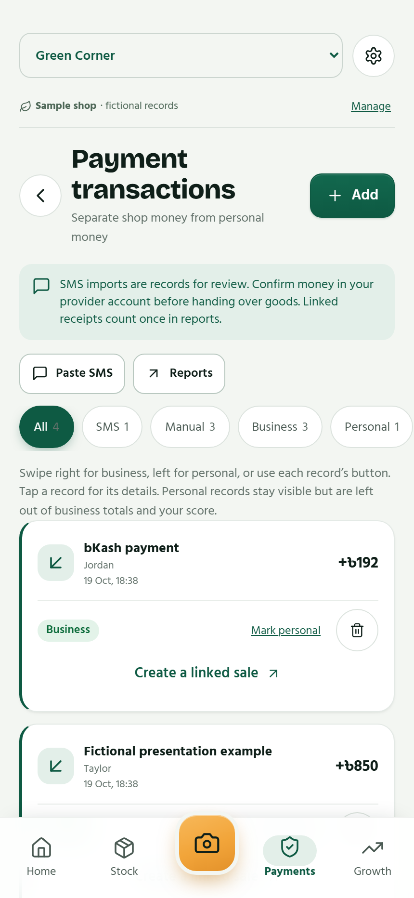
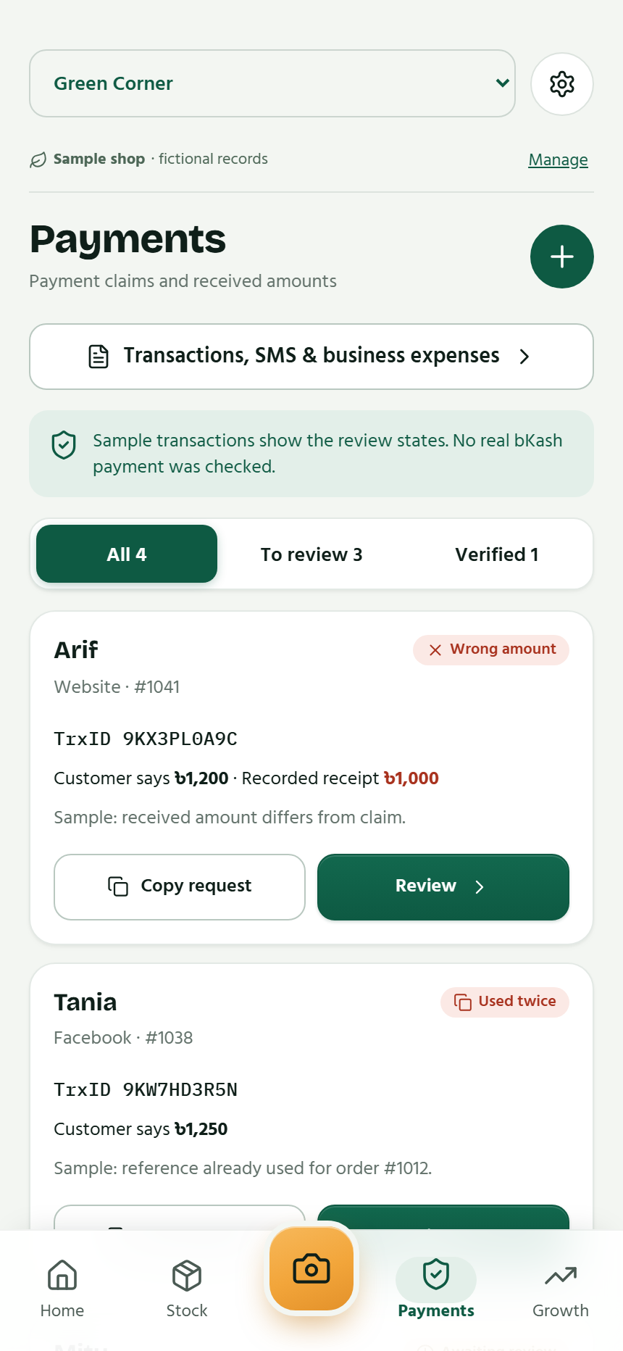
Payment messages become useful records
Review payment evidence
Import supported SMS or enter a payment manually. Read a message before import.
Keep the purpose clear
Filter All, SMS, Manual, Business or Personal. Tap a record for details.
Actual payment-account checks remain the owner's responsibility.
GreenBiz
09 / 25
Notes:
Both structured payment history and payment-claim review screens are restored. Raw SMS is viewable before import only. The on-device parser accepts selected trusted senders and patterns, rejects personal-number senders and filters unsuitable messages. SMS and customer claims are not authoritative payment-provider verification.
Sources: original GreenBiz full-concept deck; owner-confirmed financial-inclusion vision; supplied 2.1 change notes; App-Website/docs/FEATURES-2.1.md, MOTION-2.2.md and VALIDATION.md (latest version appendices). Screens show fictional sample records in the current app UI. Currency and payment labels reflect the current build, not universal market coverage.

Slide 10
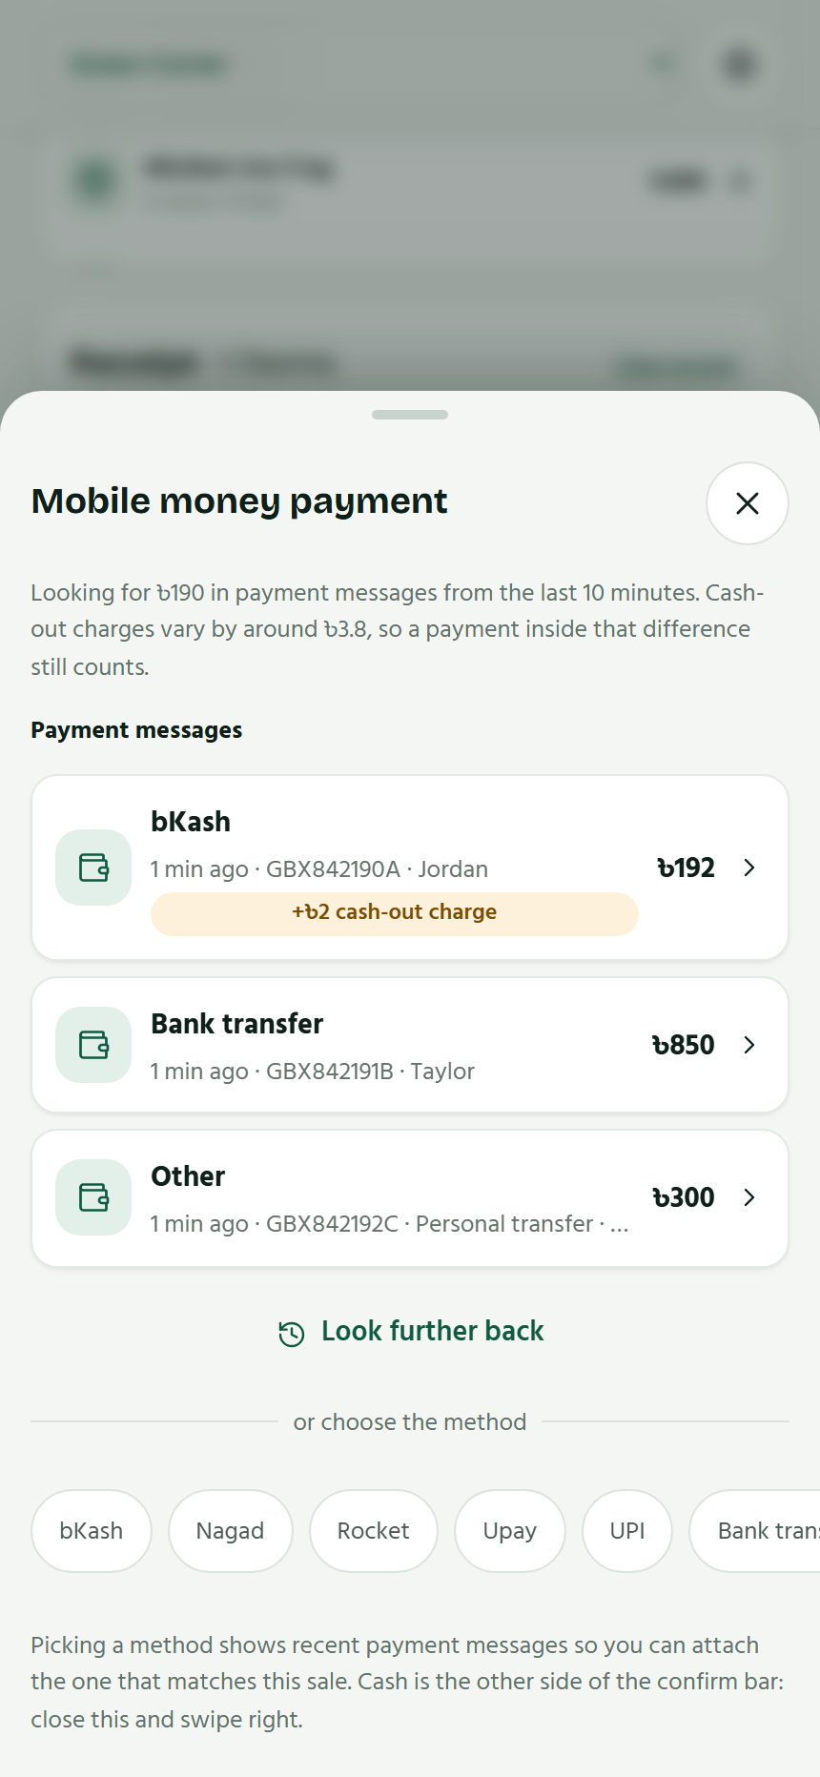
A payment matched to the sale
The closest recent match
Recent payment messages appear first, ranked by amount.
A small charge difference
Match within 2% of the bill, with a minimum allowance of 1 base-currency unit.
A clear exception path
Refresh, look further back or record manually. Ask before saving a mismatch separately.
GreenBiz
10 / 25
Notes:
Tolerance is 2% of the bill with a minimum of one current base-currency unit. The receipt retains the actual received amount and the sale retains its own total. Look further back searches up to 30 days. Records outside the band are saved separately only after confirmation. This is not a global-currency configuration claim.
Sources: original GreenBiz full-concept deck; owner-confirmed financial-inclusion vision; supplied 2.1 change notes; App-Website/docs/FEATURES-2.1.md, MOTION-2.2.md and VALIDATION.md (latest version appendices). Screens show fictional sample records in the current app UI. Currency and payment labels reflect the current build, not universal market coverage.

Slide 11
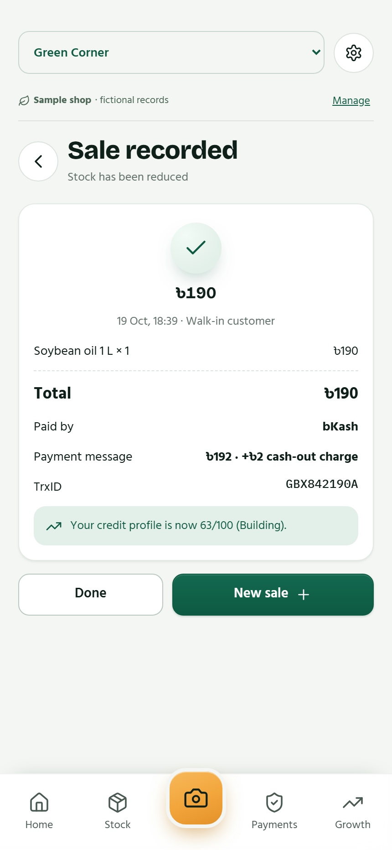
Live payments and a clear receipt
When a payment arrives
An Android prompt can start a sale. A matching banner can attach it during checkout.
When the sale completes
The receipt shows items, method, TrxID, customer and the updated business profile.
Notification amounts stay hidden on the lock screen.
GreenBiz
11 / 25
Notes:
The receipt is captured from an actual fictional sale in the app. Live SMS and notification behavior are implemented but not validated on a physical phone. The owner may defer sale creation and retain the payment in Payments. Lock-screen amount hiding and arrival behavior remain device checks.
Sources: original GreenBiz full-concept deck; owner-confirmed financial-inclusion vision; supplied 2.1 change notes; App-Website/docs/FEATURES-2.1.md, MOTION-2.2.md and VALIDATION.md (latest version appendices). Screens show fictional sample records in the current app UI. Currency and payment labels reflect the current build, not universal market coverage.

Slide 12
A linked receipt counts once
Illustrative records in one currency
Record | Amount | Effect on reported cashflow
Sale | 100 | Adds sale income of 100
Linked payment receipt | 102 | Adds no extra sale income
Business expense | 20 | Subtracts 20
Net cashflow for these records: 80
GreenBiz
12 / 25
Notes:
Illustrative arithmetic: 100 sale income minus 20 business expense equals 80 reported cashflow. The linked payment retains a received amount of 102 but does not add extra income to these reports. This corrects any implication that both the sale and receipt contribute income. Cashflow is not accounting profit. Personal and foreign-currency records remain outside the current base-currency business totals.
Sources: original GreenBiz full-concept deck; owner-confirmed financial-inclusion vision; supplied 2.1 change notes; App-Website/docs/FEATURES-2.1.md, MOTION-2.2.md and VALIDATION.md (latest version appendices). Screens show fictional sample records in the current app UI. Currency and payment labels reflect the current build, not universal market coverage.

Slide 13
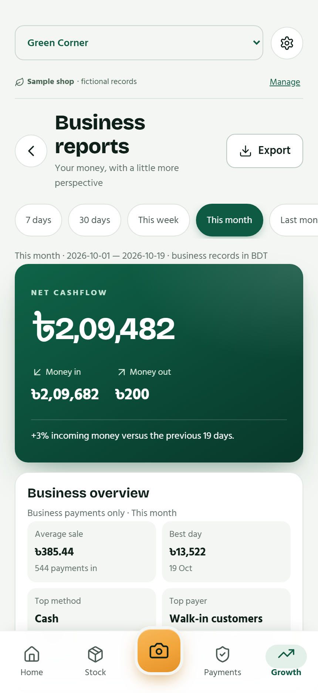
Reports that explain the business
Choose the business period
This week, this month, last month, 90 days, this year or a selected month.
Understand the change
Average sale, best periods, top method and payer, plus comparisons.
Inspect the detail
Read the period payments and export CSV for follow-up.
GreenBiz
13 / 25
Notes:
Restores report overview, previous-period comparison, payment-method mix, top payers and the newest 20 period payments. Existing 7/30-day and custom ranges remain. Screenshot values are fictional sample records, not audited merchant results. The app uses a fixed current calendar/timezone; broader localization is rollout work.
Sources: original GreenBiz full-concept deck; owner-confirmed financial-inclusion vision; supplied 2.1 change notes; App-Website/docs/FEATURES-2.1.md, MOTION-2.2.md and VALIDATION.md (latest version appendices). Screens show fictional sample records in the current app UI. Currency and payment labels reflect the current build, not universal market coverage.

Slide 14
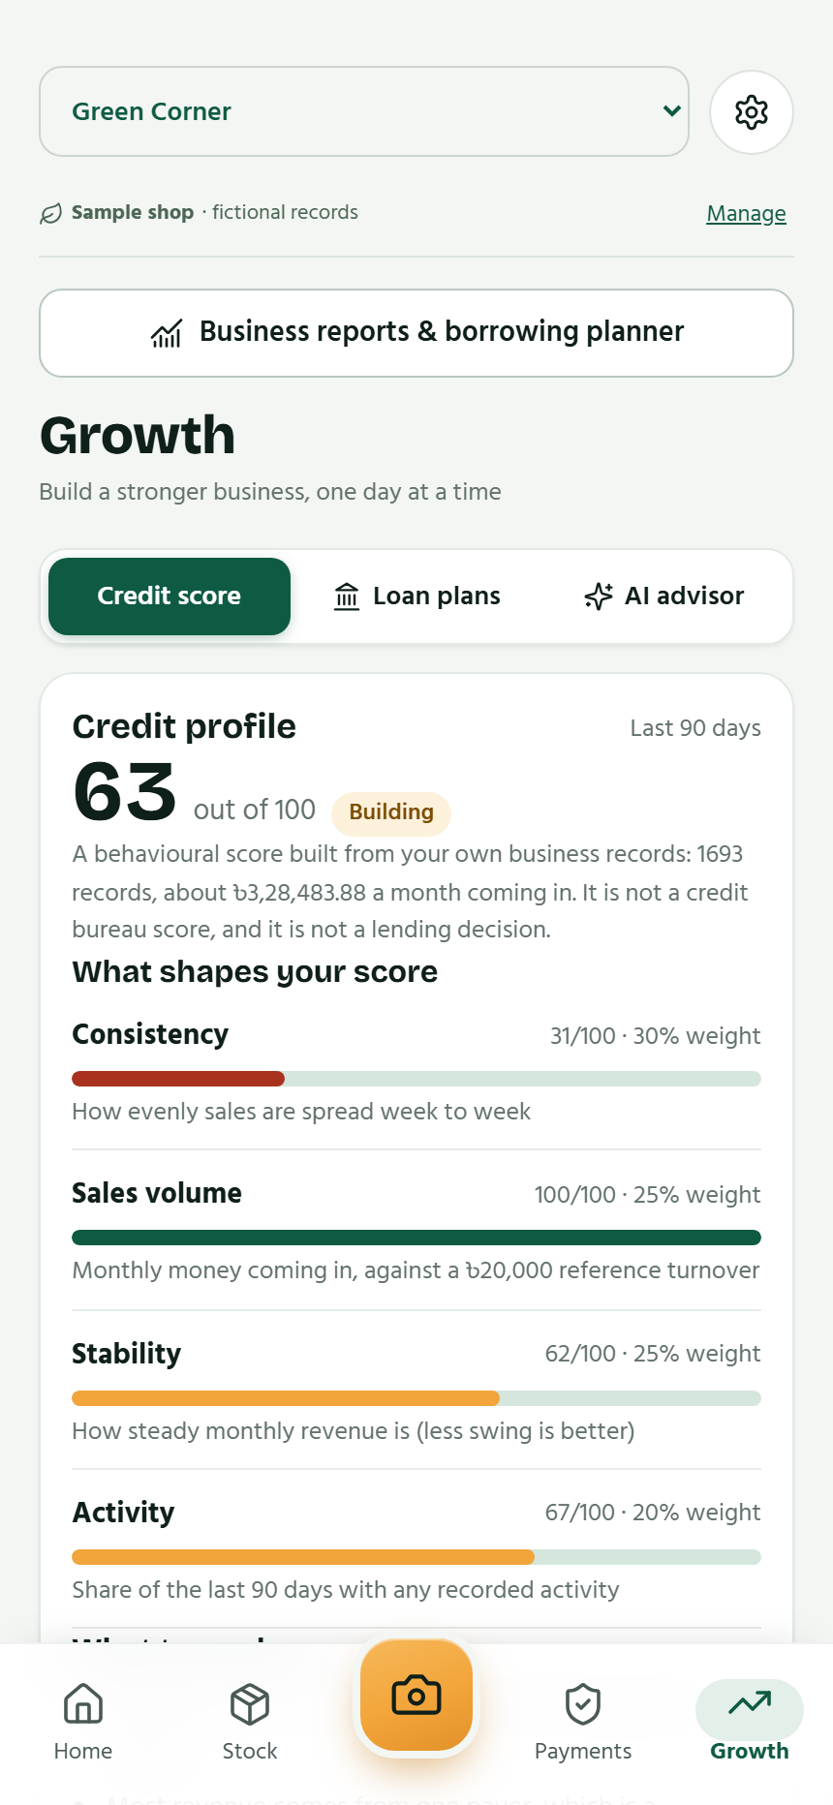
An explainable business profile
0–100
The profile explains what shapes the score
Factor weights, not a sample merchant's performance
GreenBiz
14 / 25
Notes:
Editable native chart weights: consistency 30%, volume 25%, stability 25%, activity 20%. The current merchant profile uses 90 days of eligible recorded activity. The screen includes its band and what to work on. The app also retains a separate 300–900 portal indicator; neither measure is a bureau score or lending decision. Source: shared/credit-profile.ts and FEATURES-2.1.md.
Sources: original GreenBiz full-concept deck; owner-confirmed financial-inclusion vision; supplied 2.1 change notes; App-Website/docs/FEATURES-2.1.md, MOTION-2.2.md and VALIDATION.md (latest version appendices). Screens show fictional sample records in the current app UI. Currency and payment labels reflect the current build, not universal market coverage.

Slide 15
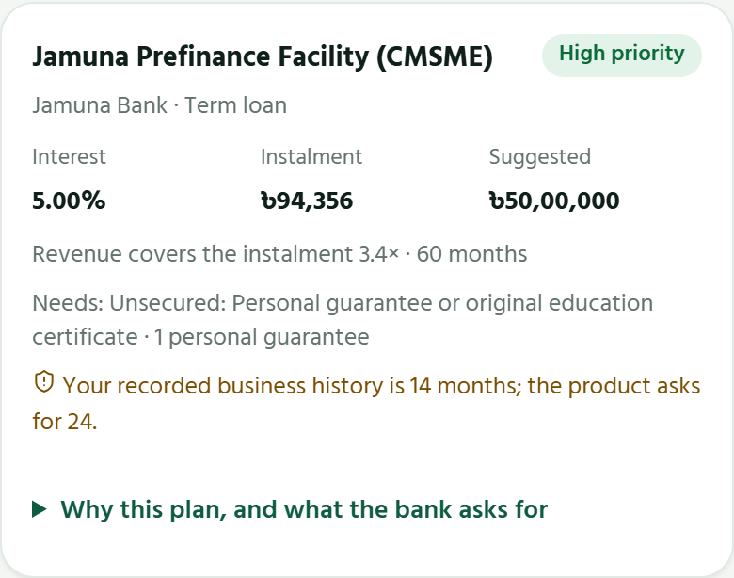
Loan plans grounded in the records
39 products
from 8 banks in the starter catalogue
Matched to recorded revenue
High priority, Good fit or Stretch, with requirements, warnings and links to terms.
Published-term estimates. Wider bank coverage remains rollout work.
GreenBiz
15 / 25
Notes:
The current catalogue covers one initial market. It is not global lender coverage. Terms were last checked 18 October 2026 according to the supplied catalogue. Capacity uses a heuristic of 50% of recorded revenue, not validated personal affordability. The owner can set a requested amount, filter banks or browse all products. Lenders make their own decisions. The screenshot shows an actual app plan with fictional business inputs, cropped to the product detail.
Sources: original GreenBiz full-concept deck; owner-confirmed financial-inclusion vision; supplied 2.1 change notes; App-Website/docs/FEATURES-2.1.md, MOTION-2.2.md and VALIDATION.md (latest version appendices). Screens show fictional sample records in the current app UI. Currency and payment labels reflect the current build, not universal market coverage.

Slide 16
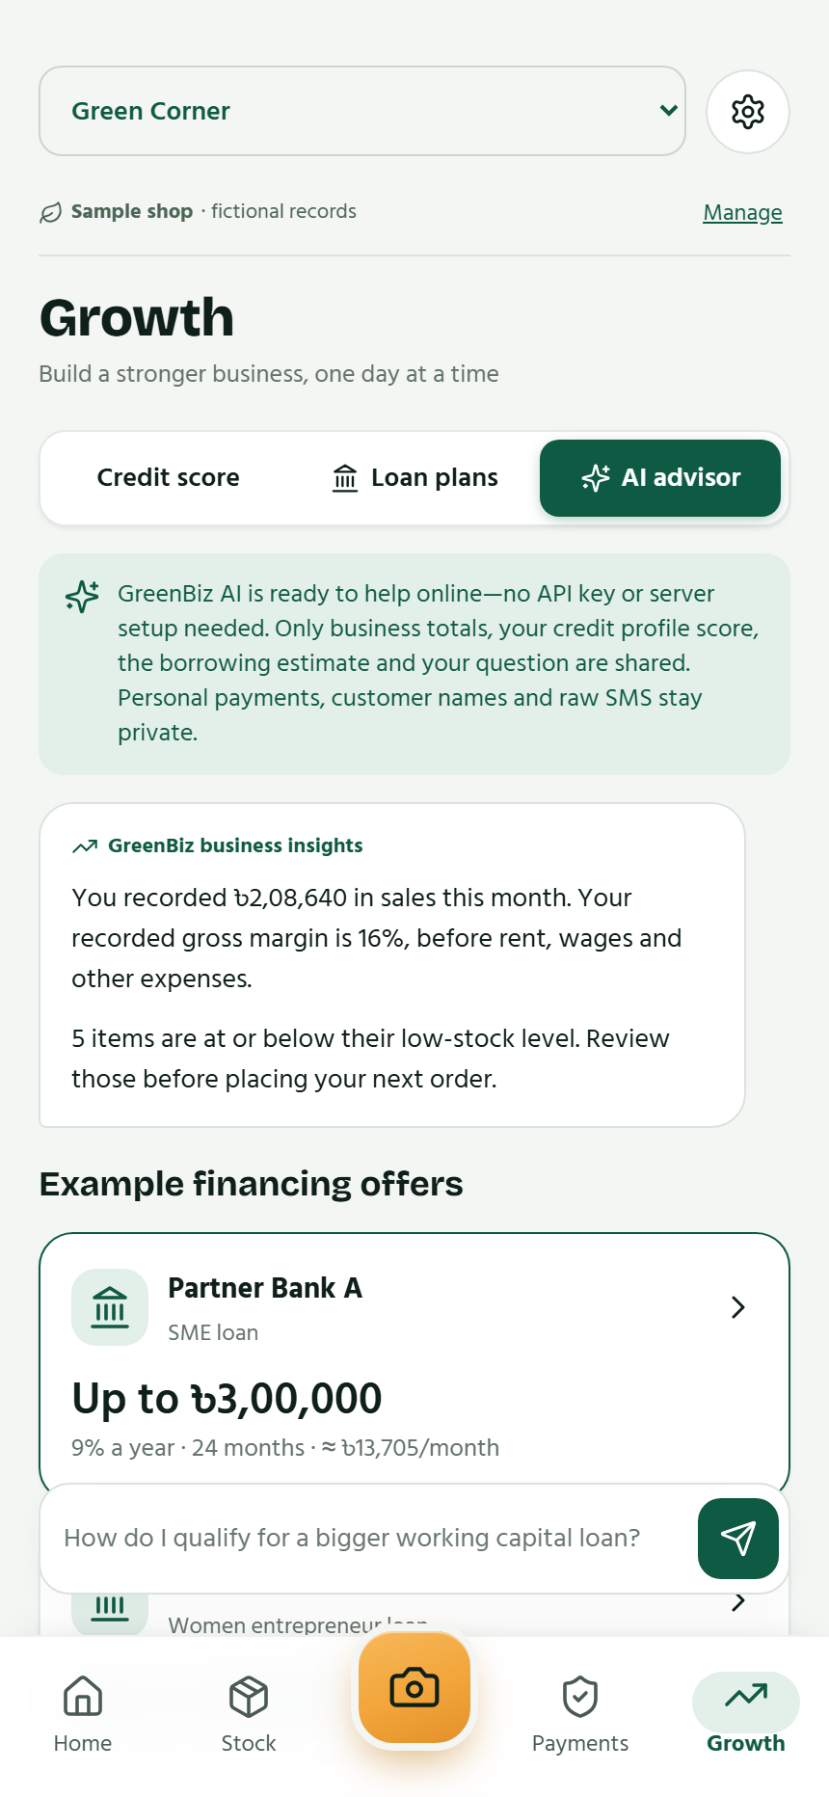
AI advice with business context
Loan
Explore preparation, borrowing assumptions and suitable questions for a lender.
Insurance
Discuss protection needs and trade-offs using the business context.
My business
Ask about stock, trading patterns and possible next steps.
GreenBiz
16 / 25
Notes:
Actual advisor UI showing deterministic business insights and fictional example offers. Selected topics are Loan, Insurance and My business. AI advice context contains business aggregates, the profile and borrowing estimate. The screenshot is not a live provider-response test. This is planning assistance, not a lender approval or insurance quote. Photo-stock and sale-assistance tasks appear earlier. Users confirm any resulting record changes.
Sources: original GreenBiz full-concept deck; owner-confirmed financial-inclusion vision; supplied 2.1 change notes; App-Website/docs/FEATURES-2.1.md, MOTION-2.2.md and VALIDATION.md (latest version appendices). Screens show fictional sample records in the current app UI. Currency and payment labels reflect the current build, not universal market coverage.

Slide 17
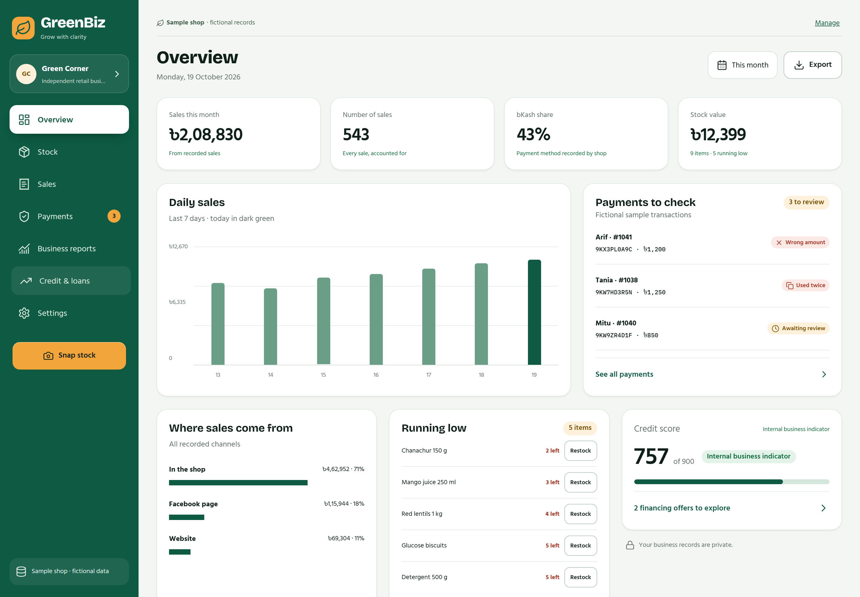
The shop on a larger screen
A desktop view
Stock, sales, payments and trends on a desktop workspace.
Sample app workspace, with fictional records
GreenBiz
17 / 25
Notes:
The full web-dashboard story from the earlier deck is restored. The screenshot shows the actual responsive app in a large viewport. Device-mode demonstration does not establish public cloud hosting or multi-user synchronization; optional server mode has separate requirements.
Sources: original GreenBiz full-concept deck; owner-confirmed financial-inclusion vision; supplied 2.1 change notes; App-Website/docs/FEATURES-2.1.md, MOTION-2.2.md and VALIDATION.md (latest version appendices). Screens show fictional sample records in the current app UI. Currency and payment labels reflect the current build, not universal market coverage.

Slide 18
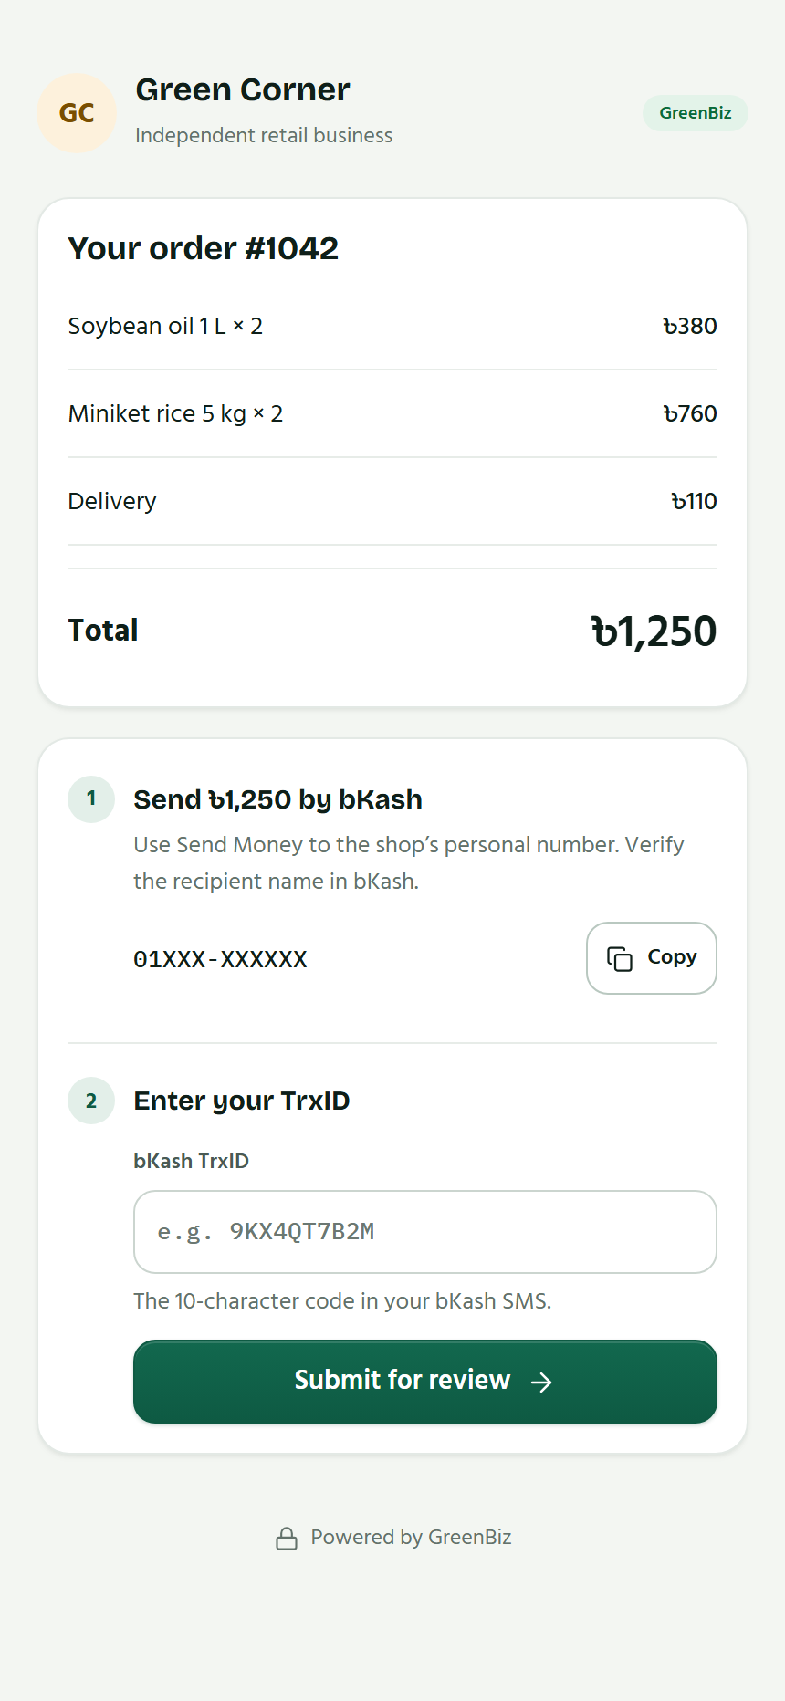
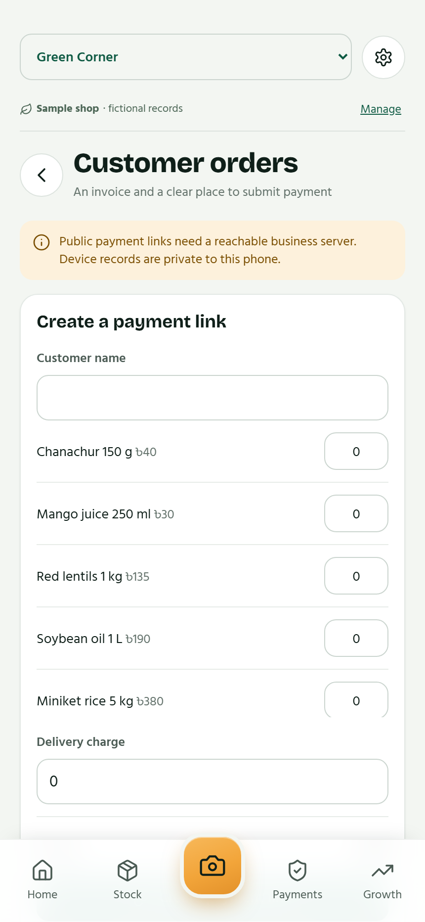
Customer invoices and payment claims
A link for one invoice
Customers see the items and submit their payment reference.
A merchant review step
The shop reviews claims and resolves mismatches or repeated references.
Invoice creation and stock-sale recording remain separate actions.
GreenBiz
18 / 25
Notes:
Customer invoice and merchant invoice-list screens are restored. The actual customer UI uses a browser-local fictional invoice fixture. Public invoice links require an operated business service. Creating an invoice alone does not create a stock sale. Capability links expose one invoice. A payment reference is a claim for merchant review, not automatic provider verification.
Sources: original GreenBiz full-concept deck; owner-confirmed financial-inclusion vision; supplied 2.1 change notes; App-Website/docs/FEATURES-2.1.md, MOTION-2.2.md and VALIDATION.md (latest version appendices). Screens show fictional sample records in the current app UI. Currency and payment labels reflect the current build, not universal market coverage.

Slide 19
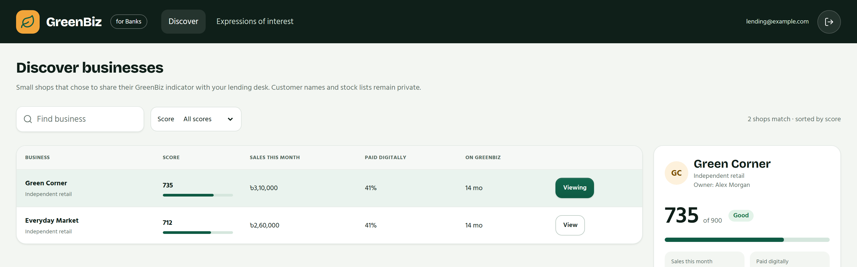
Consent-based access for financial institutions
The owner chooses what to share with a lending desk.
Portal UI with fictional data. Partnerships and public hosting remain future work.
GreenBiz
19 / 25
Notes:
Actual bank-portal UI, rendered with browser-local fictional API fixtures. No real institution or merchant data is shown. Authorized bank users can review consented summaries, create offers and request documents. Merchants may express interest. The optional portal is not publicly deployed and no live bank partnership is claimed. The portal uses its separate 300–900 internal indicator, not the merchant 0–100 profile.
Sources: original GreenBiz full-concept deck; owner-confirmed financial-inclusion vision; supplied 2.1 change notes; App-Website/docs/FEATURES-2.1.md, MOTION-2.2.md and VALIDATION.md (latest version appendices). Screens show fictional sample records in the current app UI. Currency and payment labels reflect the current build, not universal market coverage.

Slide 20
Managed AI without a user API key
01
02
03
Owner selects
Managed service
Owner reviews
A photo, sale request or business question
The provider key stays outside the app
A suggestion before any business action
Raw SMS and personal transactions stay outside the advice context.
GreenBiz
20 / 25
Notes:
The owner funds the managed AI service and keeps provider credentials as hosted secrets. Users supply no AI API key. The service limits requests and does not store task prompts, photos or replies in its application database. Selected inputs necessarily reach the chosen provider and are subject to its policies. Free text should avoid personal data. Raw SMS is never sent for fallback AI parsing.
Sources: original GreenBiz full-concept deck; owner-confirmed financial-inclusion vision; supplied 2.1 change notes; App-Website/docs/FEATURES-2.1.md, MOTION-2.2.md and VALIDATION.md (latest version appendices). Screens show fictional sample records in the current app UI. Currency and payment labels reflect the current build, not universal market coverage.

Slide 21
Device tools and optional cloud services
Mode | What it provides | What the owner needs
Device shop | Core records, stock, sales and reports | Create a shop on the phone
Managed AI | Photo, sale and advice assistance | An internet connection
Optional cloud | Shared accounts, invoices and bank tools | An operated business service
Offline cloud edits queue and pause on conflicts.
Device exports protect records before uninstalling or clearing data.
GreenBiz
21 / 25
Notes:
Device mode operates offline. Managed AI needs internet but no user key. Optional cloud mode uses authenticated accounts, cached workspaces, a durable operation queue and explicit conflict handling. It is not automatic conflict merging. Device shops do not automatically migrate to cloud accounts. Use device exports before uninstalling or clearing app data.
Sources: original GreenBiz full-concept deck; owner-confirmed financial-inclusion vision; supplied 2.1 change notes; App-Website/docs/FEATURES-2.1.md, MOTION-2.2.md and VALIDATION.md (latest version appendices). Screens show fictional sample records in the current app UI. Currency and payment labels reflect the current build, not universal market coverage.

Slide 22
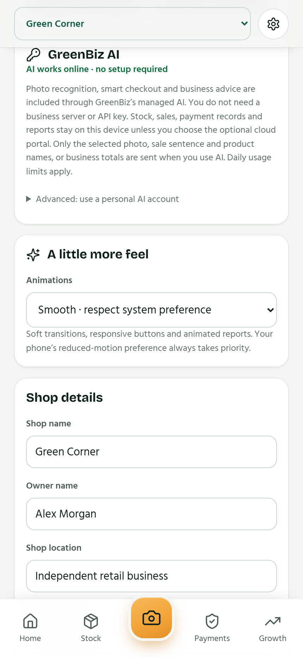
Motion that supports the work
Responsive feedback
Swipe checkout, spring sheets, clear success moments and gentle haptics.
Readable movement
Staged entrances, animated counters, chart reveals and stable navigation.
User control
Reduced motion and touch-feedback controls.
GreenBiz
22 / 25
Notes:
Motion features come from the current 2.2 documentation: View Transitions, CSS fallback, staggered arrivals, money counters, chart and gauge reveals, swipe feedback, draggable sheets, success animation and optional haptics. Reduced motion honors user and system preferences. View Transitions need a recent WebView. Physical-phone frame-rate and haptic checks have not been performed.
Sources: original GreenBiz full-concept deck; owner-confirmed financial-inclusion vision; supplied 2.1 change notes; App-Website/docs/FEATURES-2.1.md, MOTION-2.2.md and VALIDATION.md (latest version appendices). Screens show fictional sample records in the current app UI. Currency and payment labels reflect the current build, not universal market coverage.

Slide 23
A global rollout built on a shared core
01
02
03
Validate the core
Adapt each market
Connect institutions
Physical-phone checks and a production release process
Language, currency, calendar and payment formats
Suitable partners, terms and consent-based workflows
GreenBiz
23 / 25
Notes:
Global ambition is the owner direction. These are rollout workstreams, without invented dates or committed partners. Version 2.2 does not establish worldwide payment support, global bank coverage, universal underwriting or fully localized currency/calendar accounting.
Sources: original GreenBiz full-concept deck; owner-confirmed financial-inclusion vision; supplied 2.1 change notes; App-Website/docs/FEATURES-2.1.md, MOTION-2.2.md and VALIDATION.md (latest version appendices). Screens show fictional sample records in the current app UI. Currency and payment labels reflect the current build, not universal market coverage.

Slide 24
The current release and next checks
108
23
4
Unit and API tests
Browser journeys
Native SMS parser tests
Latest documented build: 2.2.0, debug-signed for internal testing
Next: physical-device validation, release signing and store preparation
GreenBiz
24 / 25
Notes:
Counts come from the supplied validation for app 2.2, not app tests rerun for this deck. The 2.2 change adds motion and visual finish, without record/sync/calculation changes. Latest documented lint, type checks and builds passed. Physical-device SMS, notification, speech, camera, frame-rate and haptics checks remain outstanding. Production signing and Play Store publication are not complete. Optional business portals are not publicly deployed.
Sources: original GreenBiz full-concept deck; owner-confirmed financial-inclusion vision; supplied 2.1 change notes; App-Website/docs/FEATURES-2.1.md, MOTION-2.2.md and VALIDATION.md (latest version appendices). Screens show fictional sample records in the current app UI. Currency and payment labels reflect the current build, not universal market coverage.

Slide 25
Every small business
deserves a financial history.
GreenBiz builds it through everyday business activity.
The goal is better decisions today and a clearer path to financial inclusion.
GreenBiz
25 / 25
Notes:
Closing vision confirmed by the owner: financial inclusion is the central objective. Useful records give owners more visibility and can support informed conversations with financial institutions. Access depends on consent, suitable institutions and market-specific implementation. No credit approval or financial outcome is guaranteed.
Sources: original GreenBiz full-concept deck; owner-confirmed financial-inclusion vision; supplied 2.1 change notes; App-Website/docs/FEATURES-2.1.md, MOTION-2.2.md and VALIDATION.md (latest version appendices). Screens show fictional sample records in the current app UI. Currency and payment labels reflect the current build, not universal market coverage.

