Slide 1
VLSI
Course teacher:
Mubasshar-Ul-Ishraq Tamim
Lecturer, Department of CSE.
Mid-Term

Slide 2
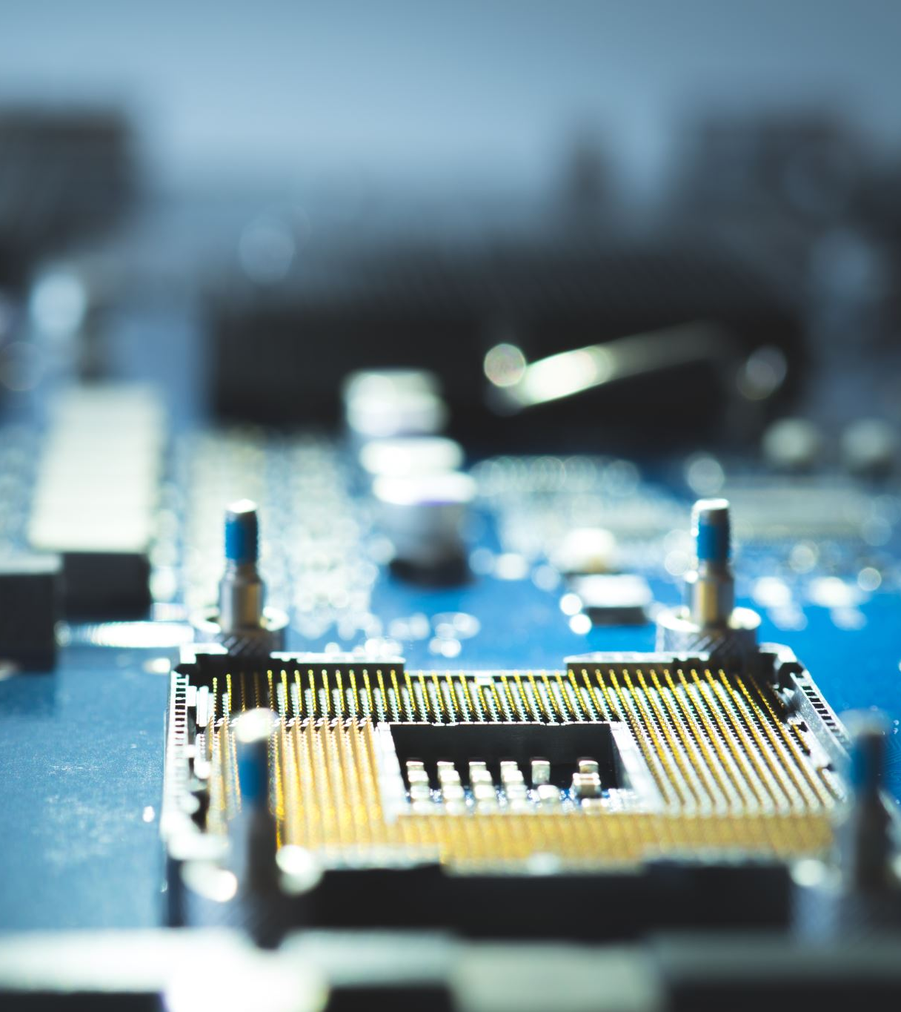
Motivation of the Course
Think about early computers – they were huge machines, filling entire rooms, and could only do very simple calculations. At that time, each chip had only a few transistors. But today, a single smartphone chip has billions of transistors. So the motivation is clear:
We want smaller devices.
We want faster performance.
We want less power consumption.
And, most importantly, we want all of this at a lower cost.
This is only possible because of VLSI technology – where we can put millions and billions of transistors on a single chip.
Example: The Intel 4004 chip in 1971 had 2300 transistors. A modern Intel Core i7 has billions of transistors. That is the power of VLSI.”

Slide 3
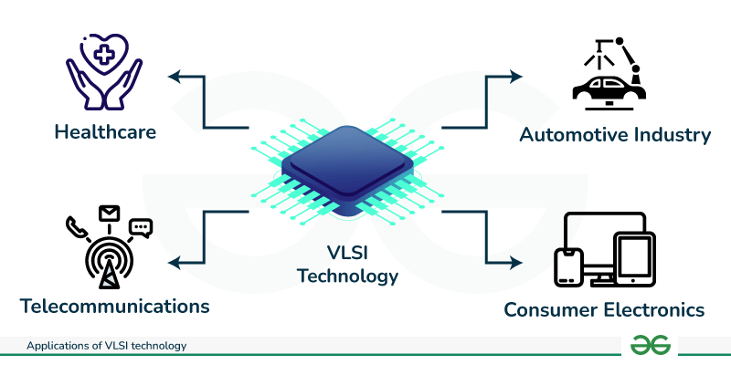

VLSI
VLSI (Very Large Scale integration) is a process of integrating hundreds or thousands of transistors onto a single silicon semiconductor microchip.
In present years, contemporary VLSI technology Complex digital systems can now be realized on a single silicon chip.

Slide 4
VLSI Advantage
The Advantages of VLSI technology
Compact Size: Traditional circuits are significantly greater than VLSI circuits because of electronic circuits are created to ensure the computation of digital logic circuits.
Consumes less Power: VLSI circuits are better than Traditional circuits because VLSI circuits are eco-friendly. This is necessary for the battery life saving.
High performance: By adding the high number of transistors on a chip so to accomplish VLSI circuits are high speeds with they perform complex tasks.
Cost-Effectiveness: By using VLSI technology, electronic circuits which are complicated that they are executed in large quantity. All the features and various components are implemented on a single chip. Electronic circuits are used and implemented because of their easy accessibility.
Increased Reliability: Comparing to discrete devices, some short link and better manufacturing capabilities used by VLSI circuits because of their better reliability in terms of errors and failures.

Slide 5
Electronics
A system is simply a collection of parts working together to perform a task.
Example 1: A computer system has input, CPU, memory, and output.
Example 2: Our human body is also a system: heart, lungs, brain – all working together.
In electronics, we also use this hierarchy:
System → like a smartphone.
Subsystem → like the camera or processor.
Modules → like an adder circuit inside the processor.
Circuits → made of logic gates.
Devices → the actual MOS transistors.”
Input → Processing → Output.

Slide 6
Design Abstraction Levels
Engineers design chips, they don’t start by directly drawing transistors.
They design in levels of abstraction.
System Level → Decide the functions. Example: A calculator should add, subtract, multiply.
Algorithm Level → How will addition be done?
RTL Level (Register Transfer Level) → Use registers, transfer data.
Gate Level → Represent with AND, OR, NOT gates.
Transistor Level → Convert gates into MOSFETs.
Physical/Layout Level → Draw the actual design on silicon.
Ex: Think of building a house. First, you decide the purpose of rooms (system). Then, you make a floor plan (algorithm). Then you design walls and doors (RTL). Finally, you build with bricks (transistors).”

Slide 7
Delay and Interconnect Issues
In digital circuits, signals take time to move. This time is called delay.
In older circuits, the delay mostly came from the transistor itself. But in modern VLSI, the main problem is interconnects – the wires that connect transistors.
These wires have:
Resistance (R)
Capacitance (C)
So, the delay ≈ R × C.
Example: Imagine you are driving on a road. If the road is narrow (high resistance) and there are too many cars (high capacitance), traffic will move very slowly.
That’s exactly what happens with interconnects – they slow down signals.
Other issues:
Crosstalk noise: when one signal disturbs another.
High power consumption.”

Slide 8
MOS Fundamentals
What is MOS?
MOS is a structure used to make the MOSFET (Metal-Oxide-Semiconductor Field Effect Transistor), the most important device in VLSI design.
It is the building block of modern digital circuits.
All processors, memory chips, and logic circuits are made from MOSFETs.

Slide 9
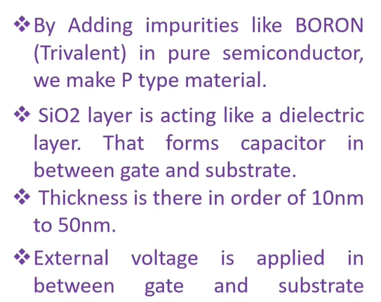
Structure of MOS
The MOS structure has three main parts:
Metal (Gate):
  A thin layer of metal (or polysilicon in modern chips).
  Acts like the switch handle.
Oxide:
  A very thin layer of insulator (usually silicon dioxide, SiO₂).
Semiconductor (Substrate):
  Base material, usually silicon..

Slide 10
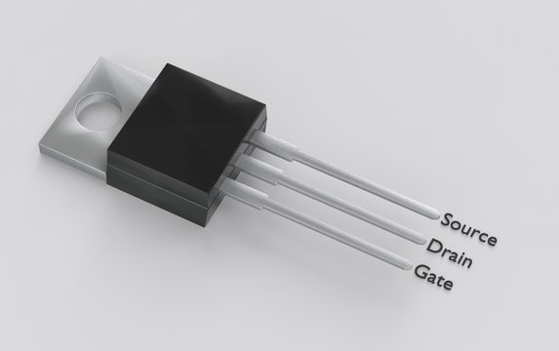
MOSFET
MOSFET is the heart of VLSI.
Billions of MOSFETs exist inside a modern chip (processors, memory, etc.).
Acts as a switch and amplifier.
Foundation of digital logic (0 & 1).
What is MOSFET?
MOSFET = Metal–Oxide–Semiconductor + Field Effect
It is a 3-terminal/4-terminal transistor.
Current flows between Source & Drain.
Controlled by voltage applied at Gate (via electric field).
Think: Like a water tap – Source = tank, Drain = pipe, Gate = tap handle.

Slide 11
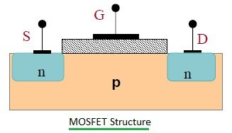
How Does MOSFET Work
Normally, no current flows between Source and Drain because the oxide is an insulator.
When we apply a voltage to the Gate (Vgs):
  Electric field is created.
  This field attracts charge carriers in the semiconductor.
  A channel is formed between Source and Drain.
  Now current can flow
Key point: Gate voltage controls current flow.

Slide 12
Modes of MOSFET Operation
MOS can work in three modes depending on Gate voltage (Vgs) and Drain voltage (Vds).
Cut-off (OFF mode):
  If Vgs<Vt (threshold voltage), no channel forms.
  Transistor OFF → no current.
Linear (or Triode mode):
  If Vgs>Vt and small Vds.
  A channel forms → current flows like a resistor.
Saturation mode:
  If Vgs>Vt and large Vds.
  Channel pinches near Drain → current becomes almost constant.
  MOS works like a controlled current source.
Cut-off = OFF switch, Linear = Dimmer switch (variable resistor), Saturation = Fully ON switch.

Slide 13
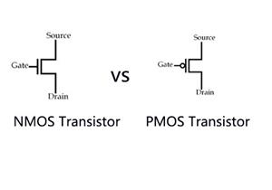
Types
Types of MOSFET
NMOS:
  Current flows via electrons (faster).
  ON when Gate voltage is positive.
PMOS:
  Current flows via holes (slower).
  ON when Gate voltage is negative.
Modern circuits use CMOS = NMOS + PMOS together.

Slide 14
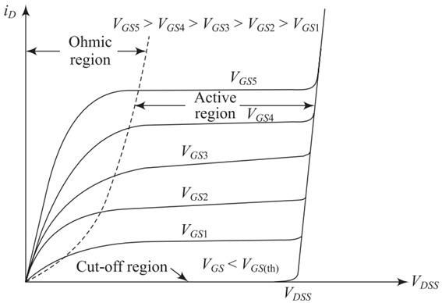
MOSFET I–V
What is I–V Characteristic?
"I–V" means relationship between current (I) and voltage (V) in MOSFET.
We usually study: Drain current (Id) vs Drain-to-Source Voltage (Vds) for different values of Gate-to-Source Voltage (Vgs).
Helps us understand how MOSFET works as a switch or amplifier.
So, we will find how Id changes when we vary Vgs and Vds.

Slide 15

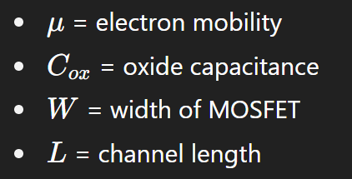

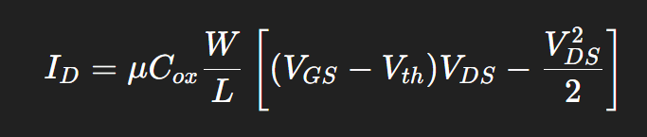
Equations
Cutoff Region (OFF mode)
Condition: ​ (Gate–Source voltage less than threshold voltage).
Meaning: Gate is too weak to form a channel → no current flows.
Current: ID≈0.
Linear / Triode Region (Resistive mode)
Condition: small Vds.
Meaning: Channel is formed and behaves like a resistor.
Current equation:

Slide 16

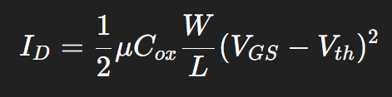
Equations
Saturation Region (Active mode)
Condition: large Vds.
Meaning: Channel is "pinched off" at drain side → current stops increasing much.
Current equation:
In this region, MOSFET acts like an amplifier or switch.

Slide 17
Introduction to Scaling
VLSI = millions/billions of transistors in a chip.
To increase speed, packing density, and performance, MOSFET size is reduced.
This process is called Scaling.
Benefits of scaling:
Higher circuit speed (faster switching).
Lower power per gate.
More devices per unit area → higher integration.
BUT: Scaling introduces new challenges (leakage, short channel effects, velocity saturation).
Why Scaling is Important
Smaller device → Shorter channel length.
Shorter channel → Faster current response.
Shorter interconnects → Reduced delay.
Reduced device size → Lower power consumption (in ideal scaling).
Essential for Moore’s Law: doubling transistors every ~2 years.

Slide 18
Types
Types of Scaling
Constant-Field Scaling (Dennard Scaling):
  All dimensions (length, width, oxide thickness) reduced by factor k.
  Voltages also scaled by k.
  Electric field remains constant.
  Pros: Reliable operation, lower power.
  Cons: Requires lowering supply voltage, which is difficult in practice.
Constant-Voltage Scaling:
  Only physical dimensions are scaled down.
  Voltages are kept the same.
  Electric field increases → higher speed but higher power density.
  Cons: More hot carrier effects and device degradation.
Generalized Scaling:
  Dimensions scaled by k, voltages scaled by α (α < k).
  Electric field partly increases.
  A compromise between speed and reliability.

Slide 19
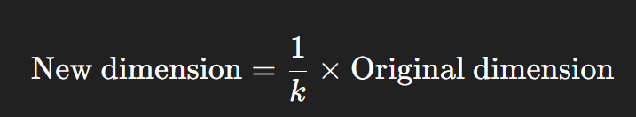
Factor
The Scaling Factor k
k is the reduction factor we use when shrinking a MOSFET.
If k = 2, it means the new device is half the size of the original.
In general:
Example (k = 2)
Channel length (L): Original = 1 µm → New = 0.5 µm
Channel width (W): Original = 1 µm → New = 0.5 µm
Oxide thickness (tox): Original = 10 nm → New = 5 nm
If it’s constant-field scaling, then even voltage scales:
Supply Voltage (Vdd): Original = 5 V → New = 2.5 V

Slide 20
Mobility Degradation
Mobility = how easily electrons/holes move through the channel.
In short-channel MOSFETs, strong electric fields are present in the channel near the gate.
These high fields scatter carriers (electrons/holes), making them move slower.
Effect:
Reduces drain current.
Lowers the speed of the transistor.
Analogy:
Imagine trying to run through a crowded street → you move slower because of frequent collisions.

Slide 21
Subthreshold Current (Leakage Current)
Even when Vgs < Vth (transistor should be OFF), some small current still flows from drain to source.
This is called subthreshold leakage.
Why it happens:
Short channel → weaker gate control → carriers sneak through.
Effect:
Wasted power in OFF state.
Increases standby power consumption in chips.

Slide 22
Threshold Voltage Variation
Threshold Voltage (Vth) is the minimum voltage required at the gate to form a conducting channel.
In short-channel MOSFETs, Vth does not stay constant → it changes with channel length and drain voltage.
Effect:
Harder to design stable circuits.
Vth may reduce (device turns ON too easily) or increase (hard to switch ON).

Slide 23
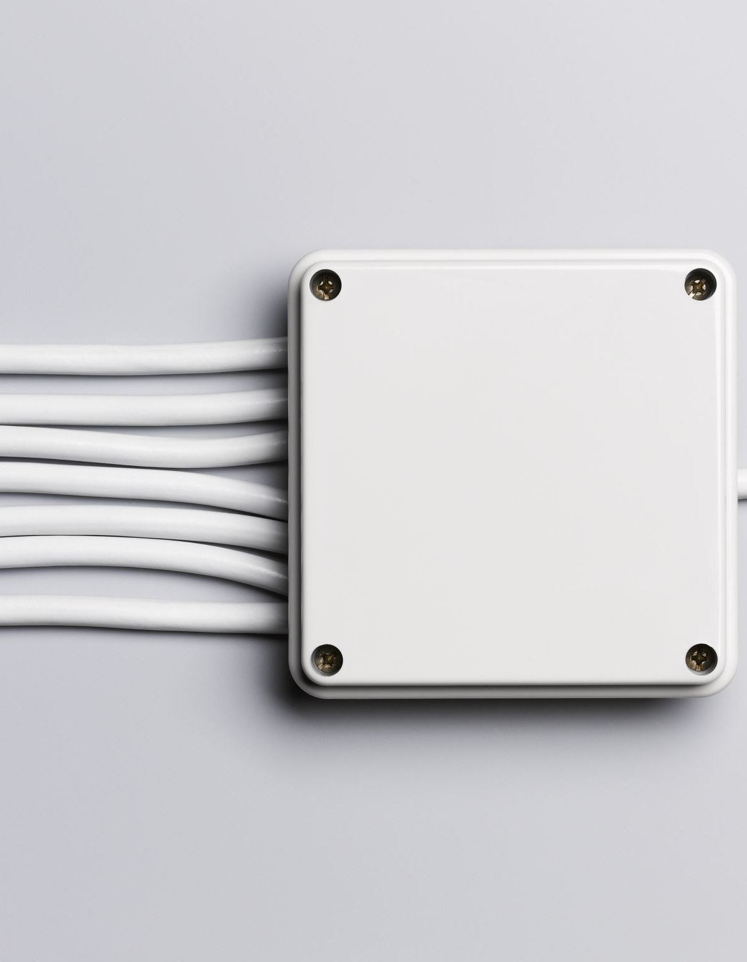
Drain-Induced Barrier Lowering (DIBL)
Normally, the gate controls the barrier that stops current flow when the device is OFF.
But in short-channel MOSFETs, a high drain voltage can lower this barrier.
Result:
Even if Vgs < Vth, current flows because the drain is helping carriers overcome the barrier.
Effect:
  Reduces threshold voltage.
  Increases leakage current.
Analogy:
Think of a dam (gate) blocking water. If the water level (drain voltage) rises too high, it spills over even if the dam is closed.

Slide 24
Drain Punch Through
What it means:
When channel is very short, the depletion region from the drain side extends all the way to the source side.
This creates a direct path for current, bypassing the gate control.
Effect:
Device cannot turn OFF properly.
Leakage current becomes very large.

Slide 25
Hot Carrier Effect
What it means:
In short-channel MOSFETs, carriers (electrons/holes) get accelerated to very high energy due to strong electric fields near the drain.
These high-energy carriers are called hot carriers.
Effect:
They can get trapped in the gate oxide.
This degrades performance over time (shifts Vth, reduces mobility).
Long-term reliability problem.
Analogy:
Like over-speeding cars on a highway → some crash into barriers (oxide), damaging the road.

Slide 26
Surface States and Interface Trapped Charge
What it means:
At the interface between the silicon and gate oxide, there can be trapped charges or defects.
These interact with carriers in the channel.
Effect:
Reduces mobility.
Causes instability in threshold voltage.
Leads to noise and unreliable operation.
Analogy:
Imagine walking on a sticky floor – you get slowed down because of traps (charges).

Slide 27
Fabrication Process
Introduction
Fabrication process in VLSI/IC design means making integrated circuits (ICs) on a silicon wafer.
It involves a sequence of chemical, mechanical, and thermal processes like oxidation, lithography, etching, deposition, and doping.
The goal is to create MOS transistors (and interconnections) that can work as logic gates, memory cells, or analog components.

Slide 28
Photolithography
Definition:
A process used to transfer circuit patterns (like gate, source, drain regions) onto the silicon wafer using light.
Steps:
  Coating: Apply photoresist (a light-sensitive chemical) on the wafer.
  Masking: Place a mask (like a stencil with the desired pattern) over the wafer.
  Exposure: Shine UV light through the mask.
  Developing: Exposed/unexposed parts of photoresist are dissolved, leaving the pattern on wafer.
  Etching: Remove unwanted silicon or oxide according to the pattern.
Analogy: Like printing a design on T-shirt using a stencil and light.

Slide 29
Fabrication Process
General Flow:
Oxide Growth (silicon dioxide layer grown on wafer).
Photolithography (to define patterns).
Etching (remove unwanted layers).
Doping/Ion implantation (to make n-type or p-type regions).
Deposition (adding materials like polysilicon, metals).
Metallization (wiring interconnections).
Passivation (final protective layer).
Goal: Build millions of MOSFETs and connect them to form circuits.

Slide 30
Gate Material
Earlier Technology: Metal gates (Aluminum).
Modern Technology: Polysilicon gates → later replaced by High-k dielectric + Metal gate (for nanometer technologies).
Why polysilicon used?
  Can withstand high temperatures.
  Works well with self-aligned gate technology.
  Provides better control of channel.

Slide 31

Parasitic Capacitances
Unwanted capacitances formed in MOS transistors due to overlaps and junctions.
Types:
Gate-to-source capacitance (Cgs).
Gate-to-drain capacitance (Cgd).
Drain-to-substrate junction capacitance (Cdb).
Source-to-substrate junction capacitance (Csb).
Effect:
Slows down switching speed.
Increases power consumption.
Limits maximum frequency.

Slide 32

Self-Aligned Silicon Gate Technology
Technique where the gate itself is used as a mask to align source and drain regions.
How it works:
  Deposit polysilicon gate.
  Use the gate as a mask to implant source and drain.
  Source and drain automatically align with gate edges → no misalignment problem.
Advantages:
  Smaller devices (scaling possible).
  Better performance.
  Reduced parasitic capacitance.

Slide 33
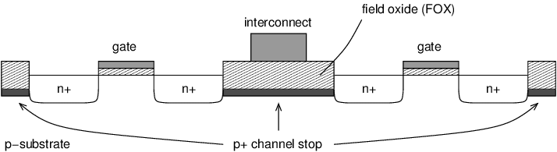
Channel Stopper
Definition: A heavily doped region created under field oxide areas (outside the channel region).
Purpose:
Prevents inversion layer leakage outside the intended channel.
Stops parasitic channels from forming between source and drain.
Analogy: Like putting barriers so current flows only in the proper path.

Slide 34
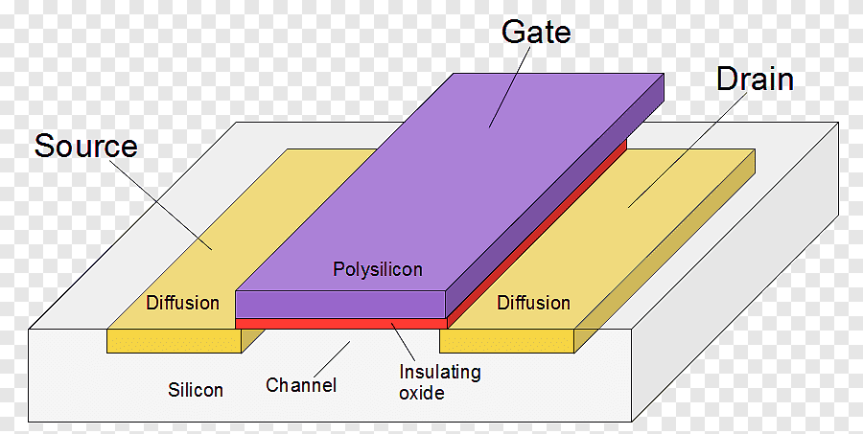
Polysilicon Deposition
What it is:
A process of depositing a thin film of polysilicon (polycrystalline silicon) on the wafer using Chemical Vapor Deposition (CVD).
Why polysilicon?
Used as gate material.
Can act as resistors or interconnects.
Works well in high-temperature processes.

Slide 35
Oxide Growth
What it is:
Growing a thin layer of silicon dioxide (SiO₂) on silicon wafer.
Types:
Field oxide (thick, for isolation).
Gate oxide (thin, under MOS gate).
Methods:
Thermal oxidation: Heat silicon wafer in oxygen/steam → oxide grows.
Uses:
Insulating layer.
Gate dielectric.
Masking material for diffusion/implantation.

Slide 36
Active Mask or Isolation Mask (Thin-ox Mask)
Definition:
Special mask used to define active areas (where transistors will be formed) and isolate them from each other.
Process:
Use isolation oxide (thick SiO₂) in regions where no transistor is needed.
Only “active” regions (thin oxide) are left open for MOSFET fabrication.
Purpose:
Prevents interaction between nearby transistors.
Ensures reliability and avoids leakage.

Slide 37
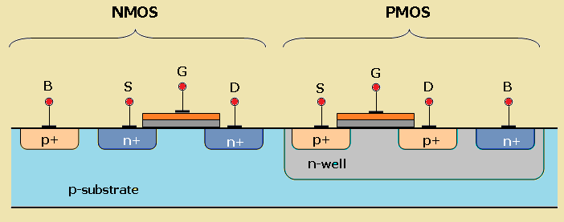
General Aspects of CMOS Technology
Why polysilicon preferred over aluminum as gate material?
Earlier Technology
In early MOSFETs (1960s–70s), aluminum (Al) was used as gate material.
But aluminum had serious limitations:
  High-temperature problem → Aluminum melts at ~660°C, but fabrication requires >1000°C (for diffusion/oxidation).
  Not compatible with self-aligned gate technology → Aluminum gate cannot act as a mask during source/drain implantation.
  Work function mismatch → Threshold voltage (Vth) control was poor.
Polysilicon (Polycrystalline Silicon) Advantages
High-temperature stability → Can withstand >1000°C (needed for thermal oxidation and ion implantation).
Self-alignment possible → Polysilicon gate can act as a mask → ensures source/drain regions align perfectly with the gate.
Work function tuning → By doping polysilicon (n+ or p+), threshold voltage can be adjusted.
Compatibility → Works well with silicon dioxide gate dielectric.
Scalability → Suitable for VLSI miniaturization.
Conclusion: Polysilicon replaced aluminum because it enables self-aligned MOSFETs, supports high-temperature processes, and provides better Vth control.

Slide 38
Channel Stopper Implant
Problem
In MOSFETs, especially in short channel devices, an unwanted parasitic channel can form outside the intended channel region (under the field oxide).
This parasitic conduction causes leakage currents.
Solution → Channel Stopper Implant
Definition: A heavily doped p+ or n+ region (depending on substrate type) placed under the field oxide region.
Purpose: Prevents inversion layer formation in isolation regions.
Function
Stops carriers from flowing outside the transistor channel.
Prevents punch-through leakage and parasitic conduction.

Slide 39
Local Oxidation of Silicon (LOCOS)
Definition
LOCOS = A process used to create thick field oxide on a silicon wafer for device isolation. Field oxide separates active device regions (where MOSFETs are built) from each other.
Process Steps
Pad oxide grown on wafer (thin oxide layer to protect silicon).
Silicon nitride (Si₃N₄) deposited → acts as oxidation mask (prevents oxide growth in active areas).
Photolithography used to open areas where field oxide is required.
Thermal oxidation performed → thick SiO₂ grows in exposed regions (field regions). After oxidation, nitride removed → leaving thin oxide (active areas) and thick oxide (isolation).
Advantages
Simple, reliable, widely used in early CMOS.
Disadvantage
Bird’s Beak Effect: During oxidation, oxide grows laterally under the nitride mask, reducing active area → wastes chip space and limits scaling.

