Slide 1

Concepts
Models
Routes
Controllers
Components
Templates
}
Hooks

Slide 2
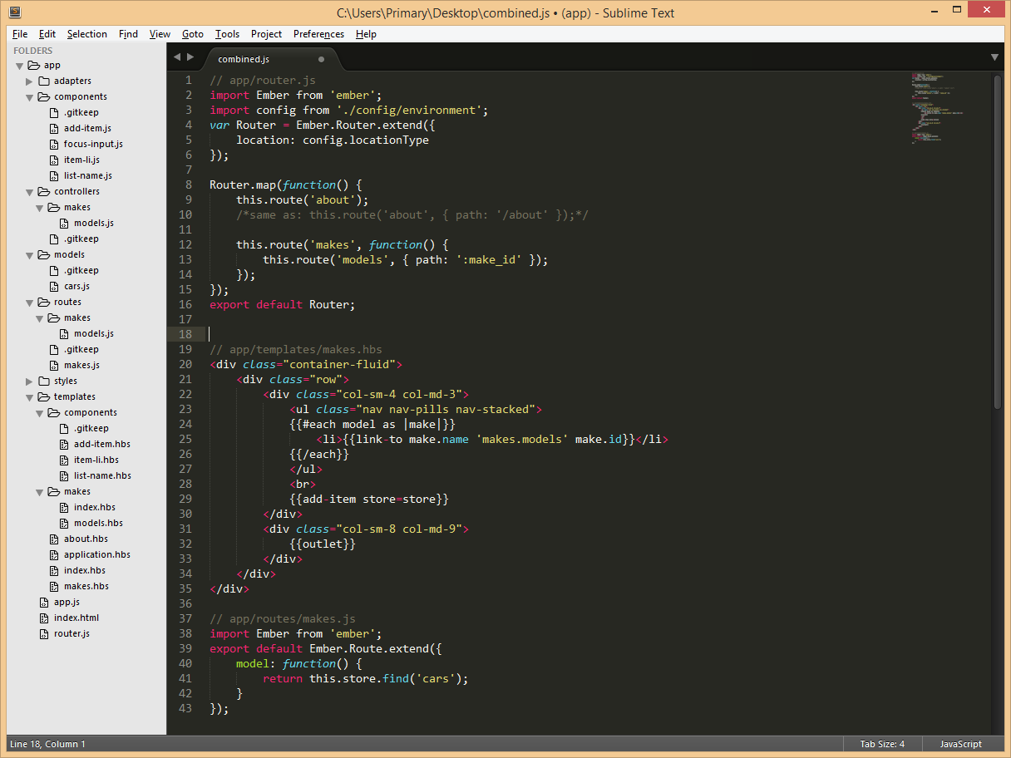
Route Definition
Defined routes
About: #!/about
Makes: #!/makes
Models: #!/makes/1 [id]
Implicit routes:
Application
Loading
Index
Error
Conventions Matter!
Route Name | Template | Route | Controller
Index | templates/index.hbs | route/index.js | controller/index.js
About | templates/about.hbs | route/about.js | controller/about.js
Makes | templates/makes.hbs | route/makes.js | controller/makes.js
Models | templates/makes/models.hbs | route/makes/models.js | … /makes/models.js

Slide 4
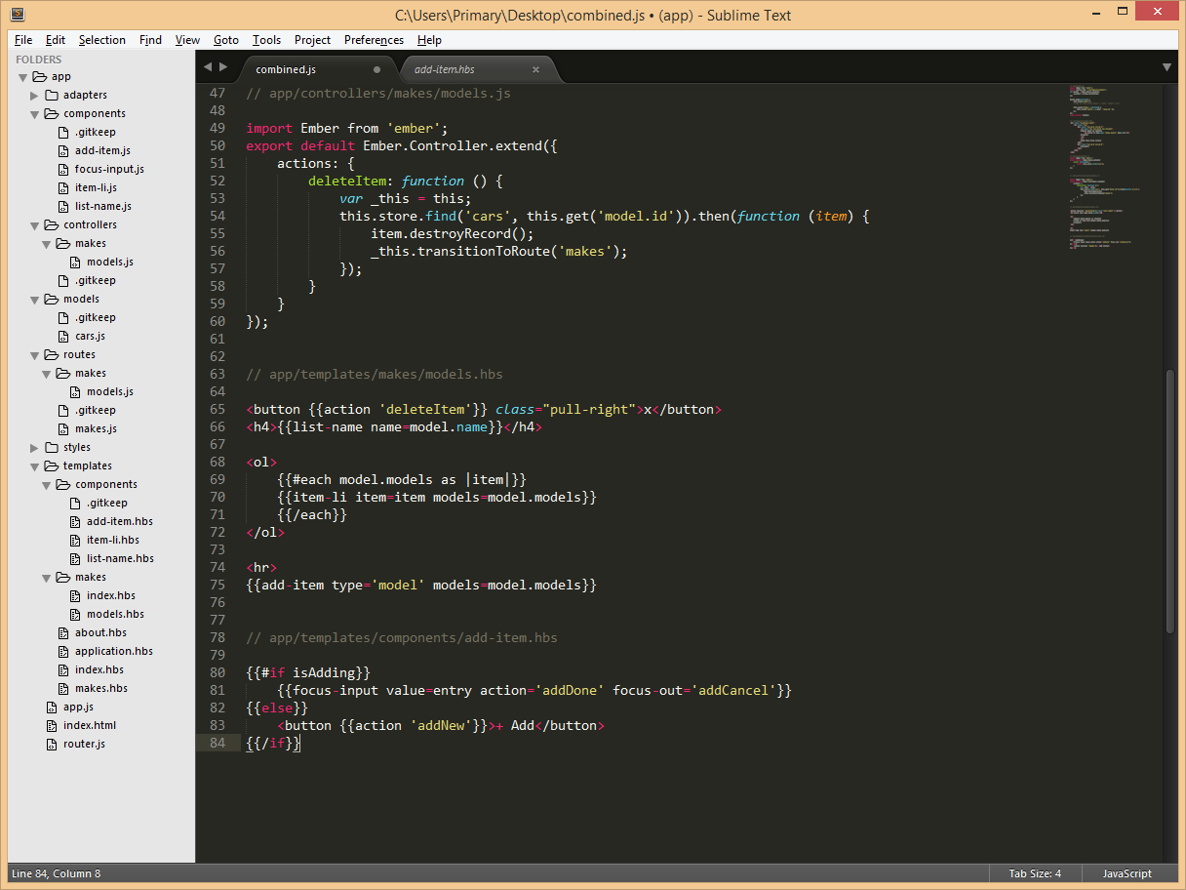

Slide 6
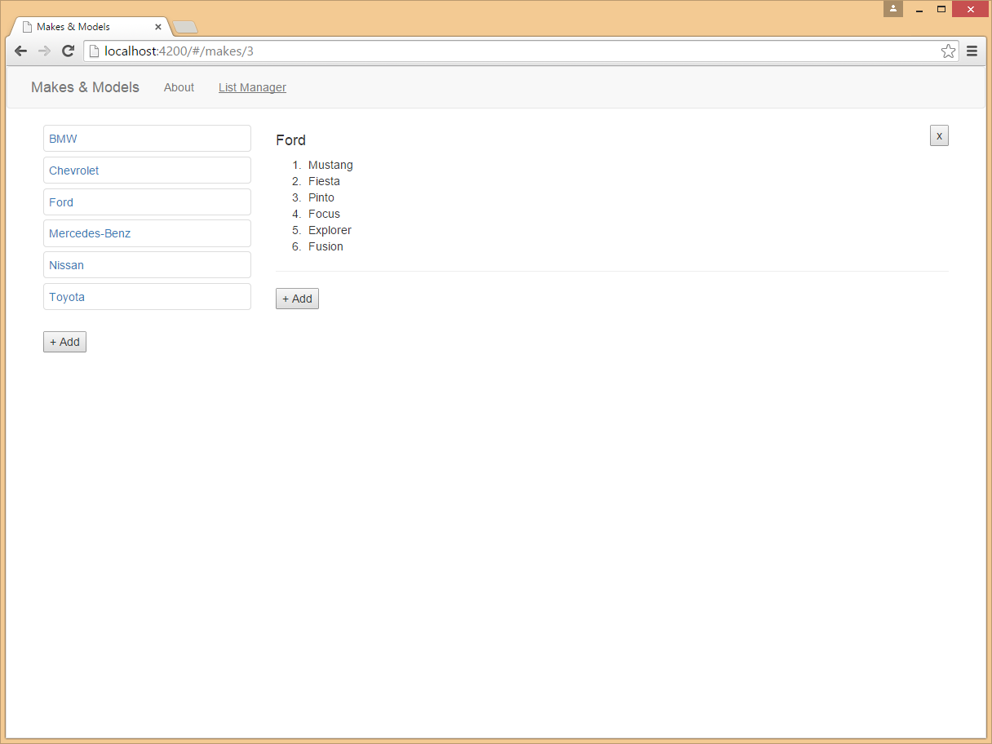

Slide 7
Starter Pack

Slide 8




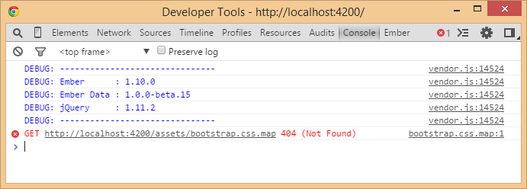


Ember Data (Optional, but helpful!)
{{HTMLBars}}
Developer Tools
+

Slide 9
Install node and npm
> npm install -g ember-cli
> npm install -g bower
> npm install -g phantomjs
Create a new project
> ember new my-project
> cd my-project
my-project> ember server
Launch web browser: http://localhost:4200
Adding bootstrap (example):
my-project> ember install:bower bootstrap
Edit Brocfile.js
app.import('bower_components/bootstrap/dist/css/bootstrap.css');
Ready for dist?
my-project> ember build

