Slide 1
Track 1: HTML Fundamentals
Building the Structure of the Web
Objective: Learn how to structure web pages using HTML and build a complete personal profile website.
By the end of this track, students will be able to:
Explain how the Web works
Create a properly structured HTML document
Add text, links, images and lists
Create tables and forms
Use semantic HTML
Apply basic accessibility principles
Follow HTML best practices
Build a multi-page personal profile website

Slide 2
Slide 1 — Introduction to the Web
What is the Web?
Key terms
The World Wide Web (WWW) is a system of interconnected resources that can be accessed over the Internet using web browsers.
Internet
Browser — Chrome, Firefox, Edge, Safari
Client — Usually the user's browser/device
Server — Provides web resources
URL — Address of a resource
HTTP — Communication protocol used by the Web
A global network connecting computers and devices.
Provides the infrastructure for communication.
"What happens after you type a website address into your browser and press Enter?"
Web
A service that runs on the Internet.
Allows us to access websites and web resources through browsers.
Use their answers to introduce the client-server model.
The basic Web ecosystem
USER → BROWSER → HTTP REQUEST → SERVER → HTTP RESPONSE → BROWSER → WEB PAGE

Slide 3
Slide 2 — HTML Document Structure
What is HTML?
Understand the structure
HTML = HyperText Markup Language
HTML is a markup language used to structure the content of web pages.
Think of a website as a house:
Element
Purpose
<!DOCTYPE html>
Declares the HTML document type
HTML = Structure
CSS = Appearance
JavaScript = Behavior
<html>
Root of the document
<head>
Metadata and document information
Basic HTML document
<title>
Browser tab title
<!DOCTYPE html>
<html>
<head>
<title>My Profile</title>
</head>
<body>
<h1>Welcome to My Website</h1>
<p>This is my personal profile.</p>
</body>
</html>
<body>
Visible page content

Slide 4
Slide 3 — Text, Links, Images & Lists
Building Content with HTML
1. Headings
5. Lists
HTML provides six heading levels:
Unordered list:
<h1>Main Heading</h1>
<h2>Section Heading</h2>
<h3>Subsection</h3>
<ul>
<li>HTML</li>
<li>CSS</li>
<li>JavaScript</li>
</ul>
Use headings to create a meaningful content hierarchy.
2. Paragraphs
Ordered list:
<p>
I am a beginner web developer learning HTML.
</p>
<ol>
<li>Learn HTML</li>
<li>Learn CSS</li>
<li>Build a website</li>
</ol>
3. Links
<a href="about.html">About Me</a>
Mini Challenge
The href attribute tells the browser where the link should go.
Ask students to create:
4. Images
"About Me" containing a heading, paragraph, profile image, list of hobbies and a link.
<img src="profile.jpg" alt="A photo of John">
src → location of the image
alt → alternative text describing the image

Slide 5
Slide 4 — Tables and Forms
Organizing Data & Collecting Information
HTML Tables
Forms
Tables are useful for tabular data.
Forms allow users to submit information.
<table>
<tr>
<th>Name</th>
<th>Course</th>
<th>Score</th>
</tr>
<tr>
<td>John</td>
<td>HTML</td>
<td>85</td>
</tr>
<tr>
<td>Mary</td>
<td>HTML</td>
<td>90</td>
</tr>
</table>
<form>
<label for="name">Name:</label>
<input type="text" id="name" name="name">
<label for="email">Email:</label>
<input type="email" id="email" name="email">
<button type="submit">Send</button>
</form>
Common form elements
form
label
input
textarea
select
option
button
Key concept
Important table elements
Tables display data.
Forms collect user input.
<table> — Table
<tr> — Table row
<th> — Header cell
<td> — Data cell

Slide 6
Slide 5 — Semantic HTML
Give Your Content Meaning
Semantic HTML means using HTML elements according to their meaning and purpose, rather than using generic containers for everything.
Common semantic elements
<header>
<nav>
<main>
<section>
<article>
<aside>
<footer>
Example
<header>
<h1>John's Profile</h1>
</header>
<nav>
<a href="index.html">Home</a>
<a href="about.html">About</a>
<a href="contact.html">Contact</a>
</nav>
<main>
<section>
<h2>About Me</h2>
<p>I am a web development student.</p>
</section>
<section>
<h2>My Skills</h2>
<p>HTML, CSS and JavaScript.</p>
</section>
</main>
<footer>
<p>© 2026 John</p>
</footer>

Slide 7
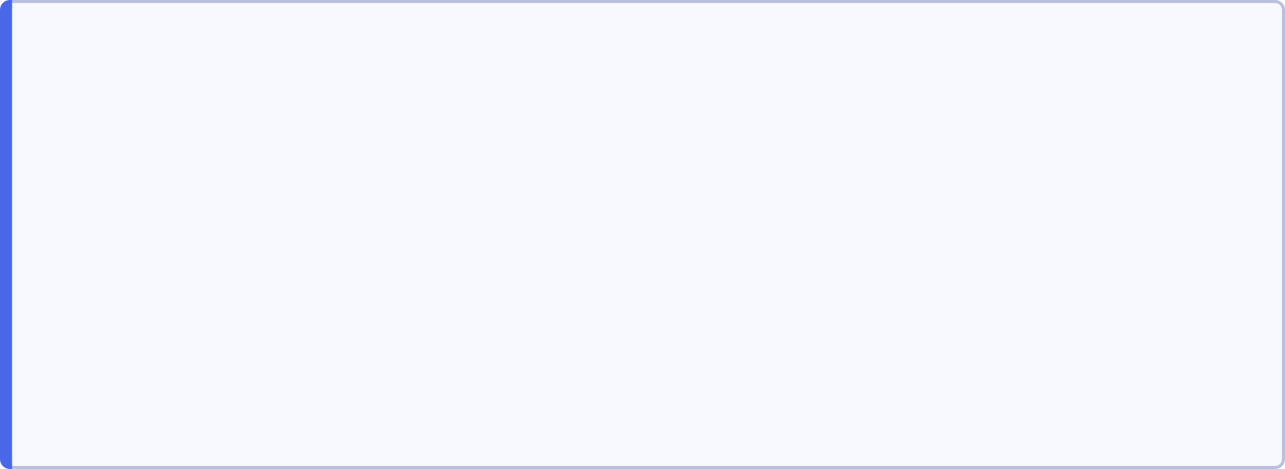


Slide 6 — Accessibility
Build Websites Everyone Can Use
Accessibility means designing websites that can be used by people with different abilities and assistive technologies.
Semantic HTML helps assistive technologies understand the structure of your page.
1. Use meaningful headings
2. Give images alternative text
Good:
<img src="profile.jpg" alt="Portrait of John">
<h1>My Profile</h1>
<h2>About Me</h2>
<h2>My Skills</h2>
Don't use:
<img src="profile.jpg" alt="image">
Avoid choosing headings simply because they look bigger or smaller.
when you can provide a meaningful description.
3. Label form fields
4. Use meaningful links
Good:
Better:
<label for="email">
Email Address
</label>
<input type="email" id="email">
<a href="about.html">Read about me</a>
Instead of:
<a href="about.html">Click here</a>
Golden rule: Don't just make your website work. Make it usable by as many people as possible.

Slide 8
Slide 7 — HTML Best Practices
Write Clean, Maintainable HTML
1. Use proper document structure
5. Always use alt for images
<!DOCTYPE html>
<html>
<head>...</head>
<body>...</body>
</html>
<img src="profile.jpg" alt="John smiling">
6. Associate labels with inputs
<label for="email">Email</label>
<input type="email" id="email">
2. Use lowercase HTML for uniformity
7. Don't use HTML for styling
<h1>My Profile</h1>
Avoid:
rather than mixing uppercase and lowercase.
<center>Hello</center>
3. Indent your code
Good indentation makes your code easier to read.
HTML should primarily describe structure and meaning. CSS should handle presentation and styling.
<section>
<h2>My Skills</h2>
<ul>
<li>HTML</li>
<li>CSS</li>
</ul>
</section>
8. Keep your code organized
A simple project might look like:
my-profile/
│
├── index.html
├── about.html
├── contact.html
└── images/
└── profile.jpg
4. Use meaningful names
id="contact-form" is better than id="box1"

Slide 9
Slide 8 — Putting Everything Together
Build a Personal Profile Website
Project Goal
Create a Personal Profile Website using everything you've learned.
Required pages
Home Page
About Page
Contact Page
Include:
Include:
Include:
Your name
Welcome message
Navigation links
Short introduction
Profile image
Biography
Education
Hobbies/interests
Skills
Lists
Contact information
Contact form
Name field
Email field
Message field
Submit button
Add a table
Include at least 5 rows and 5 columns.
Requirements checklist
Multiple HTML pages
Working navigation
Text
Images
Links
Lists
Table
Form
Semantic HTML
Accessible images/forms
Clean HTML structure

Slide 10
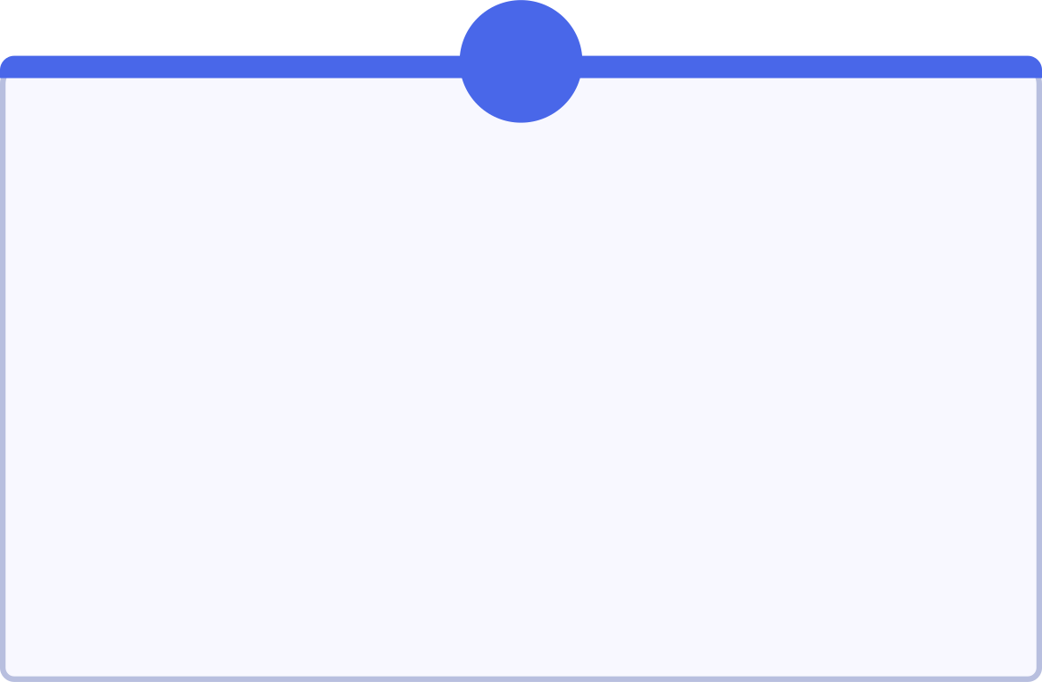

Slide 9 — Recap & Practical Challenge
What Have We Learned?
1
2
3
Module 1 — Introduction to the Web
Module 2 — HTML Document Structure
Module 3 — Text, Links, Images & Lists
Internet vs Web
Browser
Client
Server
URL
HTTP
DOCTYPE
html
head
title
body
Headings
Paragraphs
Links
Images
Ordered/unordered lists
4
5
6
Module 4 — Tables & Forms
Module 5 — Semantic HTML & Accessibility
Module 6 — HTML Best Practices
Tables
Rows and cells
Form controls
Labels
User input
Clean structure
Proper indentation
Meaningful names
Maintainable code
Separation of structure and styling
Semantic elements
Meaningful structure
Alt text
Form labels
Accessible links

Slide 11
🎯 Final Challenge
Build your Personal Profile Website.
Before submitting, ask yourself:
Can a visitor navigate every page?
Can they learn who I am?
Can they see my image and information?
Can they view my data in a table?
Can they contact me using my form?
Is my HTML semantic, accessible and well organized?

