Slide 1
Restaurant Billing System
Data Structure Project

Slide 2
Group Members
Syed Durraiz Azam Shah

Slide 3
Objective
The main objective of the project was to introduce a billing system of the restaurant.
The purpose was to reduce the difficulty of ordering in the restaurant.
Ordering any food became easy when the customer was checking while sitting in the restaurant, about his bill and orders.

Slide 4
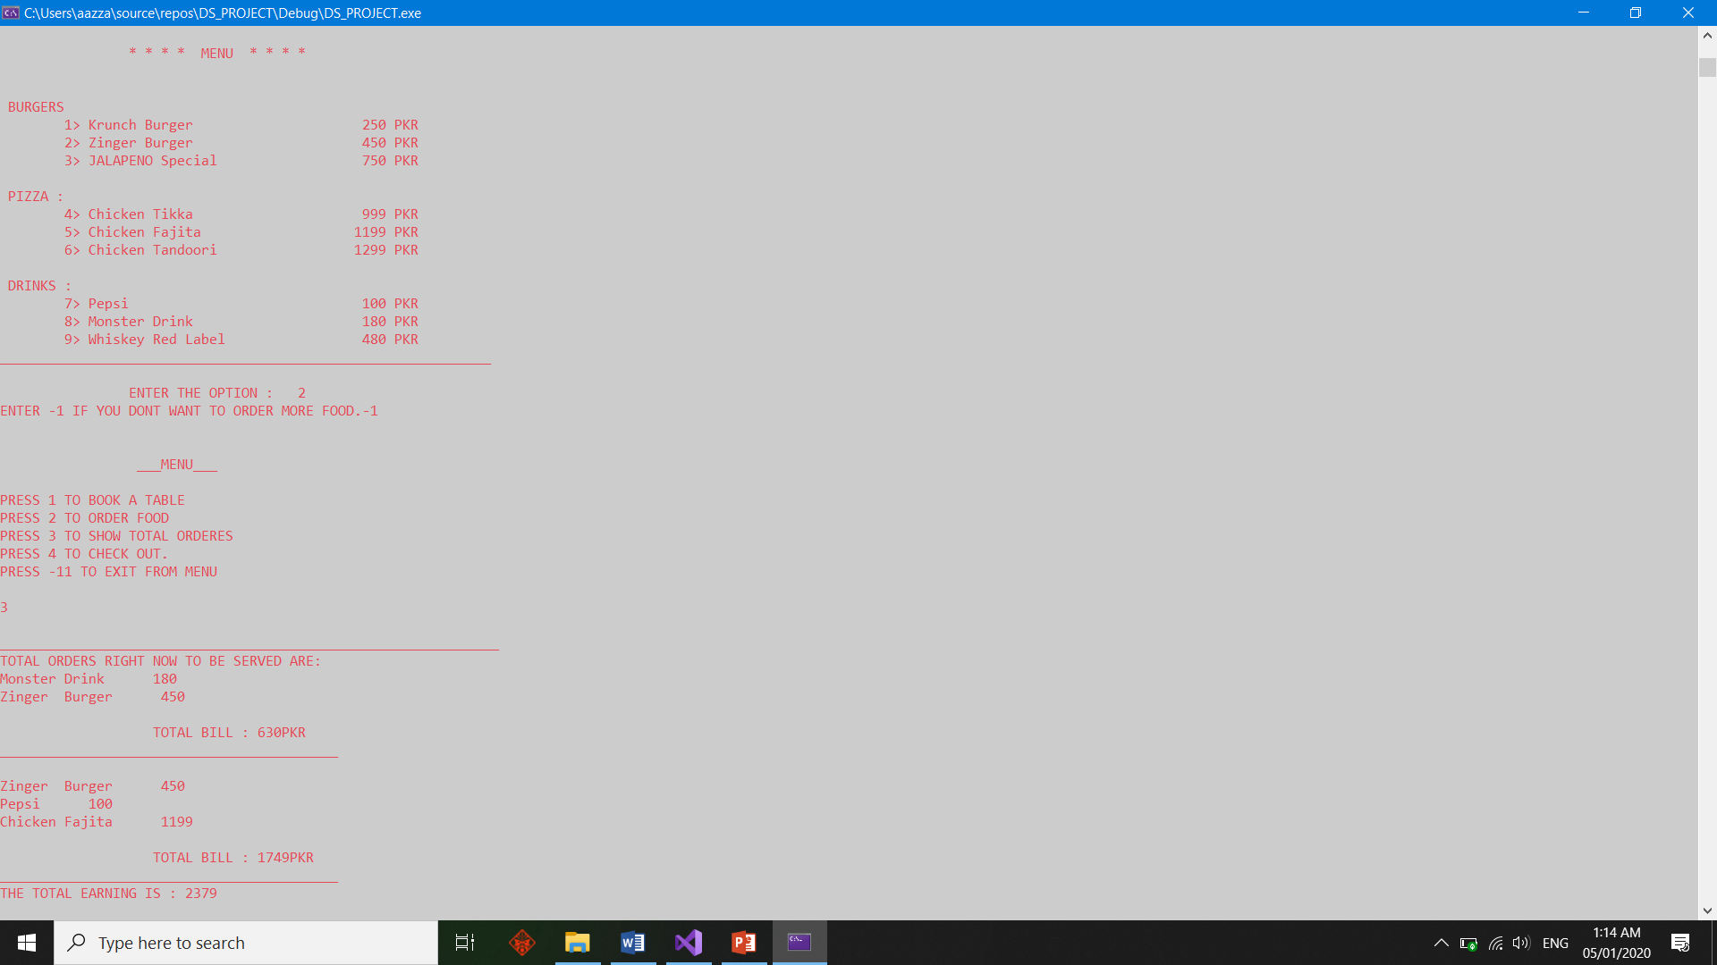
SAMPLE RESULT

Slide 5
Working of the System
The whole billing system is coded in c++ language.
The menu is displayed to the customer, the customer chooses the dish and places the order.
The orders are being taken whenever the customer calls for ordering.
The menu of the restaurant will be containing three types of drinks, burgers and pizzas.

Slide 6
Working of the System
The data structure of queue is used in storing information about the customers.
The customers will enter the restaurant and take his respective table.
After that, he will order the food.
For leaving the restaurant, he will have to make a call for it.
When leaving, customer will pay the bill.

Slide 7
Working of the System
Stack data structure is mainly used in storing the information about the orders that the customers gives.
The dishes will be served to the customers in pattern of firstly ordered dish.

Slide 8
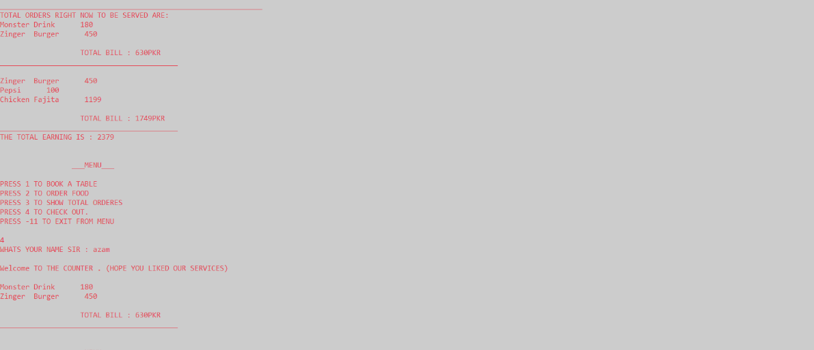
CHECK OUT TIME

Slide 9
Working of the System
The system also calculates the profit for the restaurant when any customer leaves.
File handling has also been used in the program to store the customer details and his calculated bill.
The billing and customer details and profits could also be viewed by the user after the program ends.

Slide 10
Thank You. Any Question?

