Slide 1


Movie Recommendation System
Deon Durrant

Slide 2
Business and Data Understanding
Problem Statement
The King Isle event coordinator is responsible for organizing and recommending movie screenings for the residents of the island. The event coordinator needs to provide top five personalized movie recommendations to each resident based on their previous movie ratings. By analyzing the historical ratings given by residents to other movies, the system should predict which movies each resident would likely enjoy in the future and prioritize the highest-rated one

Slide 3
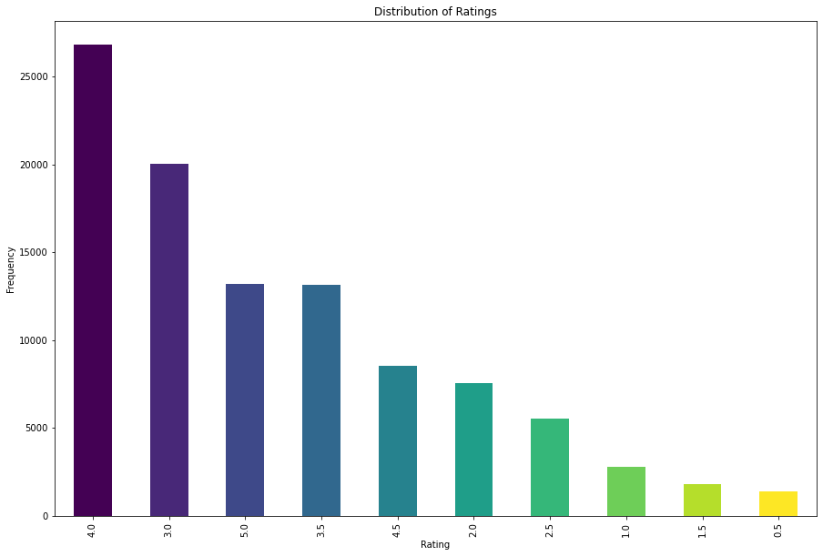
Business and Data Understanding
Rating Distribution
Rating are either implicit or explicit.
Explicit rating scale 0-5.
Positive ratings of movies
more common.
Possible positive bias in the ratings..

Slide 4
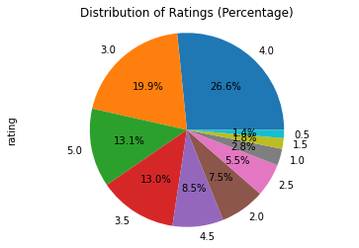
Business and Data Understanding
Ratings Percentage Distribution
Percentage distribution of ratings skews toward higher ratings
48.17%. ratings 4.0 -5.0, yet 4.0 (26.60%)
32.91% ratings 3.0 to 3.5
18.91% of ratings below 3.0

Slide 5
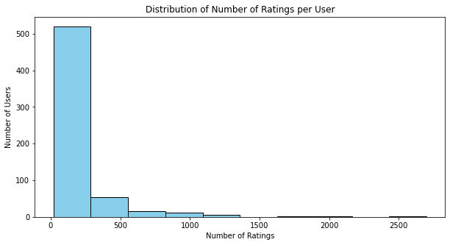
Business and Data Understanding
Distribution of ratings across users
Most users fall into the first bin (approx. 250 ratings)
Low user engagement
Suggest data sparsity
Fewer users with high rating engagements

Slide 6

Recommendation System: Technique and Model selection
Model-based Collaborative filter- creates a predictive machine learning model of the data
Alternating Least Squares(ALS) Method
Evaluation Metrics
Root mean square error RMSE- accuracy of the model's prediction
Precision@K- percentage of relevant items in a list of recommendations

Slide 7

Recommendation System Objectives and Implementation
To address the problem, the recommendation system was designed to:
Generate the top 5 recommended movies for each user
Generate the top 5 recommended users for each movie
Proof of concept
Recommend 5 movies to distinct users
Recommend 5 distinct movies to 5 user
Personalized Recommendations

Slide 8
Top 5 Users Recommendation for Each Movie
userId | Title | Predicted Rating
53 | Dracula: Dead and Loving It (1995) | 3.548811
558 | Dracula: Dead and Loving It (1995) | 3.3245075
327 | Dracula: Dead and Loving It (1995) | 3.2381494
371 | Dracula: Dead and Loving It (1995) | 3.0953596
276 | Dracula: Dead and Loving It (1995) | 3.0835876

Slide 9
Performance Metrics for Movie Recommendation System
Metric | Top 5 Recommended Movies per User | Top 5 Users Recommendation for Each Movie
Root Mean Square Error (RMSE) | 0.4464 Strong prediction accuracy with deviations of 0.44 units. | 0.6255 Moderate accuracy with 0.63 units deviation from actual ratings.
Precision@K (4.5 relevance) | 0.6614 66% of recommended movies meet threshold. | 0.2830 28.3% of the top 5 recommended users for each movie met the threshold.
Precision@K (4.0 relevance) | 0.8763 87% of recommended movies meet a lenient 4.0 threshold. | 0.5944 59.4% of the top 5 recommended users for each movie are considered relevant .

Slide 10
User-Centric Recommendation Comparison Summary
Metric | Top 5 Recommended Movies per User | Recommending 5 Distinct Movies to 5 Users | Recommending 5 Movies to 20 Distinct Users
Root Mean Square Error (RMSE) | 0.4464 | 0.5131 Moderate accuracy with 0.51units from actual ratings. | 0.2510 High accuracy with predictions close to actual ratings.
Precision@K (4.5 relevance) | 0.6614 66% of movies are relevant to the user. | 0.36 36% of the recommended movies meet a strict 4.5 threshold. | 0.84 84% of recommended movies meet a strict 4.5 threshold.
Precision@K (4.0 relevance) | 0.8763 87% of movies are relevant to the user. | 1.0 All (100%) recommended movies meet a lenient 4.0 threshold. | 0.96 96% of recommended movies meet a lenient 4.0 threshold.

Slide 11
Demonstration of Personalized Recommendations
userId | Title | Genres | Predicted Rating
54 | Dragon Ball Z: The History of Trunks (Doragon bôru Z: Zetsubô e no hankô!! Nokosareta chô senshi - Gohan to Torankusu) (1993) | Action, Adventure, Animation | 4.0924816
54 | On the Beach (1959) | Drama | 4.0924816
54 | Seve (2014) | Documentary, Drama | 4.00343
54 | Deathgasm (2015) | Comedy, Horror | 3.9777083
54 | Saving Face (2004) | Comedy, Drama, Romance | 3.9490638

Slide 12
Demonstration of Personalized Recommendations
Relevance Threshold | Precision@K | Interpretation
4.0 | 0.4 | 40% of the top 10 recommended movies are considered relevant by the user.
4.5 | 0.0 | None of the top K recommended movies were considered relevant 0%.

Slide 13

Conclusion
The collaborative filtering system successfully addressed the business needs by offering relevant and high-quality recommendations.
Prediction accuracy RMSE range: 0.2510- 0.6255 indicating highly to moderately accurate predictions.
Precision@K:
Better performance with a lenient threshold of 4.0, 96% relevance in recommendations.
Struggled with conservative 4.5 threshold
Effectively balances prediction accuracy and relevance

Slide 14
Next Steps
Refine Model Parameters and Improve Accuracy
Incorporate Hybrid Recommendations
Expand Evaluation Metrics:
Mix of accuracy metrics and qualitative metrics
Recommendations Refinement:
Feature engineer and incorporate implicit feedback to better capture user preferences and improve recommendation quality for individual users

Slide 15

Questions
Thank You!
Email:DurrantDeon@gmail.com
LinkedIn: linkedin.com/in/dr-d-durrant

