Slide 1

Subscriber Retention: Halting the Churn
Deon Durrant

Slide 2
Business and Data Understanding
Problem Statement
SyriaTel, a major telecommunications provider, is interested in minimizing resources expended on customers who are likely to terminate their services, a phenomenon known as churn. Customers' churn intentions maybe predictive by identifying and isolating patterns hidden in the data.

Slide 3
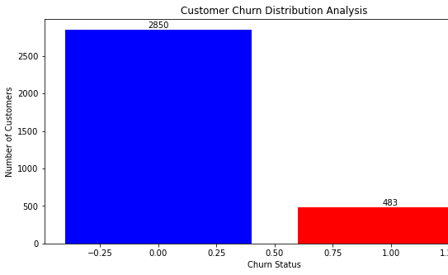
Business and Data Understanding
Churn Distribution Analysis
2850 instances “not-churned “
483 instances “churned”
SyriaTel has a churn rate of 14.49%

Slide 4
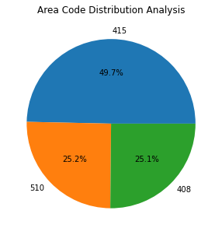
Business and Data Understanding
Area Code Distribution Analysis
49.7% of the customers are from 415 area code
25.2 % in area code 510
25.1% in area code 408

Slide 5
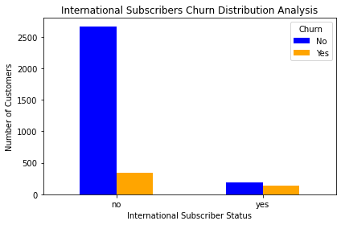
Business and Data Understanding
International Subscribers Churn Distribution
10.38% subscribers have an international plan
39.56% of international plans subscribers terminated the service

Slide 6
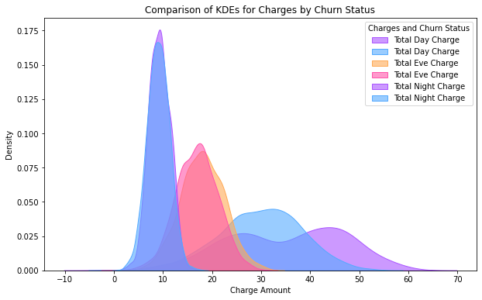
Business and Data Understanding
Churn Rates and Telephone Charges by Time of Day
Day Usage Churn
Churned customers have two distinctive peaks indicating different customer behavior within the subset
Evening Usage Churn
Non-churned extends tail to the right, higher total evening charge for some non-churned customers.
Night Usage Churn
High degree of overlapping, feature is not distinguishing churn and not-churn

Slide 7
Modeling Evaluation: Analysis of models’ performances
Precision: Random Forest (0.88), lowest rate of false churn(positives).
Recall: KNN (0.41) highest rate of true positives/churn
F1 Score: KNN and Decision Tree (0.51 overall performance.
Accuracy: Random Forest (0.90), overall correctness of the predictions.
AUC Score: Logistic Regression (0.7453), ability to distinguish between churn and not-churn
Model Comparison
Model | Precision | Recall | F1 Score | Accuracy | AUC Score
Logistic Regression | 0.56 | 0.17 | 0.26 | 0.86 | 0.7453
KNN | 0.70 | 0.41 | 0.51 | 0.89 | 0.6882
Decision Tree | 0.75 | 0.39 | 0.51 | 0.858 | 0.6847
Random Forest | 0.88 | 0.31 | 0.46 | 0.90 | 0.6538

Slide 8
Modeling Evaluation: Analysis of models’ performances ode
Confusion Matrices Model Performance
Model | True Negatives (TN) | False Positives (FP) | False Negatives (FN) | True Positives (TP)
Logistic Regression | 838 | 19 | 119 | 24
KNN | 832 | 25 | 85 | 58
Decision Tree | 838 | 19 | 87 | 56
Random Forest | 851 | 6 | 98 | 45
KNN
highest TP accurately predict churn
lowest FN where the model incorrectly predicts 'No Churn', but customer churns.
Random Forest
highest TN predicts 'No Churn
lowest FP, predicts 'Churn' but customer does not churn

Slide 9
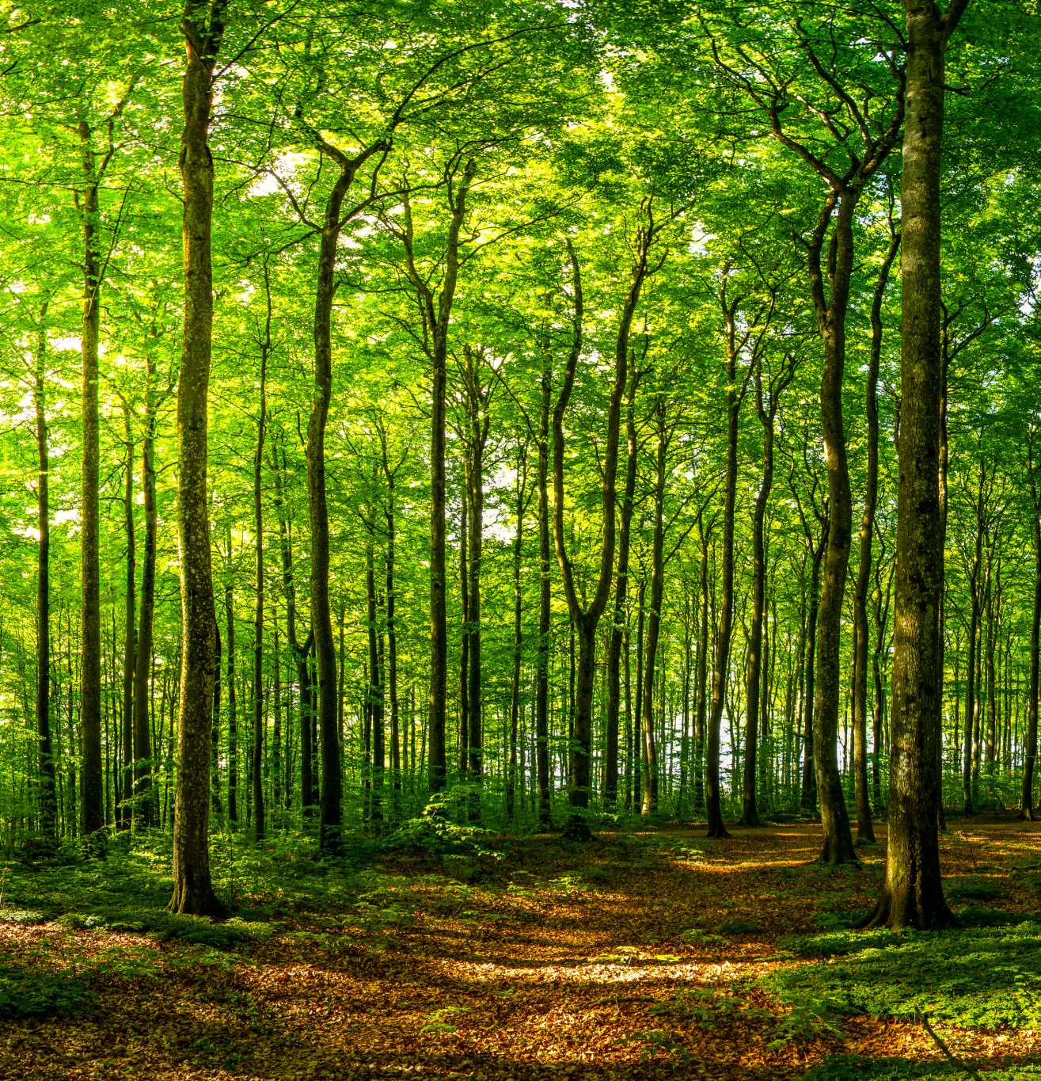
Modeling Model Selection and Tuning
Random Forest selected because
It achieved a high recall, the highest precision, F1 score, and accuracy scores among the models evaluated.
The ability to handle highly-correlated variables
Easy to evaluate variable importance or contribution to model
Reduce risk of overfitting compared to other models
Hyperparameter Tuning
GridSearchCV: to obtain the best parameters for the model

Slide 10
Modeling Evaluation: Model Improvement Analysis
Metric | rf | model_rf | Difference %
Precision | 0.88 | 0.80 | -9.09%
Recall | 0.31 | 0.49 | +58.06%
F1-score | 0.46 | 0.61 | +32.61%
Accuracy | 90% | 91% | +1.11%
AUC Score | 0.65 | 0.73 | +12.31%
Precision.
model_rf shows a decrease in precision by 9.09%
higher tendency to classify not-churn(negatives) cases as churn(positives)
Recall
model_rf is 58.06% higher than rf
better at identifying actual positive cases overall.
F1-Score
32.61% improvement
more robust in balancing between missing churns and maintaining accuracy in those predictions.
Accuracy
1.11% improvement
makes correct predictions on a slightly higher percentage of the total dataset
AUC Score
12.31%, improvement
enhanced predictive performance.

Slide 11
Modeling Evaluation: Model Improvement Analysis
Model | True Negatives (TN) | False Positives (FP) | False Negatives (FN) | True Positives (TP)
rf | 851 | 6 | 98 | 45
model_rf | 839 | 18 | 73 | 70
TN are slightly lower at 839, drop in correctly identifying not-churn.
FP increase to 18, model is more aggressive in predicting churn but with associated errors
FN are reduced to 73, indicating better performance in catching positive cases compared to rf.
Significantly higher TP at 70, suggesting better effectiveness at identifying churn.

Slide 12
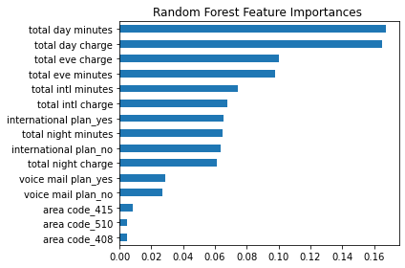
Analysis of the feature importances
Daytime usage
Total Day Minutes( 0.167243), Total Day Charge(0.164814)
Daytime usage is highest predictor of churn
Day rate = 0.17
Evening time usage
Total Evening Charge(0.100384), Total Evening Minutes (0.097512 )
Eve rate= 0.085
International usage and plan
Total International Minutes (0.074507), Total International Charge (0.067571)
International Plan: Yes (0.065110), No (0.063774)
International rate= 0.27

Slide 13

Predictive Recommendations
Concentrated Usage Analysis
Accurate and meticulous data collection for usage analysis
Employ detailed analysis of usage patterns, including rate structure for different times of day.
Allocate resources to track and analyze high-risk customers and employ mitigation strategies to stem churn
Customer Segmentation
Utilize insights on plan types and usage patterns to segment customers
Allotment rate structure for international subscribers to curb churn
Invest in Subscription Analytics
Acquire dashboards to monitor high-importance features in real-time, allowing for proactive measures to prevent churn
Survey customers at the point of cancel
Utilize churn survey to gather data to understand why customers cancel their accounts.

Slide 14

Next Steps
Improve model predictive performance and accuracy
Utilize other ensemble techniques such as Adaboost
Conduct feature engineering: reveal hidden data or patterns in the dataset that are not immediately apparent
Create feature interactions
Binning of continuous variables

Slide 15

Questions
Thank You!
Email:DurrantDeon@gmail.com
LinkedIn: linkedin.com/in/dr-d-durrant

