Slide 1
Skin Disease Recognition with Image Processing,Neural Network an Raspberry Pi
By:
151805011 Dursun ERYILMAZ

Slide 2
Content
Introduction
Requirements
Dataset
Preprocessing
Model Train
Live Camera Test
Conclusion
Feature Works
Reference

Slide 3
Introduction
This project covers three type of skin disease recognition by using image processing and neural network. Supervised learning approach was used to train neural network. Dataset images used to create the neural network model were taken from the HAM10000 (Human Against Machine) image dataset. This Project aim to classify Melanocytic nevi, Melanoma, Benign keratosis. It is aimed to spend less processing power at the artificial neural network stage by creating a numerical data set with the information obtained from the form of the lesion.

Slide 4
Requirements
A computer with webcam and a python environment to satisfy project's requirements specified below is needed
Python 3.7
OpenCV 4.2
Keras 2 (Tensorflow backend)
Numpy
Pandas

Slide 5
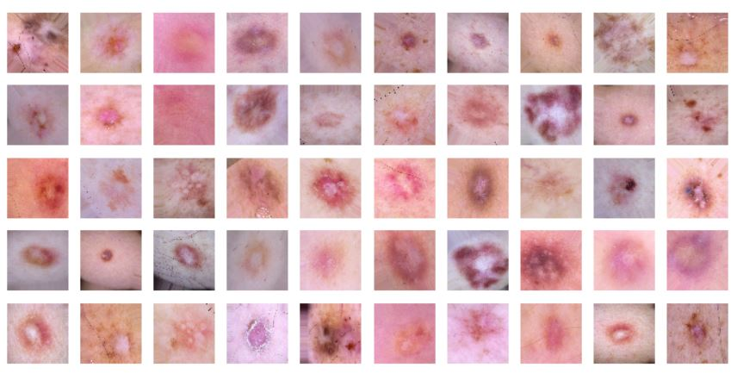
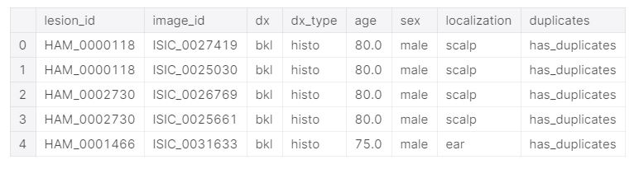
Dataset
Data set contains seven type of skin lesion.
These are classes: Melanocytic nevi, Melanoma, Benign keratosis, Basal cell carcinoma, Actinic Keratoses, Vascular, Dermatofibroma
I choose Melanocytic nevi, Melanoma, Benign keratosis
Fig. 5.2 – meta-data values of images in HAM10000 dataset
Fig 5.1 - Sample images from data set

Slide 6
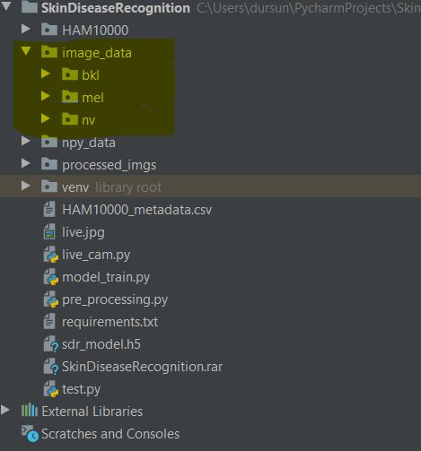
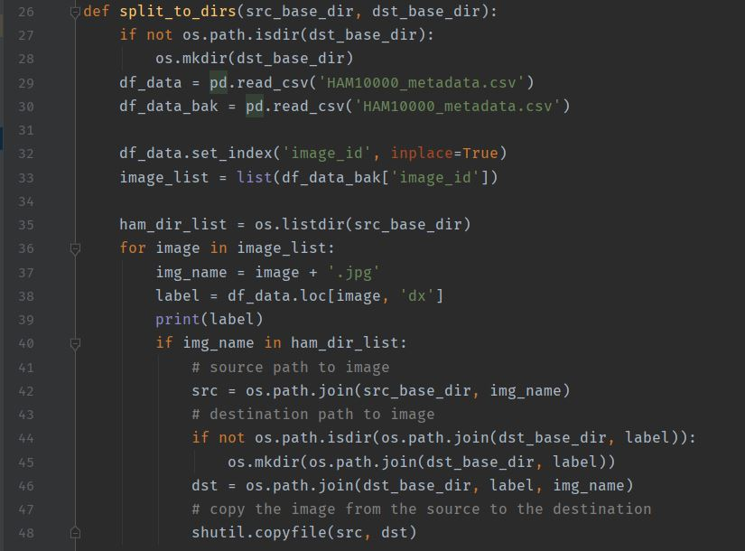
Preprocessing
All images were splitted into proper folders according to it’s classes, in a folder in project directory called ‘image_data’.
Fig. 6.1 – Directory view of splitted images
Fig. 6.2 – Split function

Slide 7
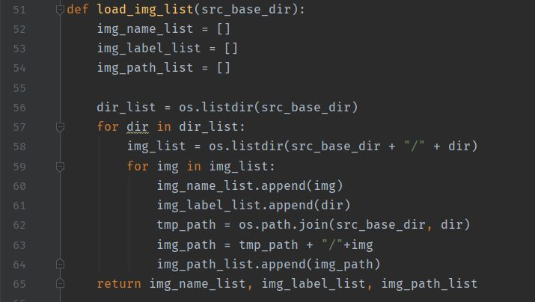
Preprocessing Cont.
Names, paths and labels of splitted images were loaded into lists
Fig. 7.1 Image name, path, label list loader function

Slide 8
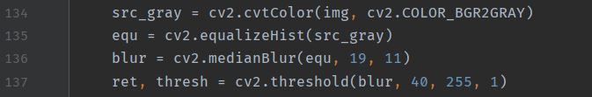
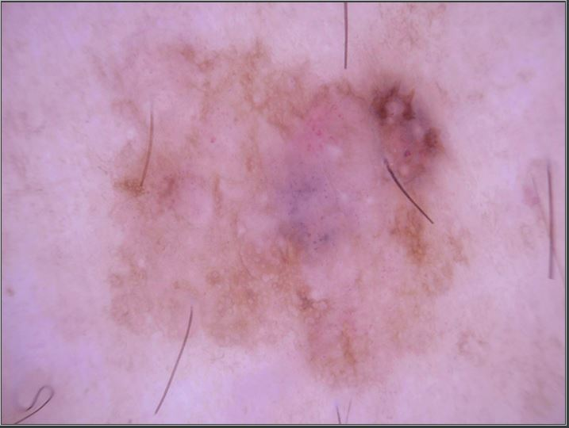
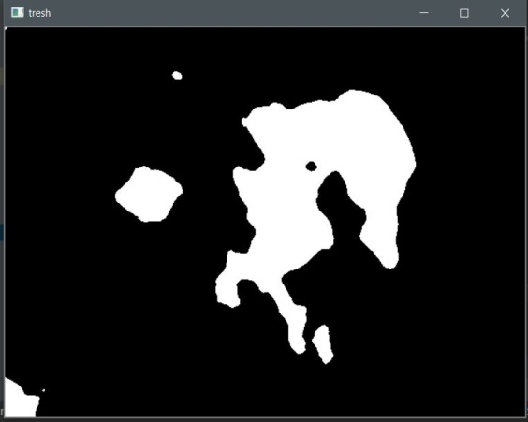
Preprocessing Cont.
To one image grayscale conversion, histogram equalization, median blur and thresholding were applied.
Fig. 8.1 Grayscale conversion, histogram equalization, median blur and thresholding implementation.
Fig. 8.2 Original image
Fig. 8.2 Processed image

Slide 9
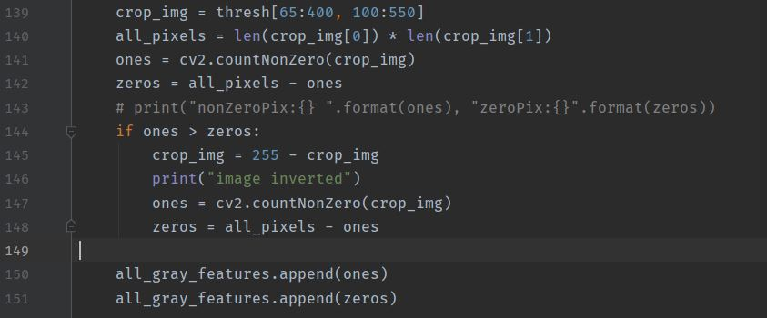
Preprocessing Cont.
Image cropped. Number of non-zero pixels and number of zero pixels counted. If number of nonzeros bigger than number of zeros then image inverted. Because lesion should nonzero and be in foreground.
Fig. 9.1 Image crop, count number of nonzero and zeros and inver t image if necessary.

Slide 10
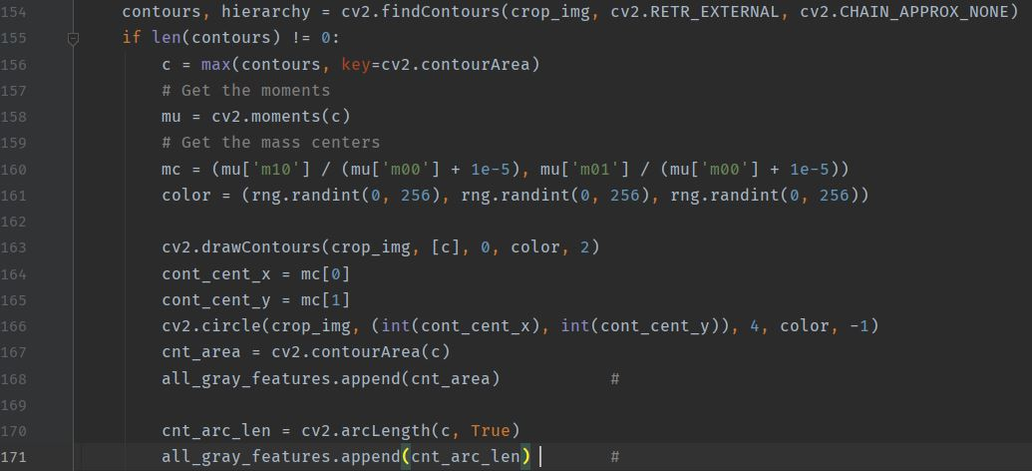
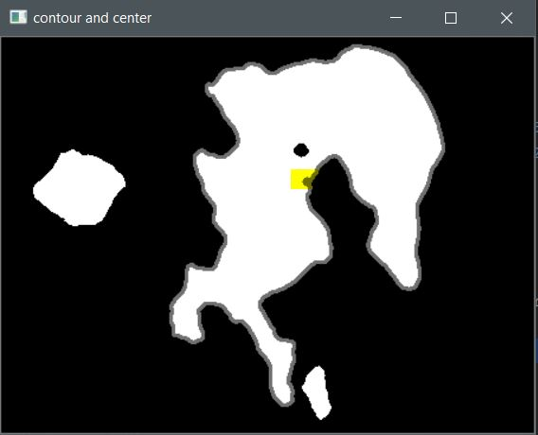
Preprocessing Cont.
Cropped image's contours calculated and biggest one selected. Center of contour, area and perimeter lengths found for selected contour.
Fig. 10.1 Get biggest contour and find center points, area, perimeter lenght.
Fig. 10.2 Founded contour perimeter and center point.

Slide 11
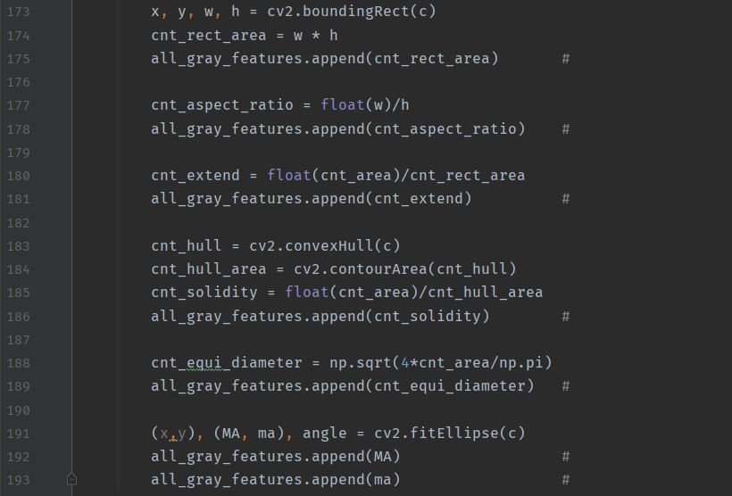
Preprocessing Cont.
Bounding rectangle area, aspect ratio, extend value, solidity value, diameter value, major length value and minor lenght value calculated and used as features.
Fig. 11.1 Feature calculations.

Slide 12
Preprocessing Cont.
Image resized as 7x5 px, and flattened to get array and use as feature vector.
Fig. 12.1 Resize image and flatten it.

Slide 13
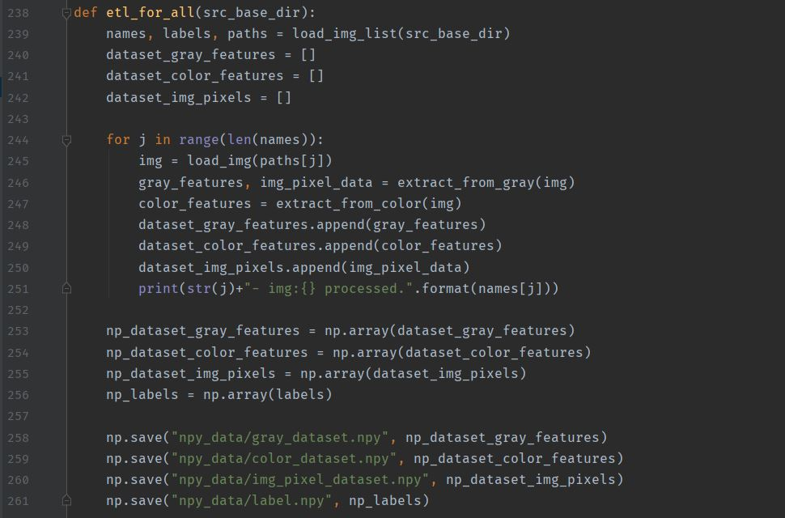
Preprocessing Cont.
Previous steps were applied to all images using below function. Identified features extracted and then saved as numpy files.
Fig. 13.1 Feature extraction function for all images.

Slide 14
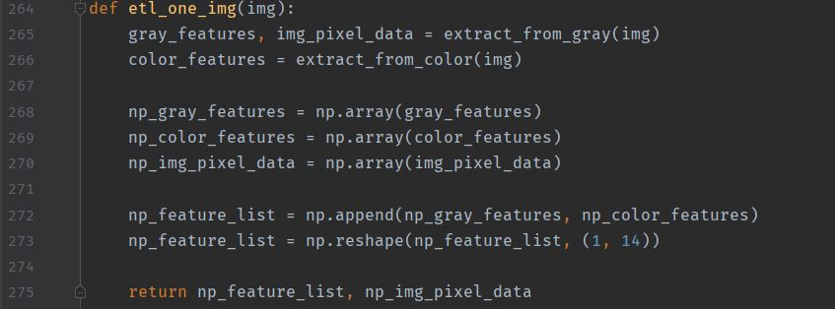
Preprocessing Cont.
Below steps applied one image. Identified features extracted to use model prediction step.
Fig. 14.1 Feature extraction for one image.

Slide 15
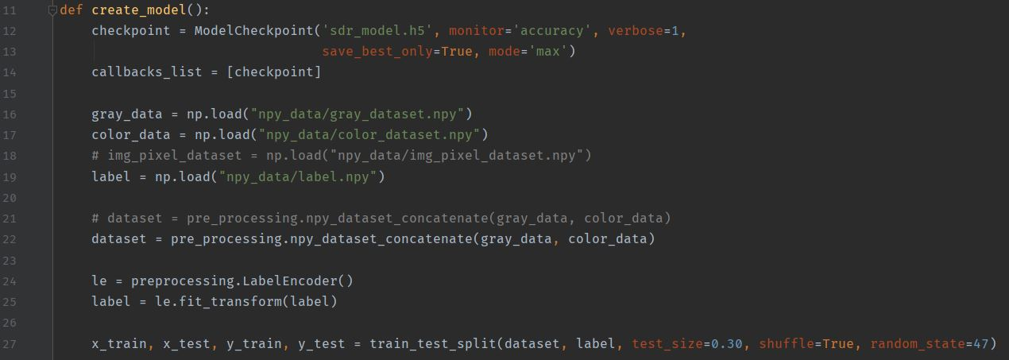
Model Train
Model checkpoint was created to save model at high accuracy. Saved numpy data files were loaded and splitted into train and test pieces.
Fig. 15.1 create_model function part-1.

Slide 16
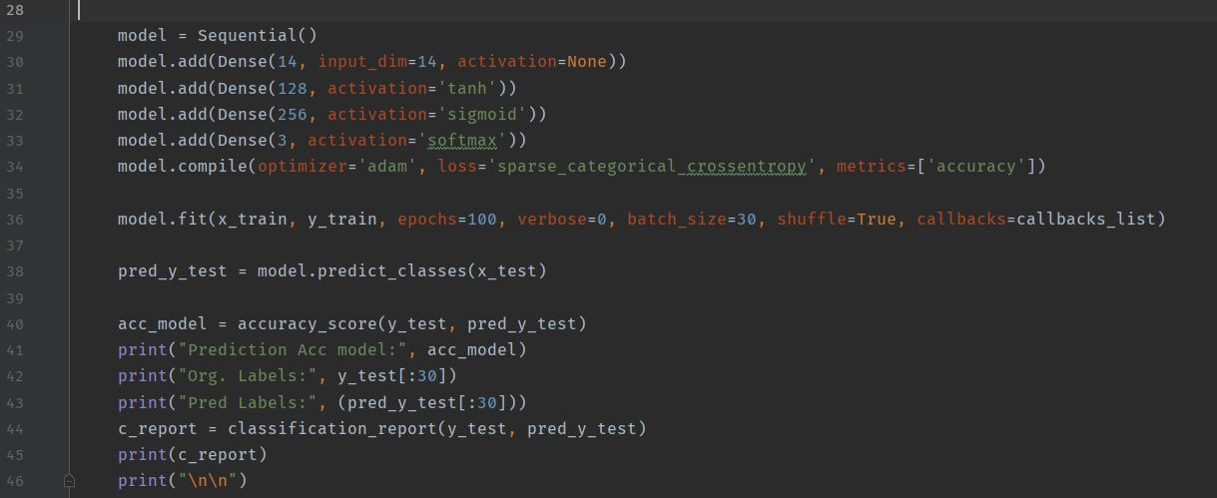
Model Train Cont.
Sequential model created, layers added, model compiled,train data fitted,test data predicted and result printted to screen with classification result.
Fig. 16.1 create_model function part-2

Slide 17
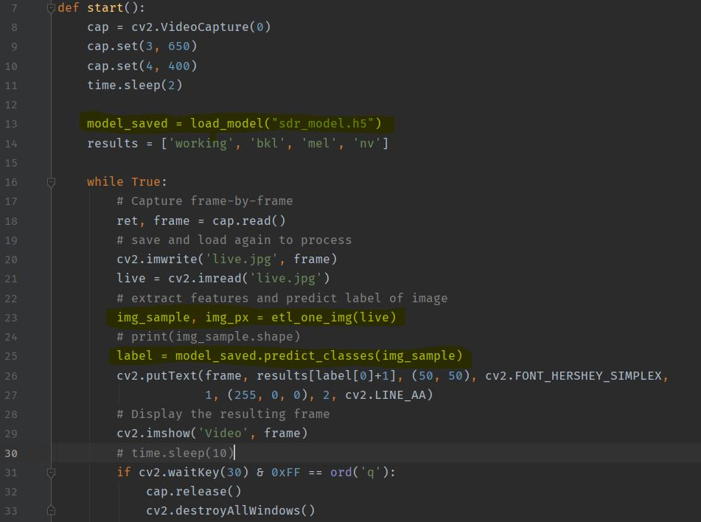
Live Camera Test
Saved model loaded, live frame captured from camera and saved to use. Saved frame processed by previous functions and predicted by loaded model and result showed to camera preview.
Fig. 17.1 Live camera test function.

Slide 18
Conclusion
Project can classify lesions 40% – 45% correctly.

Slide 19
Feature Works
This project can evolve a product with raspberry pi and a camera (module or USB).
In this situation raspberry pi can serve camera preview which includes classification result in a webserver using RPi Cam Web Interface to avoid using a screen to decrease cost.

Slide 20
Reference
https://dataverse.harvard.edu/dataset.xhtml?persistentId=doi:10.7910/DVN/DBW86T
https://www.kaggle.com/vbookshelf/skin-lesion-analyzer-tensorflow-js-web-app/execution
https://keras.io/api/
https://docs.opencv.org/4.3.0/d6/d00/tutorial_py_root.html https://www.kaggle.com/vbookshelf/skin-lesion-analyzer-tensorflow-js-web-app
https://www.semanticscholar.org/paper/Expert-System-For-Diagnosis-Of-Skin-Diseases-Amarathunga-Ellawala/44ea2264c70c2d631ef5f638179c0c44eff78078#paper-header
https://www.hindawi.com/journals/cmmm/2018/8145713/
https://www.analyticsvidhya.com/blog/2019/08/3-techniques-extract-features-from-image-data-machine-learning-python/
https://keras.io/getting_started/
https://docs.opencv.org/master/d1/d32/tutorial_py_contour_properties.html

