Slide 1

RESUME MAKER
QUICK AND EASY WAY TO CREATE RESUME
By Diptiba Jadeja - 19DCS041 Durva Banthia - 19DCS006 Khushi Chauhan - 19DCS017

Slide 2
Outline
Easiest way to create resume
Choose your field
Enter your details
download your resume PDF
Which will do such things:
Reduce your time
No neded to worry about design
Easy to use

Slide 3


Problem Statement
To Create a website which allows user to choose their fields which field they belong to.
Users have to Enter details which reqiured on their Resume. And finally they should be Download their Resume in PDF Format.

Slide 4



Software Requirements
Software Requirements
Xampp
Sublime Text Editor Google Chrome Canva

Slide 5
Scope
You can make good first impression in future by making
your resume attractive.
Many people are not good at designing so they can use resume maker and can get readymade resume.
For different field there are different resume format so one don't need to worry about your resume format and
field.

Slide 6

Defination
In our project, to create a resume user need to choose their relevant fields and user need to enter their data like personal information
,education ,experience, skills, project and award and then by clicking the submit button user gets their resume PDF . In this way, our projects works to provide resume easily.

Slide 7
Flow Chart
Home page
Engineering
Which
Management
Field
Medical
Engineering. php
Management. php
Medical.php

Slide 8




Reset
Reset
Engineering.php
Enter Data
Submit
Fatch Data from Engineering.php and save into database in php
Fatch Data from Database and make PDF
Resume in PDF format
using mpdf and php

Slide 9
Reset
Reset
Medical.php
Enter Data
Submit
Fatch Data from Medical.php and save into database in php
Fatch Data from Database and make PDF
Resume in PDF format
using mpdf and php

Slide 10
^{Reset} Management.php
Reset
Enter Data
Submit
Fatch Data from Management.php and save into database in php
Fatch Data from Database and make PDF
Resume in PDF format
using mpdf and php

Slide 11
Implementation Screenshots
Main page of Project

Slide 12
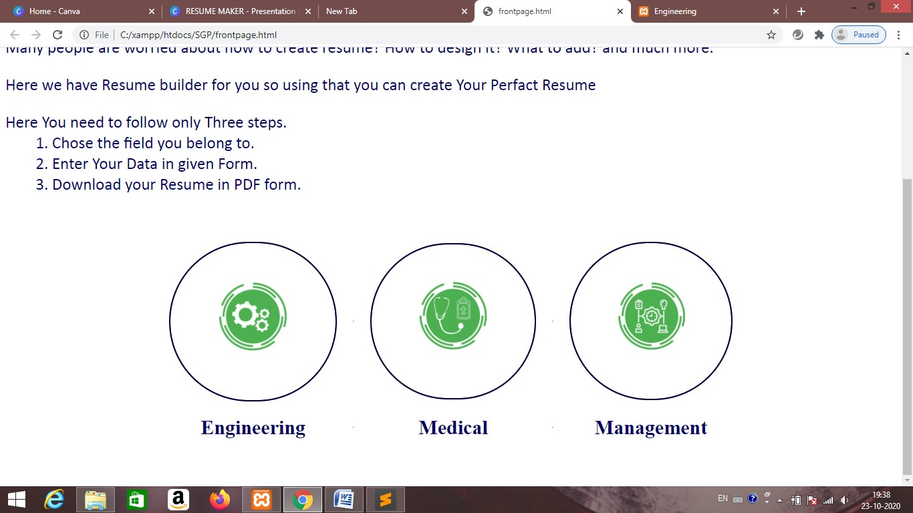
Implementation Screenshots

Slide 13
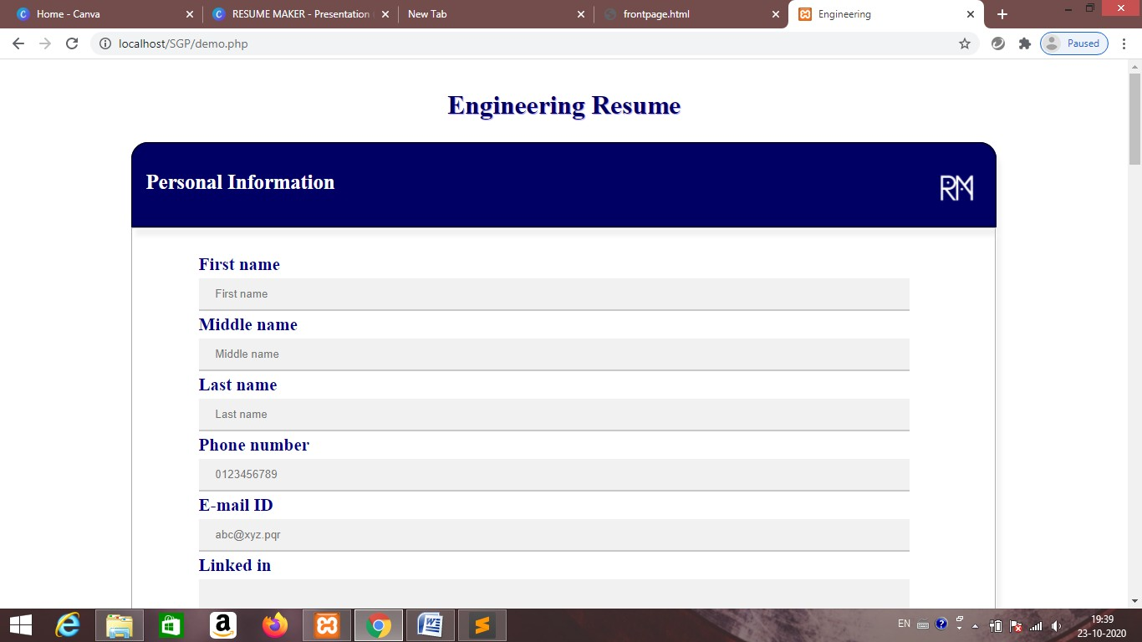
Implementation Screenshots

Slide 14
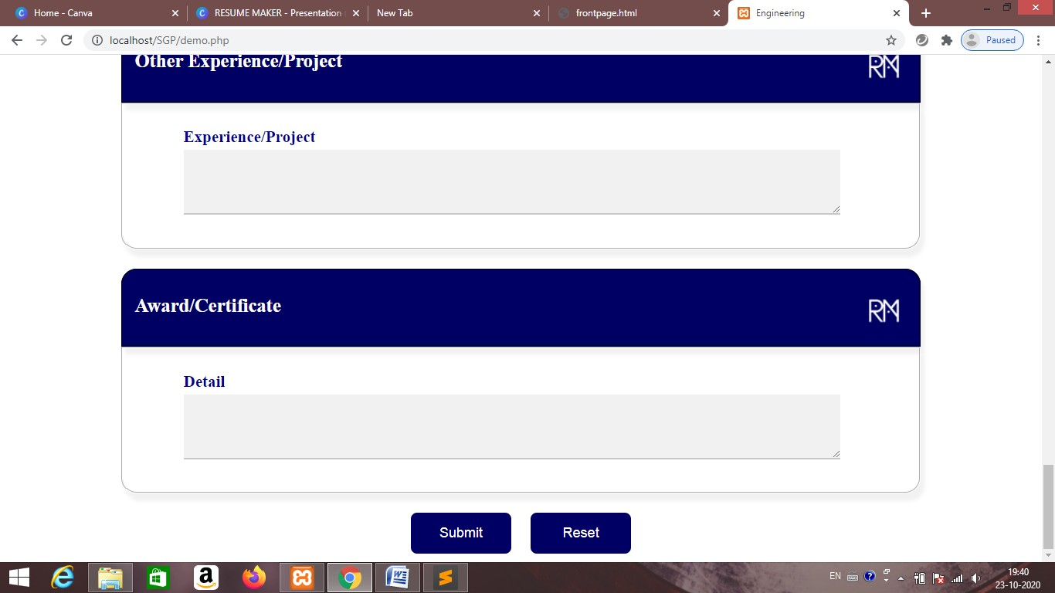
Implementation Screenshots

Slide 15
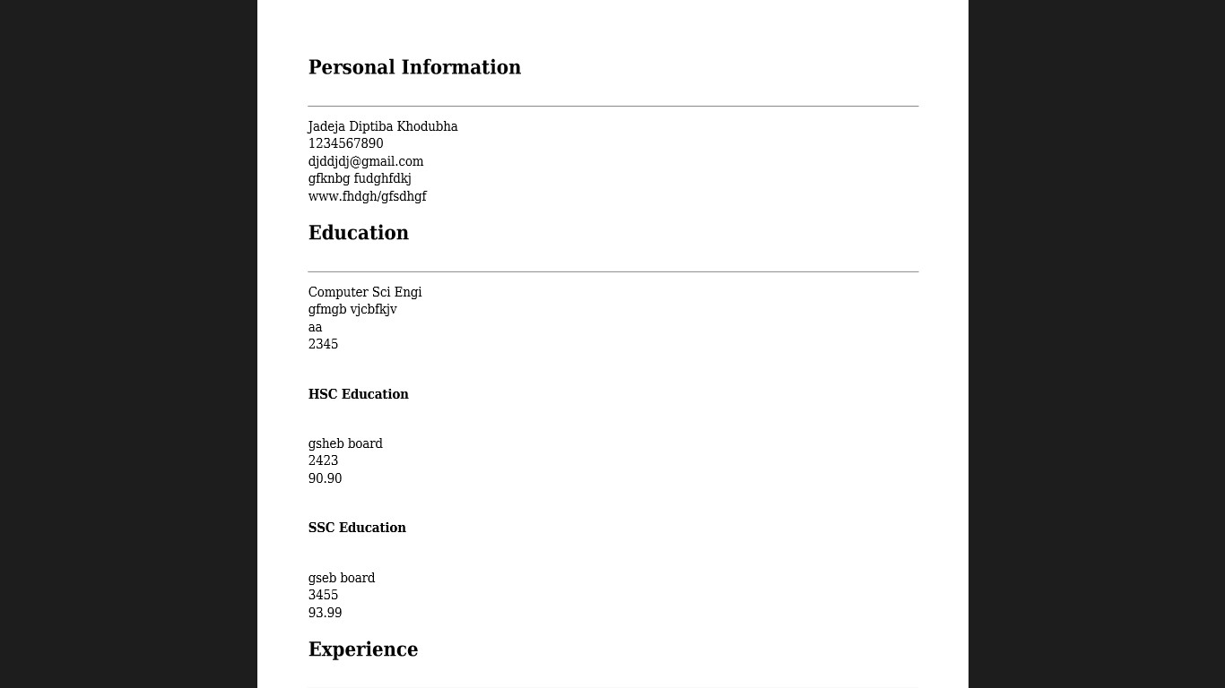
Implementation Screenshots

Slide 16
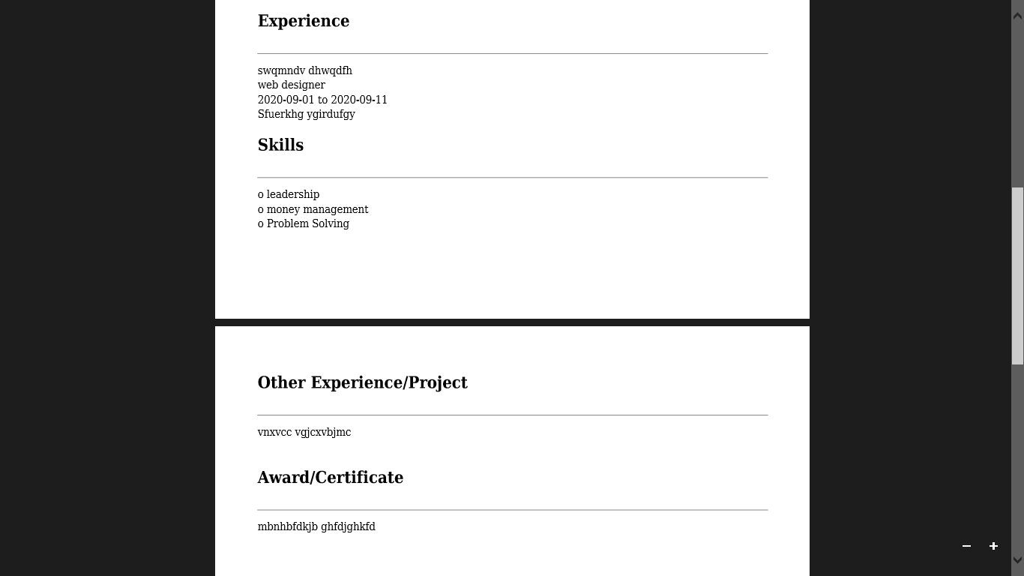
Implementation Screenshots

Slide 17

Limitations
In this system we haven't provided different format of resume yet
In this project we have not added fields other then Engineering, Medical and Management.

Slide 18
Furure Enhancement
In future,
we are thinking to provide different format option so user can choose their resume format.
we are thinking to provide different fields so user with different field can also use it.
we are thinking to provide better user interface so, user can work more efficiently.

Slide 19

Roles and responsibilities of every Project Member
Jadeja Diptiba Khodubha
Main Page Designing and coding, Logo Designing, Engineering From Designing and Coding, Database Management using PHP and MY SOL, class work in PHP to convert in PDF

Slide 20
Roles and responsibilities of every Project Member
Banthia Durva RavindraKumar
Mangement and Medical Resume form coding and Designing, Engineering final Resume Desiging using PHP work
Chauhan khushi HimmatBhai
Final Resume PHP work, PHP work for Management and Medical final Resume

Slide 21
Conclusion
By doing this project we tried to implement our knowledge to solve real- world problems. By doing this project learned about technical skill like database management and web designing etc. and soft skills like project management, team work, leadership etc under the guidence of faculties.

Slide 22
References
https://youtu.be/MnIps8Yc8CY https://www.w3schools.com/css/css_form.asp https://technosmarter.com/php/PHP-insert-data-in-database-and-display-in- table.html
https://smallbusiness.chron.com/transfer-data-form-database- 46976.html#:~:text=Moving%20information%20from%20an%20HTML,insert
%20it%20into%20the%20database https://youtu.be/2HVKizgcfjo https://youtu.be/jA1GO6g_Rw0

Slide 23
Thanking You

