Slide 1
Crowdsourcing 研究问题讨论
段雪野

Slide 2
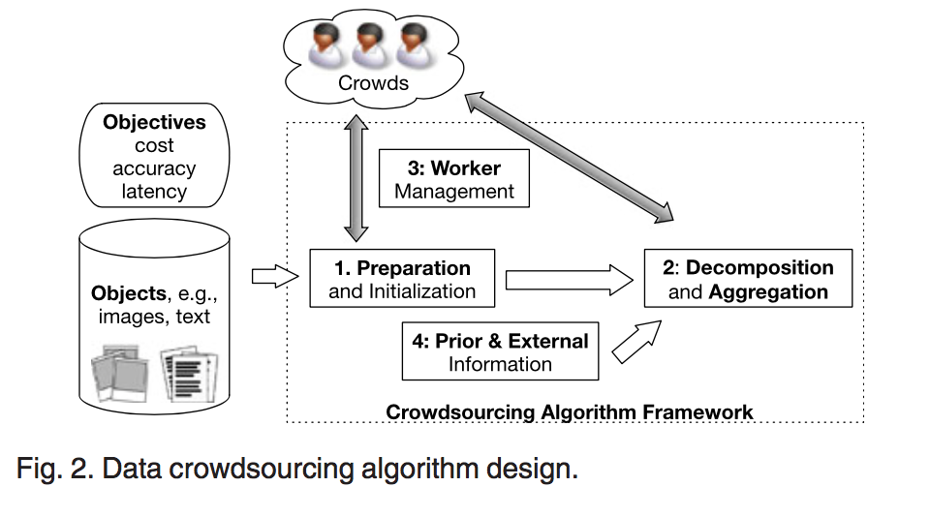
CHALLENGES IN DATA CROWDSOURCING (TKDE’16 April)
output
Data
Training set
Software
documents
money
Notes:
限制条件

Slide 3
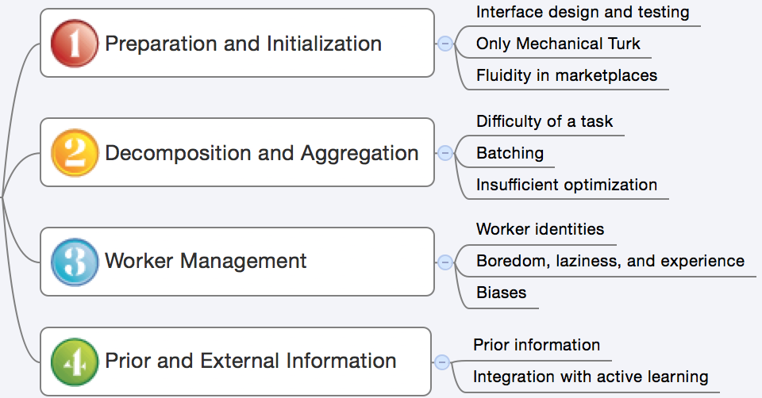
CHALLENGES IN DATA CROWDSOURCING (TKDE’16 April)
latency
Uncertainty
cost
Notes:
Accuracy --- uncertainty
Incentivization--经济激励
不容易开题
研究出来的结果是什么。
要从研究问题的角度，
不要从众包平台的角度来讲。
抓住几个点值得做的，有深度的点。
已有的工作。

Slide 4
Preparation and Initialization
Interface design and testing
Only Mechanical Turk
Fluidity in marketplaces

Slide 5
Interface design and testing
Industry users of crowdsourcing have called interface design a dark art
A lot more research is needed to understand the available interface choices and their impact on performance and accuracy
Notes:
心理学(玄学)
锚定效应(Anchoring effect)是指当人们需要对某个事件做定量估测时，会将某些特定数值作为起始值，起始值像锚一样制约着估测值

Slide 6
Only Mechanical Turk
“Designing crowdsourcing algorithms that are tailored for different platforms is an important direction for future work”
And some interface design may hardly be implemented on different platforms.
Notes:
算法对于平台的定制化
尽可能找general共性的问题有一定的矛盾

Slide 7
Fluidity in marketplaces
Studies have reported getting vastly different accuracies and latencies for their tasks if they deploy the tasks at different times during the day
Notes:
流动性比较大的影响了uncertainty
对于prior、 worker identify

Slide 8
Decomposition and Aggregation
Difficulty
Batching
Optimization

Slide 9
Difficulty
Empirical studies demonstrated how difficulty can affect error rates
Unfortunately for algorithm designers, the difficulty of a task and the ability of a worker are typically not known upfront

Slide 10
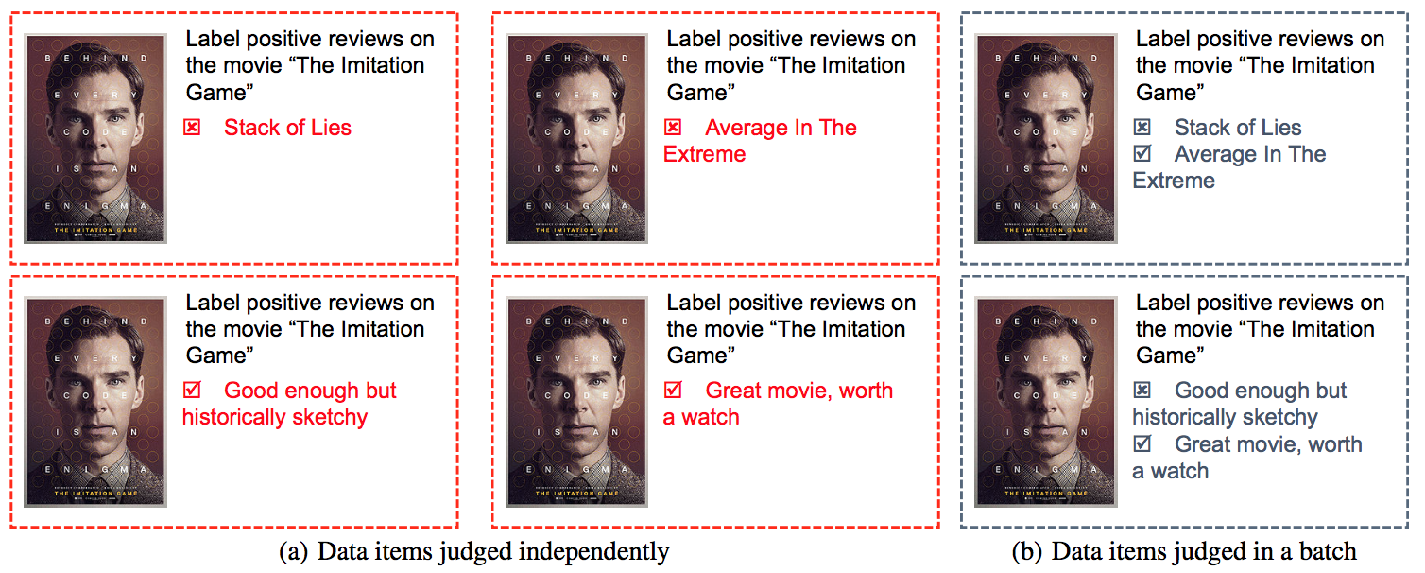
Batching
[KDD’15] Debiasing Crowdsourced Batches

Slide 11
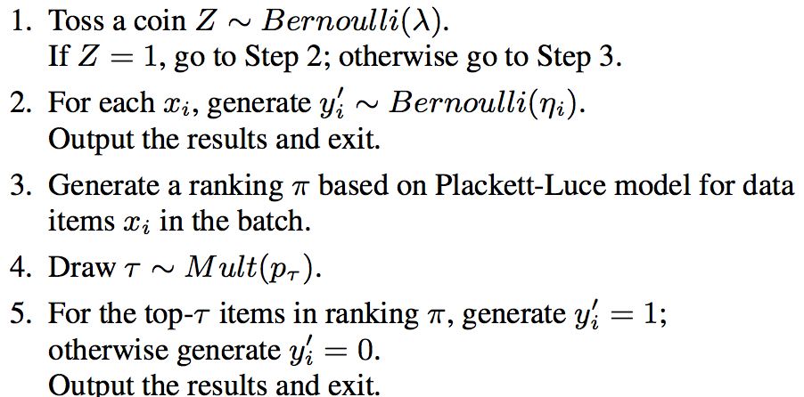
Batching
[KDD’15] Debiasing Crowdsourced Batches
Notes:
特异性很严重

Slide 12
Optimization
[IPSN’16] Recursive Ground Truth Estimator for Social Data Streams
Recursive Estimator
t(k-1) -> t(k)
Interpolative Estimator
Inside a time

Slide 13
Worker Management
Worker identities
Boredom, laziness, and experience
Biases

Slide 14
Worker identities
Workers have very different abilities, with different abilities and processing speeds for different types of tasks, and taking this into account can help us route tasks to appropriate workers
Notes:
行为识别

Slide 15
Boredom, laziness, and experience
Human workers will often avoid doing work if they can; they will “satisfice” by doing the least amount of work necessary
Collusion is very hard to detect automatically and correct for
Notes:
Collusion --为了控制成本

Slide 16
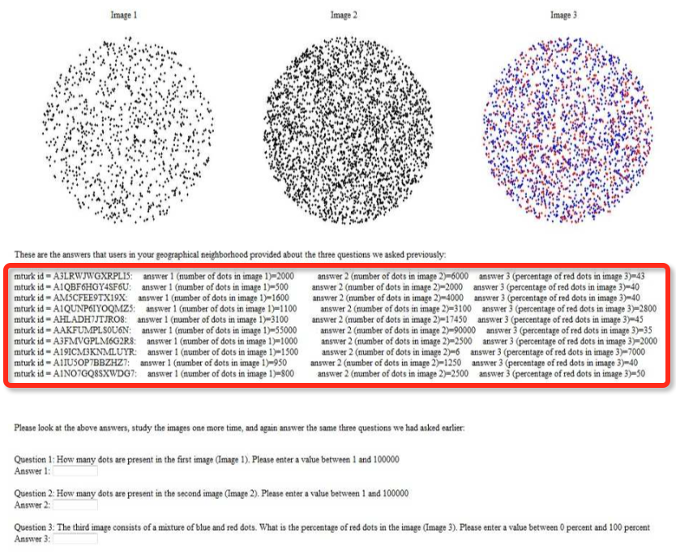

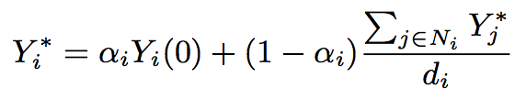
Biases
[KDD’13]Debiasing Social Wisdom
Notes:
设计比较巧妙
问题，只证明了选择和social network存在影响
难易程度有关—普通标注任务，可能根本不需要

Slide 17
Prior and External Information
Prior information
Integration with active learning

Slide 18
Prior information
Incorporating prior information into crowd results may be more powerful and may lead to more benefits.
疑惑点: 对于标注类任务，关于先验的矛盾?
混淆了requester与platform
Platform只关心requester是否接受worker的标注。 platform不能按照不同requester的设计，记录每个case的标注情况(T/F, domain, difficulty…)
Requester不易获取platform积累的worker的详细先验。
如何实施：Requester 与 platform 融合？Golden task?

Slide 19
Integration with active learning
[ICML’ 11] Active Learning from Crowds
Choose label sample
Multi-labeler scenario
Active learning in multi- labeler scenario
Without ground truth
Uncertainty sampling
Suitable annotators
more efficient
less costly
Notes:
1 如何uncertainty sampling 从而不适用迭代的方式
2 感觉更像是做分类任务的人，附带需要考虑的事情，还是以原问题的分类任务为主

Slide 20
DISCUSSION
用户识别(流动性)
目的: 通过行为判别用户所属类型。例: 提交频率过高是否为恶意用户
难点: 准确的Ground truth
优化、流动性
目的:构建General recursive estimator, 不仅用于truth discovery
历史特征信息与新数据特征信息
任务难度
目的:研究任务难度与错误率(任务完成情况的关系)关系
人工筛选明显难度上有差异的任务; 基于任务属性、文本相似度、参与以及完成情况将任务分类
Notes:
平台的视角

