Slide 1
TASK ASSIGNMENT SYSTEM WITH RELIABILITY

Slide 2
Outline
APPLICATION SCENARIO
TASK ASSIGNMENT SYSTEM WITH RELIABILITY
INFORMATION COMMUNICATION

Slide 3
APPLICATION SCENARIO
Crowdsourcing platform
10 questions for customer C1
One HIT of 2000 questions
Which 10 to be assigned
10 questions for customer C2
Customers who want to do the HIT
10 questions for customer C3

Slide 4
APPLICATION SCENARIO
System
Online assignment strategies
Uncertainty of a question
Requester
Optimal training data on labeling algorithms (classifiers)

Slide 5
TASK ASSIGNMENT SYSTEM WITH RELIABILITY
Challenges of Online assignment strategies
No ground truth
Unknown about worker’s quality
Scalability for different tasks
Efficiency
Collusion is very hard to detect automatically and correct for

Slide 6
TASK ASSIGNMENT SYSTEM WITH RELIABILITY
Related work
System
AskIt[ICDE’12]: entropy-like method, most uncertain questions
CDAS[PVLDB’12]: adopts a quality-sensitive answering model to measure the confidence of questions’ current results
QASCA[SIGMOD’15]: using accuracy metric or F-score metric to guarantee the quality of the result of each question. Worker specific probability; did not mention the uncertainty.
Requester
Active learning[ICML’ 11]

Slide 7
TASK ASSIGNMENT SYSTEM WITH RELIABILITY
QASCA workflow
Worker request a task
Task has a current distribution matrix
Using worker probability and current distribution matrix to calculate estimated distribution matrix
Using the estimated matrix to choose top-K questions by estimated metric(accuracy or F-score)
Update worker probability and current distribution matrix after the worker submits the result

Slide 8
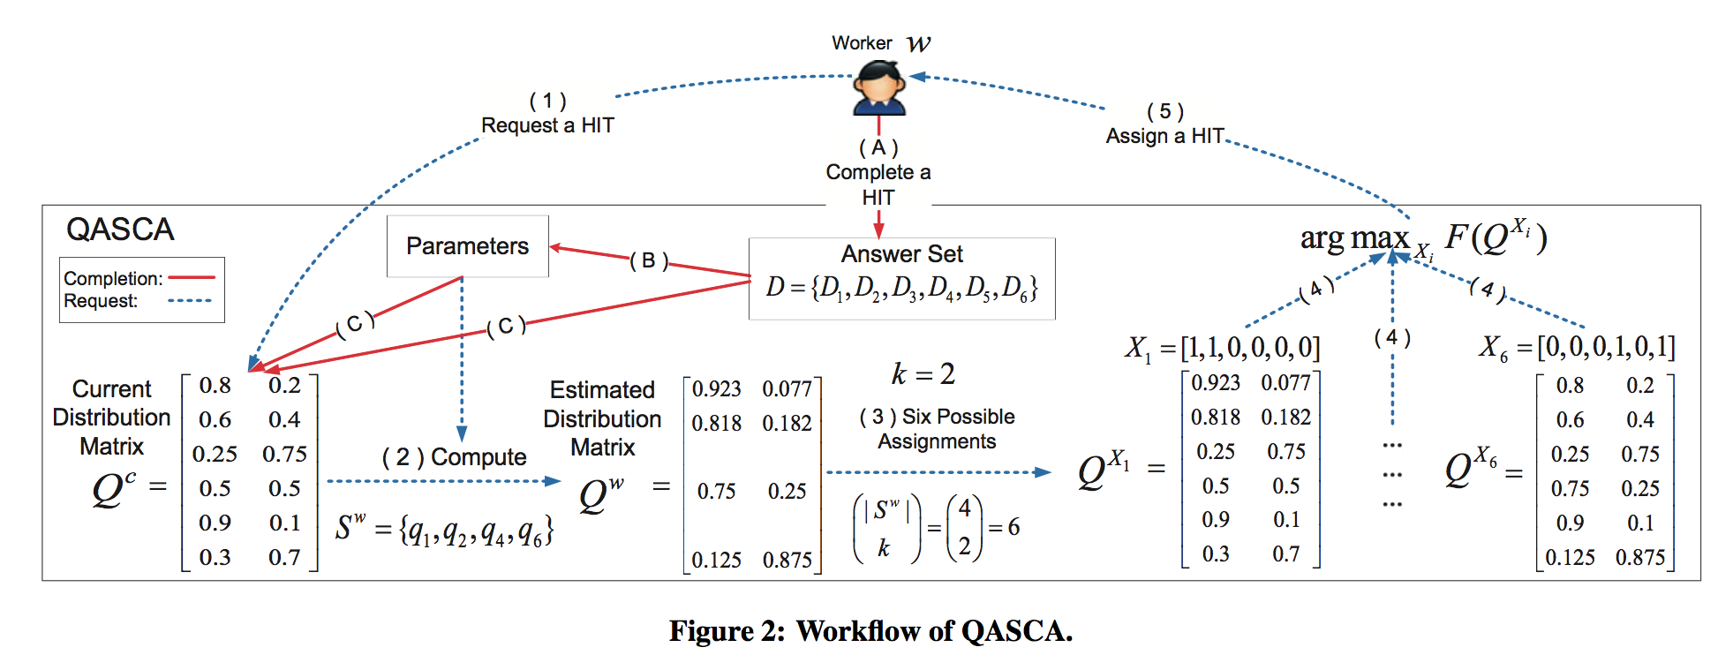
TASK ASSIGNMENT SYSTEM WITH RELIABILITY
QASCA

Slide 9
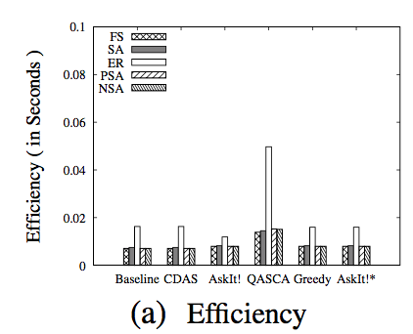
TASK ASSIGNMENT SYSTEM WITH RELIABILITY
Efficiency Problem

Slide 10
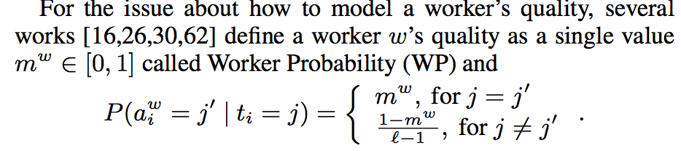
TASK ASSIGNMENT SYSTEM WITH RELIABILITY
Using worker probability

Slide 11
TASK ASSIGNMENT SYSTEM WITH RELIABILITY
Recursive Ground Truth Estimator for Social Data Streams[IPSN’16]
k-1
DATA
k
k+1
Treat the computed prior as an exact probability estimate in order to compute the belief inside the window
TIME
Computing Mean Reliability with Maximum a Posteriori Estimation

Slide 12
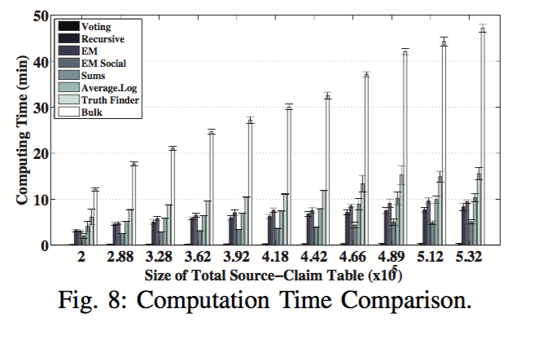
TASK ASSIGNMENT SYSTEM WITH RELIABILITY
Recursive Ground Truth Estimator for Social Data Streams

Slide 13
TASK ASSIGNMENT SYSTEM WITH RELIABILITY
Work to be done
Suitable Data
Derivation

Slide 14
INFORMATION COMMUNICATION
System
Unknown of ground truth
Unknown about the Reliability of Workers
Requester
Lack of Golden Task

Slide 15
INFORMATION COMMUNICATION
Why not help system and requester communicate information to each other?
For instance, requesters provide golden tasks to the system; system gives the requesters the reliability of a worker.
How to make it possible if no one has tried this?
No real data
Hard to change an existing system/platform

Slide 16
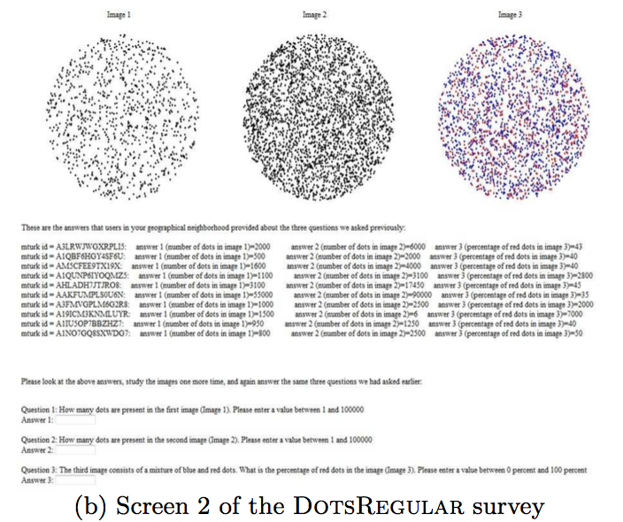
INFORMATION COMMUNICATION
Debiasing social wisdom[KDD’13] (social network of workers)

Slide 17
INFORMATION COMMUNICATION
Work to do
Prove the significance of information communication
Construct information communication alternation on existing state-of-art method, and make comparison about classification results.
Find suitable format of reliability
Easy to compute. For instance, [mean covariance capacity ]
More than a single value

Slide 18
INFORMATION COMMUNICATION
Format of reliability
From Truth Discovery to Trustworthy Opinion Discovery: An Uncertainty-Aware Quantitative Modeling Approach[KDD’16]
Treat reliability as probability density function
Towards Confidence in the Truth: A Bootstrapping based Truth Discovery Approach[KDD’16]
Treat reliability as confidence interval
We need more information from the reliability

