Slide 1

QASCA: A Quality-Aware Task Assignment System for Crowdsourcing Applications
SIGMOD’15

Slide 2
APPLICATION SCEN
APPLICATION SCENARIO
MOTIVATION
PROBLEM STATEMENT
EVALUATING QUALITY METRICS
DISTRIBUTION MATRICES
EXPERIMENTS
DISCUSSION

Slide 3
APPLICATION SCENARIO
Croudsourcing platform
10 questions for customer C1
HIT of 2000 questions
Which 10 to be assigned
10 questions for customer C2
Customers who want to do the HIT
10 questions for customer C3

Slide 4
MOTIVATION
Propose a novel task assignment framework and formalize the online task assignment problem
Generalize the definition of evaluation metrics

Slide 5
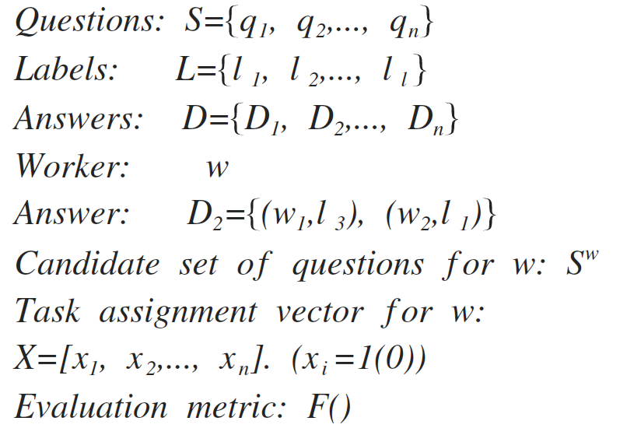
PROBLEM STATEMENT
The task assignment problem.

Slide 6
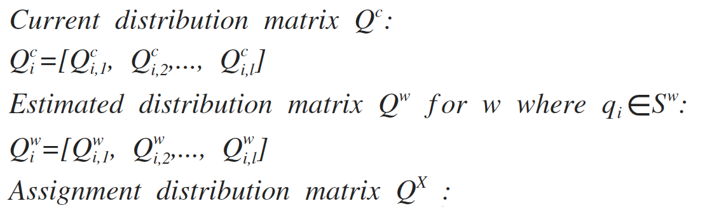
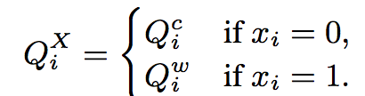
PROBLEM STATEMENT
The task assignment problem.

Slide 7
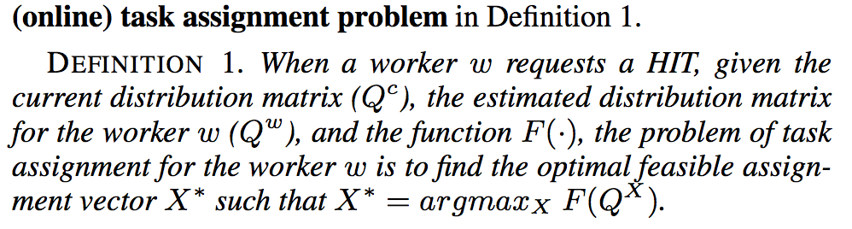
PROBLEM STATEMENT
The task assignment problem

Slide 8
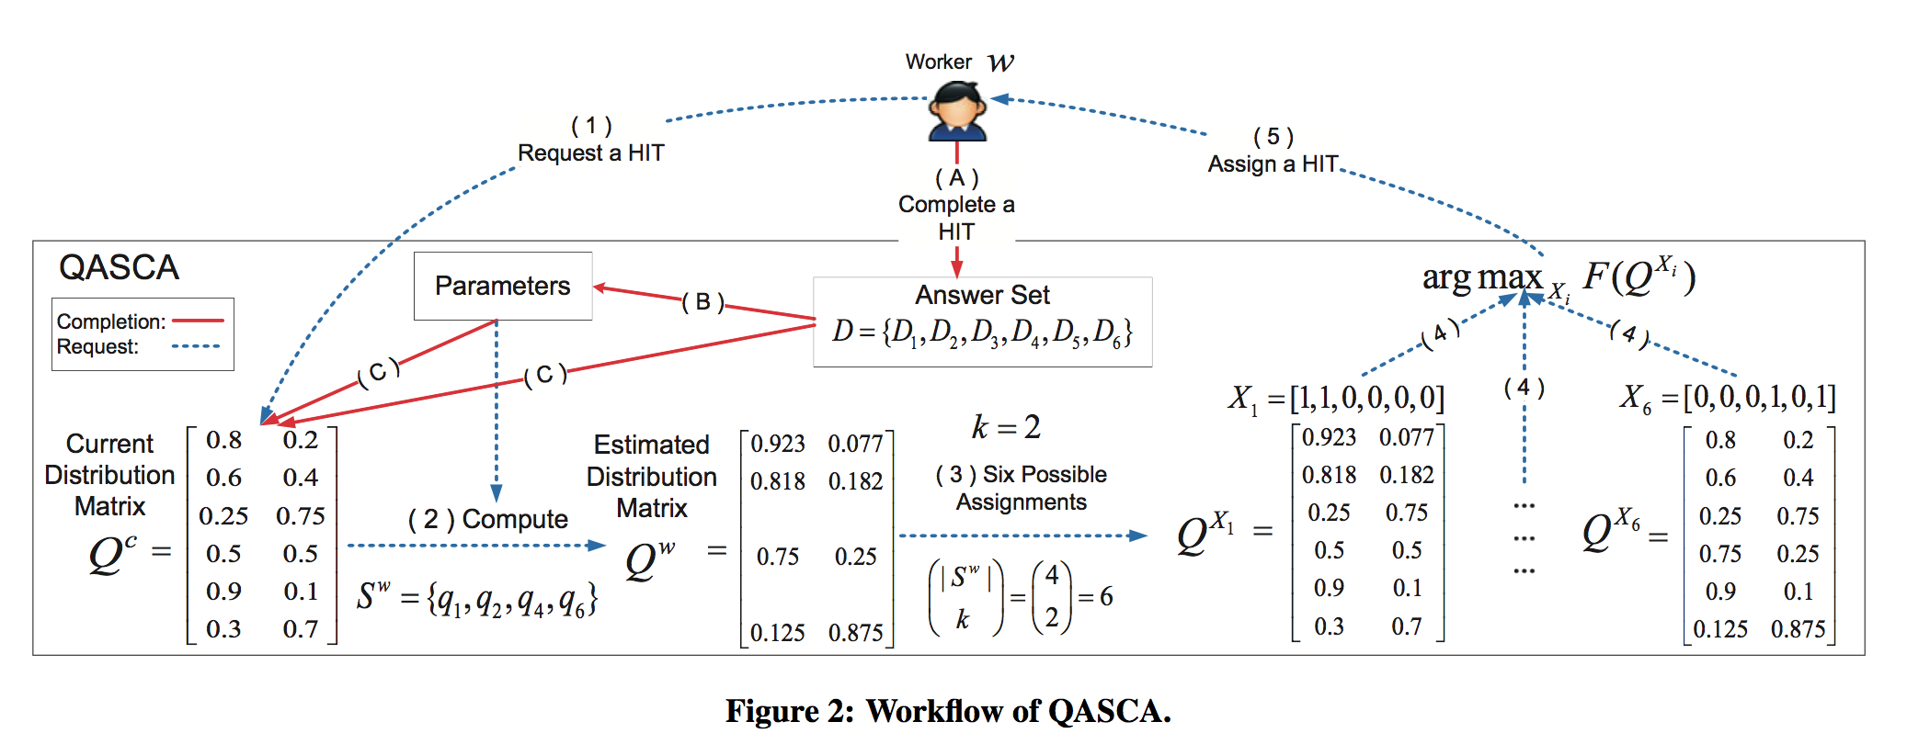
PROBLEM STATEMENT

Slide 9
EVALUATING QUALITY METRICS
Accuracy quality metrics
F-score quality metrics

Slide 10

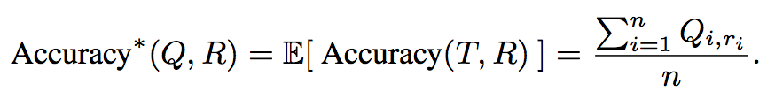
Accuracy

Slide 11
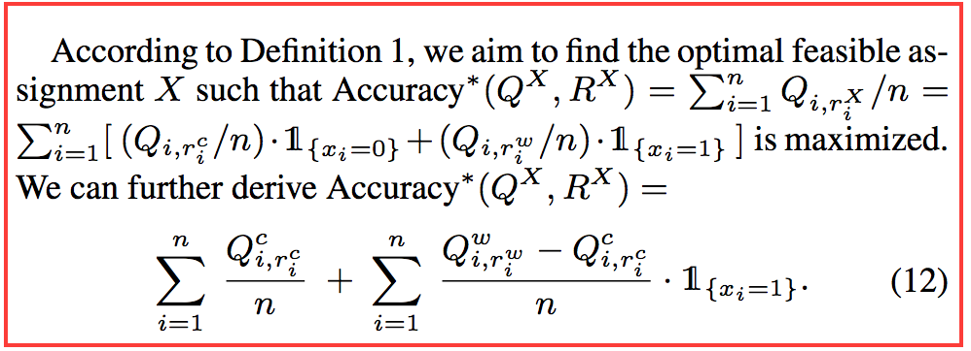
Accuracy
Online assignment algorithm

Slide 12
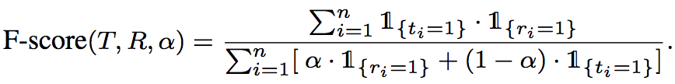
F-score
The optimal result for each question is not only dependent on the question’s distribution itself

Slide 13
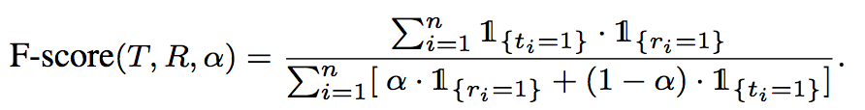

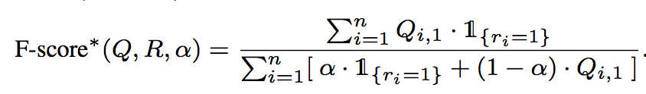
F-score
Approximate

Slide 14
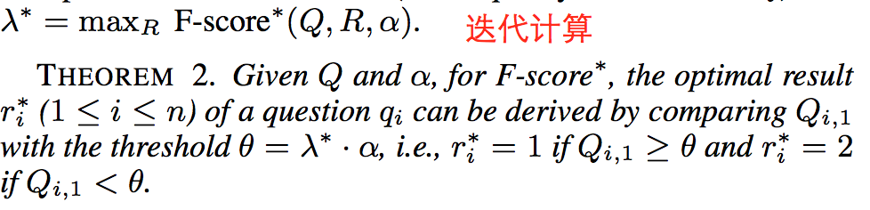
F-score
Optimal
Notes:
初始化λ，然后迭代

Slide 15
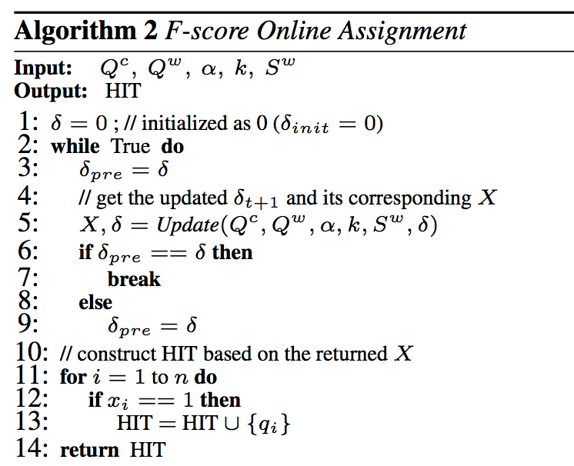
F-score
Online assignment algorithm

Slide 16
DISTRIBUTION MATRICES

Slide 17

DISTRIBUTION MATRICES
Current distribution matrix
Notes:
P(Di) nomalize

Slide 18
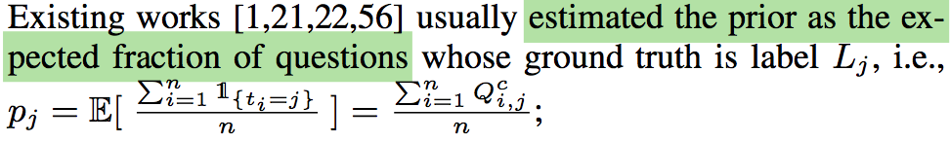

DISTRIBUTION MATRICES
Current distribution matrix
Notes:
每一个HIT一个这样的结论

Slide 19
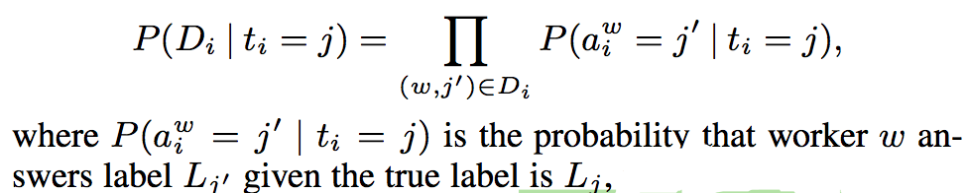
DISTRIBUTION MATRICES
Current distribution matrix

Slide 20
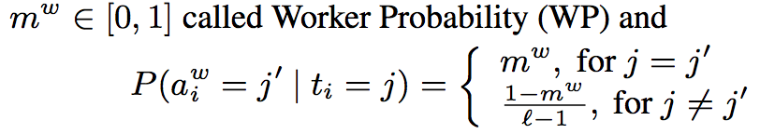
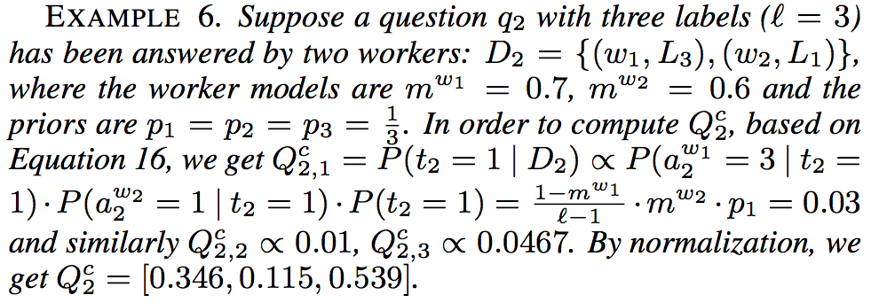
DISTRIBUTION MATRICES
Worker model
Notes:
基于其他人的答题，计算得到的D2

Slide 21
DISTRIBUTION MATRICES
Worker model
Notes:
基于其他人的答题，计算得到的D2

Slide 22
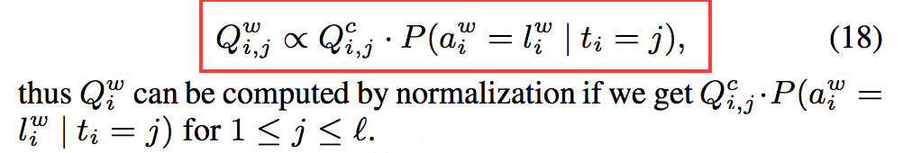
DISTRIBUTION MATRICES
Estimated distribution matrix
1. estimate the index of the label that worker w will answer. Sampling based on the probability distribution as below:
2.
Notes:
1. independent of D

Slide 23
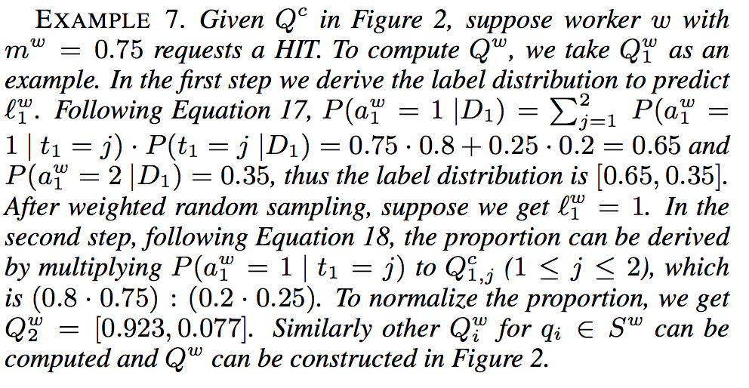
DISTRIBUTION MATRICES

Slide 24
EXPERIMENTS
Data
Films Poster (FS)
Sentiment Analysis (SA)
Entity Resolution (ER)
Positive Sentiment Analysis (PSA)
Negative Sentiment Analysis (NSA)

Slide 25
EXPERIMENTS
Baseline
Baseline: Random
CDAS: measure the confidence of questions’ current results
AskIt: entropy-like method, most uncertain questions
MaxMargin: the highest expected marginal improvement, disregarding the characteristics of the worker
ExpLoss: considering the expected loss

Slide 26
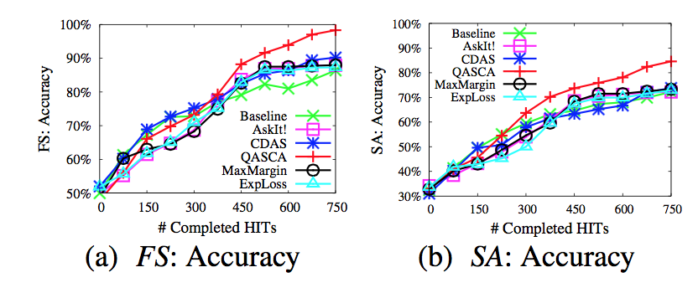
EXPERIMENTS
Notes:
纵坐标是quality

Slide 27
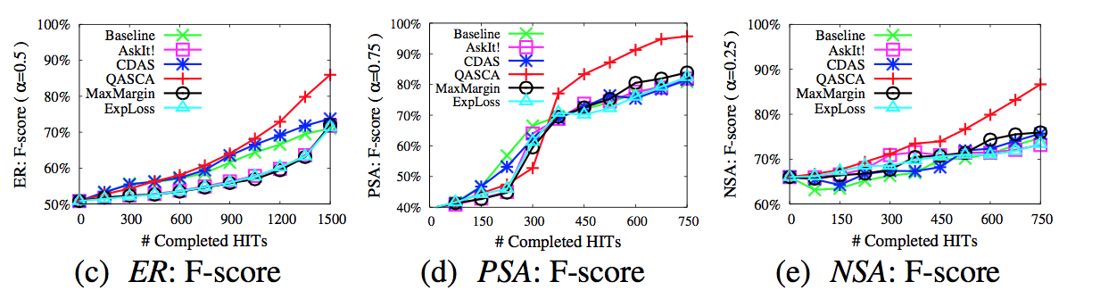
EXPERIMENTS

Slide 28
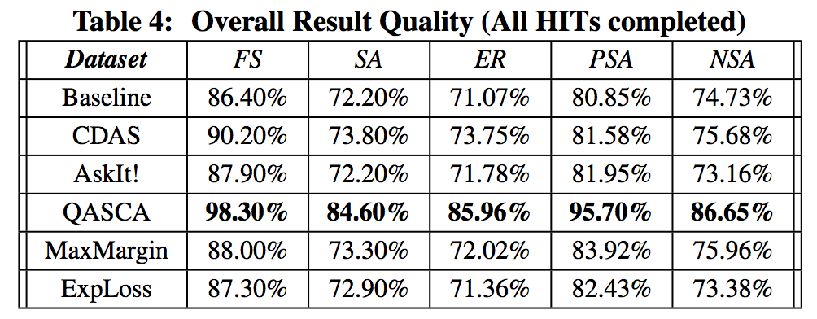
EXPERIMENTS

Slide 29
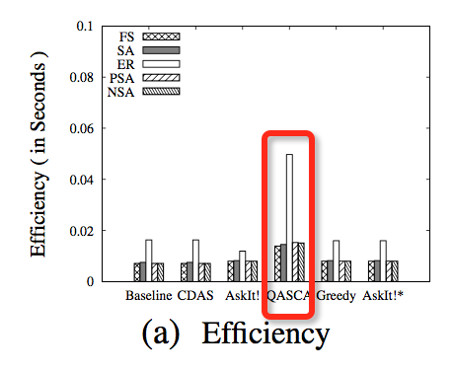
EXPERIMENTS

Slide 30

DISCUSSION
1. 从系统的角度看，在不知道label的ground truth情况下，完成了quality-aware task assignment
2. Worker的quality定义比较简单，支持其他worker model。例如之前讲的Recursive truth finder工作的reliability的计算
3. Feasibility of P(Di) 与
Notes:
1.accuracy metric, f-score metric 更general的评价指标来沟通system和requester
2.Qc很容易被影响，系统更趋近于选择服从大众选择

