Slide 1
Perception of Serbian Lexical Pitch Accents: Evidence from Native and Non-native Listeners’ Classification
Dušan Nikolić & Stephen Winters
University of Calgary

Slide 2
Previous Research
Dupoux et al. (2001, 2008) found that French listeners had difficulties when contrasting stress.
This was attributed to listeners’ inability to rely on word-prosodic units because French does not have lexical stress.
French listeners could not access phonological representations of stress, and thus they were stress insensitive.

Slide 3
Previous Research
Rahmani et al. (2015)
Stress sensitivity with:
Dutch
Japanese
Persian
French
Indonesian
lexical pitch accent
stress or pitch accent
Word-level prosodic unit
stress
N/A
N/A
French and Indonesian listeners were insensitive to stress contrasts.
Speakers of languages with no word-level prosodic category
…would be insensitive to any world-level prosodic contrasts.

Slide 4
Previous Research
Nikolic & Winters (2022)
English (non-native) and Serbian (native) listeners’ discrimination of Serbian lexical pitch accents
English listeners achieved the same accuracy on the task as Serbian listeners.
No insensitivity to lexical pitch accents as hypothesized by Rahmani et al. (2015).

Slide 5
Previous Research
Sequence Recall Task Problem
Listeners are already given category labels of the two contrasting items.
… They might be insensitive to these two categories and not to the word-level prosodic category
The task explores what is *not* there rather than what is
… It attempts to trigger insensitivity to a category

Slide 6
The Present Study
Our goal was to investigate what the perception of lexical pitch accents would be if there were no pre-existing category labels.
Modified version of the Free Classification Task (Imai & Gardner, 1965; Clopper, 2008; Atagi & Bent, 2016)
No pre-determined category labels
No pre-determined number of groups
Classifications based on similarity

Slide 7
RQ:
What are the differences in perception of lexical pitch accents between native (Serbian) and non-native (French) listeners?

Slide 8
Terminology
Perception = the way of hearing and processing stimuli
Lexical pitch accents = word-prosodic categories (stress, tones) that distinguish between the word meaning in languages such as Swedish, Japanese, Basque, and Serbian.

Slide 9
The Present Study
Free Classification Task:
Mainly used to explore (dis)similarities between regional varieties (Clopper & Pisoni, 2006; Clopper, 2008; Atagi & Bent, 2013; Bent et al., 2016)
Allows for the greater variation in the ‘perceptual space’
Data obtained is visualized by using Multidimensional scaling (MDS) and clustering analysis (Kruskal & Wish, 1978; Levshina, 2015)

Slide 10
Methodology
Stimuli
“rejav” [ˈrejav] and “kavan” [ˈkavan]
Patterned according to Serbian phonotactics
Produced in 4 Serbian lexical pitch accents
Lexical Pitch Accents
ToBI representation
Short- falling (SF)
H*L
Pitch movement
Vowel
Short-rising (SR)
L*H
Long-falling (LF)
(H*L)ː
Long-rising (LR)
(L*H)ː

Slide 11
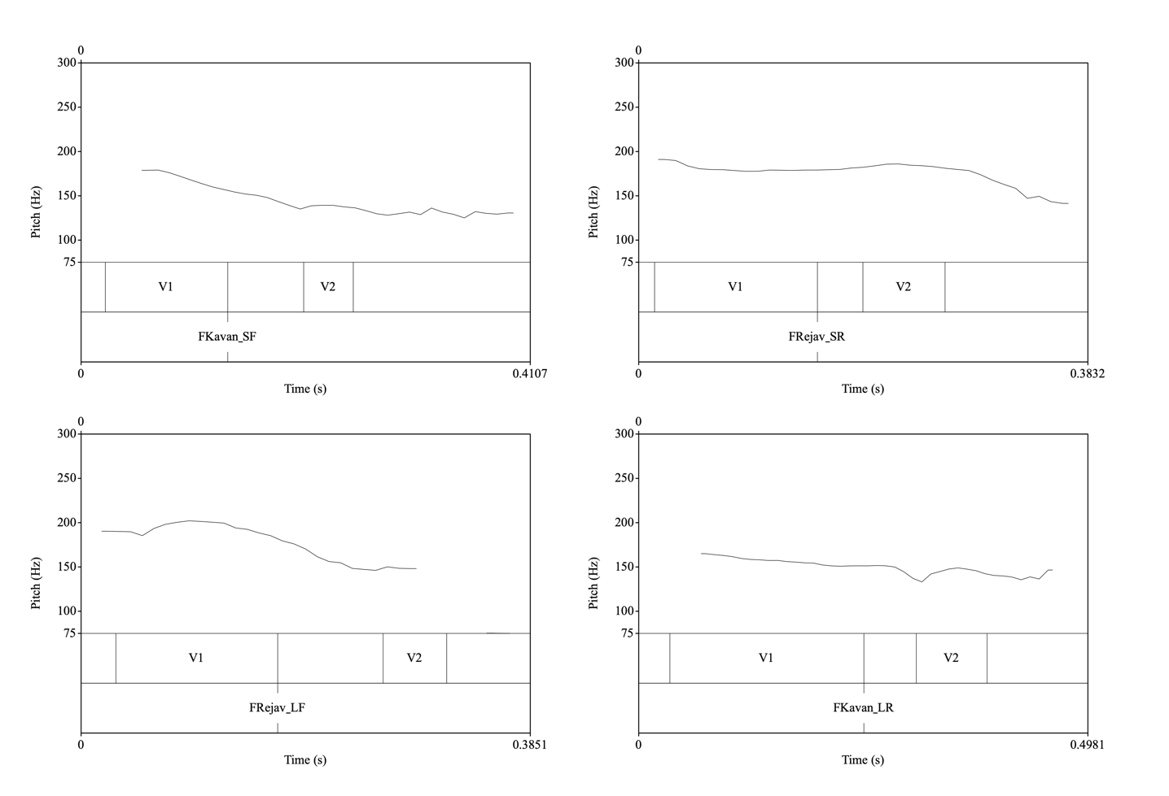
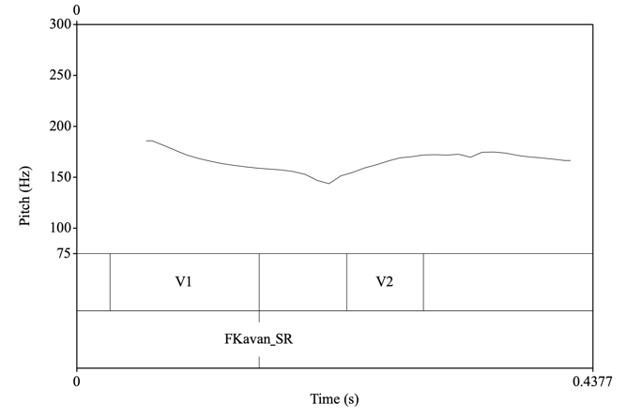

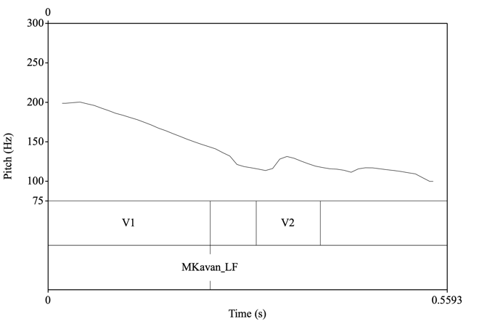
Methodology
Lexical Pitch Accents (Godjevac, 2005)
H*
L*
H
L
H*
L*
H
L
Notes:
I did not control for the difference in length between the male and female, because length is one of the important cues of lexical pitch accents.

Slide 12
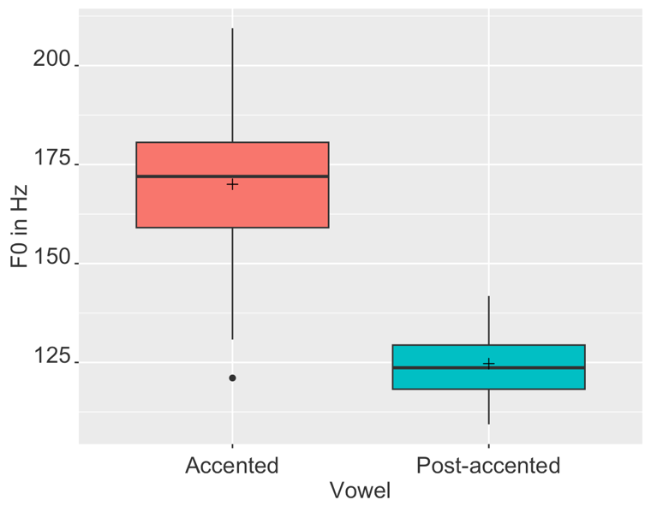
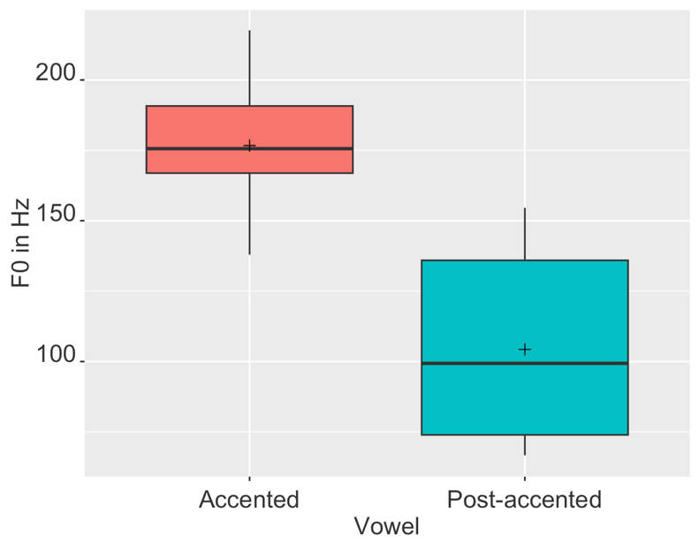
Lexical pitch accents - Falling
***
***
Male
Female

Slide 13
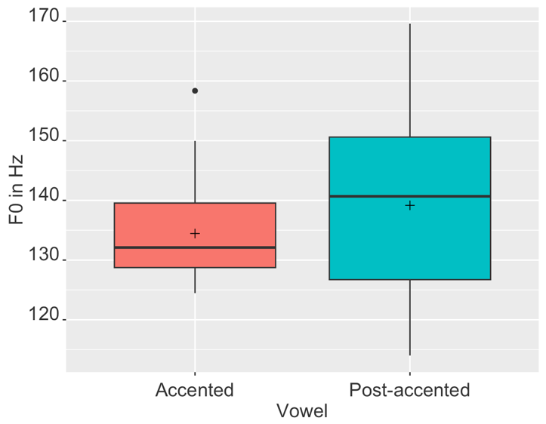
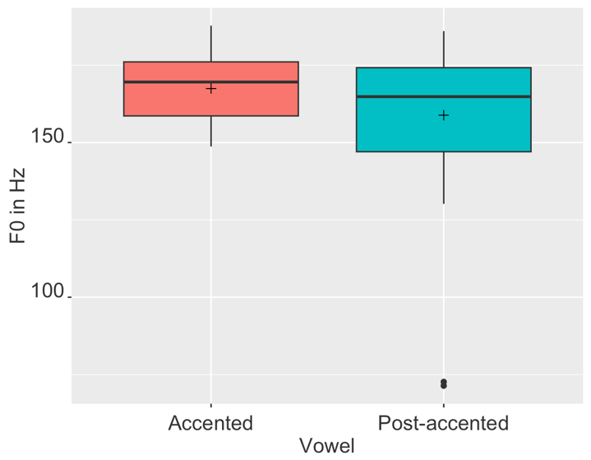
Lexical pitch accents - Rising
p = 0.82
p = 0.84
Male
Female
A slight rise or equal F0 between accented and post-accented vowels (Ivić & Lehiste, 1986)

Slide 14
Methodology
2 talkers
one female and one male talker
native speakers of Serbian
Participants
40 Serbian speakers (M_{age} = 23.2)
60 French speakers (M_{age} = 27.2)

Slide 15
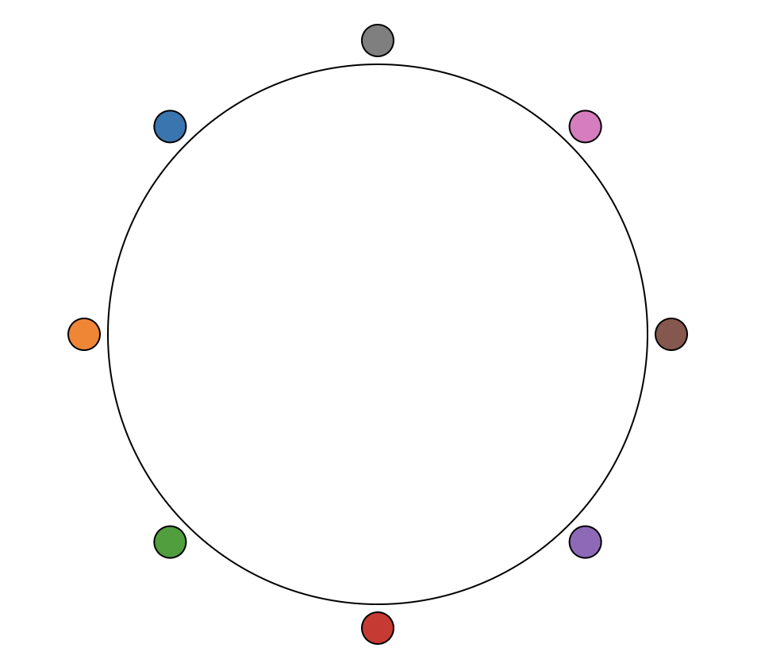
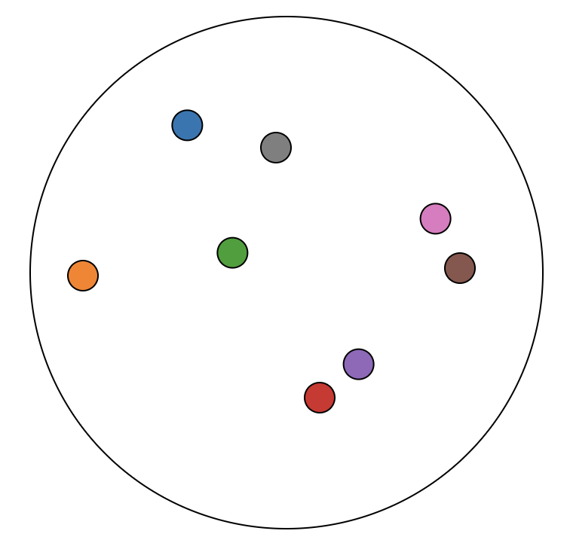
Methodology
Procedure
Online free classification
Cognition.run platform
Free Classification task based on toolbox built by Donhauser and Klein (2022)
Before
After
https://sjikenbl5u.cognition.run/

Slide 16
Methodology
Procedure
Listeners were instructed not to classify lexical pitch accents based on their gender (male/female) or item (”rejav”/”kavan”) similarity.
Male
“rejav”
Female
“kavan”

Slide 17
Methodology
Procedure
2 sets of items with 8 lexical pitch accents each
1st – Free classification I = FCI
2nd – Free classification II = FCII
Data analyzed by using the MDS and Hierarchical Clustering (Levshina, 2017) in RStudio.

Slide 18
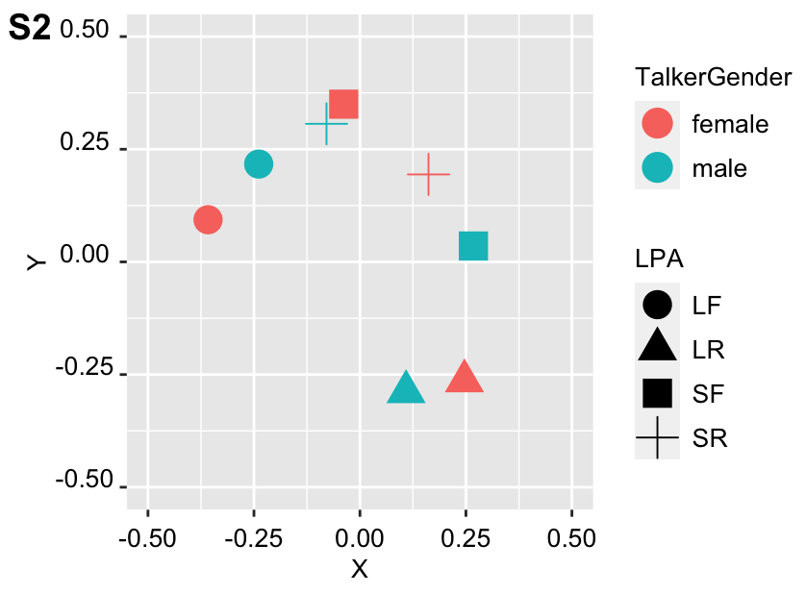
Methodology
Data collection
The Python script from Donhauser and Klein (2022) was used to convert the coordinates to similarity matrices
… by calculating Euclidean distances per listener. The most similar tokens had the value 1, while the most dissimilar tokens were 0.

Slide 19
Methodology
Multidimensional Scaling
= method that creates a visual representation of
distances or dissimilarities between sets of objects
 |  | 587 | 1212 | 701
 | 587 |  | 920 | 940
 | 1212 | 920 |  | 879
 | 701 | 940 | 879
City | Atlanta | Chic. | Denver | Hou.
Atlanta
Chicago
Denver
Houston
Chicago
Denver
Atlanta
How well does the configuration fit the data?
The answer is the stress value.
Houston

Slide 20
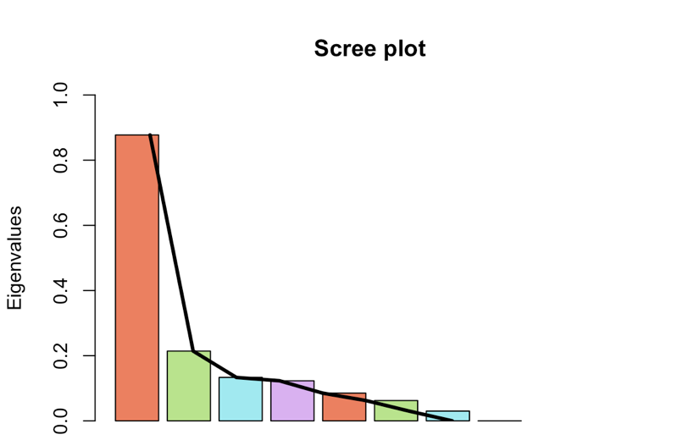
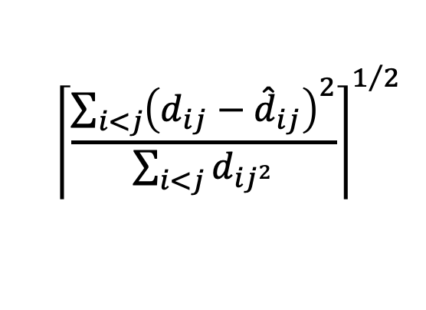
Methodology - MDS
Determine the # of dimensions
Calculate Stress
$${\left\lceil \frac{\sum_{i<j}{{\left(d_{ij}−{\hat{d}}_{ij}\right)}^{2}}}{\sum_{i<j}{d_{{ij}^{2}}}}\right\rceil }^{1/2}$$
0.2 ≤ Stress Poor
0.1 ≤ Stress < 0.2 Fair
0.05 ≤ Stress < 0.1 Good
Stress < 0.05 Excellent
”Elbow technique”
1 2 3
Number of dimensions

Slide 21
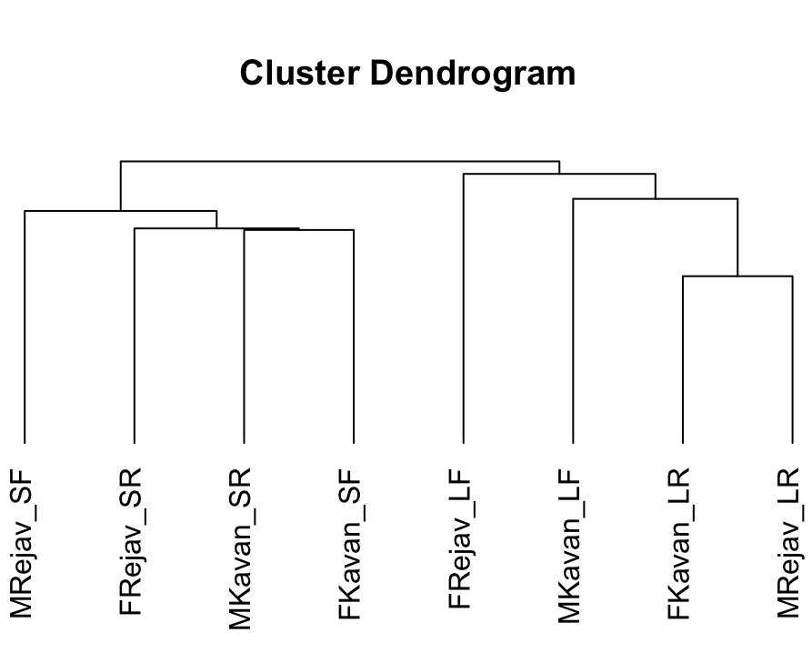
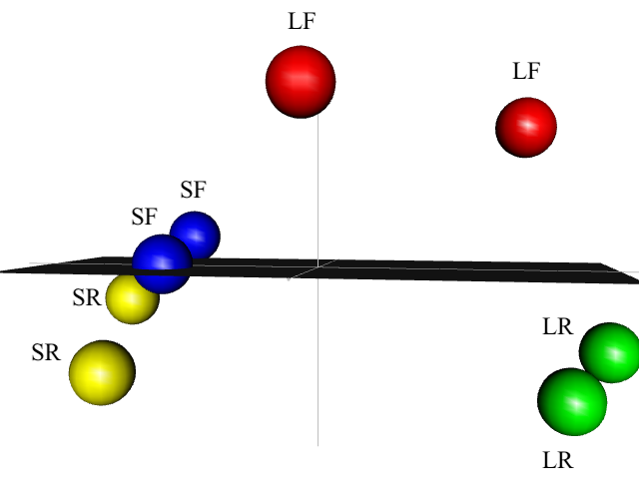
Results: FCI, Serbian
MDS cmdscale()
Clustering hclust()
Notes:
Stress - 0.177 = “fair”

Slide 22
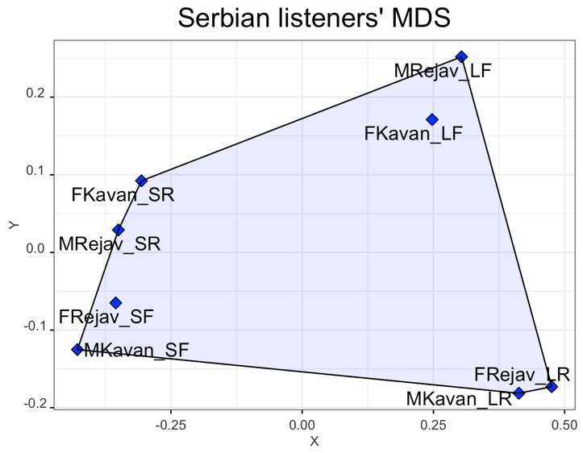
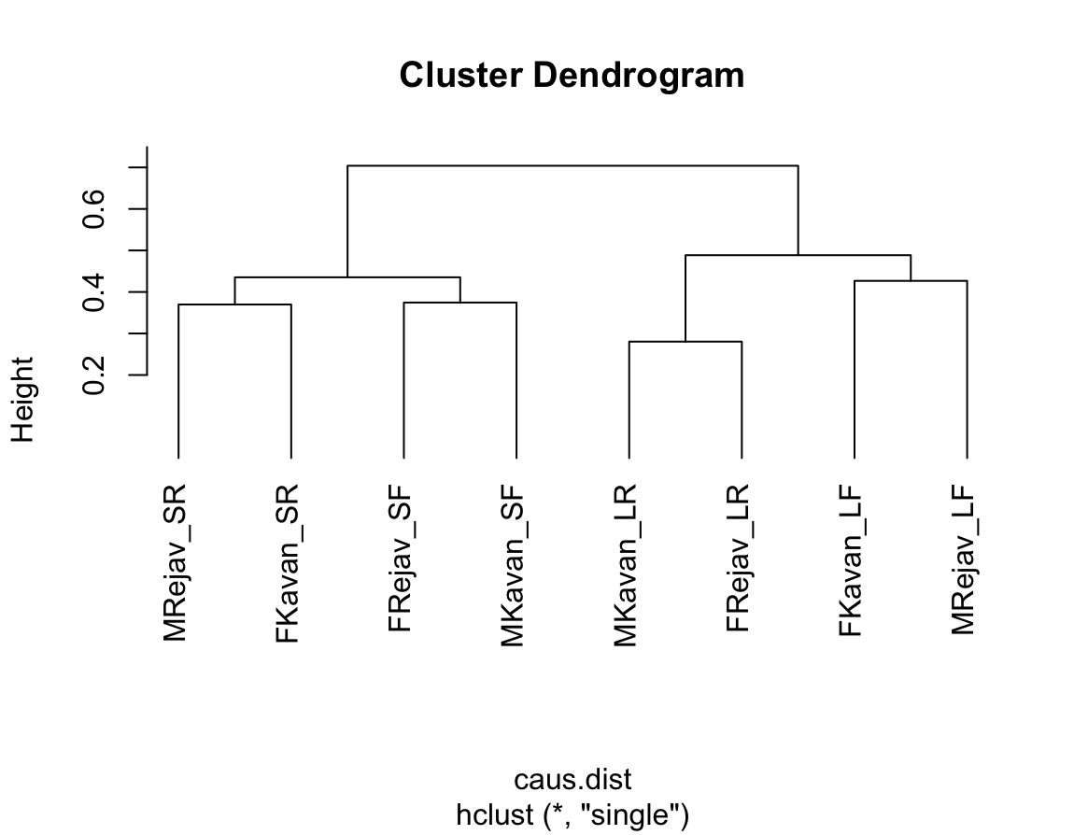
Results: FCII, Serbian
MDS
Clustering
Notes:
Stress - 0.24 = ‘fair’

Slide 23
Methodology
Hierarchical Clustering (Levshina, 2015)
Dendrogram
Chicago
Denver
Atlanta
Houston Atlanta Chicago Denver
Houston

Slide 24
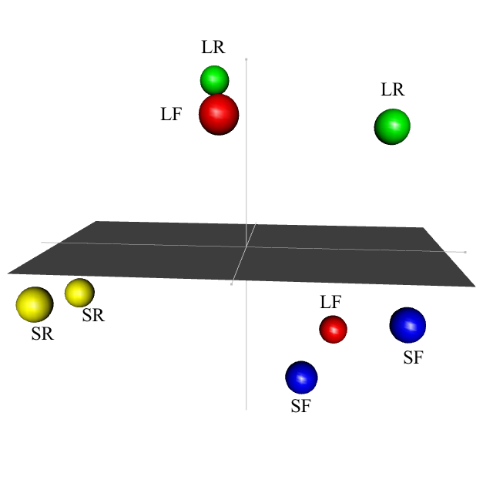
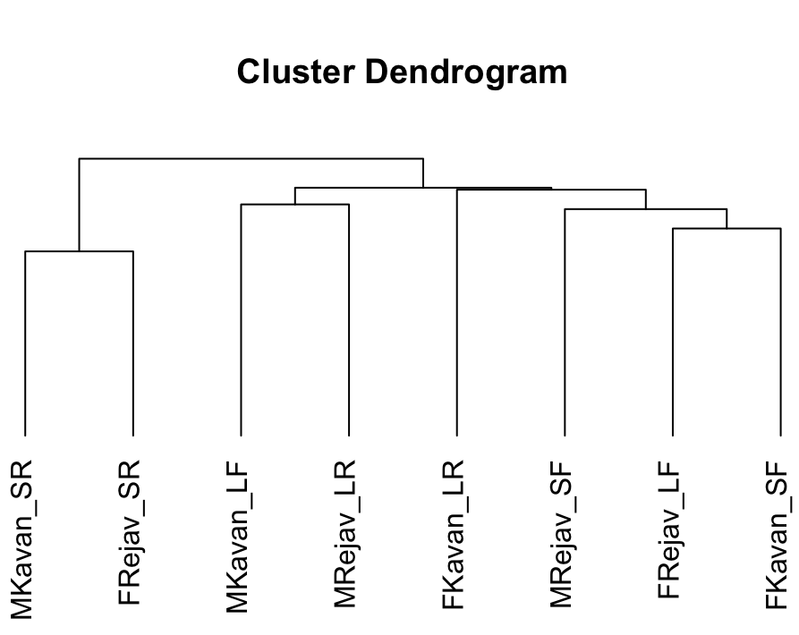
Results: FCI, French
MDS cmdscale()
Clustering hclust()
Notes:
Stress - 0.18 = ‘fair’

Slide 25
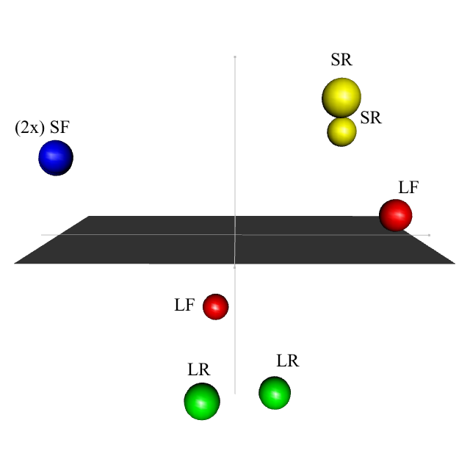
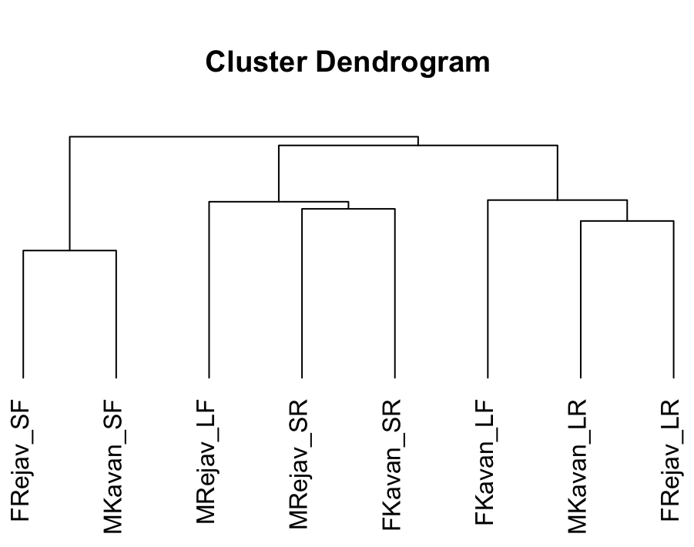
Results: FCII, French
MDS cmdscale()
Clustering hclust()
Notes:
Stress - 0.06 = ‘fair’

Slide 26
Discussion
Serbian
The perceptual space created retains the distance between the long-falling and long-rising lexical pitch accents.
The perceptual space between the short-falling and short-rising is reduced, almost not existing.
Previous research shows that this difference is becoming extensively obscured (Lehiste & Ivic, 1986; Subotic et al., 2012; Sredojevic, 2017; Nikolic, 2020).

Slide 27
Discussion
French
The perceptual space created confuses long-falling lexical pitch accents with the rest of the groups.
This could be because the F0 peak alignment is different for each talker and it influences the way the ‘falling’ part of the lexical pitch accent is perceived or not perceived (Nikolic, 2020).

Slide 28
Discussion
What are the differences in perception of lexical pitch accents between native (Serbian) and non-native (French) listeners?
Serbian (native) and French (non-native) listeners created 3 major groups
When given enough resources and time
…non-native listeners can ‘develop’ distinct prosodic categories based on two acoustic dimensions – length and pitch
...and they are able to use these categories to encode a number of lexical pitch accents.

Slide 29
Thank you!

Slide 30
References:
Atagi, E., & Bent, T. (2016). Auditory free classification of native and nonnative speech by nonnative listeners. Applied Psycholinguistics, 37(2), 241-263
Chen, J., Antoniou, M., & Best, C. T. (2023). Phonological and phonetic contributions to perception of non-native lexical tones by tone language listeners: Effects of memory load and stimulus variability. Journal of Phonetics, 96, 101199
Clopper, C. G. (2008). Auditory free classification: Methods and analysis. Behavior Research Methods, 40(2), 575-581.
Donhauser, P. W., & Klein, D. (2022). Audio-Tokens: A toolbox for rating, sorting and comparing audio samples in the browser. Behavior Research Methods, 1-8.
Dupoux, E., Peperkamp, S., & Sebastián-Gallés, N. (2001). A robust method to study stress “deafness”. The Journal of the Acoustical Society of America, 110(3), 1606-1618.
Dupoux, E., Sebastián-Gallés, N., Navarrete, E., & Peperkamp, S. (2008). Persistent stress ‘deafness’: The case of French learners of Spanish. Cognition, 106(2), 682-706.
Godjevac, S. (2005). Transcribing Serbo-Croatian Intonation. In S-A. Jun (Ed.), Prosodic typology: The phonology of intonation and phrasing (pp. 146–171). Oxford: Oxford University Press.
Grice, M., Ritter, S., Niemann, H., Roettger, T. B. (2017). Integrating the discreteness and continuity of intonational categories. Journal of Phonetics, 64, 90–107
Imai, S., & Garner, W. R. (1965). Discriminability and preference for attributes in free and constrained classification. Journal of Experimental Psychology, 69(6), 596.
Kruskal, J. B., & Wish, M. (1978). Multidimensional scaling (No. 11). Sage.
Lehiste, I., Ivić, P. (1986). Word and sentence prosody in Serbo-Croatian. Cambridge, MA: MIT Press.
Levshina, N. (2015). How to do linguistics with R. Data Exploration and Statistical Analysis, Amsterdam-Philadelphia.
Nikolić, D. (2020). F0 Acoustic Parameters’ Effects on Discrimination of Lexical Pitch Accents.
Nikolić, D., & Winters, S. (2022). Are Serbian and English listeners insensitive to lexical pitch accents in Serbian?. Phonetica, 79(4), 397-423.
Rahmani, H., Rietveld, T., & Gussenhoven, C. (2015). Stress “deafness” reveals absence of lexical marking of stress or tone in the adult grammar. PloS one, 10(12), e0143968
RStudio Team. (2019). RStudio: Integrated Development for R. RStudio, PBC, Boston, MA. http://www.rstudio.com/.
Theodore, R. M. (2021). Conducting speech perception experiments remotely: Some tools, successes, and challenges. The Journal of the Acoustical Society of America, 149(4), A109-A110.

