Slide 1
Spring Cloud at Netflix
Taylor Wicksell and Jon Schneider
@twicksell @jon_k_schneider

Slide 2
https://github.com/netflix-spring-one
To start you need:
sample-eureka
sample-membership
sample-recommendations
In sample-recommendations:
git checkout tags/start
From the directory where you clone sample-eureka and sample-membership:
./gradlew bootRun > out.log

Slide 3
Collection<SpringBootApplication>
Recommendations
REST to DNS name
Membership

Slide 4
Collection<SpringBootApplication>
REST to DNS name
Membership
Recommendations
Route53
Elastic Load Balancer
Membership
Membership
Notes:
In principle this is no different

Slide 5
Eureka
Recommendations
REST to VIP
Membership
Membership
Membership
Eureka Server
Register
Register
Metrics Backend
Circuit Breaker Dashboard
Delivery Automation
Notes:
Benefits to client side load balancing.
The operation of Eureka is platform agnostic – works equally well in a private data center or a cloud platform like AWS.
Anything that needs to operate against the set of all services operates against the service discovery platform.

Slide 6
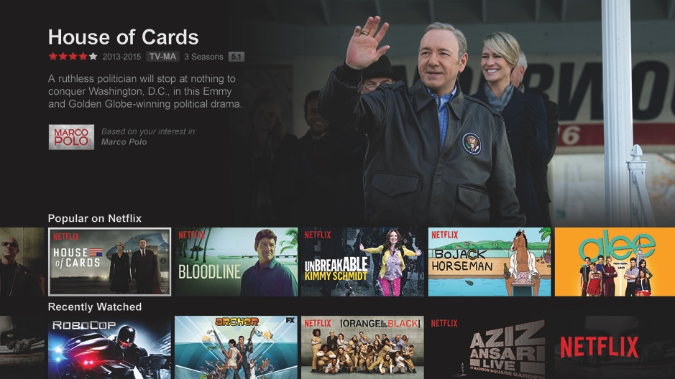
Hystrix

Slide 7
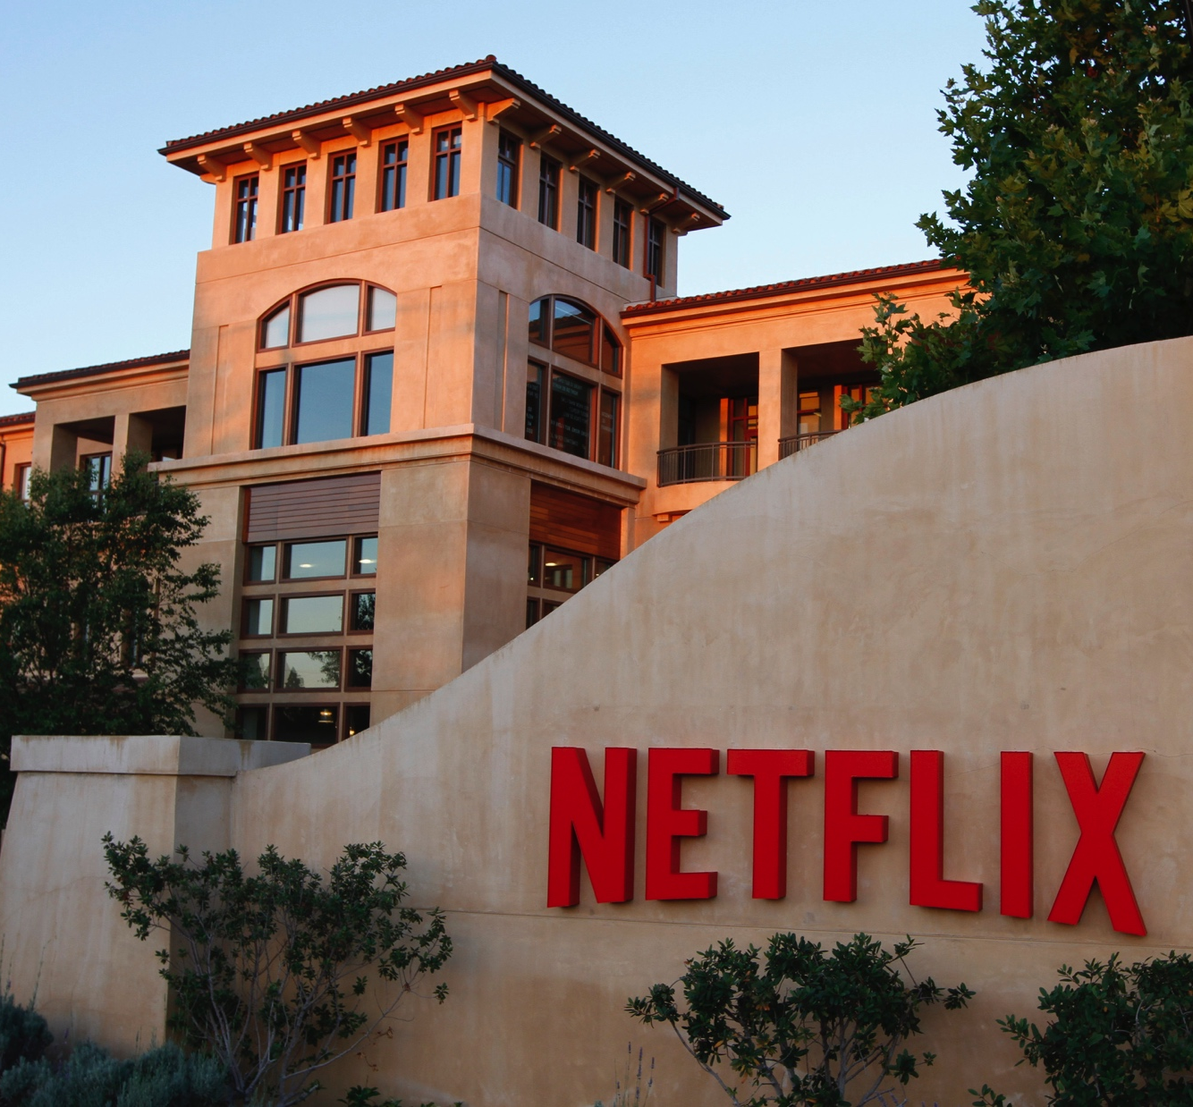
Thanks!
Always hiring: https://jobs.netflix.com
Pull requests and issues always welcome:
https://github.com/Netflix

