Slide 1
3rd Week Meeting
Urban Green Space Mapping Through Remote Sensing for Frankfurt/Main, Germany
☃️ ☃️ ☃️ 🎄❄️ **Holiday Edition** ❄️🎄 ☃️ ☃️ ☃️

Slide 2
Agenda
Recapping where we are in the project
Overview plan for dataset creation
Timeline of project
Annotation requirement to receive a certificate of completion
Overview teams dl strategies
Francisco may introduce his challenge and usefullness about change detection mamba
Vijaya introduces similar benchmarking competition
Team Building and Ground Truth Annotation Progress
Progress Update
Feedback about QGIS
Detailed Discussion on Input size of Data-Set
Detailed Discussion on Team‘s DL Strategies
Read-out
Single Teams
Q&A session about QGIS

Slide 3
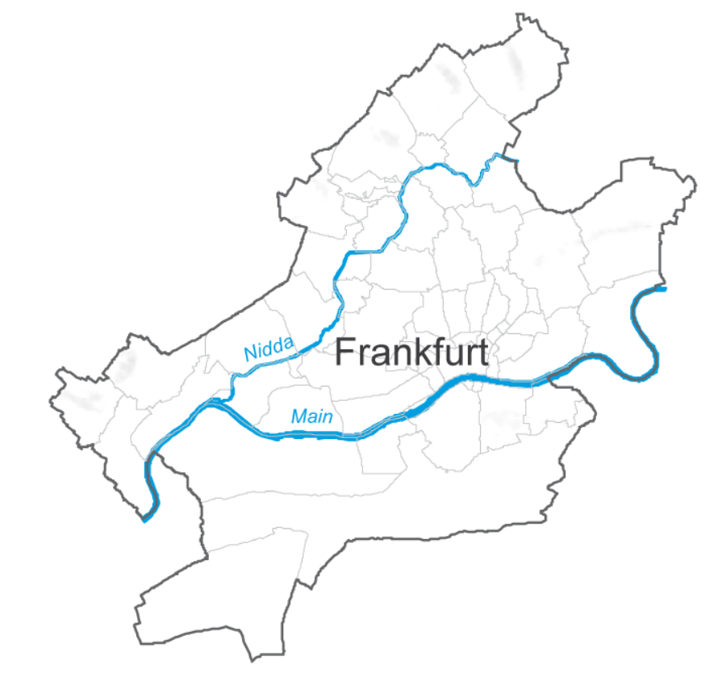
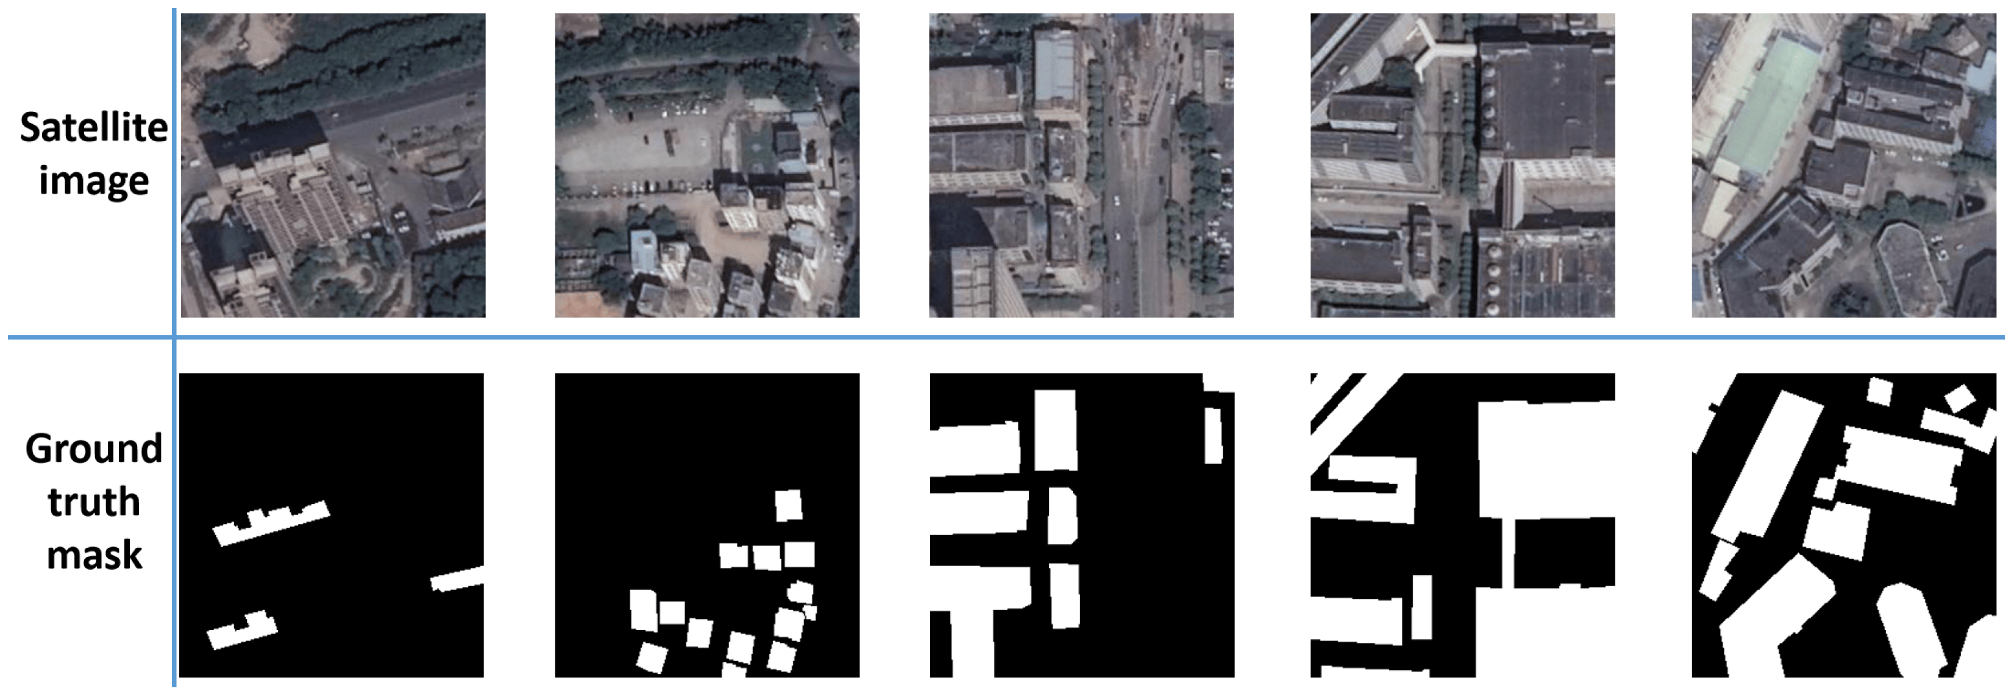
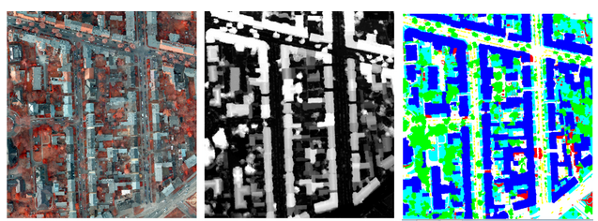
1.1 Overview plan for dataset creation
1.
3.
Download satellite images of chosen geographic patches
Final steps:
Inspect validity of images and masks
Generate statistic about presence of minority class (vegetation)
Potentially, adapt masks for images containing agricultural fields
Decide into which patch sizes for geographic loacations Frankfurt can be divided into
5.
2.
Create simplified and updated vector map which segments all regions of interest into 6 classes
4.
Create DL Masks on the fly using vector data

Slide 4
1.2 where are we in the project
*dataset creation starts/ first coding to clarify ideas
** coding needs to be start/ training starts
8th Dec ->
5th Jan ->
2nd Feb ->
*
15th Dec ->
12th Jan ->
9th Feb ->
**
22nd Dec ->
19th Jan ->
16th Feb ->
Use this time as pseudo-holidays – do relaxedly the annotation?
Buffer time if we need an elongation to polish up?
29th Dec ->
26th Jan ->
23rd Feb ->

Slide 5
1.3 Announcement recap
Annotation of images is mandatory
If you do not help in the annotation you will receive no certificate, no access to the data and you will be excluded from the project

Slide 6
1.4 Proposed Deep Learning Strategies
Team | Proposed Strategy | Adapted Strategy | Initial Prediction
A | Kernel-based MESMA/ Clustering | Several? | Pixel-level classification
B | U-net | U-net | Segmentation
C | U-net and Input amplification | U-net and Input amplification | Pixel-level classification
D | DL Method of Choice | SAM-2? | Pixel-level classification
E | SGU-MLP | SGU-MLP | Pixel-level classification
F | Mamba I | Plain Mamba | Pixel-level classification
G | Mamba II | U-net/Mamba | *****????*****
H | ***Analysis of Temperature, Vegetation, Topography*** | *****????***** | *****????*****
- To be discussed further later during this meeting

Slide 7
1.5 @Francisco -> Change Detection Mamba
https://ieeexplore.ieee.org/document/10565926
https://github.com/ChenHongruixuan/MambaCD

Slide 8
1.6 @Vijaya introduces benchmark competition

Slide 9
2. Team Building and Ground Truth Annotation Progress
Points To Discuss:
Progress Update
Feedback about QGIS

Slide 10
Checklist
Do you have an overview who is in your team (actively)?
Has your team a dedicated spreadsheet to know who works on which images?
Have you installed the LTR version of QGIS?
Have you noted down which images you are gonna work on?
https://docs.google.com/spreadsheets/d/11wqoOhFnsQ-JCstanNbjnTP3d_6l-2KFgdWjMoxaIrg/edit?pli=1&gid=0#gid=0
Have you seen the segmentation Isabella provided?
Have you installed the Open Street Map plugin? -> QuickOSM
Regarding specific QGIS operations:
Have you taken a look on the vector menu which options it provide?
Do you know how to create a new layer?
Do you know how to edit a layer?
Do you know how to copy an object?
Do you know how to tag a layer with „Omdena_category“?

Slide 11
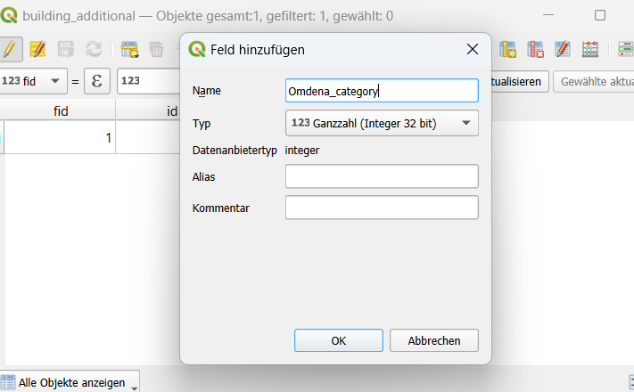
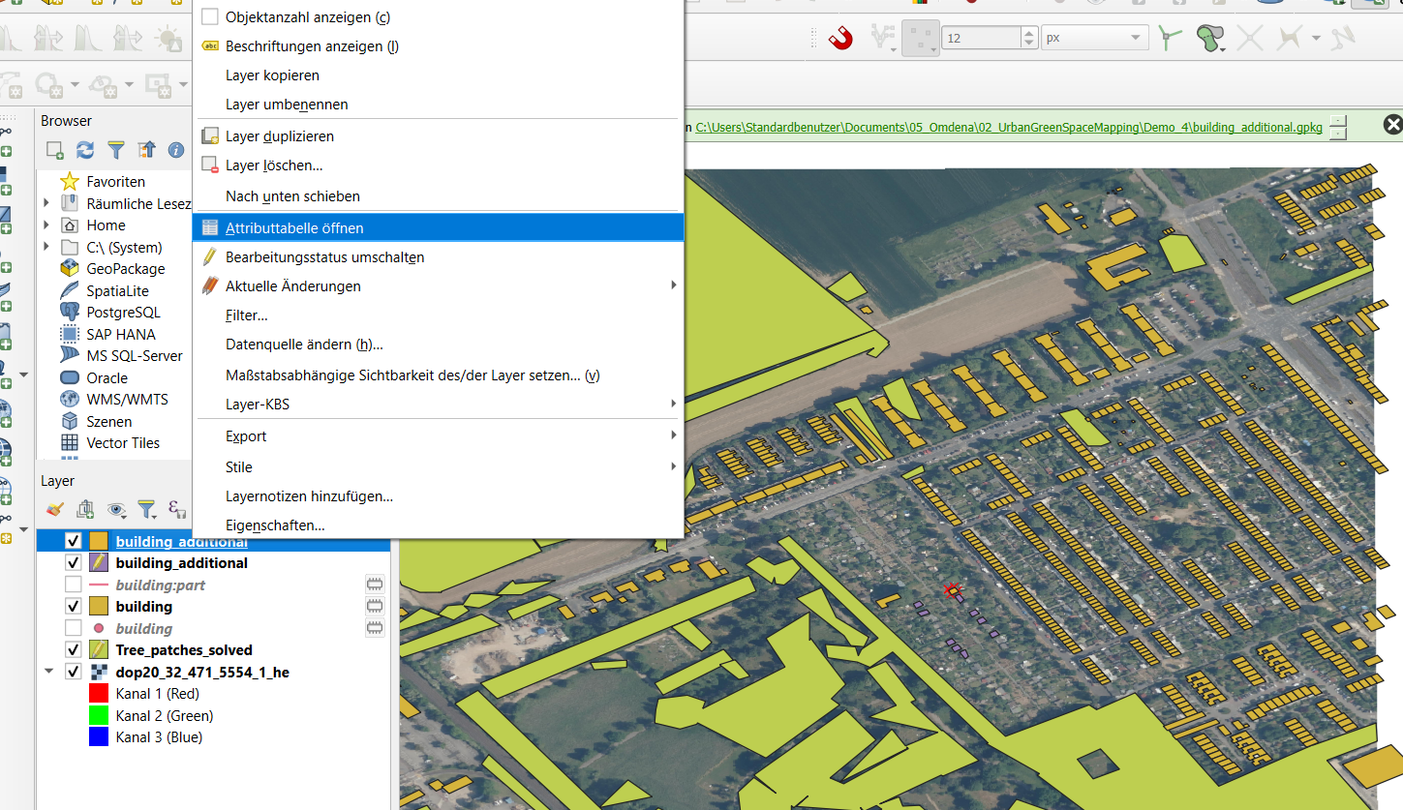
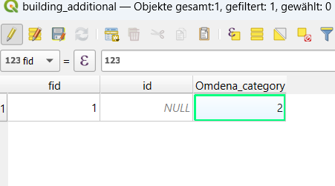
Sample Output
-> TIP: do trees as often as possible as polygons and not as dots

Slide 12
2. Team Building and Ground Truth Annotation Progress
Team | No. of Images Allocated
A | 40 images allocated
B | 40 images allocated
C | Some extra photos due to inactive members
D | 12 photos only?
E | 40 images allocated
F | 40 images allocated
G | 40 images allocated
H | Not allocated yet
Feedback? :

Slide 13
3. Detailed Discussion on Input size of Data-Set

Slide 14
128 pixels * 128 pixels
1 patch = 1280 m * 1280 m
Frankfurt: 152 patches (-> plus 1 more year if needed)
Potsdam: 3 patches
MULC: more than 1‘000 patches
Suggestions:
Take 5 images (different time points) per location for Frankfurt and Potsdam – repeat once for shifted geographies
Select locations from MULC (only 2 time points per location) so that the final number of MULC images is supposed to be equal to final number for Frankfurt and Potsdam (=775 MULC locations)
Perform data augmentation on all images to increase dataset by a factor of 7
Final dataset: ~21‘700 images

Slide 15
Consequences of dataset size on neural network architecture
U-net: a depth of 4 to 5 levels (4–5 downsampling steps, reducing from 128×128 to 8×8 or 4×4 at the bottleneck)?
With such a depth, class weights are likely needed to detect the minority class or loss weighting
Also, needed is an appropriate metrics like F1-score or precision-recall
Measures against overfitting have to be taken, such as dropout, batch normalization, or L2 regularization
On the upside: it is doable with our computational resources
ALSO – look into U-net variants designed for smaller dataset sizes: U-Net++ - but also have a look on other ideas in literature such as TinyU-Net, Squeeze U-Net etc.

Slide 16
4. Detailed Discussion on Team‘s DL Strategies

Slide 17
4.1 Target Read-out
Vegetation Space
Chlorophyll content of pixel
The uncertainty measure for our prediction we can account for
Advantage: can account for different vegetation densities in mixed pixels
Likely Method: Using Spectral indices
Chlorophyll Index (CIred-edge): (NIR/Red-edge)−1(\text{NIR}/\text{Red-edge}) - 1(NIR/Red-edge)−1
MERIS Terrestrial Chlorophyll Index (MTCI): (Red-edge3−Red)/(Red-edge3−Red-edge1)
The above in combination with NDVI/EVI or Sentinel-1 measures (e.g. vegetation density based on backscatter)
Please, help research about these concepts!!

Slide 18
Plan of Team C
Proposal
U-net with softargmax: https://arxiv.org/pdf/1903.06562
Use Input Amplification as originally suggested: https://www.sciencedirect.com/science/article/pii/S2352938524000168
May need to work with spectral indices
Adjust Loss function (use weighted loss functions?)
Establish measures against overfitting

Slide 19
Plan of Team D
Proposal: Segment anything model 2
Change input layer that the model can handle multispectral images
Replace the mask output head with a per-pixel classification head that generates probabilities for each pixel across multiple classes
Enhance the decoder to support dense pixel-level classification. This involves increasing its capacity to model fine-grained spatial details and directly output per-pixel probabilities
Adjust loss function to categorical cross-entropy or Kullback-Leibler (KL) divergence
Use evaluation metrics like mean squared error (MSE) or log loss to evaluate the quality of probabilistic outputs
Fine-tune SAM on pixel-labeled datasets where mixed-class probabilistic outputs are annotated

Slide 20
Plan of Team A
Use different pixel-level classification methods and compare them
https://www.mdpi.com/2072-4292/15/11/2832
https://arxiv.org/pdf/2001.07307
https://www.cedric-richard.fr/Articles/chen2011novel.pdf

Slide 21
Other teams‘ plans (as of now):
Team E: SGU-MLP? Pixel-level classification? Involved role in the dataset generation phase?
Team F: discussing different mamba options? Pixel-level classification?
Team G: U-net/Mamba? Output?
Team H: ??

Slide 22
5. Q&A session about QGIS

Slide 23
Outcomes
One of Francisco‘s approaches (besides CD mamba involving ensemble model): https://element84.com/machine-learning/finding-changes-on-the-earth-with-natural-language
https://github.com/satellite-image-deep-learning/techniques
https://github.com/sacridini/Awesome-Geospatial
https://livingatlas.arcgis.com/en/browse/?q=dlpk#q=dlpk&d=2
Paste your name next to the images you are working on in this list: https://docs.google.com/spreadsheets/d/11wqoOhFnsQ-JCstanNbjnTP3d_6l-2KFgdWjMoxaIrg/edit?pli=1&gid=0#gid=0
Install OSM in QGIS using the QuickOSM plugin
Augmentation strategy: specify it
Slack channel will be set up to discuss data set creation
Create channel to discuss read-out (vegetation area vs chlorophyll content)
The channels:
https://omdenaberlinu-coz3160.slack.com/archives/C086S3SMARG
https://omdenaberlinu-coz3160.slack.com/archives/C086KFAVDF0

Slide 24
https://arxiv.org/pdf/2111.07942
https://arxiv.org/pdf/2305.16239

