Slide 1
2nd Week Meeting
Urban Green Space Mapping Through Remote Sensing for Frankfurt/Main, Germany

Slide 2
Agenda
Creating the Ground Truth
Progress Update
Feedback about QGIS
Team Building
Progress in Dagshub Sign-ups
Progress in first individual team meetings and pm tools
Defining methodology for each team
Some discussions that need to be started now:
Read-Out for mapping urban vegetation
Project during the festive season
Marius shares his thoughts on https://zenodo.org/
Questions

Slide 3
1. Creating the ground truth
Points to Discuss
Progress Update
Feedback about QGIS

Slide 4
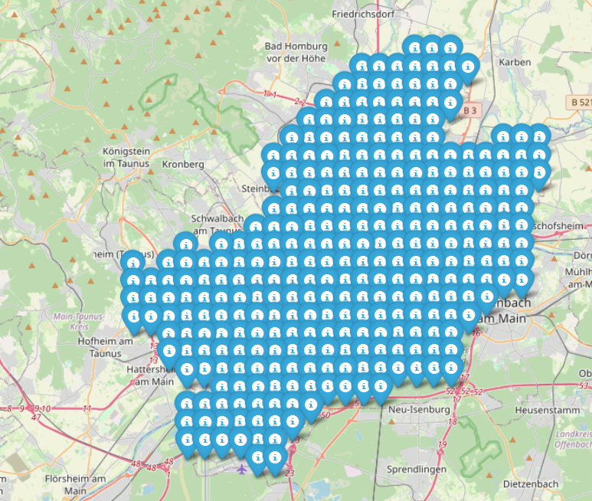
The air photographs are freely downloadable in RGB jpg format
Download location https://gds.hessen.de/
There are 310 photos sized 1 km x 1 km for Frankfurt
The files are in jpg format acconpanied by jgw files
Jgw files specify the lower left corner of the jpg images
Point coordinated were projected from EPSG:25832 to EPSG:4326 for visualisation
In the image to the lefft the point location of each upper left corner is shown
I have applied for tif-format images where the near-infrared channel is included

Slide 5
Proposed Workflow for creating „ground truth“ (reference data set)
Segment air photographs with SAM 2
Create vector-file maps from segmentation output
Peer review created maps
Who: Isabella and Dorothea – potentially 2 more volunteers with adequate hardware
Who: ideally 52 volunteers so that every volunteer gets 6 images
Who: ideally 52 volunteers so that every volunteer gets 6 images
How: use notebook adapted to local-machine set-up based on model creators‘ instructions (https://colab.research.google.com/github/roboflow-ai/notebooks/blob/main/notebooks/how-to-segment-images-with-sam-2.ipynb)
How:
- Receive original images with their segmentation outcomes (binary masks)
- Convert raster data of masks to vector data according to standardized protocol
- Cluster segments into pre-defined classes
- Inspect labelling visually using QGIS
How:
- Receive labelled vector maps and control them visually using QGIS

Slide 6
Feedback about sample image and segmentation
No feedback (just one positive one)
Batches of images for actual annotation will be given out tonight to single teams
Teams are asked to organize the annotation as a team

Slide 7
2. Team Building
Points To Discuss:
Progress in Dagshub Sign-ups
Progress in first individual team meetings and pm tools
Defining methodology for each team

Slide 8
Overview who is here from the single teams
TEAM | Present during this meeting:
D* | Oscar, Lauren, Chaitree, Vinicius -> need to put up table to note down initial ideas, maybe make initial meeting brief
E | Marius, Tom, John, Vijaya -> Tom will post suggestion for first meeting
A | Bergson, Elena, Joshua, Faith, Andreea, Sanika -> about to have a first meeting, but need to clarify first date *** Dorothea needs to join
C | Tsovinar, Venkat, Cansu, Zeyad, Sreekutty -> need to set up first meeting
F | Fatma, Aany -> Aany will write down suggestions in the team channel
H | Rola, Luka, Namrata -> couldn‘t agree on a time so far but will have it soon, want to decide about the focus in their first meeting
G | Verena, Kris, Vaikunth, Soumyashis, Mamata, Paulo -> some time after the project meeting but had an initial smaller meeting
B | Cheng Zhen, Aissiou, Bakhtiyar, Krzystof ->
Silence Awards
* Winner of Week 2 – most silent team

Slide 9
2. Team Building
Team | Dagshub? | First Meeting? | Organizing Annotation? | Task tracking? | Code sharing? | Definition of Focus? | Literature tracking? | Resources?
A
B
C
D
E
F
G
H
*Interested in a Team Gaming Kick-Off event?*

Slide 10
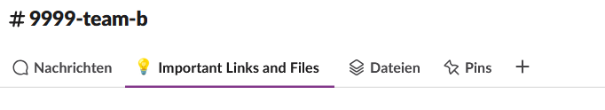
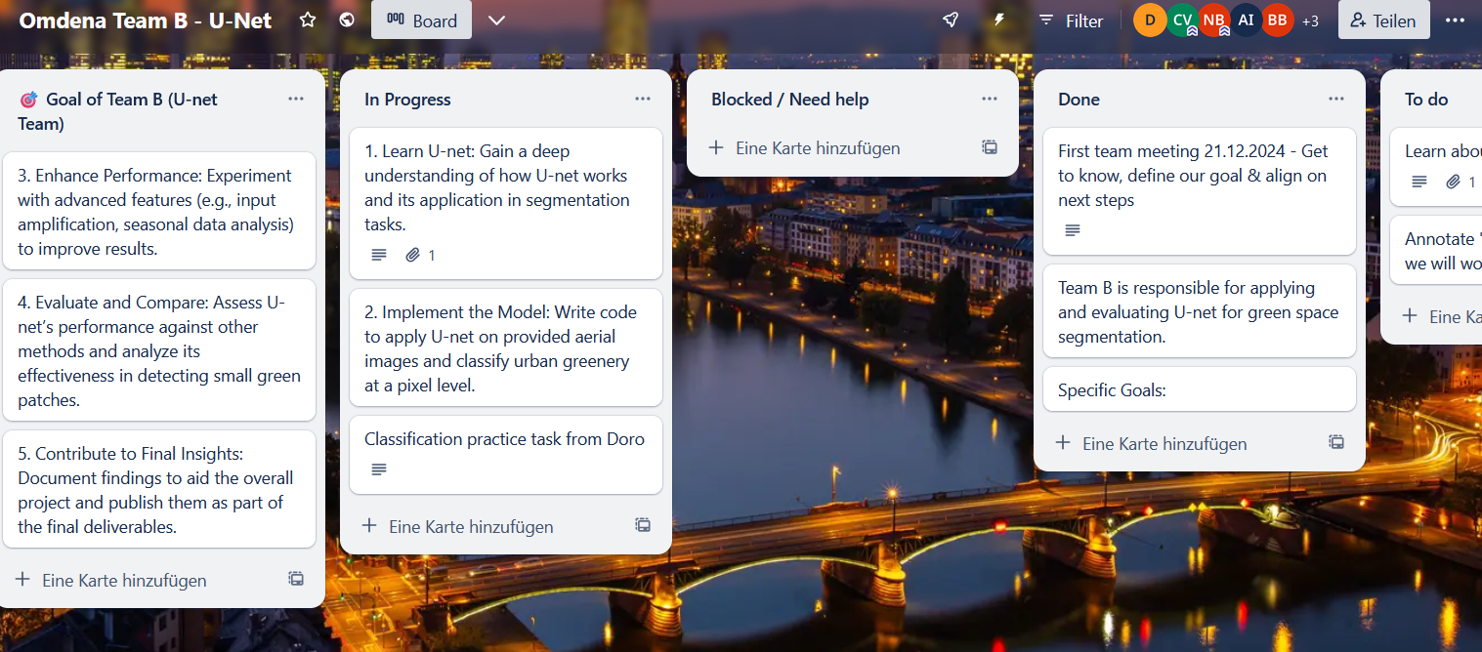
Example Trello Board of Team B
!!!

Slide 11
Alternatives to Trello
ClickUp: https://clickup.com
Linear: https://linear.app
Shortcut: https://shortcut.com
OpenProject: https://www.openproject.org

Slide 12
3. Some discussions that need to be started now
Points to Discuss
Read-Out for mapping urban vegetation
Project timeline
Zenodo.org

Slide 13
Metrix |  | Potential errors
Vegetation Area | Most commonly used | Errors arise due to mixed pixels, shadows, or non-vegetated surfaces like bare soil or impervious surfaces that have similar spectral properties to vegetation in certain indices -> Frankfurt’s topography is varied
Vegetation Volume |  | Errors may arise from inaccurate height data or limited availability of high-resolution data for specific urban areas
Aboveground Biomass |  | AGB estimation may suffer from errors due to the inability to differentiate between species or types of vegetation and the mixed pixel problem in urban environments.
Vegetation Density |  | The major error arises from mixed pixels in highly fragmented urban areas, where some pixels contain a mix of vegetation and non-vegetation surfaces
Leaf Area Index | Most commonly used | LAI estimates can be affected by atmospheric conditions, sensor saturation, and mixed pixels in densely built urban areas. Accuracy can be low in highly heterogeneous urban landscapes unless high-resolution data are used.
Some form of „Green index“ |  | NDVI is highly sensitive to mixed pixels and variations in sensor resolution. It may not differentiate well between vegetation and other types of land cover that have similar spectral properties, leading to errors, particularly in urban settings with complex land cover.
Canopy Cover |  | mixed pixels, resolution limitations, and misclassification due to shadows, seasonality, and the complexity of urban landscapes

Slide 14
3.1 Using Sentinel-1 + Sentinel-2 Integration
Most Reliable with Sentinel-2:
Vegetation Area (via NDVI/EVI)
Leaf Area Index (LAI)
Green Index (e.g., NDVI)
Canopy Cover
Most Reliable with Sentinel-1:
Vegetation Volume (via SAR backscatter)
Aboveground Biomass (AGB) (indirectly, using structural models)
Vegetation Density (via backscatter sensitivity)
How Integration Improves Reliability:
Sentinel-2 provides accurate spectral data, especially for vegetation indices, canopy cover, and LAI.
Sentinel-1 improves the analysis by contributing structural and textural information, especially in urban areas with mixed pixels and complex land cover.
The best approach would be to use Sentinel-2 for vegetation area, canopy cover, and green indices, while integrating Sentinel-1 to refine structural estimates like vegetation volume, biomass, and density, especially in areas with high urban density or mixed pixels.

Slide 15
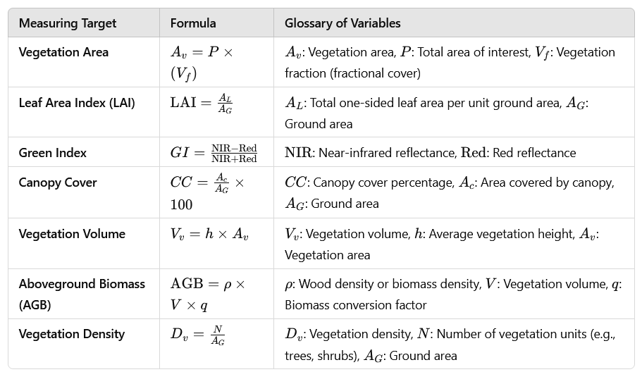
I do not think this is correct (source: https://conf2023.gdn.int/wp-content/uploads/2023/10/Assessing-Urban-Biodiversity-trends-using-Satellite-Imagery.pdf) – vegetation density can be estimated by spectral indices (e.g. NDVI) and radar information (Sentinel-1)

Slide 16
3.1 Some more food for thought
Pixel-level classification or segmentation?
Team A: Pixel-level classification
Team B: Segmentation
Other teams?
Computational efficiency read-out?
Comparison with Air photographs
Impervious surfaces
Building
Low vegetation
Tree
Open Water
Clutter/background

Slide 17
3.2 Project during the festive season
8th Dec ->
5th Jan ->
2nd Feb ->
15th Dec ->
12th Jan ->
9th Feb ->
22nd Dec ->
19th Jan ->
16th Feb ->
Use this time as pseudo-holidays – do relaxedly the annotation?
Buffer time if we need an elongation to polish up?
29th Dec ->
26th Jan ->
23rd Feb ->

Slide 18
3.3 Storing Dataset at zenodo.org?

Slide 19
4. Questions?

Slide 20
Outcomes
Decision on final read outs for project was postponed -> mostlikely vegetation area – maybe some measure to explain the uncertainty of the method (e.g. estimate vegetation density)
Krzystof suggested using Open Street Map (OSM) segmentation information besides the provided sam-2 segmentation – it may be easier to compare first with the images and then use
Zenodo would allow contributors to be academically acknowledged – zenodo requires a specific file and is most likely integrated with Git
Despite holidays on the 29th there will be a meeting for everybody who wants

