Slide 1
miniRPG
C# .NET 10
Windows Forms
Windows Forms Game Engine
Perlin Noise
Matěj Dušek a František Kopecký
60 FPS

Slide 2
Přehled projektu
Co je miniRPG?
Momentální Funkce
Perlin Noise world generation
Chunk-based terrain rendering
Fully animated character
Smooth camera follow system
ECS (Entity-Component-System)
Inventory + Hotbar system
Interactable ore mining
60 FPS game loop
Notes:
miniRPG je 2D RPG hra postavená kompletně ve Windows Forms. Projet se zaměřuje na čistou architekturu, výkonost, a stavění pořádné hry od základu.

Slide 3
Jak hra funguje
Forms (UI Layer)
Klíčové Funkce
MainForm · Load · Input events
Render Layers
Game
IRenderLayer interface — Každý system vykresluje zvlášť
Game.cs · Všechno inicializuje
System Loop
Each system gets Update(World, deltaTime) per frame
Chunk Manager
Engine
Bake terrain chunks to Bitmap, reuse until dirty
Spouští všechny systémy
Delegates/Events
OnInteract action on interactable components
Componenty
Nesou data a přidávají se na všechny entity

Slide 4
Popis nejhlavnějších algotitmů a funkcí
Perlin Noise Generace
Chunk-Based Terrain
Vlastní 2D Perlin noise implementace
Biome scale + detail scale layering
Seeded — same world every time
Generates tiles on-the-fly per chunk
World split into 16×16 tile chunks
Only visible chunks are loaded
Baked to Bitmap — drawn in one call
Dirty flag triggers re-bake on change
Smooth Game Loop (60 FPS)
Interakce
Application.Idle loop — no timer lag
PeekMessage for idle detection
Delta-time based movement
Decoupled update from render speed
Pythagorean distance check per entity
CheckRadius scans all interactables
IsInRange flag drives UI feedback
Delegate OnInteract — fully decoupled

Slide 5
Požadavky
2× Form
MainForm (game) + Load (splash screen)
2× Custom Component
InventoryComponent, HotbarComponent, StatisticBarComponent…
Logic ≠ UI
Engine / Systems / World — zero UI code in game logic
Delegates / Events
Interactable.OnInteract, Application.Idle game loop
Complex Algorithm
Perlin noise map gen + chunk baking system
Graphics + Game Loop
Graphics.DrawImage per layer, Application.Idle + PeekMessage
Save / Load (JSON/XML)
Planned — game state serialization with error handling
GitLab + 10 Commits
Ongoing — meaningful commits spread over semester
README + Architecture Diagram
Mermaid diagram + controls + AI logbook section
Let's Play + PowerPoint
This presentation + 1-minute gameplay video
Done

Slide 6
Týmové Rozdělení Práce
Matěj Dušek — Engine
František Kopecký — UI & Game
ECS architecture design
Perlin noise & generace terénu
Chunk baking & ChunkManager
Game loop (Application.Idle)
Vykreslování
Camera smooth-follow system
Inventory & hotbar system
Databáze a vykreslování itemů
Interaction system (mining)
Stat bar UI component
Sprite & animace art assetů
Save/Load system

Slide 7
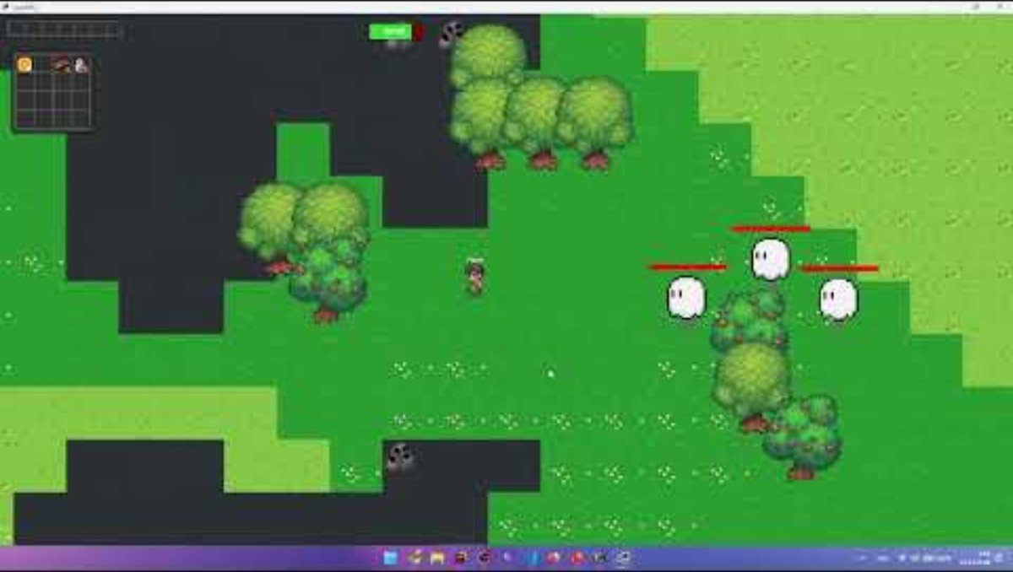
Let’s play video

Slide 8
AI Logbook
Where and how AI tools were used during development
FPS optimization
Capped at 40 FPS despite 16ms timer. AI suggested Application.Idle + PeekMessage loop to replace Windows Forms timer — solved the issue.
Chunk terrain system
Prompted AI to design a chunk + Bitmap baking architecture for better tile rendering performance. Implemented the design ourselves.
NativeMethods.cs
PeekMessage P/Invoke boilerplate was AI-generated (marked in comments). We verified and understood it before using it.
Architecture review
Used AI to review ECS design and suggest where to use interfaces vs abstract classes in the rendering pipeline.

Slide 9
Co by jsme chtěli přidat do budoucna
Figthing expandace
PLANED
Více enemies, více zbraní a potionů
Survival Elementy
PLANNED
Hunger, stamina, day/night cycle feeding into stat bars.
Rozšíření Itemů
PLANNED
Více typů oréček, dřeva a jídla

Slide 10
Momentální bugy
- Některé ores se spawnují dvakrát na jednom místě
-

Slide 11
miniRPG
Děkujeme za pozornost
Otázky?
60
∞
C#
Target FPS
World Size
Language

