Slide 1
Network Science Project 1
Sitnikov Andrey

Slide 2
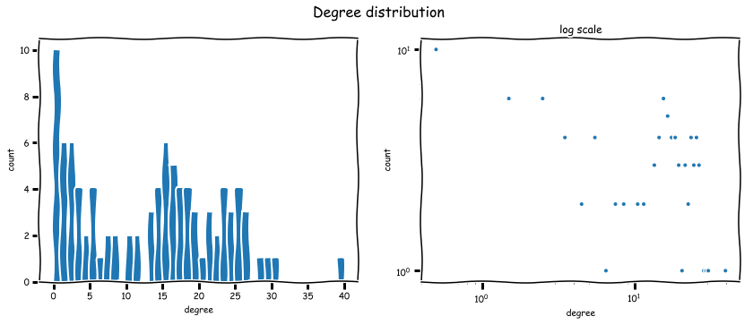
Network summary
Each node has the following attributes:
Name, sex, city, count (total number of friends)
Number of nodes: 94
Number of edges: 597
Diameter: 7
Clustering coefficient: 0.53

Slide 3
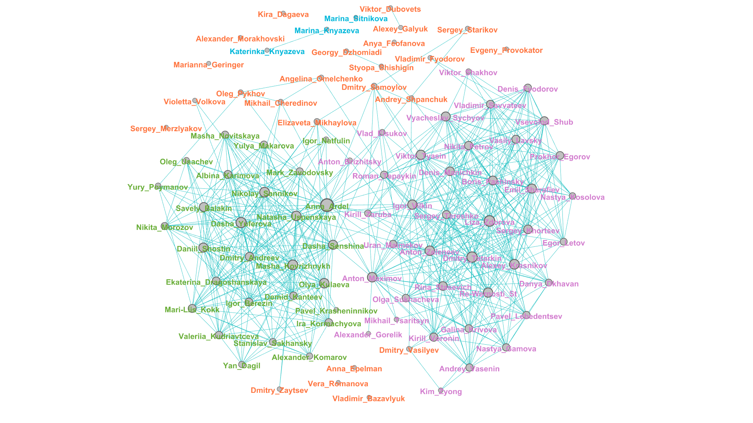
Visualization
green - school friends
purple - MIPT (university) friends
blue - family
orange - others

Slide 4
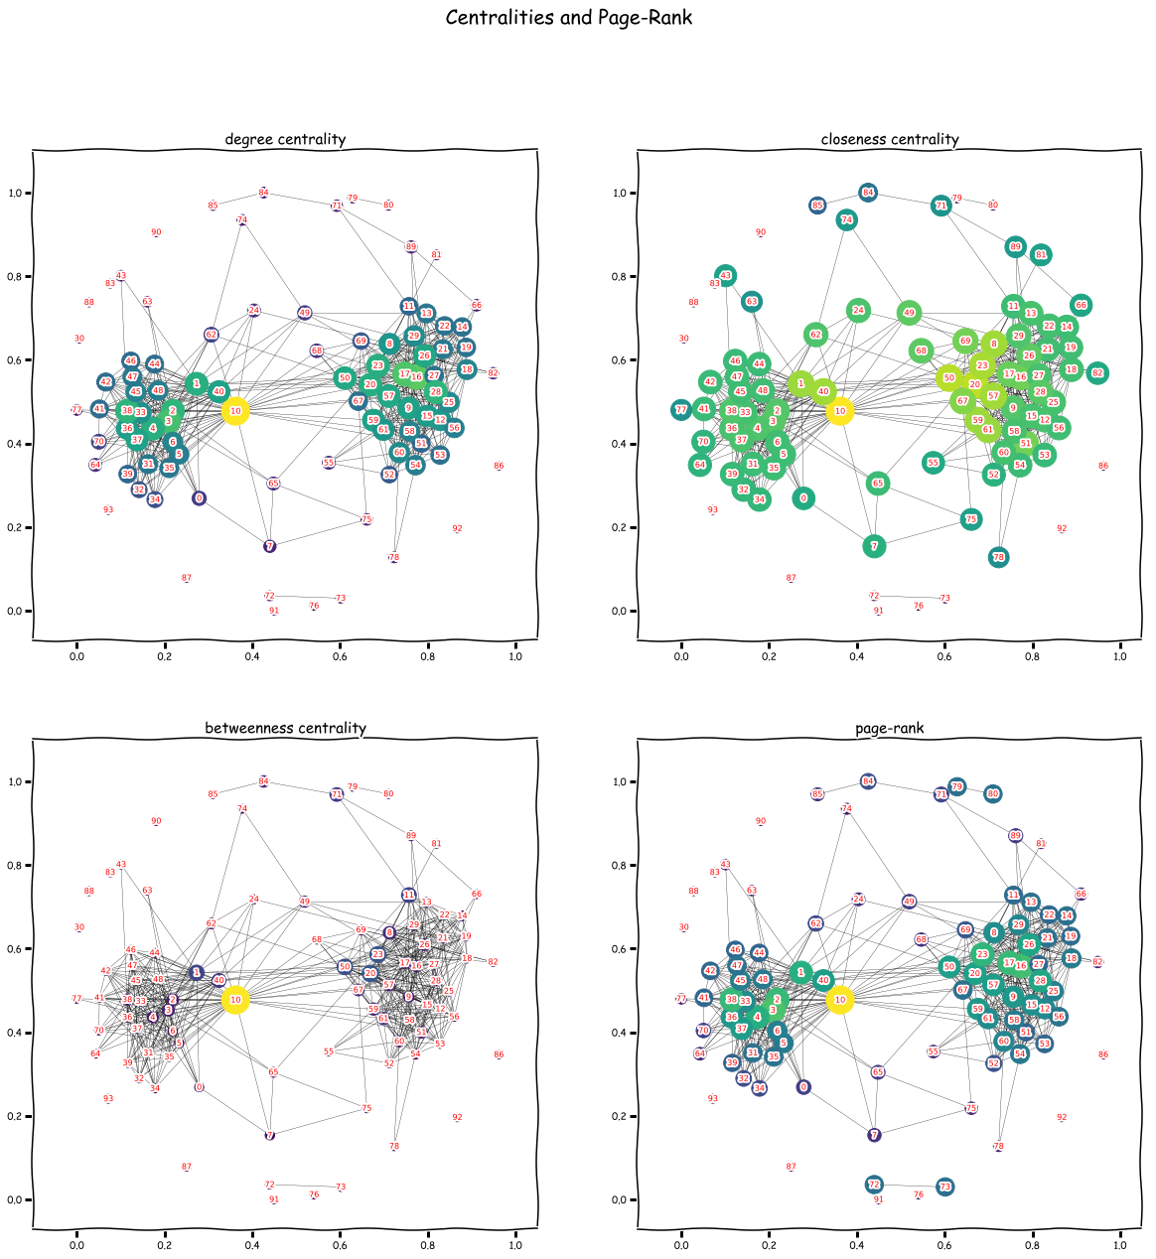
Centralities and Page-Rank
10 – Anna Ardel
20 – Anton Zeleneev
50 – Igor Vilkin

Slide 5
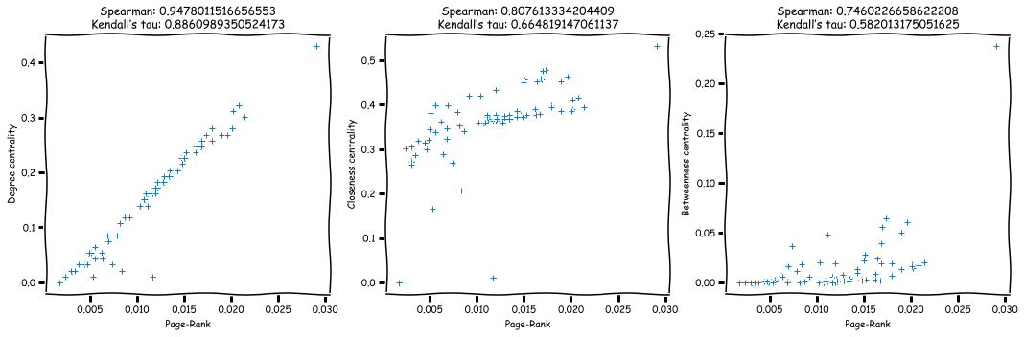
Comparison Page-Rank with centralities

Slide 6
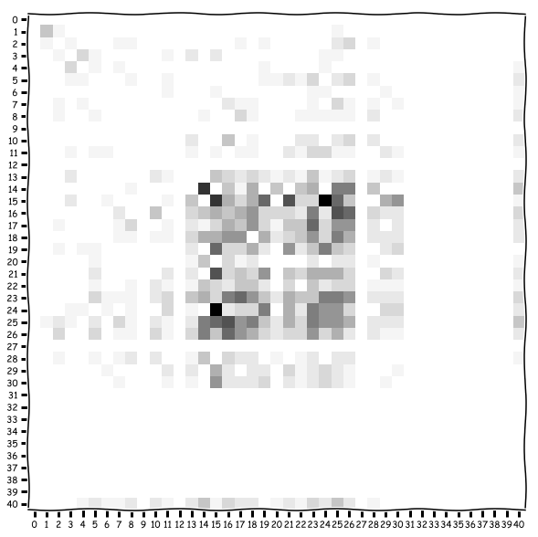
Assortative coefficient for node degree: -0.07

Slide 7
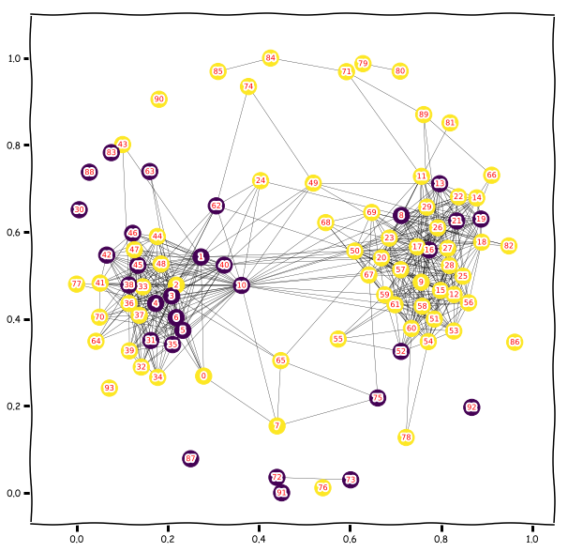
Assortative coefficient for sex: 0.09

Slide 8
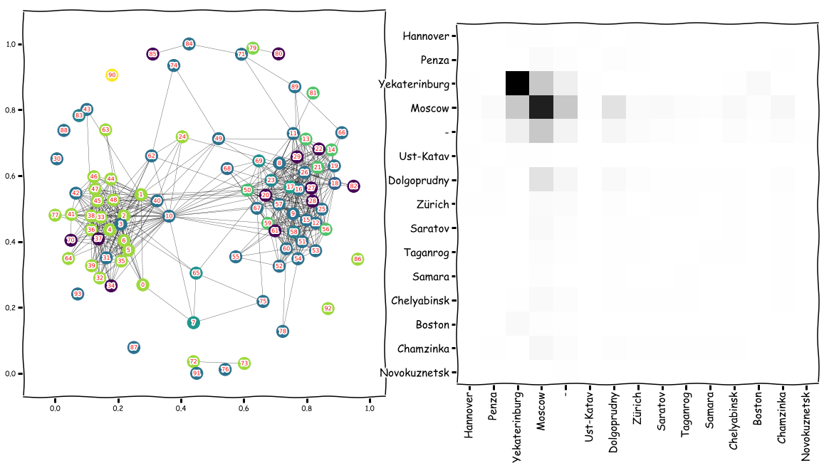
Assortative coefficient for city: 0.17

Slide 9
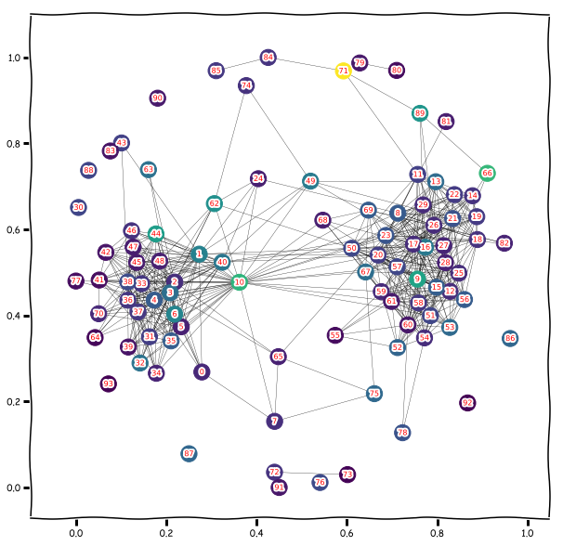
Assortative coefficient for total number of friends: -0.02

Slide 10
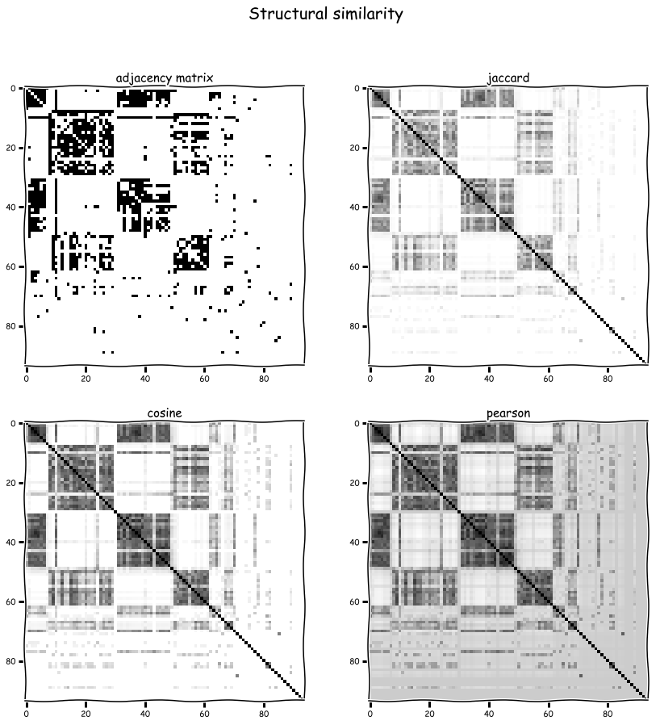

Slide 11
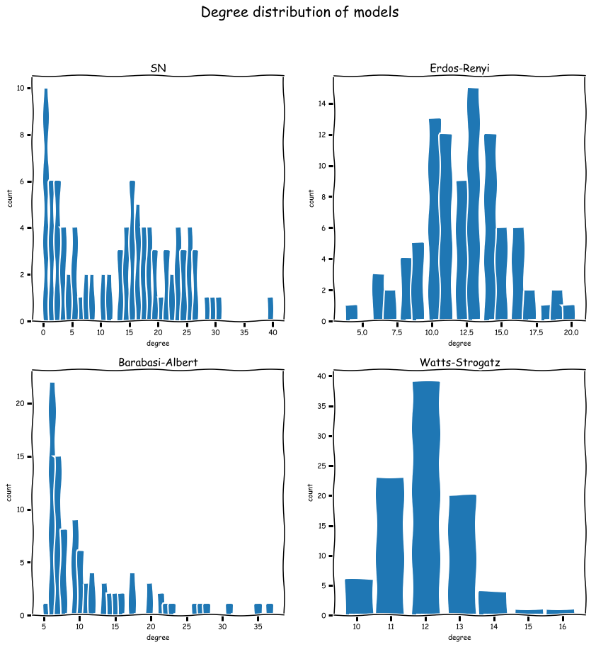
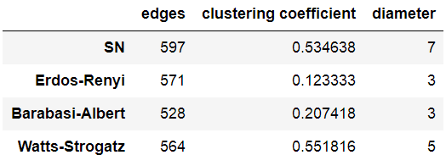
The closest random graph model

Slide 12
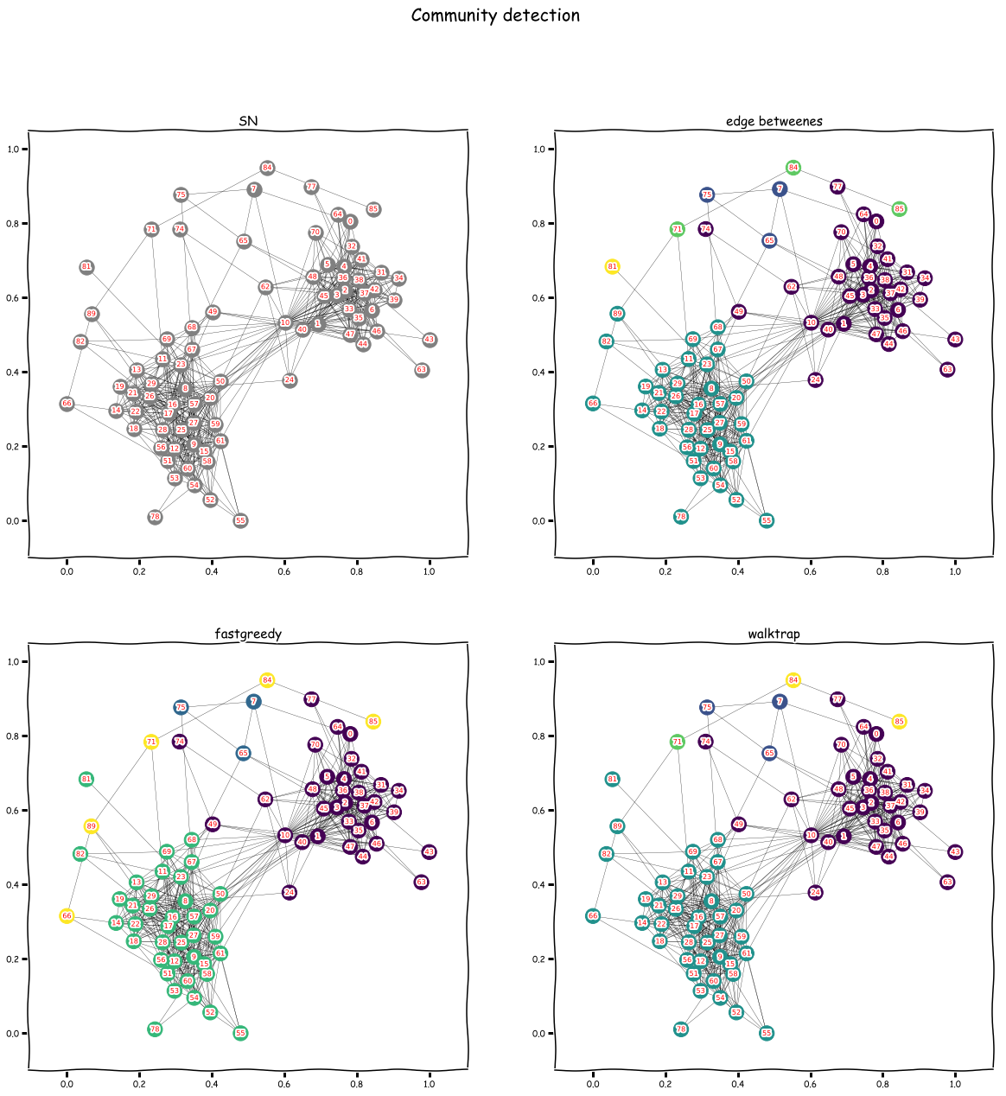
Community detection
Modularity for all algorithms: 0.46

