Slide 1


Customer
Transaction Prediction
WBS Consultancy
Designed for UNIVERSAL PLUS Bank

Slide 2






INDEX
WBS Consultancy
METHODOLOGY
PROJECT UNDERSTANDING
DATA INSIGHTS
LET’S TALK BUSINESS
OUR SOLUTION
OUR TEAM
Designed for UNIVERSAL PLUS Bank

Slide 3
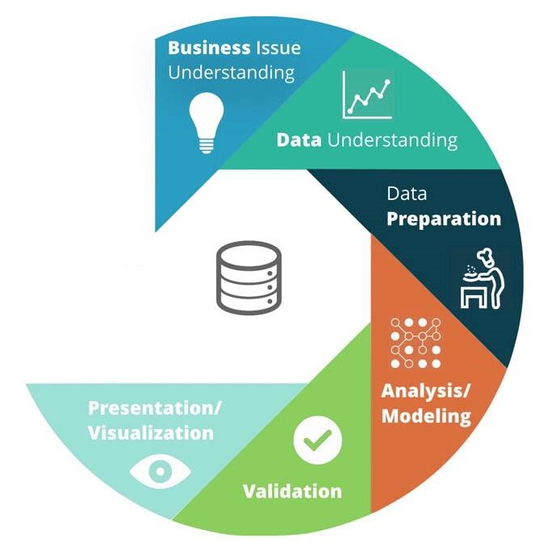
METHODOLOGY
WBS Consultancy
CRISP DM
Designed for UNIVERSAL PLUS Bank

Slide 4



PROJECT UNDERSTANDING
WBS Consultancy
WHY
WHAT
HOW
Cutting Edge AI
Analytical Skills
Business Acumen
Customer Retention
Customer Satisfaction
Cost
Predictive Model
Profit Maximisation
Designed for UNIVERSAL PLUS Bank

Slide 5
DATA INSIGHTS
WBS Consultancy
TOTAL CUSTOMER TRANSACTIONS
200 Features
100,000 Records
10%
90%
86%
14%
10%
90%
10%
90%
PROMISING CUSTOMER TRANSACTIONS
RADICAL CUSTOMER TRANSACTIONS
Designed for UNIVERSAL PLUS Bank

Slide 6


LET’S TALK BUSINESS
WBS Consultancy
PRIMARY GOAL
SECONDARY GOAL
Retain all the promising customers
Cost Optimisation (Maximise Profit)
Designed for UNIVERSAL PLUS Bank

Slide 7

LET’S TALK BUSINESS
WBS Consultancy
Without Our Model
10 Positive
100 Customer Transactions
90 Negative
Avg. Cost per cust. = ‘C’
Avg. Revenue per cust. = ‘R’
1. Target is very high, Profitability very low
Total Cost = 100C
Total Revenue = 10R
2. Cost of the Project needs to be reduced
Profit Requirement: R > 10C
Designed for UNIVERSAL PLUS Bank

Slide 8
PROBLEM SOLUTION
WBS Consultancy
With Our Model
14% Cost reduction
Additional 40% Cost reduction
Accuracy
86
Promising
Customer
Transactions
34
Target
Customer
Transactions
100
Customer
Transactions
Data
Insights
Optimised
ML Classifier
80%
Designed for UNIVERSAL PLUS Bank

Slide 9
OUR SOLUTION
WBS Consultancy
Avg. Cost per cust. = ‘C’
Avg. Revenue per cust. = ‘R’
Total Cost
Profit Requirement (Target)
ACCURACY
Without
Model
R > 10C
100 C
Target Reduced
by 50%
80%
66% Cost Reduction
With
Model
34 C
R > 5C
Designed for UNIVERSAL PLUS Bank

Slide 10
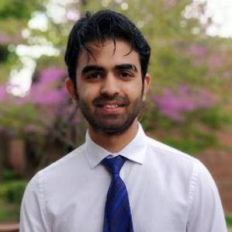
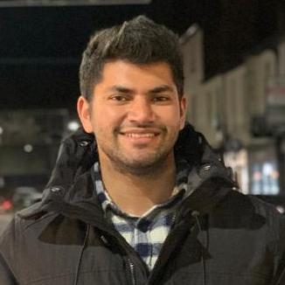

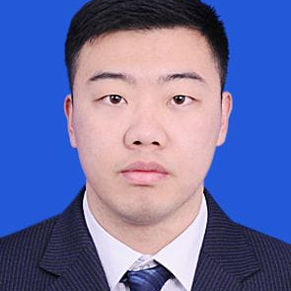
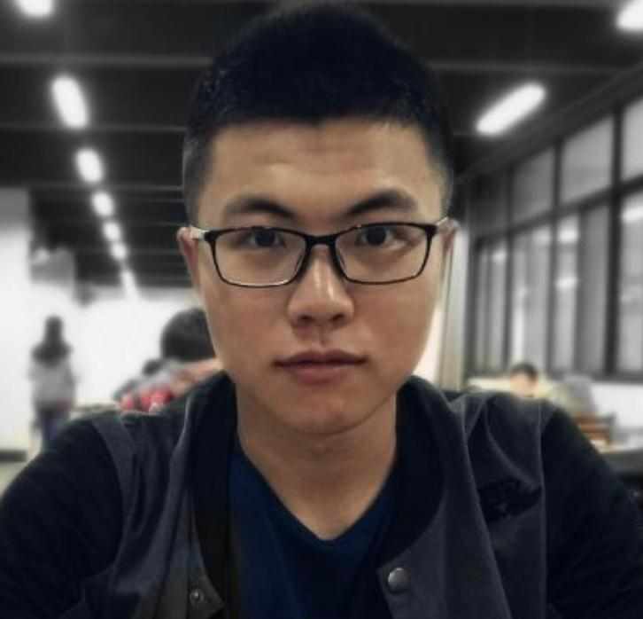
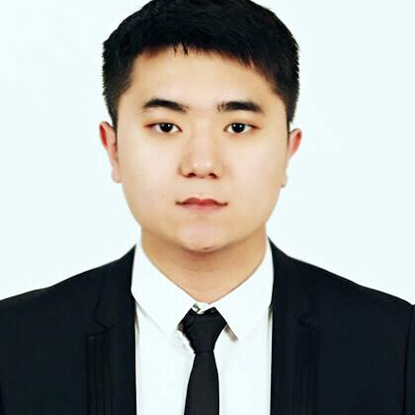
OUR TEAM
WBS Consultancy
Dushant Gohri
Stylianos Killas
Rohan Kunte
Qixin Jia
Mingjian Ma
Cheng Cheng
Designed for UNIVERSAL PLUS Bank

Slide 11

THANK YOU
WBS Consultancy
Designed for UNIVERSAL PLUS Bank

