Slide 1



Laptop Price Prediction Using Machine Learning
Submitted to
Dr. Sachin Kansal
Presented by
Dushar Khatri (102217166)

Slide 2

PURPOSE
OBJECTIVE
Predict laptop prices based on key specifications like RAM, CPU, SSD, and display.
Provide an interactive tool for users to estimate laptop prices based on their desired configurations.
Assist in making informed decisions when purchasing laptops, balancing performance and budget.
Leverage machine learning to generate reliable price predictions.
Helping consumers understand how specific features affect price.

Slide 3

Literature Review
Identified Gaps
Existing tools lack specificity for laptops
Limited interactivity prevents users from experimenting with configurations
Few solutions cater to students and non-technical consumers.
Key Research
Machine learning models like Linear Regression and Random Forest are widely used for price prediction.
Feature Engineering: Techniques such as creating derived attributes (e.g., ppi) .
Importance of combining numerical and categorical features (e.g., RAM, brand, CPU type).
Addressing these Gaps
Interactive tool specifically for laptop price prediction.
User-friendly design via a Streamlit app.
Bridges academic research with real-world applications, empowering informed decision-making.

Slide 4

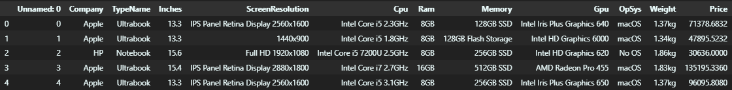
Methodology
DATASET
Contains detailed information about various laptop models, including their technical specifications and price.

Slide 5








WORKFLOW
Dataset
Preprocessing
Feature Selection
& Engineering
Deployment
Model Evaluation
Model Training

Slide 6

RESULTS
 | R2 Score | MAE
Linear Regression | 0.80732 | 0.21017
Ridge Regression | 0.81273 | 0.20926
Lasso Regression | 0.80718 | 0.21114
KNN | 0.80314 | 0.19264
Decision Tree | 0.84117 | 0.18254
SVM | 0.80831 | 0.20239
Random Forest | 0.88734 | 0.15860
MODEL PERFORMANCE
Best Model:
Random Forest Regressor performed the best with an R² of 0.88 and MAE of 0.15.

Slide 7
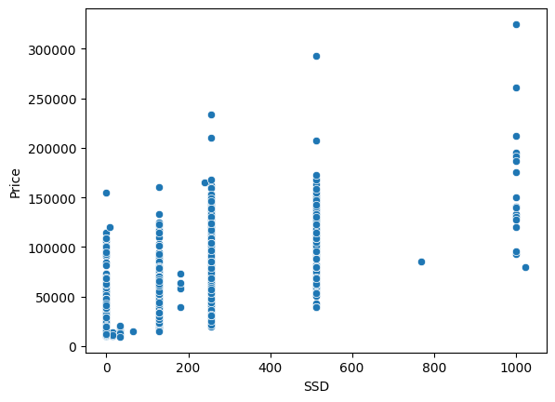
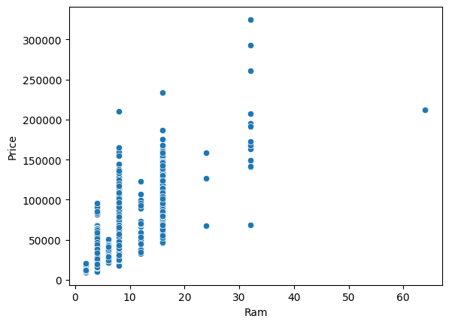
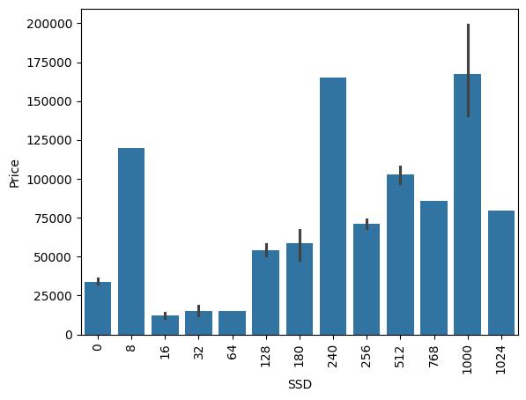
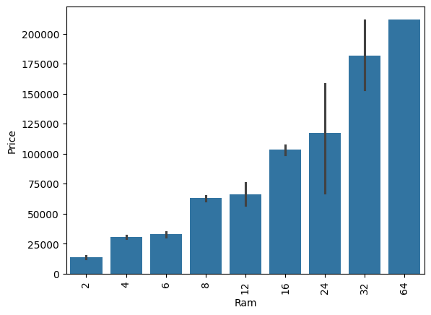

Key features impacting price
RAM and SSD are the strongest predictors of laptop price.
Price vs SSD
Price vs RAM

Slide 8
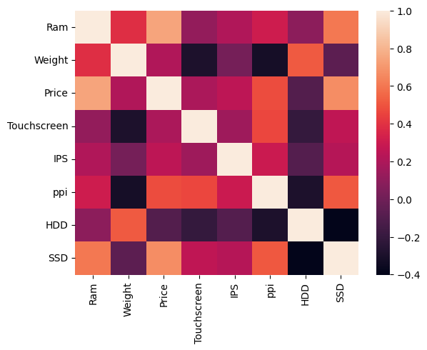
Visible correlations between Price and RAM, Price and SSD,
RAM and SSD, Weight and HDD etc.

Slide 9
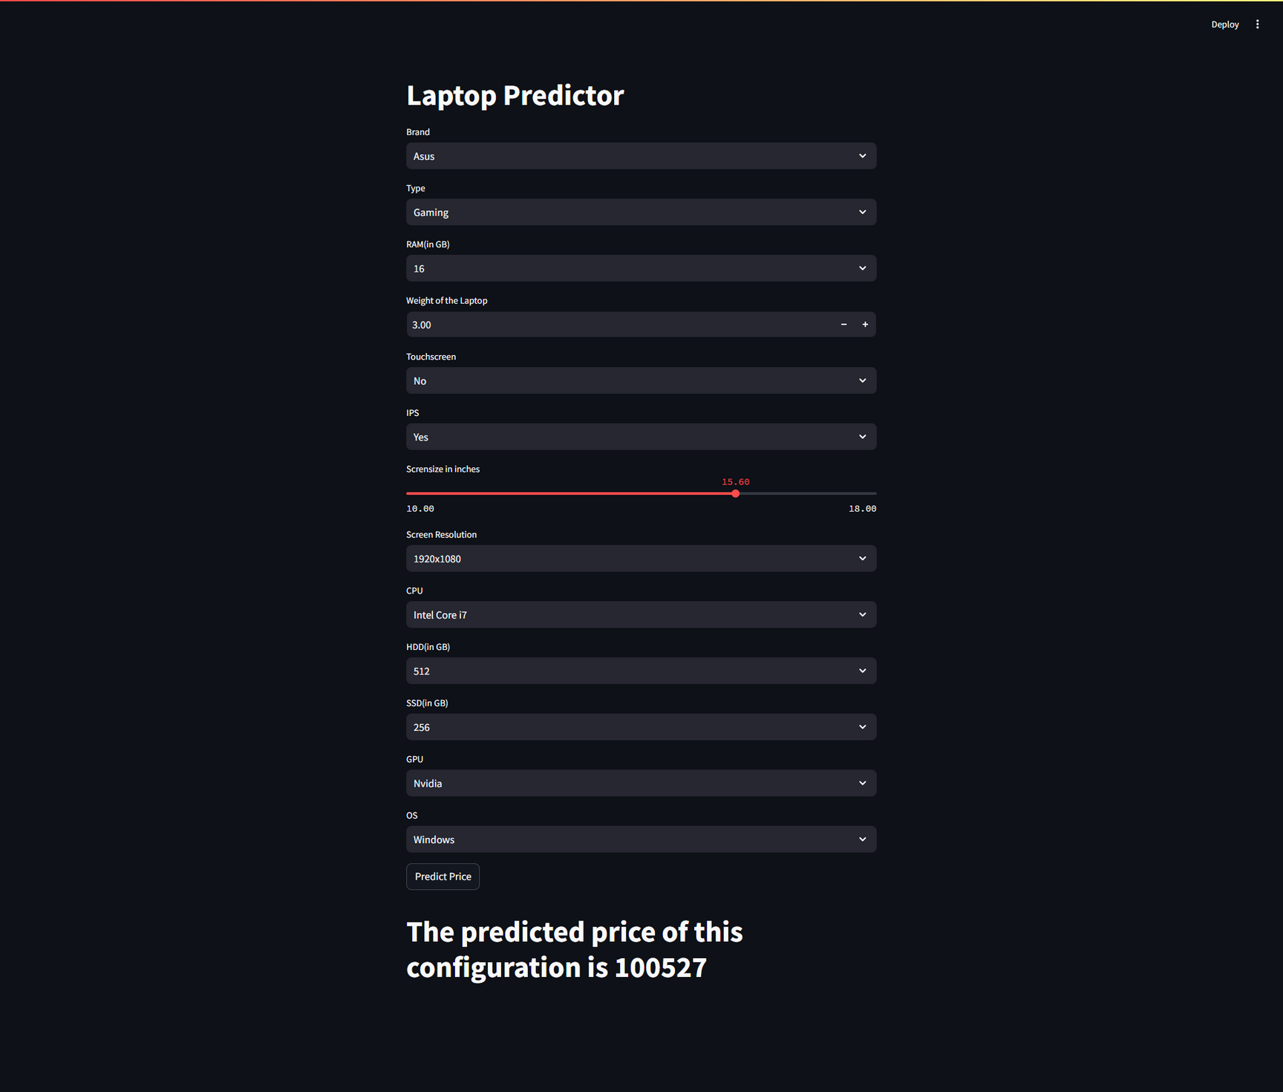
Streamlit Interface

Slide 10
CONclusion
Practical Implications
The tool helps students and buyers make informed decisions on laptop pricing based on configurations.
It could be used by retailers for better pricing strategies.
Key Findings
RAM and SSD are the top predictors of laptop price.
ppi (Pixels Per Inch) also affects price, with higher values leading to more expensive laptops.
Random Forest performed the best with an R² of 0.85 and MAE of 0.11.
Future Recommendations
Expand the dataset with more laptop models and features (e.g., battery life).
Explore neural networks for improved accuracy.
Adapt the tool for other electronics (smartphones, tablets).

Slide 11
References
Dataset - https://www.kaggle.com/datasets/jacksondivakarr/laptop-price-prediction-dataset
References - https://www.ijnrd.org/papers/IJNRD2303124.pdf
References - https://www.analyticsvidhya.com/blog/2021/11/laptop-price-prediction-practical-understanding-of-machine-learning-project-lifecycle/

