Slide 1
Accessibility

Slide 2
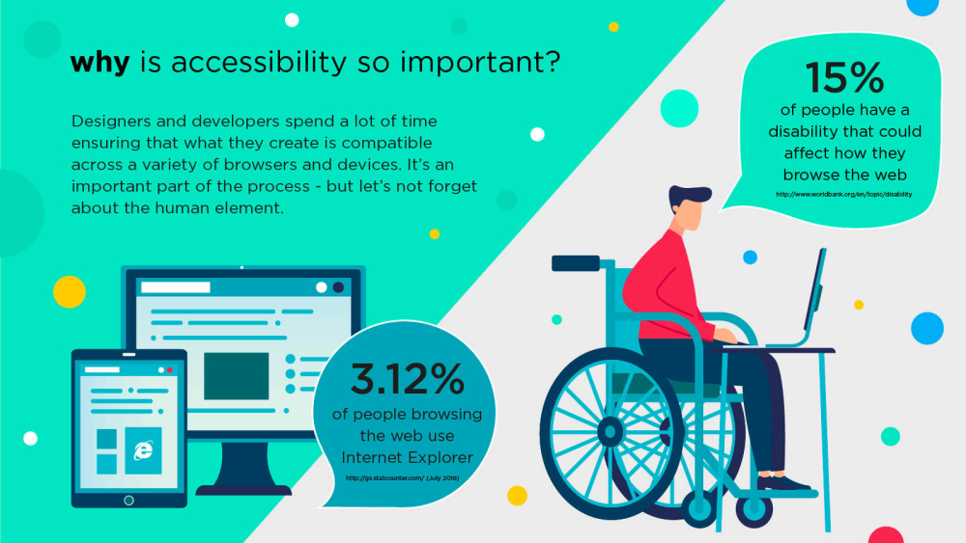

Slide 3
Accessibility
“The power of the Web is in its universality. Access by everyone regardless of disability is an essential aspect.”
Tim Berners-Lee, W3C Director

Slide 4
Web Accessibility is a Marketplace Issue
At least 10% of the population in most countries has disabilities;
visual, auditory, physical, speech, cognitive, and neurological disabilities can all affect access to the Web
Average age of population in many countries is increasing;
aging sometimes results in combinations of accessibility issues;
vision & hearing changes, changes in dexterity & memory.
Some of us become temporarily disabled due to accident or illness
Few organizations can afford to deliberately miss this market sector.

Slide 5
Disabilities == Different abilities
cognitive and neurological disabilities
dyslexia and dyscalculia
attention deficit disorder
intellectual disabilities
memory impairments
mental health disabilities
seizure disorders
multiple disabilities
aging-related condition
visual disabilities
blindness
low vision
colour blindness
hearing impairments
deafness
hard of hearing
physical disabilities
motor disabilities

Slide 6
SO…THESE CAN EFFECT OUR ACCESS
Mobile connections
Slow Internet Connection
Old / New Browser
Missing Plug-ins
No Speakers / Noisy Environment
Small Display / Mobile Device
Eyes Busy / Hands Busy
Language
Computer / Mobile power / capabilities

Slide 7
What can we do
To help the people with disabilities
To help everyone
Your watching - https://www.youtube.com/watch?v=3f31oufqFSM
Good code
Test your sites

Slide 8
Why should we bother?

Slide 9
Why? (According to W3C (2018))
The Web must be accessible to provide equal access and equal opportunity to people with diverse abilities. Indeed, the UN Convention on the Rights of Persons with Disabilities recognizes access to information and communications technologies, including the Web, as a basic human right.
Accessibility supports social inclusion for people with disabilities as well as others, such as older people, people in rural areas, and people in developing countries.
Accessibility also benefits people without disabilities.
There is also a strong business case for accessibility. Accessibility overlaps with other best practices such as mobile web design, device independence, multi-modal interaction, usability, design for older users, and search engine optimization (SEO). Case studies show that accessible websites have better search results, reduced maintenance costs, and increased audience reach, among other benefits. Developing a Web Accessibility Business Case for Your Organization details the benefits of web accessibility.
http://www.w3.org/standards/webdesign/accessibility

Slide 10
WHY? – The Law
America – Section 508
http://www.section508.gov
UK Disability Discrimination Act
http://www.nidirect.gov.uk/the-disability-discrimination-act-dda
http://www.webcredible.com/blog-reports/web-accessibility/uk-website-legal-requirements.shtml
UK Equality Act
https://www.gov.uk/service-manual/helping-people-to-use-your-service/making-your-service-accessible-an-introduction

Slide 11
Why?
A proportion of your audience is disabled. We don’t want to loose them
Nearly one in every five people in the UK has a disability or impairment, and over half of households have a connection to someone with a disability.
In Sri Lanka about 8.7% of the total population above the age of 5 live with some form of disability, and it is estimated that about 300,000 people in the 18-60 age group have some form of disability. About 57% of disabled people are male, and 43% are female, as of 2012.

Slide 12
W3C Guidelines

Slide 13
About their influence
https://www.w3.org/standards/webdesign/accessibility
https://www.w3.org/WAI/ (Web accessibility Initiative)
https://www.w3.org/WAI/fundamentals/accessibility-intro/
What you should be bothered about - Web Content Accessibility Guidelines (WCAG) 2.1 - https://www.w3.org/TR/WCAG21/ (Recommendation June 18)
Perceivable
Operable
Understandable
Robust

Slide 14
Perceivable
Provide text alternatives for any non-text content so that it can be changed into other forms people need, such as large print, braille, speech, symbols or simpler language.
Provide alternatives for time-based media.
Create content that can be presented in different ways (for example simpler layout) without losing information or structure.
Make it easier for users to see and hear content including separating foreground from background.

Slide 15
Operable
Make all functionality available from a keyboard.
Provide users enough time to read and use content.
Do not design content in a way that is known to cause seizures.
Provide ways to help users navigate, find content, and determine where they are.

Slide 16
Understandable and robust
Understandable
Make text content readable and understandable.
Make Web pages appear and operate in predictable ways.
Help users avoid and correct mistakes.
Robust
Maximize compatibility with current and future user agents, including assistive technologies.

Slide 17
The standards
Level A – Basic accessibility features
Level AA – Most common user barriers
Level AAA – Highest and strongest barriers

Slide 18
Consider Colour Blindness

Slide 19
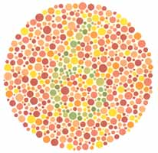
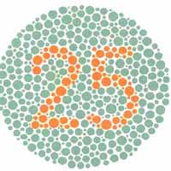
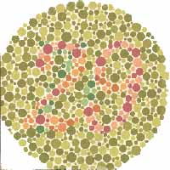
COLOUR BLIND
Care should be taken as 1 in 12 men and 1 in 200 women are colour blind.

Slide 20



COLOUR BLINDNESS
Hats. | As seen by a person with deuteranopia. | As seen by a person with protanopia, another form of red/green deficit.

Slide 21
PROBLEMS FOR PEOPLE WITH COLOUR BLINDNESS
Meaning that is conveyed by colour alone
Colour that is used as a unique marker to emphasise text on a Web site
Text that inadequately contrasts with background colour or patterns
Browsers that do not support user override of authors' style sheets
Solution - Ensure that all information conveyed with colour is also available without colour, for example from context or mark-up

Slide 22
Consider blind / poor sight

Slide 23
TECHNOLOGIES USED
Screen readers (JAWS, WindowEyes, Home Page Reader)
Braille readers
Text browsers directing content to speech synthesizers
Screen magnifiers (ZoomText and others)
Large monitors, low resolution (< 640x480)
Personal style sheets (font sizes & colour combinations)

Slide 24
PROBLEMS FOR VISUAL IMPAIRMENTS
Images that do not have alt text
Complex images (e.g. graphs or charts) that are not adequately described
Video that is not described in text or audio
Tables that do not make sense when read serially (in a cell-by-cell or "linear" mode)
Forms that cannot be tabbed through in a logical sequence or that are poorly labelled
Document formats that may be difficult for screen readers to interpret
Web pages or images, that have poor contrast, and whose contrast cannot be easily changed through user override of author style sheets

Slide 25
Consider hearing

Slide 26
HEARING IMPAIRMENTS
Deafness
Deaf community is a linguistic community
First language is sign language
Hard of hearing

Slide 27
Problems for hearing issues
Use of long sentences, uncommon or sophisticated vocabulary
Lack of captions or transcripts of audio on the Web
Lack of content-related images in pages full of text, which can slow comprehension for people whose first language may be a sign language instead of a written/spoken language

Slide 28
Consider other issues

Slide 29
SEIZURES
Seizure disorders
Triggered by visual flickering or audio signals at a certain frequency
To use the Web, people with seizure disorders may need to turn off animations, blinking text, or certain frequencies of audio

Slide 30
Cognitive impairments - Dyslexia / Dyscalculia
Difficulty processing written or spoken language, or numbers when read visually or heard
May rely on getting information in several ways at the same time (e.g. pictures / animation and text)
Provide alt text that can be converted to audio to supplement visuals
Don’t use unnecessarily complex language
Complex sentence structures
Use of long words or sophisticated language

Slide 31
Motor / Motability
Without use of hands / arms
Muscular / skeletal conditions
Must be able to navigate without a mouse / touch

Slide 32
Tips and testing

Slide 33
ACCESSIBILITY MEANS DULL
WRONG!!!!!!
An accessible page is NOT a dull, plain boring text
WAI (www.w3.org) guidelines tell you how to do things accessibly, they don’t say “Don’t do it”
Web accessibility is not about restricting your design; it's about enhancing it!

Slide 34
Testing Accessibility
Validate the HTML and CSS
WAVE Testing
http://wave.webaim.org/
Chrome extension https://chrome.google.com/webstore/detail/wave-evaluation-tool/jbbplnpkjmmeebjpijfedlgcdilocofh/related
Test the colours for colour blindness
Take a screen shot and test in one of the testers
Colour contrast checker - https://webaim.org/resources/contrastchecker/
Lighthouse Testing - dev tools audit

Slide 35
Extra reading
https://developers.google.com/web/fundamentals/accessibility/
https://developer.mozilla.org/en-US/docs/Web/Accessibility
https://webaim.org/ / http://webaim.org/intro/
Infographic - https://www.abrightclearweb.com/web-accessibility-in-the-uk/

