Slide 1



Machine Learning Application in Optimization of woven two-layered hydraulic pipes
Indian Institute Of Technology Roorkee
Presented By-
Dushyant Singh Udawat, Undergrad, IIT - Roorkee
Notes:
Add UBC logo + your University logo

Slide 2
Table of Contents
Product Description
Two-layered Woven Hydraulic Pipe.
Snaking Issue
Overall Objective
Data Summary
Stages I – Pre-analysis of data
Excel
Insights discussion
Stage II – MACHINE LEARNING PREDICTION MODELS
Procedure to select best models
Model performances for dataset
Model Comparison
Stage III – Explainable AI
LIME and SHAP comparison and selection of SHAP
SHAP Insights
Next Steps
Optimization

Slide 3
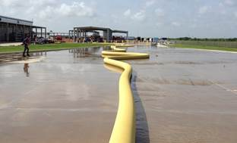
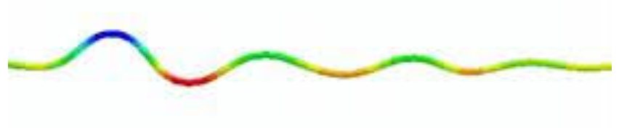
Product Description
Two-layered Woven Composite Hydraulic Pipe
Expected Application
to transport working fluids (e.g., water for oil and gas firefighting, water sand slurries in mining activities, among others
Snaking Issue
axial buckling of the hose structure under pressurized, causing interference with other personnel or equipment on the worksite
Implications on finance
Challenges
That’s why the use of Machine Learning
Notes:
Explainations –
There is a two layered pipe here which

Slide 4
Overall Objectives
Reduce the Number of Snaking, Snaking Length, Snaking Amplitude in the hose in such a way as to decrease the cost to the company.
Get Insights on the data provided.
Make prediction models to predict the snaking in a hose.
Provide the manufacturer with an AI-based decision-making tool.

Slide 5
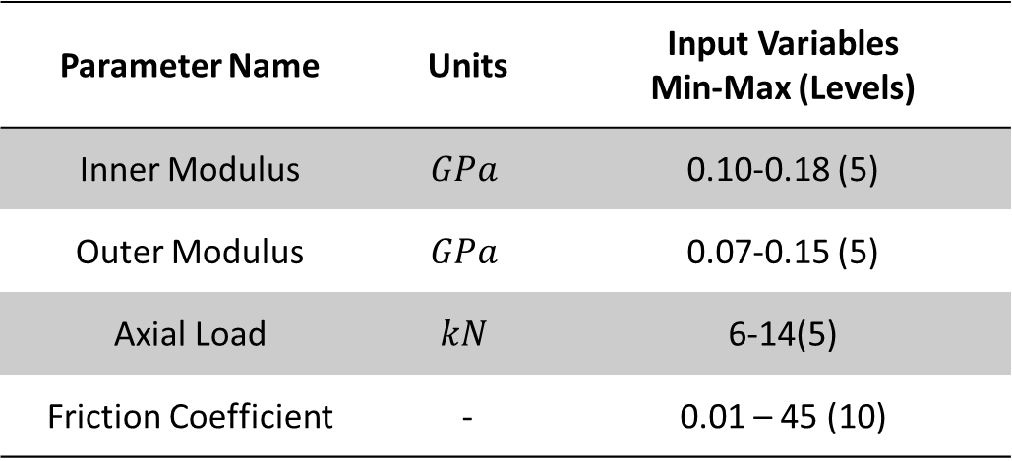
Data Summary - Inputs
Parameter Name | Units | Input Variables Min-Max (Levels)
Inner Modulus | $$GPa$$ | 0.10-0.18 (5)
Outer Modulus | $$GPa$$ | 0.07-0.15 (5)
Axial Load | $$kN$$ | 6-14(5)
Friction Coefficient | - | 0.01 – 45 (10)
We have four Parameters:
Inner Modulus
Outer Modulus
Axial Load
Friction factor between the
hose and ground.
These Parameters are changeable either during operations or during design process. Simulations gives us the data which is then used in Machine Learning methods to give predictions and get insights.
The data is generated for five values of each parameter. Therefore, giving a total of 5*5*5*10 1250 samples.
Notes:
(are simulations 100percent correct ?)

Slide 6
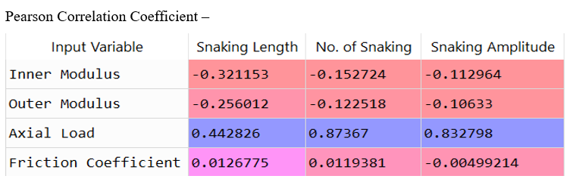
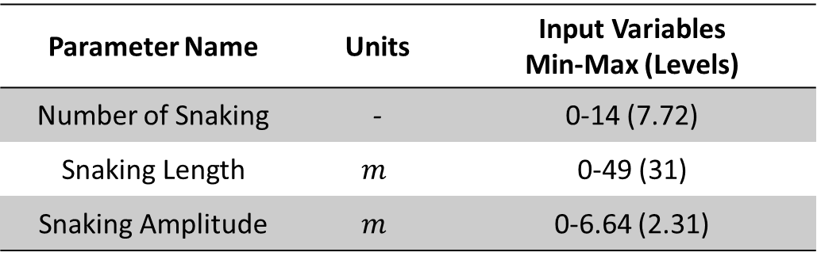
Data Summary - Outputs
Output Data Description
We have three output variables regarding snaking behavior
Snaking Length,
No. of Snaking,
Snaking Amplitude.
Their Description is as shown in the table.
Their Correlation with input variables can be seen in the adjoining figure.
Parameter Name | Units | Input Variables Min-Max (Levels)
Number of Snaking | - | 0-14 (7.72)
Snaking Length | $$m$$ | 0-49 (31)
Snaking Amplitude | $$m$$ | 0-6.64 (2.31)
Notes:
(are simulations 100percent correct ?)

Slide 7
STAGE I Pre-Analysis of Data

Slide 8
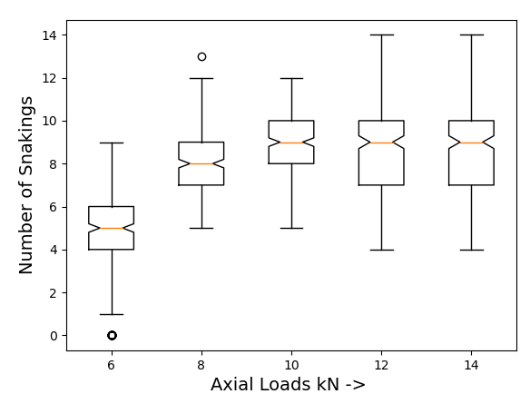
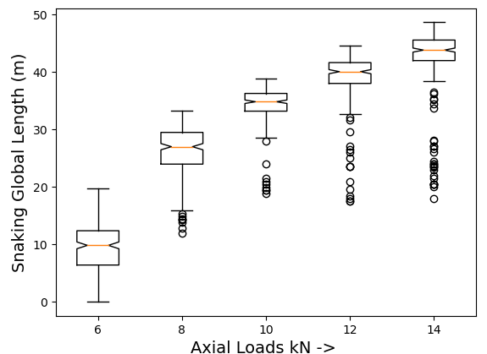
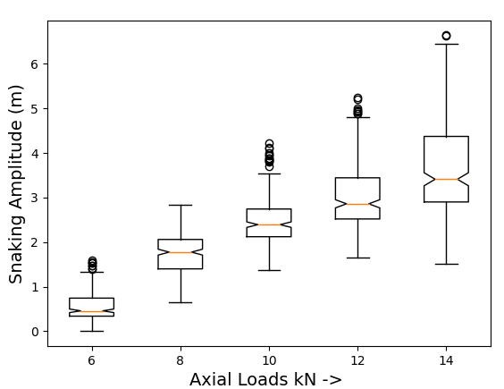
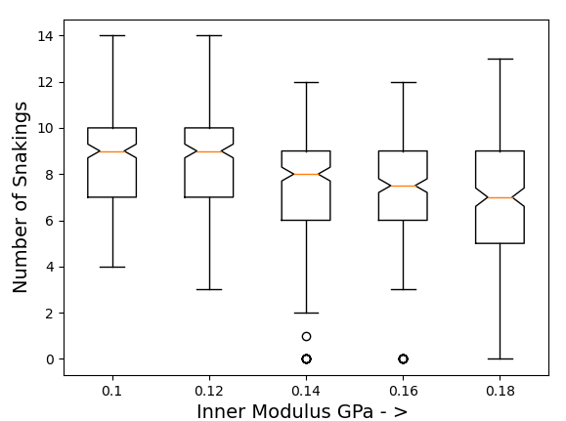
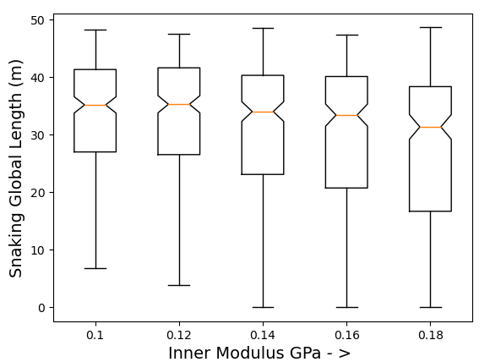
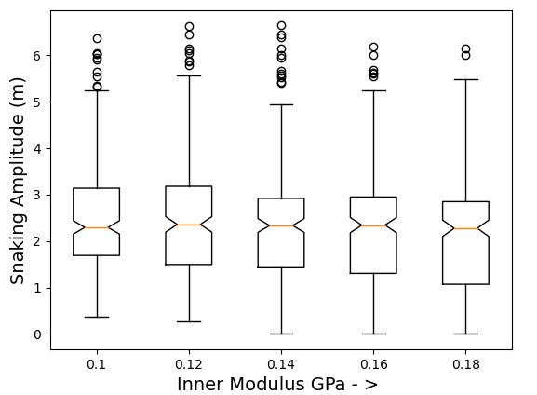
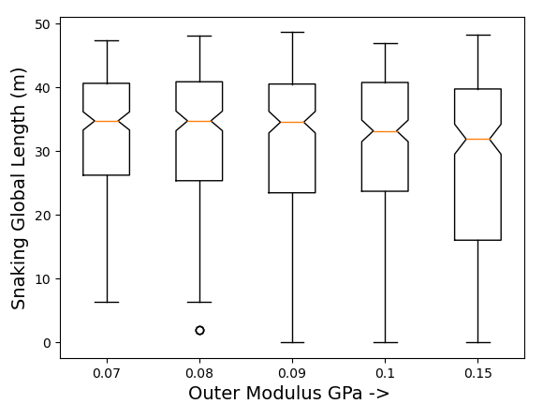
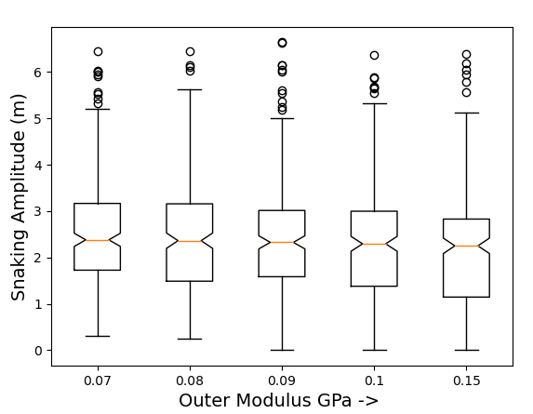
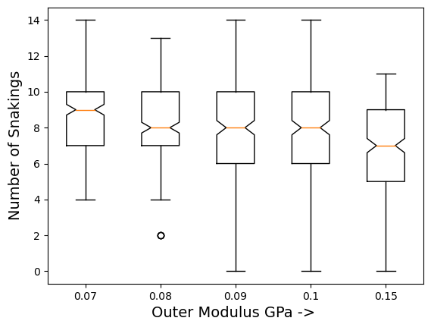
Snaking Length
Number of Snaking
Snaking Amplitude
Axial load
Inner Modulus
Outer Modulus

Slide 9
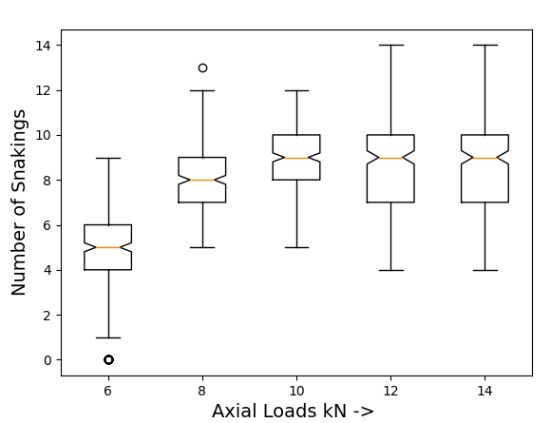
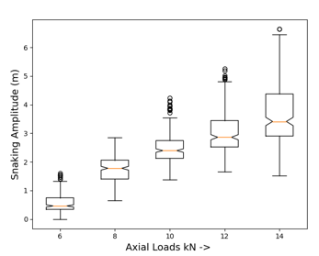
Insights
The single most important factor is the axial Load, the values changes a lot as we increase the loads from 6kN to 8kN.
After load>6kN, the variation in output parameters from modulus is less. This is corroborated by Linear Regression on separate Data, when Axial Load = 6 kN, and axial load > 6kN.

Slide 10
After load>6kN, the variation in output parameters from modulus is lesser. ( Linear Regression on separate Data)
After Axial Load > 6kN, Role of Inner Modulus is more important than Outer Modulus.
Generally, as inner and outer modulus increases, the tendency for snaking reduces slightly (Correlation)
For zero Snaking Condition –
Axial load < 7kN, Inner modulus > 0.13, Outer modulus> 0.13.
No dependence on the friction coefficient
(Correlation, Explainable AI, Models testing)

Slide 11
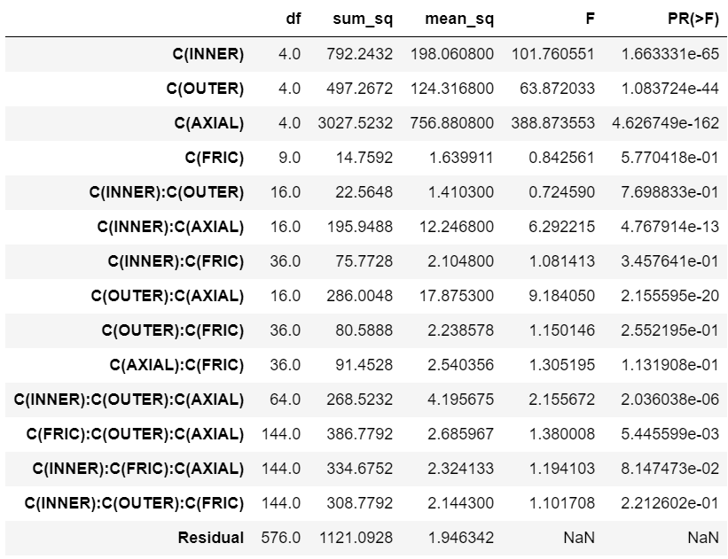
ANOVA
ANOVA Analysis Shows – (Show fig. for Number of Snaking)
Significant Variables – Inner , Outer and Axial load.
Insignificant = Friction and all its interactions.
Interaction between inner and outer modulus is Insignificant. (for Numbers of Snaking)
Interaction of Inner and Outer Modulus with Axial load are significant.
Interactions are similar in Length and Number of Snaking.
Interactions in case of amplitude, are not significant at all.
Interactions of Inner and outer modulus are not significant for NUM and AMP but it is significant for LEN.

Slide 12
STAGE – II Machine Learning Prediction Models

Slide 13
Procedure Employed to select Machine Learning Model -
Design the model and train it.
Optimize hyper-parameters to get the best cross-validation accuracy based on r2_score (Coefficient of Determination) and MSE (Mean Squared Error).
Consider the Importance of Accuracy, Speed, Interpretability and choose a Machine Learning model for each of the different output.

Slide 14
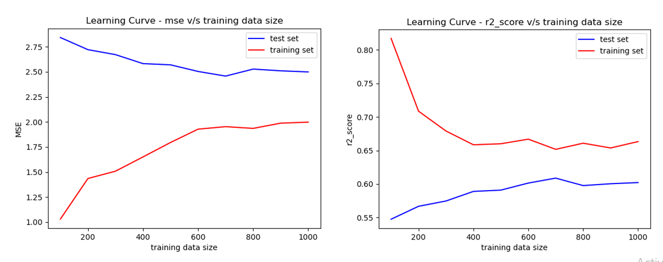
Learning Curve for XGBoost Predictor for Number of Snaking (12 such graphs are there for various models and Output variables)

Slide 15
SELECTION OF BEST MODELS
We have considered four factors that might help us to choose our model.
Interpretability
Training Speed
Accuracy (Both of them)
Since dataset is small, training speed is not an issue for us.
Next slide will go through results of selection of best models.

Slide 16
SELECTION OF MODELS -
Model | Interpret-ability |  | R² Coefficient of Determination (Highest) | MSE |  | Training Speed
Number of Snaking
Linear Regression | High | 0.321 |  |  | 4.268 | High
SVR | Low | 0.545 |  |  | 2.856 | Low
Decision Tree(*) | High | 0.600 |  |  | 2.508 | High
XGBoost(**) | Low | 0.602 |  |  | 2.500 | Low
Global Length of Snaking
Linear Regression | High |  | 0.764 |  | 41.78 | High
SVR | Low |  | 0.873 |  | 23.32 | Low
Decision Tree (*) | High |  | 0.880 |  | 21.24 | High
XGBoost (**) | Low |  | 0.881 |  | 21.22 | Low
Snaking Amplitude
Linear Regression(*) | High |  | 0.708 |  | 0.495 | High
SVR | Low |  | 0.712 |  | 0.483 | Low
Decision Tree | High |  | 0.711 |  | 0.490 | High
XGBoost(**) | Low |  | 0.723 |  | 0.460 | Low

Slide 17
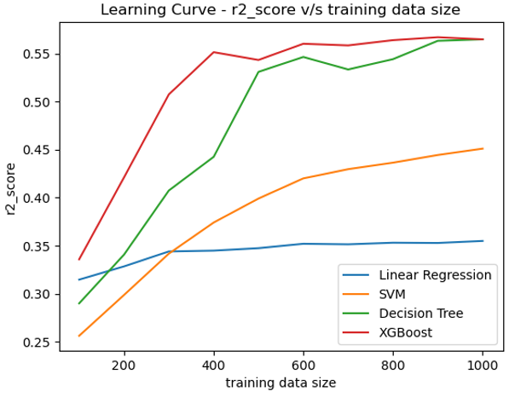
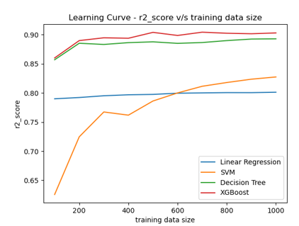
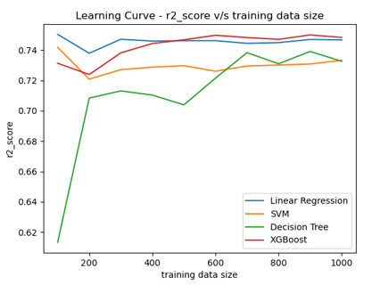
Learning Curve Comparison
Below are three figure showing the learning curves of various ML Models.
(Left to Right : For Number of Snaking predictor, Snaking Length, Snaking amplitude.)

Slide 18
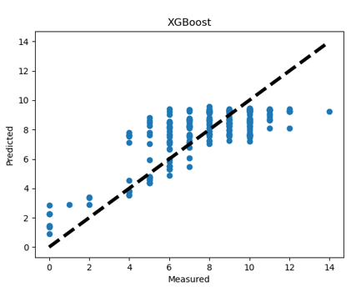
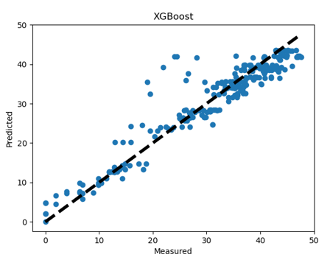
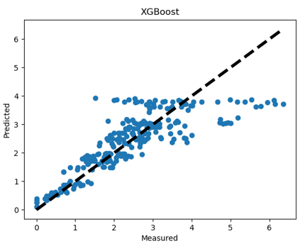
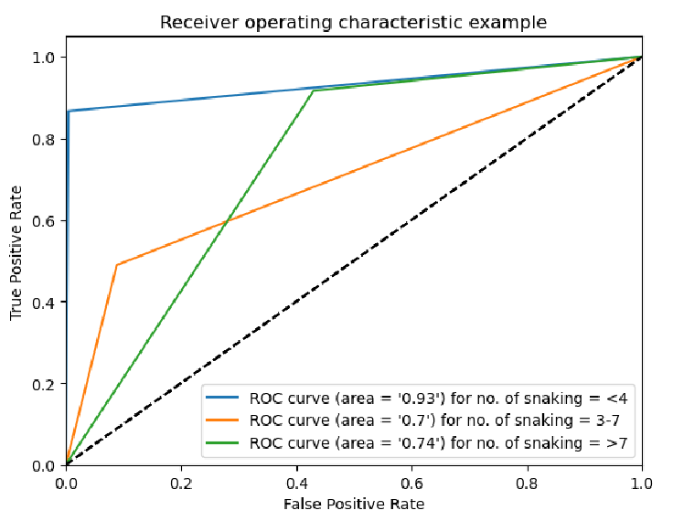
Pareto Charts for Best Models
Below are three figure showing the Pareto charts of best Predictors (Left to Right : For Number of Snaking predictor, Snaking Length, Snaking amplitude.)
Used to measure visually see how well a model is performing by plotting the predicted values against true values.

Slide 19
Stage – III Explainable AI

Slide 20
Interpretability - LIME v/s SHAP
Better Interpretability Leads to Better Adoption
Initially, SHAP and LIME explainable AI methods. SHAP was considered more appropriate – Data Size.
LIME performs a Linear Regression in vicinity of the input data sample. - Contributions
SHAP computes the contribution of each feature to the final output of any sample
Important: Only gives info about Model structure.

Slide 21
SHAP (SHapley Additive exPlanations)
The goal of SHAP is to explain the prediction of an instance x by computing the contribution of each feature to the prediction.
What is the Shapley Value?
Contributions
Example
Two people are to break stones. (A- 10, B-15 , together – 30 stones)
But how much of these 30 stones were broken by A ? – (12.5 stones)
Order matters

Slide 22
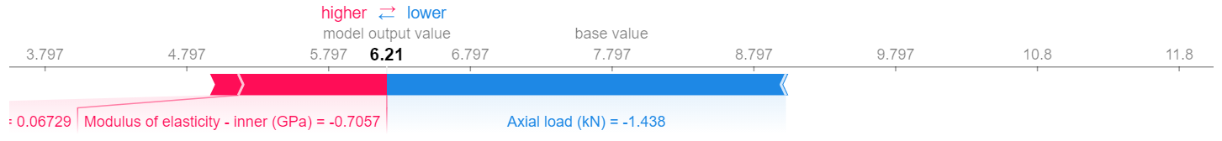
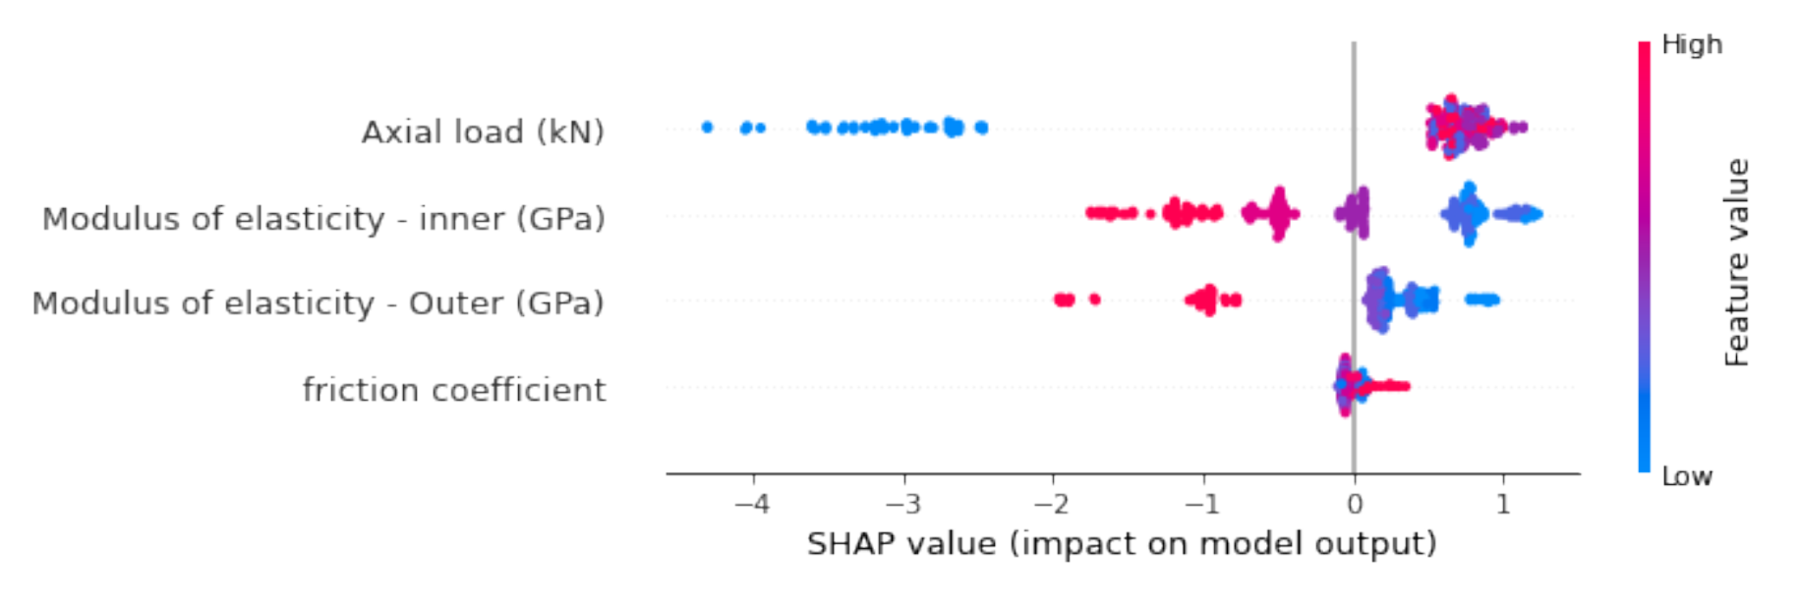
SHAP Results - Understanding
SHAP Summary Plot of Number of Snaking

Slide 23
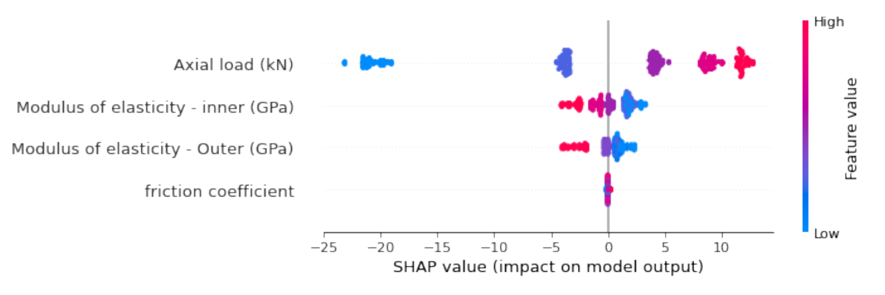
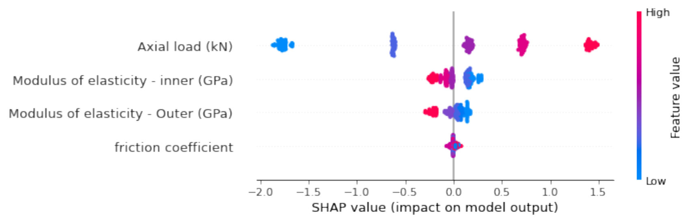
SHAP Summary Plot of Snaking length
SHAP Summary Plot of Snaking Amplitude

Slide 24
Insights from SHAP -
The insights from SHAP mostly corroborates the pre-analysis but are easy to interpret.
Existence of threshold.
The impact is almost constant for all the other values of axial loads on number of snaking.
Friction factor behavior is as expected, extremely low contact for almost all the values.

Slide 25
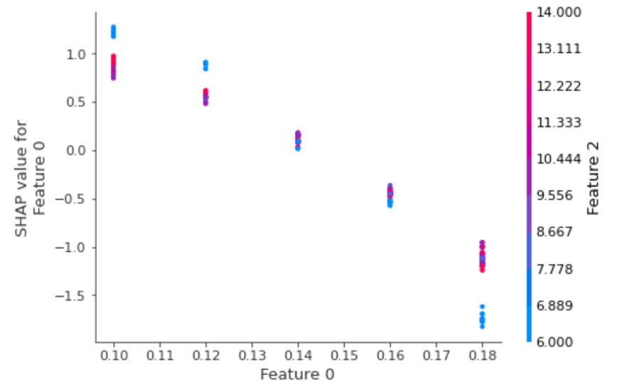
As shown in the dependence plot in figure, the impact of inner and outer modulus is significantly amplified for Axial Load = 6kN. Feature 0 is Inner Modulus in MPa, Feature 2 is Axial Load in kN.

Slide 26
Other Activities -
Other models tested –
Neural Network.
Poisson Classification.
Classification in case of number of snaking
XGBoost and Decision tree.
New data creation
Randomized.

Slide 27
NEXT STEPS
Optimization.
We want to see the application of Bayesian Optimization in this setting.

Slide 28
THE END.

