Slide 1
Biological comparison: WT versus KJ

Slide 2
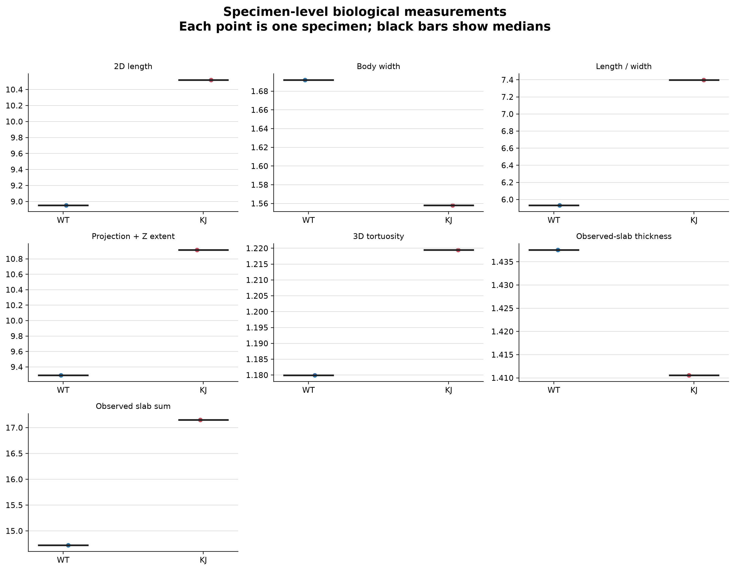
Specimen-level overview

Slide 3
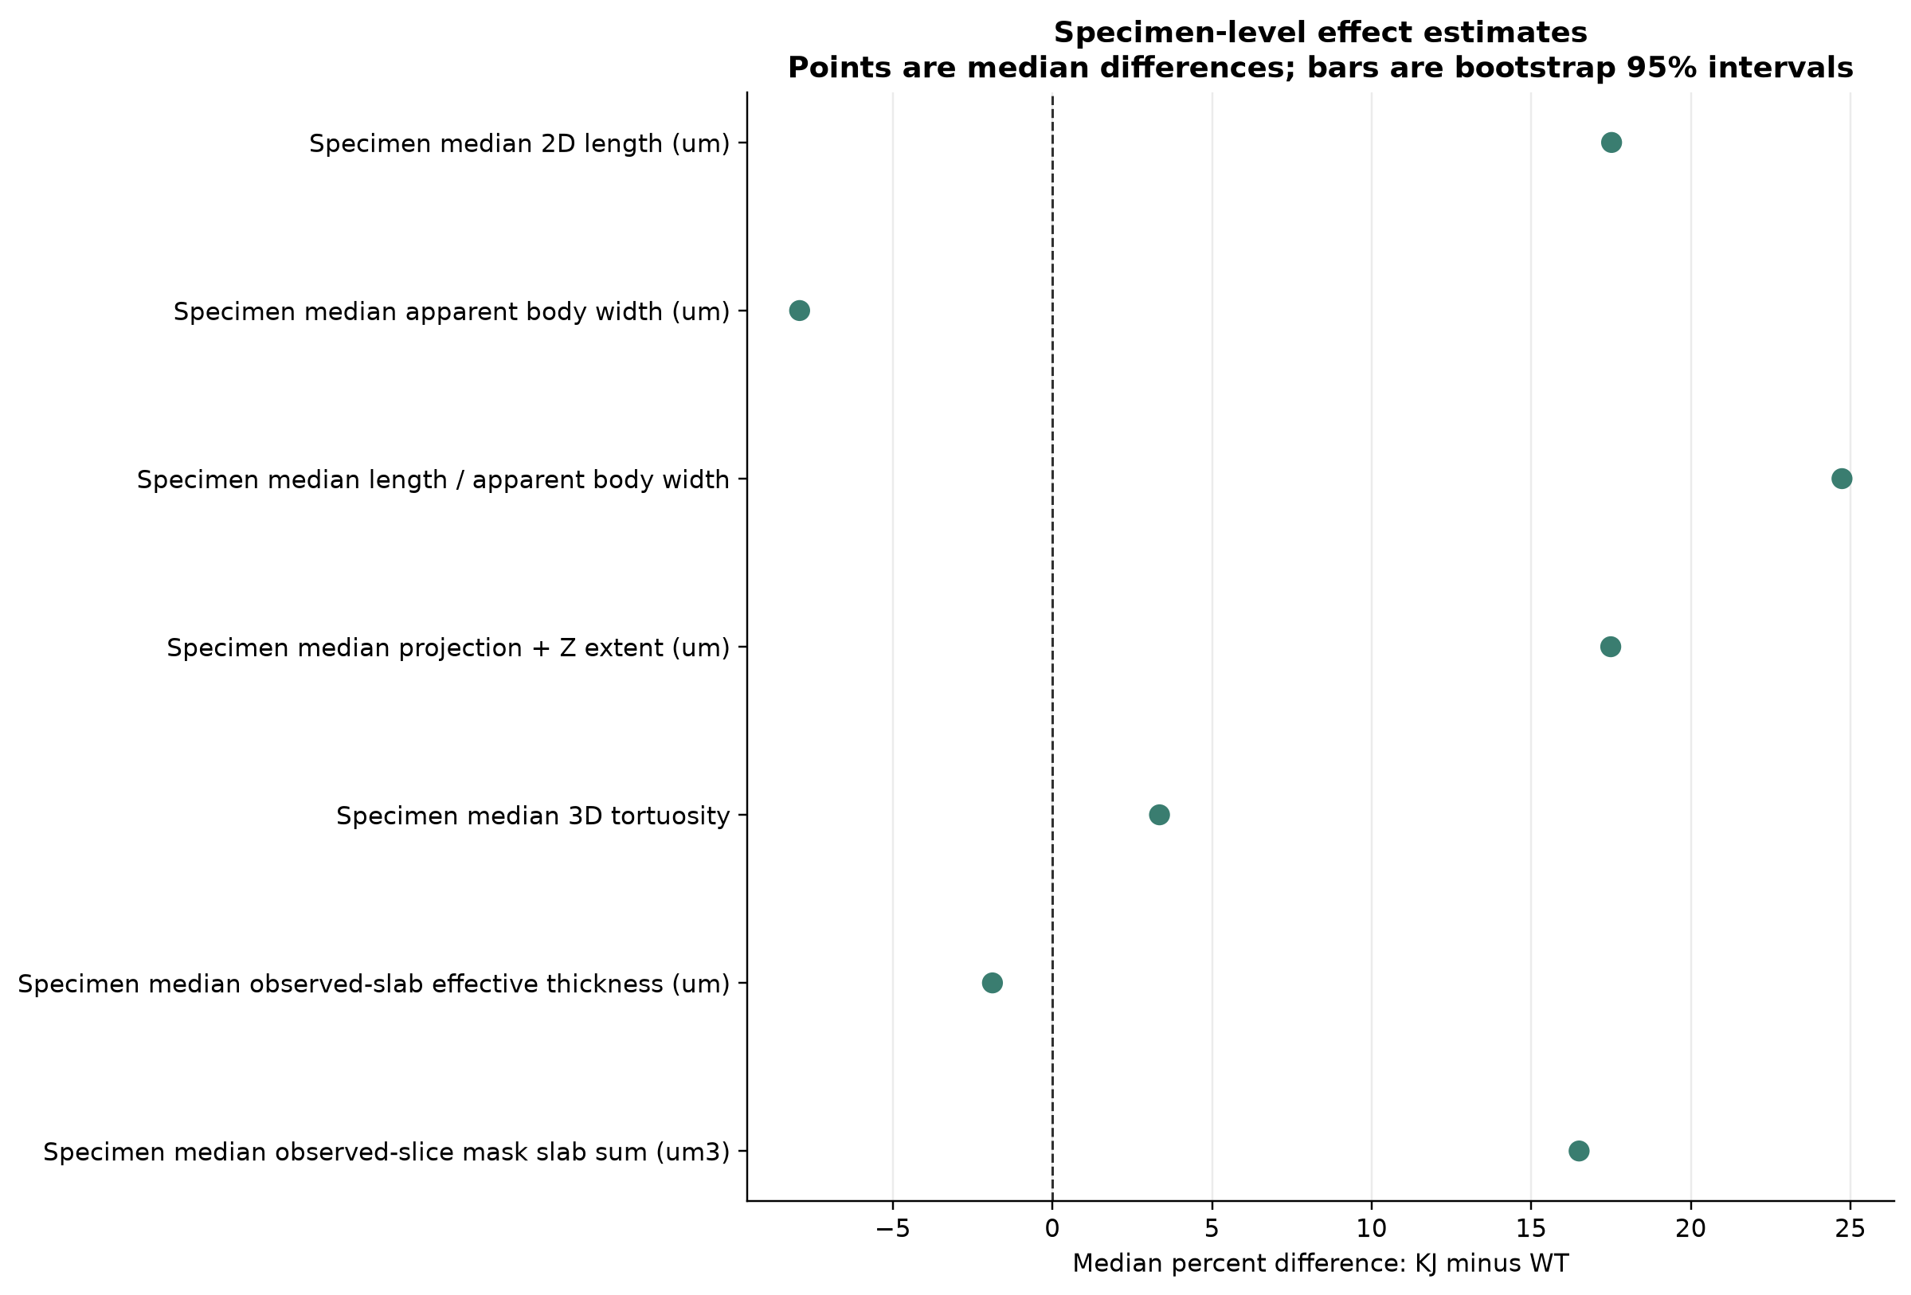
Effect-size forest plot

Slide 4
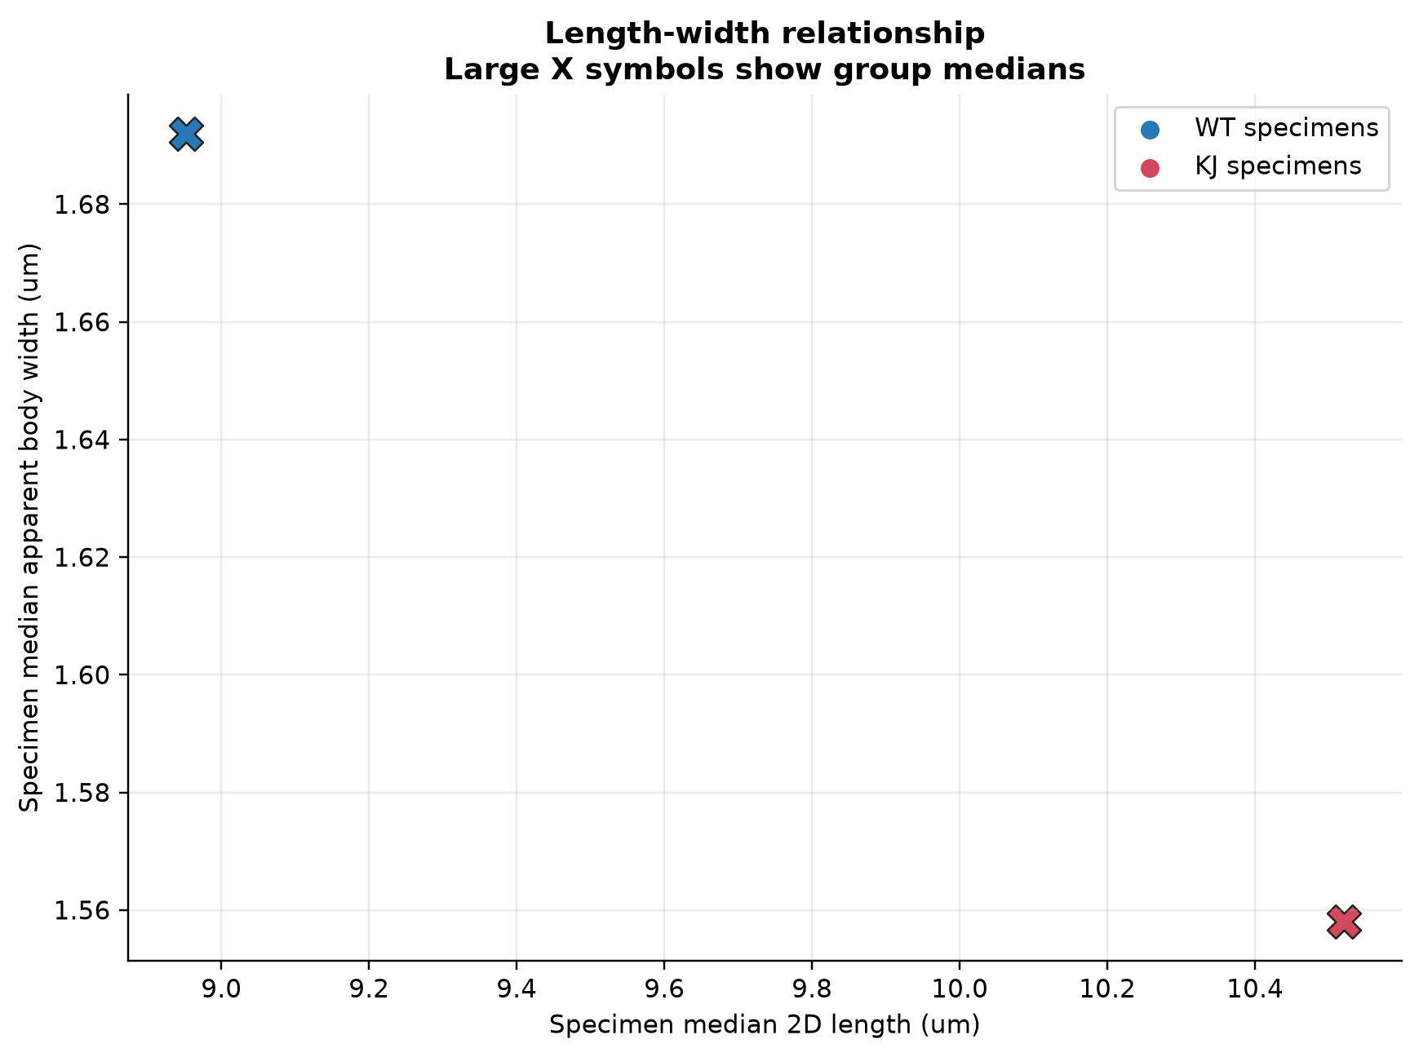
Length-width relationship

Slide 5
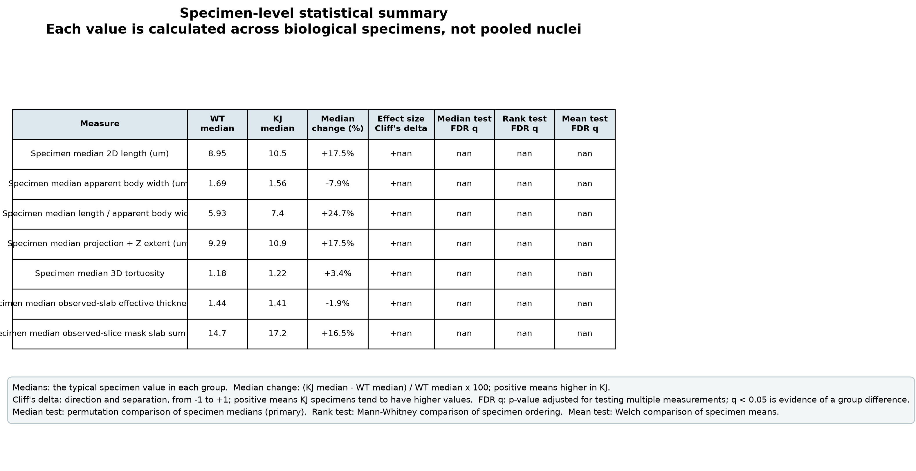
Biological statistical summary

Slide 6
Statistical methods
Biological specimen is the replicate; nuclei are nested measurements.
Descriptive comparison only. Inferential statistics are unavailable until each group has at least 3 biological specimens.
When available, the permutation median test is primary; Mann-Whitney and Welch tests are sensitivity analyses.
Nuclei are never treated as independent biological replicates.

Slide 7
How to interpret the measurements
2D length: Are nuclei typically longer in the image plane? The specimen median of each reconstructed nucleus's maximum calibrated 2D centerline length. Higher values indicate longer projected nuclei.
Body width: Are nuclei typically broader or thinner? The specimen median of representative-plane subpixel perpendicular body chords. Higher values indicate broader apparent masks; width remains sensitive to PSF, focus, and mask boundaries.
Length / width: Are nuclei more elongated or more rounded? A shape ratio. Higher values indicate longer, more slender nuclei; interpret it together with length and width.
Projection + Z extent: Do nuclei have a larger combined image-plane and Z extent? A calibrated hypotenuse combining maximum lateral centerline extent with Z span. It is orientation-sensitive and is not an integrated 3D centerline.
3D tortuosity: Are nuclei straighter or more curved? Estimated path length divided by end-to-end distance. Values near 1 are straight; larger values indicate increasing curvature.
Observed-slab thickness: Is the observed mask slab effectively thicker? A diameter proxy derived from volume divided by length. It is not a direct width and is PSF- and segmentation-sensitive.
Observed slab sum: How much calibrated observed-slice mask slab does a typical nucleus occupy? Filled-mask area on observed planes multiplied by Z spacing, with no missing-plane interpolation. It depends on thresholds, sampling, and PSF.

