Slide 1
Quality control: WT versus KJ

Slide 2
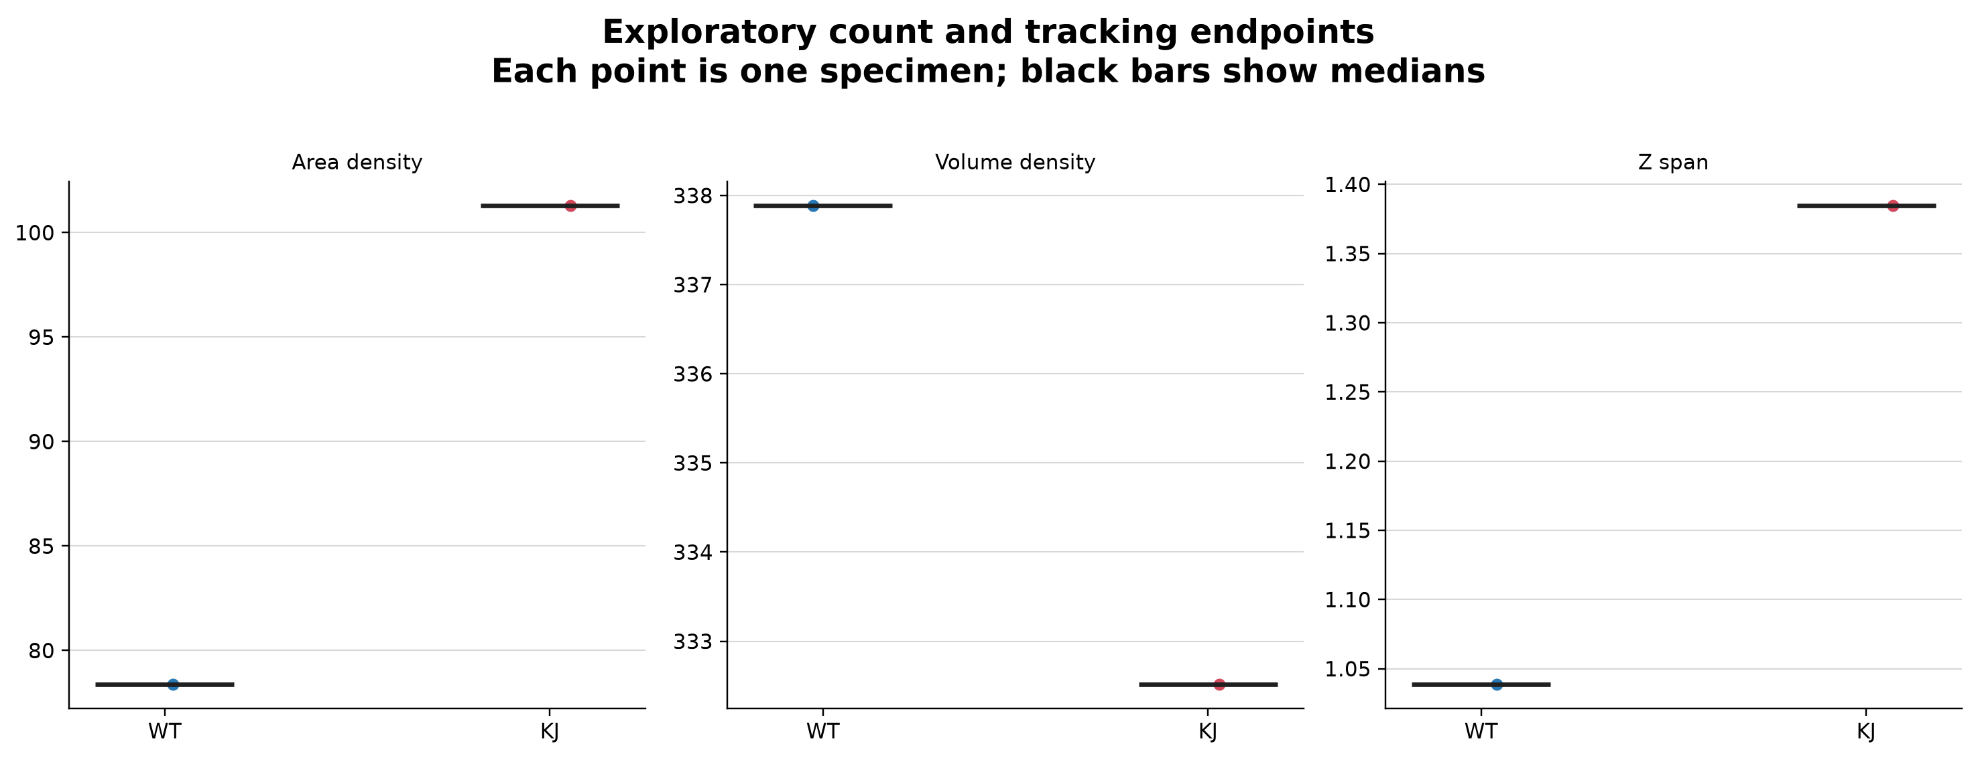
Exploratory count and tracking endpoints

Slide 3
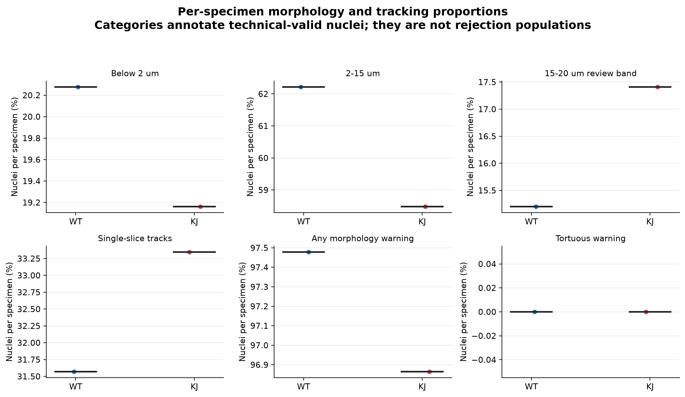
Morphology-warning and tracking proportions

Slide 4
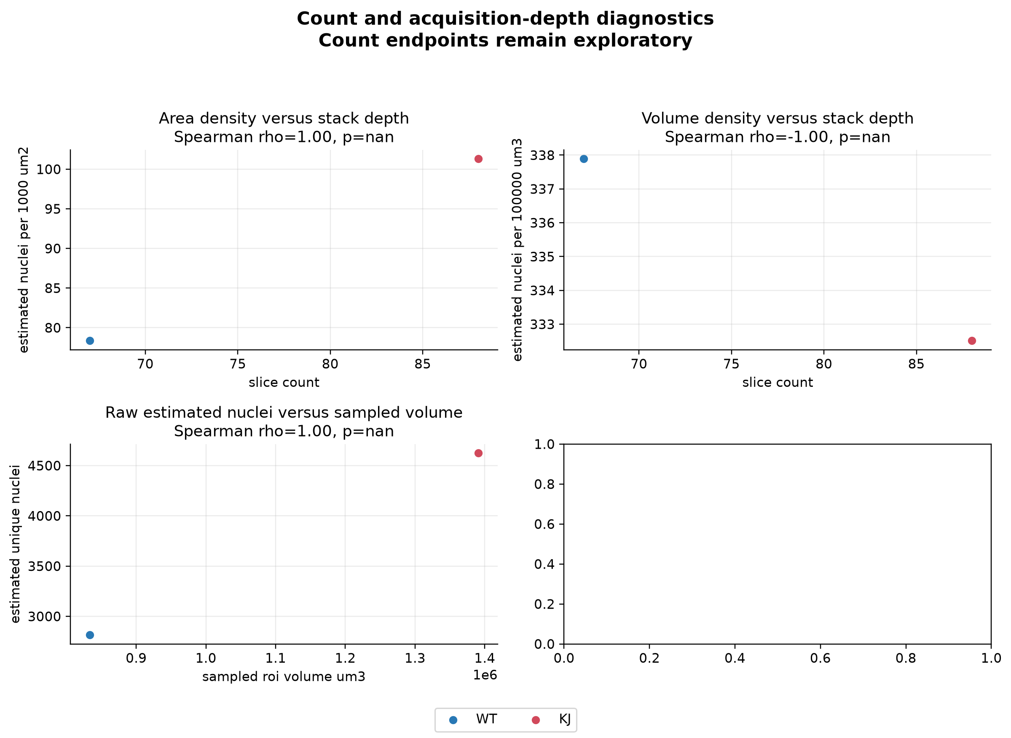
Count and stack-depth diagnostics

Slide 5
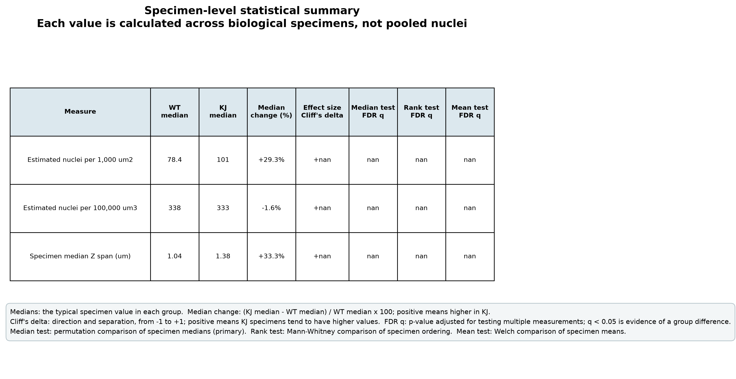
Exploratory QC statistical summary

Slide 6
How to use these diagnostics
These are technical and exploratory diagnostics, not the primary biological result.
Count endpoints require acquisition-depth review.
Morphology warnings annotate unusual technical-valid nuclei; they do not reject them.
Tracking Z span is acquisition- and linking-sensitive.
The primary biological report is in ../01_biological_results.

