Slide 1
Assignment 1
Network security
Project #2: Encryption and Decryption using transposition algorithm
Hritik Goel (2018148)
Dushyant Panchal (2018033)

Slide 2
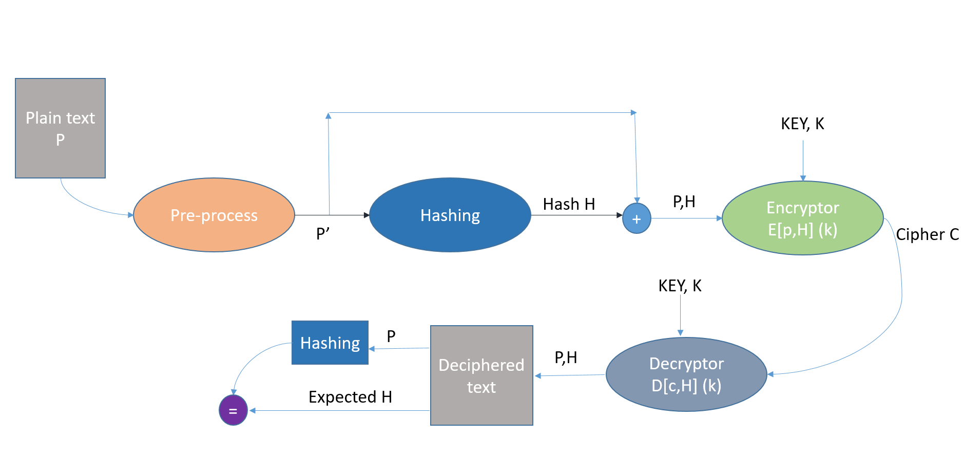
DESCRIPTION

Slide 3
Modules
Preprocess
Cleans the plaintext to contain only characters (a-z).
Pads the string accordingly leaving space for the hash code.
This padding ensures that we have enough characters to not leave any row empty while encryption.

Slide 4
Modules
HashFunction(String Input)
Suppose Input = s1 s2 s3 … sn
Fills a matrix of 8 (in our case) columns with the Input.
Initialise hash code with a’s.
Take character-wise xor by each row and rotate left after each operation.

Slide 5
Modules
Encryptor
Performs encryption through transposition.
Populate plaintext as a matrix
Permute columns as guided by the key.
Read column by column to obtain the ciphertext.

Slide 6
Modules
Decryptor
Performs decryption through transposition.
Populate ciphertext as a matrix along ‘key length’ columns.
Permute columns as guided by the key.
Read row by row to obtain the plaintext.

Slide 7
Modules
PropertyCheck (π)
Plaintext that we encrypt = plaintext + 8-character hashcode.
If the last 8 characters = hash(remaining characters), satisfies π.

Slide 8
Modules
BruteForce
Iterate over all possible permutations for key size 2 to 9.
We create a list of candidate keys through bruteforce over 1 sample.
Next, we tried candidate keys on the rest 4 samples.
Correct key satisfies all the samples.

Slide 9
THANK YOU

