Slide 1
Assignment 3
Network security
Project #1: Public Key Distribution Authority (PKDA)
Hritik Goel (2018148)
Dushyant Panchal (2018033)

Slide 2
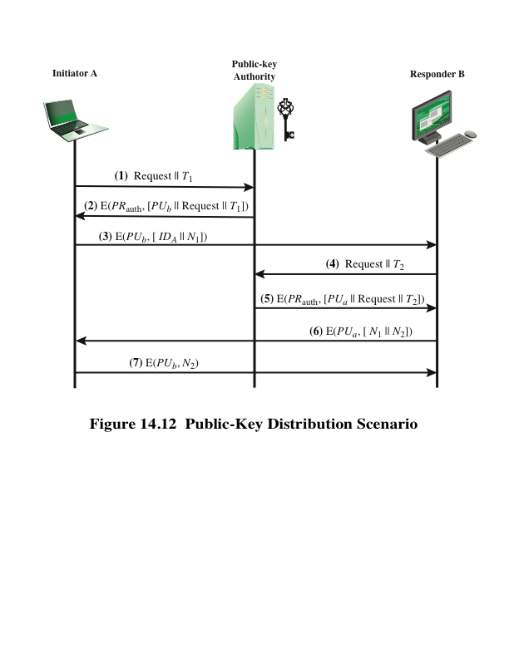
DESCRIPTION
A,B and PKDA have their own {private key, public key} taken in code.
A and B know the PU of PKDA.
A and B receives the PU of each other from PKDA.
After receiving the PU of each other, A sends 3 messages {Hi1, Hi2, Hi3} to B.
{Got-it1, Got-it2, Got-it3} is received by A from B as a reply.

Slide 3
Modules
Class RSA
encrypt
decrypt
rsa_core_operation : efficiently calculates “m^x (mod n)”
Some utility functions
rsa_encode_string : encodes a string as tuple(int)
rsa_decode_string : decodes a tuple(int) to string
Note: Supported strings may only contain a-z and 0-9. Special characters are ignored.

Slide 4
Modules
Class PKDA
process_message_from_client
simulates processing a client request for public key of another client.
nonce_response : performs nonce operation.
generate_timestamp

Slide 5
Modules
Class Client
gen_message_for_pkda : simulate sending msg to request for public key
process_message_from_pkda : simulate processing response from pkda
gen_message_for_client : simulate sending msg to another client
process_message_from_client : simulate processing message from client
Similar to PKDA
nonce_generate
nonce_response
generate_timestamp

Slide 6
SIMULATION
PKDA
Following Key-Pairs were used.
PKDA:
PU: (37,119)
PR: (13,119)
A:
PU: (29,91)
PR: (5,91)
B:
PU: (17,91)
PR: (17,91)
Get K-PU-B
Get K-PU-A
Hi1
A
B
Got-It1

Slide 7
THANK YOU

