Slide 1
🏦 Bluestock Fintech
Mutual Fund Analytics Platform
Capstone Project | Individual Submission | 2026
Dushyant Sharma
Python · SQLite · Power BI · mfapi.in · AMFI Data

Slide 2
Problem & Objective
❓ India's MF industry manages ₹67+ lakh crore AUM — yet retail investors lack easy analytical tools
📊 Objective: Build a full-stack analytics platform from raw AMFI data to interactive dashboard
🎯 Cover ETL → Cleaning → SQL DB → EDA → Risk Metrics → Power BI Dashboard
👥 Target: Retail investors, financial advisors, and fintech analysts
✅ All data from public sources: AMFI India + mfapi.in REST API — no API keys required

Slide 3
Data Sources & Scale
📁 Dataset
Rows
Description
01_fund_master
40
40 AMFI schemes — codes, AMC, risk grade
02_nav_history
46,000
Daily NAV Jan 2022–May 2026
03_aum_by_fund_house
90
Quarterly AUM for top 10 AMCs
04_monthly_sip_inflows
48
SIP inflows — ₹31,002 Cr milestone
08_investor_transactions
32,778
SIP/Lumpsum/Redemption across 12 states
10_benchmark_indices
8,050
Nifty 50, Nifty 100, BSE SmallCap

Slide 4
Data Pipeline & Architecture
1️⃣ EXTRACT
mfapi.in REST API + 10 AMFI CSVs
2️⃣ TRANSFORM
Pandas cleaning · forward-fill NAV · validate types
3️⃣ LOAD
SQLite star schema · 11 tables · 5.5 MB DB
4️⃣ ANALYSE
Sharpe · Sortino · Alpha · Beta · VaR · HHI
5️⃣ VISUALISE
Power BI 4-page dashboard · dark fintech theme

Slide 5
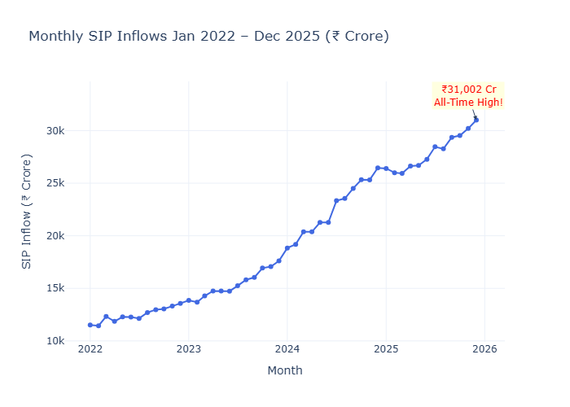
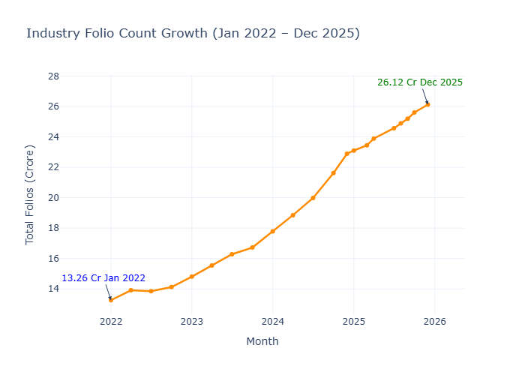
EDA Highlights — Market Overview
SIP inflows hit ₹31,002 Cr all-time high (Dec 2025)
Folios doubled: 13.26 Cr → 26.12 Cr in 4 years

Slide 6
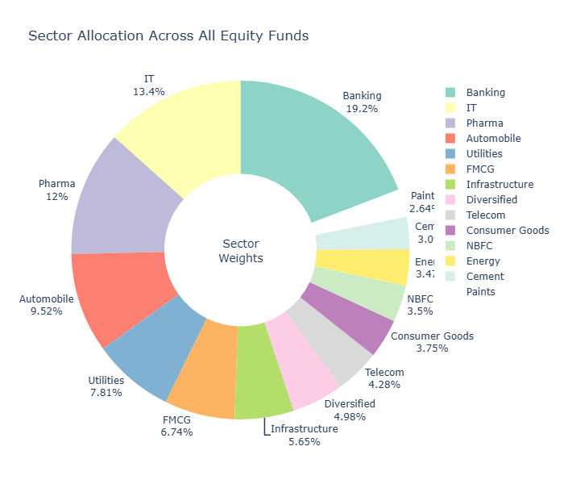
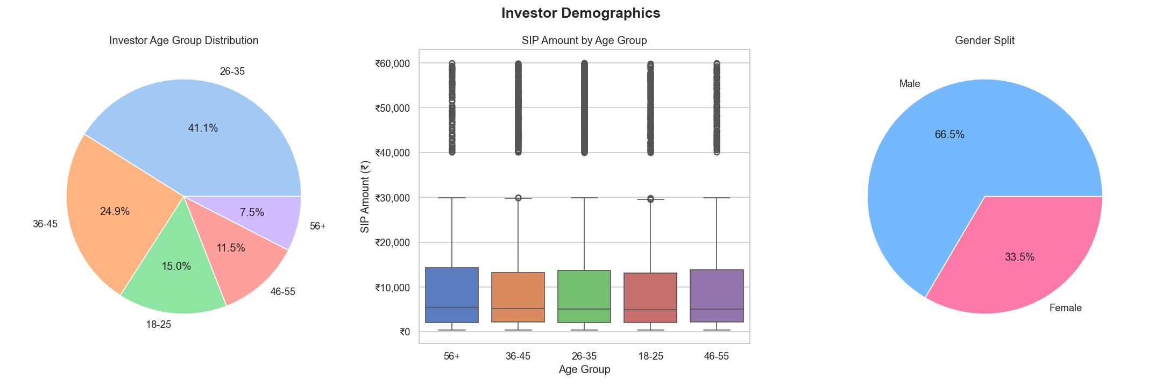
EDA Highlights — Fund & Investor Analysis
Banking dominates sector allocation (₹62,840 Cr)
26–35 age group drives highest SIP volumes

Slide 7
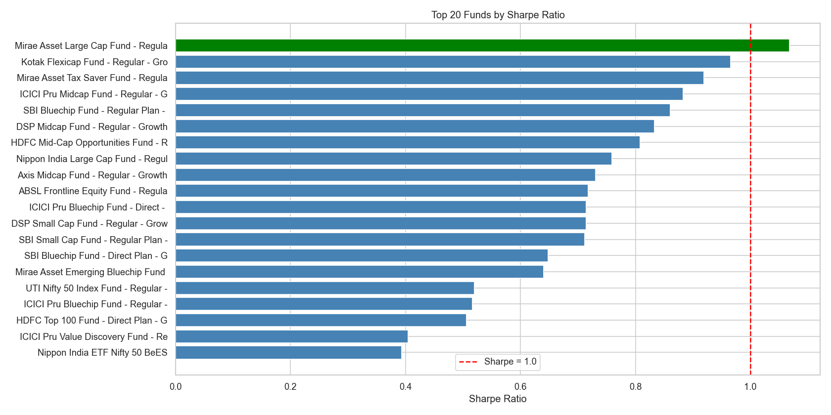
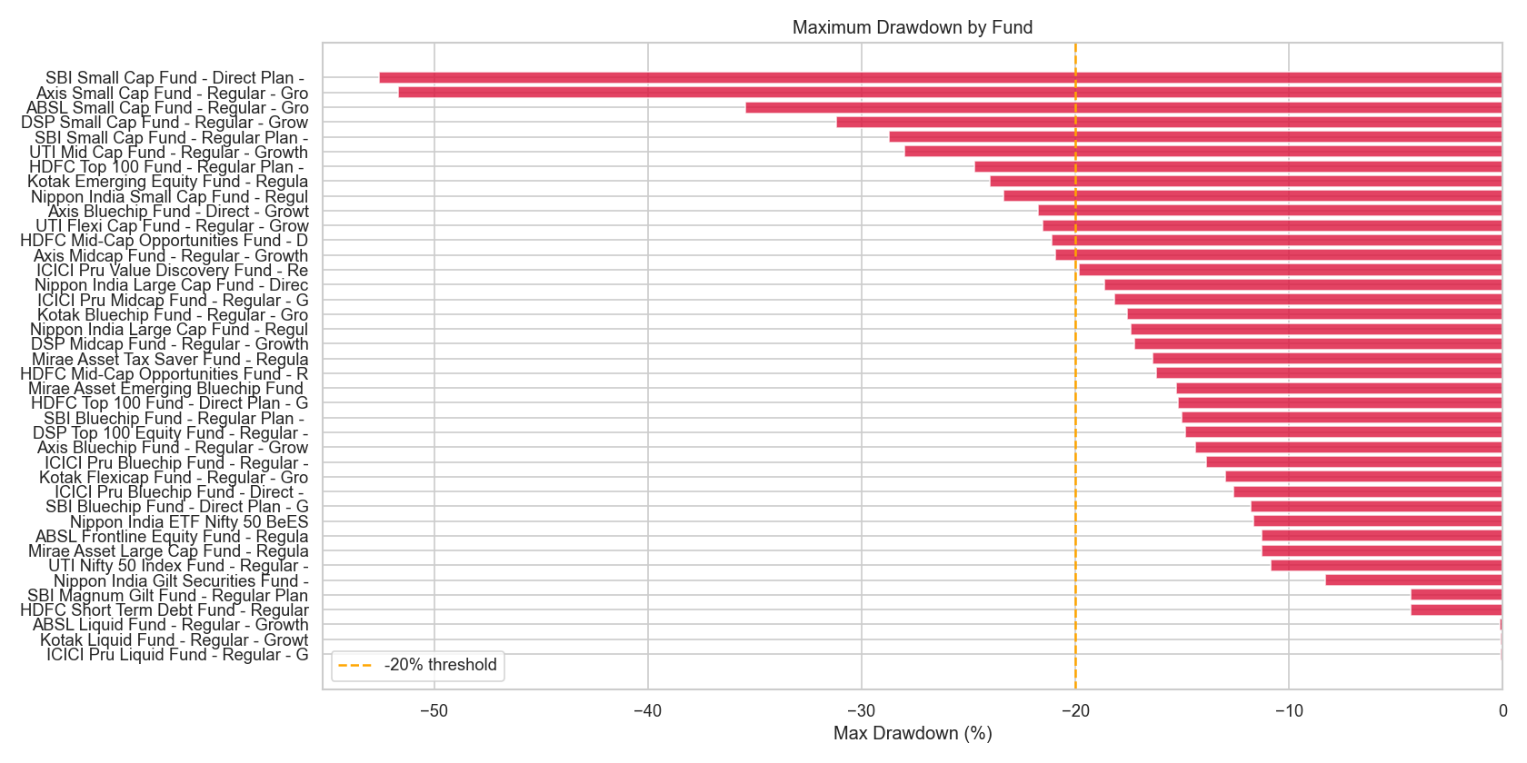
Performance Metrics — Risk & Return
Top funds maintain Sharpe > 1.0 consistently
Small cap funds show worst max drawdown (−24%+)

Slide 8
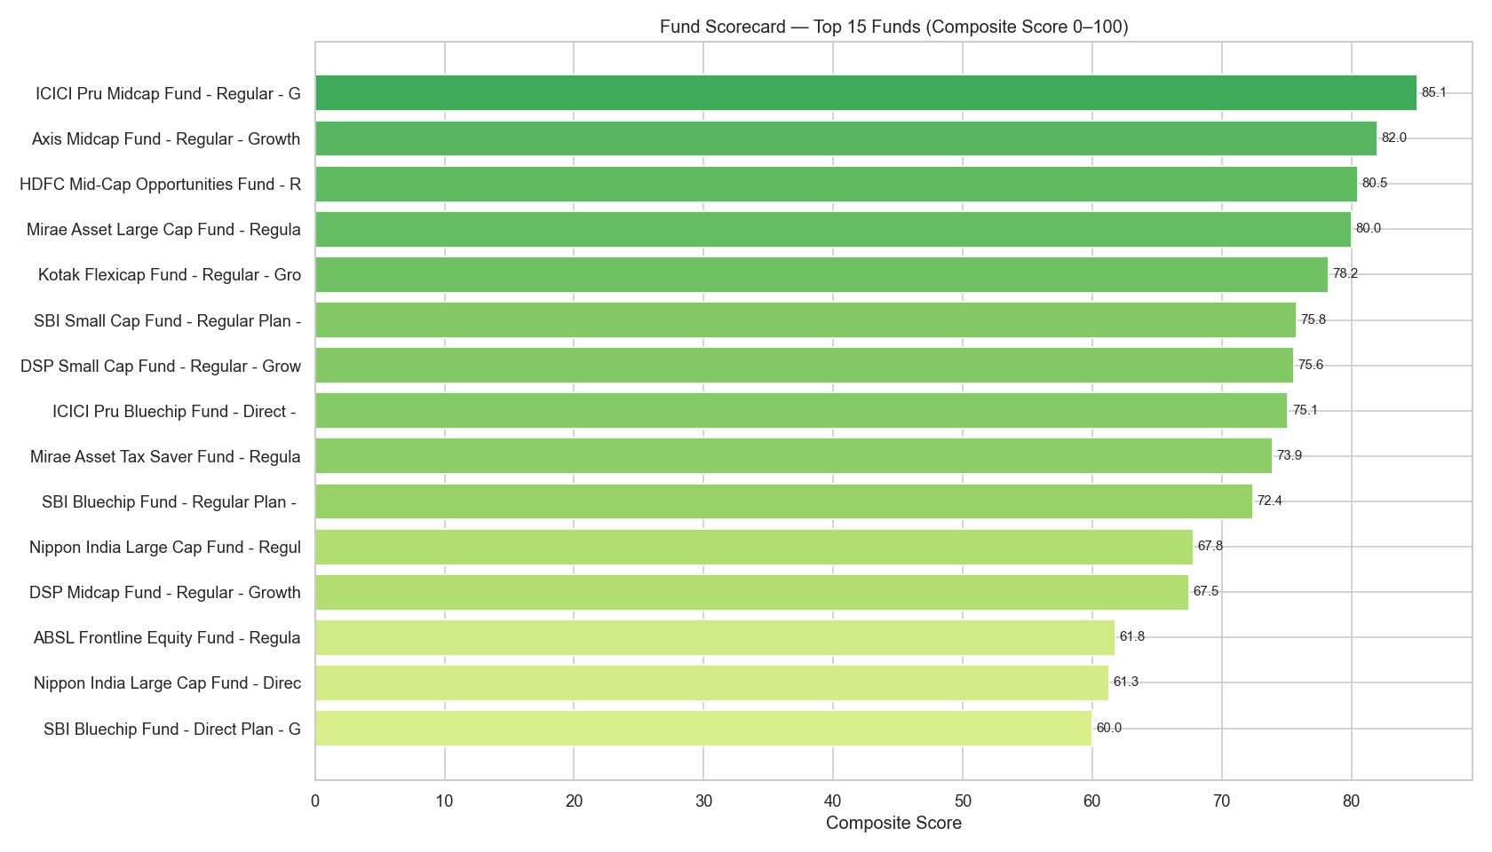
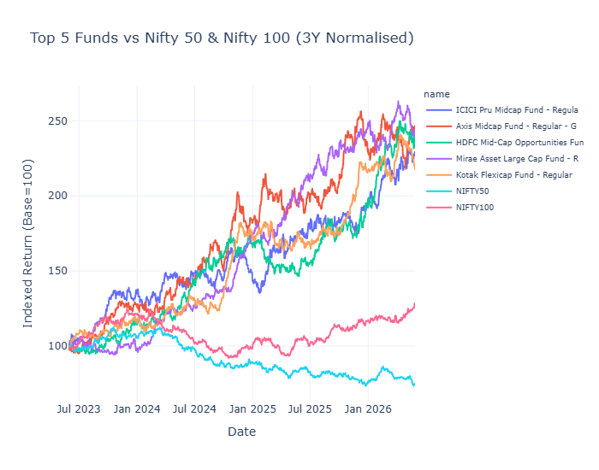
Performance Metrics — Scorecard & Benchmark
Composite scorecard ranks all 40 funds (0–100)
Top funds outperform Nifty 50 on normalised basis

Slide 9
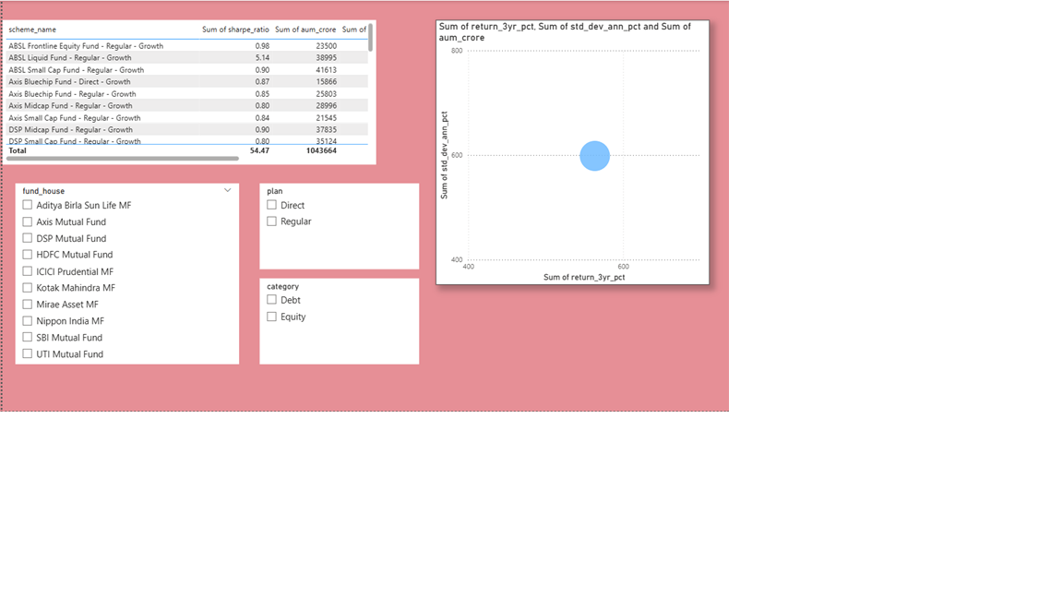
Power BI Dashboard — Industry Overview & Fund Performance

Slide 10
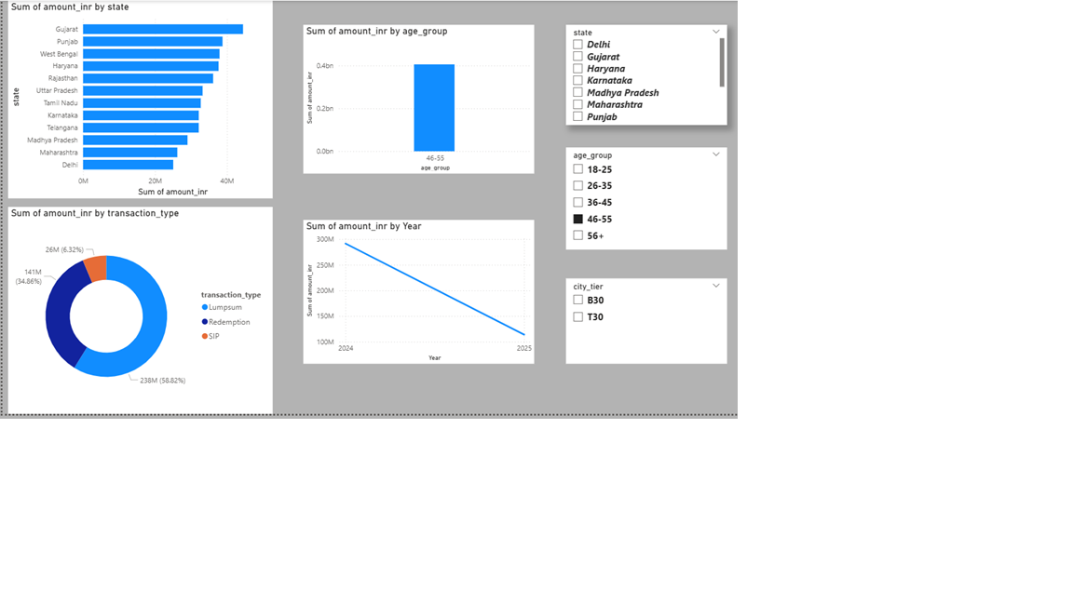
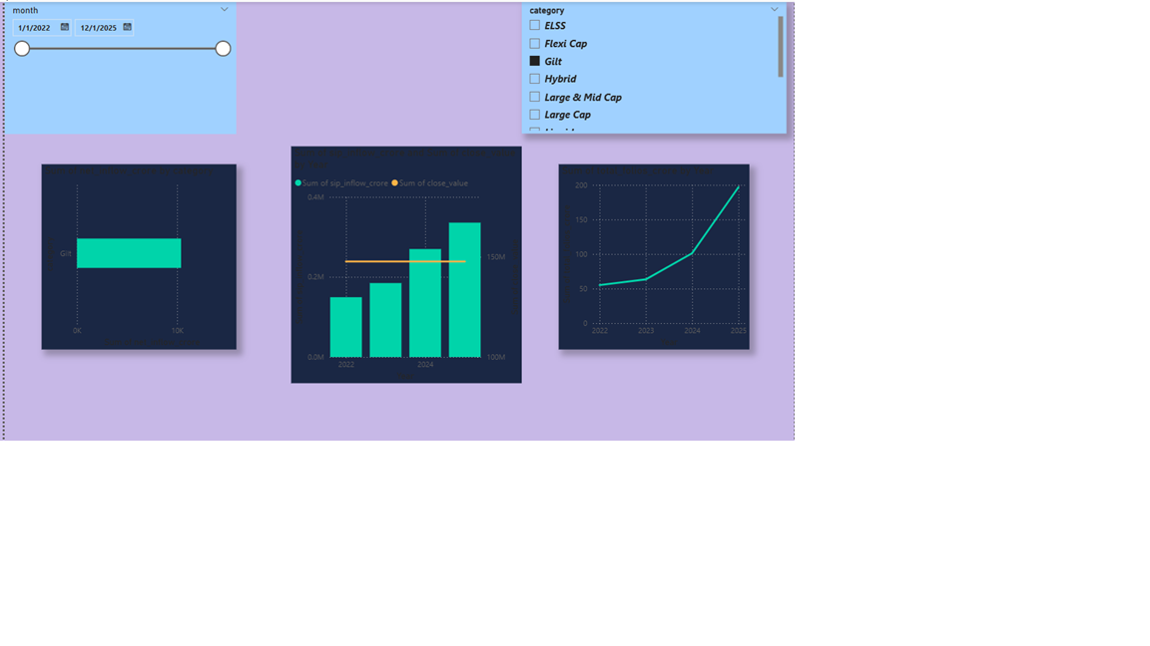
Power BI Dashboard — Investor Analytics & SIP Trends

Slide 11
Key Findings & Recommendations
🏆 SBI MF leads industry AUM at ₹12.5L Cr — 106% growth since 2022
📈 SIP inflows hit ₹31,002 Cr all-time high in Dec 2025 — retail boom
📊 Folios doubled to 26.12 Cr — massive financial inclusion success
⚠️ Small cap VaR exceeds −2.5%/day — suitable only for 5Y+ horizon
🎯 Top 3 recommended funds (Moderate risk): HDFC Top 100, Mirae Large Cap, ICICI Bluechip
🔍 75%+ investors maintain SIP continuity — strong discipline observed

Slide 12
Thank You
Dushyant Sharma
Bluestock Fintech Internship Capstone | 2026
github.com/dushyant2006/mf_analytics

