Slide 1
Git Branching - Rebasing

Slide 2
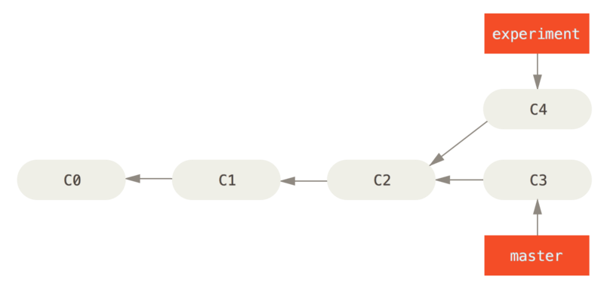
Simple divergent history

Slide 3
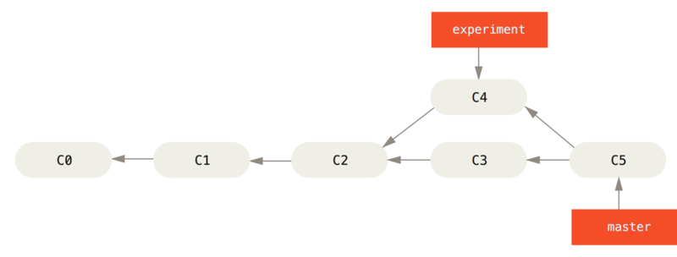
Merging to integrate diverged work history

Slide 4
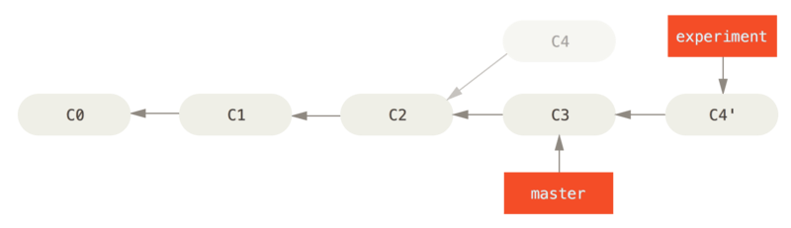
The Basic Rebase
$ git checkout experiment
$ git rebase master
First, rewinding head to replay your work on top of it...
Applying: added staged command

Slide 5
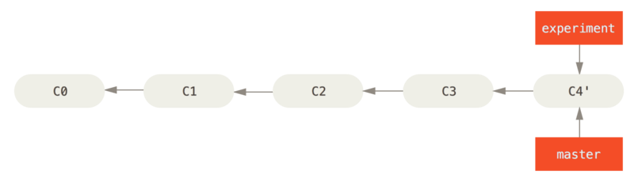
Fast-forwarding the master branch
$ git checkout master
$ git merge experiment

Slide 6
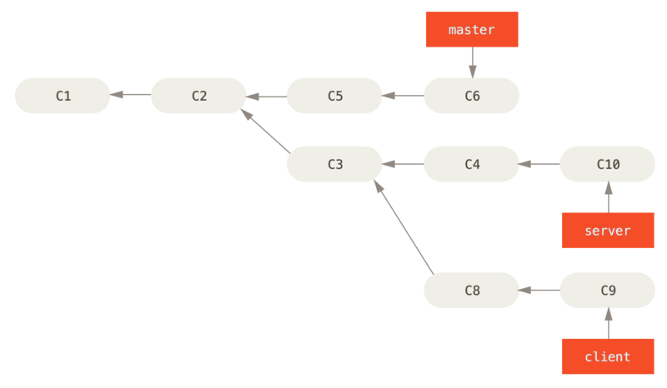
A history with a topic branch off another topic branch

Slide 7
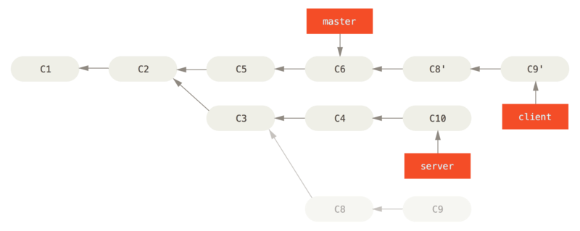
git rebase --onto master server client

Slide 8
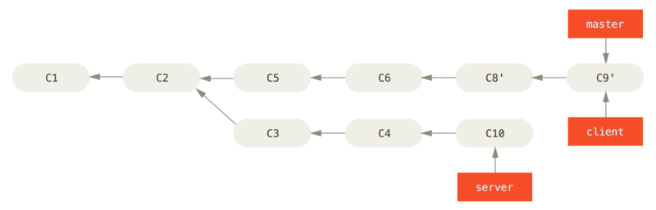
Fast-forwarding your master branch to include the client branch changes
$ git checkout master
$ git merge client

Slide 9
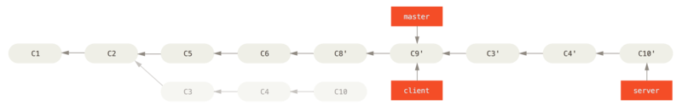
Rebasing your server branch on top of your master branch
git rebase master server
$ git checkout master
$ git merge server

Slide 10
Rebase vs. Merge

