Slide 1



SMART INDIA HACKATHON 2024
TITLE PAGE
Problem Statement ID – SIH1591
Problem Statement Title – Student Innovation
Theme- Travel & Tourism
PS Category- Software
Team ID-
Team Name - Byte Busters

Slide 2

Travel Mate
Overview: We’re creating a platform called Travel Mate where travelers can connect with verified local travel agencies, guides, who offer customized travel packages. It focuses on safety, personalization, and supporting local agencies businesses through enhanced verification and AI-driven recommendations
Key Features
Separate Portals: Guides and users have distinct entries. Guides manage package details and offer customization, while users search for destinations, view details, and book secure, customizable packages.
Two-Step Verification: Guides undergo rigorous verification with national ID, driving license, and government approval, earning a "Verified" badge. User and guide data is securely protected.
AI-Powered Personalization: AI-driven recommendations suggest tailored travel packages based on user preferences, making it easy for users to browse, explore, and customize options, ensuring a personalized and effortless booking experience
Easy, Secure Bookings: Users browse, explore, and customize travel options with secure transactions, reducing planning effort.
User-Visible Reviews: Users leave reviews for guides, which are visible to all, enhancing guide credibility and boosting business growth for travel agencies.
2

Slide 3
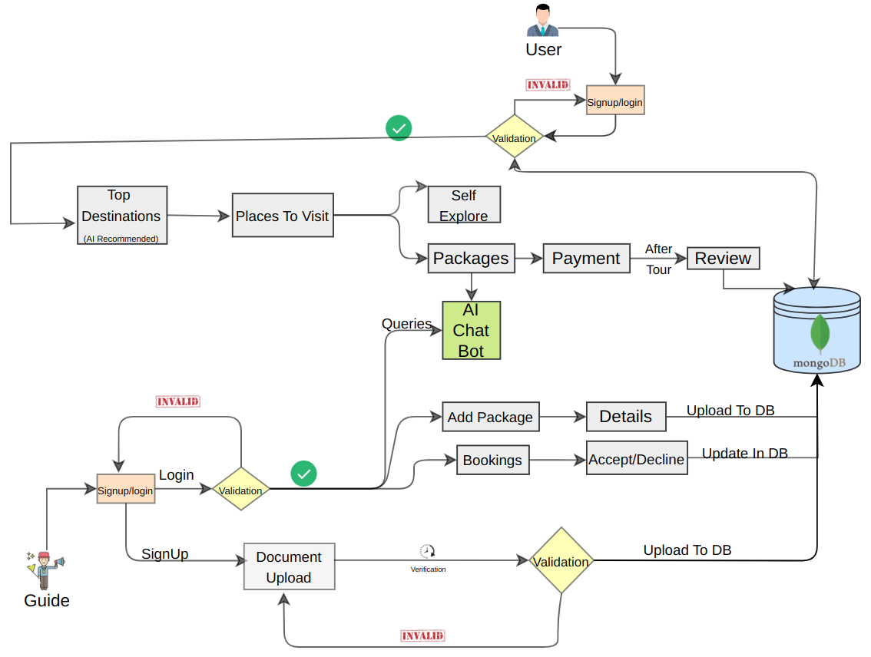
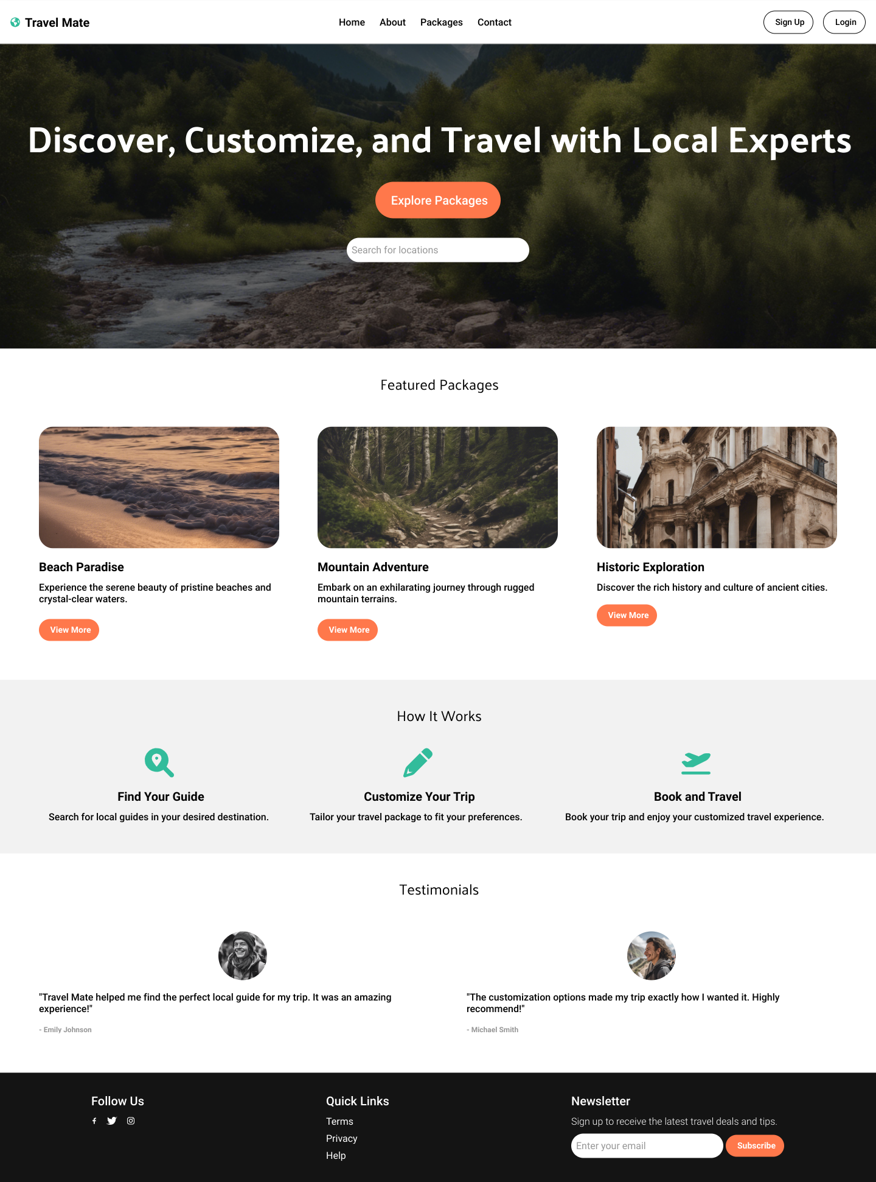
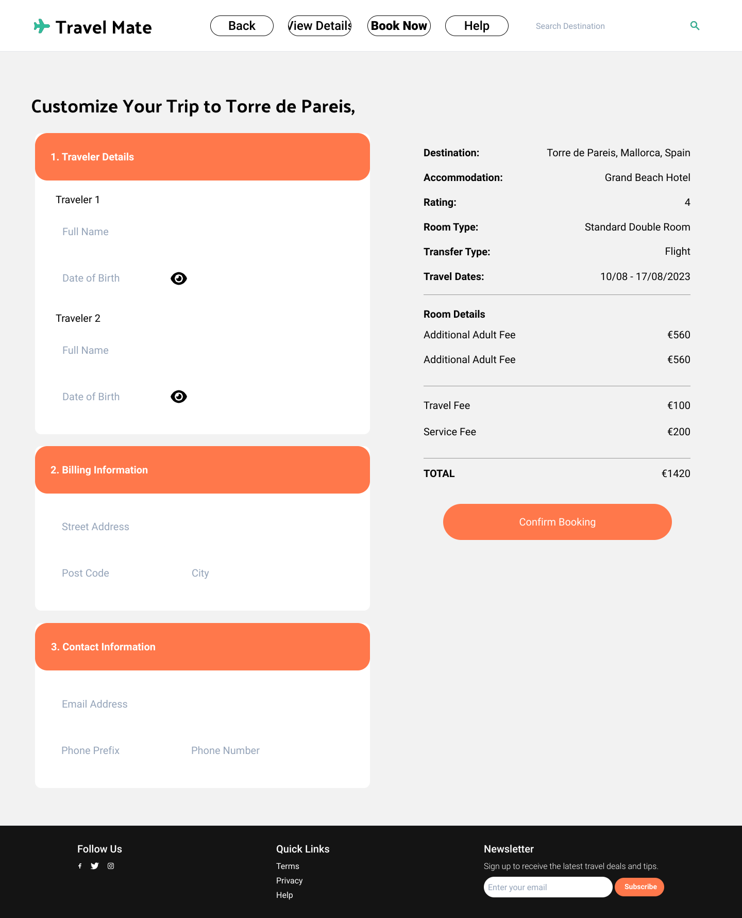

TECHNICAL APPROACH
Prototype:
Flow Chart:
Technologies Used:
3

Slide 4
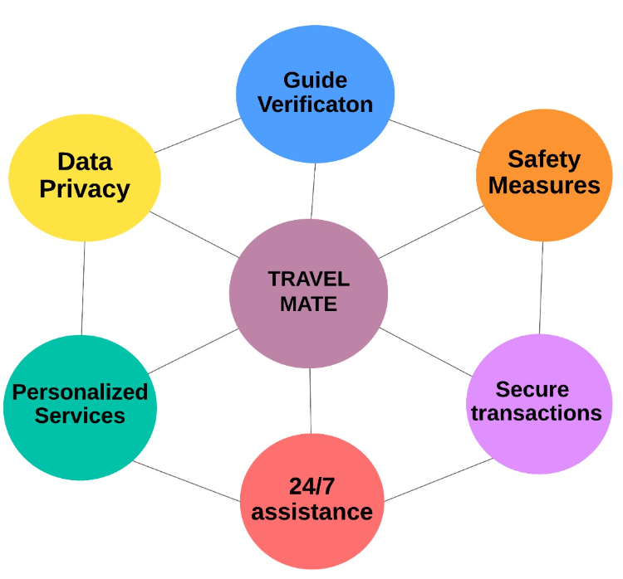
FEASIBILITY AND VIABILITY
Feasibility :
Secure Transactions
Verified Guides
Growing Demand for Personalized Travel
Remote and Digital Lifestyle
Partnerships with Local Guides and Vendors
User Acquisition Strategy
Viability :
Revenue Streams
Scalable Model
Unique Selling Proposition
Enhanced Trust and Safety
Long-term User Retention
Market Expansion Potential
Potential Challenges and Risks:
Unverified Guides
- False claim about qualifications or experience of guide.
Limited Knowledge
- Travelers lack local insights.
Unreliable Sources
- Finding trustworthy information is challenging.
Lack of Connection
- Missing personalized experiences.
Overcoming Challenges:
Background Checks
- Robust guide verification.
Feedback Mechanisms
- Travelers to provide review and rating.
Flexible booking options
- Diverse and customizable tour packages.
Detailed descriptions
- Day-by-day plans with key activities
4

Slide 5


IMPACT AND BENEFITS
Enhanced Safety and Trust: Secure payment systems and trusted guides minimize risks, enhancing traveler confidence.
Boost to Local Economies: Directly connects tourists with local agencies, thereby supporting local employment.
Personalized Travel Experience: Offers customizable packages and AI-powered recommendations based on preferences, budget, and interests.
Increased Visibility and Business Opportunities: Expands opportunities for guides, offering access to larger pool of potential clients seeking for personalized experiences.
Mutual Benefits: The platform is designed to simplify travel planning for users while enabling travel agencies to expand their reach and grow their business.
Streamlined Communication: The platform offers secure, direct communication between travelers and guides, enabling users to easily discuss and finalize customized travel plans, enhancing convenience and trust.
5

Slide 6
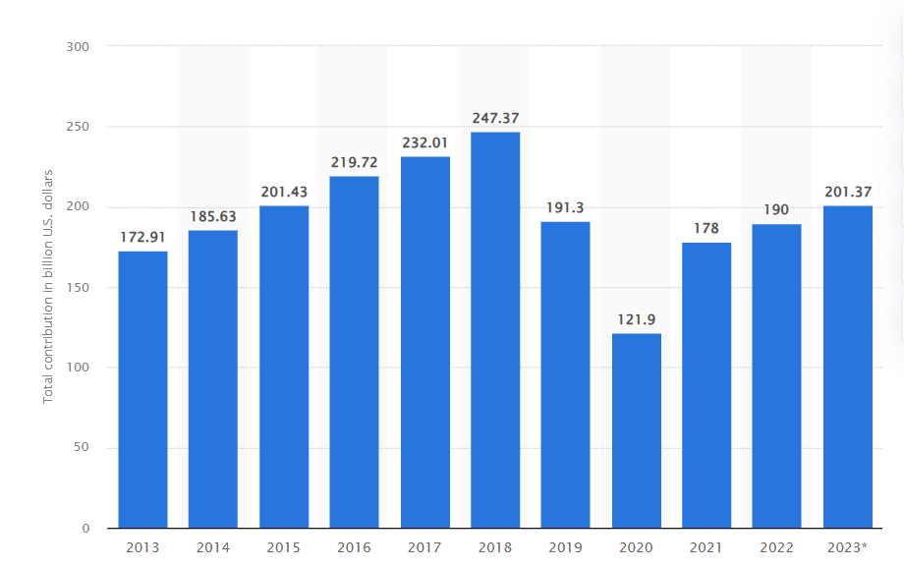
RESEARCH AND REFERENCES
Details and Links:
Author: Dr. Nimit Chowdhary and Dr. Monika Prakash published in 15-17 May 2008
Title of web page: Challenges of tourist guiding-An assessment of situation in India
Link: Microsoft Word - 288-302 Dr. Nimit Chowdhary.doc (iimk.ac.in)
Author: S.B. ANIL KUMAR published in 18 Feb 2020
Title of web page: Role of Travel Agency in Development of Tourism in India
Link: Role-of-Travel-Agency-in-Development-of-Tourism-in-India.pdf (researchgate.net)
STATISTICS:
Links : India Tourism Statistics 2024 | Top Sources of Foreign Domestic Visitors (theworldstatistics.com)
India Tourism Statistics 2024 | Major Sources of International and Domestic Visitors
6

