Slide 1
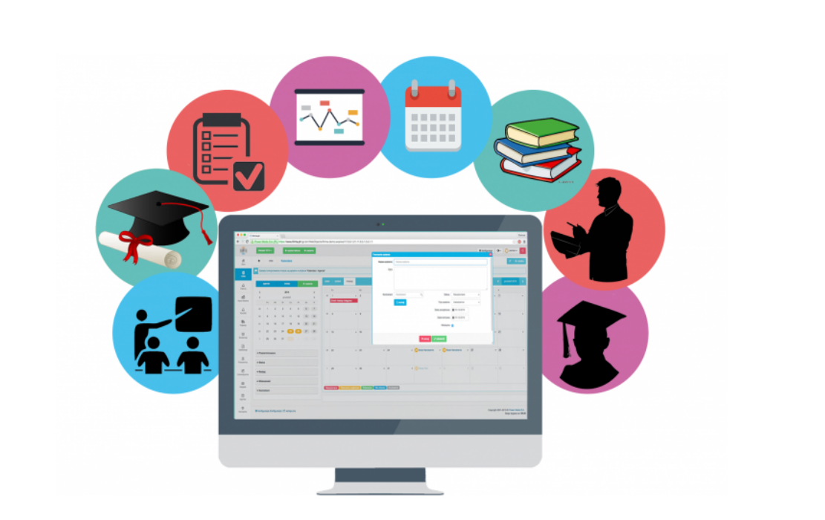
University Management System

Slide 2
Bangladesh Army University of Science & Technology
Department of Computer Science and Engineering
University Management System
Course Code: CSE 2200
Course Title: Software Development Project-I
Soumya Mallick (200101066)
Md. Talath Un Nabi (200101076)
Most. Taosin Tamanna (200101111)

Slide 3
Motivation and Problem
An University has to store lots of data of students & teachers
These data has to be stored securely
Data has to be accessible at any moment
Data has to be accessible through any device

Slide 4
Objective
Design and Develop more accurate and a better University Management System -
important key behind motivating this Project.​
Reduce unnecessary paperwork.​
More secure database.​
Easy, accurate and faster access of data.​​

Slide 5
Project Proposal
To overcome the drawbacks of existing system, we proposed a project named ‘University Management System’ which will:
Contain student data
Access data through web platform

Slide 6
Technology Platform
Backend:
php
javascript
Frontend
html
css
Database:
mysql
Project Management Tool:
GitHub

Slide 7
Reason for choosing Website
Cross-Platform
Universally Accessible
Accessible anywhere & anytime
Cloud-based
Less risk of unauthorized access

Slide 8
Flow Chart:
Log In Page
Admin Login
Student Login
Search
Edit
Edit
Database
Add New
Show Details
Show Info
Delete
Log Out

Slide 9
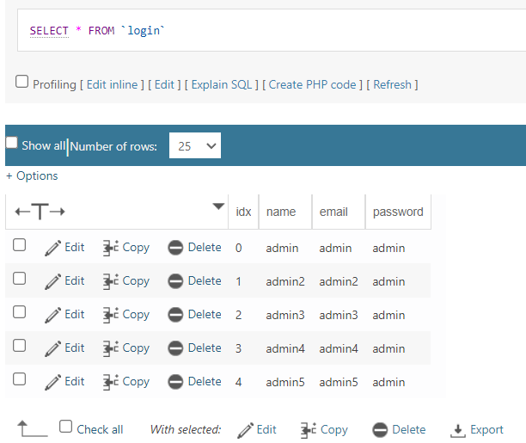
Database Table
Database: sdponedb Table: login

Slide 10
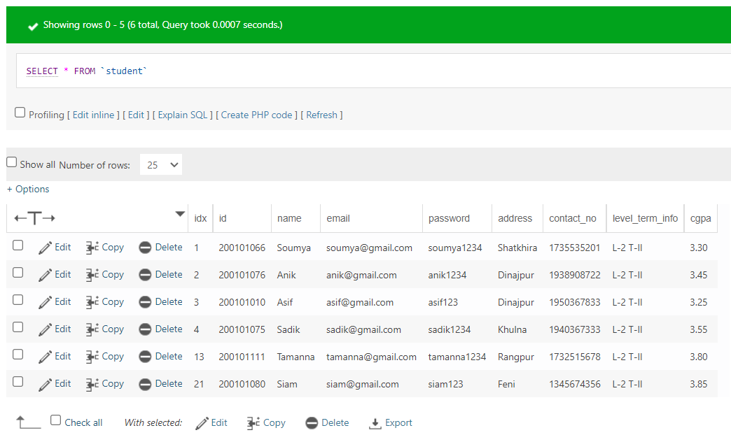
Database Table
Database: sdponedb Table: student

Slide 11
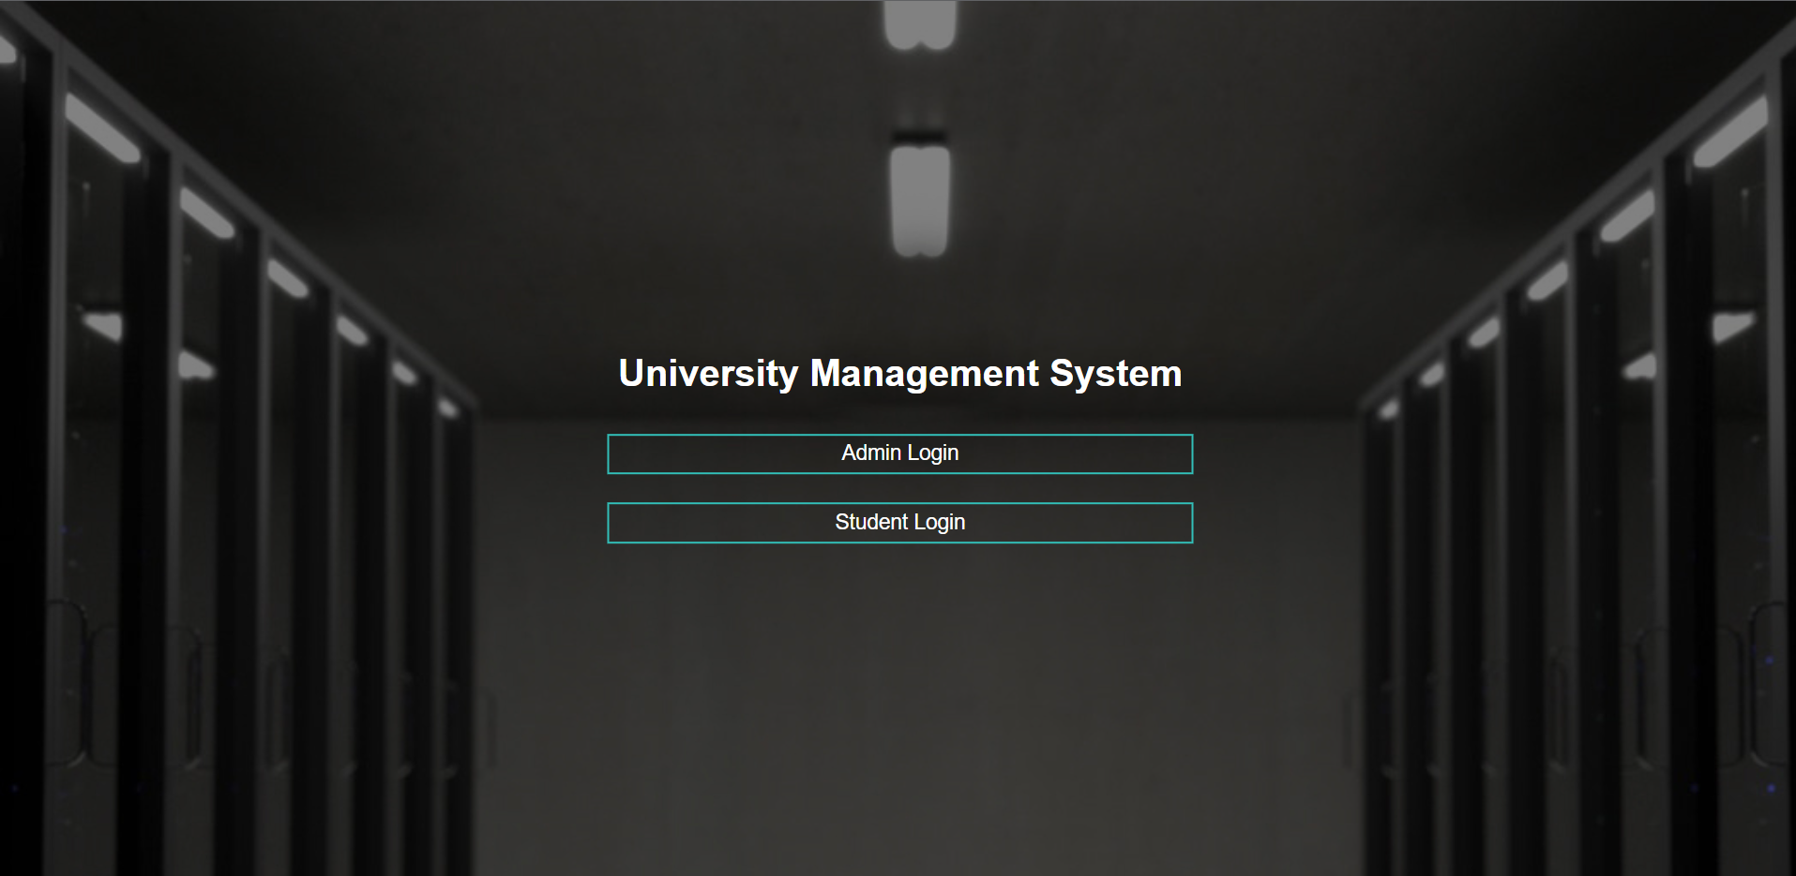
Project Snapshots
Homepage

Slide 12
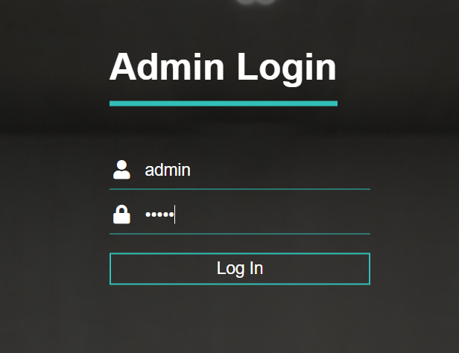
Project Snapshots
Admin Login Page
login Table:
Admin Login Page uses login credentials from ‘login’ table

Slide 13
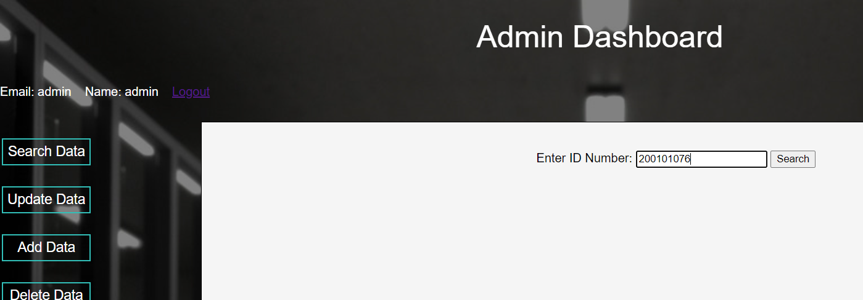
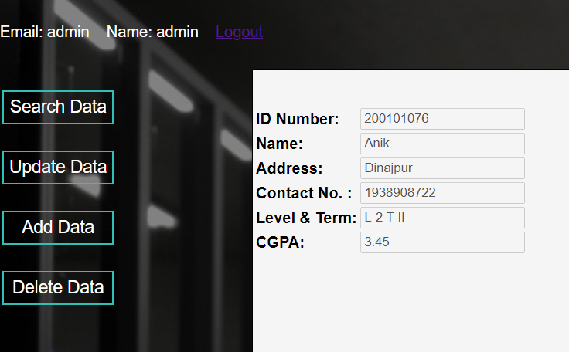
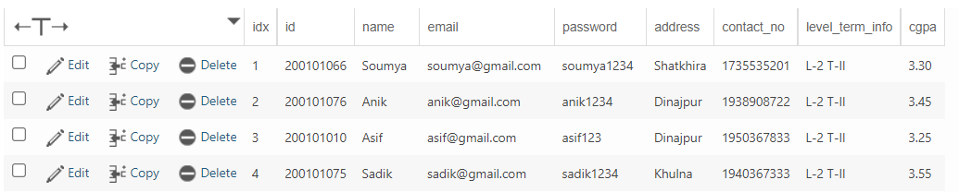
Project Snapshots
Admin Dashboard – ‘Search Data’ button
Student Data can be accessed through ID number using ‘Search Data’ button

Slide 14
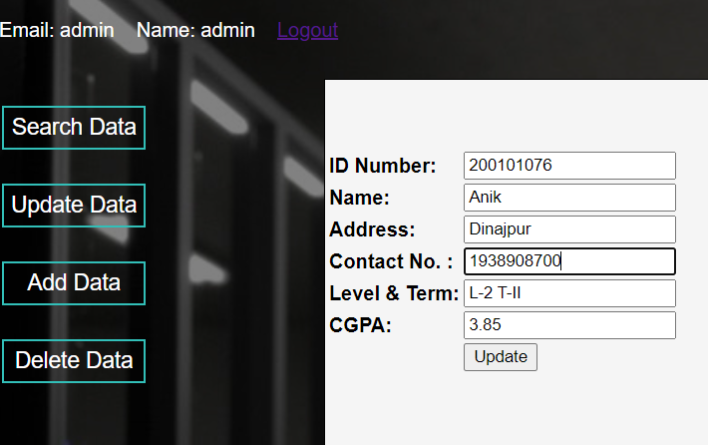
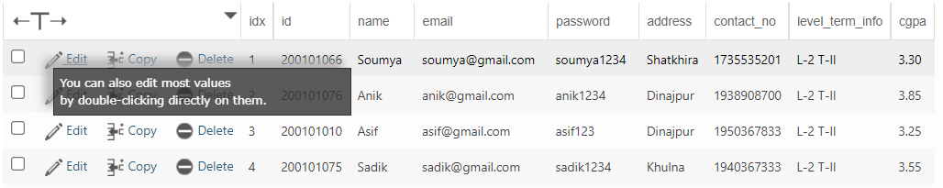
Project Snapshots
Admin Dashboard – ‘Update Data’ button
Before Update:
After Update:
Student Data can be updated through ID number using ‘Update Data’ button

Slide 15
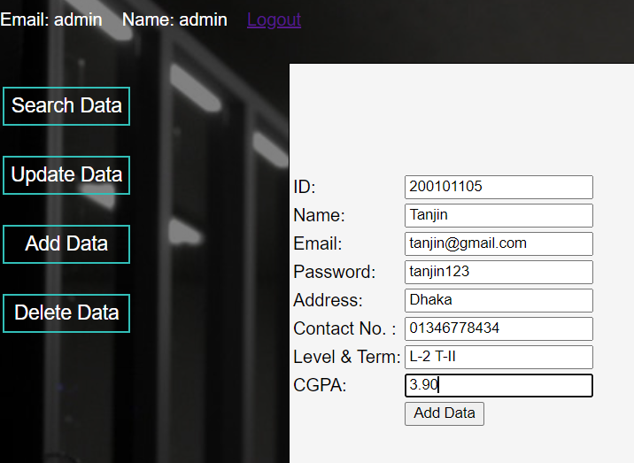
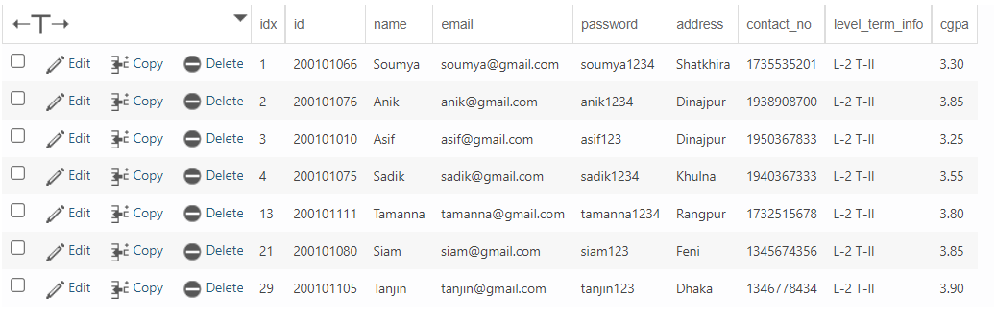
Project Snapshots
Admin Login Page – ‘Add Data’ button
New Data can be added to Database using ‘Add Data’ button

Slide 16
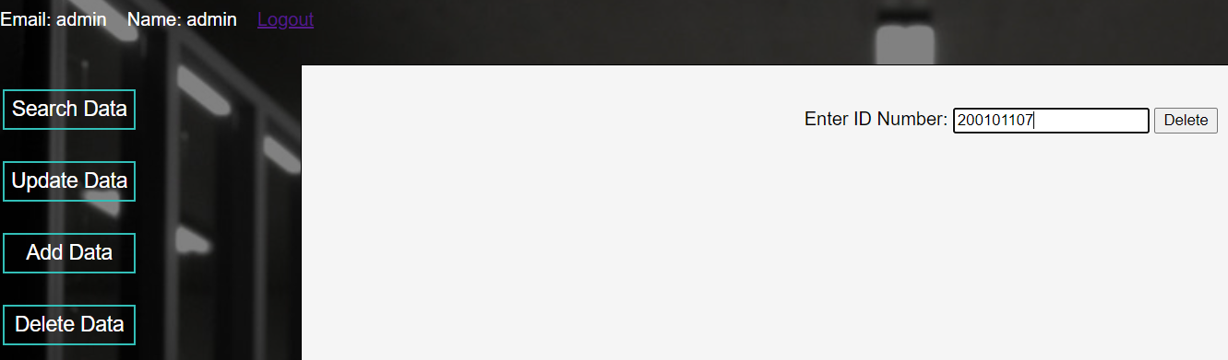
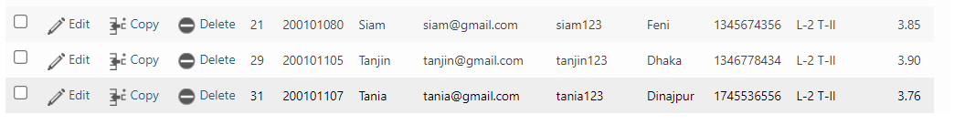
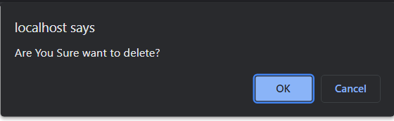
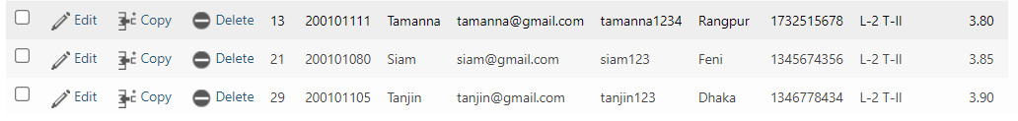
Project Snapshots
Admin Login Page – ‘Delete Data’
Before Deletion:
Delete Alert:
After Deletion:
Student Data can be deleted using ID number through ‘Delete Data’ button

Slide 17
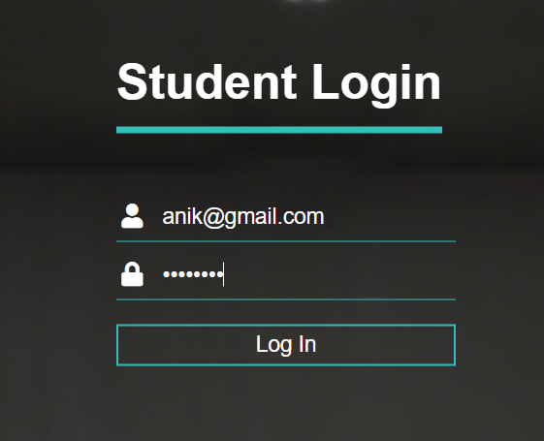
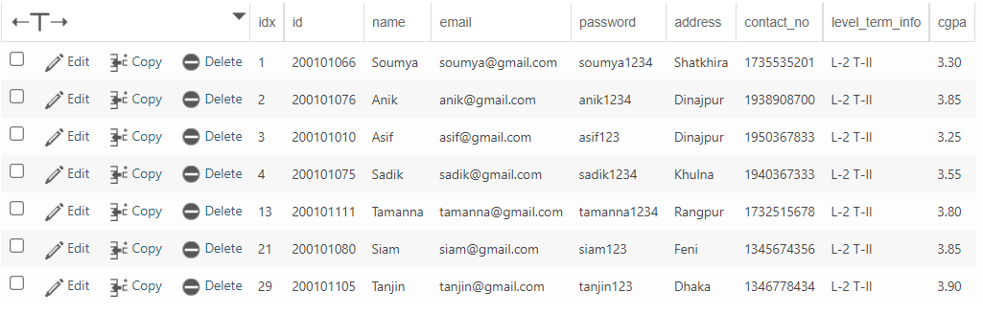
Project Snapshots
Admin Login Page
student Table:
Student Login Page uses student login credentials from ‘student’ table

Slide 18
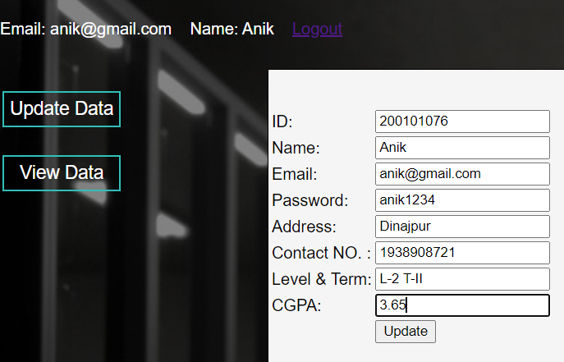
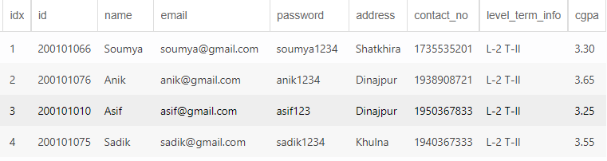
Project Snapshots
Student Dashboard- ‘Update Data’ button
Before:
After:
A student can Update his details using ‘Update Data’ button

Slide 19
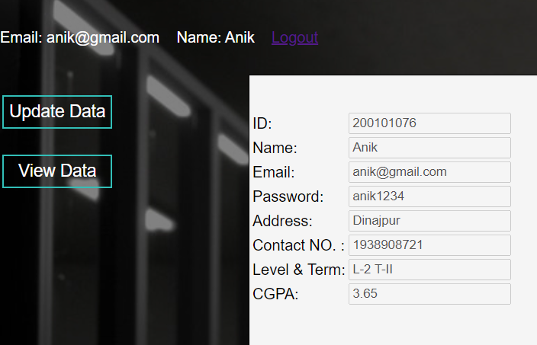
Project Snapshots
Student Dashboard – ‘View Data’ button
A student can view his data using ‘View Data’ button

Slide 20
Next Goal
UI Improvements
Add responsiveness to the website
Bug Fixes
Add More Features
Secured Database
More updates

Slide 21
Learning From Project
Backend Development using ‘php’ & ‘javascript’
Frontend Development using ‘html’ & ‘css’
Database connectivity through backend development
Familiarization with Project Management Tool

Slide 22
Discussion & Conclusion
It has been a great pleasure for us to work on this exciting and challenging project. This project proved great for us as it provided practical knowledge of programming in ‘php’, ‘javascript’ and ‘mysql’. It also helped us to build a new skill through Web Development. This project will provide better opportunities and guidance in future in developing projects independently.

Slide 23
Thank You!
Any Questions or Suggestions?

