Slide 1
HASHING

Slide 2
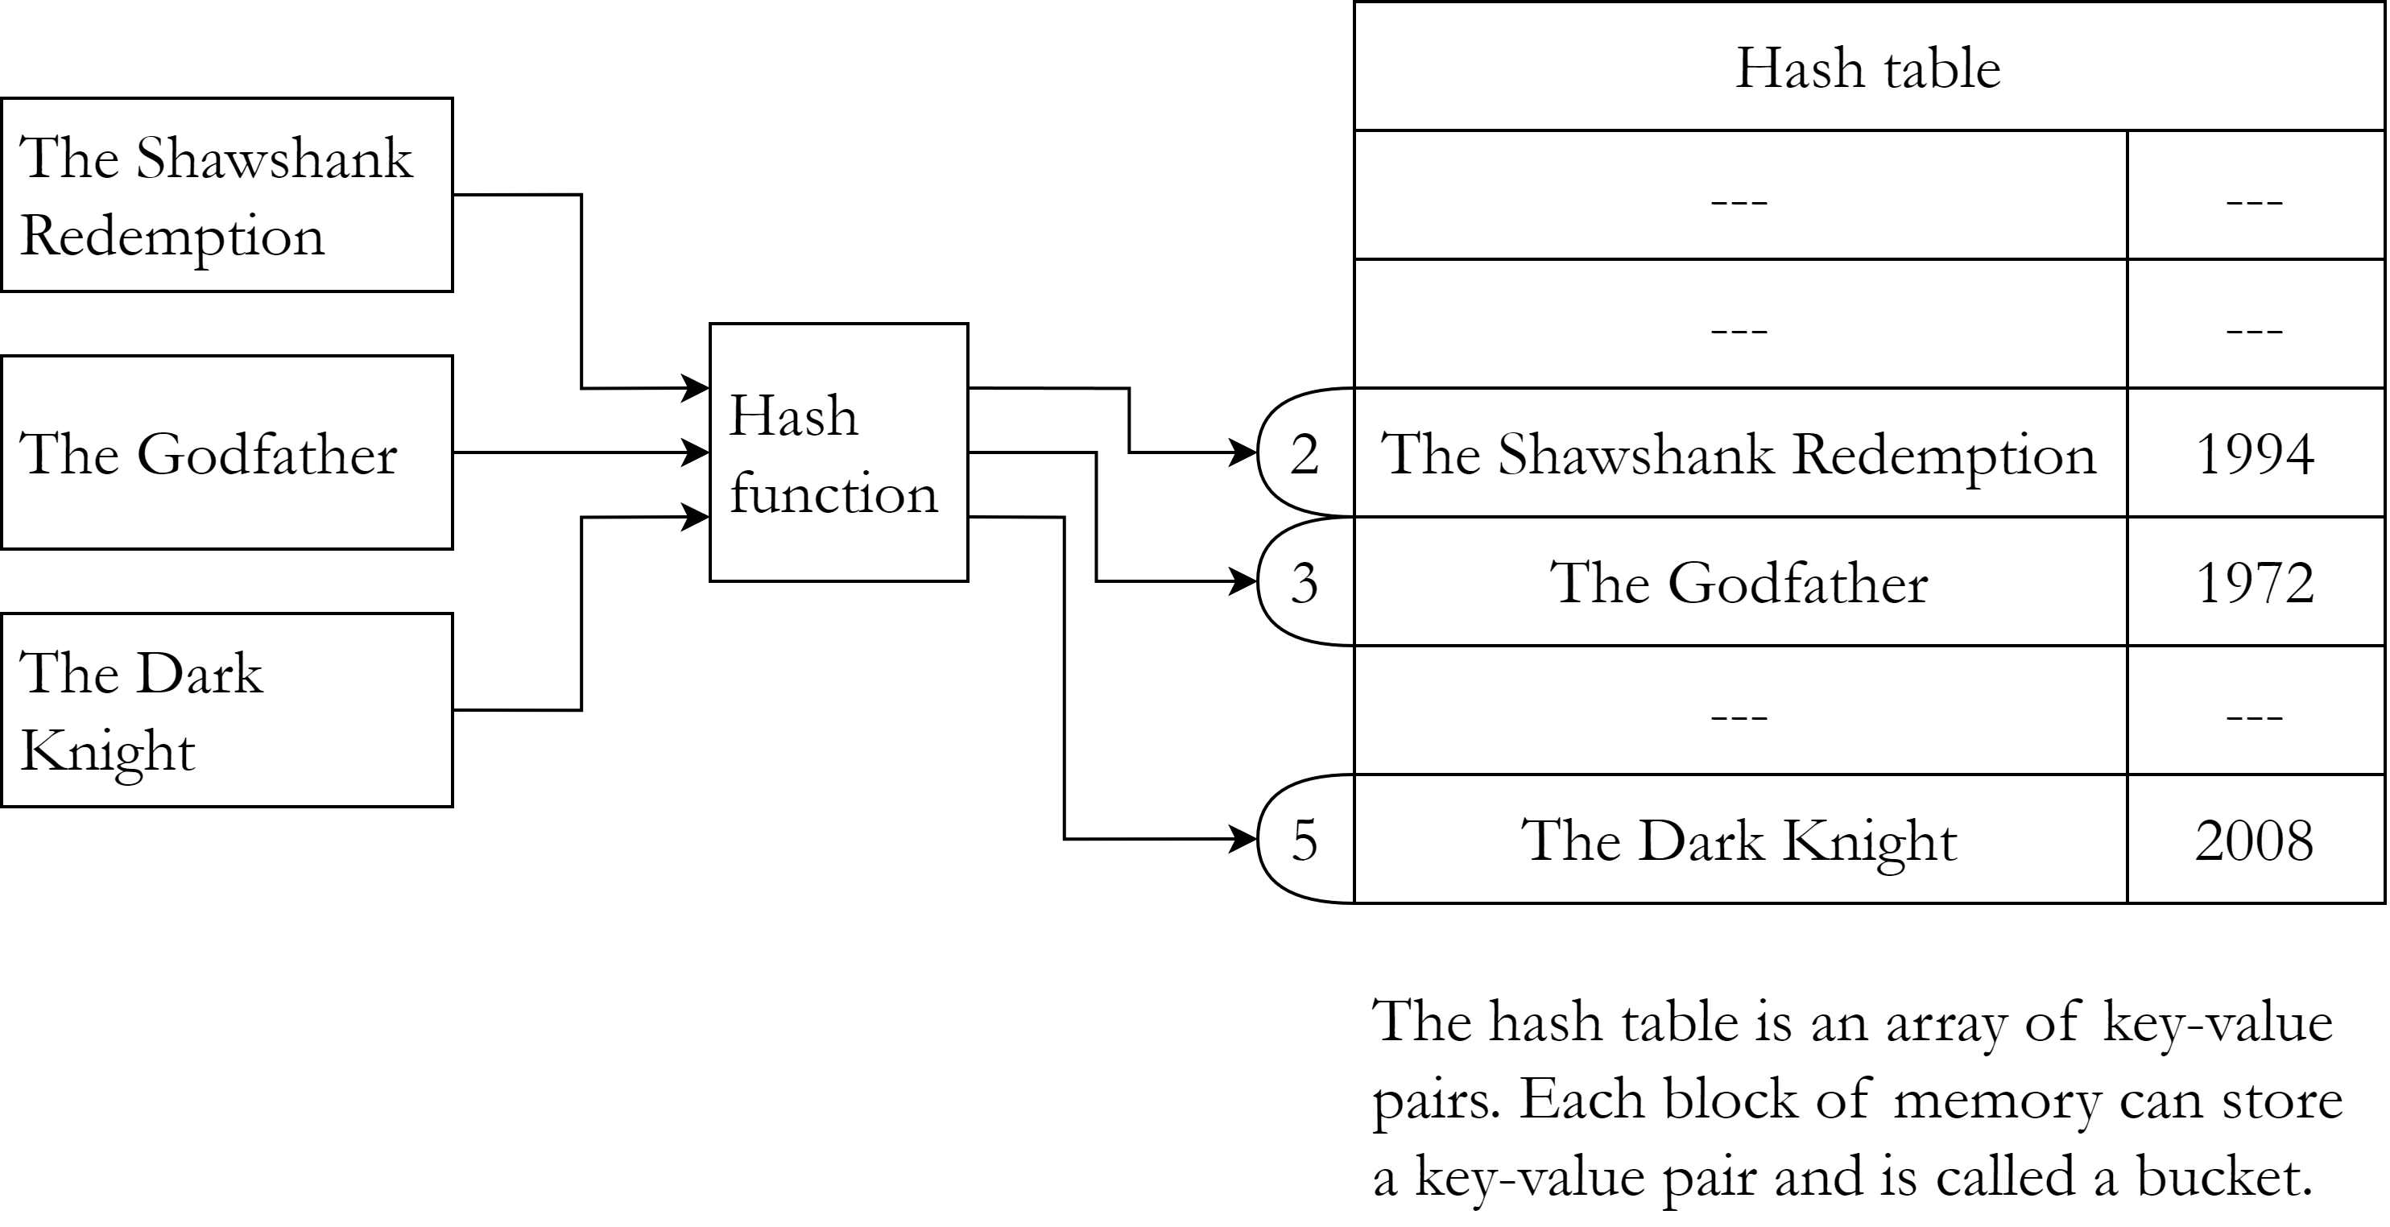
Hash table
A hash table is a data structure which stores key-value pairs.
A hash function is used to decide where a pair will be stored on the basis of the key.
Insertion, deletion and search operations are very fast in hash tables and ideally have O(1) time complexity.

Slide 3
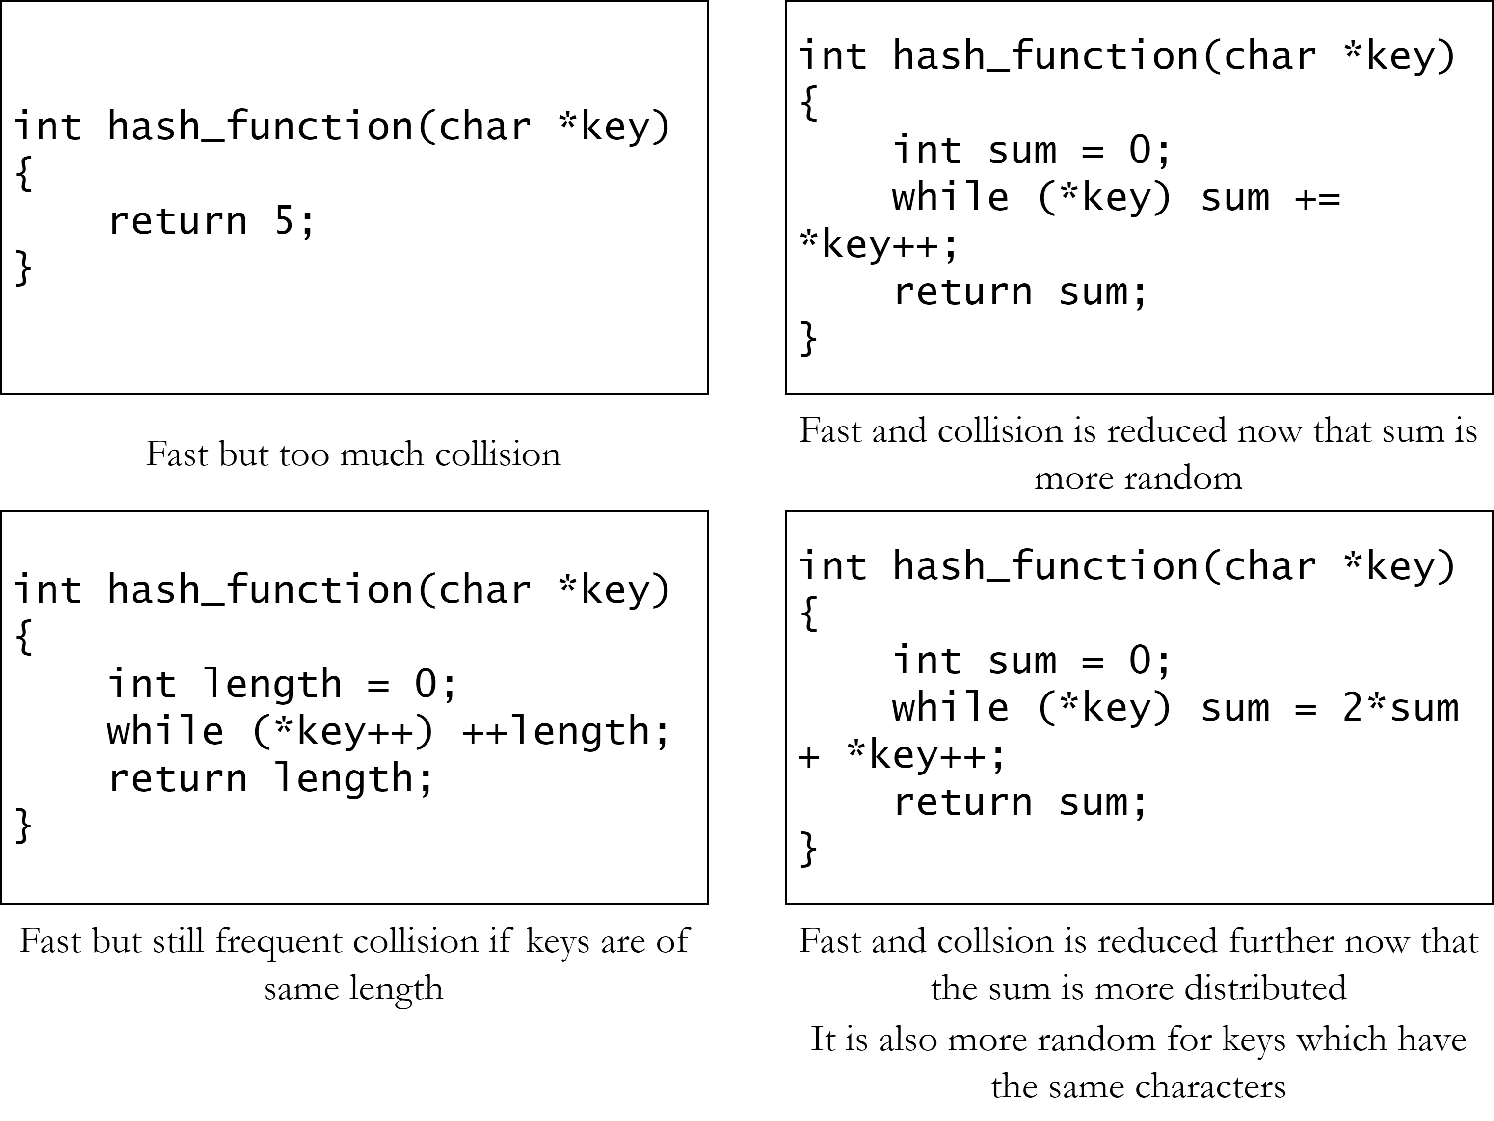
Hash function
A hash function takes the key as argument and returns a hash.
The hash can be used to insert or search the key in a hash table.
Different keys may return the same hash. It is called collision.
A good hash function must be fast and it should also reduce collision.

Slide 4
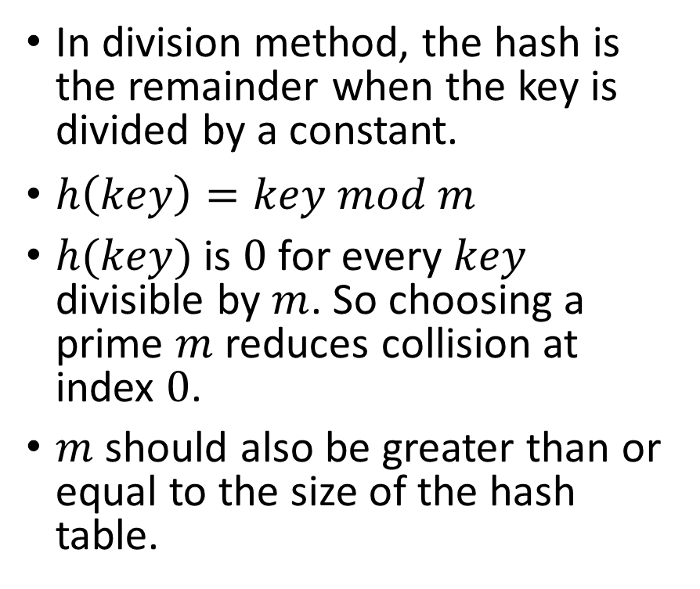
Hash function – Division method
In division method, the hash is the remainder when the key is divided by a constant.
$h\left(key\right)=key mod m$
$h(key)$ is $0$ for every $key$ divisible by $m$. So choosing a prime $m$ reduces collision at index $0$.
$m$ should also be greater than or equal to the size of the hash table.
int division_method(int key) {
const int m = 29;
return key % m;
}

Slide 5
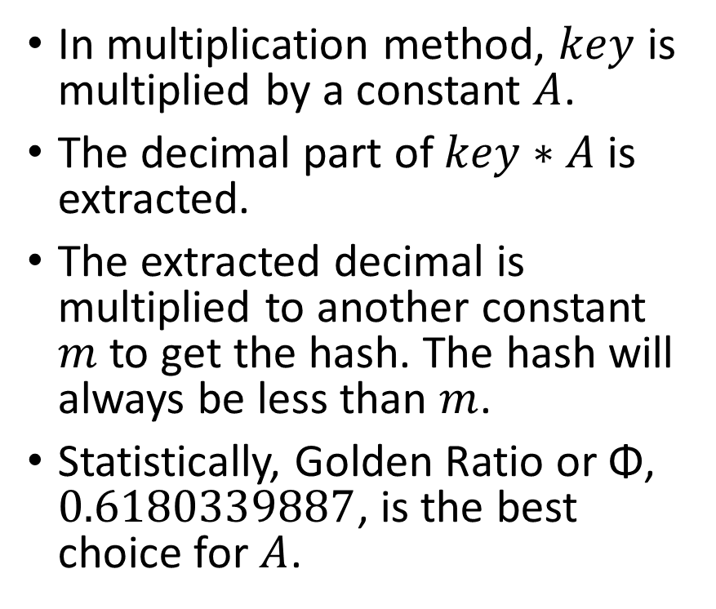
Hash function – Multiplication method
In multiplication method, $key$ is multiplied by a constant $A$.
The decimal part of $key∗A$ is extracted.
The extracted decimal is multiplied to another constant $m$ to get the hash. The hash will always be less than $m$.
Statistically, Golden Ratio or Φ, $0.6180339887$, is the best choice for $A$.
int multiplication_method(int key) {
const double A = 0.6180339887;
const int m = 60;
double extracted = A*key –
floor(A*key);
return floor(m*extracted);
}

Slide 6


Hash function – Mid-square method
In mid-square method, $key$ is squared.
A constant, $r$ digits are selected from the middle as the hash.
The hash can be any combination of $r$ digits, so the range of hash is $[0, {10}^{r})$.
int midsquare_method(int key) {
const int r = 3;
int key_sq = key * key;
int n = count_digits(key_sq);
int start = (n-r) / 2;
key_sq /= ten_raised(start);
return key_sq –
(key_sq/ten_raised(r)) *
ten_raised(r);
}

Slide 7
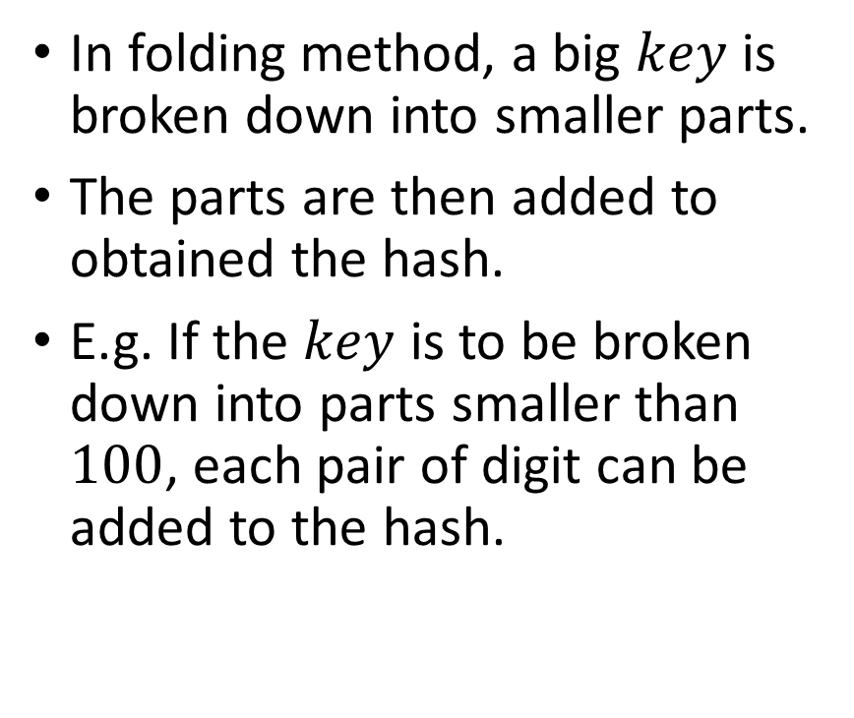
Hash function – Folding method
In folding method, a big $key$ is broken down into smaller parts.
The parts are then added to obtained the hash.
E.g. If the $key$ is to be broken down into parts smaller than $100$, each pair of digit can be added to the hash.
int folding_method(int key) {
const int partition_size =
100;
int hash = 0;
while (key > 0) {
hash += key %
partition_size;
key /= partition_size;
}
return hash % partition_size;
}

Slide 8
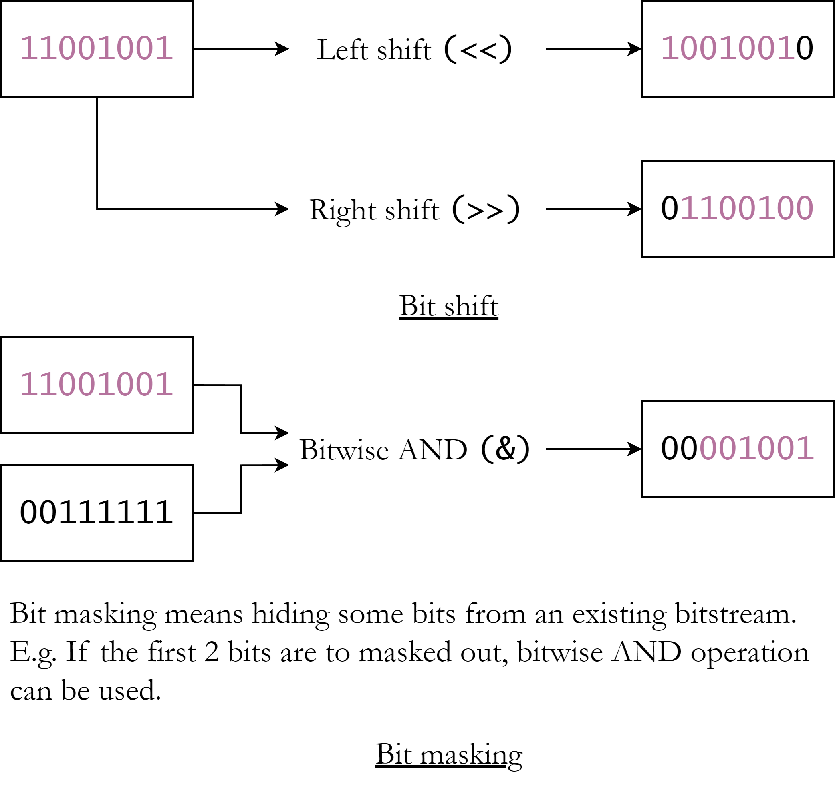
Hash function – Bit-rotation method
Hash can be obtained by rotating bits of an integer in different ways.
Bit-rotation relies on bit shift and bit masking.
A simple algorithm is the BSD checksum which is used to check file integrity but can also be used to hash keys, especially string keys.

Slide 9
Hash function – BSD checksum
In BSD checksum, the hash is circular shifted. In the usual shifting, data is lost, but circular shifting preserves it.
Then the key is added and then the hash is masked ensuring no overflow occurs.
In the case of string, each character is added.
uint bsd_checksum(const
char *key) {
uint hash = 0;
while (*key) {
hash = (hash >> 1) |
((hash & 1) << 15);
hash += *key++;
hash &= 0xffff;
}
return hash;
}

Slide 10
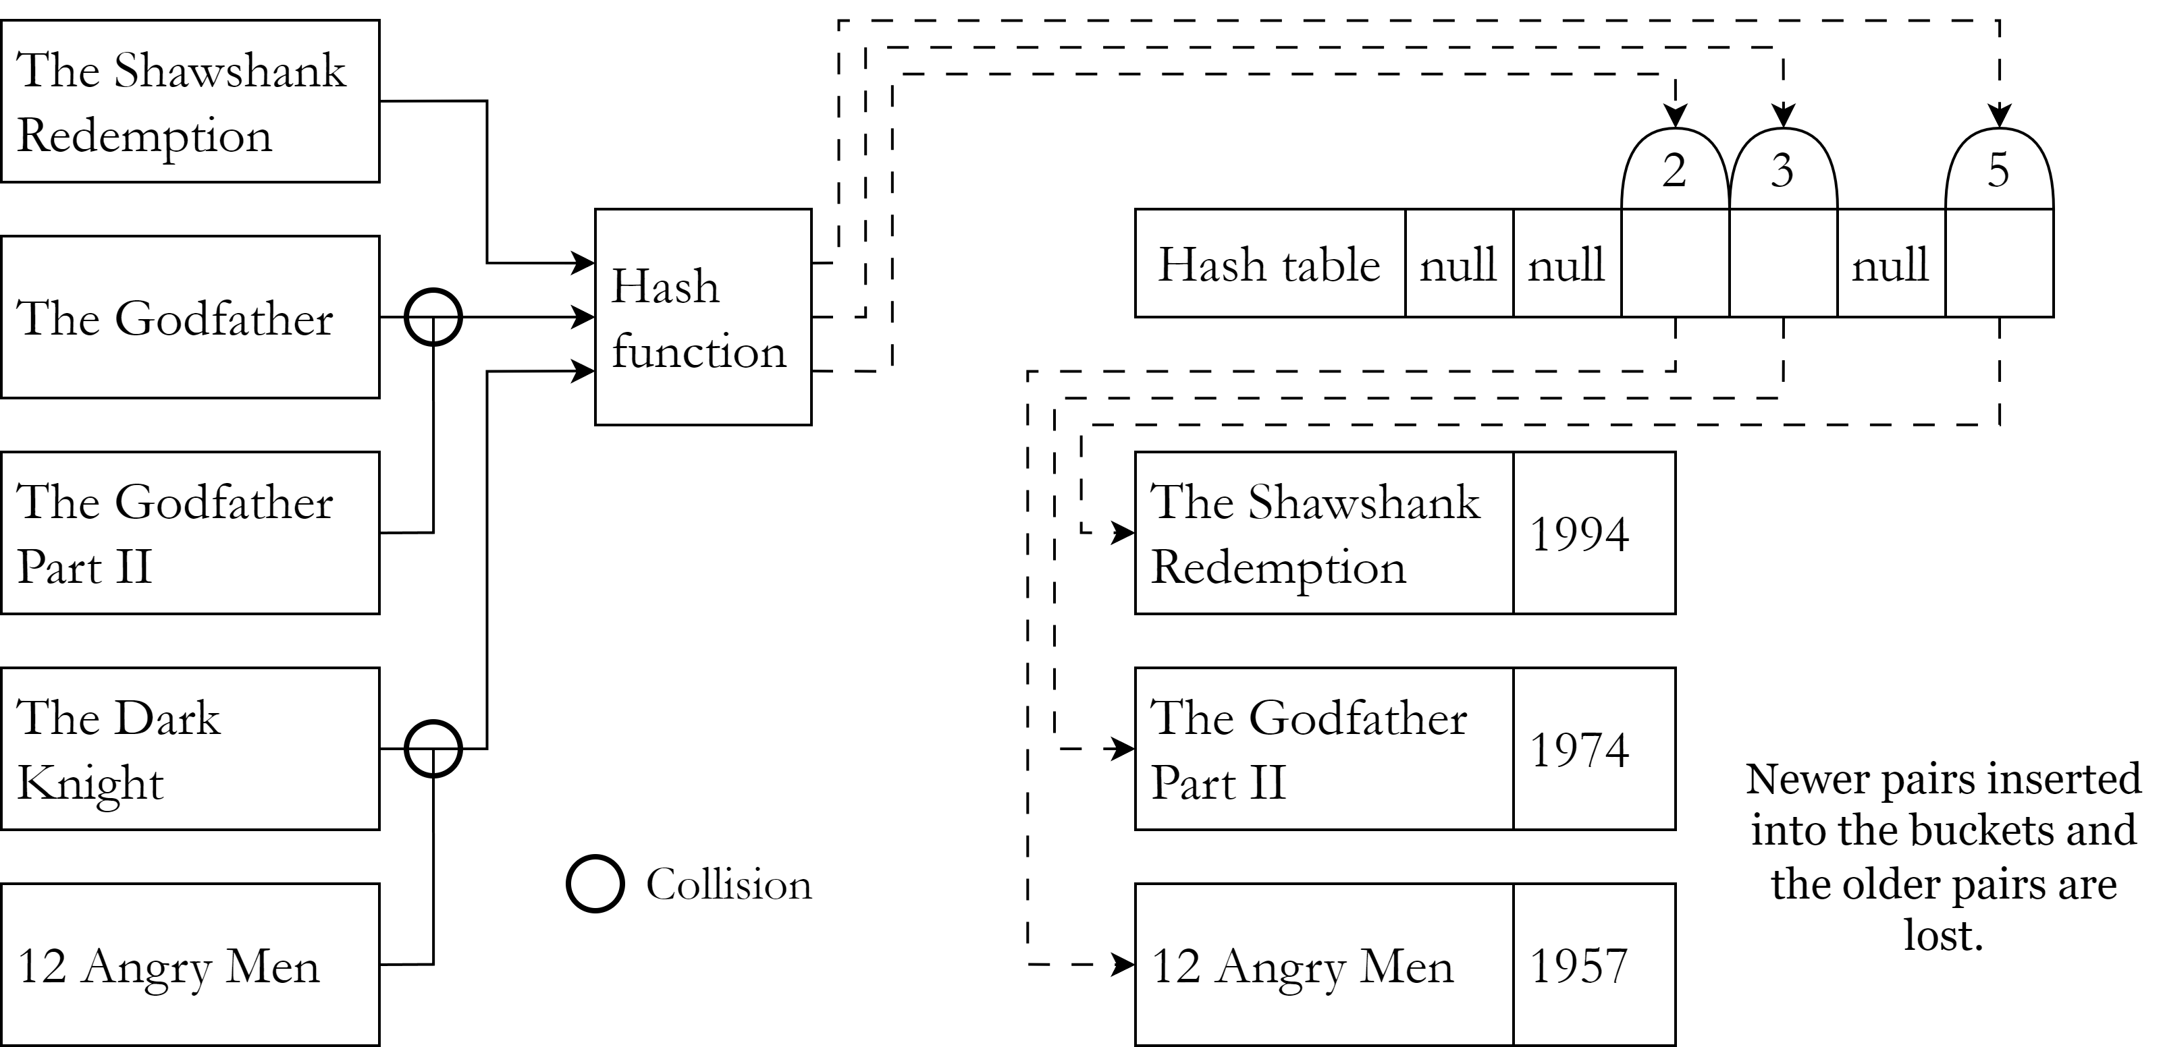
Collision
A hash function may return the same hash for different keys. This is called collision.
If two keys have the same hash, only one key-value pair can be stored at the hash index.
The other pair needs to be stored at another memory location. This is called collision resolution.

Slide 11
Collision resolution techniques
Separate chaining: Each bucket is a node which contains reference to the hash table items. It can be any data structure like a linked list, a tree or maybe even another hash table.
Open addressing: Instead of creating another data structure to hold colliding items, it can be stored in another empty bucket in the hash table.

Slide 12
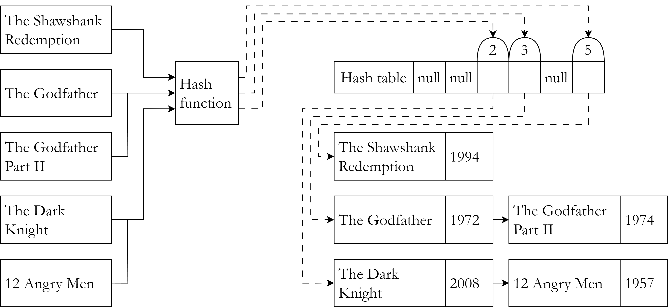
Separate chaining – Linked list
In this method, each element is a linked list of key-value pairs.
If two keys have the same hash, both key-value pairs will be the member of the linked list in the hash index.
It is to be noted that extra memory is allocated in linked lists even if the hash table has empty buckets.

Slide 13

Separate chaining – Linked list
bool hash_insert(Node **table, Movie
*movie)
{
uint hash = hash_function(movie
->name);
if (table[hash] == NULL) {
table[hash] =
create_node(movie);
...
Movie *hash_search(Node **table, char
*movie_name)
{
uint hash =
hash_function(movie_name);
Node *curr = table[hash];
while (curr) {
if (strcmp(curr->movie->name,
...

Slide 14
Separate chaining – Linked list
Insertion: item -> bool
Find the hash.
If array[hash] is null
array[hash] = Node(item)
3. Else if another item of the same
key exists in array[hash], replace
or ignore item.
4. Else append Node(item) to
array[hash].
Search: key -> value
Find the hash.
Traverse array[hash].
If node is null, return null.
Else if an item with key is
found, return item.

Slide 15
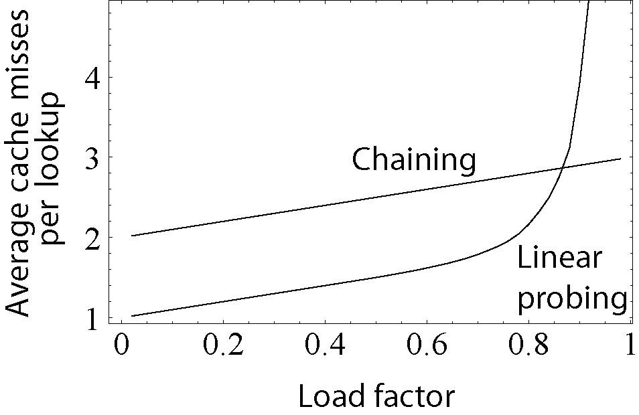
Open addressing – Linear probing
In this method, if the hash of a key-value pair is already occupied, a linear search is performed and the pair is stored in the next empty bucket.
Hash tables are not completely filled so that there are more empty buckets to be found.
Load factor is the ratio of the number of occupied spaces and total number of buckets.

Slide 16
Open addressing – Linear probing
Insertion: item
Movie *hash_search(HashTable *table,
char *movie_name)
{
uint hash =
hash_function(movie_name);
int offset = 0, index;
Movie **array = table->array;
...

Slide 17
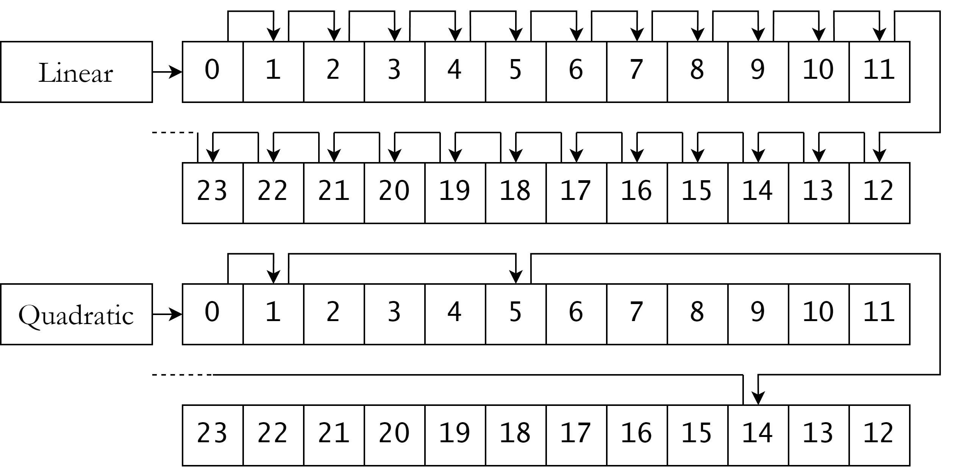
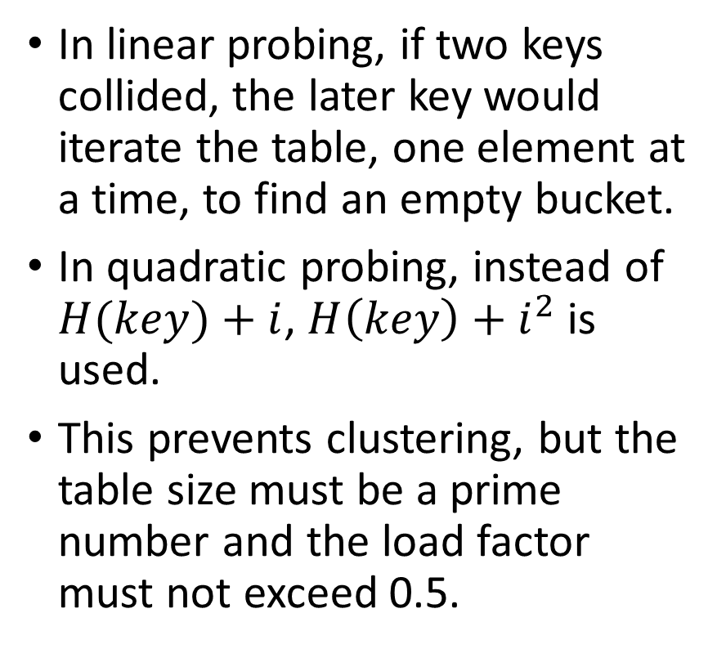
Open addressing – Quadratic probing
In linear probing, if two keys collided, the later key would iterate the table, one element at a time, to find an empty bucket.
In quadratic probing, instead of $H(key)+i$, $H\left(key\right)+i^{2}$ is used.
This prevents clustering, but the table size must be a prime number and the load factor must not exceed 0.5.

Slide 18
Open addressing – Quadratic probing
bool hash_insert(HashTable *table,
Movie *movie) {
if (table->length >=
LOAD_FACTOR*TABLE_SIZE)
return false;
uint hash = hash_function(movie
->name);
int offset = 0, index;
Movie **array = table->array;
...
Movie *hash_search(HashTable *table,
char *moviename)
{
uint hash =
hash_function(moviename);
int offset = 0, index;
Movie **array = table->array;
for (int i = 0; i < TABLE_SIZE;
++i) {
...

Slide 19
Collision resolution – Coalesced hashing
Coalesced hashing is a hybrid of open addressing and separate chaining.
When there is a collision, the pair is stored in another location in the table, but the address of the location is stored in the previous location so that it can be easily accessed during search operation.

Slide 20
Collision resolution – Coalesced hashing
bool hash_insert(HashTable
*hashtable, Movie *movie) {
if (hashtable->length >
LOAD_FACTOR*TABLE_SIZE)
return false;
uint hash = hash_function(movie
->name);
...
Movie *hash_search(HashTable
*hashtable, char *moviename)
{
uint hash =
hash_function(moviename);
Node **table = hashtable->table;
Node *node = table[hash];
...

Slide 21
Rehashing
Collisions become more frequent as the table gets filled.
Thus it is crucial to increase the size of the hash table every time the hash table exceeds a certain load factor, this is called rehashing.
The hashes usually change with change in table size, so rehashing has a linear complexity unless some rehashing algorithm is used.

Slide 22
Conclusion

Slide 23
Bibliography
Hash table – Wikipedia
Hash function – Wikipedia

Slide 24
The End
Credits:

Slide 25

int count_digits(int n) {
int count = 0;
for (; n != 0; n /= 10, ++count);
return count;
}
int ten_raised(int n) {
int result = 1;
for (int i = 0; i < n; i++)
result *= 10;
return result;
}

Slide 26
bool hash_insert(Node **table, Movie
*movie)
{
uint hash = hash_function(movie
->name);
if (table[hash] == NULL) {
table[hash] =
create_node(movie);
return true;
}
Node *lastnode = table[hash];
while (lastnode->next != NULL) {
if (strcmp(lastnode->movie
->name, movie->name) == 0)
return false;
lastnode = lastnode->next;
}
lastnode->next = create_node(movie);
return true;
}

Slide 27
Movie *hash_search(Node **table, char
*movie_name)
{
uint hash =
hash_function(movie_name);
Node *curr = table[hash];
while (curr) {
if (strcmp(curr->movie->name,
movie_name) == 0)
return curr->movie;
curr = curr->next;
}
return NULL;
}

Slide 28
bool hash_insert(HashTable *table, Movie
*movie)
{
if (table->length >=
LOAD_FACTOR*TABLE_SIZE)
return false;
uint hash = hash_function(movie
->name);
int offset = 0, index;
Movie **array = table->array;
for (; offset < TABLE_SIZE;
++offset) {
index = (hash+offset)
%TABLE_SIZE;
if (array[index] &&
strcmp(array[index]->name, movie->name)
== 0)
return false;
else if (array[index] == NULL) {
array[index] = movie;
++table->length;
return true;
}
}
return false;
}

Slide 29
Movie *hash_search(HashTable *table,
char *movie_name)
{
uint hash =
hash_function(movie_name);
int offset = 0, index;
Movie **array = table->array;
for (; offset < TABLE_SIZE;
++offset) {
index = (hash+offset)
%TABLE_SIZE;
if (array[index] &&
strcmp(array[index]->name, movie_name)
== 0)
return array[index];
}
return NULL;
}

Slide 30
bool hash_insert(HashTable *table, Movie
*movie) {
if (table->length >=
LOAD_FACTOR*TABLE_SIZE)
return false;
uint hash = hash_function(movie
->name);
int offset = 0, index;
Movie **array = table->array;
for (int i = 0; i < TABLE_SIZE; ++i)
{
offset = i*i;
index = (hash+offset)
%TABLE_SIZE;
if (array[index] &&
strcmp(array[index]->name, movie->name)
== 0)
return false;
else if (array[index] == NULL) {
array[index] = movie;
++(table->length);
return true;
}
}
return false;
}

Slide 31
Movie *hash_search(HashTable *table,
char *moviename)
{
uint hash =
hash_function(moviename);
int offset = 0, index;
Movie **array = table->array;
for (int i = 0; i < TABLE_SIZE; ++i)
{
offset = i*i;
index = (hash+offset)
%TABLE_SIZE;
if (array[index] &&
strcmp(array[index]->name, moviename)
== 0)
return array[index];
}
return NULL;
}

Slide 32
bool hash_insert(HashTable *hashtable,
Movie *movie) {
if (hashtable->length >
LOAD_FACTOR*TABLE_SIZE)
return false;
uint hash = hash_function(movie
->name);
Node **table = hashtable->table;
if (table[hash] == NULL) {
table[hash] =
create_node(movie);
++(hashtable->length);
return true;
}
Node **lastnode_ptr = &table[hash];
while ((*lastnode_ptr)->next) {
if (strcmp((*lastnode_ptr)
->movie->name, movie->name) == 0)
return false;
lastnode_ptr =
&((*lastnode_ptr)->next);
}
int lastindex = lastnode_ptr –
table, offset = 0, index;
for (; offset < TABLE_SIZE;
++offset) {
index = (lastindex+offset)
%TABLE_SIZE;
if (table[index] == NULL) {
table[index] =
create_node(movie);
(*lastnode_ptr)->next =
table[index];
++(hashtable->length);
return true;
}
}
return false;
}

Slide 33
Movie *hash_search(HashTable
*hashtable, char *moviename)
{
uint hash =
hash_function(moviename);
Node **table = hashtable->table;
Node *node = table[hash];
while (node) {
if (strcmp(node->movie->name,
moviename) == 0)
return node->movie;
node = node->next;
}
return NULL;
}

