Slide 1
HASHING

Slide 2
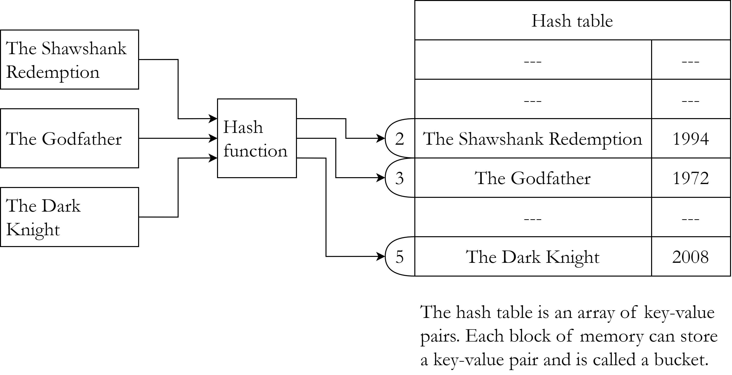
Hash table
A hash table is a data structure which stores key-value pairs.
A hash function is used to decide where a pair will be stored on the basis of the key.
Insertion, deletion and search operations are very fast in hash tables and ideally have O(1) time complexity.

Slide 3
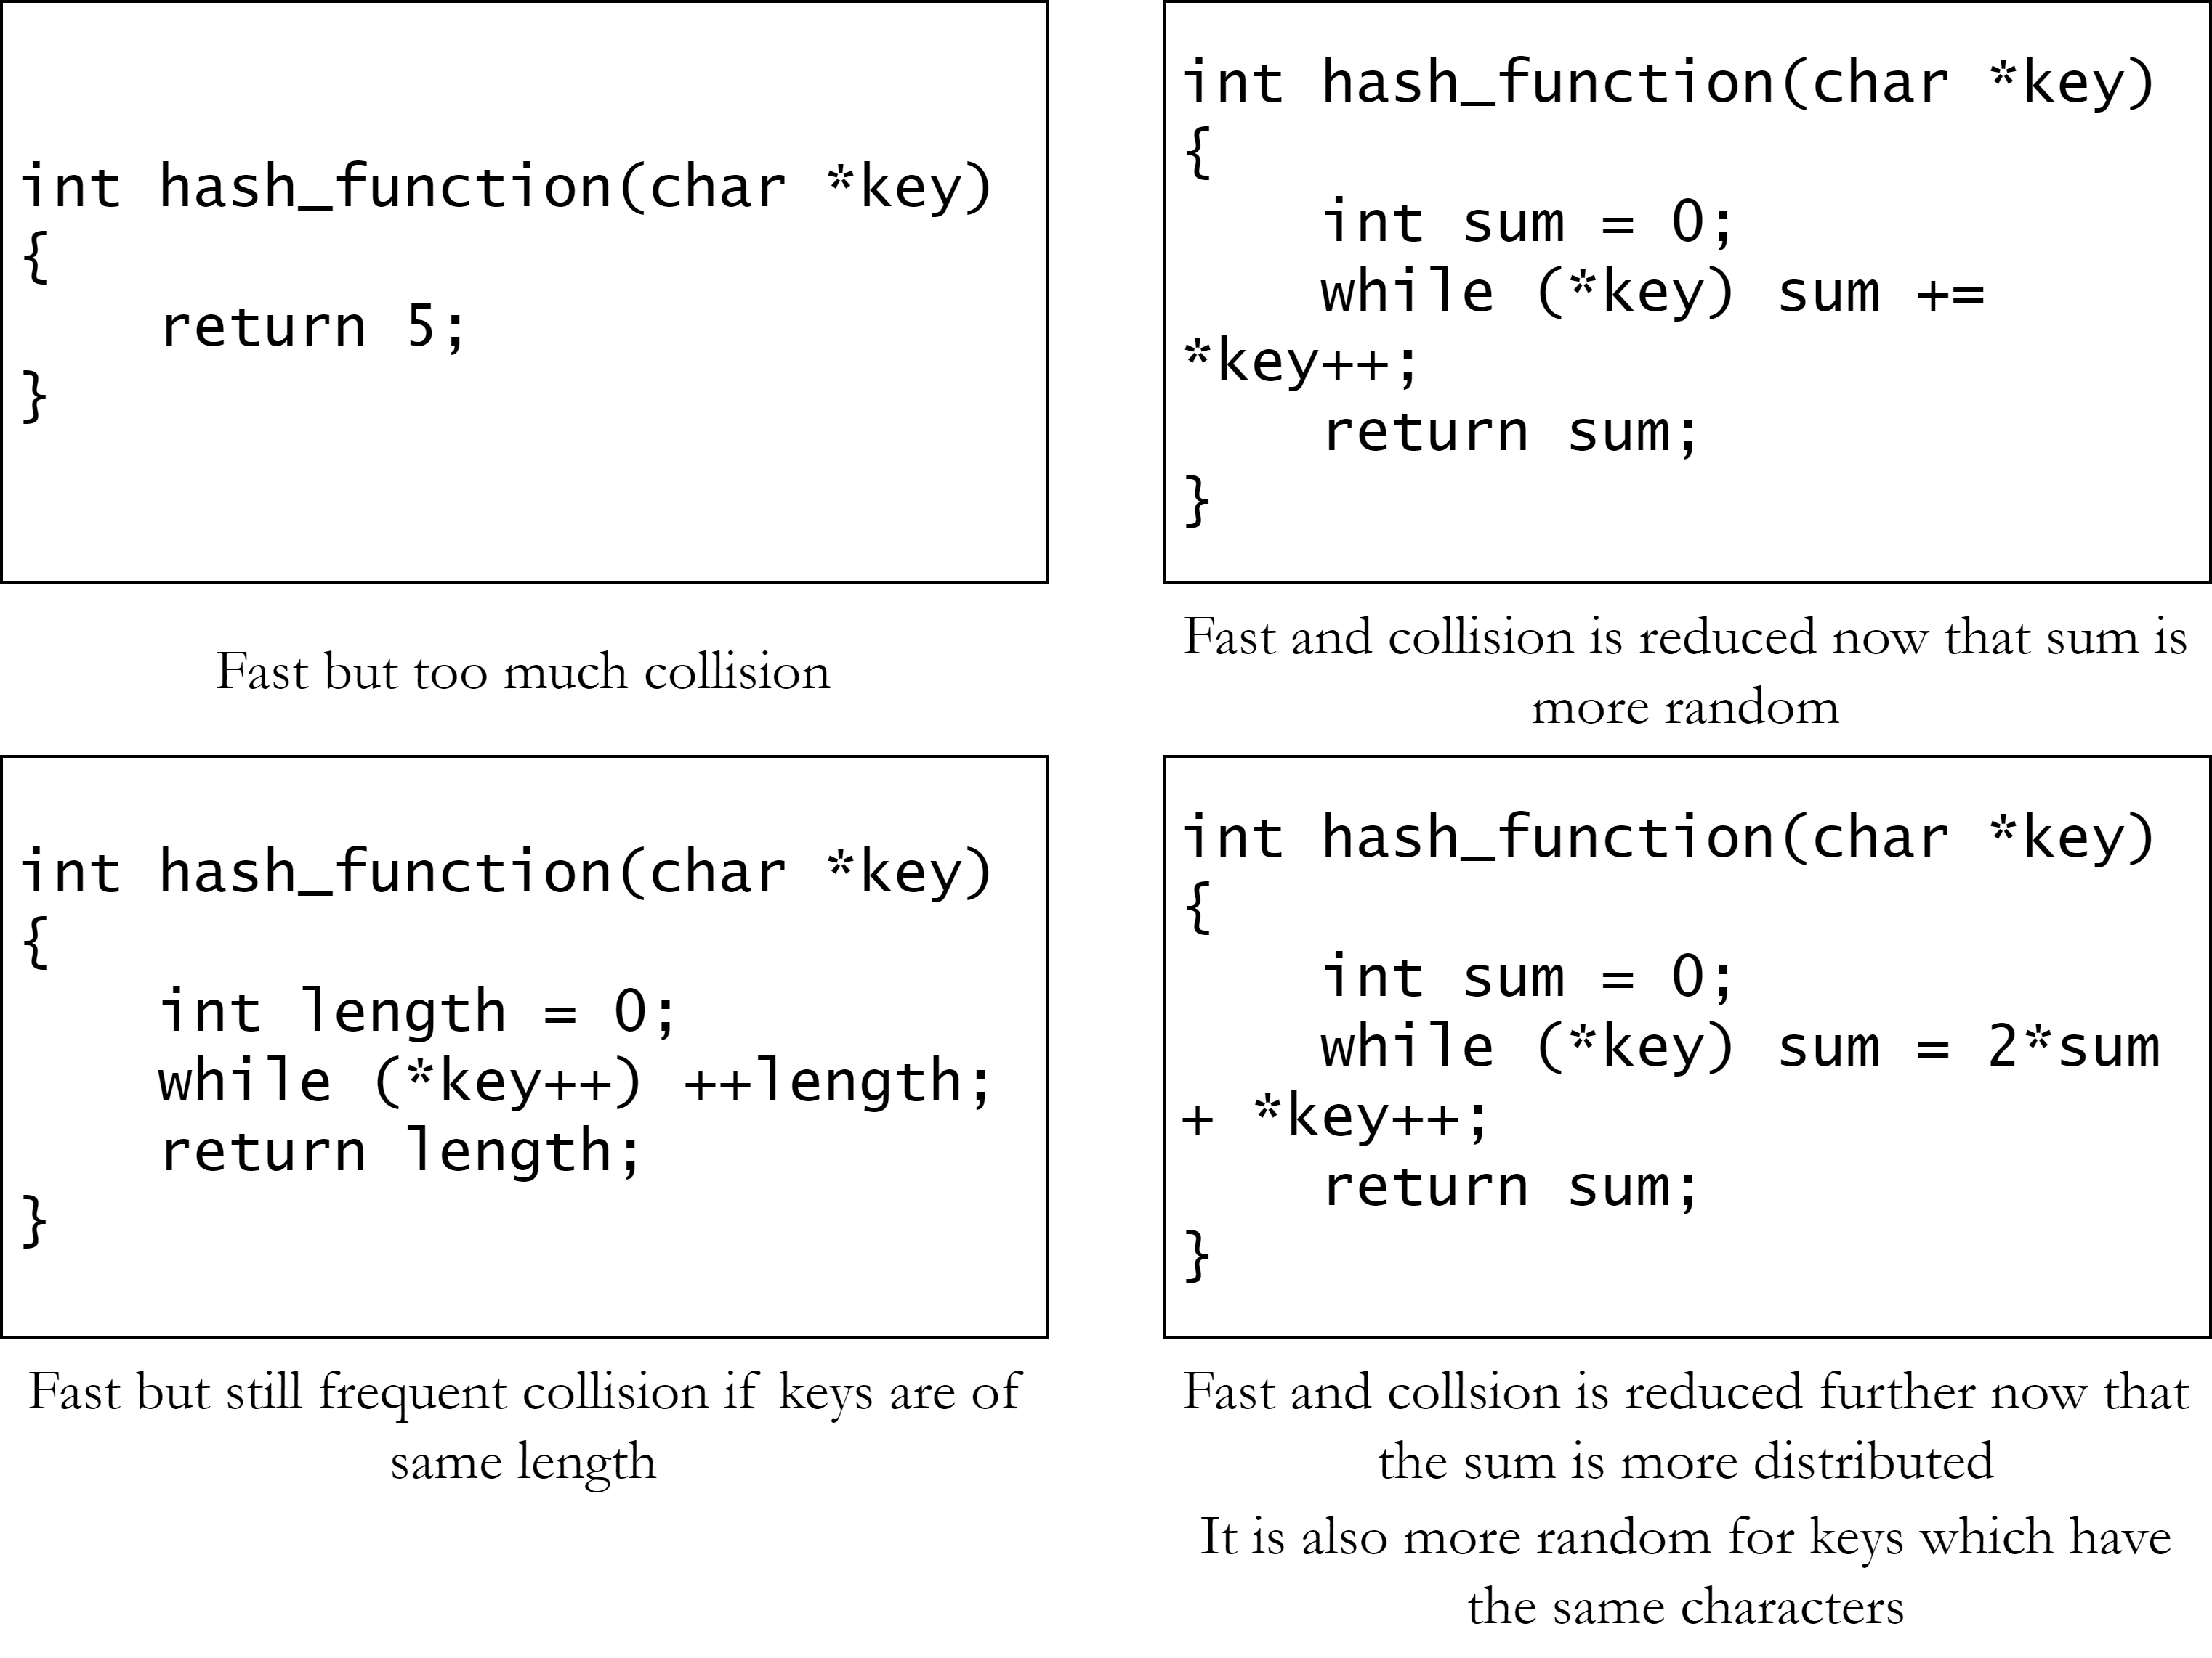
Hash function
A hash function takes the key as argument and returns a hash.
The hash can be used to insert or search the key in a hash table.
Different keys may return the same hash. It is called collision.
A good hash function must be fast and it should also reduce collision.

Slide 4
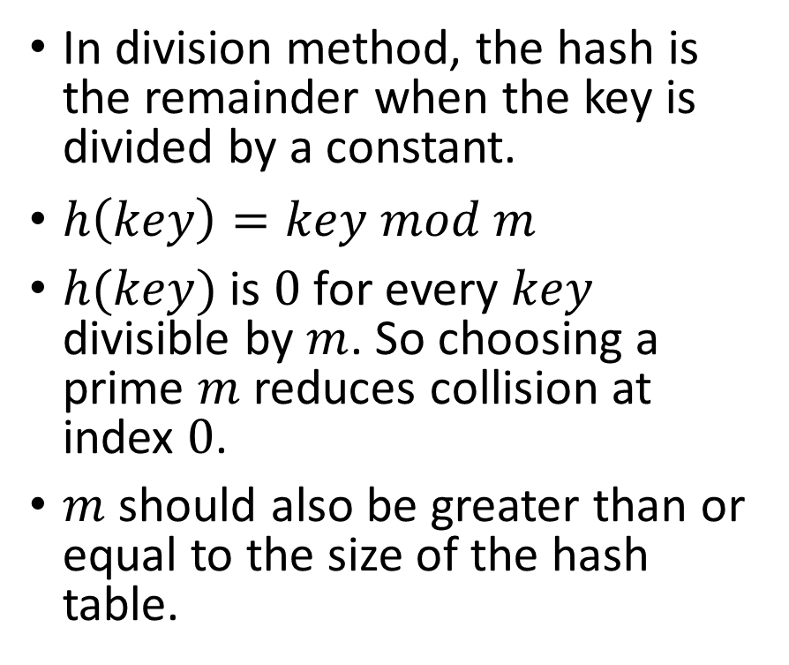
Hash function – Division method
In division method, the hash is the remainder when the key is divided by a constant.
$h\left(key\right)=key mod m$
$h(key)$ is $0$ for every $key$ divisible by $m$. So choosing a prime $m$ reduces collision at index $0$.
$m$ should also be greater than or equal to the size of the hash table.
int division_method(int key)
{
const int m = 29;
return key % m;
}

Slide 5
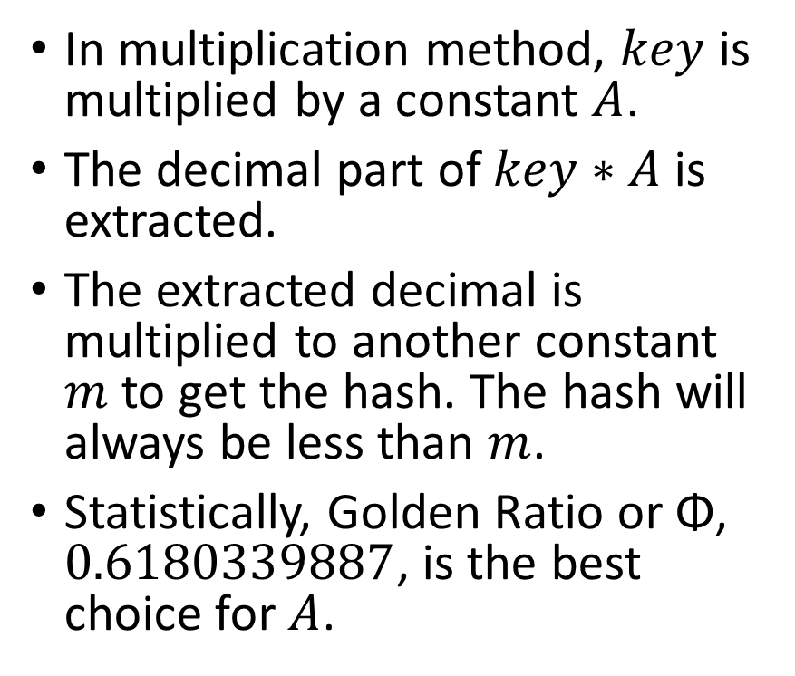
Hash function – Multiplication method
In multiplication method, $key$ is multiplied by a constant $A$.
The decimal part of $key∗A$ is extracted.
The extracted decimal is multiplied to another constant $m$ to get the hash. The hash will always be less than $m$.
Statistically, Golden Ratio or Φ, $0.6180339887$, is the best choice for $A$.
int multiplication_method(int key)
{
const double A = 0.6180339887;
const int m = 60;
double extracted = A*key –
floor(A*key);
return floor(m*extracted);
}

Slide 6

Hash function – Mid-square method
In mid-square method, $key$ is squared.
A constant, $r$ digits are selected from the middle as the hash.
The hash can be any combination of $r$ digits, so the range of hash is $[0, {10}^{r})$.
int midsquare_method(int key)
{
const int r = 3;
int key_sq = key * key;
int n = count_digits(key_sq);
int start = (n-r) / 2;
key_sq /= ten_raised(start);
return key_sq –
(key_sq/ten_raised(r)) *
ten_raised(r);
}

Slide 7
Hash function – Mid-square method
int count_digits(int n)
{
int count = 0;
for (; n != 0; n /= 10,
++count);
return count;
}
int ten_raised(int n)
{
int result = 1;
for (int i = 0; i < n; i++)
result *= 10;
return result;
}

Slide 8
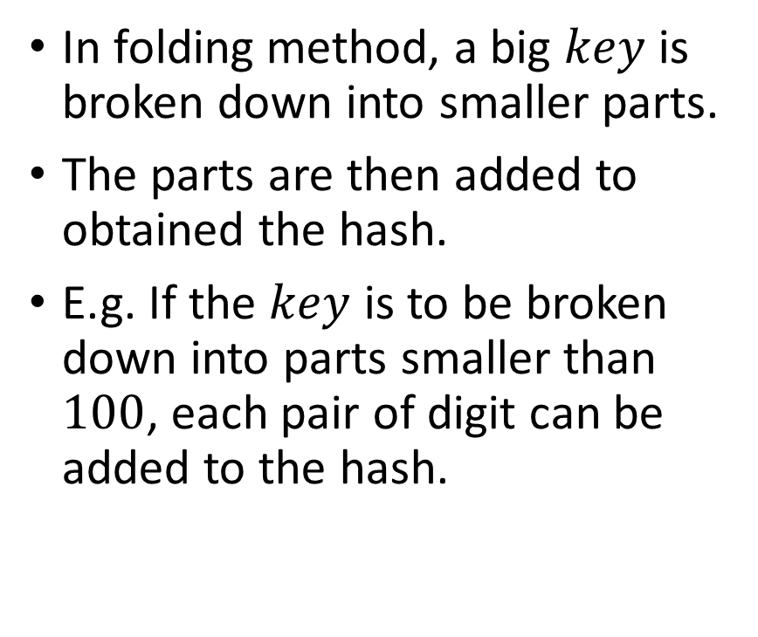
Hash function – Folding method
In folding method, a big $key$ is broken down into smaller parts.
The parts are then added to obtained the hash.
E.g. If the $key$ is to be broken down into parts smaller than $100$, each pair of digit can be added to the hash.
int folding_method(int key)
{
const int partition_size =
100;
int hash = 0;
while (key > 0) {
hash += key %
partition_size;
key /= partition_size;
}
return hash % partition_size;
}

Slide 9
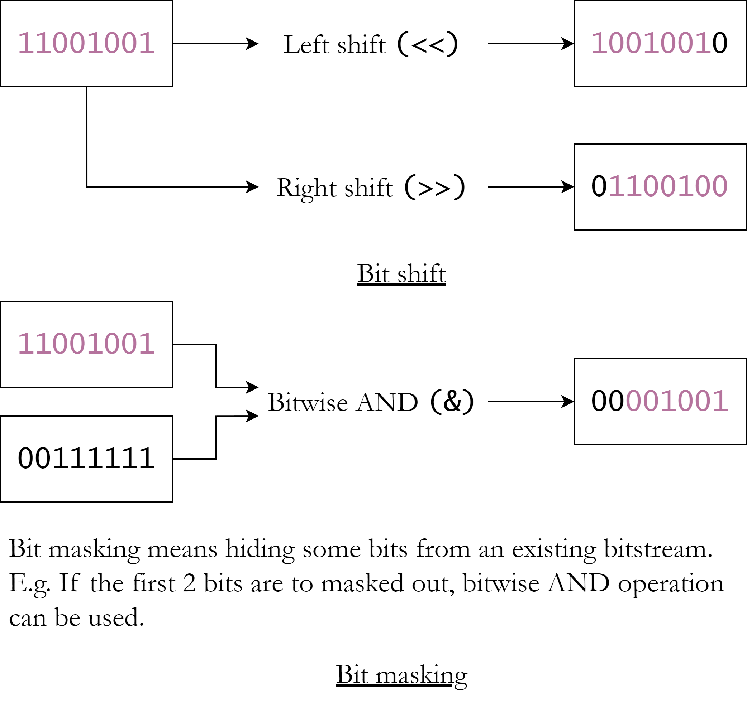
Hash function – Bit-rotation method
Hash can be obtained by rotating bits of an integer in different ways.
Bit-rotation relies on bit shift and bit masking.
A simple algorithm is the BSD checksum which is used to check file integrity but can also be used to hash keys, especially string keys.

Slide 10
Hash function – BSD checksum
In BSD checksum, the hash is circular shifted. In the usual shifting, data is lost, but circular shifting preserves it.
Then the key is added and then the hash is masked ensuring no overflow occurs.
In the case of string, each character is added.
uint bsd_checksum(const
char *key)
{
uint hash = 0;
while (*key) {
hash = (hash >> 1) |
((hash & 1) << 15);
hash += *key++;
hash &= 0xffff;
}
return hash;
}

Slide 11
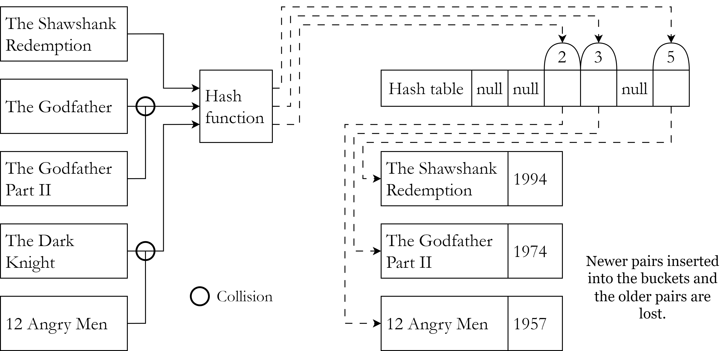
Collision
A hash function may return the same hash for different keys. This is called collision.
If two keys have the same hash, only one key-value pair can be stored at the hash index.
The other pair needs to be stored at another memory location. This is called collision resolution.

Slide 12
Collision resolution techniques
Separate chaining: Each bucket is a node which contains reference to the hash table items. It can be any data structure like a linked list, a tree or maybe even another hash table.
Open addressing: Instead of creating another data structure to hold colliding items, it can be stored in another empty bucket in the hash table.

Slide 13
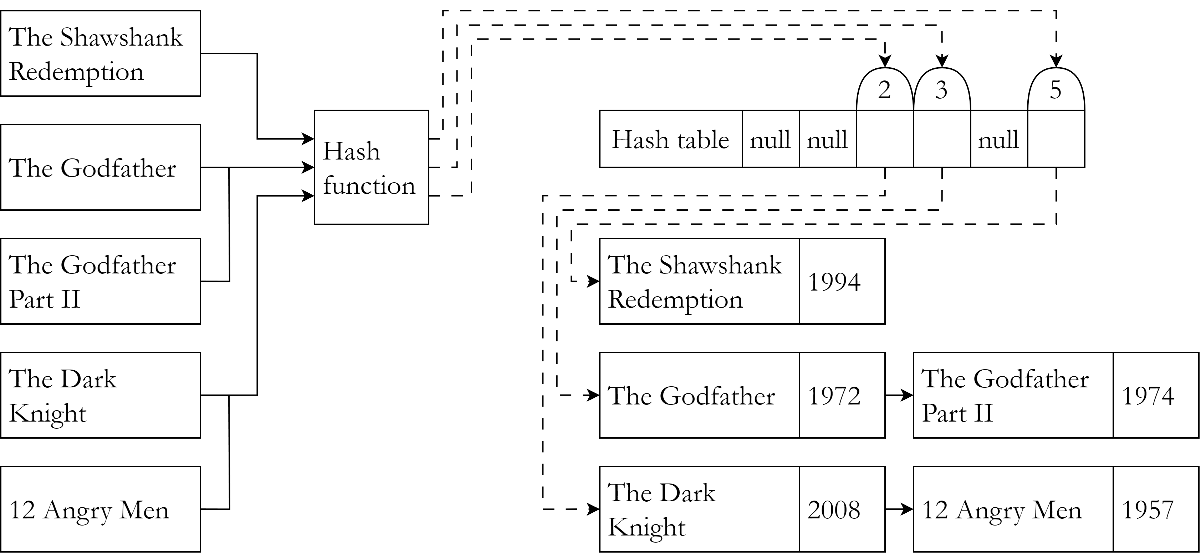
Separate chaining – Linked list
In this method, each element is a linked list of key-value pairs.
If two keys have the same hash, both key-value pairs will be the member of the linked list in the hash index.
It is to be noted that extra memory is allocated in linked lists even if the hash table has empty buckets.

Slide 14
Separate chaining – Linked list
bool hash_insert(Node **table, Node
*node)
{
uint index = hash_function(node
->movie->name);
if (!table[index]) {
table[index] = node;
return true;
}
return insert_node(table[index],
node);
}
Movie *hash_search(Node **table,
char *movie_name)
{
uint index =
hash_function(movie_name);
Node *curr = table[index];
while (curr) {
if (strcmp(curr->movie->
name, movie_name) == 0)
return curr->movie;
curr = curr->next;
}
return NULL;
}

Slide 15
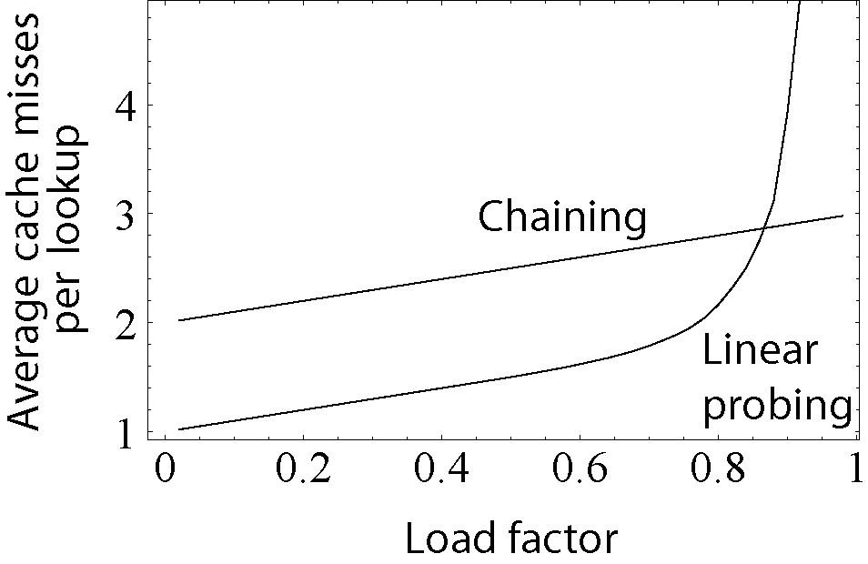
Open addressing – Linear probing
In this method, if the hash of a key-value pair is already occupied, a linear search is performed and the pair is stored in the next empty bucket.
Hash tables are not completely filled so that there are more empty buckets to be found.
Load factor is the ratio of the number of occupied spaces and total number of buckets.

Slide 16
Open addressing – Linear probing
bool hash_insert(HashTable *table,
Movie *movie)
{
if (table->length >=
LOAD_FACTOR*TABLE_SIZE) return false;
uint hash = hash_function(movie
->name);
int i, index;
Movie **array = table->array;
for (i = 0; i < TABLE_SIZE; ++i) {
index = (hash+i)%TABLE_SIZE;
if (array[index] &&
strcmp(array[index]->name, movie
->name) == 0) return false;
else if (!array[index]) {
array[index] = movie;
++table->length;
return true;
}
}
return false;
}

Slide 17
Open addressing – Linear probing
int hash_search(HashTable *table,
char *movie_name)
{
uint hash =
hash_function(movie_name);
int i, index = hash;
Movie **array = table->array;
for (i = 0; i < TABLE_SIZE; ++i) {
index =
(hash+i)%TABLE_SIZE;
if (array[index] &&
strcmp(array[index]->name,
movie_name) == 0)
return index;
}
return -1;
}

Slide 18
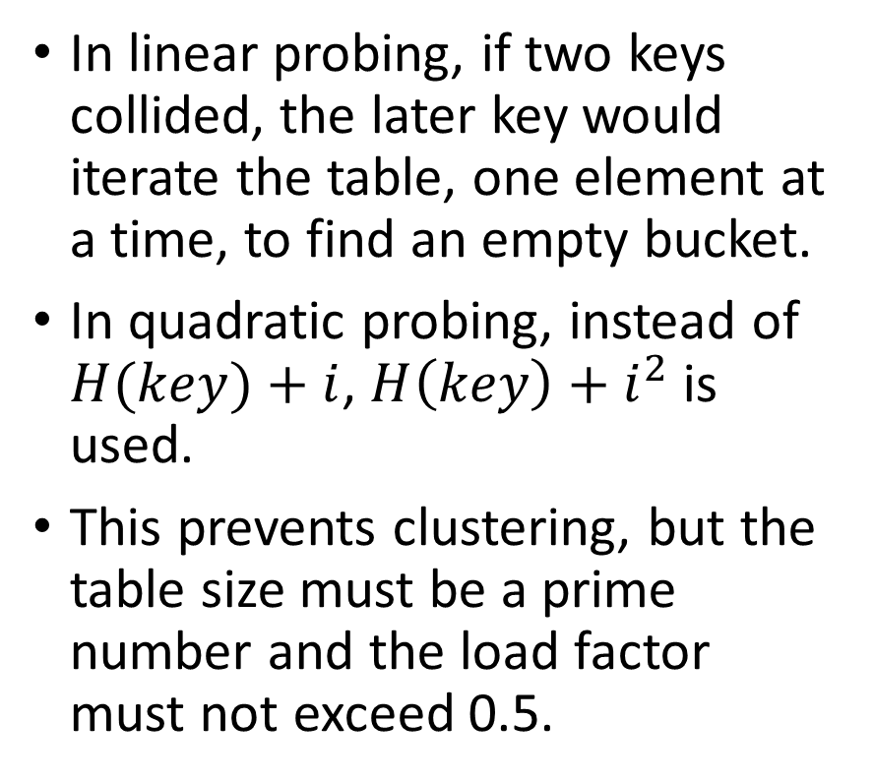
Open addressing – Quadratic probing
In linear probing, if two keys collided, the later key would iterate the table, one element at a time, to find an empty bucket.
In quadratic probing, instead of $H(key)+i$, $H\left(key\right)+i^{2}$ is used.
This prevents clustering, but the table size must be a prime number and the load factor must not exceed 0.5.

Slide 19
Open addressing – Linear probing
bool hash_insert(HashTable *table,
Movie *movie)
{
if (table->length >=
LOAD_FACTOR*TABLE_SIZE) return false;
uint hash = hash_function(movie
->name);
int i, index;
Movie **array = table->array;
for (i = 0; i < TABLE_SIZE; ++i) {
index = (hash+i*i)%TABLE_SIZE;
if (array[index] &&
strcmp(array[index]->name, movie
->name) == 0) return false;
else if (!array[index]) {
array[index] = movie;
++table->length;
return true;
}
}
return false;
}

Slide 20
Open addressing – Quadratic probing
int hash_search(HashTable *table,
char *movie_name)
{
uint hash =
hash_function(movie_name);
int i, index = hash;
Movie **array = table->array;
for (i = 0; i < TABLE_SIZE; ++i) {
index =
(hash+i*i)%TABLE_SIZE;
if (array[index] &&
strcmp(array[index]->name,
movie_name) == 0)
return index;
}
return -1;
}

Slide 21
Conclusion

Slide 22
Bibliography
Hash table – Wikipedia
Hash function – Wikipedia

