Slide 1


HASHING
CC-5 Data Structures
Department of Computer and System Sciences
Visva Bharati University
Shantiniketan – 731325
Arpan Pal
Bijan Roy
Harsh Sarkar
Vigyan Kumar

Slide 2
INTRODUCTION
DEFINITION
In Computer Science, hashing is the process of mapping data of arbitrary size to fixed-size values called hash codes or hashes.
PURPOSE
Hashing is used to make hashed data structures like hash tables and hash sets where insertion, searching and deletion ideally take constant time.
Hashing is used in cryptography to store and send confidential data.
Hashing is used to check file integrity and detect changes in files.

Slide 3

HASH TABLE
DEFINITION
A hash table is a hashed data structure which stores key-value pairs called items.
Items are stored into buckets according to hashes returned by a hash function. This makes operations very fast.
HASH TABLE OPERATIONS
Insertion
Deletion
Searching
KEY COMPONENTS
Buckets: Storage locations identified by indices generated from the hash function. Each bucket contains an item.
Hash function: A mathematical function which returns the bucket index where an item should be stored.
Collision resolution: Techniques for handling collisions, i.e. when two keys have the same hash.

Slide 4
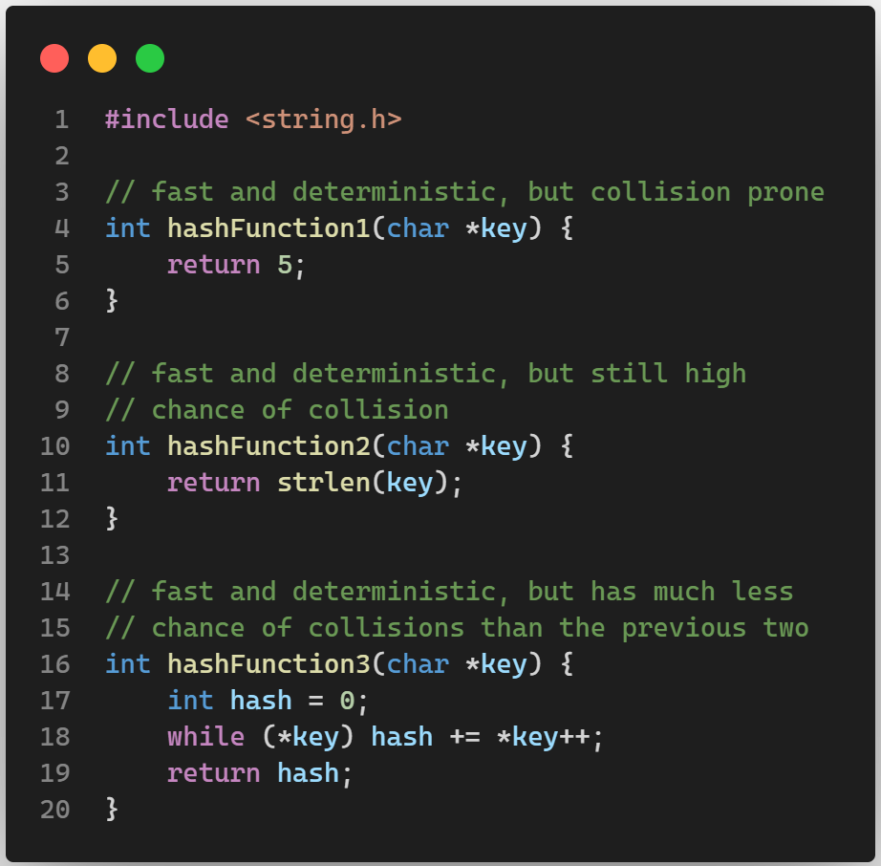
HASH FUNCTION
DEFINITION
A hash function is a mathematical function which takes a variable length key as an argument and returns a fixed length value called hash.
PURPOSE
To return the index where an item has to be stored.
To ensure even distribution of data across the hash table.
CHARACTERISTICS
Deterministic: The function must always return the same hash for the same key.
Fast: The hash should not take too long to compute.
Minimum collision: A good function aims at minimizing collision.

Slide 5

COLLISION
DEFINITION
A collision occurs when two different keys hash to the same index or location in the hash table.
Collisions are important to address because if not handled properly, they can lead to data being overwritten or mixed up in the same location in the hash table.
The colliding pair needs to be stored at another memory location. This is called collision resolution.
Collision resolution techniques can broadly be categorized in two categories:
Separate chaining
Open addressing

Slide 6

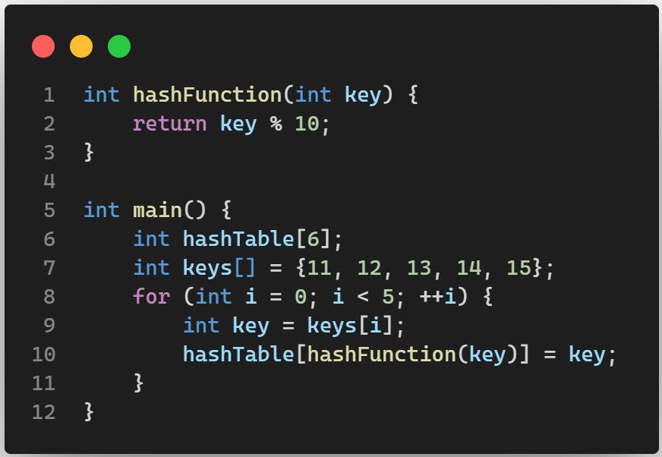
HASH TABLE
A hash table is a data structure which stores key-value pairs according to hash codes returned by a hash function of the keys.
A simple implementation of a hash table is given below.

Slide 7
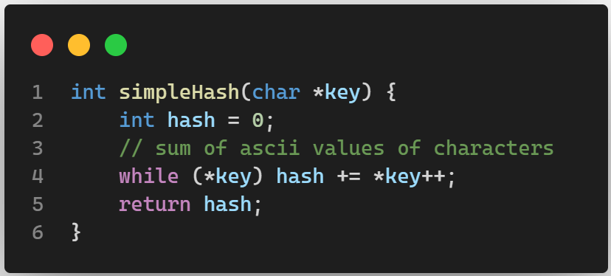
HASH FUNCTION
A hash function is a function which takes a variable length key as an argument and returns a fixed length hash.
CRITERIA
A hash function must have the following characteristics:
It should be fast to compute.
It should always return the same hash for the same key.
It should be chosen such that it reduces collision.
It should be chosen such that it evenly distributes items across the hash table.

Slide 8
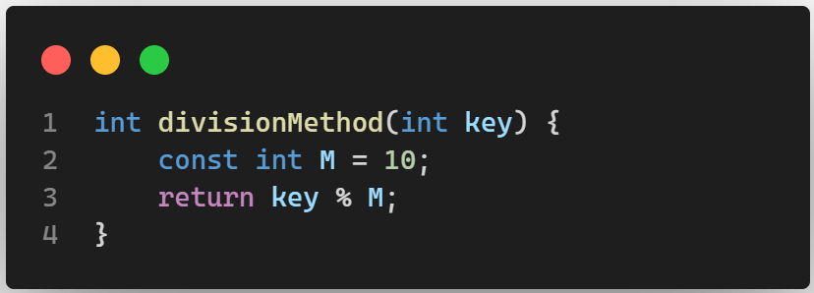
DIVISION METHOD
In this method, the hash is the remainder obtained when the key is divided by a constant M.
M is smaller or equal to the size of the hash table.
Remainder or modulo operation is used in many hash functions, but if M is divisible by too many numbers, clustering will increase. So M is preferably a prime number.
Formula
$$H\left(key\right)=key \% M$$

Slide 9
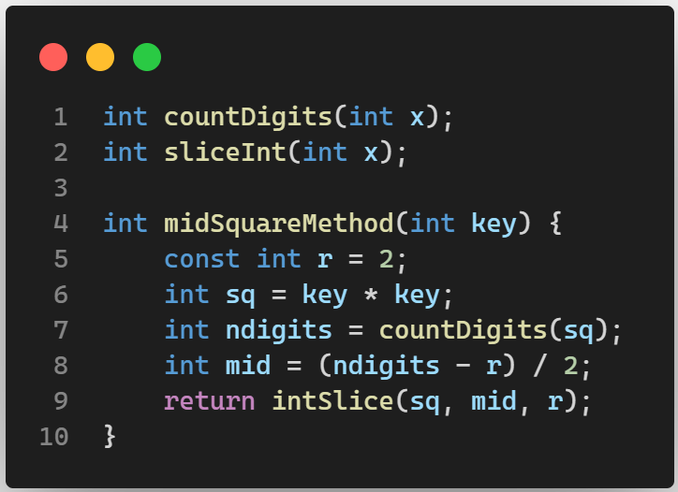
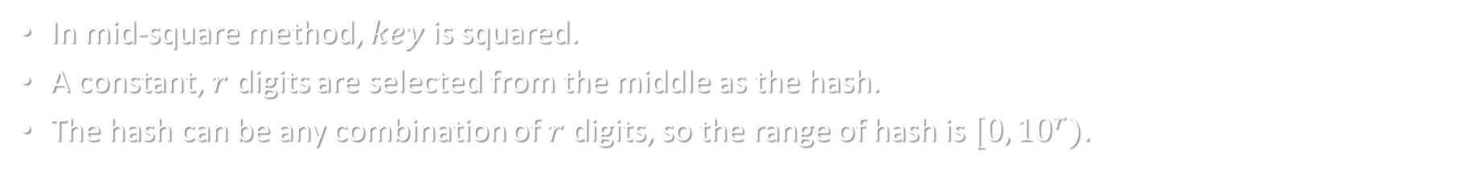
MID SQUARE METHOD
In mid-square method, $key$ is squared.
A constant, $r$ digits are selected from the middle as the hash.
The hash can be any combination of $r$ digits, so the range of hash is $[0, {10}^{r})$.

Slide 10
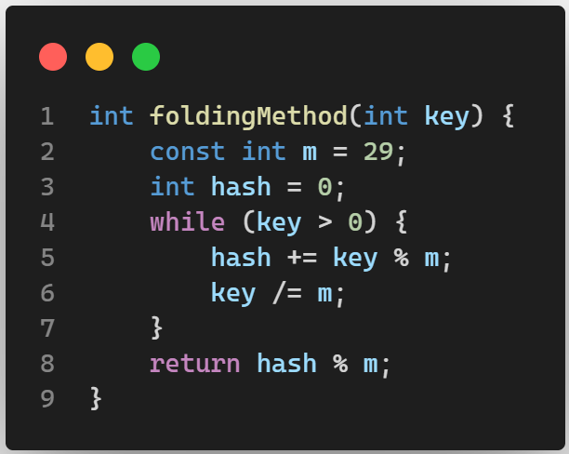
DIGIT FOLDING METHOD
In folding method, a big $key$ is broken down into smaller parts.
The parts are then added to obtain the hash.

Slide 11
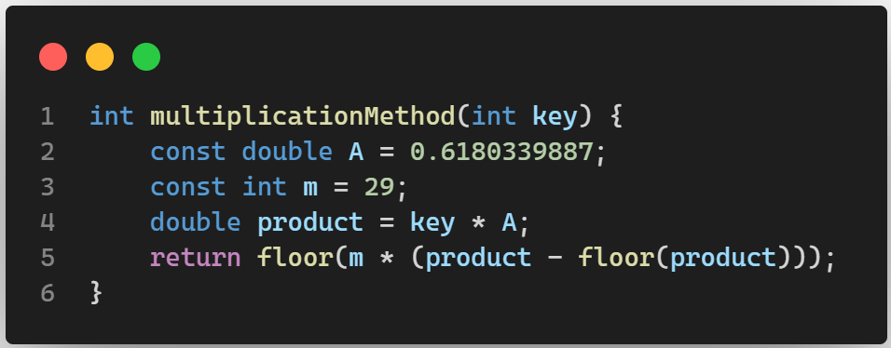
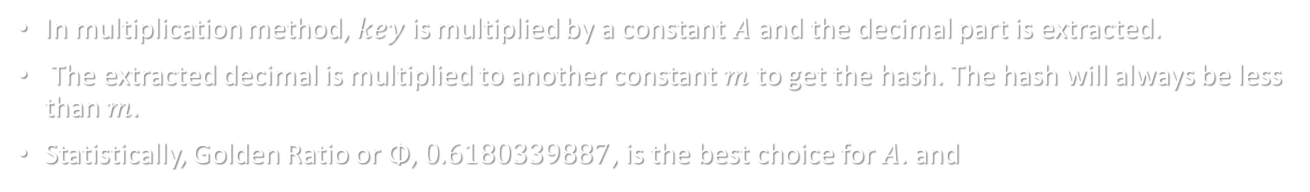
MULTIPLICATION METHOD
In multiplication method, $key$ is multiplied by a constant $A$ and the decimal part is extracted.
The extracted decimal is multiplied to another constant $m$ to get the hash. The hash will always be less than $m$.
Statistically, Golden Ratio or Φ, $0.6180339887$, is the best choice for $A$. and
FORMULA
$$H\left(key\right)=floor(m∗\left(key∗A−floor\left(key∗A\right)\right))$$

Slide 12

HASH TABLE OPERATIONS
INSERTION Adds a new key-value pair into the hash table.
DELETION Removes an existing key-value pair from the hash table.
SEARCHING Find and retrieve the value associated with a specific key.

Slide 13
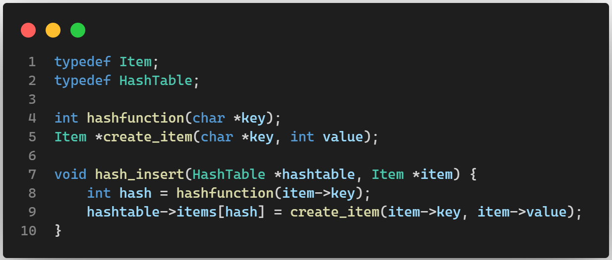
INSERTION

Slide 14
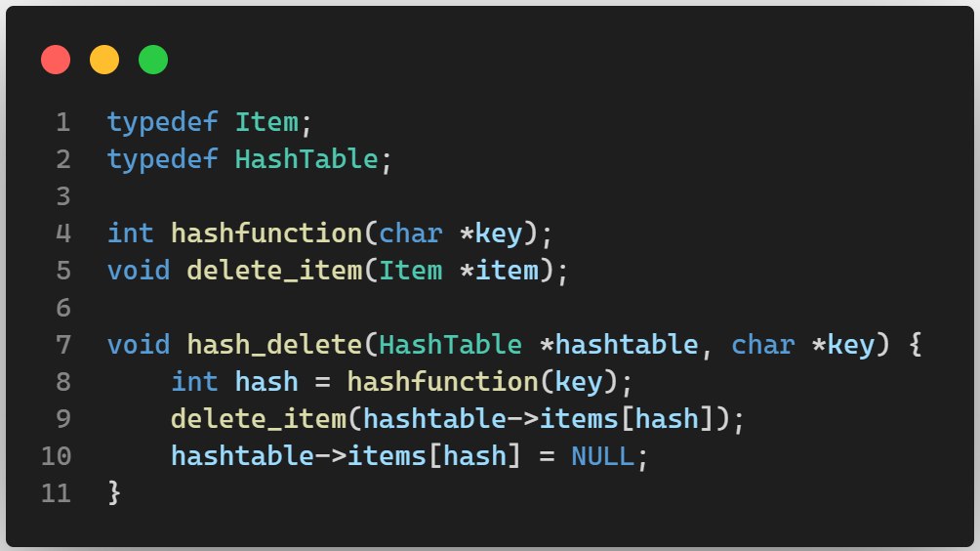
DELETION

Slide 15
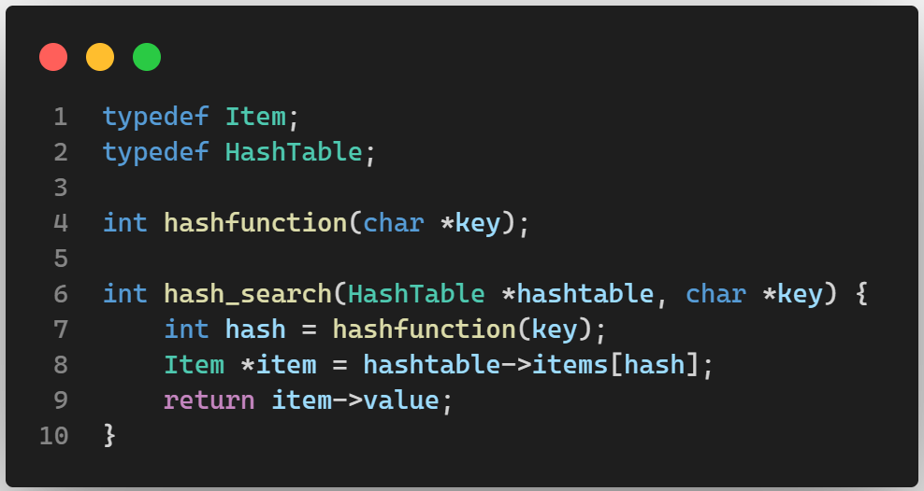
SEARCHING

Slide 16
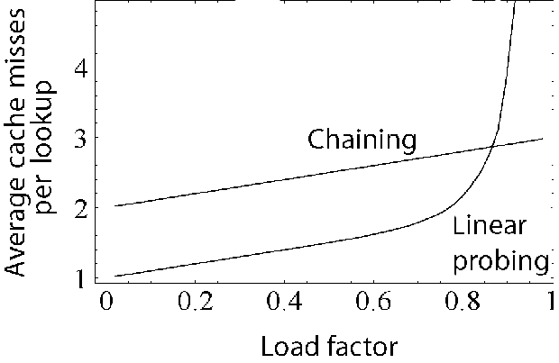

LOAD FACTOR
The load factor is defined as the ratio of the number of elements stored in the hash table and the total number of slots or buckets available in the table.
It is denoted by the symbol λ.
The efficiency of a hash table decreases as it starts filling up. So a maximum load factor is selected so that a proportion of the hash table is always empty.
$$λ=\frac{Number of items}{Length of hash table}$$

Slide 17

COLLISION RESOLUTION TECHNIQUES
DEFINITION
Collision resolution is crucial for handling situations where multiple keys hash to the same index in a hash table.
TYPES
Separate chaining: In this technique, each bucket is a linked data structure like linked list or tree. All keys having the same hash are nodes in the structure at the hash’th bucket.
Open addressing: In open addressing, no separate chains are created, colliding keys are stored at empty buckets in the hash table at an offset from the hash’th bucket.

Slide 18
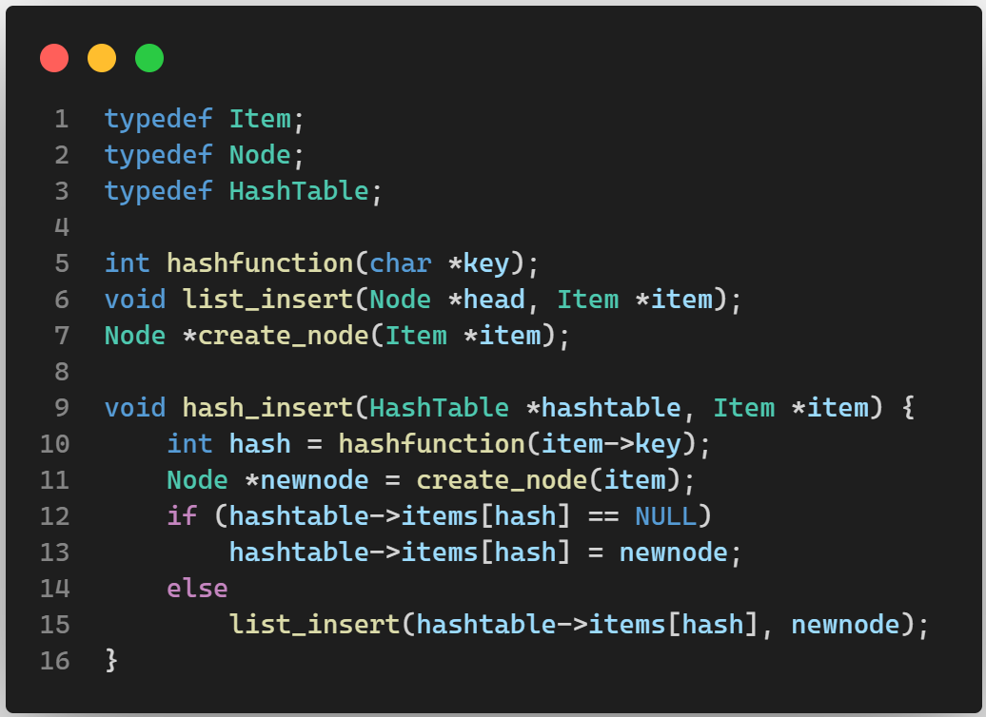
SEPARATE CHAINING
In this method, each bucket contains a node. Each node contains an item and a reference to one or more nodes.
If there are collisions, pointer to the colliding nodes can be stored in the existing node.
The node can be part of any suitable data structure like linked list, tree or even another hash table.

Slide 19
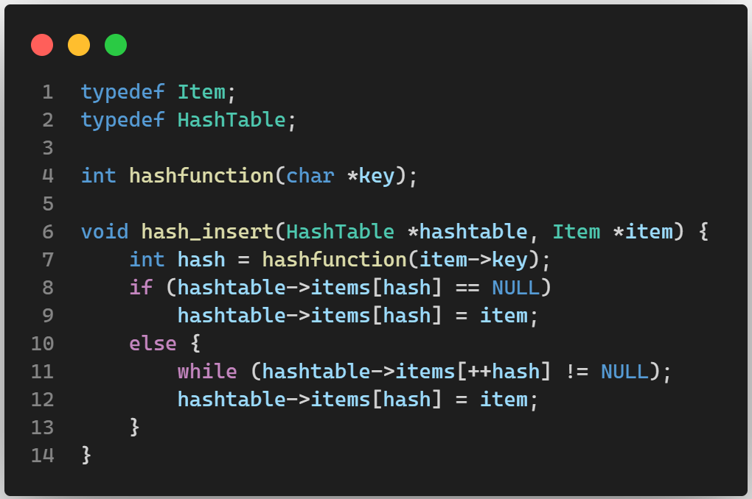

LINEAR PROBING
In this method, if an item already exists in a bucket, colliding items are placed at an offset from the hash where there is no item.
The offset is searched by sequentially checking each bucket one after the other.
So the hash is $H+i$.

Slide 20
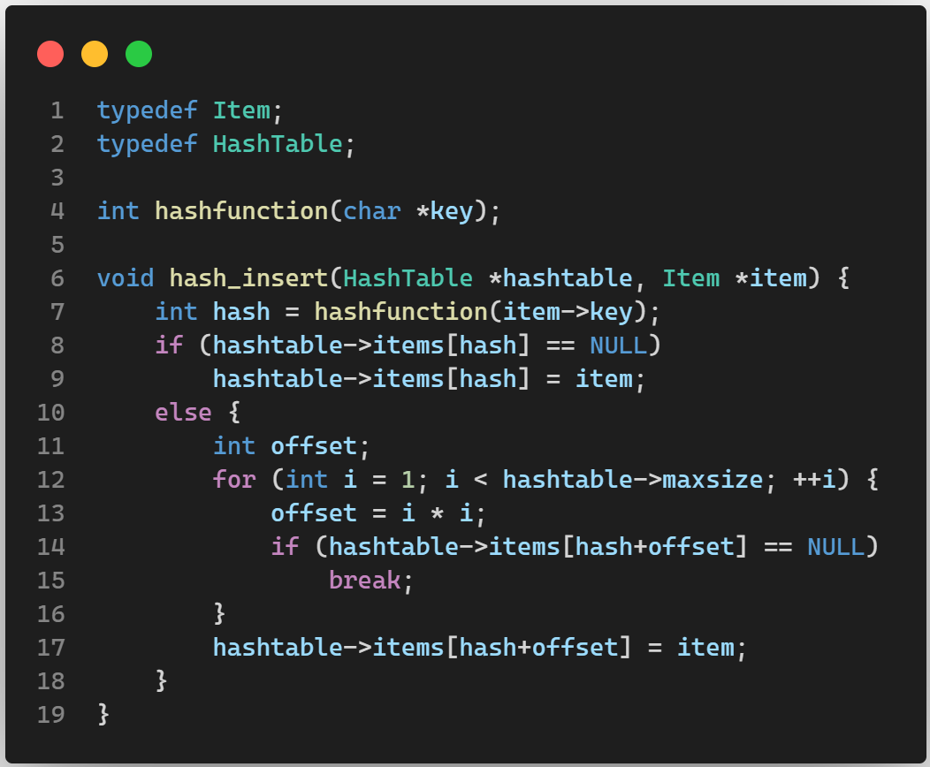

QUADRATIC PROBING
Like in linear probing, colliding items are placed at an offset from the hash.
But unlike in linear probing where the offsets are (1, 2, 3, …), in quadratic probing the offsets are (1, 4, 9, …).
So the hash is $H+i^{2}$.

Slide 21
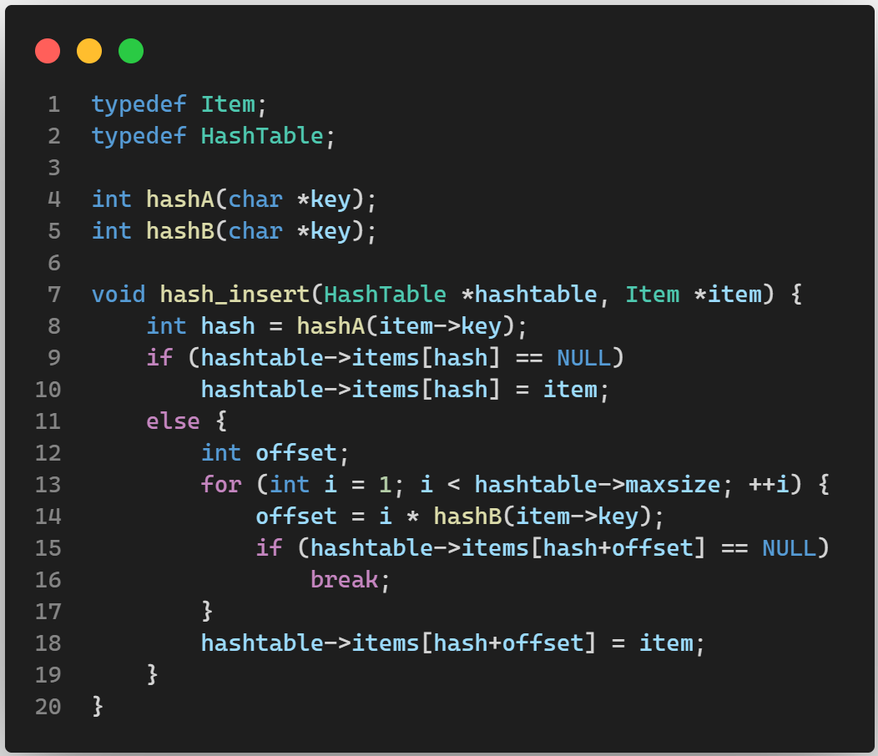
DOUBLE HASHING
Double hashing also places colliding items at an offset from their hash, but the offset is obtained by another hash function.
Generally there are two hash functions 𝐻₁ and 𝐻₂. Offset is a multiple of 𝐻₂ (𝑘𝑒𝑦).
So the hash is 𝐻₁ + 𝑖.𝐻₂.

Slide 22
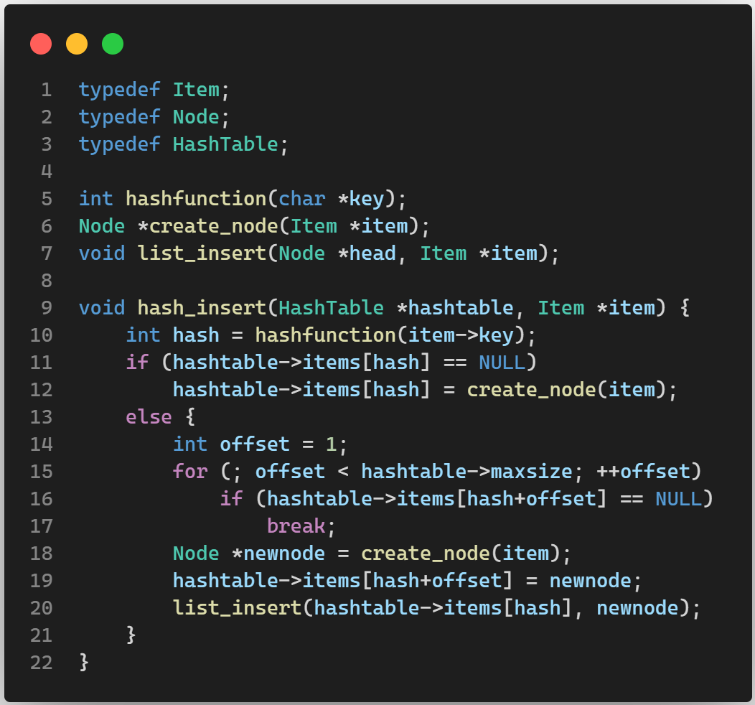
COALESCED HASHING
Like separate chaining, colliding items are inserted as nodes in a linked data structure at the hash’th bucket.
But unlike separate chaining, the nodes of the data structure are stored in empty buckets of the hash table (like in open addressing).
Since a node at hash position is connected to the colliding nodes which are present in other parts of the hash table, it takes lesser time to find the colliding nodes.

Slide 23

HASHING FOR SECURITY
Hashing is widely used in cyber security to safeguard passwords and sensitive data.
Instead of storing passwords in plain text, websites and applications convert them into hashes before storing them in databases.
This way, even if the database is breached, attackers would encounter hashes that are extremely difficult to reverse-engineer back into the original passwords.

Slide 24
CRYPTOGRAPHIC HASH FUNCTIONS
Cryptography hash functions are mathematical algorithms that take an input (or message) of any length and produce a fixed-size output, commonly referred to as a hash value or hash code. These functions are designed to be one-way, meaning it's computationally infeasible to reverse the process and retrieve the original input from the hash value.
CHARACTERISTICS
Fixed Output Size
Irreversibility
Deterministic
Collision Resistance
EXAMPLES
SHA-256 (Secure Hash Algorithm 256-bit)
SHA-3
BLAKE2
Whirlpool
RIPEMD-160

Slide 25

SALTING
Salting: Addition of a unique random value (salt) to each password before hashing further strengthens security by preventing attackers from using pre computed tables (rainbow tables) to crack passwords efficiently.

Slide 26
ACKNOWLEDGEMENT
We would like to express our special gratitude to Mrs. Sanchita Pal Choudhuri who gave us the opportunity to do this wonderful presentation on hashing which helped us a lot in doing research on this topic and learn new topics regarding this course.

Slide 27
REFERENCES
https://en.wikipedia.org/wiki/Hash_function
https://en.wikipedia.org/wiki/Open_addressing
https://en.wikipedia.org/wiki/Cryptographic_hash_function

Slide 28
THANK YOU

