Slide 1
Collision Resolution

Slide 2
Seperate Chaining
In this method, each bucket contains a node. Each node contains an item and a reference to one or more nodes.
If there are collisions, pointer to the colliding nodes can be stored in the existing node.
The node can be part of any suitable data structure like linked list, tree or even another hash table.
insert(hashtable, item)
Find hash of item.
If hashtable[hash] is NULL, place a node containing item there.
Else chain the node containing item to the node at hashtable[hash].

Slide 3
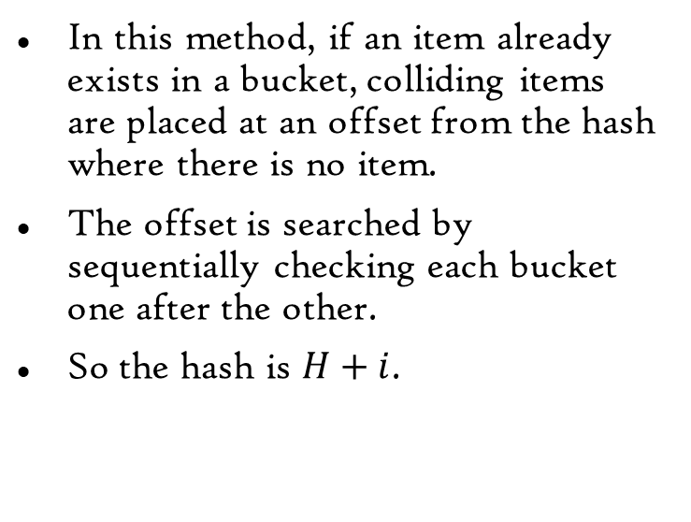
Linear Probing
In this method, if an item already exists in a bucket, colliding items are placed at an offset from the hash where there is no item.
The offset is searched by sequentially checking each bucket one after the other.
So the hash is $H+i$.
insert(hashtable, item)
Find hash of item.
If hashtable[hash] is NULL, place item there.
Else
While current bucket is not empty, check the next bucket.
If bucket is empty, place item in it.

Slide 4
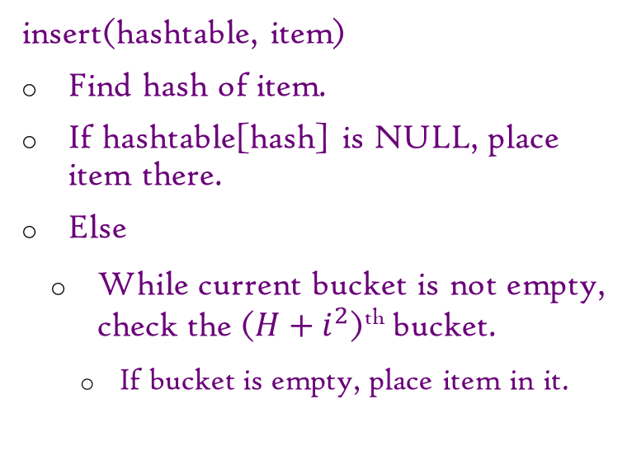
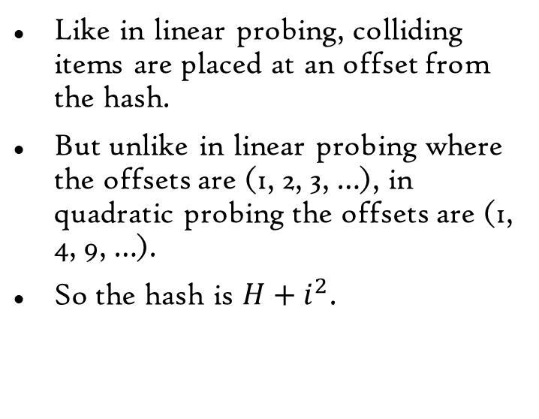
Quadratic Probing
Like in linear probing, colliding items are placed at an offset from the hash.
But unlike in linear probing where the offsets are (1, 2, 3, …), in quadratic probing the offsets are (1, 4, 9, …).
So the hash is $H+i^{2}$.
insert(hashtable, item)
Find hash of item.
If hashtable[hash] is NULL, place item there.
Else
While current bucket is not empty, check the ($H+i^{2}$)^{th} bucket.
If bucket is empty, place item in it.

Slide 5
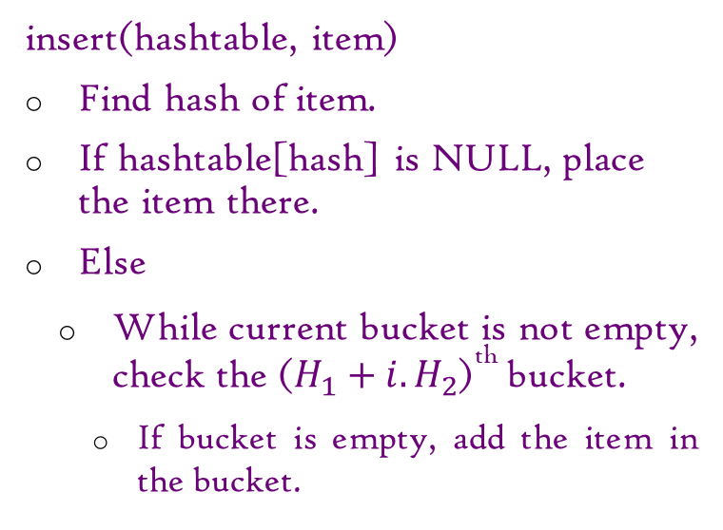
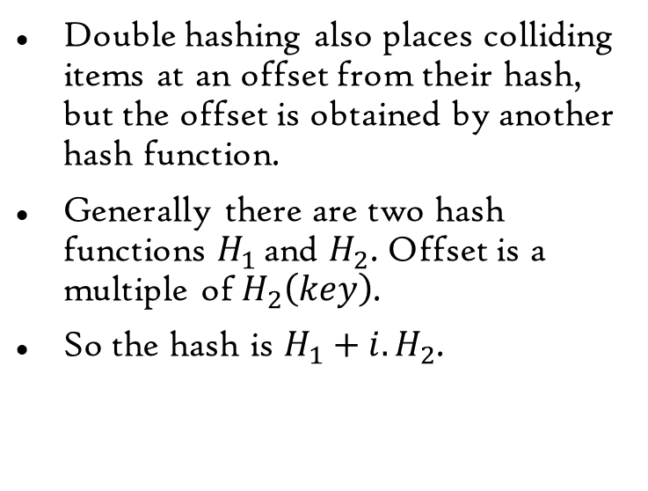
Double Hashing
Double hashing also places colliding items at an offset from their hash, but the offset is obtained by another hash function.
Generally there are two hash functions $H_{1}$ and $H_{2}$. Offset is a multiple of $H_{2}\left(key\right)$.
So the hash is $H_{1}+i.H_{2}$.
insert(hashtable, item)
Find hash of item.
If hashtable[hash] is NULL, place the item there.
Else
While current bucket is not empty, check the ($H_{1}+i.H_{2}$)^{th} bucket.
If bucket is empty, add the item in the bucket.

Slide 6
Coalesced Hashing
Coalesced hashing uses a linked list to link all the items having the same hash.
But the nodes of the linked list are placed in the hash table and not as separate chains.
insert(hashtable, item)
Find hash of item.
If hashtable[hash] is NULL, place a node containing item there.
Else
While current bucket is not empty, check the next bucket.
If bucket is empty, add the item as a node into the linked list at hash and store the new node at the empty bucket.

Slide 7
Acknowledgement
Hash table – Wikipedia
Open addressing – Wikipedia

Slide 8
End
Nya~

