Slide 1
Networking
Semester III

Slide 2
Sampling

Slide 3
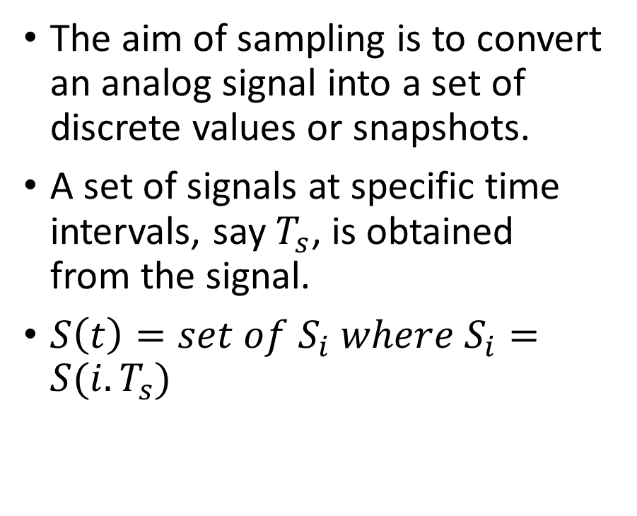
Sampling
The aim of sampling is to convert an analog signal into a set of discrete values or snapshots.
A set of signals at specific time intervals, say $T_{s}$, is obtained from the signal.
$S\left(t\right)=set of S_{i} where S_{i}=S(i.T_{s})$

Slide 4
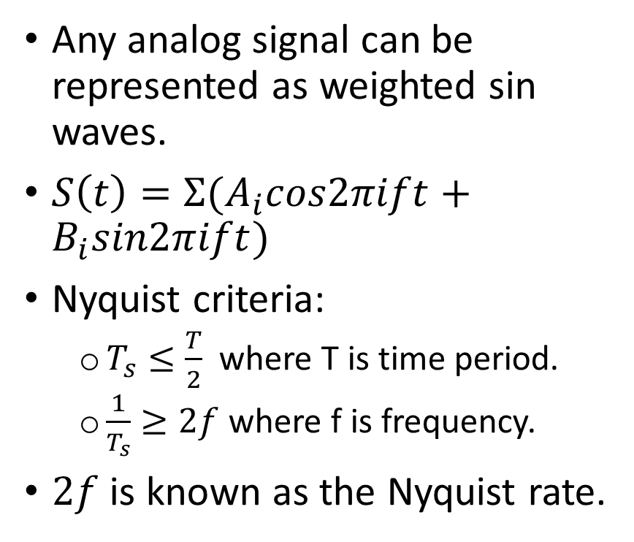
Sampling
Any analog signal can be represented as weighted sin waves.
$S\left(t\right)=Σ(A_{i}cos2πift+B_{i}sin2πift)$
Nyquist criteria:
$T_{s}≤\frac{T}{2}$ where T is time period.
$\frac{1}{T_{s}}≥2f$ where f is frequency.
$2f$ is known as the Nyquist rate.

Slide 5
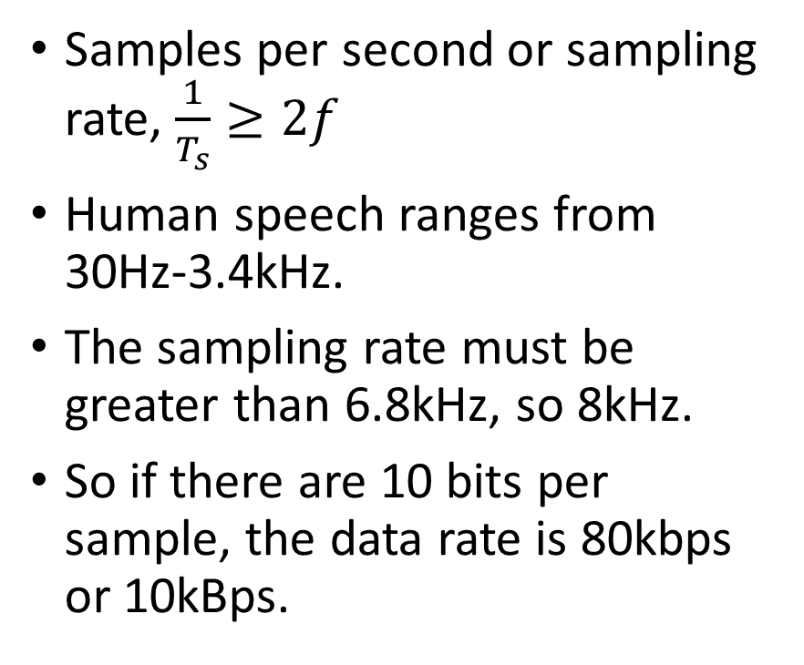
Nyquist Rate
Samples per second or sampling rate, $\frac{1}{T_{s}}≥2f$
Human speech ranges from 30Hz-3.4kHz.
The sampling rate must be greater than 6.8kHz, so 8kHz.
So if there are 10 bits per sample, the data rate is 80kbps or 10kBps.

Slide 6
Pulse Code Modulation (PCM)
Quantization is the process of deriving an approximate value from the samples obtained from an analog signal.
The process of sampling and quantization together is called pulse code modulation or PCM.
It changes analog pulses to discrete vaules with which the computer can work.

Slide 7
Line coding

Slide 8
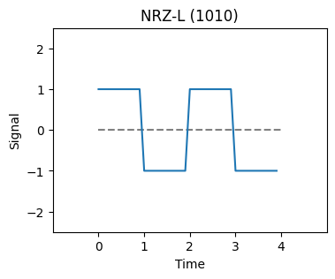
NRZ-L (Non Return to Zero – Level)
+V volt is transmitted if 1, -V volt is transmitted if 0.
If the average sample value received is positive, it is considered 1, if sample value is negative it is considered 0.
For long streams of 0s or 1s, synchronization is lost.

Slide 9
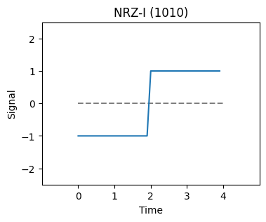
NRZ-I (Non Return to Zero – Inverse)
Transition if 1 is transmitted.
No transition if 0 is transmitted.
Loss of synchronization during long stream of 0s.

Slide 10
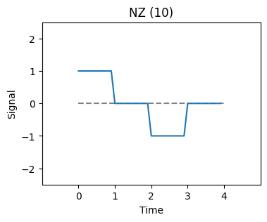
RZ (Return to Zero)
Transmits a zero sample after each bit.
In this way synchronization is maintained but due to the presence of three states, it is more error prone.

Slide 11
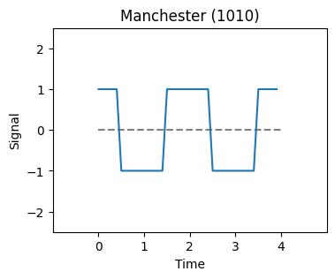
Manchester Coding
Transmits bit for half length of the sample and alternate bit for the next half sample.
There is a transition every half sample so synchronization is not lost.
But uses double the bandwidth.

Slide 12
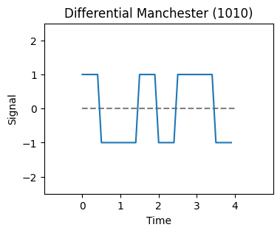
Differential Manchester
After every transmission, there is a transition.
There is a transition at half-length if 0, no transition at half-length if 1.
Guarantees synchronization but twice the bandwidth is required.

Slide 13
Wireless transmission

Slide 14
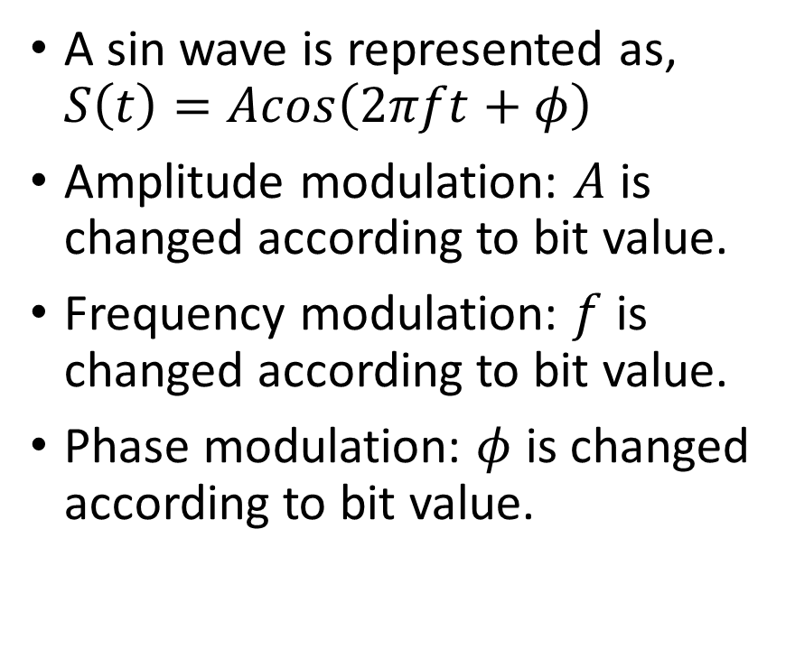
Modulating Sin-wave Carrier
A sin wave is represented as, $S\left(t\right)=Acos\left(2πft+φ\right)$
Amplitude modulation: $A$ is changed according to bit value.
Frequency modulation: $f$ is changed according to bit value.
Phase modulation: $φ$ is changed according to bit value.

Slide 15
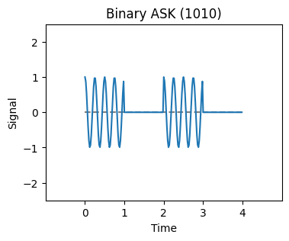
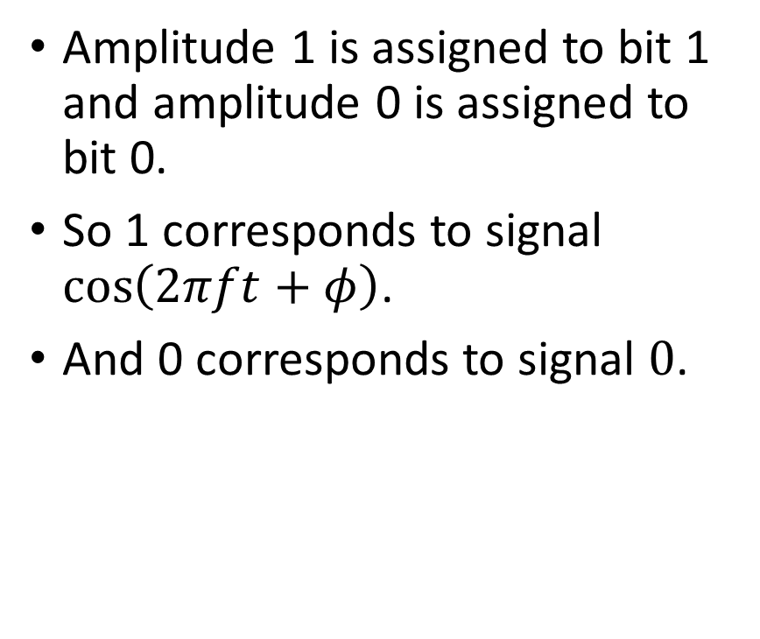
Amplitude Shift Keying (Binary, BASK)
Amplitude 1 is assigned to bit 1 and amplitude 0 is assigned to bit 0.
So 1 corresponds to signal $\cos\left(2πft+φ\right)$.
And 0 corresponds to signal $0$.

Slide 16
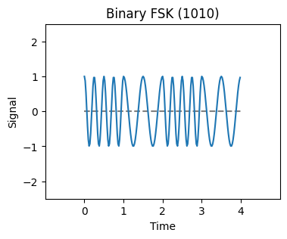
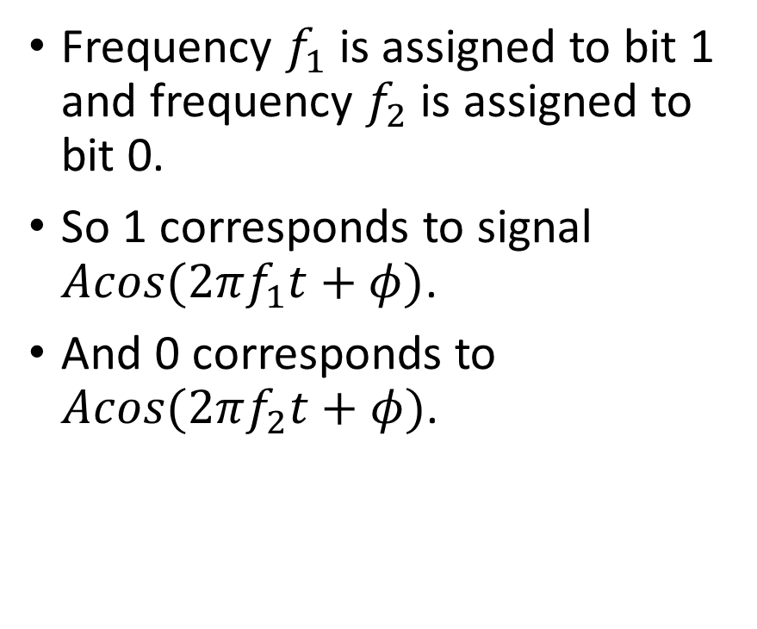
Frequency Shift Keying (Binary, BFSK)
Frequency $f_{1}$ is assigned to bit 1 and frequency $f_{2}$ is assigned to bit 0.
So 1 corresponds to signal $Acos(2πf_{1}t+φ)$.
And 0 corresponds to $Acos(2πf_{2}t+φ)$.

Slide 17
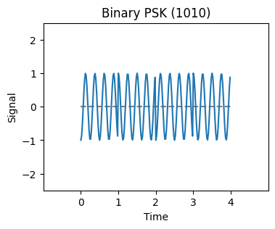
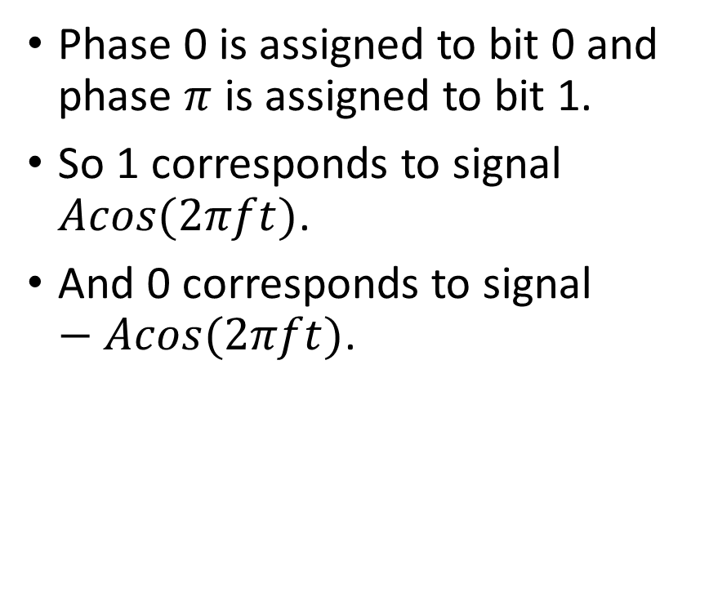
Phase Shift Keying (Binary, BPSK)
Phase 0 is assigned to bit 0 and phase $π$ is assigned to bit 1.
So 1 corresponds to signal $Acos(2πft)$.
And 0 corresponds to signal $−Acos(2πft)$.

Slide 18

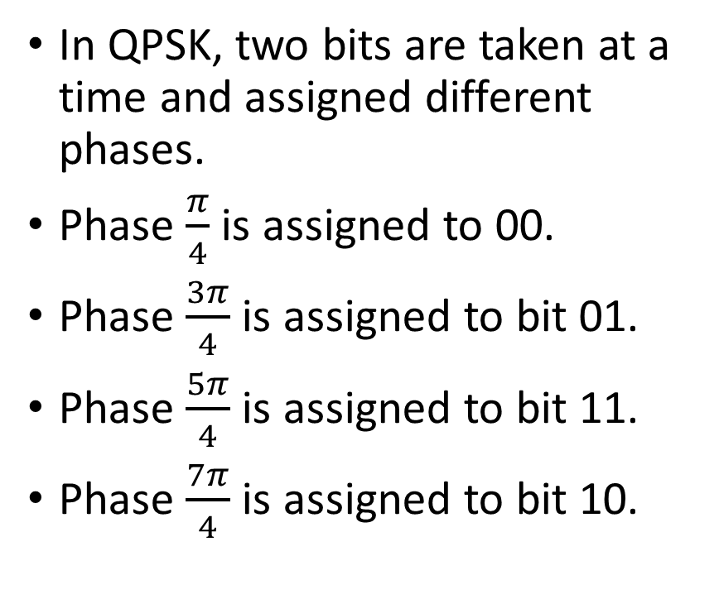
Phase Shift Keying (4-ary, QPSK)
In QPSK, two bits are taken at a time and assigned different phases.
Phase $\frac{π}{4}$ is assigned to 00.
Phase $\frac{3π}{4}$ is assigned to bit 01.
Phase $\frac{5π}{4}$ is assigned to bit 11.
Phase $\frac{7π}{4}$ is assigned to bit 10.

Slide 19
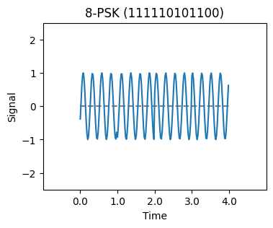
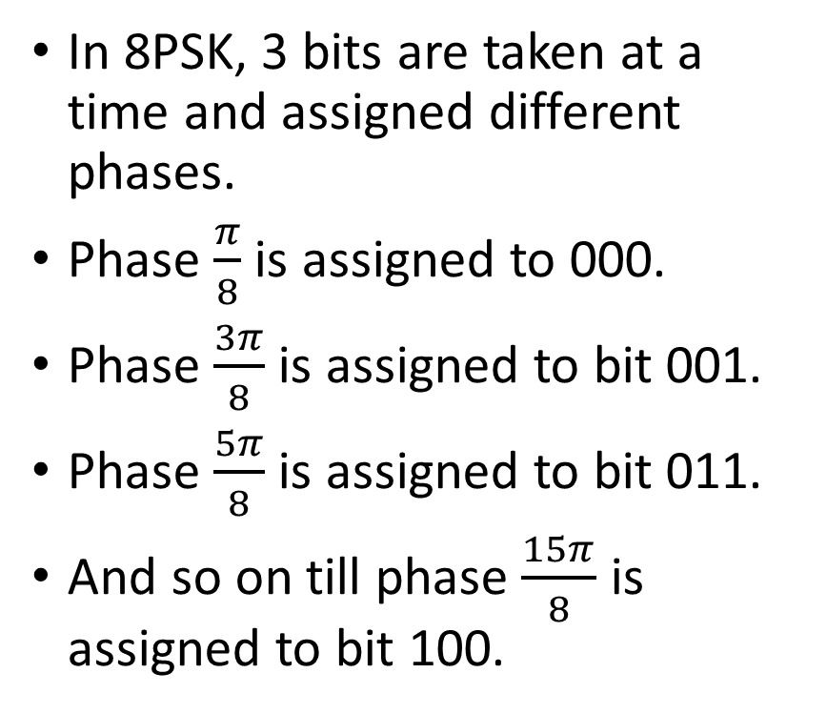
Phase Shift Keying (8-ary, 8PSK)
In 8PSK, 3 bits are taken at a time and assigned different phases.
Phase $\frac{π}{8}$ is assigned to 000.
Phase $\frac{3π}{8}$ is assigned to bit 001.
Phase $\frac{5π}{8}$ is assigned to bit 011.
And so on till phase $\frac{15π}{8}$ is assigned to bit 100.

