Slide 1

Note Taking App
Code Refactoring and Bug Fixing
IN124098

Slide 2
About me
My name is Dussa Vinaykumar, and I am currently working as an intern at Innomatics Research Labs as a data scientist. I hold a Bachelor's degree in Information Technology (B.Tech) with a specialization in Information Technology. As a data science enthusiast, I am passionate about leveraging data-driven insights to solve real-world problems and drive meaningful impact. Throughout my academic and professional journey, I have developed a strong foundation in data analysis, machine learning, and statistical modeling. I am eager to continue learning and expanding my skill set in the field of data science while contributing effectively to innovative projects at Innomatics Research Labs.
Linkedin url : https://www.linkedin.com/in/vinaydussa17/
Github url : https://github.com/dussa-vinay17
IN124098

Slide 3

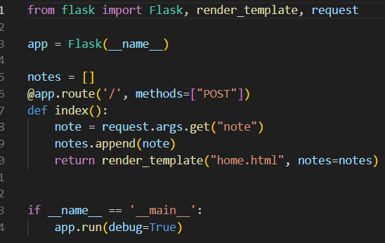

Project Description
The Note Taking App is a simple web tool created using Python Flask and HTML in Visual Studio Code. It lets users write and view notes easily. Python Flask handles the backend tasks, like storing and displaying notes, while HTML designs the interface. Users can add notes in a text field and click "Add Note" to save them. The notes appear in a list below the input field. Visual Studio Code is used for coding. With Flask and HTML, this app provides a straightforward way to manage notes.
Issue Identification

Slide 4
Bug Description & Approach to Resolve
@app.route('/', methods=["POST"]): Handles requests to the root URL ('/') only if they use the POST method, typically used for submitting data to the server.
@app.route('/', methods=["GET","POST"]): Handles requests to the root URL ('/') for both GET and POST methods, allowing the function to handle fetching and submitting data.
‘GET’ and ‘POST’ method in the route decorator, we ensure that the associated function can handle different types of request, making the application more versatile and user-friendly.
The ‘if’ statement is used to check if the request method is “POST” before retrieving the value of the “note” input field. This ensured that the code only executes when the form us submitted using the POST method, preventing errors or unexpected behavior. It helps in handling different types of requests appropriately and ensure that the code behaves as expected based on the type of request received
‘request.args.get(“note’)’ is used to get data from the query string in the URL, typically used with GET request.
‘request.form.get(“note”)’ is used to get data from form submission, typically used with POST request.
In the provided code, ‘request.form.get(“note”)’ is used because the data is expected to come from a form submission, which is typically sent the POST method. This ensure that the code retrieves the “note” value from the form submission and adds it to the list of notes.
In conclusion, the Python code provided for the note-taking application has been successfully debugged and enhanced. By implementing appropriate fixes such as using the correct request methods. The bugs related to data submission and retrieval have been addressed, ensuring that users can add notes effectively. Additionally, the HTML code has been updated with a more descriptive title and improved from button attributes.

Slide 5
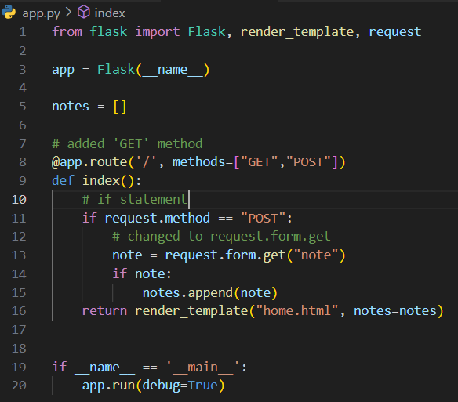
The Complete Python Code
.

Slide 6
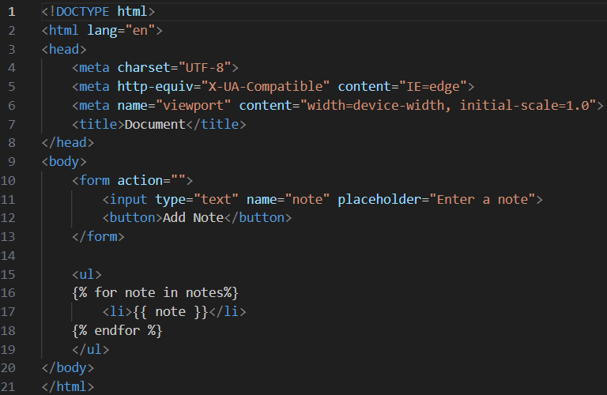


Given HTML Code
.

Slide 7
Bug Description & Approach to Resolve
‘<title>Note Taking Application</title>’ is more specific and tells users that its an app for taking notes.
‘<title>Document</title>’ is vague and doesn’t give any information about what the webpage is for.
We used ‘<title>Note Taking Application</title>’ to make it clear to users what the app does, which helps with usability and navigation.
‘<form action=“/” method=“post”>’ specifies that the form data will be sent to the root URL (“/”) using the POST method. This means that the data will be sent securely and without being visible in the URL>
‘<form action=“”>’ doesn’t specify where the form data will be sent, so it defaults to the current URL. This can lead to unexpected behavior and is generally not recommended.
We used ‘<form action=“/” method=“post”>’ to ensure that the form data is sent securely to the correct endpoint for processing, which helps maintain the functionality and security of the application.
‘<button type=“submit”> Add Note</button>’ specifies that the button is a submit button, which means it will submit the form when clicked. This is essential for forms because it triggers the form submission process.
‘<button>Add Note</button>’ doesn’t specify any particular behavior, so it behaves like a regular button without any default action associated with it.
We used ‘<button types=‘submit’>Add Note</button>’ to ensure that clicking the button triggers the form submission process, allowing users to add their notes effectively. It provides clarity and ensures consistent functionality across different browsers and devices.

Slide 8
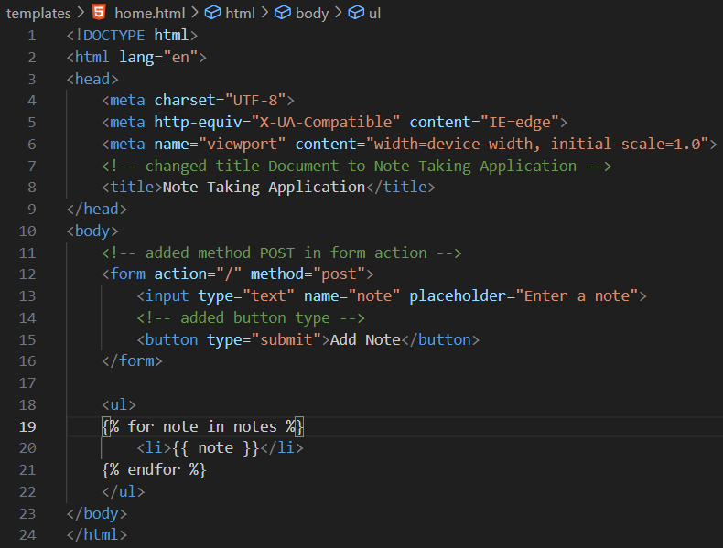
The Complete HTML Code

Slide 9
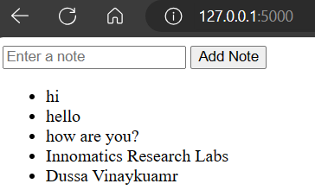
The Final Output
The output we get is a list of notes that users have added to the Note Taking Application. These notes are displayed on the webpage below the input field and add button. Each note is listed as a separate item in an unordered list format. This output allows users to view the notes they've entered, facilitating easy access and reference to their notes.

Slide 10
Conclusion
The project culminated in the successful development of a Note Taking Application, a testament to our team’s dedication and problem-solving abilities. Leveraging Python, Flask, and HTML, we overcame challenges and refine the application’s functionality. Through meticulous code refactoring and bug resolution, we ensured a seamless user experience. Flask served as the backbone, enabling robust backend development, while HTML provided the foundation for creating an intuitive and visually appealing frontend interface. Our collaborative efforts and commitment to excellence were evident throughout the project, resulting in a fully functional application that meets the needs of users. This endeavor underscored the importance of teamwork, adaptability, and technical proficiency in software development projects. We are proud of our accomplishments and look forward to applying our newfound skills to future endeavors.

Slide 11

THANK YOU

