Slide 1
ANDROID – FRAGMENTS
L. Grewe

Slide 2
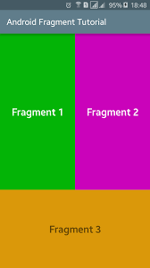
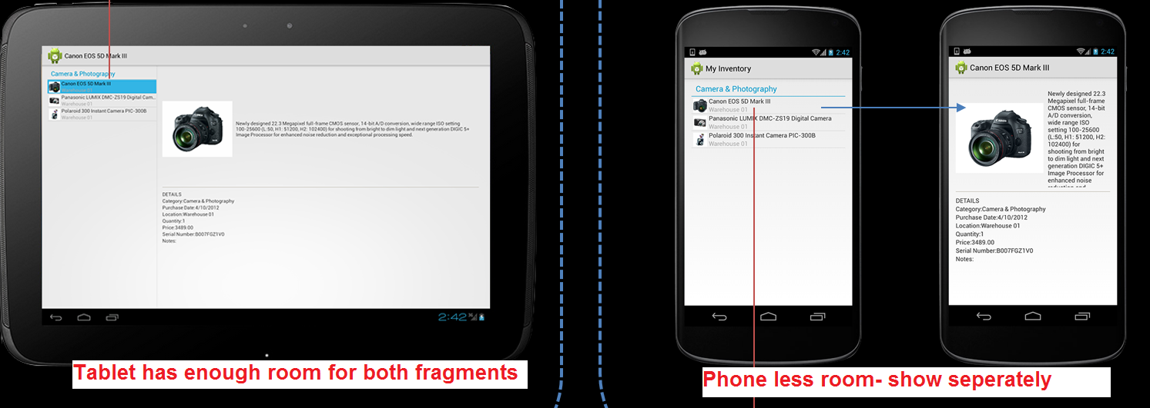
Fragment
An activity is a container for views
When you have a larger screen device than a phone –like a tablet it can look too simple to use phone interface here.
→ Fragments
    Mini-activities, each with its own set of views
    One or more fragments can be embedded in an Activity
    You can do this dynamically as a function of the device type (tablet or not) or orientation
    ALSO, you can reuse fragments --- like reuse of mini interfaces

Slide 3
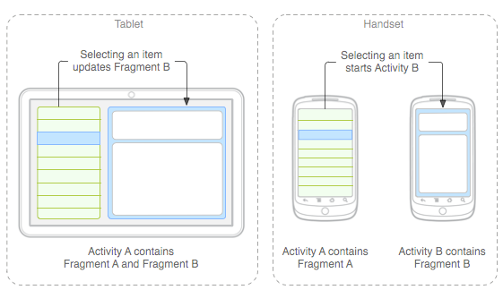
Fragment Idea
primarily to support more dynamic and
flexible UI designs on large screens, such as tablets.
→ Fragments
    Mini-activities, each with its own set of views
    One or more fragments can be embedded in an Activity
    You can do this dynamically as a function of the device type (tablet or not) or orientation
You might
decide to run
a tablet in
portrait mode
with the handset
model of only
one fragment
in an Activity

Slide 4
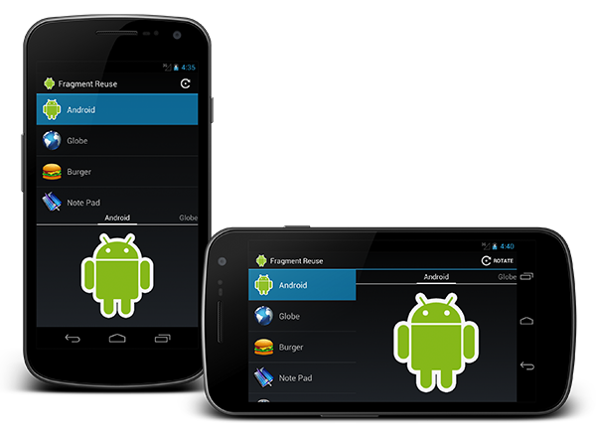
Fragment
Activity=
2 Fragments
A Fragment represents a behavior or a portion of user interface in an Activity.
You can combine multiple fragments in a single activity to build a multi-pane UI and reuse a fragment in multiple activities.
You can think of a fragment as a modular section of an activity, which has its own lifecycle, receives its own input events, and which you can add or remove while the activity is running (sort of like a "sub activity" that you can reuse in different activities).

Slide 5
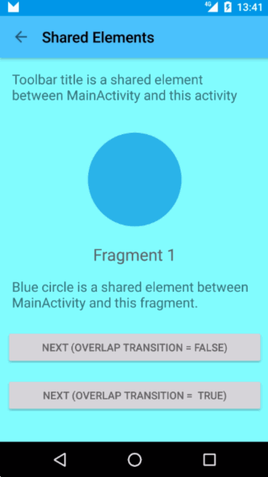
Animated Illustration of Fragment as part of UI—changing (replacing)
Starting:
FragementTransaction: replace
Fragment 1 with Fragment 2
Activity
TextView
Fragment 1
Activity
TextView
Fragment 2

Slide 6
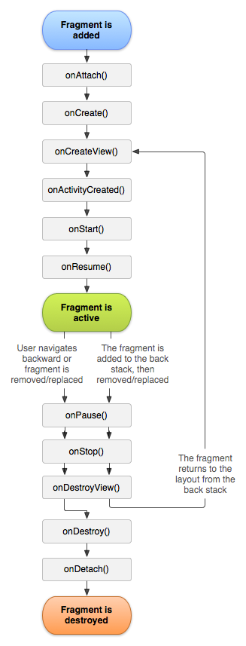
Fragment Lifecycle
Fragment in an Activity---Activity Lifecyle influences
  Activity paused → all its fragments paused
  Activity destroyed → all its fragments are destroyed
  Activity running → manipulate each fragment independently.
Fragment transaction →add, remove, etc.
  adds it to a back stack that's managed by the activity—each back stack entry in the activity is a record of the fragment transaction that occurred.
  The back stack allows the user to reverse a fragment transaction (navigate backwards), by pressing the Back button.

Slide 7
Fragment inside Activity
it lives in a ViewGroup inside the activity's view hierarchy
fragment has its own view layout.
via XML: Insert a fragment into your activity layout by declaring the fragment in the activity's layout file, as a <fragment> element,
via CODE: from your application code by adding it to an existing ViewGroup.
you may also use a fragment without its own UI as an invisible worker for the activity.

Slide 8
Fragment – extend a Fragment class
via CODE: extend android.app.Fragment OR one of its subclasses (DialogFragment, ListFragment, PreferenceFragment, WebViewFragment )
IMPORTANT: must include a public empty constructor. The framework will often re-instantiate a fragment class when needed, in particular during state restore, and needs to be able to find this constructor to instantiate it. If the empty constructor is not available, a runtime exception will occur in some cases during state restore.
CALL Back functions (like Activity) : examples onCreate(), onStart(), onPause(), and onStop().

Slide 9
Fragment methods (callback functions)
onAttach(Activity) called once the fragment is associated with its activity.
onCreate(Bundle) called to do initial creation of the fragment.
onCreateView(LayoutInflater, ViewGroup, Bundle) creates and returns the view hierarchy associated with the fragment.
onActivityCreated(Bundle) tells the fragment that its activity has completed its own Activity.onCreaate.
onStart() makes the fragment visible to the user (based on its containing activity being started).
onResume() makes the fragment interacting with the user (based on its containing activity being resumed).

Slide 10
Fragment methods (callback functions)
As a fragment is no longer being used, it goes through a reverse series of callbacks:
onPause() fragment is no longer interacting with the user either because its activity is being paused or a fragment operation is modifying it in the activity.
onStop() fragment is no longer visible to the user either because its activity is being stopped or a fragment operation is modifying it in the activity.
onDestroyView() allows the fragment to clean up resources associated with its View.
onDestroy() called to do final cleanup of the fragment's state.
onDetach() called immediately prior to the fragment no longer being associated with its activity.

Slide 11
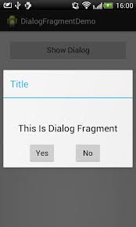
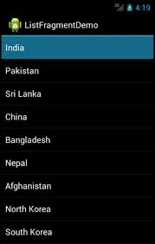
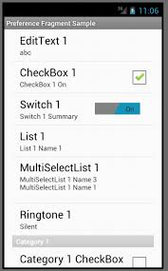
Create your own Fragment class OR use known sub-classes
DialogFragment
  Displays a floating dialog. Using this class to create a dialog is a good alternative to using the dialog helper methods in the Activity class, because you can incorporate a fragment dialog into the back stack of fragments managed by the activity, allowing the user to return to a dismissed fragment.
ListFragment
  Displays a list of items that are managed by an adapter (such as a SimpleCursorAdapter), similar to ListActivity. It provides several methods for managing a list view, such as the onListItemClick() callback to handle click events.
PreferenceFragment
  Displays a hierarchy of Preference objects as a list, similar to PreferenceActivity. This is useful when creating a "settings" activity for your application.
NOTE: sometimes there are multiple ways to achive something like a List –either with ListView
or ListFragment → they have different methods and lifecycles.

Slide 12
Fragments and their UI
--- how to specify the UI of a Fragment

Slide 13
Fragments and their UI
Most fragments will have a UI
Will have its own layout
you must implement the onCreateView() callback method, which the Android system calls when it's time for the fragment to draw its layout. Your implementation of this method must return a View that is the root of your fragment's layout.
      Note some subclasses of Fragment like ListFragment have already implemented this method and you don’t need to override.

Slide 14
Fragments and their UI – onCreateView() using XML
Can implement onCreateView using XML
public static class ExampleFragment extends Fragment {
@Override
public View onCreateView(LayoutInflater inflater, ViewGroup container,
Bundle savedInstanceState) {
// Inflate the layout for this fragment
return inflater.inflate(R.layout.example_fragment, container, false);
}
}
Activity parent’s
ViewGroup
Bundle that provides data about the previous
instance of the fragment, if the fragment is being resumed
Have example_fragment.xml file that contains the layout
This will be contained in resource layout folder.

Slide 15
Fragments –Adding to an Activity
--- what are the options: XML or via Code

Slide 16
OPTION1 –adding to an Activity via Activity layout XML.
<?xml version="1.0" encoding="utf-8"?>
<LinearLayout xmlns:android="http://schemas.android.com/apk/res/android"
android:orientation="horizontal"
android:layout_width="match_parent"
android:layout_height="match_parent">
<fragment android:name="com.example.ExampleFragment "
android:id="@+id/list"
android:layout_weight="1"
android:layout_width="0dp"
android:layout_height="match_parent" />
<fragment android:name="com.example.news.ExampleFragment"
android:id="@+id/viewer"
android:layout_weight="2"
android:layout_width="0dp"
android:layout_height="match_parent" />
</LinearLayout>
2 fragment instances
Need unique ids for each so system can
restore the fragment if the activity is restarted

Slide 17
OPTION2 –creating and adding to an Activity a Fragment via CODE.
/*Inside Activity Code where you want to add Fragment (dynamically anywhere or in onCreate() callback)
*/
//get FragmentTransaction associated with this Activity
FragmentManager fragmentManager = getFragmentManager();
FragmentTransaction fragmentTransaction = fragmentManager.beginTransaction();
//Create instance of your Fragment
ExampleFragment fragment = new ExampleFragment();
//Add Fragment instance to your Activity
fragmentTransaction.add(R.id.fragment_container, fragment);
fragmentTransaction.commit();
This points to the Activity ViewGroup in which the fragment should be placed, specified by resource ID

Slide 18
FragmentManager
--class used to manage the Fragments and can generate a FragementTransaction from

Slide 19
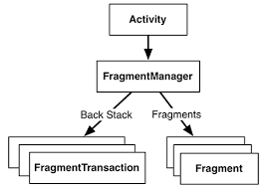
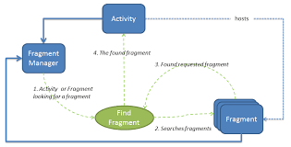
Managing Fragments
FragmentManager methods:
Get fragments that exist in Activity =
  findFragmentById() (for fragments that provide a UI in the activity layout)
  findFragmentByTag() (for fragments that do or don't provide a UI).
Pop fragments off the back stack,
  popBackStack() (simulating a Back command by the user).
Register a listener for
changes to the back stack
  addOnBackStackChangedListener().
BackStack – is owned
by an Activity and any
Fragment you put on it means
when user hits “back” you can
pop off from the BackStack a
Fragment to return to it

Slide 20
FragmentManager – using it to grab “handle” of fragment referenced by id
// get FragmentManager associated with Activity
FragementManager fm = getFragmentManager();
// Suppose you have a Fragement class called DetailFragmentsand you
// now it was created using id “details”
DetailsFragment details = (DetailsFragment)
getFragmentManager().findFragmentById(R.id.details);
//Now you can call any methods you want on the details fragment
*******
Note: the id used to create the Fragment previous was
“details”

Slide 21
FragmentTransaction
Used to replace, add and remove DYNAMICALLY fragments

Slide 22
How to create FragmentTransaction instance
You get it from the current FragmentManager –this
code is somewhere inside your Activity class
// get FragementTransaction from Manager
FragmentTransaction transaction = getFragmentManager().beginTransaction();

Slide 23
FragmentTransaction - methods
fragmentTransaction.add (containerViewID, fragment);
  As seen in previous slide lets you add fragment to UI with new ID
fragmentTransaction.replace(containerViewId, fragment, tag);
  As seen in previous slide lets you replace (if there or otherwise adds) fragment with another based on id
fragmentTransaction.add(containerViewId, fragment, tag);
  Lets you directly add a new Fragment with a new id associated with it
fragmentTransaction.addToBackStack(name);
  As seen in previous slide lets you add transaction to BackStack (so can return to previous fragment state when user hits “back”)

Slide 24
Example (repeated) ADDING fragment dynamically
/*Inside Activity Code where you want to add Fragment (dynamically anywhere or in onCreate() callback)
*/
//get FragmentTransaction associated with this Activity
FragmentManager fragmentManager = getFragmentManager();
FragmentTransaction fragmentTransaction = fragmentManager.beginTransaction();
//Create instance of your Fragment
ExampleFragment fragment = new ExampleFragment();
//Add Fragment instance to your Activity
fragmentTransaction.add(R.id.fragment_container, fragment);
fragmentTransaction.commit();
This points to the Activity ViewGroup in which the fragment should be placed, specified by resource ID

Slide 25
Example REPLACING fragment dynamically
/*Inside Activity Code where you want to add Fragment (dynamically anywhere or in onCreate() callback)
*/
// STEP 1: Create new fragment and create FragementTransaction from Manager
Fragment newFragment = new ExampleFragment();
FragmentTransaction transaction = getFragmentManager().beginTransaction();
// STEP 2: Replace whatever is in the fragment_container view with this fragment
// and add the transaction to the back stack (so can navigate back)
transaction.replace(R.id.fragment_container, newFragment);
transaction.addToBackStack(null);
// STEP 3: Commit the transaction
transaction.commit();
newFragment replaces whatever fragment (if any) that is currently in the layout container identified by the R.id.fragment_container
If you do not call addToBackStack() when you perform a transaction
that removes/replaces a fragment, then that fragment is destroyed when the
transaction is committed and the user cannot navigate back to it.
Whereas, if you do call addToBackStack() when removing/replacing a fragment,
then the fragment is stopped and will be resumed if the user navigates back.

Slide 26
Fragments --- MORE
---various additional concepts regarding Fragments

Slide 27
Example of using a subclass ---ListFragment
Taken from http://www.techrepublic.com/blog/app-builder/get-started-with-android-fragments/1050
See our OUTLINE– example ListFragment

Slide 28
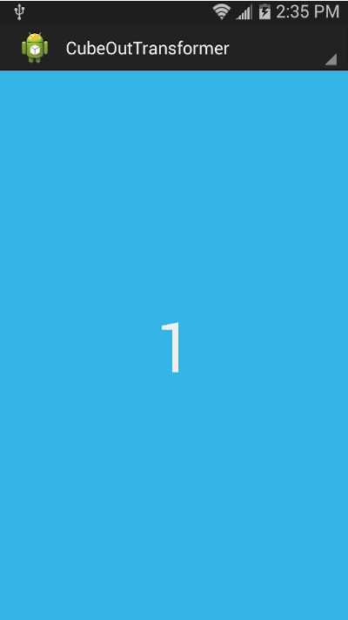
There’s more you can do with FragmentTransaction –like animation
Read your book , look at developer site
/ /Create and commit a new fragment transaction that adds the fragment for the back of
// the card, uses custom animations, and is part of the fragment manager's back stack.
BackFragment achterkant= BackFragment.newInstance("blabla"); getFragmentManager() .beginTransaction()
// Replace the default fragment animations with animator resources representing
// rotations when switching to the back of the card, as well as animator
// resources representing rotations when flipping back to the front (e.g. when
// the system Back button is pressed).
.setCustomAnimations( R.animator.card_flip_right_in, R.animator.card_flip_right_out, R.animator.card_flip_left_in, R.animator.card_flip_left_out)

Slide 29
Fragment with NO UI
---yes, though not common you can have a Fragment with no UI
used to provide a background behavior for the activity without presenting additional UI.

Slide 30
Adding Fragment that has NO UI, using Code
use a fragment to provide a background behavior for the activity without presenting additional UI.
use add(Fragment, String) (supplying a unique string "tag" for the fragment, rather than a view ID).
  it's not associated with a view in the activity layout, it does not receive a call to onCreateView(). So you don't need to implement that method.
If you want to get the fragment from the activity later, you need to use findFragmentByTag().
For an example activity that uses a fragment as a background worker, without a UI, see the FragmentRetainInstance.java sample at
https://android.googlesource.com/platform/development/+/master/samples/ApiDemos/src/com/example/android/apis/app/FragmentRetainInstance.java

