Slide 1
Mobile Programming
Android Platform

Slide 2
What is Android
Android is a software package and linux based operating system for mobile devices such as tablet computers and smartphones.
It is developed by Google and later the OHA (Open Handset Alliance). Java language is mainly used to write the android code even though other languages can be used.
The goal of android project is to create a successful real-world product that improves the mobile experience for end users.
There are many code names of android such as Lollipop, Kitkat, Jelly Bean, Ice cream Sandwich, Froyo, Ecliar, Donut etc which is covered in next page.

Slide 3
What is Open Handset Alliance (OHA)
It's a consortium of 84 companies such as google, samsung, AKM, synaptics, KDDI, Garmin, Teleca, Ebay, Intel etc.
It was established on 5th November, 2007, led by Google. It is committed to advance open standards, provide services and deploy handsets using the Android Plateform.

Slide 4
Features of Android
It is open-source.
Anyone can customize the Android Platform.
There are a lot of mobile applications that can be chosen by the consumer.
It provides many interesting features like weather details, opening screen, live RSS (Really Simple Syndication) feeds etc.
It provides support for messaging services(SMS and MMS), web browser, storage (SQLite), connectivity (GSM, CDMA, Blue Tooth, Wi-Fi etc.), media, handset layout etc.

Slide 5
Categories of Android applications
Entertainment
Tools
Communication
Productivity
Personalization
Music and Audio
Social
Media and Video
Travel and Local etc.

Slide 6
History of Android
The history and versions of android are interesting to know. The code names of android ranges from A to J currently, such as Aestro, Blender, Cupcake, Donut, Eclair, Froyo, Gingerbread, Honeycomb, Ice Cream Sandwitch, Jelly Bean, KitKat and Lollipop, Marshmallow, Nougat, Oreo. Let's understand the android history in a sequence.
Initially, Andy Rubin founded Android Incorporation in Palo Alto, California, United States in October, 2003.
In 17th August 2005, Google acquired android Incorporation. Since then, it is in the subsidiary of Google Incorporation.
The key employees of Android Incorporation are Andy Rubin, Rich Miner, Chris White and Nick Sears.
Originally intended for camera but shifted to smart phones later because of low market for camera only.
Android is the nick name of Andy Rubin given by coworkers because of his love to robots.
In 2007, Google announces the development of android OS.
In 2008, HTC launched the first android mobile.

Slide 7
Android Versions, Codename and API
Code name | Version number | Initial release date | API level | Support status
(No codename)[4] | 1 | 23-Sep-08 | 1 | Unsupported
(Internally known as "Petit Four")[4] | 1.1 | 9-Feb-09 | 2 | Unsupported
Cupcake | 1.5 | 27-Apr-09 | 3 | Unsupported
Donut[5] | 1.6 | 15-Sep-09 | 4 | Unsupported
Eclair[6] | 2.0–2.1 | 26-Oct-09 | 5–7 | Unsupported
Froyo[7] | 2.2–2.2.3 | 20-May-10 | 8 | Unsupported
Gingerbread[8] | 2.3–2.3.7 | 6-Dec-10 | 9–10 | Unsupported
Honeycomb[9] | 3.0–3.2.6 | 22-Feb-11 | 11–13 | Unsupported
Ice Cream Sandwich[10] | 4.0–4.0.4 | 18-Oct-11 | 14–15 | Unsupported
Jelly Bean[11] | 4.1–4.3.1 | 9-Jul-12 | 16–18 | Unsupported
KitKat[12] | 4.4–4.4.4 | 31-Oct-13 | 19–20 | Supported;[13] See clarification
Lollipop[14] | 5.0–5.1.1 | 12-Nov-14 | 21–22 | Supported
Marshmallow[15] | 6.0–6.0.1 | 5-Oct-15 | 23 | Supported
Nougat[16] | 7.0–7.1.2 | 22-Aug-16 | 24–25 | Supported
O | 8 | TBA | 26 | Beta

Slide 8
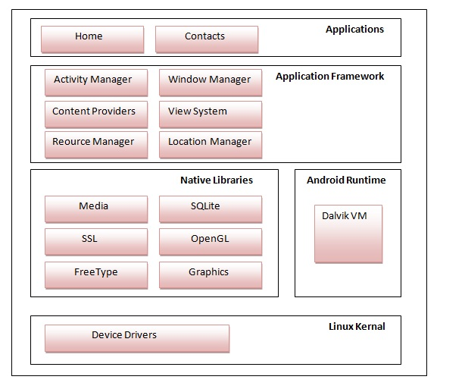
Android Architecture
1. Linux kernel
It is the heart of android architecture that exists at the root of android architecture. It is responsible for device drivers, power management, memory management, device management and resource access.
2. native libraries (middleware),
WebKit, OpenGL, FreeType, SQLite, Media, C runtime library (libc) etc.
3. Android Runtime
It has core libraries and DVM (Dalvik Virtual Machine) which is responsible to run android application. DVM is like JVM but it is optimized for mobile devices. It consumes less memory and provides fast performance.
4. Application Framework
Android API's such as UI (User Interface), telephony, resources, locations, Content Providers (data) and package managers. It provides a lot of classes and interfaces for android application development.
5. Applications
home, contact, settings, games, browsers are using android framework that uses android runtime and libraries.

Slide 9
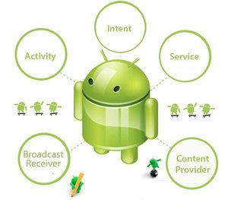
Android Core Building Blocks
1. Activity
An activity is a class that represents a single screen. It is like a Frame in AWT (Abstract Windowing Toolkit).
2. View
A view is the UI element such as button, label, text field etc. Anything that you see is a view.
3. Intent, Intent is used to invoke components. It is mainly used to:
Start the service
Launch an activity
Display a web page
Display a list of contacts
Broadcast a message
Dial a phone call etc.

Slide 10
Intent sample
Intent intent=new Intent(Intent.ACTION_VIEW);
intent.setData(Uri.parse("http://www.javatpoint.com"));
startActivity(intent);
For example, you may write the following code to view the webpage.
4. Service
Service is a background process that can run for a long time. There are two types of services local and remote. Local service is accessed from within the application whereas remote service is accessed remotely from other applications running on the same device.
5. Content Provider
Content Providers are used to share data between the applications.
6. Fragment
Fragments are like parts of activity. An activity can display one or more fragments on the screen at the same time.
7. AndroidManifest.xml
It contains information about activities, content providers, permissions etc. It is like the web.xml file in Java EE.
8. Android Virtual Device (AVD)
It is used to test the android application without the need for mobile or tablet etc. It can be created in different configurations to emulate different types of real devices.

Slide 11
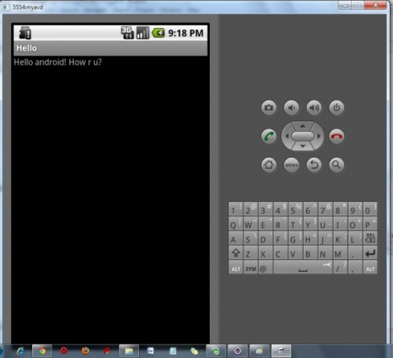
Android Emulator
emulator -avd <AVD NAME>
Android Emulator is used to run, debug and test the android application. If you don't have the real device, it can be the best way to run, debug and test the application.
It uses an open source processor emulator technology called QEMU.
The emulator tool enables you to start the emulator from the command line. You need to write:
emulator -avd <AVD NAME>

Slide 12
Install Android
Android supports java, c++, c# etc. language to develop android applications. Java is the officially supported language for android. All the android examples of this site is developed using Java language and Eclipse IDE.
Here, we are going to tell you, the required software to develop android applications using Eclipse IDE or android studio.
There are two ways to install android.
By ADT Bundle
By Setup Android studio Manually

Slide 13
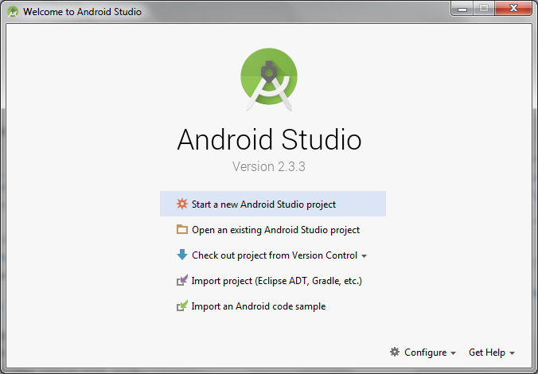
Install android studio
Android Studio v2.3.3 (June 2017) This is a minor update to add support for Android O (API level 26) → android-studio-bundle-162.4069837-windows.exe.
Android Studio 3.0 Beta 1 is now available Thursday, August 10, 2017
Start a new project in Android Studio

Slide 14
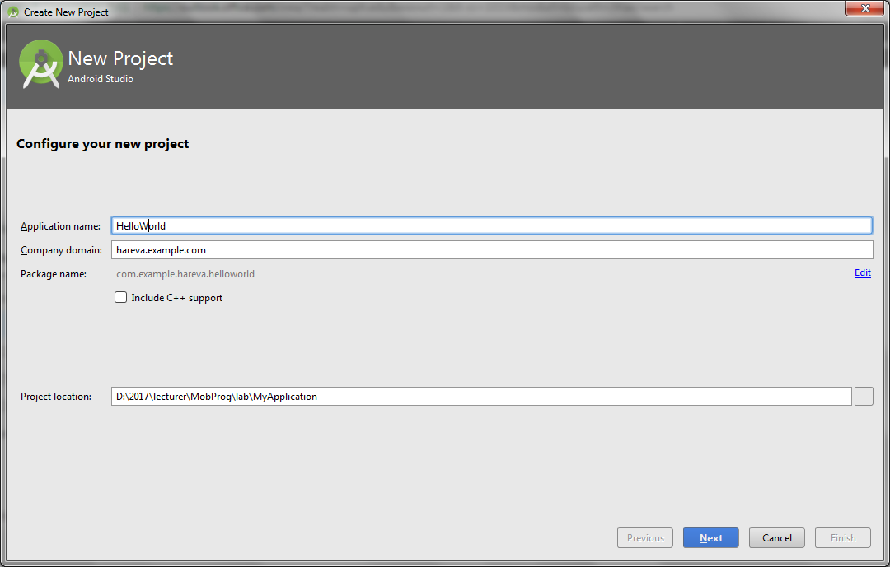
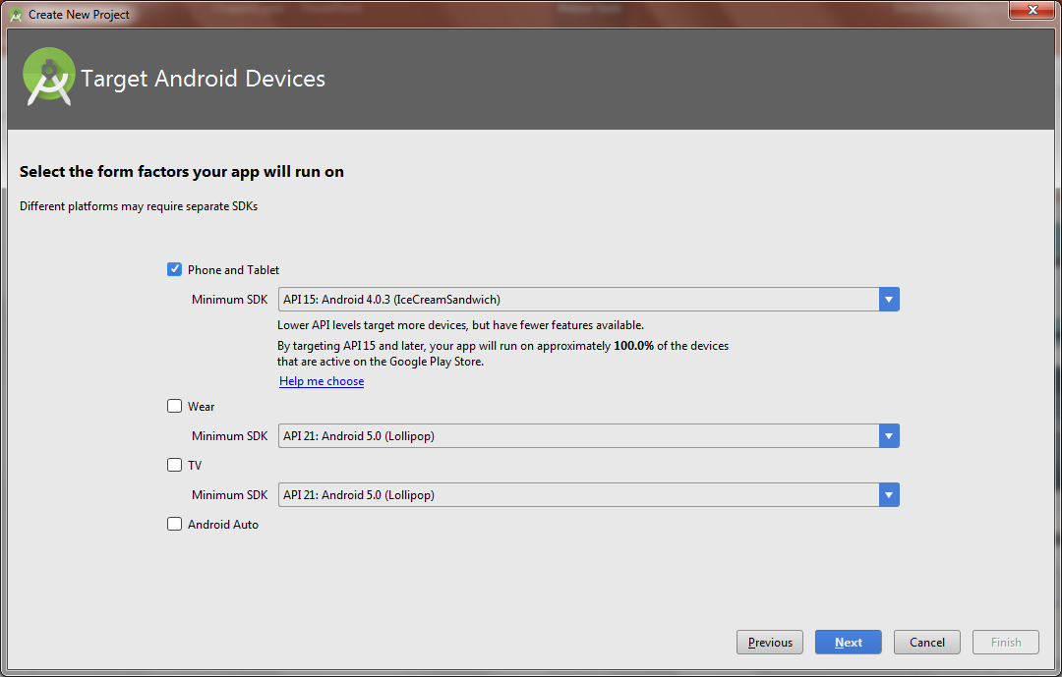
Configure

Slide 15
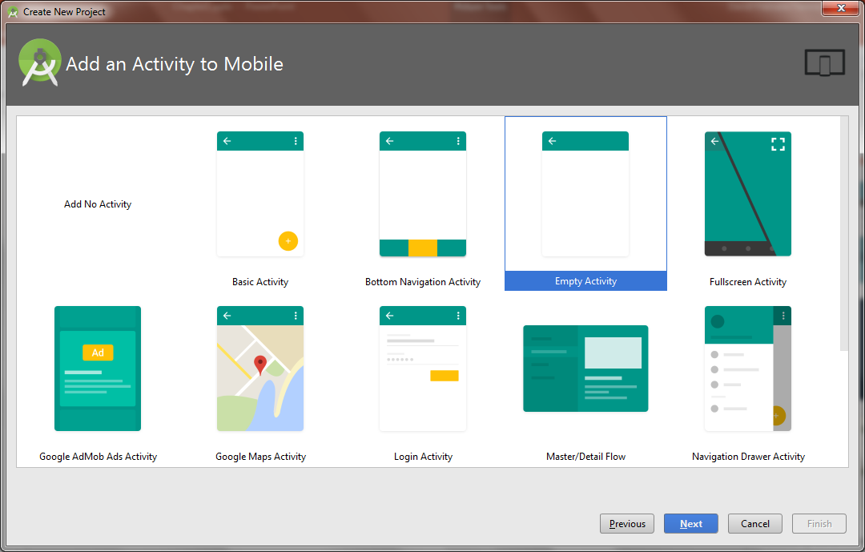
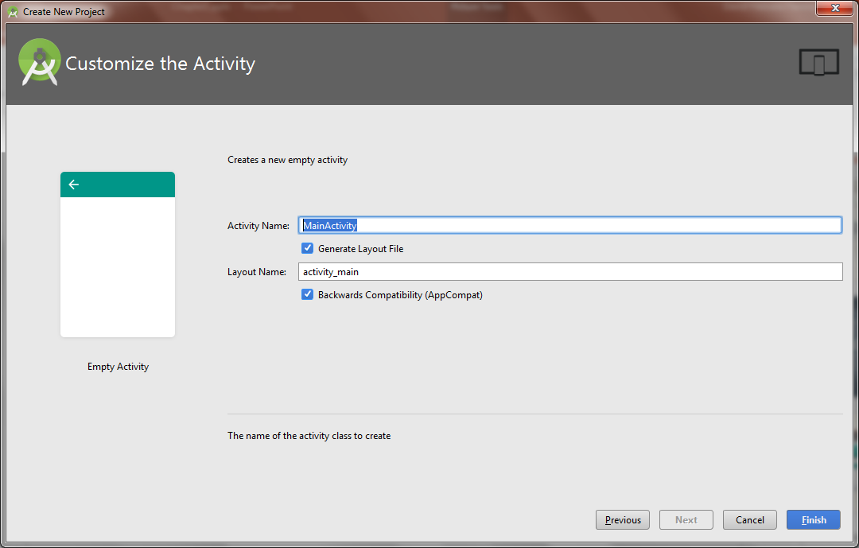
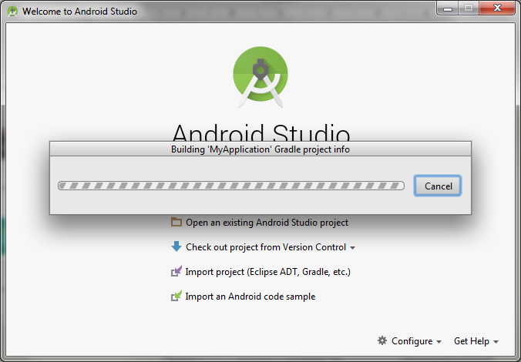
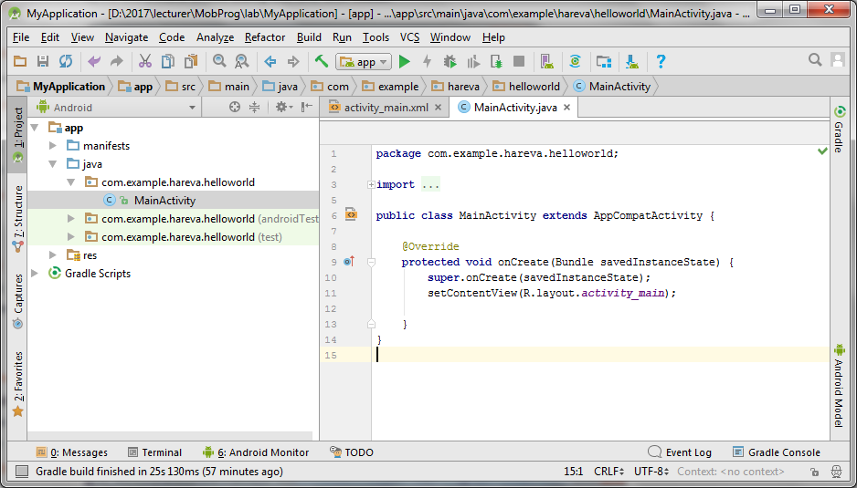

Slide 16
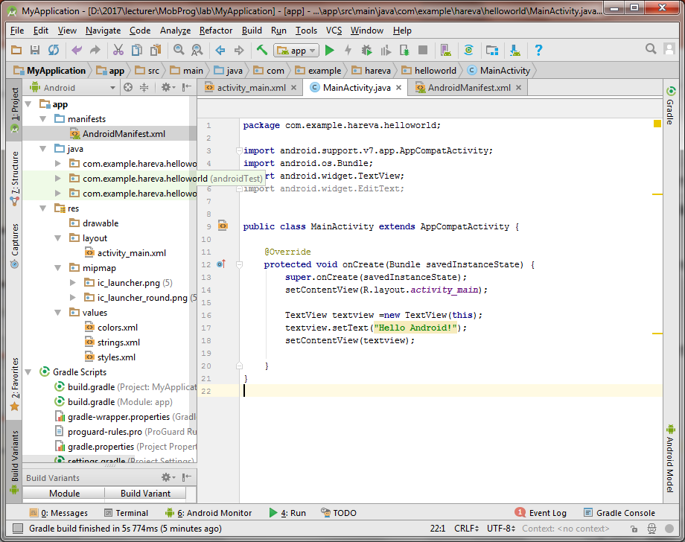
Manifest
Java source
resources
contain apk file
Generated R.java

Slide 17
Java source
package com.example.hareva.helloworld; import android.support.v7.app.AppCompatActivity; import android.os.Bundle; import android.widget.TextView; import android.widget.EditText; public class MainActivity extends AppCompatActivity { @Override protected void onCreate(Bundle savedInstanceState) { super.onCreate(savedInstanceState); setContentView(R.layout.activity_main); TextView textview =new TextView(this); textview.setText("from java --> Hello Wolrd!"); //textview.setText(R.string.hello_world); setContentView(textview); } }
// File: MainActivity.java
package com.example.hareva.helloworld; import android.support.v7.app.AppCompatActivity; import android.os.Bundle; import android.widget.TextView; import android.widget.EditText; public class MainActivity extends AppCompatActivity { @Override protected void onCreate(Bundle savedInstanceState) { super.onCreate(savedInstanceState); setContentView(R.layout.activity_main); TextView textview =new TextView(this); textview.setText("Hello Android!"); setContentView(textview); } }

Slide 18
Activity
File: activity_main.xml
<?xml version="1.0" encoding="tf-8"?> <android.support.constraint.ConstraintLayout xmlns:android="http://schemas.android.com/apk/res/android" xmlns:app="http://schemas.android.com/apk/res-auto" xmlns:tools="http://schemas.android.com/tools" android:layout_width="match_parent" android:layout_height="match_parent" tools:context="com.example.hareva.helloworld.MainActivity"> <TextView android:id="@+id/textView1" android:layout_width="wrap_content" android:layout_height="wrap_content" android:text="@string/hello_world" app:layout_constraintBottom_toBottomOf="parent" app:layout_constraintLeft_toLeftOf="parent" app:layout_constraintRight_toRightOf="parent" app:layout_constraintTop_toTopOf="parent" /> </android.support.constraint.ConstraintLayout>
(1) Activity is a java class that creates and default window on the screen where we can place different components such as Button, EditText, TextView, Spinner etc. It is like the Frame of Java AWT.
It provides life cycle methods for activity such as onCreate, onStop, OnResume etc.
(2) The onCreate method is called when Activity class is first created.
(3) The setContentView(R.layout.activity_main) gives information about our layout resource. Here, our layout resources are defined in activity_main.xml file.

Slide 19
R.java
…\MyApplication\app\build\generated\source\r\debug\com\example\hareva\helloworld
…
public static final int app_name=0x7f060021;
public static final int hello_world=0x7f060022;
public static final int search_menu_title=0x7f060013;
public static final int status_bar_notification_info_overflow=0x7f060014;
}
…

Slide 20
APK File
An apk file is created by the framework automatically. If you want to run the android application on the mobile, transfer and install it.
Resources
It contains resource files including activity_main, strings, styles etc.
Manifest file
It contains information about package including components such as activities, services, content providers etc. For more information about manifest file visit here: AndroidManifest.xml file.

Slide 21
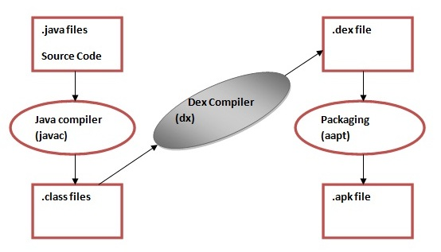
Dalvik Virtual Machine | DVM
As we know the modern JVM is high performance and provides excellent memory management. But it needs to be optimized for low-powered handheld devices as well.
The Dalvik Virtual Machine (DVM) is an android virtual machine optimized for mobile devices. It optimizes the virtual machine for memory, battery life and performance.
Dalvik is a name of a town in Iceland. The Dalvik VM was written by Dan Bornstein.
The Dex compiler converts the class files into the .dex file that run on the Dalvik VM. Multiple class files are converted into one dex file.
Let's see the compiling and packaging process from the source file:
The javac tool compiles the java source file into the class file.
The dx tool takes all the class files of your application and generates a single .dex file. It is a platform-specific tool.
The Android Assets Packaging Tool (aapt) handles the packaging process.

Slide 22
AndroidManifest.xml file in android
The AndroidManifest.xml file contains information of your package, including components of the application such as activities, services, broadcast receivers, content providers etc.
It performs some other tasks also:
It is responsible to protect the application to access any protected parts by providing the permissions.
It also declares the android api that the application is going to use.
It lists the instrumentation classes. The instrumentation classes provides profiling and other informations. These informations are removed just before the application is published etc.
This is the required xml file for all the android application and located inside the root directory.

Slide 23
A simple AndroidManifest.xml
<manifest xmlns:android="http://schemas.android.com/apk/res/android"
package="com.javatpoint.hello"
android:versionCode="1"
android:versionName="1.0" >
<uses-sdk
android:minSdkVersion="8"
android:targetSdkVersion="15" />
<application
android:icon="@drawable/ic_launcher"
android:label="@string/app_name"
android:theme="@style/AppTheme" >
<activity
android:name=".MainActivity"
android:label="@string/title_activity_main" >
<intent-filter>
<action android:name="android.intent.action.MAIN" />
<category android:name="android.intent.category.LAUNCHER" />
</intent-filter>
</activity>
</application>
</manifest>

Slide 24
Elements of the AndroidManifest.xml file
The elements used in the above xml file are described below.
<manifest>
manifest is the root element of the AndroidManifest.xml file. It has package attribute that describes the package name of the activity class.
<application>
application is the subelement of the manifest. It includes the namespace declaration. This element contains several subelements that declares the application component such as activity etc.
The commonly used attributes are of this element are icon, label, theme etc.
android:icon represents the icon for all the android application components.
android:label works as the default label for all the application components.
android:theme represents a common theme for all the android activities.
<activity>
activity is the subelement of application and represents an activity that must be defined in the AndroidManifest.xml file. It has many attributes such as label, name, theme, launchMode etc.
android:label represents a label i.e. displayed on the screen.
android:name represents a name for the activity class. It is required attribute.
<intent-filter>
intent-filter is the sub-element of activity that describes the type of intent to which activity, service or broadcast receiver can respond to.
<action>
It adds an action for the intent-filter. The intent-filter must have at least one action element.
<category>
It adds a category name to an intent-filter.

