Slide 1
Mobile Programming
Hide Title Bar

Slide 2
1. Android Hide Title Bar Example
In this example, we are going to explain how to hide the title bar and how to display content in full screen mode.
The requestWindowFeature(Window.FEATURE_NO_TITLE) method of Activity must be called to hide the title. But, it must be coded before the setContentView method.
The setFlags() method of Window class is used to display content in full screen mode. You need to pass theWindowManager.LayoutParams.FLAG_FULLSCREEN constant in the setFlags method.
@Override
protected void onCreate(Bundle savedInstanceState) {
super.onCreate(savedInstanceState);
requestWindowFeature(Window.FEATURE_NO_TITLE);
//will hide the title not the title bar
setContentView(R.layout.activity_main);
}
}
@Override
protected void onCreate(Bundle savedInstanceState) {
super.onCreate(savedInstanceState);
requestWindowFeature(Window.FEATURE_NO_TITLE);
//code that displays the content in full screen mode
this.getWindow().setFlags(WindowManager.LayoutParams.FLAG_FULLSCREEN,
WindowManager.LayoutParams.FLAG_FULLSCREEN);//int flag, int mask
setContentView(R.layout.activity_main);
}

Slide 3
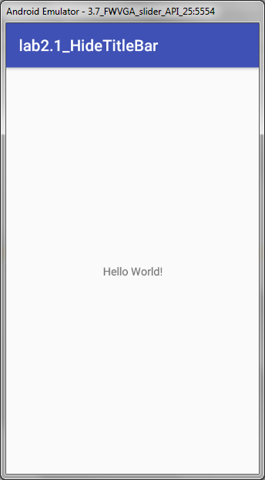
File: activity_main.xml
<RelativeLayout xmlns:androclass="http://schemas.android.com/apk/res/android"
xmlns:tools="http://schemas.android.com/tools"
android:layout_width="match_parent"
android:layout_height="match_parent"
android:paddingBottom="@dimen/activity_vertical_margin"
android:paddingLeft="@dimen/activity_horizontal_margin"
android:paddingRight="@dimen/activity_horizontal_margin"
android:paddingTop="@dimen/activity_vertical_margin"
tools:context=".MainActivity" >
<TextView
android:layout_width="wrap_content"
android:layout_height="wrap_content"
android:text="@string/hello_world" />
</RelativeLayout>

Slide 4
2. Android Screen Orientation
The screenOrientation is the attribute of activity element. The orientation of android activity can be portrait, landscape, sensor, unspecified etc. You need to define it in the AndroidManifest.xml file. For example
<activity
android:name="com.example.screenorientation.MainActivity"
android:label="@string/app_name"
android:screenOrientation="landscape"
>
Value | Description
unspecified | It is the default value. In such case, system chooses the orientation.
portrait | taller not wider
landscape | wider not taller
sensor | orientation is determined by the device orientation sensor.

Slide 5
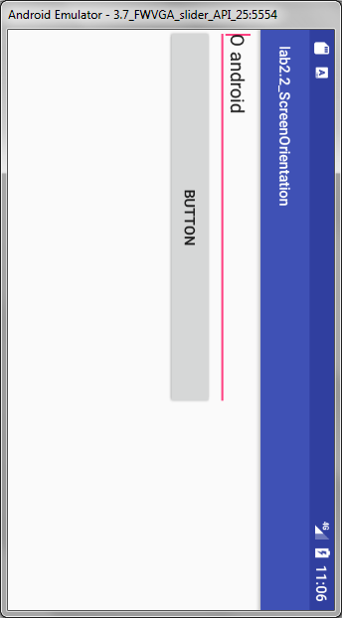
File: activity_main.xml
<RelativeLayout xmlns:androclass="http://schemas.android.com/apk/res/android"
xmlns:tools="http://schemas.android.com/tools"
android:layout_width="match_parent"
android:layout_height="match_parent"
android:paddingBottom="@dimen/activity_vertical_margin"
android:paddingLeft="@dimen/activity_horizontal_margin"
android:paddingRight="@dimen/activity_horizontal_margin"
android:paddingTop="@dimen/activity_vertical_margin"
tools:context=".MainActivity" >
<Button
android:id="@+id/button1"
android:layout_width="wrap_content"
android:layout_height="wrap_content"
android:layout_marginLeft="66dp"
android:layout_marginTop="73dp"
android:text="Button"
android:onClick="onClick"
/>
<EditText
android:id="@+id/editText1"
android:layout_width="wrap_content"
android:layout_height="wrap_content"
android:layout_centerHorizontal="true"
android:ems="10" />
</RelativeLayout>

Slide 6
Android Widgets
There are given a lot of android widgets with simplified examples such as Button, EditText, AutoCompleteTextView, ToggleButton, DatePicker, TimePicker, ProgressBar etc. Android widgets are easy to learn. The widely used android widgets with examples are given below:
Android Button Let's learn how to perform event handling on button click. Android Toast Displays information for the short duration of time. Custom Toast We are able to customize the toast, such as we can display image on the toast ToggleButton It has two states ON/OFF. CheckBox Let's see the application of simple food ordering. AlertDialog AlertDialog displays a alert dialog containing the message with OK and Cancel buttons. | Spinner Spinner displays the multiple options, but only one can be selected at a time. AutoCompleteTextView RatingBar RatingBar displays the rating bar. DatePicker Datepicker displays the datepicker dialog that can be used to pick the date. TimePicker TimePicker displays the timepicker dialog that can be used to pick the time. ProgressBar ProgressBar displays progress task.

Slide 7
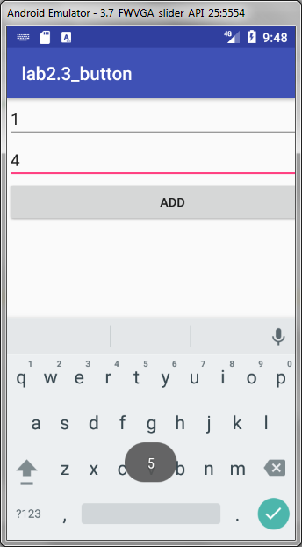
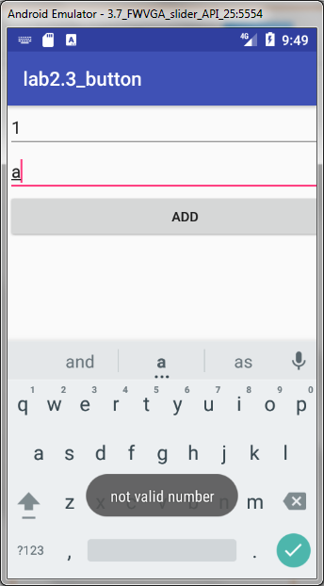
3. Button (adding values)
public class MainActivity extends AppCompatActivity implements View.OnClickListener { EditText editText1; EditText editText2; @Override protected void onCreate(Bundle savedInstanceState) { super.onCreate(savedInstanceState); setContentView(R.layout.activity_main); editText1 = (EditText) findViewById(R.id.editText1); editText2 = (EditText) findViewById(R.id.editText2); editText1.setText(""); //erase all the default name editText2.setText(""); Button buttonAdd = (Button) findViewById(R.id.buttonAdd); buttonAdd.setOnClickListener(this); } // @Override public void onClick(View view) { String[] userDataStatus = new String[2]; String value1=editText1.getText().toString(); String value2=editText2.getText().toString(); int a=0; int b= 0; try { // input validation a = Integer.parseInt(value1); b = Integer.parseInt(value2); } catch (Exception e) { Toast.makeText(getApplicationContext(),"not valid number",Toast.LENGTH_LONG).show(); return; } int sum = a + b; Toast.makeText(getApplicationContext(),String.valueOf(sum),Toast.LENGTH_LONG).show(); } }

Slide 8
4. Android Toast Example
Andorid Toast can be used to display information for the short period of time. A toast contains message to be displayed quickly and disappears after sometime.
The android.widget.Toast class is the subclass of java.lang.Object class.
Toast class is used to show notification for a particular interval of time. After sometime it disappears. It doesn't block the user interaction.
Constant | Description
public static final int LENGTH_LONG | displays view for the long duration of time.
public static final int LENGTH_SHORT | displays view for the short duration of time.
Toast toast=Toast.makeText(getApplicationContext(),"Hello Javatpoint",Toast.LENGTH_SHORT);
toast.setMargin(50,50);
toast.show();
Method | Description
public static Toast makeText(Context context, CharSequence text, int duration) | makes the toast containing text and duration.
public void show() | displays toast.
public void setMargin (float horizontalMargin, float verticalMargin) | changes the horizontal and vertical margin difference.
Notes:
See lab2.4
Will create a toast that has 50% of the containers width between the edge and the container, and 50% of the containers height between the toast and the containers edge
To create a toast that is in the top left corner of the container, with a 10 pixel margin on the left and 20 pixel margin from the top:
myToast.setGravity(Gravity.LEFT| Gravity.TOP, 10, 20)

Slide 9
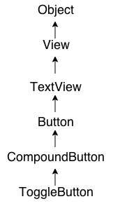
5. Android ToggleButton Example
Android Toggle Button can be used to display checked/unchecked (On/Off) state on the button.
It is beneficial if user have to change the setting between two states. It can be used to On/Off Sound, Wifi, Bluetooth etc.
Since Android 4.0, there is another type of toggle button called switch that provides slider control.
Android ToggleButton and Switch both are the subclasses of CompoundButton class.

Slide 10
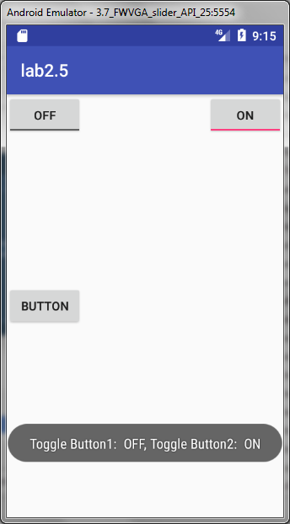
5. Android ToggleButton Example
XML Attribute | Description
android:disabledAlpha | The alpha to apply to the indicator when disabled.
android:textOff | The text for the button when it is not checked.
android:textOn | The text for the button when it is checked.
Method | Description
CharSequence getTextOff() | Returns the text when button is not in the checked state.
CharSequence getTextOn() | Returns the text for when button is in the checked state.
void setChecked(boolean checked) | Changes the checked state of this button.

Slide 11
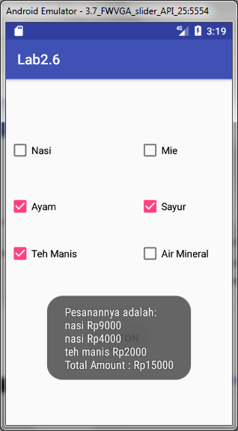
6. Android CheckBox Example
<CheckBox android:id="@+id/checkBox1" android:layout_width="wrap_content" android:layout_height="wrap_content" android:text="Nasi" app:layout_constraintTop_toTopOf="@+id/Horizontal1" android:layout_marginTop="8dp" android:layout_marginLeft="8dp" app:layout_constraintLeft_toLeftOf="@+id/vertical1" android:layout_marginStart="8dp" /> <CheckBox android:id="@+id/checkBox2" android:layout_width="wrap_content" android:layout_height="wrap_content" android:layout_marginLeft="8dp" android:layout_marginTop="8dp" android:text="Mie" app:layout_constraintLeft_toLeftOf="@+id/vertical2" app:layout_constraintTop_toTopOf="@+id/Horizontal1" android:layout_marginStart="8dp" />
…

Slide 12
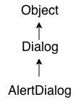
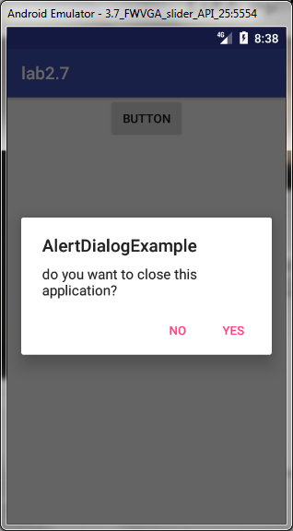
7. Alert Dialog
Android AlertDialog can be used to display the dialog message with OK and Cancel buttons. It can be used to interrupt and ask the user about his/her choice to continue or discontinue.
Android AlertDialog is composed of three regions: title, content area and action buttons.
Android AlertDialog is the subclass of Dialog class.
Example:
MyActivity.java file
...
builder = new AlertDialog.Builder(this); builder.setMessage("do you want to close this application?") .setCancelable(false) .setPositiveButton("Yes", new DialogInterface.OnClickListener() { public void onClick(DialogInterface dialog, int id) { finish(); } }) .setNegativeButton("No", new DialogInterface.OnClickListener() { public void onClick (DialogInterface dialog,int id){ // action for 'No' Button dialog.cancel(); } });
...
// create the dialog AlertDialog alert = builder.create(); // setting the title manualy alert.setTitle ("AlertDialogExample"); alert.show();
...

Slide 13
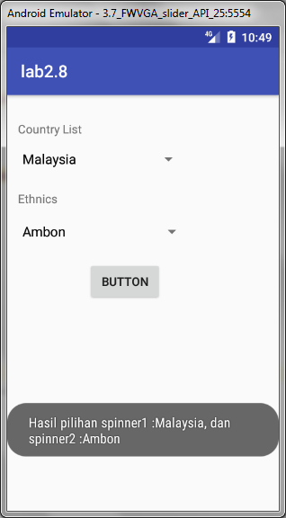
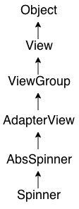
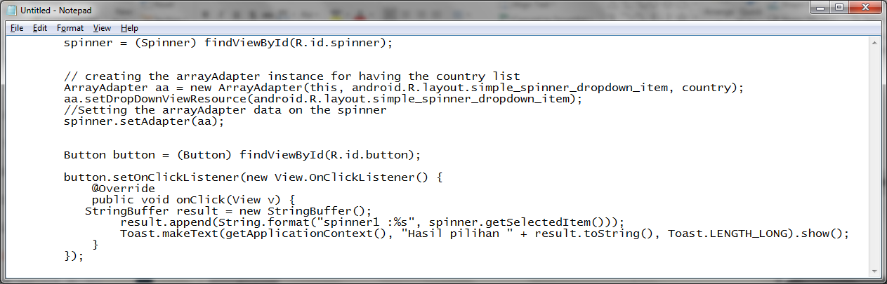
8. Spinner
Android Spinner is like the combox box of AWT or Swing. It can be used to display the multiple options to the user in which only one item can be selected by the user.
Android spinner is like the drop down menu with multiple values from which the end user can select only one value.
Android spinner is associated with AdapterView. So you need to use one of the adapter classes with spinner.
Android Spinner class is the subclass of AbsSpinner class.

Slide 14
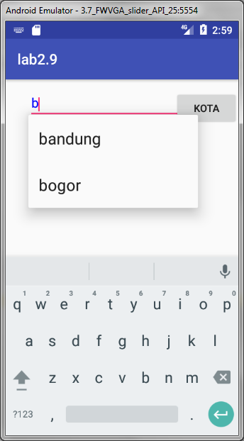
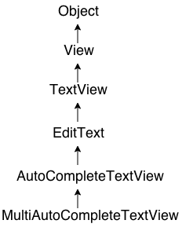
9. Autocomplete textview
Android AutoCompleteTextView completes the word based on the reserved words, so no need to write all the characters of the word.
Android AutoCompleteTextView is a editable text field, it displays a list of suggestions in a drop down menu from which user can select only one suggestion or value.
Android AutoCompleteTextView is the subclass of EditText class. The MultiAutoCompleteTextView is the subclass of AutoCompleteTextView class.
using the ArrayAdapter class to display the array content.
//MainActivity.Java file
ArrayAdapter <String> aa = new ArrayAdapter <String> (this, android.R.layout.select_dialog_item, kota); AutoComp = (AutoCompleteTextView) findViewById(R.id.autoCompleteTextView); AutoComp.setThreshold(1); AutoComp.setAdapter(aa); AutoComp.setTextColor(Color.BLUE);

Slide 15
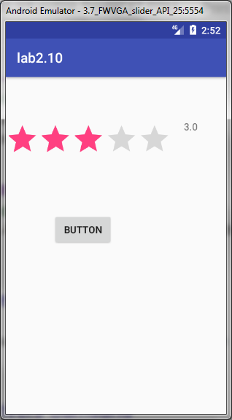
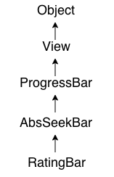
10. Android RatingBar
Android RatingBar can be used to get the rating from the user. The Rating returns a floating-point number. It may be 2.0, 3.5, 4.0 etc.
Android RatingBar displays the rating in stars. Android RatingBar is the subclass of AbsSeekBar class.
The getRating() method of android RatingBar class returns the rating number.
//MainActivity file
...
String sRatingBar = String.valueOf(rating.getRating()); textView.setText(sRatingBar);
...

Slide 16
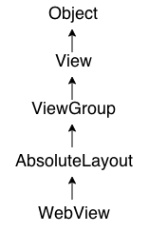
11. WebView
Android WebView is used to display web page in android. The web page can be loaded from same application or URL. It is used to display online content in android activity.
Android WebView uses webkit engine to display web page.
The android.webkit.WebView is the subclass of AbsoluteLayout class.
The loadUrl() and loadData() methods of Android WebView class are used to load and display web page.
MyActivity.java file
WebView mywebview = (WebView) findViewById(R.id.webView1);
mywebview.loadUrl("http://www.javatpoint.com/");

Slide 17
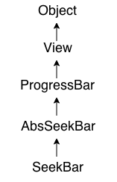
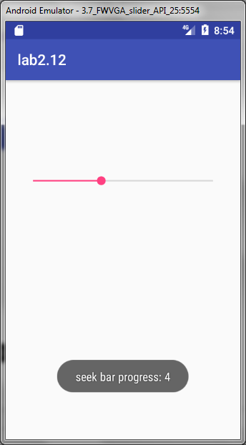
12. Seek Bar
Android SeekBar is a kind of ProgressBar with draggable thumb. The end user can drag the thum left and right to move the progress of song, file download etc.
The SeekBar.OnSeekBarChangeListener interface provides methods to perform even handling for seek bar.
Android SeekBar and RatingBar classes are the sub classes of AbsSeekBar.
public class MainActivity extends Activity implements OnSeekBarChangeListener{
…
public void onProgressChanged(SeekBar seekBar, int progress, boolean fromUser) {
Toast.makeText(getApplicationContext(), "seek bar progress: " + progress, Toast.LENGTH_LONG).show();
}
public void onStartTrackingTouch(SeekBar seekBar) {
Toast.makeText(getApplicationContext(), " Tracking Touch Start", Toast.LENGTH_LONG).show();
}
public void onStopTrackingTouch(SeekBar seekBar) {
Toast.makeText(getApplicationContext(), "Tracking Touch Start", Toast.LENGTH_LONG).show();
}

Slide 18
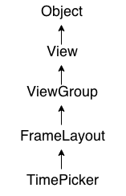
13. Time Picker
Android TimePicker widget is used to select date. It allows you to select time by hour and minute. You cannot select time by seconds.
The android.widget.TimePicker is the subclass of FrameLayout class.

Slide 19
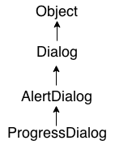
14. Android ProgressBar
We can display the android progress bar dialog box to display the status of work being done e.g. downloading file, analyzing status of work etc.
Here we are using android.app.ProgressDialog class to show the progress bar. Android ProgressDialog is the subclass of AlertDialog class.
he ProgressDialog class provides methods to work on progress bar like setProgress(), setMessage(), setProgressStyle(), setMax(), show() etc. The progress range of Progress Dialog is 0 to 10000.
ProgressDialog progressBar = new ProgressDialog(this);
progressBar.setCancelable(true);//you can cancel it by pressing back button
progressBar.setMessage("File downloading ...");
progressBar.setProgressStyle(ProgressDialog.STYLE_HORIZONTAL);
progressBar.setProgress(0);//initially progress is 0
progressBar.setMax(100);//sets the maximum value 100
progressBar.show();//displays the progress bar

Slide 20
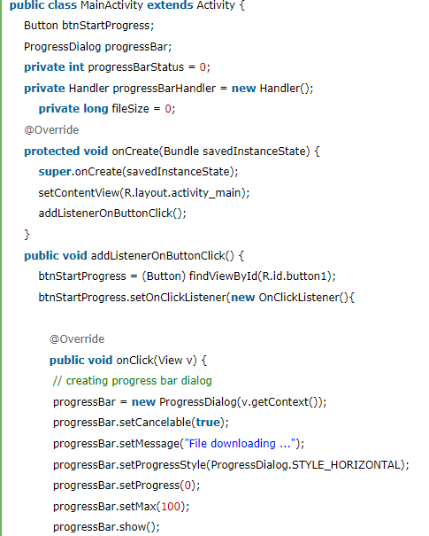
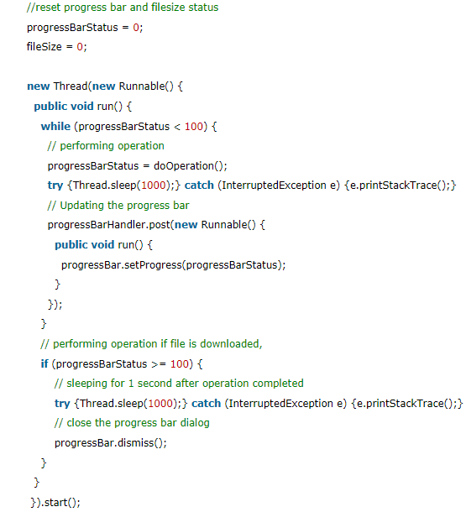
14. Android ProgressBar (cont.)

Slide 21
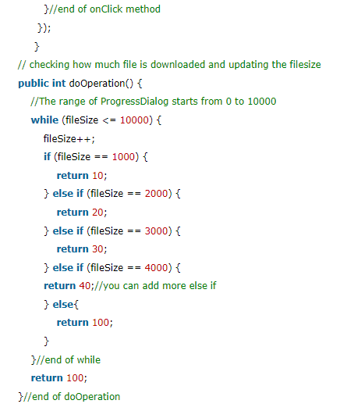
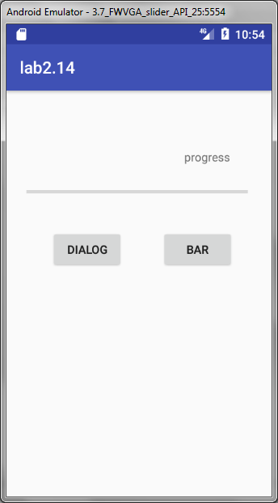
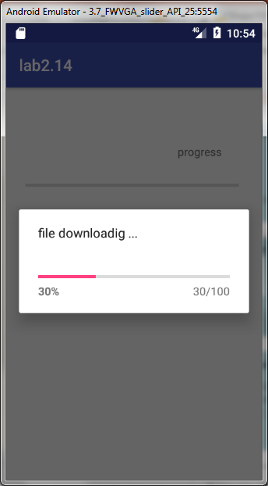
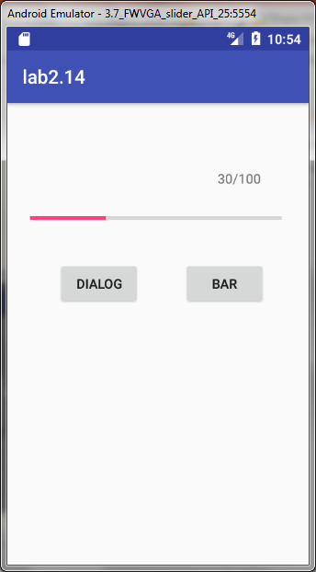
14. Android ProgressBar (cont.)

Slide 22
Handler are background threads that provide you to communicate with the UI. Updating a progressbar for instance should be done via Handler. Using Handlers you have the advantage of MessagingQueues, so if you want to schedule messages or update multiple UI elements or have repeating tasks.
AsyncTask are similar, infact they make use of Handler, but doesn't run in the UI thread, so it's good for fetching data, for instance fetching web services. Later you can interact with the UI.
Thread however can't interact with the UI, provide more "basic" threading and you miss all the abstractions of AsyncTask.

