Slide 1
Mobile Programming
Hide Title Bar

Slide 2
1. Android Activity Lifecycle
Android Activity Lifecycle is controlled by 7 methods of android.app.Activity class. The android Activity is the subclass of ContextThemeWrapper class.
An activity is the single screen in android. It is like window or frame of Java.
By the help of activity, you can place all your UI components or widgets in a single screen.
The 7 lifecycle method of Activity describes how activity will behave at different states.
Method | Description
onCreate | called when activity is first created.
onStart | called when activity is becoming visible to the user.
onResume | called when activity will start interacting with the user.
onPause | called when activity is not visible to the user.
onStop | called when activity is no longer visible to the user.
onRestart | called after your activity is stopped, prior to start.
onDestroy | called before the activity is destroyed.

Slide 3
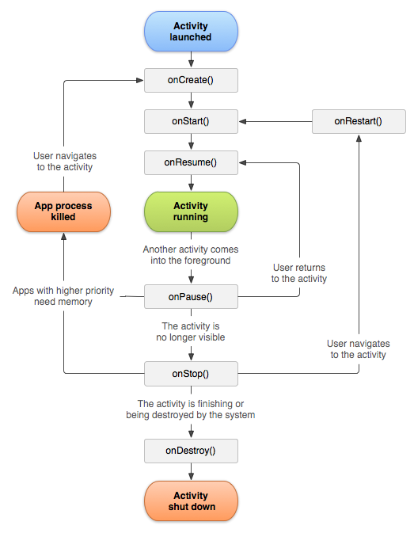
Problem1
There are 3 activities in one application, namd A, B, and C.
If activity A is onPause() state, and activity B is onResume() state and call activity C, so what the current state of all activities?
Activity A?
Activity B?
Activity C?

Slide 4
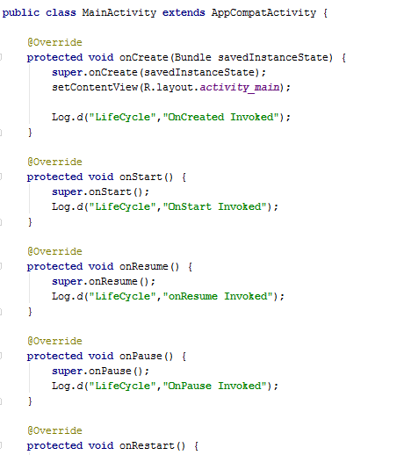
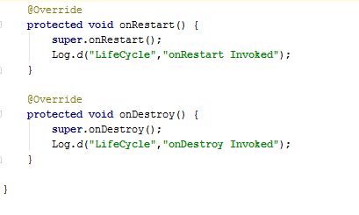

Slide 5
2. Android Intent Tutorial
Android Intent is the message that is passed between components such as activities, content providers, broadcast receivers, services etc.
It is generally used with startActivity() method to invoke activity, broadcast receivers etc.
The dictionary meaning of intent is intention or purpose. So, it can be described as the intention to do action.
The Labeled Intent is the subclass of android.content.Intent class.
Android intents are mainly used to:
Start the service
Launch an activity
Display a web page
Display a list of contacts
Broadcast a message
Dial a phone call etc.

Slide 6
Types of Android Intents
There are two types of intents in android: implicit and explicit.
1) Implicit Intent
Implicit Intent doesn't specifiy the component. In such case, intent provides information of available components provided by the system that is to be invoked.
For example, you may write the following code to view the webpage.
Intent intent=new Intent(Intent.ACTION_VIEW);
intent.setData(Uri.parse("http://www.javatpoint.com"));
startActivity(intent);
2) Explicit Intent
Explicit Intent specifies the component. In such case, intent provides the external class to be invoked.
Intent i = new Intent(getApplicationContext(), ActivityTwo.class);
startActivity(i);

Slide 7
Implicit Intent Example
public class MainActivity extends Activity {
@Override
protected void onCreate(Bundle savedInstanceState) {
super.onCreate(savedInstanceState);
setContentView(R.layout.activity_main);
final EditText editText1=(EditText)findViewById(R.id.editText1);
Button button1=(Button)findViewById(R.id.button1);
button1.setOnClickListener(new OnClickListener() {
@Override
public void onClick(View arg0) {
String url=editText1.getText().toString();
Intent intent=new Intent(Intent.ACTION_VIEW,Uri.parse(url));
startActivity(intent);
}
});
}
}

Slide 8
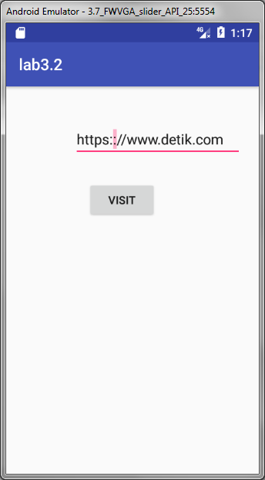
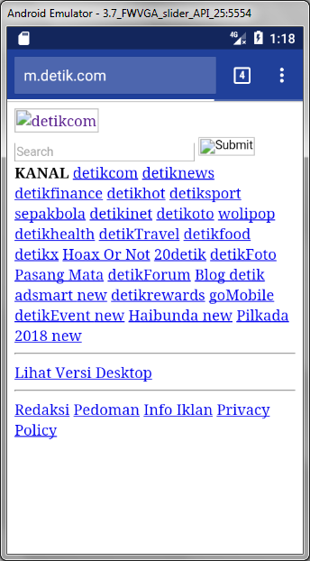

Slide 9
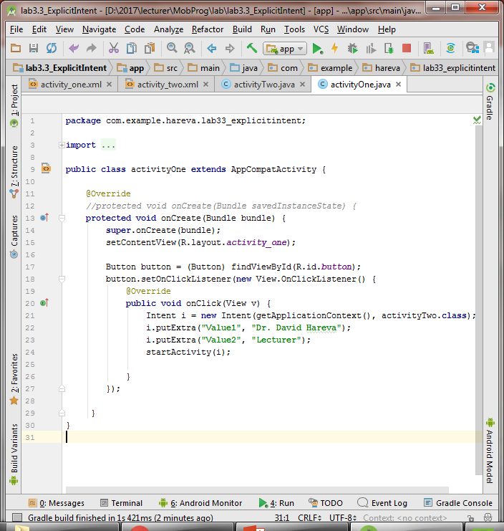
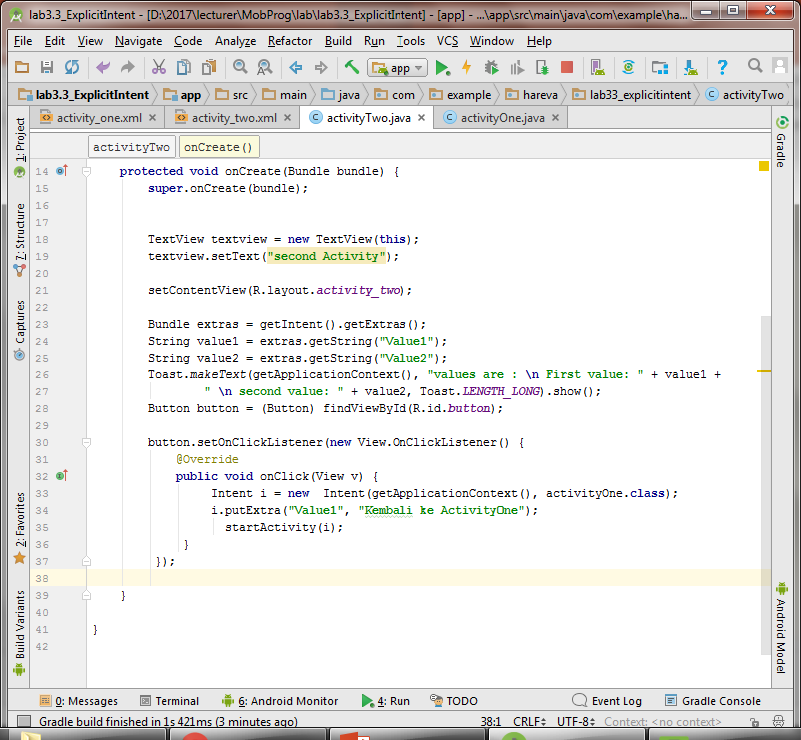
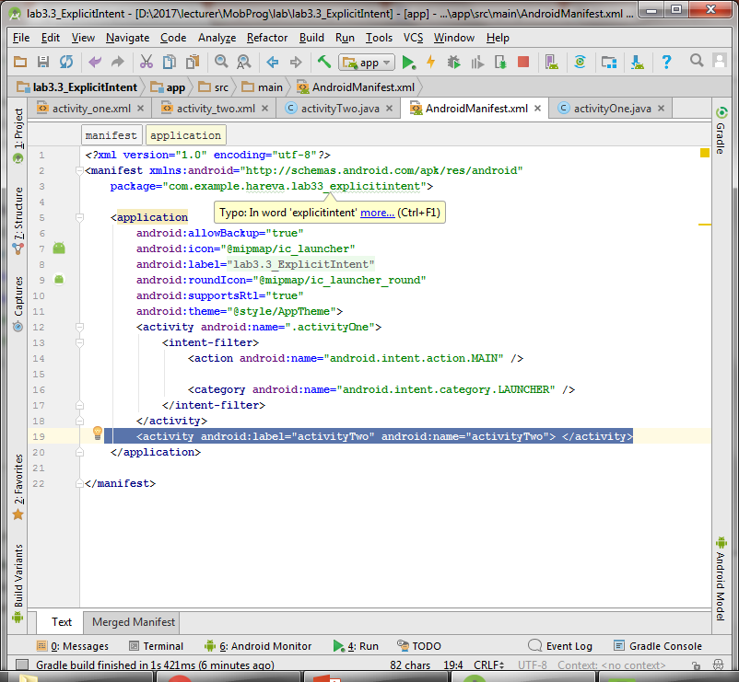
3. Explicit Intent Example

Slide 10
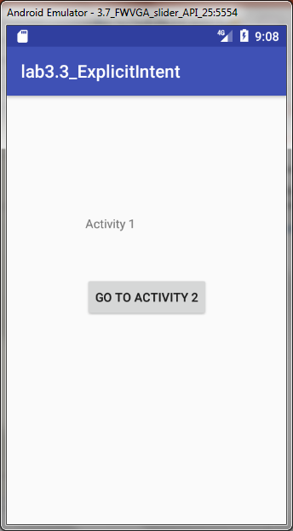
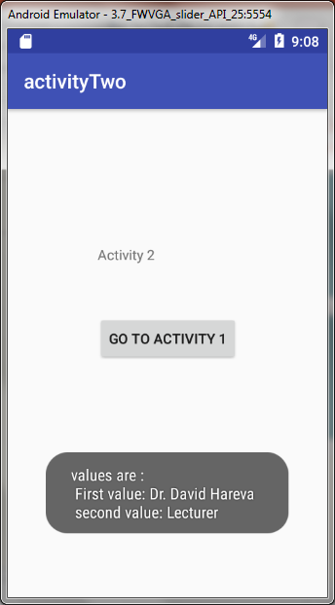
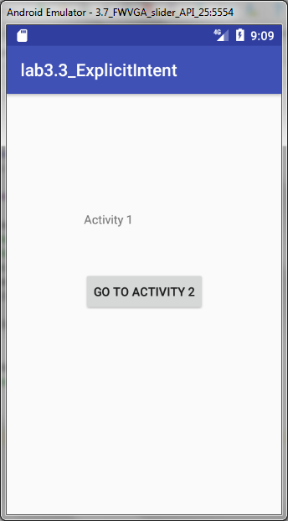
Explicit Intent Example

Slide 11
Problem1
Do problem 1 with 3 activities and their state management.
There are 3 activities in one application, namd A, B, and C.
If activity A is onPause() state, and activity B is onResume() state and call activity C, so what the current state of all activities?
Activity A?
Activity B?
Activity C?
Activity A
Activity B
Activity C

Slide 12
4. Activities and Results
By the help of android startActivityForResult() method, we can get result from another activity.
By the help of android startActivityForResult() method, we can send information from one activity to another and vice-versa. The android startActivityForResult method, requires a result from the second activity (activity to be invoked).
In such case, we need to override the onActivityResult method that is invoked automatically when second activity returns result.
Method Signature
There are two variants of startActivityForResult() method.
public void startActivityForResult (Intent intent, int requestCode)
public void startActivityForResult (Intent intent, int requestCode, Bundle options)

Slide 13
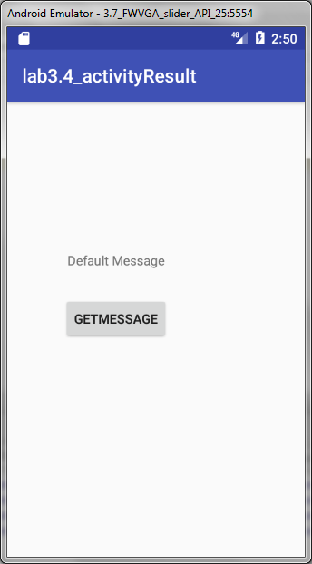
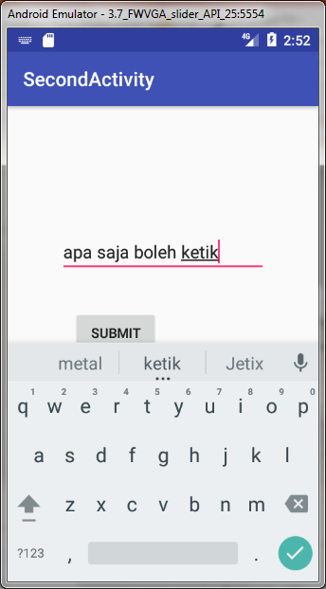
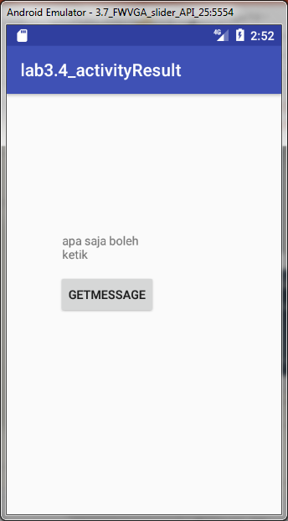

Slide 14
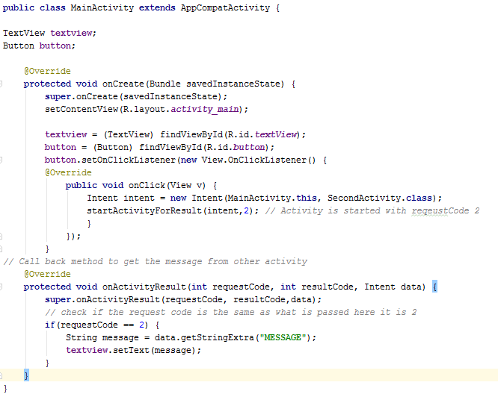
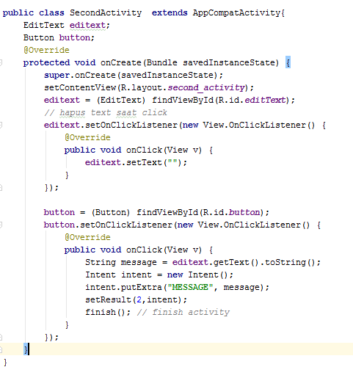
AndroidManifest.xml
<activity android:name=".SecondActivity" android:label="SecondActivity" > </activity>

Slide 15
Problem2
Alasan belajar MobProg?
Alasan belajar MobProg?
Sex :
Personal Data
Questioner
Name :
NIM :
Name :
Alasan belajar MobProg?
Program study:
NIM :
Male
Menyenangkan
Mudah
Sex :
Menantang
Terpaksa
Personal Data
Female
Suasana belajar
Program study
Submit
Submit
Alasan belajar MobProg?
Suasana belajar:
Questioner
Activity A
Activity B
Activity C

