Slide 1
Mobile Programming
Android Menu
Dr. David Hareva

Slide 2
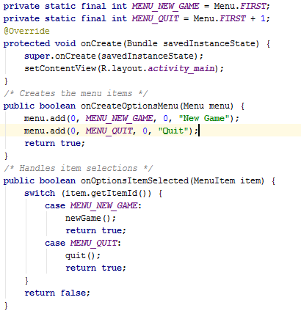
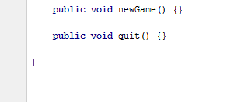
1. Option Menu
Rather than building activity's options menu during onCreate(), the way we wire up the rest of our UI, we instead need to implement onCreateOptionsMenu(). This callback receives an instance of Menu.
The first thing we should do is chain upward to the superclass (super.onCreateOptionsMenu(menu)), so the Android framework can add in any menu choices it feels are necessary. Then we can go about adding our own options.
in onCreateOptionsMenu(). Alternatively, we can implement onPrepareOptionsMenu(), which is called just before displaying the menu each time it is requested.
Given that we have received a Menu object via onCreateOptionsMenu(), we add menu choices by calling add(). There are many flavors of this method, which require some combination of the parameters (cont.)

Slide 3
1_b. Adding Icons
A group identifier (groupId): This should be NONE unless we are creating a specific grouped set of menu choices for use with setGroupCheckable().
A choice identifier (itemId): This is for use in identifying this choice in the onOptionsItemSelected() callback when a menu choice is selected.
An order identifier (order): To indicate where this menu choice should be slotted if the menu has Android-supplied choices alongside our own; for now, just use NONE.
The text of the menu choice, as a String or a resource ID (title).
Icons can also be added to items that appears in the Icon Menu with setIcon(). For example, if we modify one of the line in the Java code above after put icon into res/drawable/:
menu.add(0, MENU_QUIT, 0, "Quit") ->
menu.add(0, MENU_QUIT, 0, "Quit").setIcon(R.drawable.ic_quit);

Slide 4
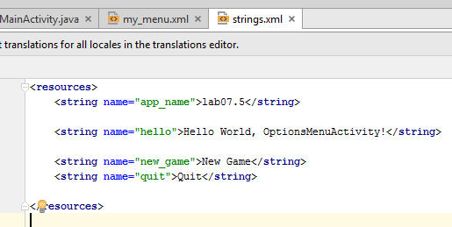
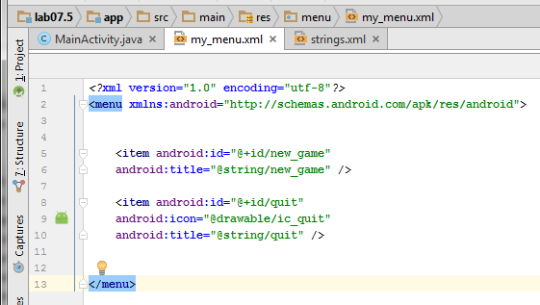
1.C Menu inflater
public class OptionsMenuActivity extends Activity {
private static final int MENU_NEW_GAME = Menu.FIRST;
private static final int MENU_QUIT = Menu.FIRST + 1;
/** Called when the activity is first created. */
@Override
public void onCreate(Bundle savedInstanceState) {
super.onCreate(savedInstanceState);
setContentView(R.layout.main);
}
@Override
public boolean onCreateOptionsMenu(Menu menu) {
MenuInflater inflater = getMenuInflater();
inflater.inflate(R.menu.my_menu, menu);
return true;
}
/* Handles item selections */
public boolean onOptionsItemSelected(MenuItem item) {
switch (item.getItemId()) {
case MENU_NEW_GAME:
newGame();
return true;
case MENU_QUIT:
quit();
return true;
}
return false;
}
public void newGame() {}
public void quit() {}
}
Instead of instantiating a Menu in our application code, we should define a menu and all its items in an XML menu resource, then inflate the menu resource (load it as a programmable object) in our application code. Using a menu resource to define our menu is a good practice because it separates the content for the menu from our application code. It's also easier to visualize the structure and content of a menu in XML

Slide 5
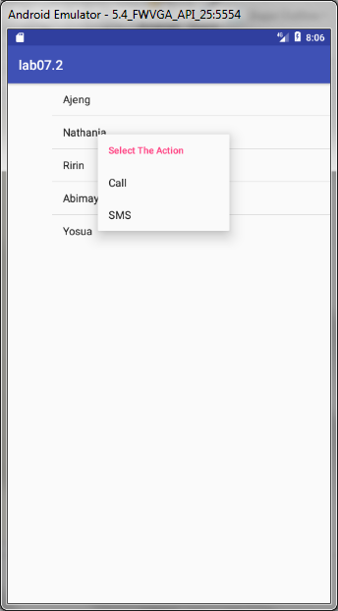
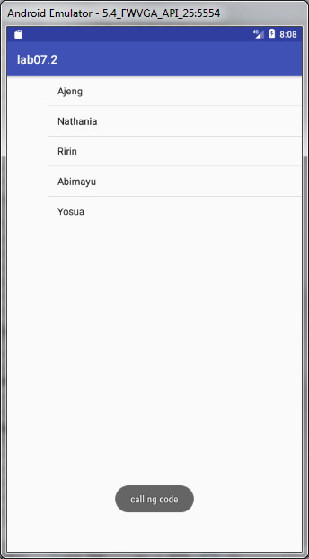
2. Android Context Menu
Android context menu appears when user press long click on the element. It is also known as floating menu. It doesn't support item shortcuts and icons.
File: activity_main.xml
<ListView
android:id="@+id/listView1"
android:layout_width="match_parent"
android:layout_height="wrap_content"
android:layout_alignParentLeft="true"
android:layout_alignParentTop="true"
android:layout_marginLeft="66dp"
android:layout_marginTop="53dp" >
</ListView>

Slide 6
public class MainActivity extends AppCompatActivity { ListView listView1; String contacts[]={"Ajeng","Nathania","Ririn","Abimayu","Yosua"}; @Override protected void onCreate(Bundle savedInstanceState) { super.onCreate(savedInstanceState); setContentView(R.layout.activity_main); listView1=(ListView)findViewById(R.id.listView1); ArrayAdapter<String> adapter=new ArrayAdapter<String>(this,android.R.layout.simple_list_item_1,contacts); listView1.setAdapter(adapter); // Register the ListView for Context menu registerForContextMenu(listView1); } @Override public void onCreateContextMenu(ContextMenu menu, View v, ContextMenu.ContextMenuInfo menuInfo) { super.onCreateContextMenu(menu, v, menuInfo); menu.setHeaderTitle("Select The Action"); menu.add(0, v.getId(), 0, "Call");//groupId, itemId, order, title menu.add(0, v.getId(), 0, "SMS"); } ///@Override public boolean onContextItemSelected(MenuItem item){ if(item.getTitle()=="Call"){ Toast.makeText(getApplicationContext(),"calling code",Toast.LENGTH_LONG).show(); } else if(item.getTitle()=="SMS"){ Toast.makeText(getApplicationContext(),"sending sms code",Toast.LENGTH_LONG).show(); }else{ return false; } return true; } }

Slide 7
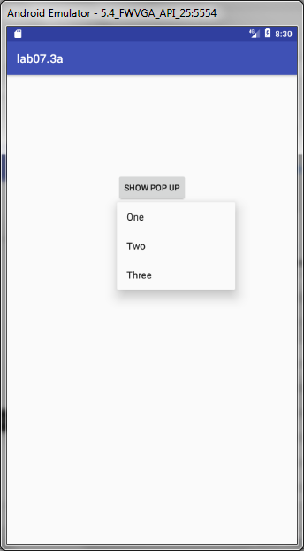
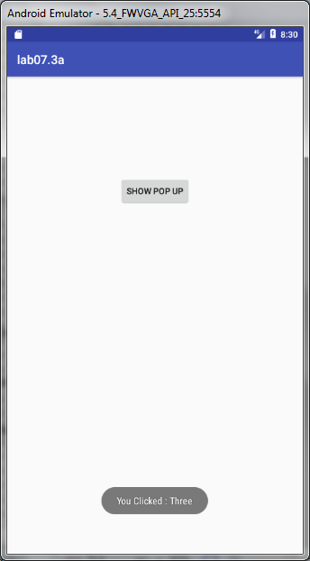
3. Android Popup Menu
Android Popup Menu displays the menu below the anchor text if space is available otherwise above the anchor text. It disappears if you click outside the popup menu.
The android.widget.PopupMenu is the direct subclass of java.lang.Object class.
Res/Menu/Popup_menu.xml
<?xml version="1.0" encoding="utf-8"?> <menu xmlns:android="http://schemas.android.com/apk/res/android"> <item android:id="@+id/one" android:title="One"/> <item android:id="@+id/two" android:title="Two"/> <item android:id="@+id/three" android:title="Three"/> </menu>

Slide 8
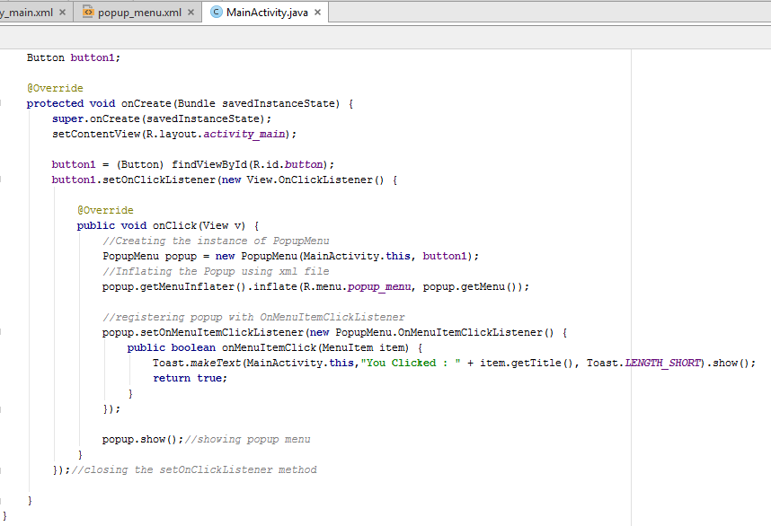

Slide 9
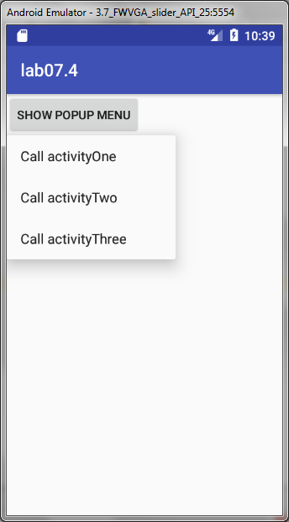
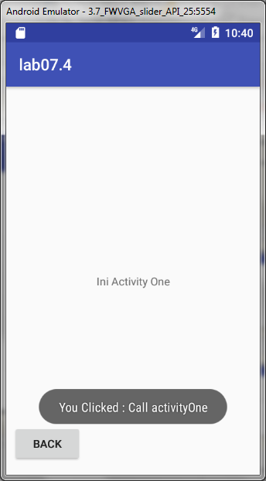
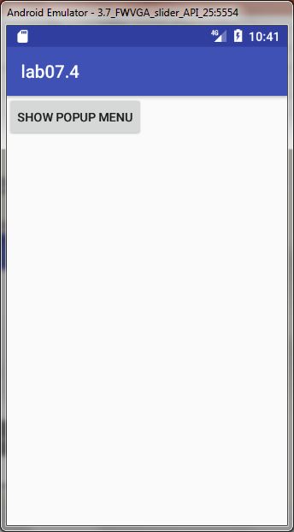
4. Problem1
Menu popup call activity

