Slide 1
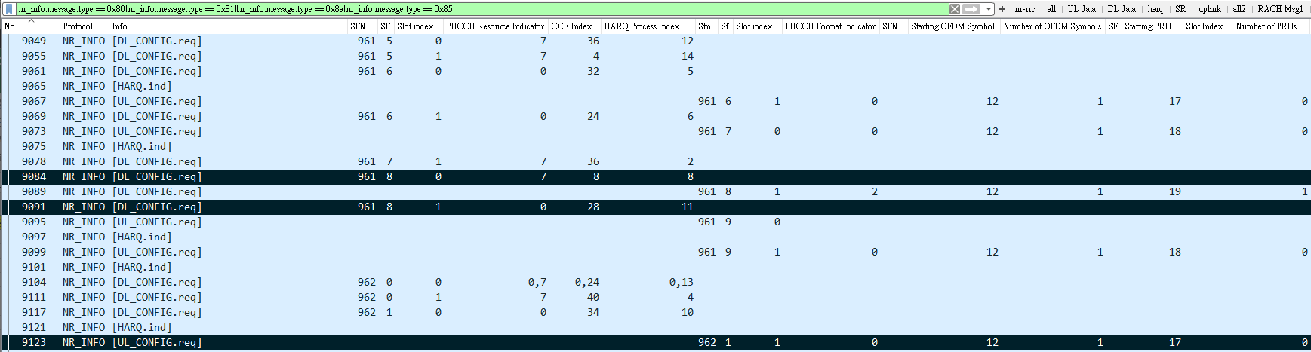
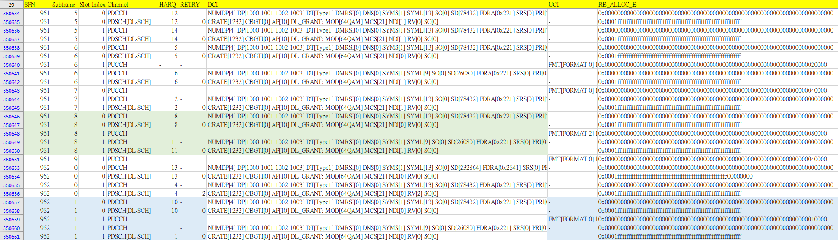
有個DCI_1_1參數PUCCH resource indicator, 當PUCCH resource set 0超過8個時, UE真實使用的PUCCH resource id必須以此為參數計算, 即TS 38.213, 9.2.3所提
Ex: log-20230619-140315_bler10_gnb_15
17

Slide 2
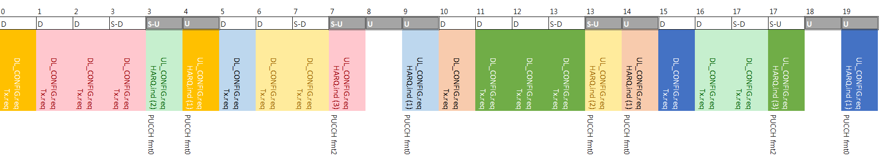
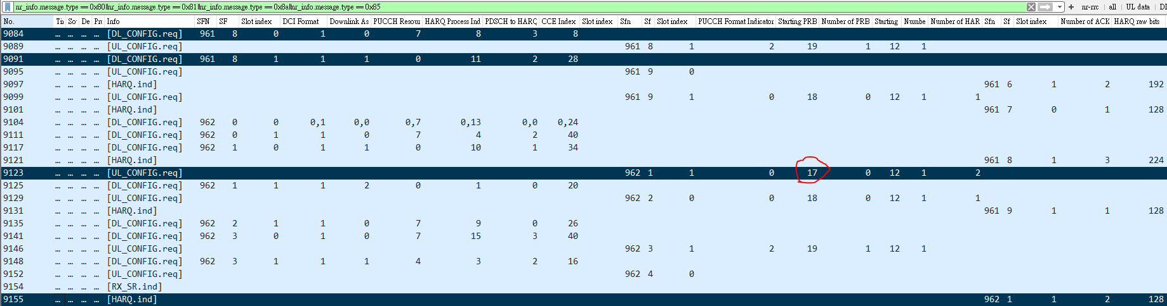
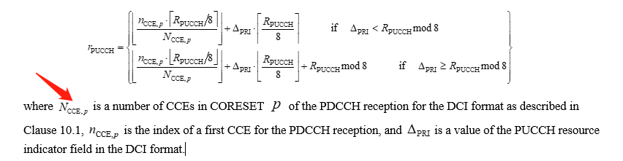
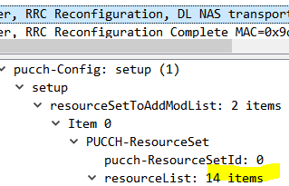
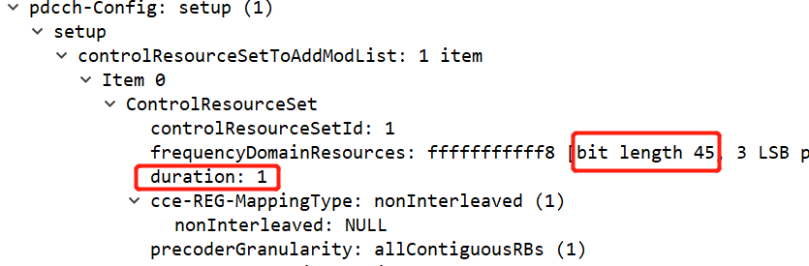
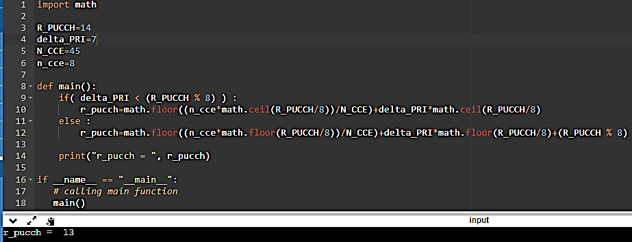
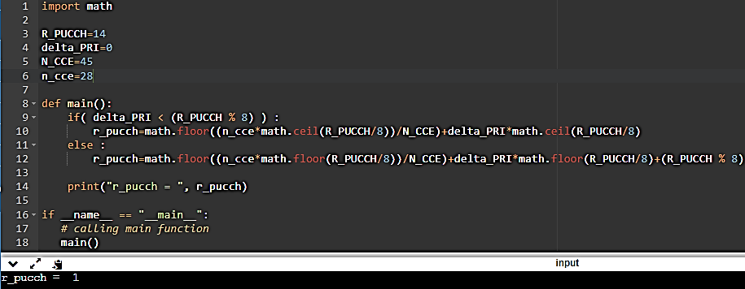
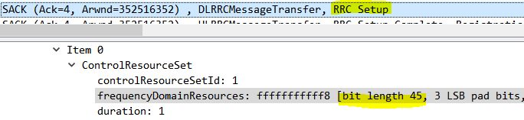
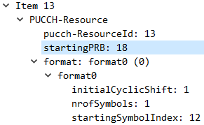
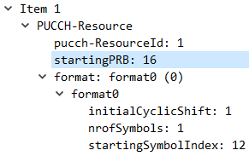
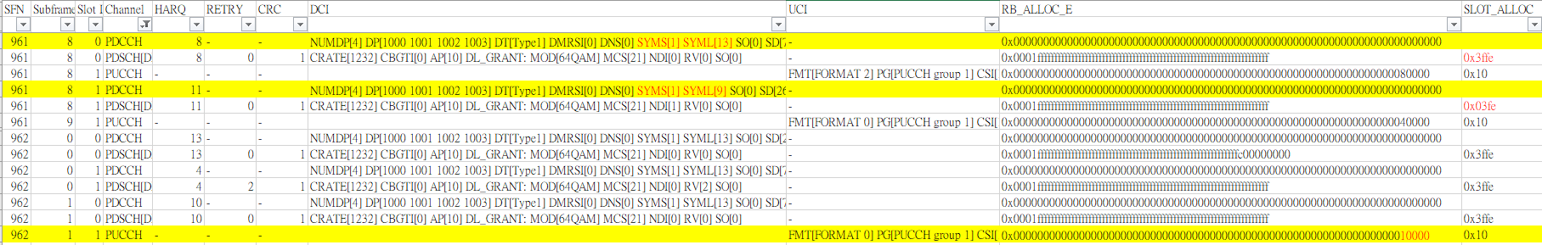
有個DCI_1_1參數PUCCH resource indicator, 當PUCCH resource set 0超過8個時, UE真實使用的PUCCH resource id必須以此為參數計算, 即TS 38.213, 9.2.3所提
Ncce is total num of CCE in the Coreset, which in your case =45
Slot 16
計算18
計算16
Slot 17
NW bbuiolog [UL_CONFIG.req] Starting PRB=17
Slot 3
UE Viavi RB_ALLOC_E=16
Notes:
0x10000 = 00010000000000000000
0x40000 = 01000000000000000000
0x80000 = 10000000000000000000
import math
R_PUCCH=14
delta_PRI=7
N_CCE=45
n_cce=8
def main():
if( delta_PRI < (R_PUCCH % 8) ) :
r_pucch=math.floor((n_cce*math.ceil(R_PUCCH/8))/N_CCE)+delta_PRI*math.ceil(R_PUCCH/8)
else :
r_pucch=math.floor((n_cce*math.floor(R_PUCCH/8))/N_CCE)+delta_PRI*math.floor(R_PUCCH/8)+(R_PUCCH % 8)
print("r_pucch = ", r_pucch)
if __name__ == "__main__":
# calling main function
main()

Slide 3
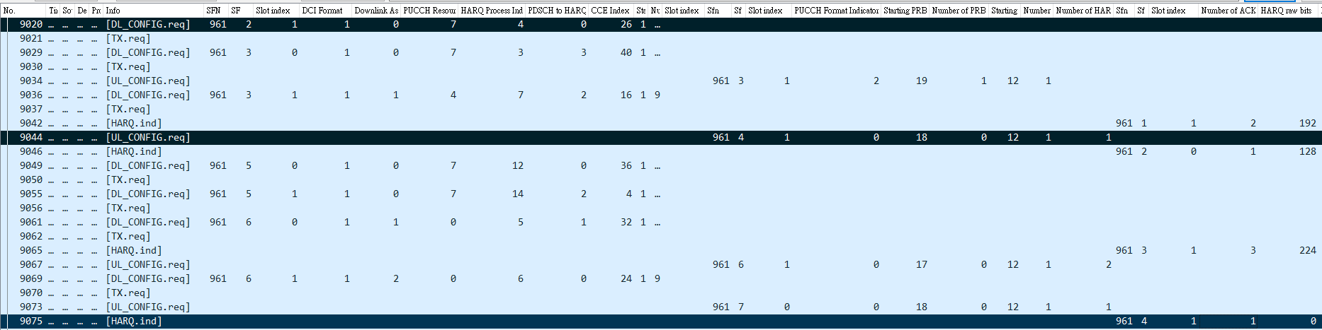
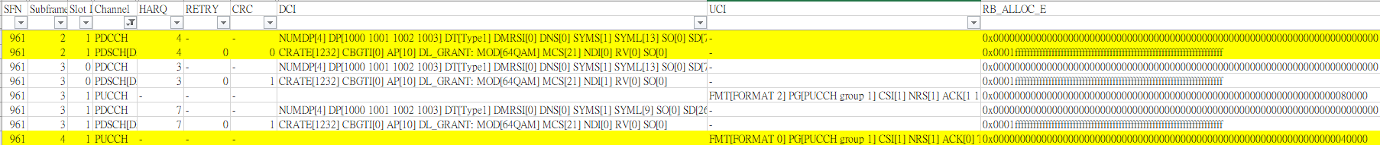
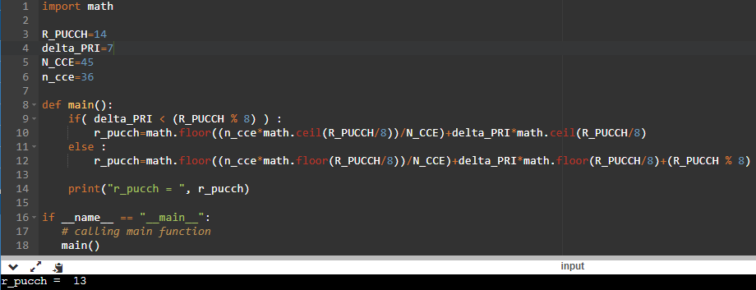
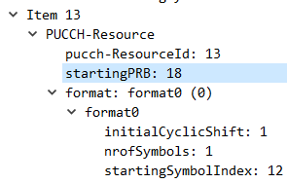
計算18
NW bbuiolog [UL_CONFIG.req] Starting PRB=18
UE Viavi RB_ALLOC_E=18
Notes:
01000000000000000000

Slide 4
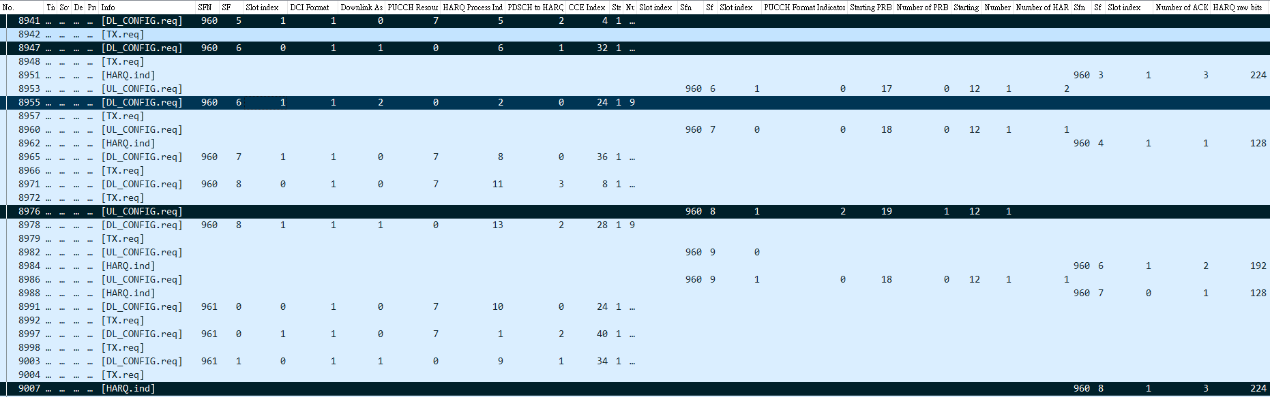

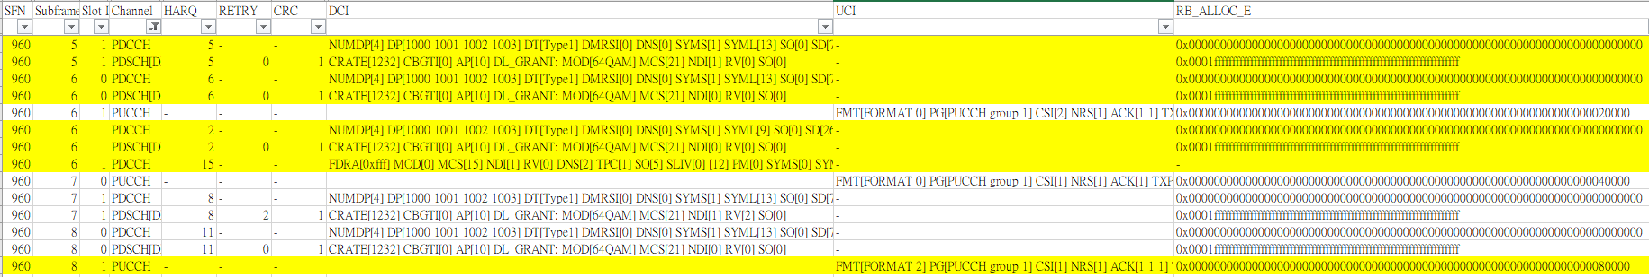
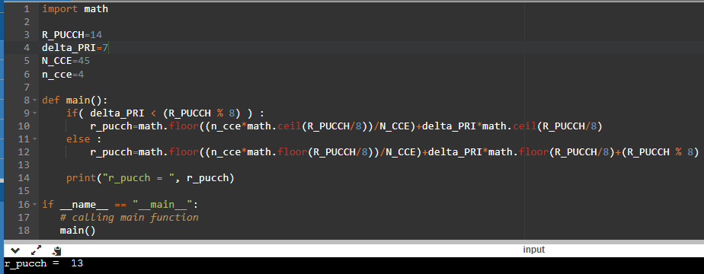
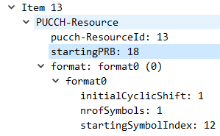
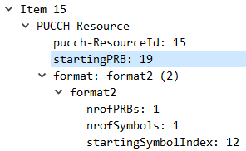
計算13
計算1
計算1
Format2是直接mapping，0就對第1個
NW bbuiolog [UL_CONFIG.req] Starting PRB=19
UE Viavi RB_ALLOC_E=19
1000 0000 0000 0000 0000

Slide 5
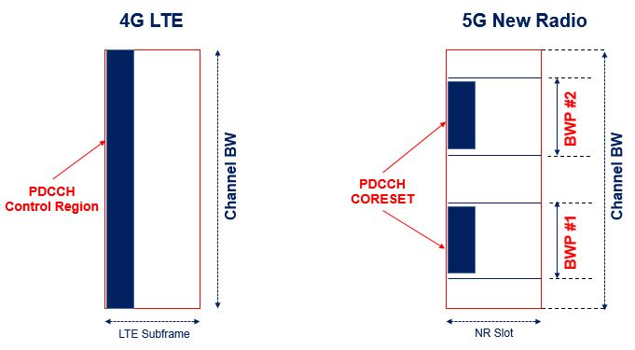
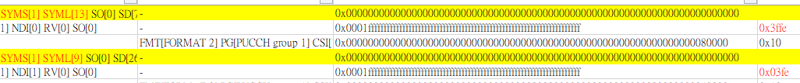
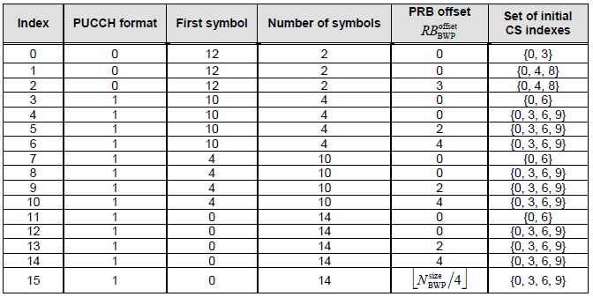


setup: 2 items
Item 0
PDSCH-TimeDomainResourceAllocation
k0: 0
mappingType: typeA (0)
startSymbolAndLength: 40 //sliv40: S=1,L=13
Item 1
PDSCH-TimeDomainResourceAllocation
k0: 0
mappingType: typeA (0)
startSymbolAndLength: 96 //sliv96: S=1,L=9
Old PUCCH format1 | New PUCCH format0
<pucchResourceCmn>3</pucchResourceCmn> <f1SymLength>4</f1SymLength> <cfgSrWithF1>1</cfgSrWithF1> | <pucchResourceCmn>0</pucchResourceCmn> <f0f2SymLength>1</f0f2SymLength> <cfgSrWithF1>0</cfgSrWithF1>

Slide 6
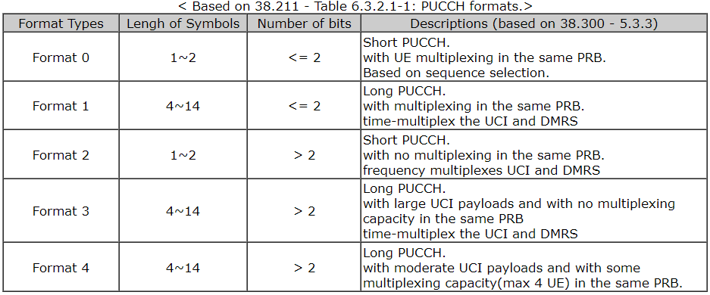
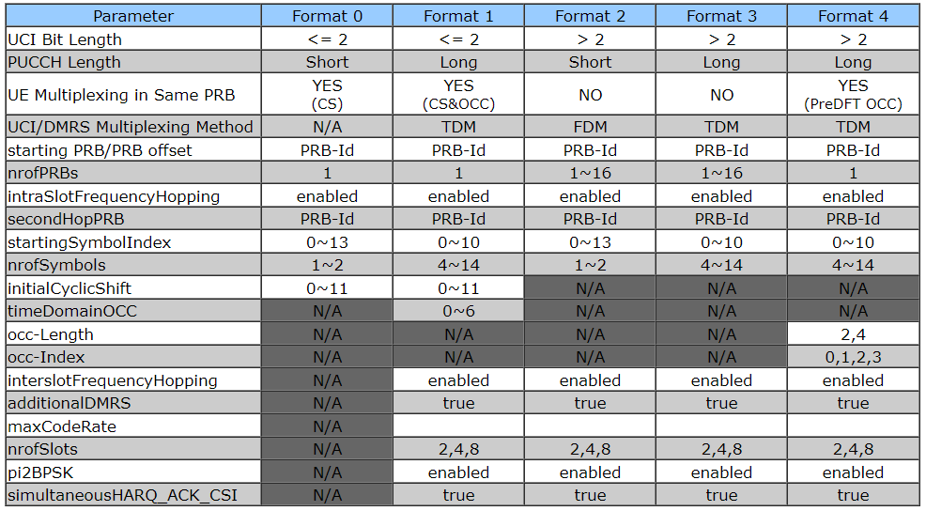
PUCCH Format 0

Slide 7
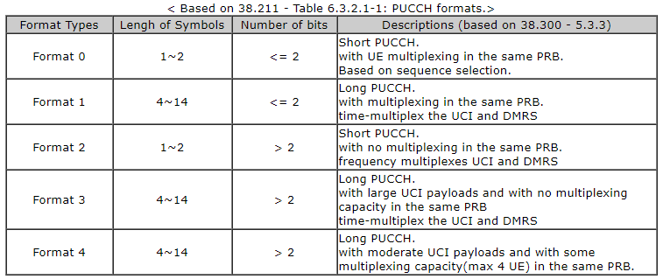

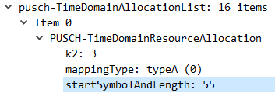
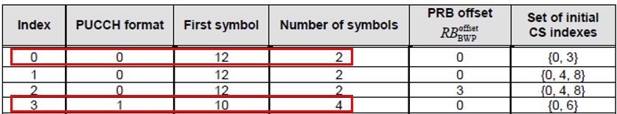
Purpose
 | 0 | 1 | 2 | 3 | 4 | 5 | 6 | 7 | 8 | 9 | 10 | 11 | 12 | 13
Format 1 |  |  |  |  |  |  |  |  |  | Pucch format 1 |  |  |  | srs
- pusch | Sliv=55, Start = 0, L=#symbols = 12
Format 0 - pucch |  |  |  |  |  |  |  |  |  |  |  |  | Fmt 0 | srs
- pusch | Sliv=55, Start = 0, L=#symbols = 12
Fixed UL – Tcp issue.
Allocated PUCCH and PUSCH resource are No overlap.
Pucch fmt 1 with 4 symbols, from 9 – 12 and PUSCH SLIV 55, start 0 to 11 and length 12
Pucch fmt 0 with 1 symbols, at 12th symbol, and PUSCH start 0 to 11.
Fixed 2 bug to support PUCCH format 0.
<pucchResourceCmn>3</pucchResourceCmn>
<f1SymLength>4</f1SymLength>
<cfgSrWithF1>1</cfgSrWithF1> //format1
 | 0 | 1 | 2 | 3 | 4 | 5 | 6 | 7 | 8 | 9 | 10 | 11 | 12 | 13
PUCCH
PUSCH
<pucchResourceCmn>0</pucchResourceCmn>
<f0f2SymLength>1</f0f2SymLength>
<cfgSrWithF1>0</cfgSrWithF1> //format0
 | 0 | 1 | 2 | 3 | 4 | 5 | 6 | 7 | 8 | 9 | 10 | 11 | 12 | 13
PUCCH |  |  |  |  |  |  |  |  |  |  |  |  | f0
PUSCH
S=6/4/4 | D | D | D | D | D | D | G | G | G | G | U | U | U | U
S=10:4:0 | D | D | D | D | D | D | D | D | D | D | G | G | G | G
S=10:2:2 | D | D | D | D | D | D | D | D | D | D | G | G | U | U
 | 0 | 1 | 2 | 3 | 4 | 5 | 6 | 7 | 8 | 9 | 10 | 11 | 12 | 13
PDCCH
PDSCH
S=6/4/4 | D | D | D | D | D | D | G | G | G | G | U | U | U | U
S=10:4:0 | D | D | D | D | D | D | D | D | D | D | G | G | G | G
S=10:2:2 | D | D | D | D | D | D | D | D | D | D | G | G | U | U

Slide 8
Test Resutls
計算網址 https://www.sqimway.com/rb_calc.php
UL-MCS | SLIV | UL-TCP | UL-UDP (err %) | DL-TCP | DL-UDP (err %) | Memo with PUCCH Format 0
17 | 83 | 51.4 M | 51.6 M (0.1%) | 16.1 M | 841M (11%) | PUCCH Format 0, cfgSrWithF1=0, pucchResourceCmn=0, Pusch length = 10
25 | 83 | 96.5 M | 51.4 M (0.1%) | 20.7 M | 852M (9.6%)
25 | 69 | 109 M | 51.8 M (0.1%) | 18.8 M | 852M (9.1%) | PUCCH Format 0, Pusch length = 11
25 | 97 | 84.1 M | 51.4 M (0.1%) | 14.4 M | 850M (9.1%) | PUCCH Format 1, cfgSrWithF1=1, pucchResourceCmn = 3, Pusch length = 9
25 | 97 | 78 M | 51.4 M (0.1%) | 14.1 M | 844M (11%) | PUCCH Format 1, Pusch length = 9, featureBit =3, maxRlcSduQSize = 2000, 200, 400,
25 | Xx 55?? | 739k | 51.8 M (0.1%) | 5.3 M | 855M (10%) | PUCCH Format 1, cfgSrWithF1=1, pucchResourceCmn = 3, Pusch length = 9, with fixMCS bin (original)
25 | 55 (no fixed) | 121 M | 51.2 M (0.1% | 68M | 860M (9.7%) | PUCCH Format 0, pucch symlength = 1,
startSymbolAndLength

Slide 9
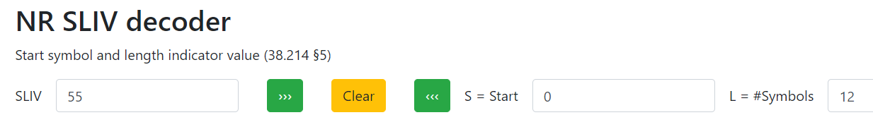
PUCCH Format 0 – DU xml setting
Old PUCCH format1 | New PUCCH format0
<pucchResourceCmn>3</pucchResourceCmn> <f1SymLength>4</f1SymLength> <cfgSrWithF1>1</cfgSrWithF1> //format1 | <pucchResourceCmn>0</pucchResourceCmn> <f0f2SymLength>1</f0f2SymLength> <cfgSrWithF1>0</cfgSrWithF1> //format0
PUSCH-TimeDomainResourceAllocation
k2: 3
mappingType: typeA (0)
startSymbolAndLength: 55

Slide 10
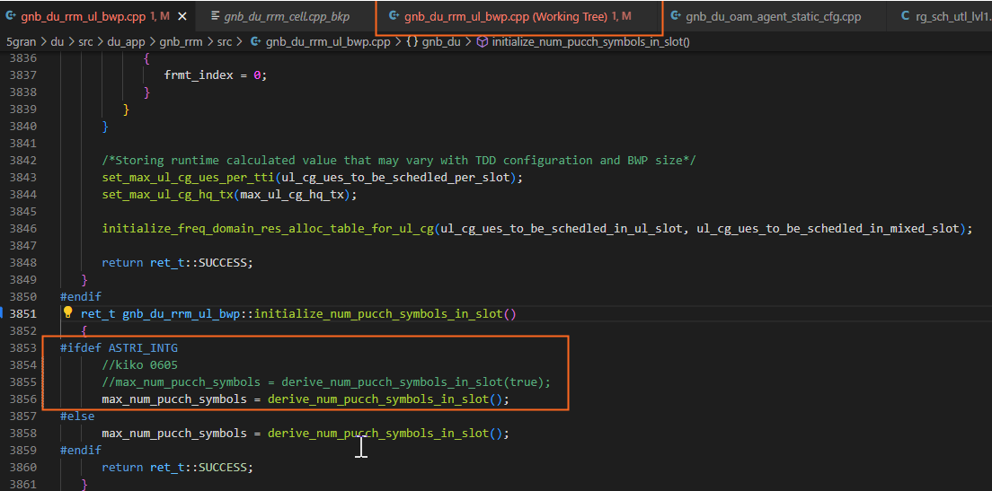
Radisys bug for PUCCH Format 0 - i
ret_t gnb_du_rrm_ul_bwp::initialize_num_pucch_symbols_in_slot()
{
#ifdef ASTRI_INTG
//kiko 0605
//max_num_pucch_symbols = derive_num_pucch_symbols_in_slot(true);
max_num_pucch_symbols = derive_num_pucch_symbols_in_slot();
#else
max_num_pucch_symbols = derive_num_pucch_symbols_in_slot();
#endif
return ret_t::SUCCESS;

Slide 11
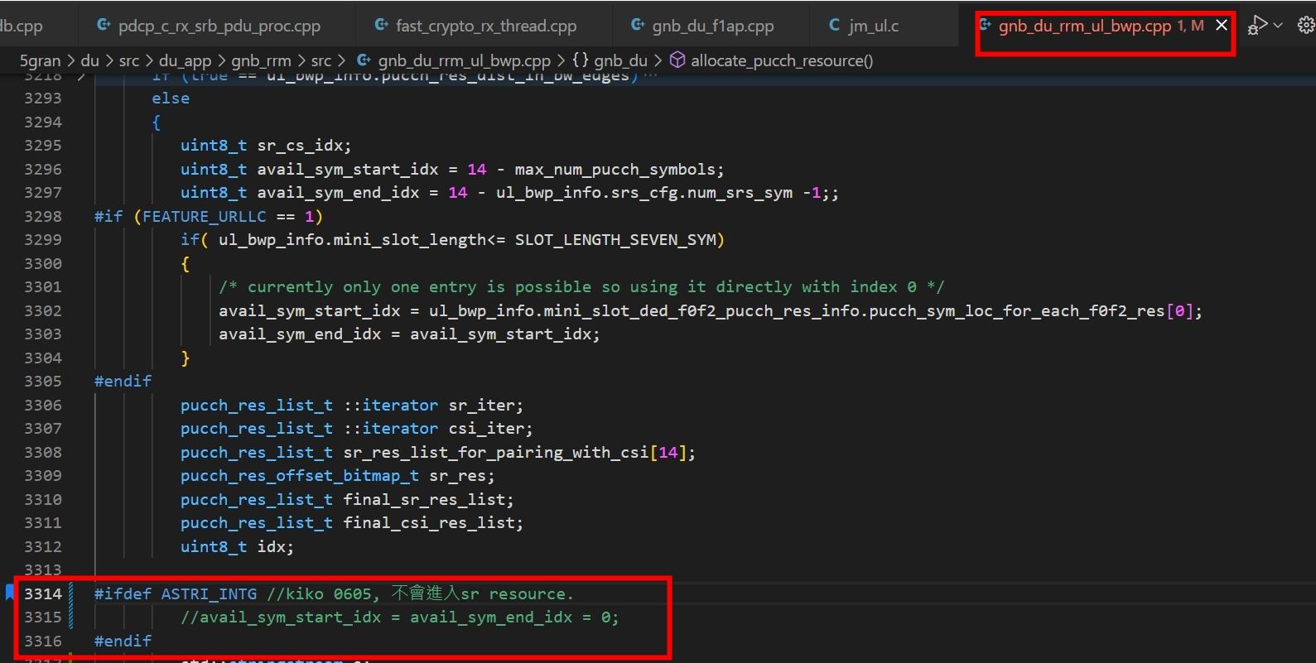
Radisys bug for PUCCH Format 0 - ii
#ifdef ASTRI_INTG //kiko 0605, 不會進入sr resource.
//avail_sym_start_idx = avail_sym_end_idx = 0;
#endif

