Slide 1
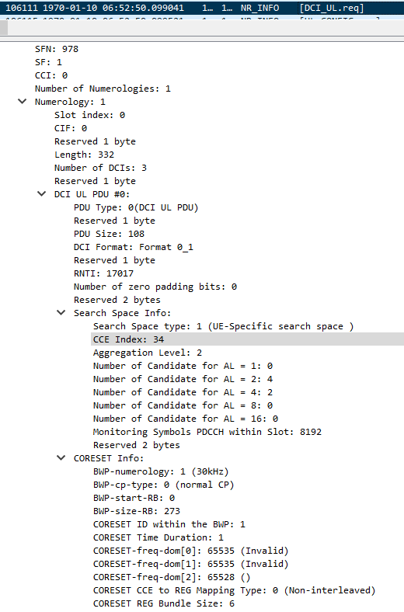
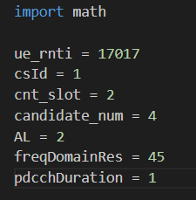

pdcch_cce_index.py
Possible first CCE index ~ possible first CCE index + AL -1
34,35
0,1
12,13
22,23
UE should decode this DCI with CCE index [34,35] or [0,1] or [12,13] or [22,23]
65535 = 1111 1111 1111 1111
65535 = 1111 1111 1111 1111
65528 = 1111 1111 1111 1000
→ 45 1’s

Slide 2

NR INFO
L1PA Message: DCI_UL.req
SFN: 978
SF: 3 //【1】Slot index
CCI: 0
Number of Numerologies: 1
Numerology: 1
Slot index: 1 //【1】Slot index=7
DCI UL PDU #2:
PDU Type: 0(DCI UL PDU)
Reserved 1 byte
PDU Size: 108
DCI Format: Format 0_1
Reserved 1 byte
RNTI: 17020 //【2】RNTI
Number of zero padding bits: 0
Reserved 2 bytes
Search Space Info:
Search Space type: 1 (UE-Specific search space ) //【3】CS ID(0:CSS, 1:UESS)
CCE Index: 20 //【Ans】CCE Index
Aggregation Level: 2 //【4】Aggregation Level
Number of Candidate for AL = 1: 0
Number of Candidate for AL = 2: 4 //【5】Number of Candidate for AL
Number of Candidate for AL = 4: 2
Number of Candidate for AL = 8: 0
Number of Candidate for AL = 16: 0
Monitoring Symbols PDCCH within Slot: 8192
Reserved 2 bytes
CORESET Info:
BWP-numerology: 1 (30kHz)
BWP-cp-type: 0 (normal CP)
BWP-start-RB: 0
BWP-size-RB: 273
CORESET ID within the BWP: 1
CORESET Time Duration: 1 //【6】CORESET Time Duration
CORESET-freq-dom[0]: 65535 (Invalid) // 【7】CORESET-freq-dom Resolution
CORESET-freq-dom[1]: 65535 (Invalid) // 【7】CORESET-freq-dom Resolution
CORESET-freq-dom[2]: 65528 () // 【7】CORESET-freq-dom Resolution
65535 = 1111 1111 1111 1111
65535 = 1111 1111 1111 1111
65528 = 1111 1111 1111 1000
→ 45 1’s

